Slide 1
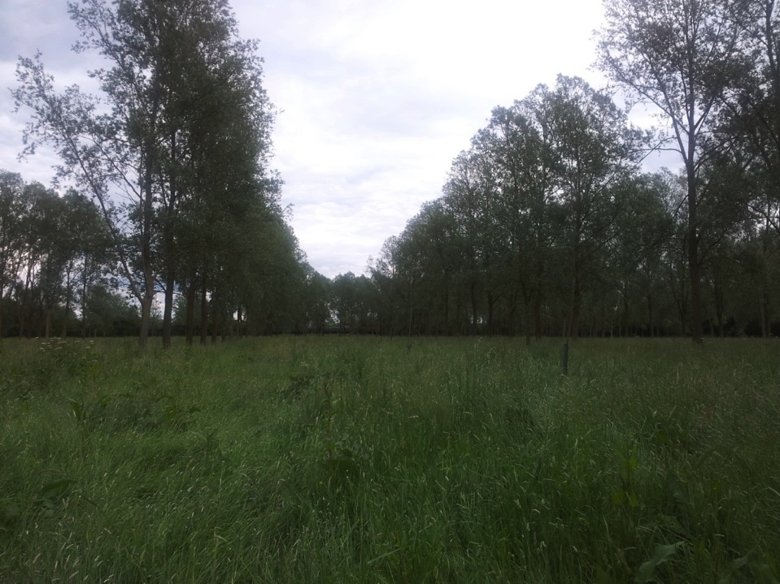
EMFCAMP 2012
Internet to a field
Nat Morris and Will Hargrave
UKNOF23 9th October 2012

Slide 2
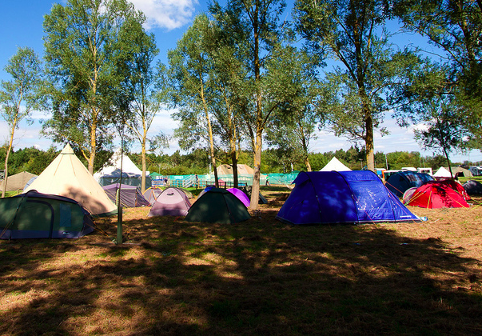
What was EMFCamp 2012?
3 day festival – Fri 31st Aug to Sun 2nd Sept
Ran by volunteers
Geeks / hackers / makers
500 licensed capacity – sold out
Photo: Russ Garrett

Slide 3
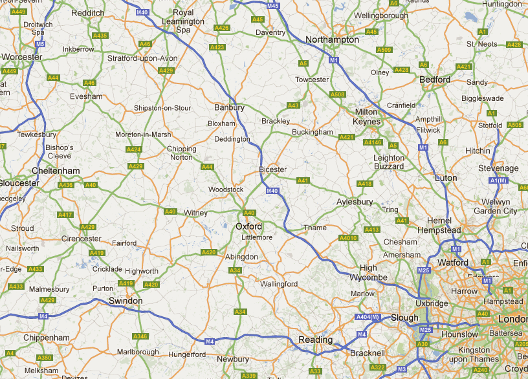
Site location

Slide 4
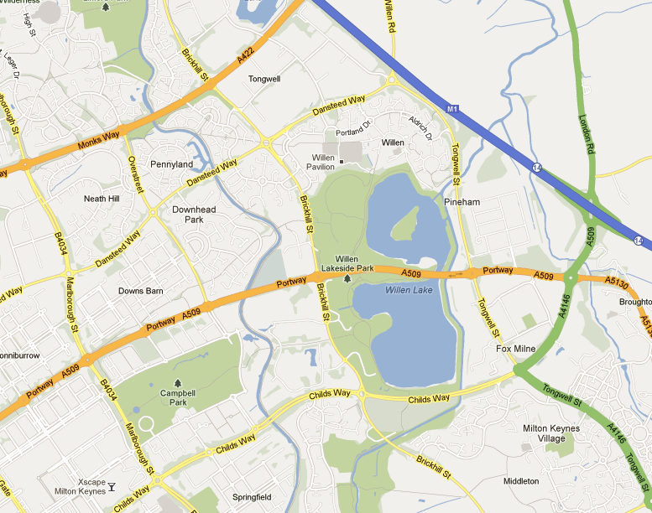
Site location
Rented from Milton Keynes Parks Trust - £1,900

Slide 5
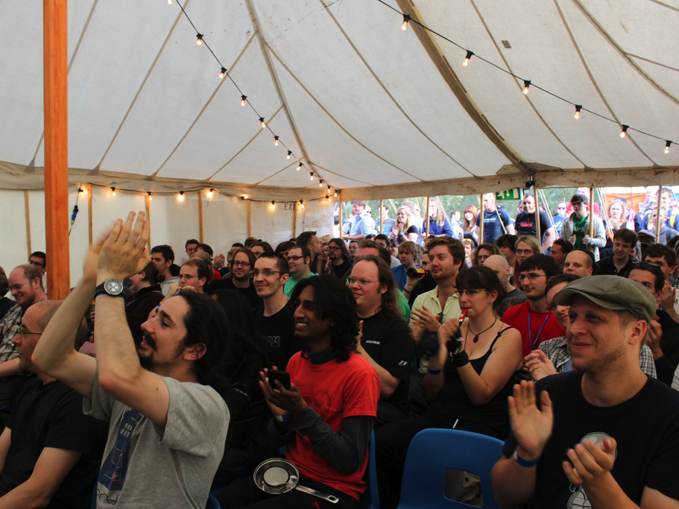
Festival site
Talks and presentations
Photo: Kitty Wong

Slide 6
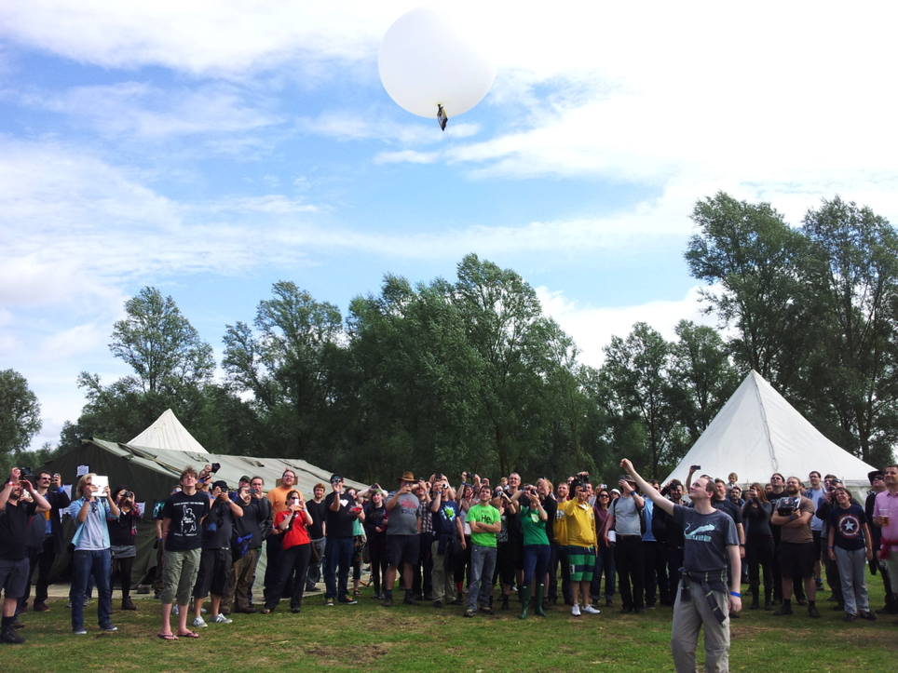
Festival site
Balloon launch
Photo: Lionel Montrieux

Slide 7
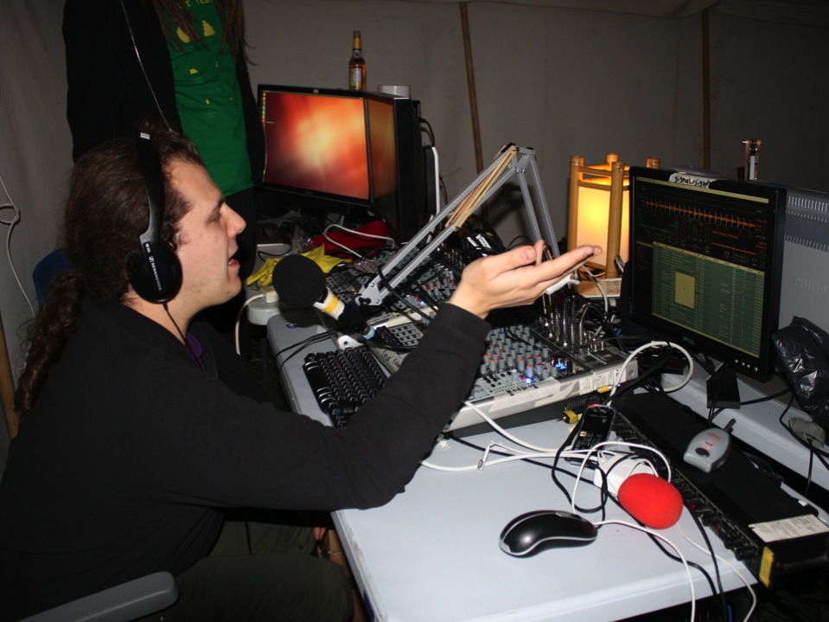
Festival site
Radio station and video streaming
Photo: Graham Morris

Slide 8
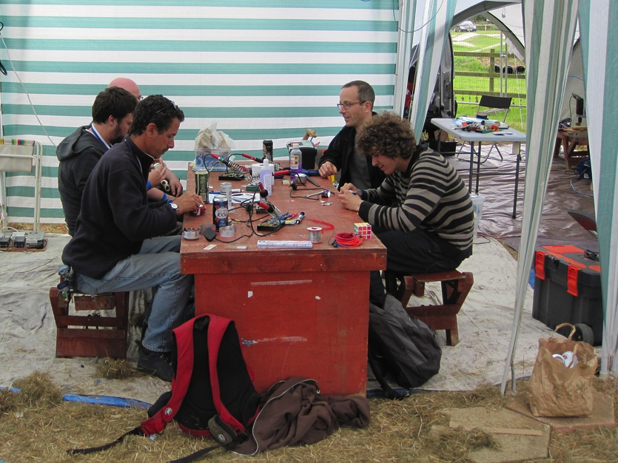
Festival site
Workshops
Photo: Nottinghack

Slide 9
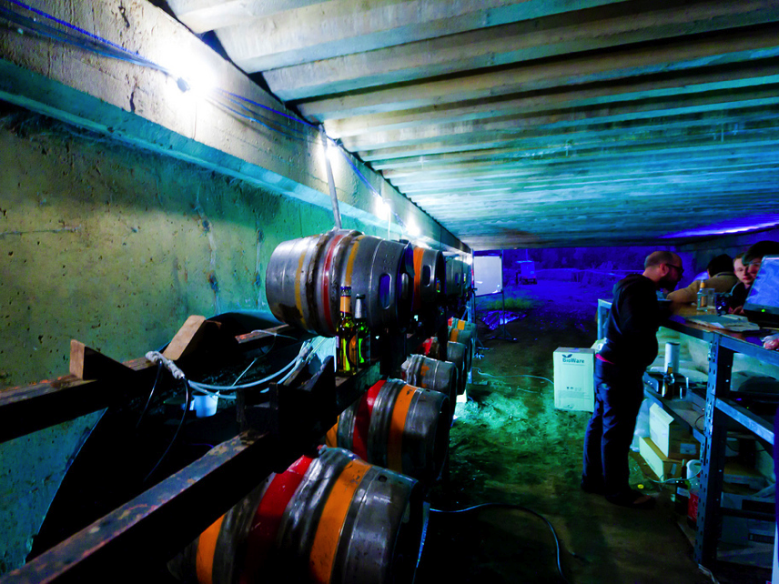
Festival site
Licensed bar under M1 bridge
Photo: Russ Garrett

Slide 10
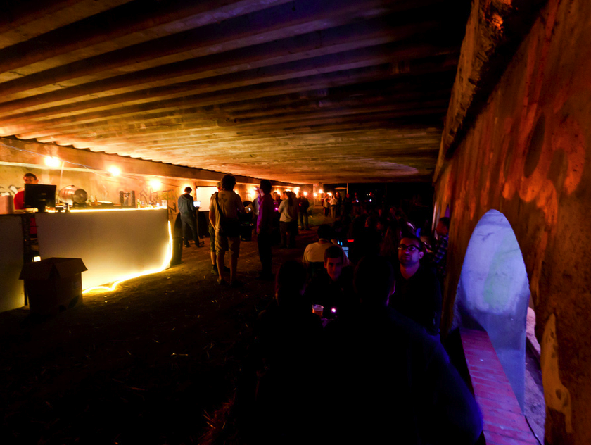
Festival site
Licensed bar under M1 bridge
Photo: Russ Garrett

Slide 11
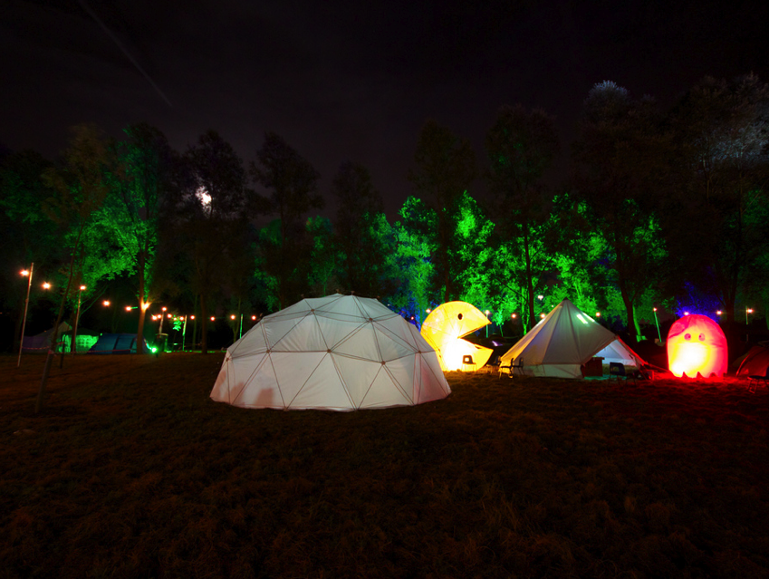
Festival site
Retro gaming tent
Photo: Andy Brockhurst

Slide 12
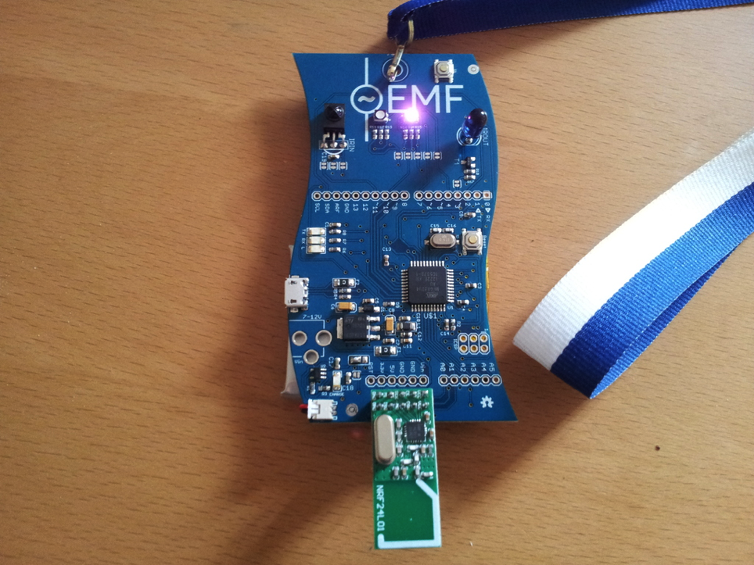
Badge
IR tx
IR rx
Atmega328
Microcontroller
MicroUSB
Sponsored by UCL
2.4ghz radio
Photo: Lionel Montrieux

Slide 13
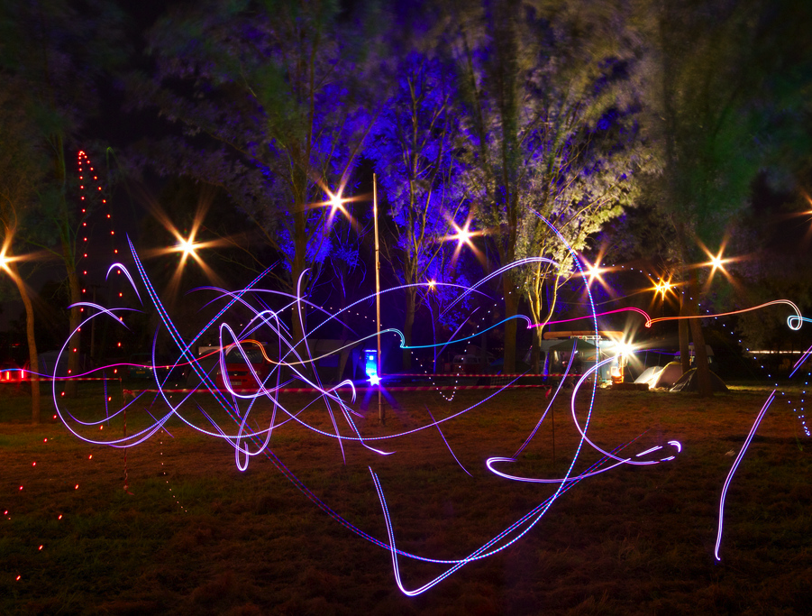
Infrastructure
Requirements:
100mbit+
Site-wide wireless
Ethernet + power to every tent
Fully dual stack
Visibility of the whole network
Multicast video
Photo: Andy Brockhurst

Slide 14
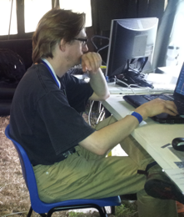
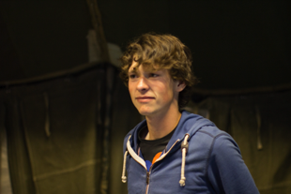
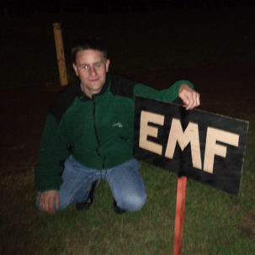
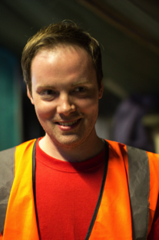
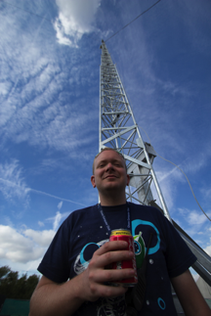
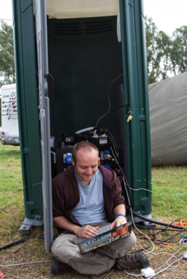
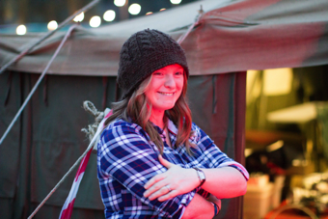
Infrastructure
Graham
Benny
Jasper
David
Mat
Will
Claire
Nat

Slide 15
Address space
Attempted to apply for temporary address space from RIPE NCC, sponsored by Goscomb.
Issued ASN, v4 + v6 PI then retracted by hostmaster after they realized they could only issue it 7 days before the event. Far too late – equipment was already configured and boxed by then.
RIPE-526 – broken ☹
Going back to address-policy-wg to alter the policy.

Slide 16
Address space
CCC / Chaos Computer Club to the rescue!
Loaned us:
AS13020
2001:067c:20a1::/48
94.45.224.0/19
But now Google is in German and BBC website carries adverts – never mind.

Slide 17
Backhaul
No existing copper or fibre
BlueSquare Milton Keynes (now Pulsant)
2.9km away

Slide 18
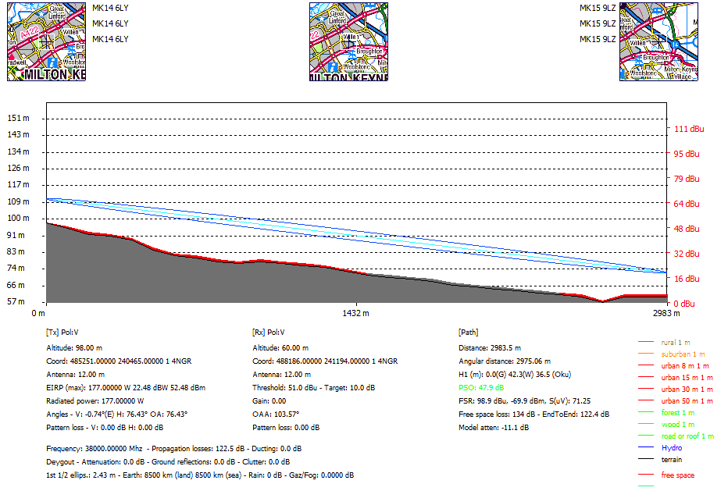
Backhaul

Slide 19
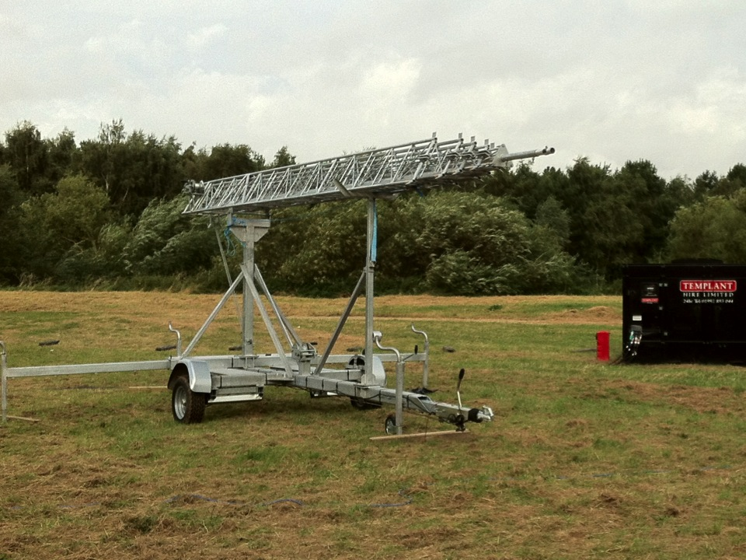
Backhaul
Hired two 30m mobile masts / VersaTowers
£1,440 for 7 days inc delivery + collection
Photo: David Croft

Slide 20
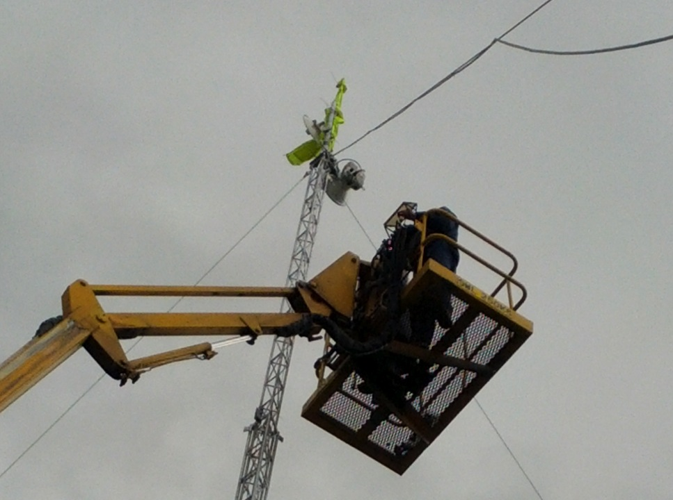
Backhaul
Jasper’s cycling jacket
27m cherry picker
Photo: Jasper Wallace

Slide 21
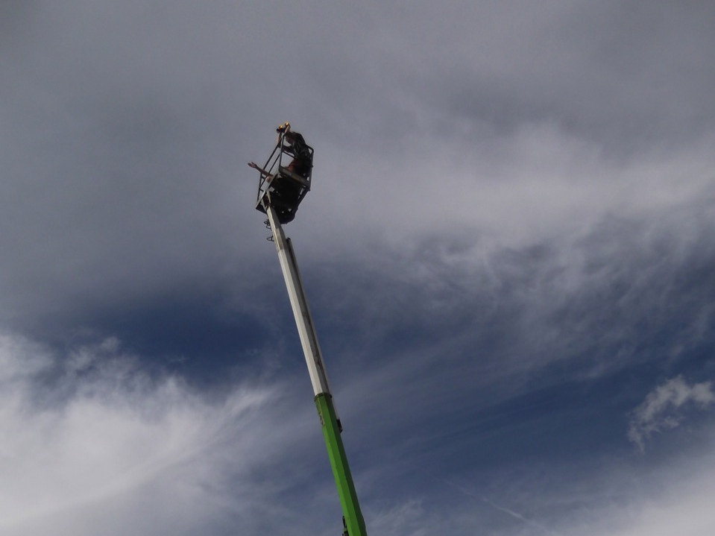
Backhaul
Spotting
17m cherry picker
Photo: Mat Burnham

Slide 22
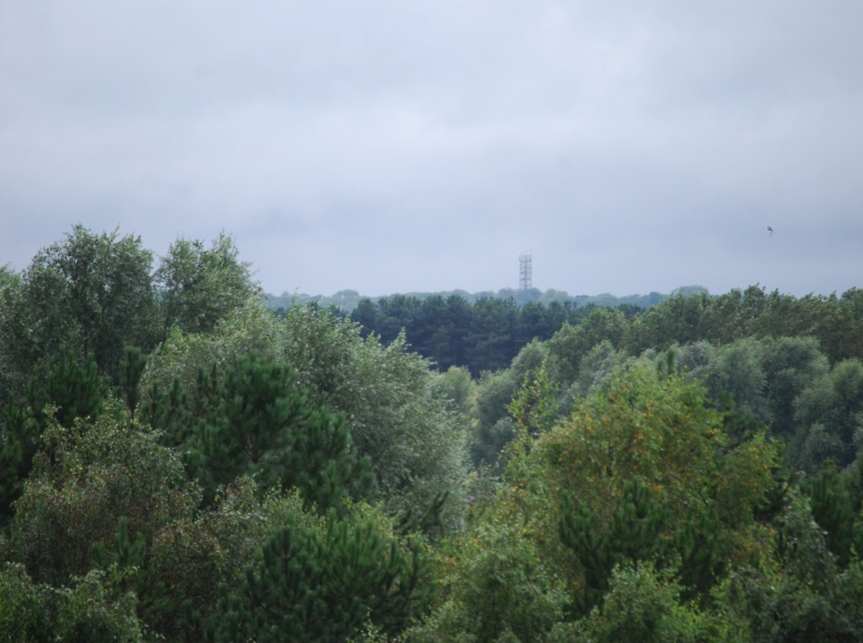
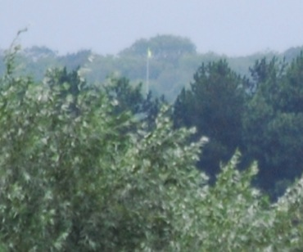
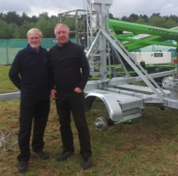
Backhaul
Looking from the site towards Pulsant
Frank + Mervyn
Photo: Rapid Wireless

Slide 23
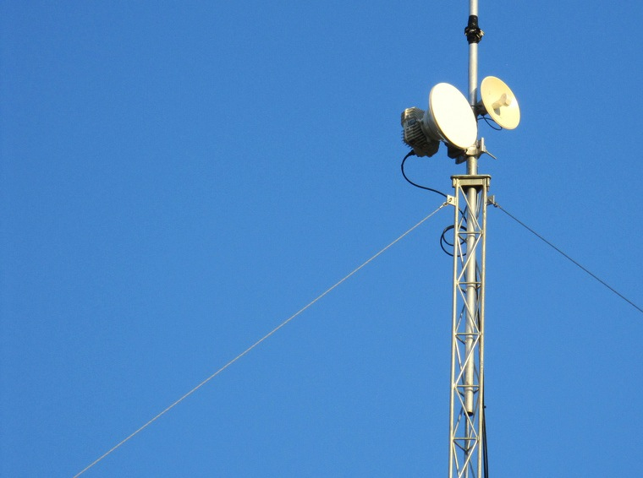
Backhaul
Primary link
DragonWave Horizon Compact
400mbit/s full duplex
18ghz OFCOM licensed
Hired from RapidWireless - £2,300
Photo: Nottinghack

Slide 24
Backhaul
Secondary link
Ubiquiti Nanobridge M
100mbit/s
5.4ghz
Bought from Linitx - £112 (for 2)
Photo: Nottinghack

Slide 25
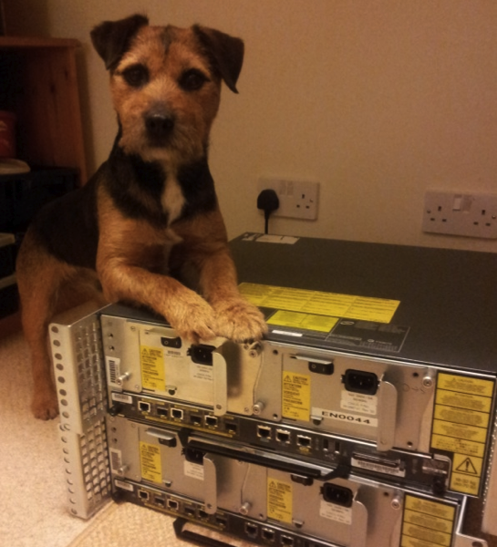
Backhaul
2 x Cisco 7206 NPE-G2
Installed in June / July

Slide 26
Backhaul
Pineham Park
1G
DragonWave
DragonWave
MK L3 Switch
ME3400
Ubiquiti
Ubiquiti
1G
100M
1G
100M
Pulsant
Transit
1G
MK Router
7206 NPE-G2
OOB
Core 1
3750G
1G
Core 2
3750G
1G
1G
THDO Router
7206 NPE-G2
Telehouse East
OOB
1G
LONAP
V4 + V6
Peering
V4 Multicast
Goscomb
Transit

Slide 27
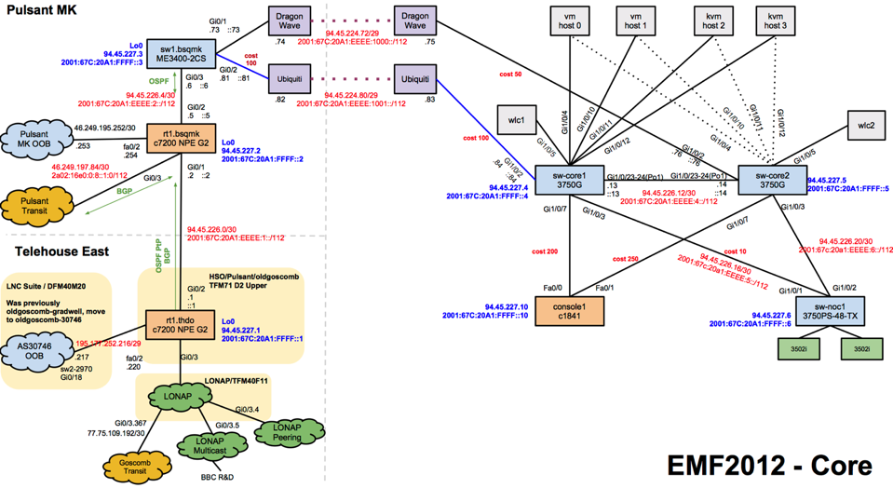
Backhaul
http://tinyurl.com/emfcore

Slide 28
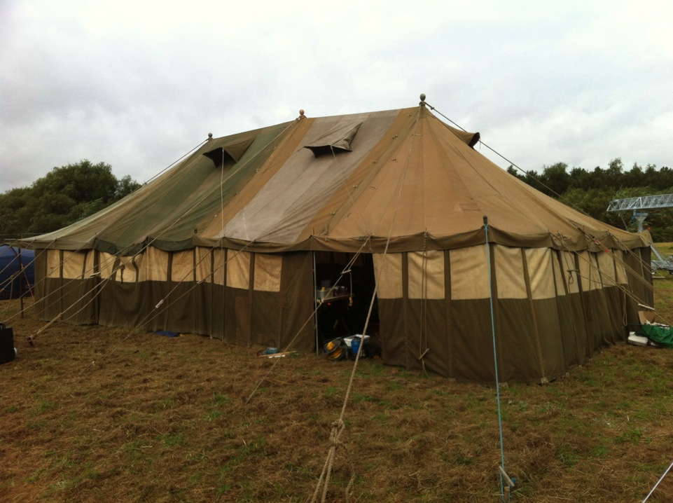
NOC
£25 donation to the Scouts
Photo: David Croft

Slide 29
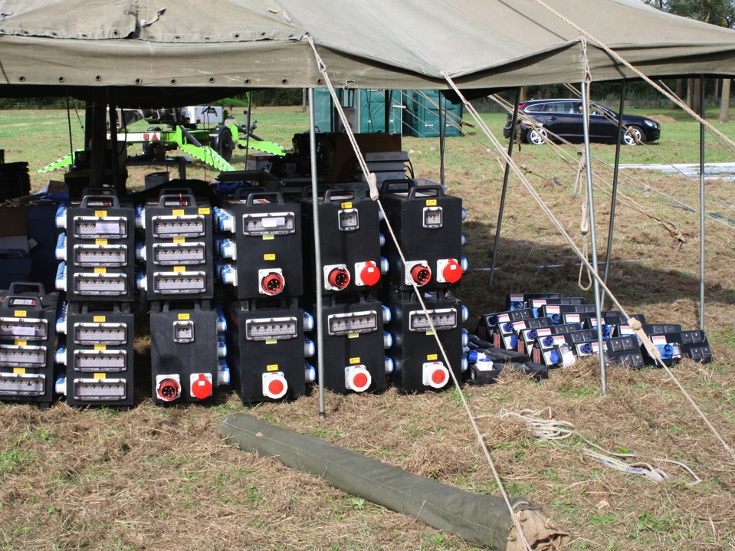
NOC
Network required power so ended up running that

Slide 30
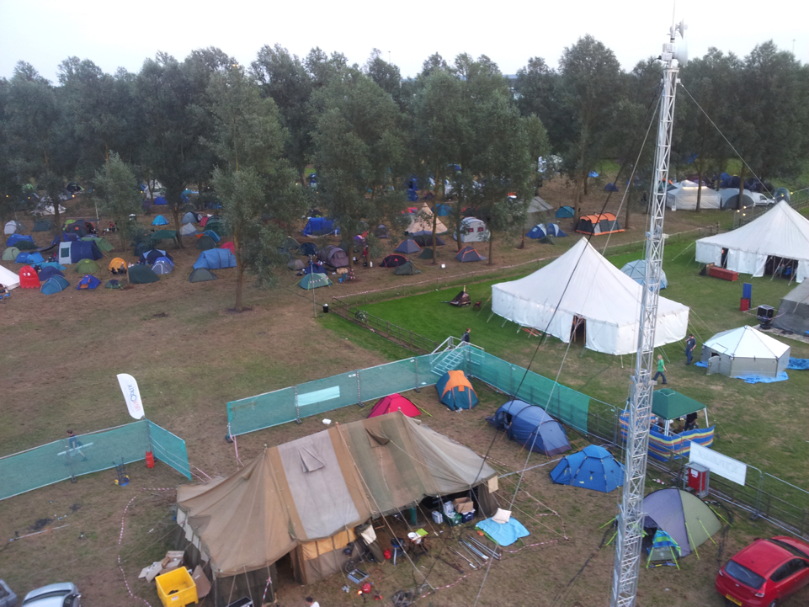
NOC

Slide 31
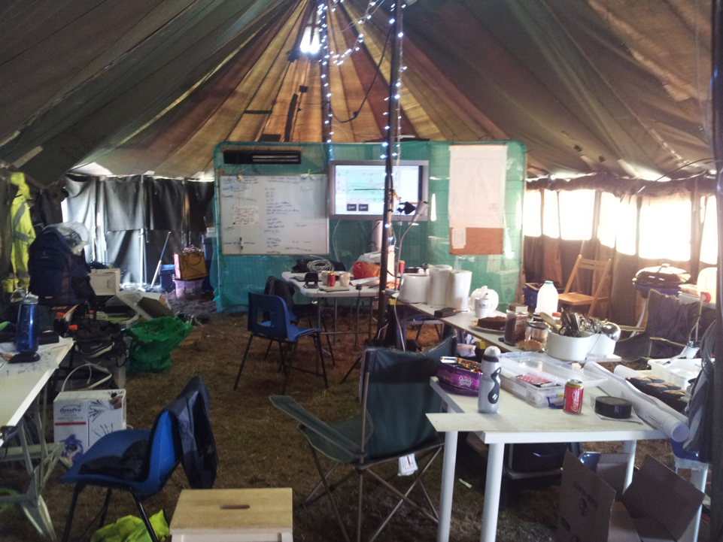
NOC
Food / work / social area

Slide 32
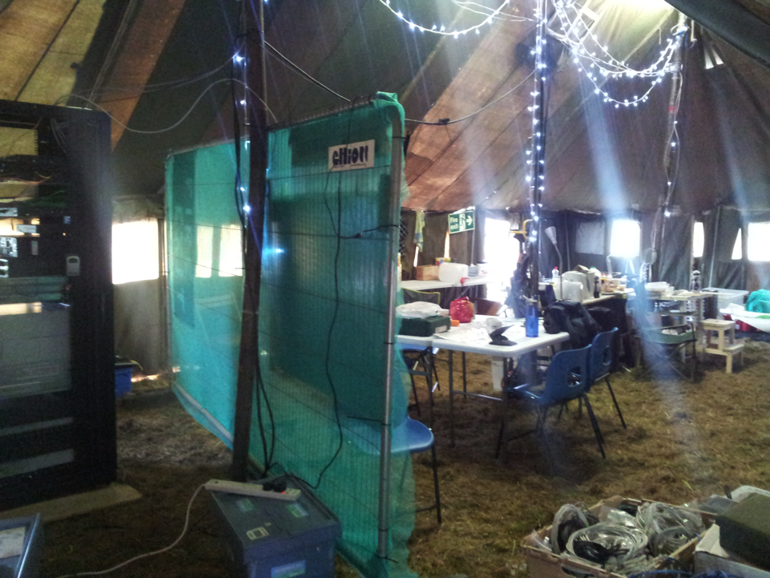
NOC
Data centre partitioning!

Slide 33
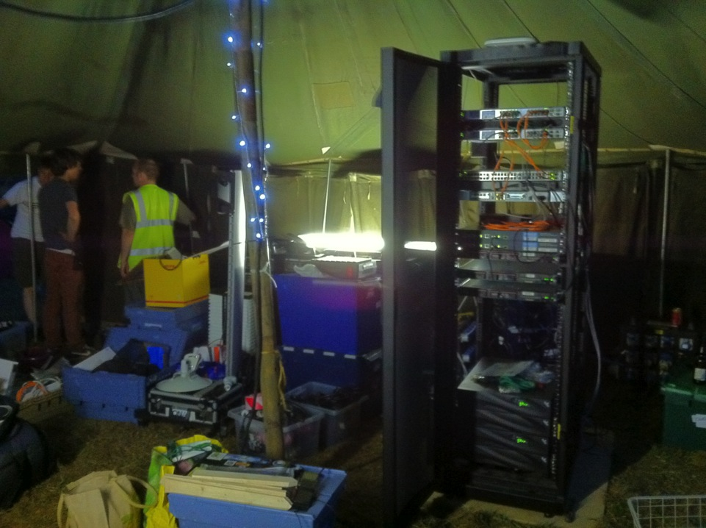
NOC
Core rack

Slide 34
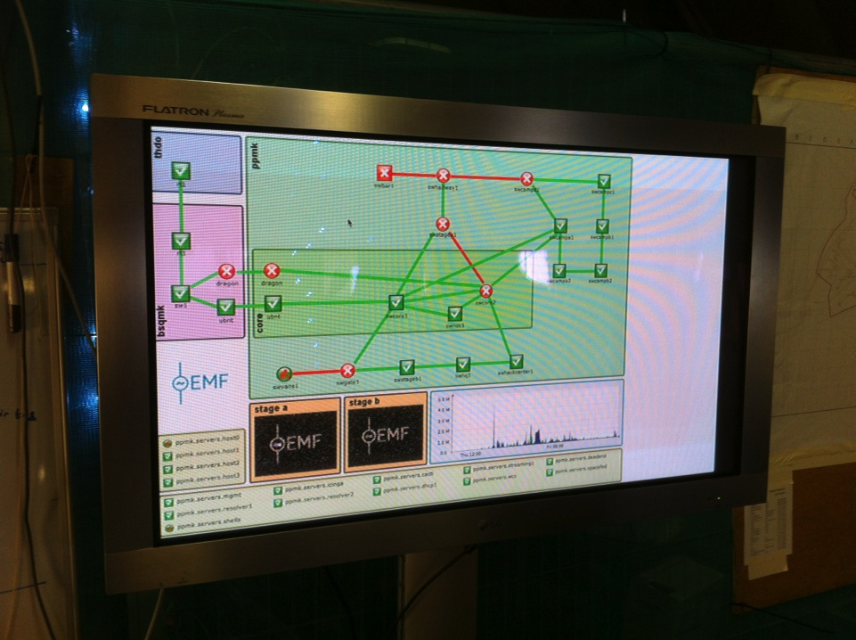
NOC
Nagvis

Slide 35
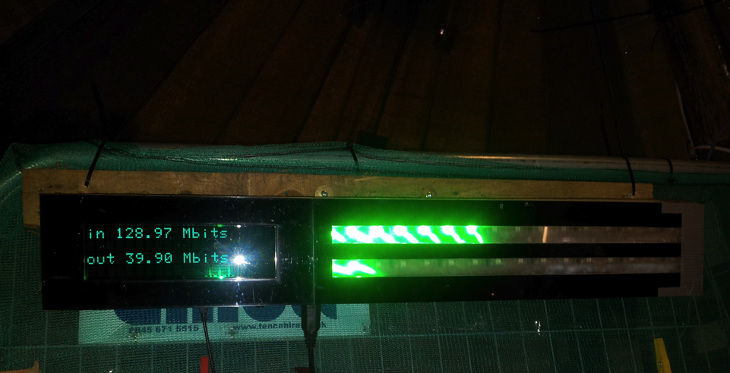
NOC
Bandwidth monitor

Slide 36
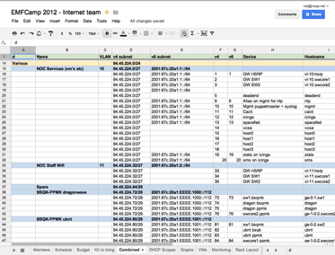
Automation
DNS Zones
Forward
Reverse
DNSSEC Signing
DHCP Scopes
- dhcpd.conf
Google Data API
Nagios
- Services per host
Google Spreadsheet
Schedule
Budget
IP Plan
DHCP Scopes
Monitoring
Rancid
Switch IOS config
https://github.com/emfcamp/emfnoc

Slide 37
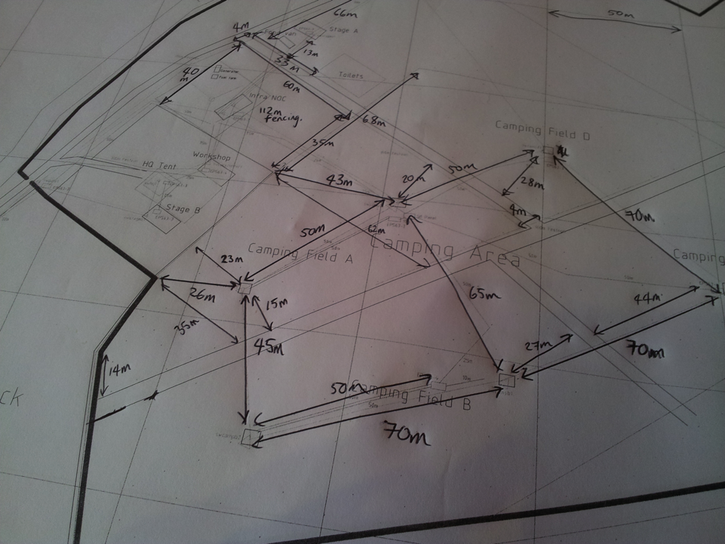
Distribution

Slide 38
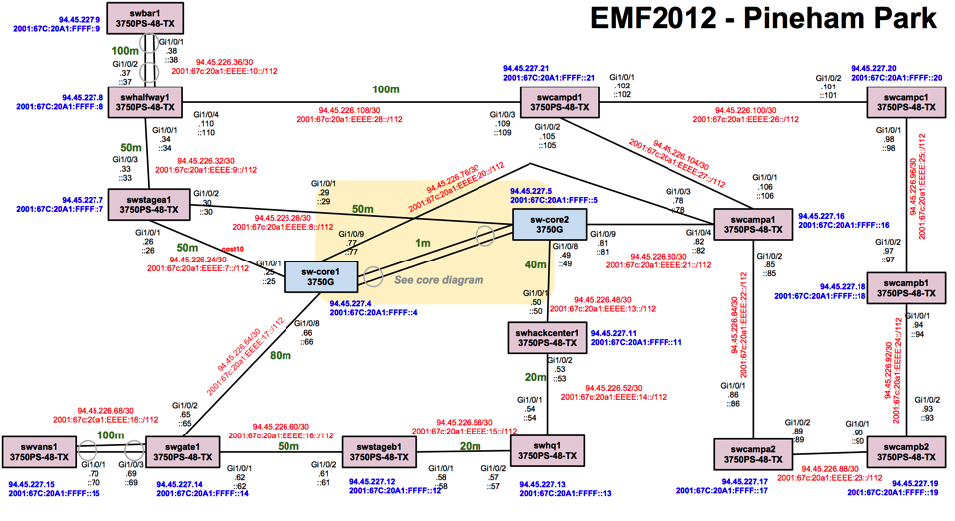
Distribution
http://tinyurl.com/emfdistro

Slide 39
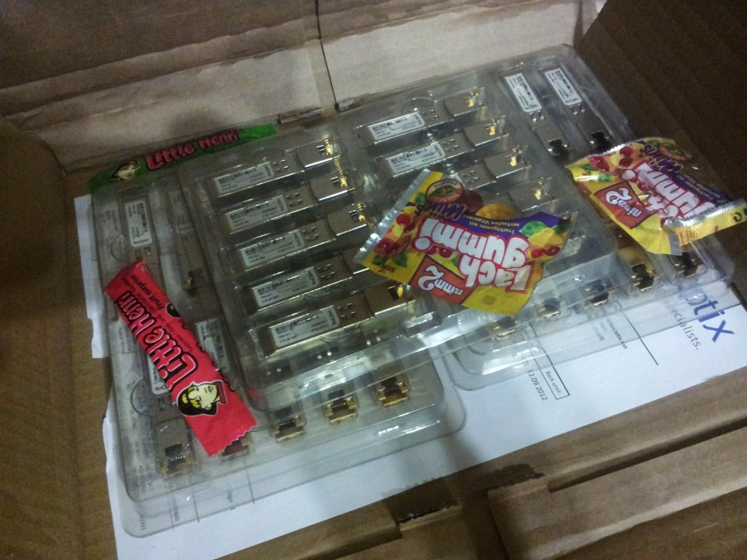
Distribution
SFP’s sponsored by FlexOptix

Slide 40
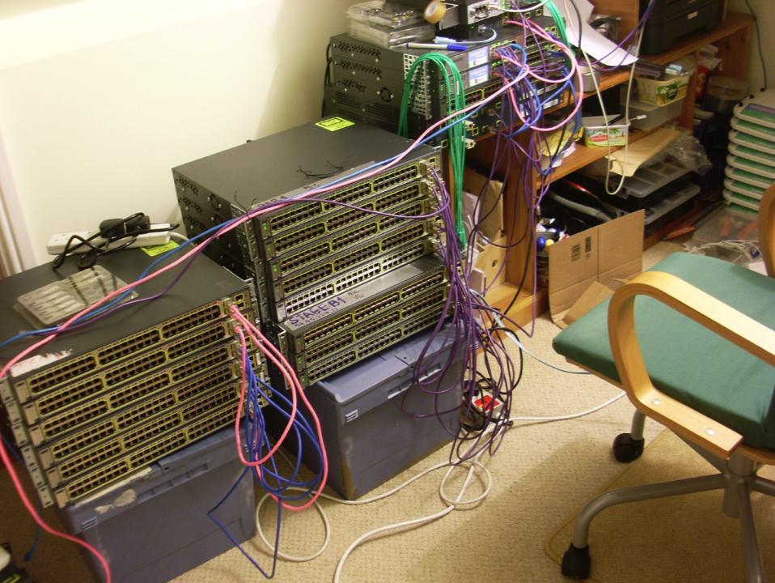
Distribution
Staging from June in Nat’s loft
GRE tunneled back to MK
Config, document + monitoring

Slide 41
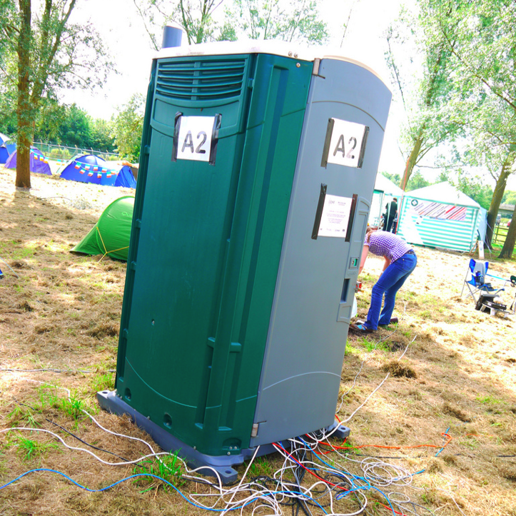
Distribution
£60/wk hire
Photo: Paul Miller

Slide 42
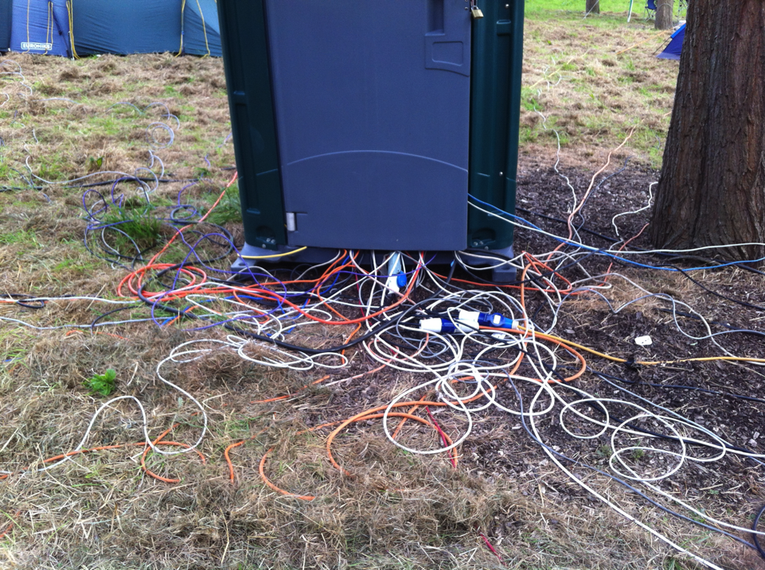
Distribution
Photo: David Croft

Slide 43
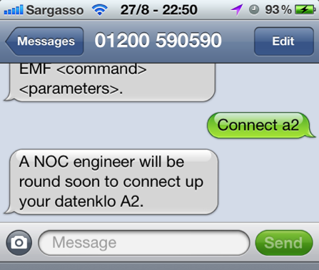
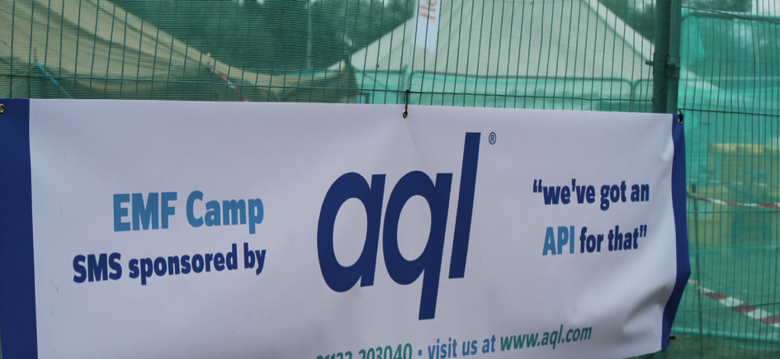
Distribution

Slide 44
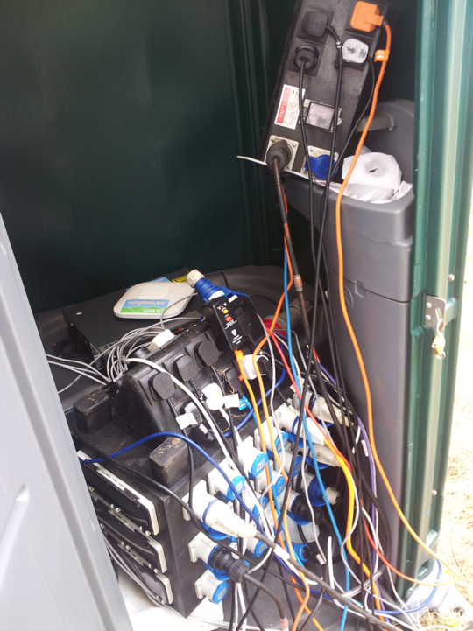
Distribution
Typical Datkenklo

Slide 45
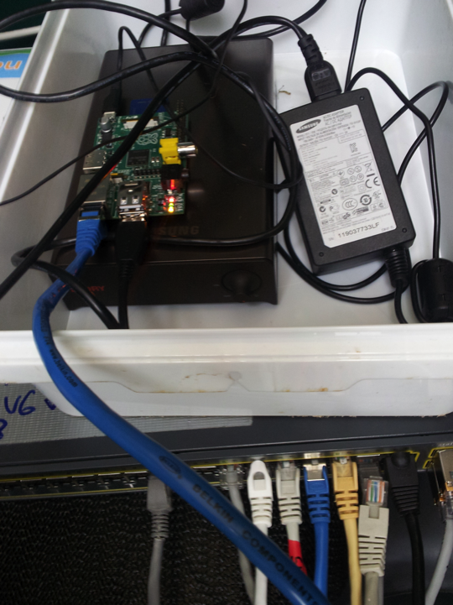
Distribution
Raspberry Pi colo

Slide 46
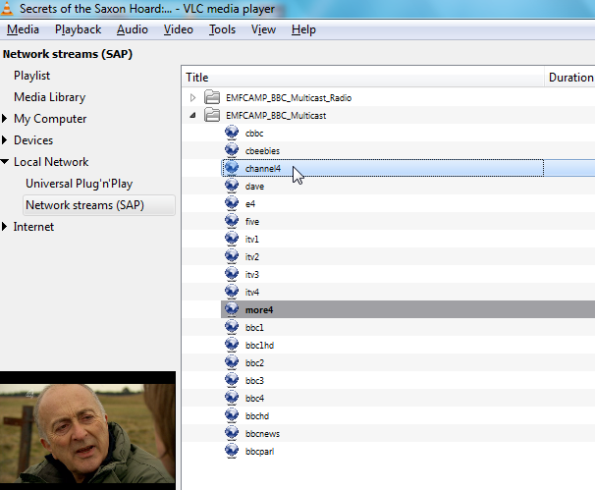
Distribution
Multicast video
BBC R&D trial over LONAP
On wired + wireless
Local SAP server
http://support.bbc.co.uk/multicast/

Slide 47
Wireless
Dual Cisco WLC 4402 Controllers

Slide 48
Wireless
WCS AP mapping

Slide 49
Wireless
http://stats.emfcamp.org/luke/
Luke’s AP association hack
Luke Brookes
Twitter: @propuke

Slide 50
Stats

Slide 51
Stats
More at http://stats.emfcamp.org

Slide 52
Feedback

Slide 53
What next?
EMF will return in 2014
Aiming for ~1500 capacity
We need your help!
Telcos with clue who can help with fibre
Network engineers who can brave the sunshine ☺
Photo: Andy Davidson

Slide 54
Questions?
Photo: Russ Garrett

