Slide 1
Minor Sporting Event
James Blessing
Oct 2012

Slide 2
Agenda
Background
Stats
Incidents
Summary

Slide 3
Background
… or what did we do during the summer?
Content Delivery Network
RTMP/E for Flash
Chunked HTTP – HLS/HDS
Small object delivery
Digital Presence Management
Limelight Video Portal
Web Content Management
Agile Storage
Olympics, Euro’s, Queens Jubilee, Wimbledon (and that’s just the UK)

Slide 4
Stats
(we all like numbers don’t we)
21% of all streams view on mobile devices
But only 45% of those on “mobile networks”
Peaks very country specific
Brazil – beach volleyball
UK – Bradley Wiggens
France – Judo
AsiaPac weren’t really engaged online

Slide 5
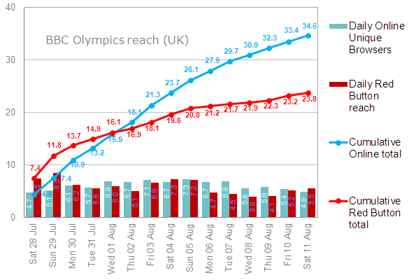
http://www.bbc.co.uk/blogs/bbcinternet/2012/08/digital_olympics_reach_stream_stats.html

Slide 6
Incidents
… because nothing ever goes to plan
DISCLAIMER
The following represent a series of networks around the world that made their own decisions for commercial or technical reasons and the impact of those decisions. The names have be changed to protect the guilty.

Slide 7
Incidents
… because nothing ever goes to plan
Not enough capacity
Network 1 upgraded one of their transit links but not their backup
Traffic Shaping
Network 2 decided to limit impact by shaping to 900kbps
Network 3 had variable shaping for peak, but configured it to go to 120kbps
Cutting it fine
Network 4 were adding additional capacity on the day of the opening ceremony
VPNs
A lot of traffic seen to be going to companies that host VPN Servers in the UK

Slide 8
Summary
Mobile devices are becoming more prevalent (even if they are using them on WiFi networks)
Traffic wasn’t quite as high as predicted, but was still much larger than previous events
Stuff happens

Slide 9
Thank You
TM and © 2012 Limelight Networks. All rights reserved.

