Slide 1
Euro-IX Update
UKNOF 24 – 17th Jan 2013
Bijal Sanghani
bijal@euro-ix.net
#euroix #bijalsanghani

Slide 2
Euro-IX Affiliates
67 affiliated IXPs :
51 IXPs in Europe (30 Countries)
Operating over 70 Internet exchanges
16 IXPs from the rest of the world
10 affiliated patrons:
ADVA Optical Networking Cisco
Brocade Force10 now DELL
Extreme Networks Juniper Networks
Interxion Telecity
MRV
Telehouse

Slide 3
What does Euro-IX do
2 Forums a year
Maintains the Website, database and tools
Mailing Lists
Working Groups and Task Forces
Euro-IX Board and Forum Program Committee
Euro-IX Twinning Program
IX-F (APIX, LAC-IX and Af-IX)
Euro-IX BMC - Benchmarking Club
Annual European IXP Report
Other project, e.g., Euro 2012 CL with RIPE NCC

Slide 4
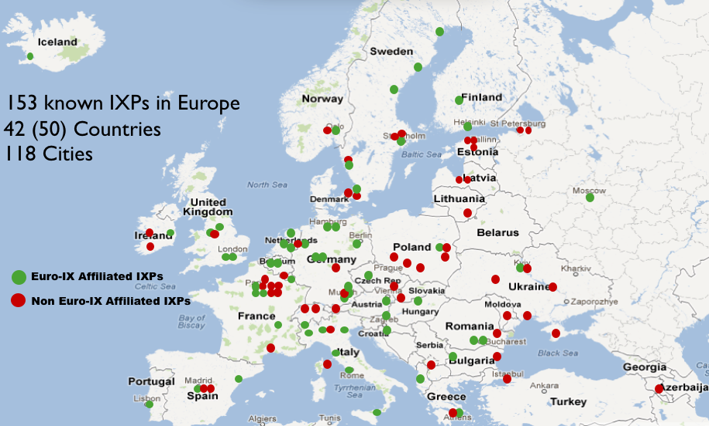

Slide 5
Euro-IX Membership Traffic (Gbps) 12 months over the Public Peering LAN

Slide 6
Euro-IX Database
Market share of switch/router vendors among European IXPs [%]

Slide 7
Route server operating systems in use [%]

Slide 8
Route server daemons in Use [%]

Slide 9
Demo

Slide 10
Questions? And Thank You!!
#euroix #bijalsanghani

