Slide 1
Activity update january 2013
__________________________________________
Andy Davidson andy@lonap.net
17th January 2013 UKNOF, Newark

Slide 2
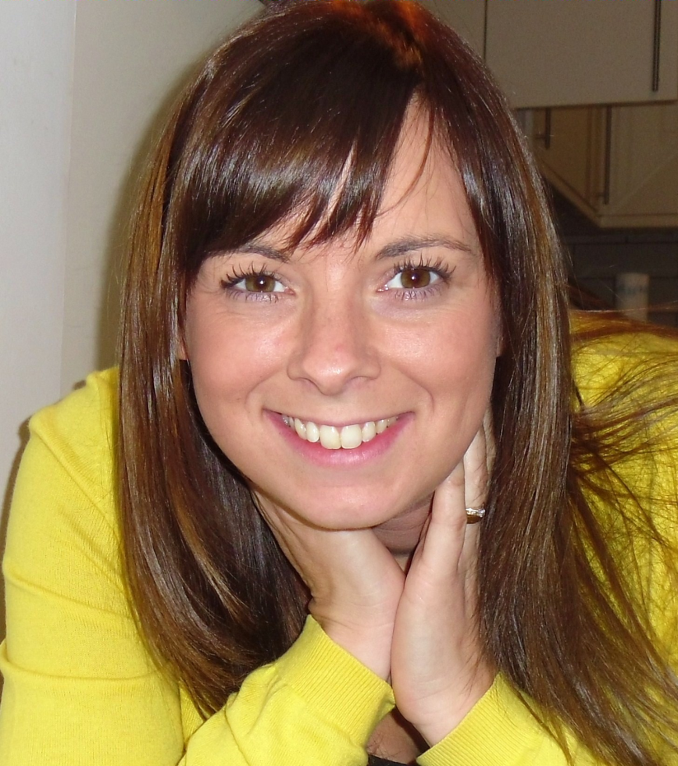
New Faces 2012/3
Rob
Kelly
Tref
Notes:
Handling 500 tickets per year (mostly technical; much of accounts work happens outside ticketing system)
Includes provisioning of ports / port changes / decommissioning of ports
Includes port config changes / support requests
(Mean) Average ticket resolution times reduced by 67% (60 to 20 days).. Includes member delays; some tickets are open very long because we’re waiting on member responses.
In 2012, the MEDIAN RESOLUTION TIME is 5 days; compared to 14 days in 2011 and 21 days in 2010!
Kelly joined LONAP in March 2011
Works a couple of days a week
She has significantly reduced the load on Seb by taking over all invoicing functions
Kelly took over all accounts receivable functions from Andy at the same time
Kelly also handles all new member joining requests to the point where the port is ready for connection
This means, in conjunction with Rob getting members plugged in quicker, we get to bill members sooner, increasing revenue.
Faster response times also help present a more professional image for LONAP

Slide 3
Membership Trend
Notes:
We’re continuing to grow at a rate of 10-12% per year (net additions; i.e. new members less leavers) but this continues to be an area of frustration along with bandwidth growth.
Andy will be talking about new products/services which we’re hoping will help this.
THIS GRAPH DOES NOT SHOW MEMBERS IN JOINING PROCESS

Slide 4
New Members 2012…
Notes:
We’ve had 21 new members recently (includes 5 in the joining process – outlined in yellow)..
... many of our new members express an interest early on but take a year or longer to connect
… we’re going to address that by putting in more resource into regular follow-up of leads in our CRM

Slide 5
Port Types
10GE
FE
GE
Inner ring = 2009; Outer ring = 2012
Notes:
We’ve seen a significant growth in 10GE ports and a reduction in FE ports.
We now have only 3 FE ports connected and we’re working to get those upgraded to GigE..

Slide 6
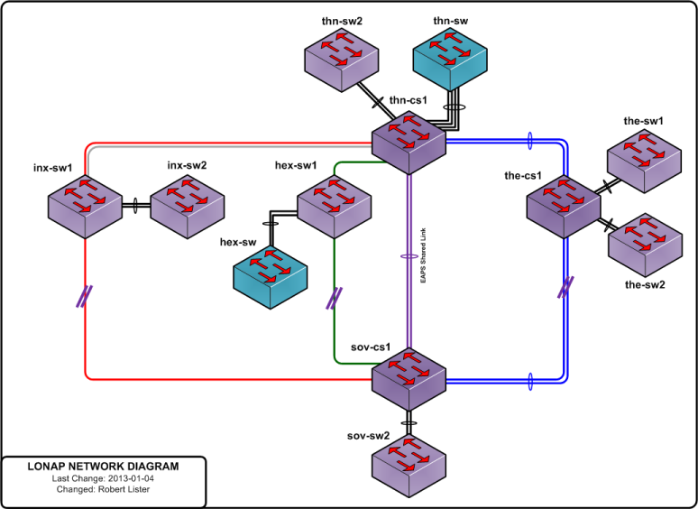
Current Network: January 2013

Slide 7
Route Servers: ASNs up
RS1: 85 ASNs (70%)
RS2: 84 ASNs (69%)
Check your sessions are configured and up to both route servers!
Notes:
As of yesterday 9/1/2013

Slide 8
IPv4 - Renumber
Members will be asked to:
renumber 193.203.5.xxx → 5.57.80.xxx
reconfigure /24 netmask to /23 or /22
Review your reverse DNS and other settings…

Slide 9
“LONAP’s job is to encourage peering
and shift my bits inside London only.
I am paid to shift bits to other cities.”

Slide 10
“I need the more value from all parts of
my infrastructure, so LONAP should do
everything to grow my peering potential.”

Slide 11
“Don’t break it!”
- Brandon

Slide 12
Remotely Connected member
(an “Associate LONAP Member”)
Various
speeds
Reseller Partner
(a “LONAP Member”)
n*10GE
LONAP
Notes:
Remote connections to LONAP
Allows networks not present in our sites to connect to LONAP via reseller to peer
Apologies for terminology.. We’re still working those out

Slide 13
Remotely Connected member
Remotely Connected member
Remotely Connected member
1GE
500Mbps
2GE
Other Services
Reseller Partner
1 x 10GE Port (or LAG)
LONAP

Slide 14
Remotely Connected member
Remotely Connected member
Remotely Connected member
1GE
500Mbps
2GE
e.g. AMS-IX
e.g. 100Mbps VLAN to AMS-IX
Reseller
Partner
1 x 10GE Port (or LAG)
e.g. 500Mbps VLAN to LONAP
LONAP
Notes:
Talk about bundling.. 100Mbps AMSIX, 250Mbps LONAP, 250Mbps Transit, etc..

Slide 15
Commercial Model
Reseller Partner
Must be “full member” of LONAP
Available on 10GE ports only
Must sign reseller agreement & comply to tech standards
Remotely Connected Member
“Associate Member”
Does not confer privileges of a ‘full member’ (e.g. voting)
Must sign end-user agreement & comply to tech standards
LONAP Bills Reseller Partner:
Reseller Partner Membership fee
Reseller Partner 10GE port(s) fees
Fee for each Remotely Connected Member
Notes:
Explain why no voting
Explain ‘reseller capable’ port can be any existing 10G port..

Slide 16
Focussing LONAP on quality..
Faster connections…
Entry level resold product = 250 Mbps
Most other reseller programmes begin at 100 Mbps
Follows LONAP mantra of larger ports at lower cost
100Mbps Broadband access circuits becoming common so 100 Mbps peering is sub-optimal
Enticing pricing to encourage promotion
Help grow LONAP to new markets
Notes:
Incentivising connections/promotions.. PREPARE FOR Q
We only have 3 x FE ports remaining on LONAP – not about to start introducing more!

Slide 17
…but can we do something
different?
Notes:
So this isn’t anything new.. AMS-IX, LINX and various other exchanges have done it..
.. So we started thinking…
…is there an opportunity not just to bring in more members to LONAP,
But help LONAP members get more value out of their ports.
We talked before about operating shared vlans with other IXPs…
…but this involved a lot of risk to LONAP (financial at least)

Slide 18
Notes:
..and then we thought, how about looking at this not just as a one-way programme..
..but a two-way one?
We’re calling this..

Slide 19
LONAP MARKETPLACE
Notes:
..the LONAP Marketplace

Slide 20
$anotherIXP
Marketplace Supplier
(a LONAP Member)
LONAP
Marketplace Customer
(a ‘directly connected’ LONAP member wanting to connect to $anotherIXP)
Notes:
Using LONAP to provide value added services..
..such as connecting to another IXP
*** NOTE: This isn’t restricted to connecting to other IXPs but that’s a possible use case ***

Slide 21
Previously not possible...
Number of MACs
CAM table size
Port Security Model
Pseudowire Model
See no MACs
No CAM table issue
No Port Security issue
Notes:
Previously not possible..
Number of MACs (AMS-IX bridges to LONAP * n times would be a problem)
CAM table size
Port Security Model (1 mac per port)

Slide 22
Marketplace
Open to direct members only
Encourages new members to join
Enhances benefit of ‘full membership’ over remote connections
Increased returns on
LONAP fees
Datacentre cross-connect costs
Router port costs
Not a replacement for L2 services across sites
Designed not to compete with members’ L2 services

Slide 23
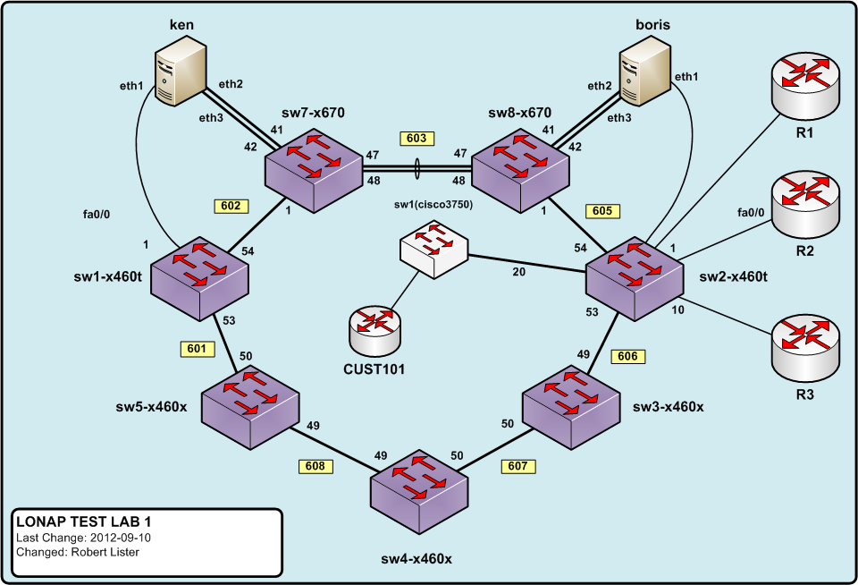
Well Tested Platform
Notes:
Two PCs with traffic generation, sampling and other tools, Ostinato, iperf, tcpdump etc.
Various routers and switches and switches to create “members” and various config situations.

Slide 24
Pricing
Special 10GE pricing promotion
Waived setup fee, saving £2,500 NRC
3 months promotional rate
Regular pricing remains market leading
£2,000 per year membership, includes GE ports
£2,500 per year 10GE ports.

Slide 25
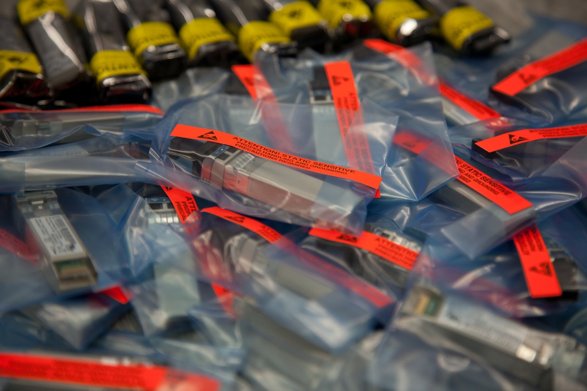
Questions ?
__________________________________________
Andy Davidson andy@lonap.net
17th January 2013 UKNOF, Newark
Twitter: @lonap @andyd .

