Slide 1
UK Spectrum update
Steve Kennedy
NetTek Ltd

Slide 2
800MHz / 2.6GHz
Spectrum auctioned and raised £2,368,273,322 for Treasury
Below the £3.5bn wanted
Everything Everywhere Ltd
2 x 5 MHz of 800 MHz and 2 x 35 MHz of 2.6 GHz £588,876,000
Hutchison 3G UK Ltd
2 x 5 MHz of 800 MHz £225,000,000
Niche Spectrum Ventures
2 x 15 MHz of 2.6 GHz and 1 x 20 MHz of 2.6 GHz (unpaired) £186,476,000
Telefónica UK Ltd
2 x 10 MHz of 800 MHz (coverage obligation lot) £550,000,000
Vodafone Ltd
2 x 10 MHz of 800 MHz, 2 x 20 MHz of 2.6 GHz and 1 x 25 MHz of 2.6 GHz (unpaired) £790,761,000
Notes:
All 2G and 3G bands can be re-farmed for 4G use
MLL Telecom have a low power GSM license and failed to win 4G spectrum
3UK don’t get EE spectrum until end of 2013

Slide 3
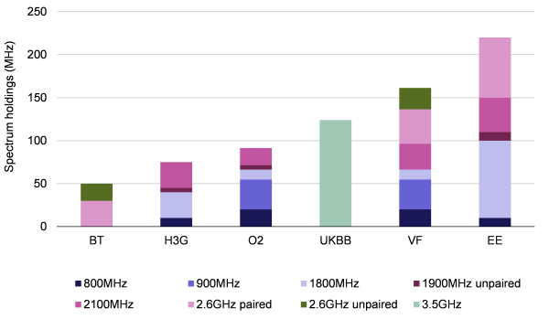
800MHz / 2.6GHz
Source: Analysys Mason

Slide 4
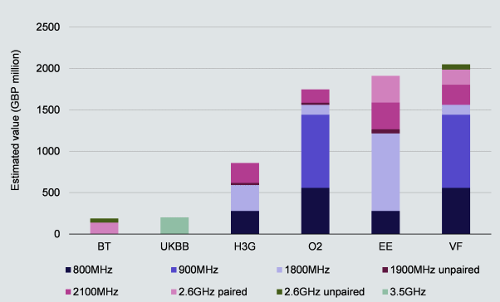
800MHz / 2.6GHz
Source: Analysys Mason

Slide 5
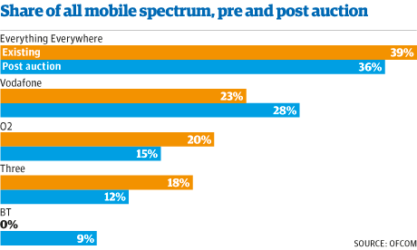
800MHz / 2.6GHz

Slide 6
800MHz / 2.6GHz
Notes:
National audit office to investigate Ofcom auction
Actual bids exceeded £5.2bn (but higher bidders only paid slightly higher than next lowest bid – like Ebay)
£1.2bn Government defficit

Slide 7
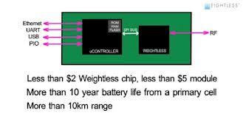
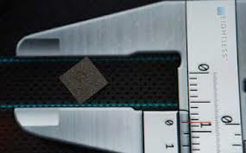
Whitespace
Trials underway
No centralised Ofcom database yet
No real roll-outs
Ofcom has specified the types of queries and responses, but not how they're implemented as this would be down to the market to implement
Neul have now produced silicon
Iceni – works from 470 – 790 MHz
6 or 8MHz channels

Slide 8
Zigbee more Internet friendly
IEEE 802.15.4
Now supports IP Direct Connect
automatically meshes
6LoWPAN
IPv6
PANA
RPL
TCP
TLS and UDP
end-to-end encryption

Slide 9
Range Networks support commercial GSM
Based on OpenBTS
Currently 2/2.5G
3G WCDMA and LTE networks
Core GSM network for less than $100,000
Basestation for around $30,000

Slide 10
Short Range Devices to move
Ofcom mandate
Moves from 10.675 to 10.699 GHz to 10.575 to 10.6 GHz
License Exempt
Needs WTA change (SI)

Slide 11
PMSE supports high power
Programming and Special Events
Old regulations Channel 38 for PMSE devices (606 - 614 MHz), but only for low power devices (under 50mW EIRP)
Now up to 10W EIRP to operate in the lower 2 channels (within channel 38), i.e. 606.7 MHz and 607 MHz

Slide 12
New DTT Multiplex available in 600MHz
License available now for £180,000
600MHz band is actually made up of frequencies from 550-606 MHz in 8MHz channels (known as channels 31 to 37)
License lasts until 2018, but Ofcom can kill with 12m notice
DVB-T2 and MPEG4
EU spectrum harmonisation means 700MHz band (current DTT) to be cleared by 2018 for wireless broadband use

Slide 13
Ofcom FAT available
It’s a LONG document
http://stakeholders.ofcom.org.uk/binaries/spectrum/spectrum-information/UKFAT_2013.pdf

Slide 14
Thank you for listening!
Email: steve@gbnet.net
@stevekennedyuk
@nettek
@eurotechnews
@citymeetstech

