Slide 1
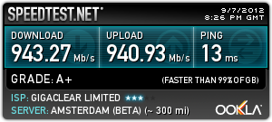
Ultrafast broadband
Christer Karlsson
CTO
christer.karlsson@gigaclear.com

Slide 2
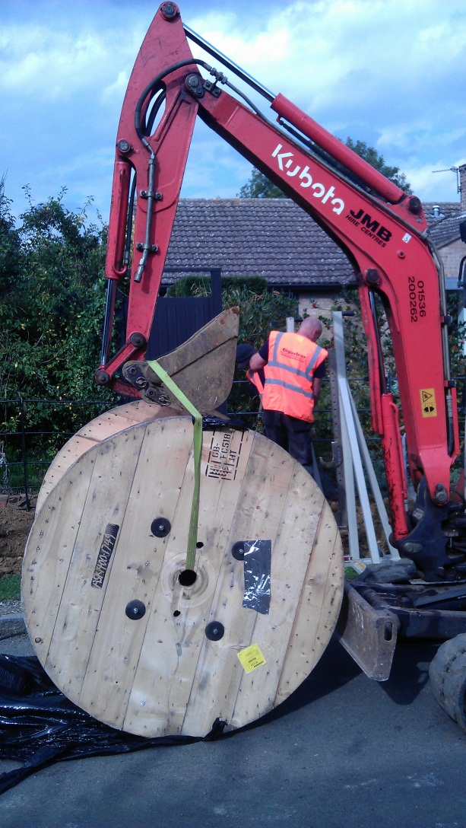
Who is Gigaclear?
Private company founded in December 2010
Full Code Powers granted by OFCOM May 2011
Opened first pure fibre network in Hambleton October 2011
Completed second 1000Mbps network in Appleton & Eaton in November 2012
Started build of new networks in Oxfordshire and Rutland in December 2012:
  2 now complete in Fyfield (Oxfordshire) and Uppingham Beeches (Rutland)
  1 in build at Frilford (Oxfordshire) completing May 2012
  Retail and Wholesale access model

Slide 3

What does Gigaclear do?
We invest in and build pure fibre to the premises, ultrafast broadband networks in rural communities
Our networks connect to the UK’s national fibre backbone using national carriers
Every property we pass gets a connection point Our networks do not touch or replace the existing copper based network
Industrialised installation to property (Self Install)
Auto provision ( Zero Touch)
Customer self-service portal (Self care)

Slide 4
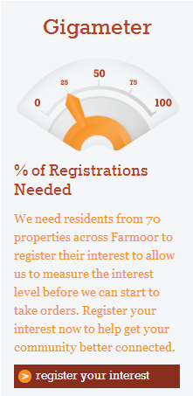
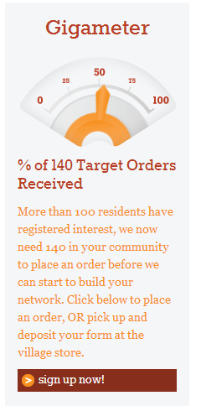
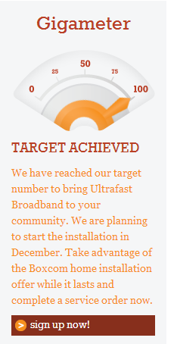
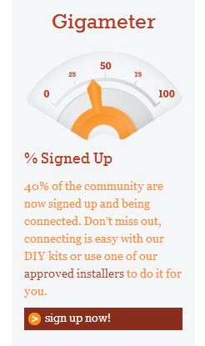
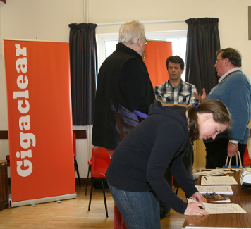
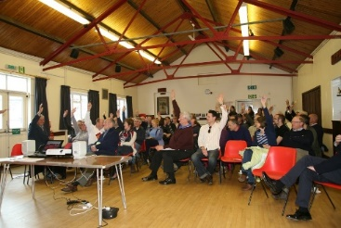
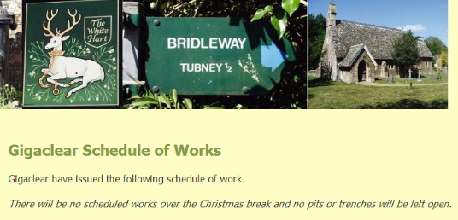
Building Interest

Slide 5
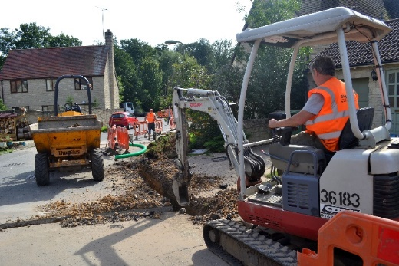
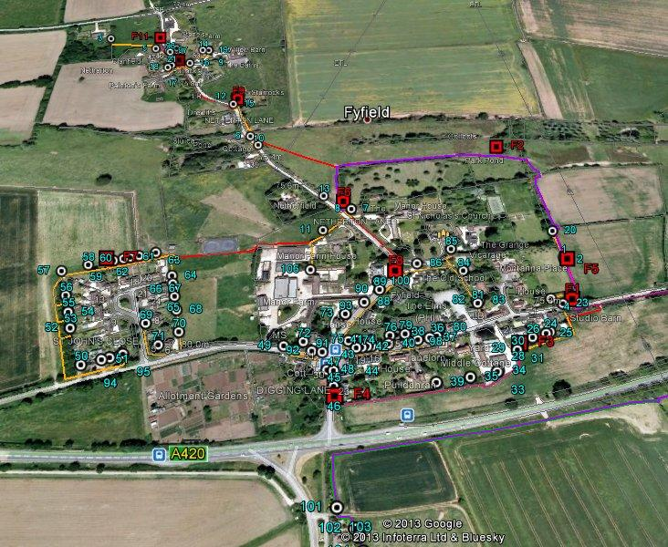
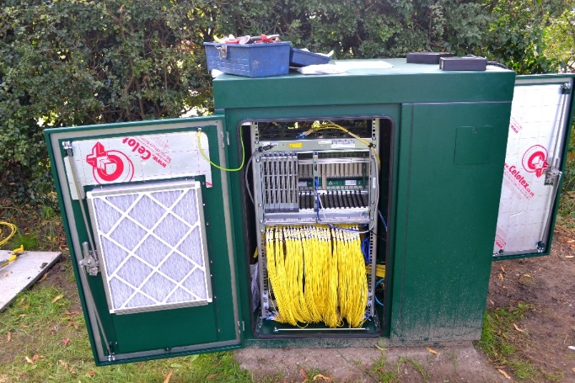
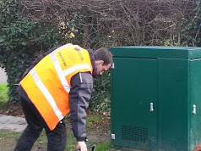
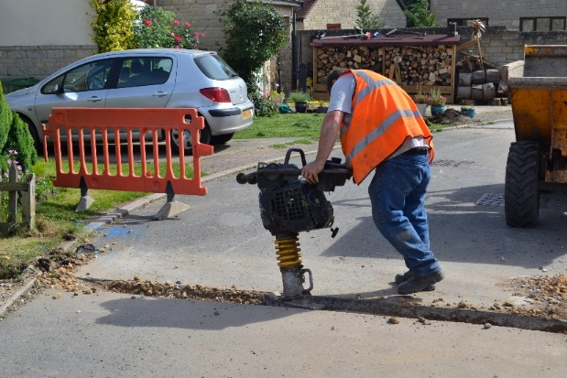
Design and Build

Slide 6
Civil works demands
Code powers from OFCOM
EtoN
Wayleaves from Landowners
Wayleaves from Households
Streetworks from Highway Authorities
Conservation Areas
Choice of method (Chain digger, Mole)
Planning, Information Dissemination and Contractors

Slide 7
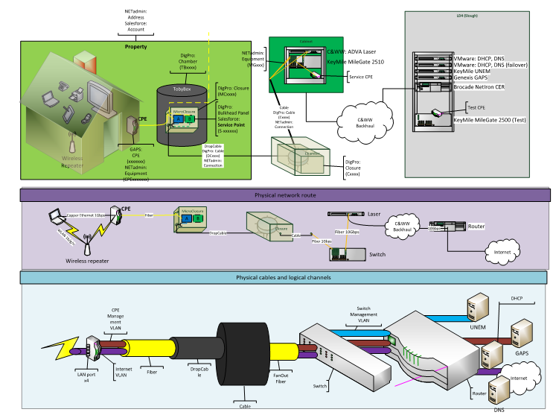
Network Over view

Slide 8















Network Over view
ASP
One Box More Functions (Service base Nodes)
e.g. IPTV, Telephony
Fiber
IP Backbone
World
Fiber
Metro
Ethernet
Metro
Ethernet
Metro
Ethernet
Edge
Optical
Transport
Fiber
Metro
Ethernet
Metro
Ethernet
Edge
Fiber
Metro
Ethernet
Transit
Peering
Fiber
Access
Network
Metro/Aggregation
Network
IP Edge
Backbone
Network
Service Provider
Networks

Slide 9
Retail and Wholesale Model
B2B
HSI
Service providers
Customers
IPTV
IPTV
VOIP
VOIP
Open service delivery architecture
Self activation of services
HSI
Business
model
Prepaid
Open access layer
Village
Village
Village
Village
Village
Village
Access technology P2P (Bidirectional)
The goal is to fully automate all processes and provision

Slide 10
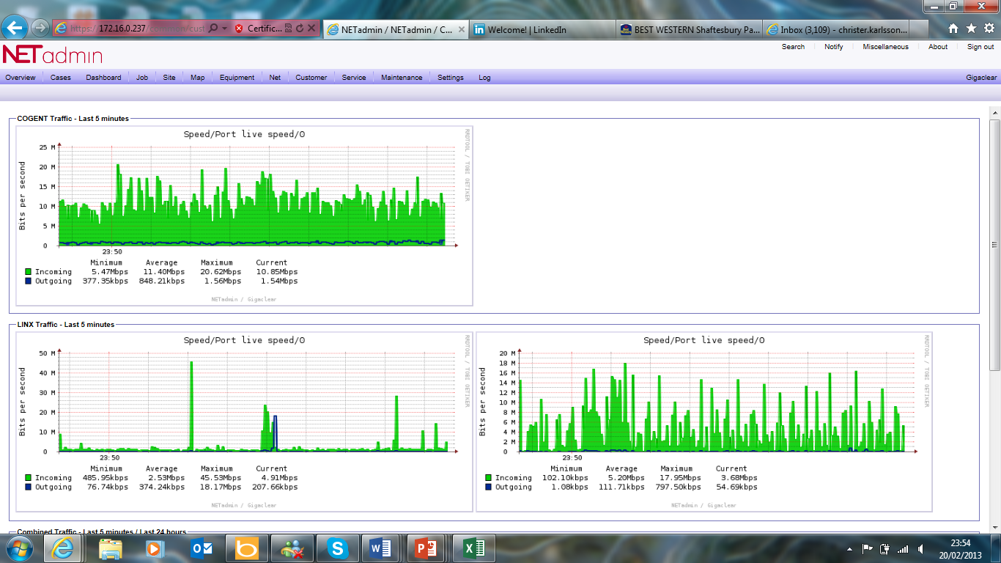
Broadband Transit and Peering

Slide 11

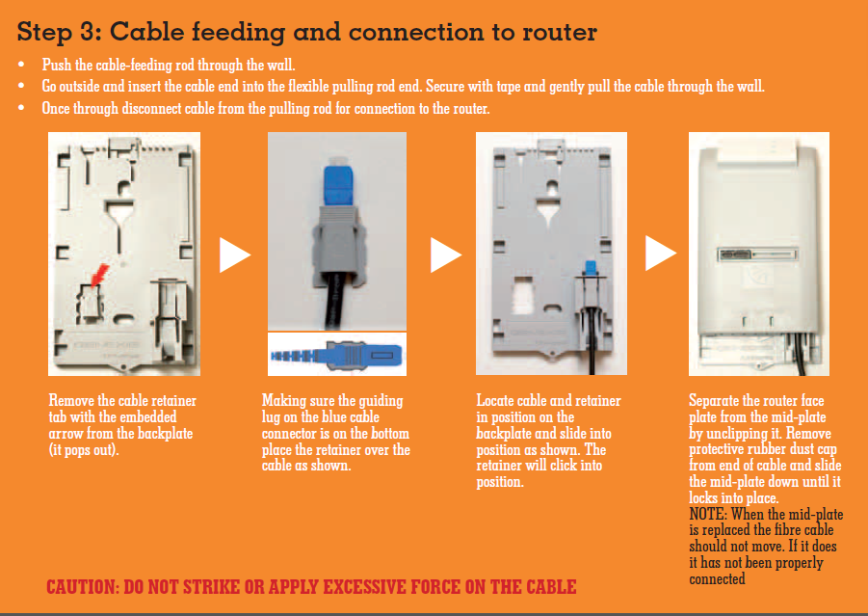
Self installation

Slide 12
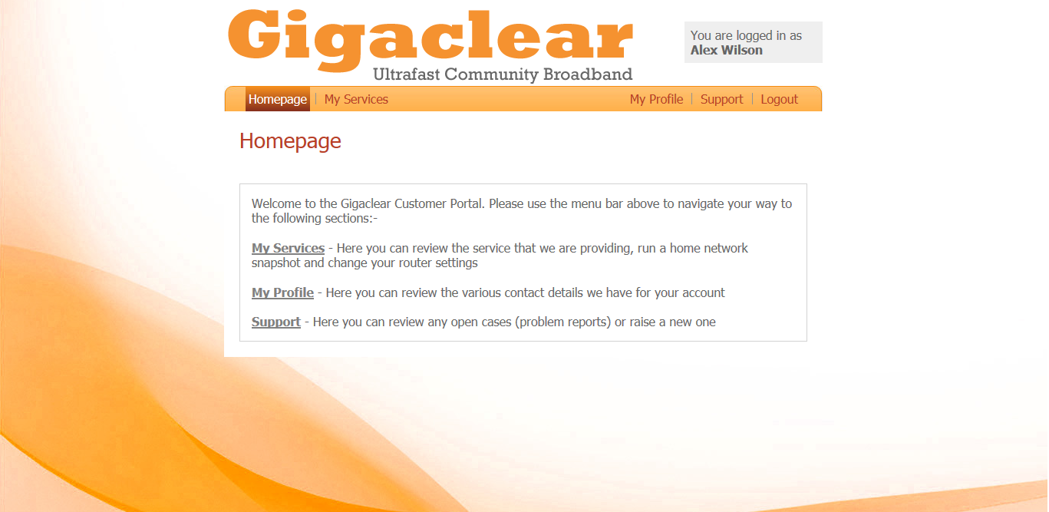
Customer Self care

Slide 13
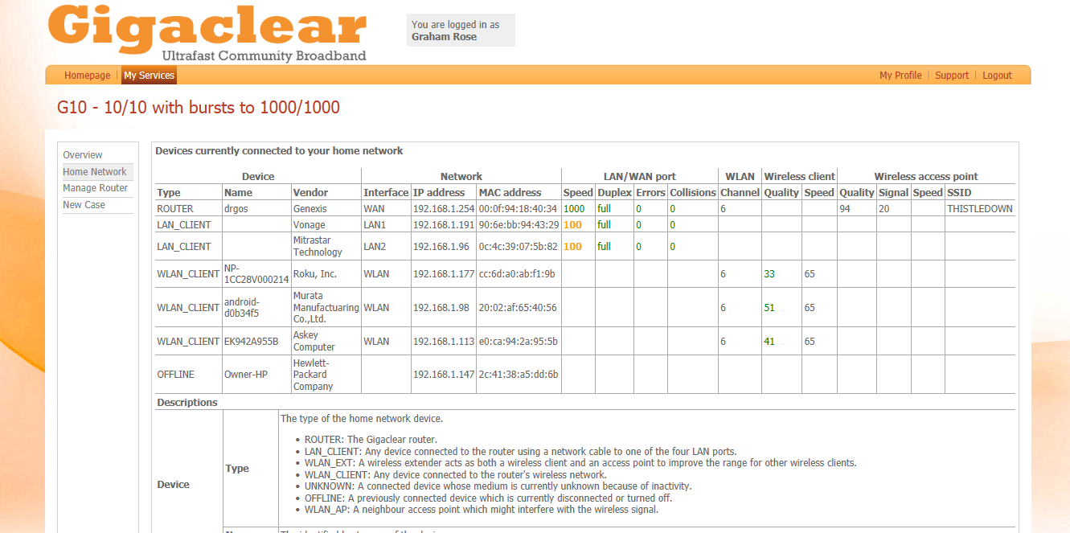
Home network tool
8888888888]

Slide 14
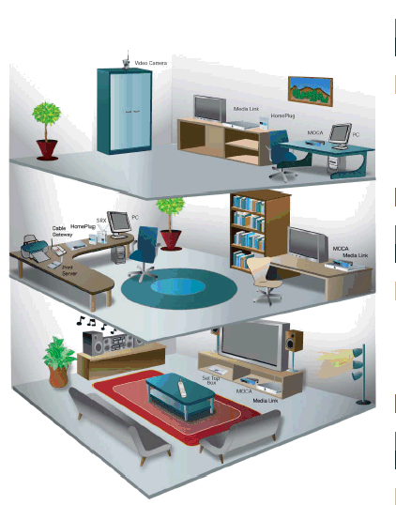

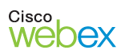

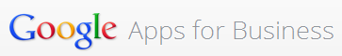




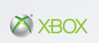
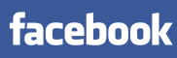



Your choice of services
Gigaclear delivers open broadband access

Slide 15



















Ultrafast Community Broadband

