Slide 1
Whitespace Spectrum
If you love something set it free…
love-hz.com
@WeLoveHz

Slide 2
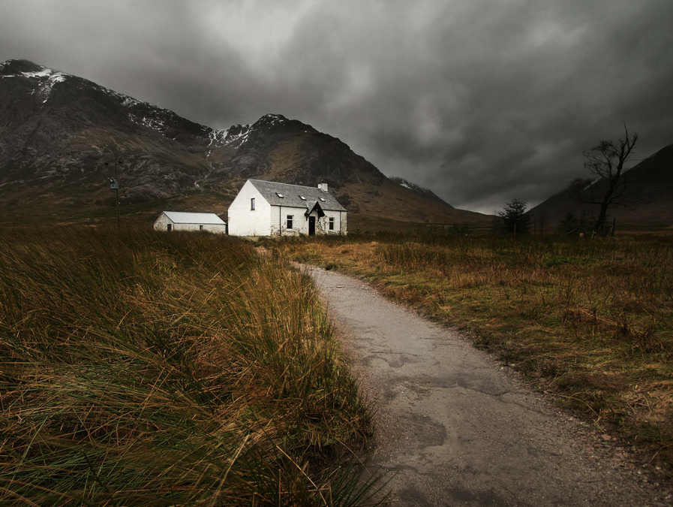
http://www.flickr.com/photos/72486075@N00/358306305/

Slide 3
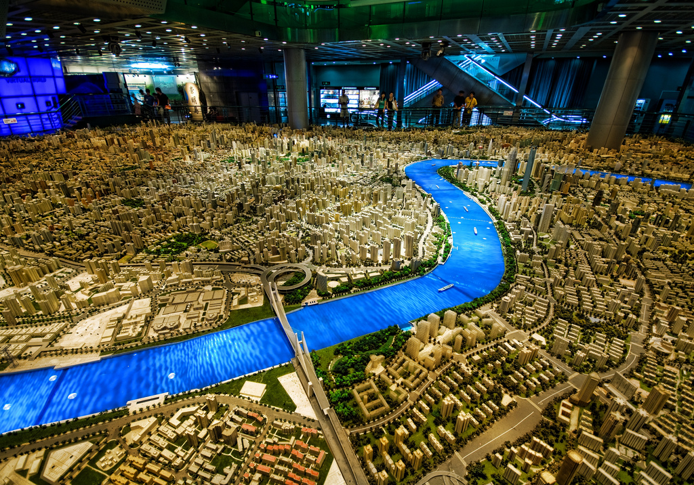

Slide 4
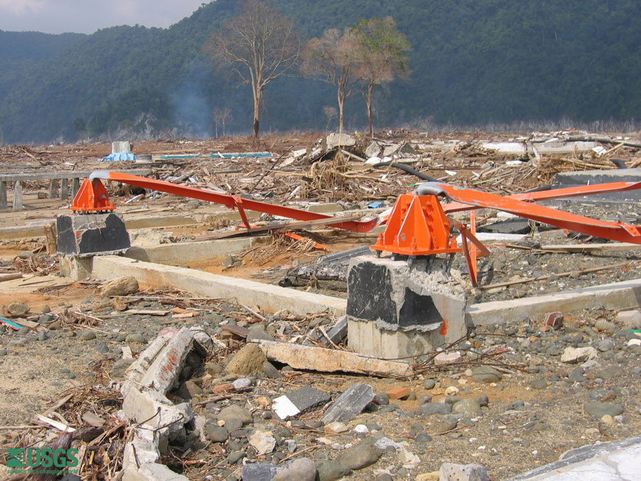

Slide 6
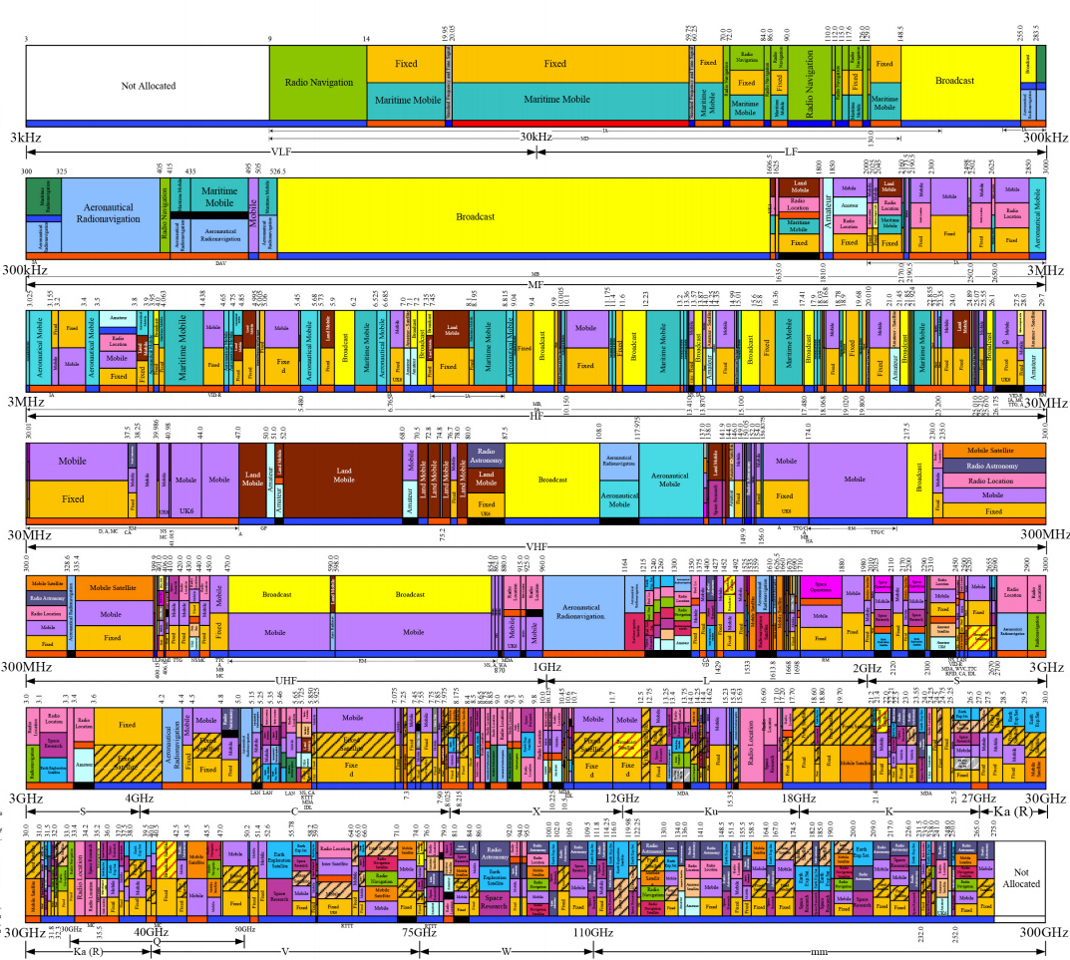
SPECTRUM
Notes:
UK Spectrum (as represented by US spectrum)

Slide 7
SPECTRUM
Wifi
TV
Wifi
Notes:
A guide – TV is the big yellow area

Slide 8
TYPES OF LICENCE
Expensive & Controlled
Licensed
GSM, 3G, 4G, Microwave links
Light Licensed
5.8Ghz
New!
Dynamic
TV Whitespace
Unlicensed
2.4GHz, 5.4GHz: Wifi, Bluetooth
Cheap & Available

Slide 9
“By 2008, devices operating in licence-exempt spectrum outsold those using licensed spectrum including the totality of televisions, radios and cellular phones.” (Thanki 2012)

Slide 10
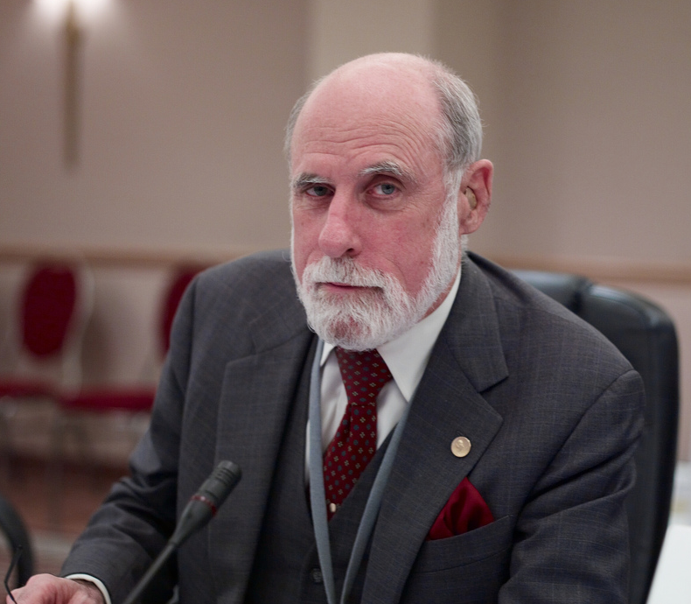
WHAT WOULD VINT DO?
“I would never do another radio spectrum auction. Think of how much GDP growth was generated by open spectrum WiFi”
-- Vint Cerf
https://twitter.com/kevinmarks/status/309051916095197185
http://www.flickr.com/photos/joi/1818985346
Notes:
Vint Cerf sez: Keep it unlicensed

Slide 11
SHARE IT
http://www.flickr.com/photos/quiteadept/5044626038/

Slide 12
WHAT IS A TV WHITESPACE?
PRE-SWITCHOVER
POST-SWITCHOVER
DIVIDEND!

Slide 13
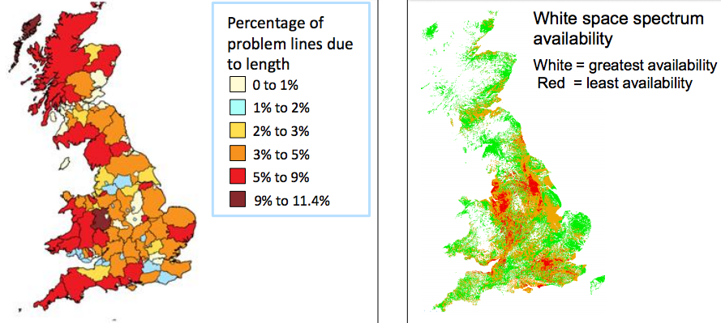
WHERE ARE TV WHITESPACES?

Slide 14
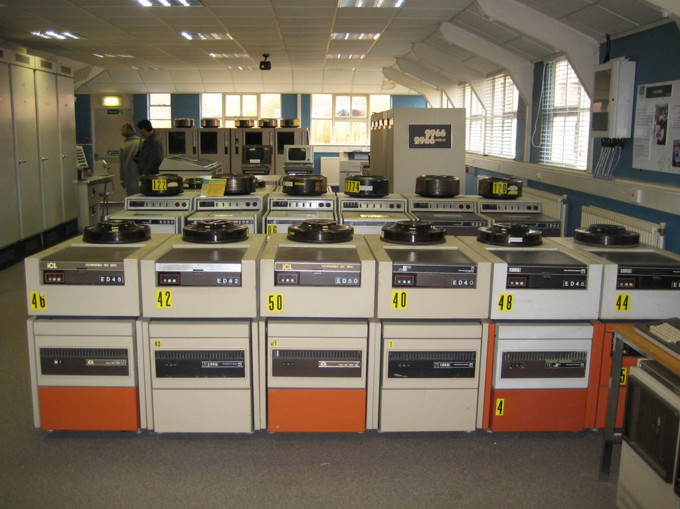
WHITESPACE DATABASE
Notes:
You need a whitespace database. Check for the incumbents, their channel usage, power and location, then register your use of that channel, your power & location.

Slide 15
Range, bandwidth, availability
Whitespace
10km
16Mbps per channel
Sparsely Populated Areas

Slide 16
APPLICATIONS
RURAL Broadband
Internet of things
Notes:
Build it yourself.

Slide 17
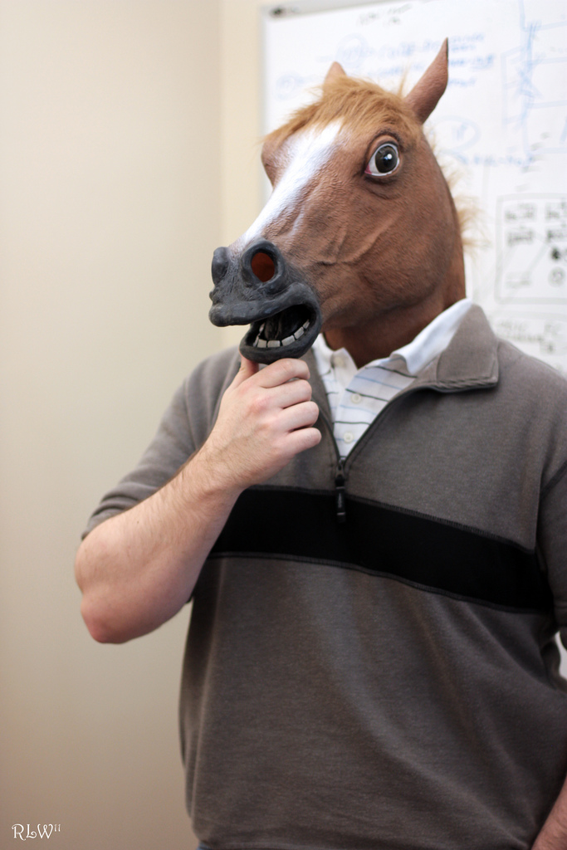
What Can YOU Do?
href="http://www.flickr.com/photos/14456988@N00/5730592664

Slide 18
FIND A WHITESPACE NEAR YOU
http://uk-whitespaces.spectrumbridge.com
Notes:
Example: Channel 22 has whitespaces wherever there are no red bits

Slide 19
OCCUPY SPECTRUM
Guerrilla sensor networks
Community broadband
INTERNET OF THINGS
EVENTS
NO SIMS
PERMISSIONLESS INNOVATION
“SUPER-WIFI”
Notes:
Build it yourself.

Slide 20
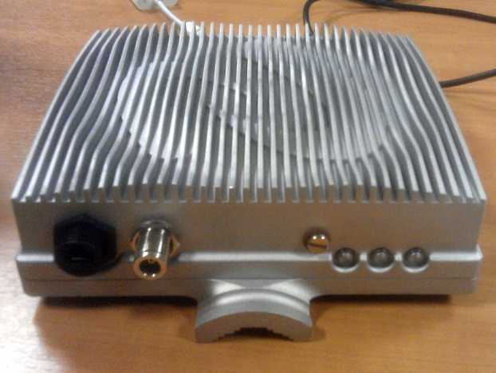
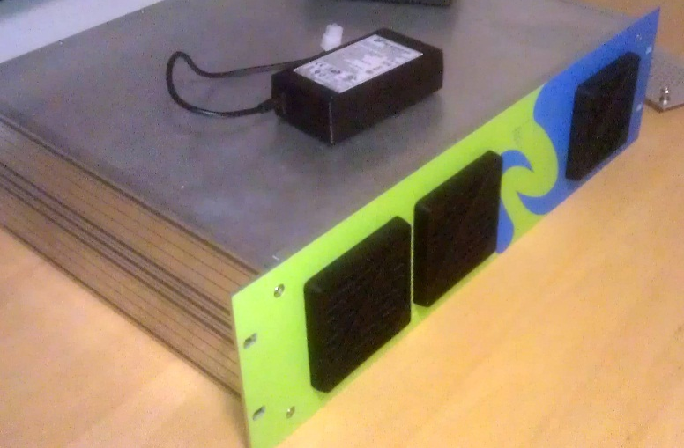
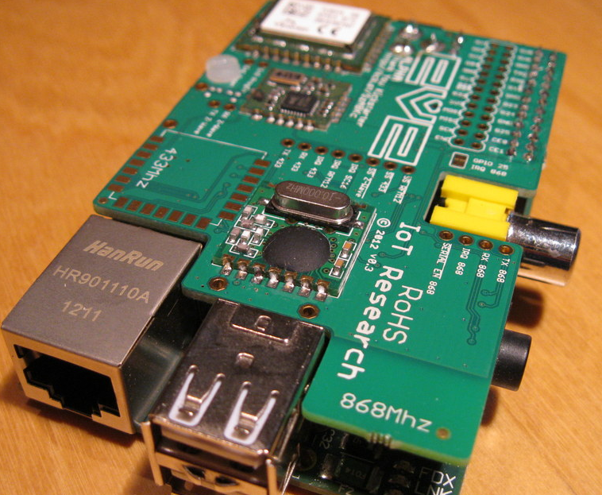
What do you need?
CPE
+
OR
BASE station
Microcontroller+Radio

Slide 21
When do we start?

Slide 22
Ben Ward
love-hz.com
@WeLoveHz

