Slide 1
BCP38 - UKNOF
Neil McRae and others
(names omitted to protect the guilty^w innocent).

Slide 2
Big Network Attack Cycle
Huge Attack happens
Waste money coping with it
Not enough happens
Everyone bangs on about BCP 38

Slide 3
BCP38 - what is it?
Denying access to the network to traffic with spoofed addresses from _your_ customers.
Helping to ensure that traffic is traceable to its correct source network.
Stops your customers driving cost in your network.
Stops our industry costs increasing and government intervention.
Other good things…

Slide 4
Filtering your customer FOONET
access-list 199 remark **All acceptable prefixes from FOONET**
access-list 199 permit ip host 194.8.68.130 any
access-list 199 permit ip host 193.112.33.4 any
access-list 199 permit ip host 193.112.33.34 any
access-list 199 permit ip 195.151.3.0 0.0.0.7 any
access-list 199 permit ip 195.151.6.0 0.0.0.7 any
access-list 199 permit ip 195.21.70.0 0.0.0.255 any
And attach to an interface
If you need to log
access-list 199 deny ip any any log
But you need a pretty good logging setup as the volume is significant.

Slide 5
Where to do it?
Deploy filters on your customer edge
PE / Access Device / BRAS
Datacentre edge gateway (more and more attacks from here) – Cloud providers are a real issue here.
Standardisation in cloud makes firing up instant VM based botnets
Be wary if you have a customer who sells transit via BGP – you may consider building filter list from your prefix list (you do have prefix lists on your customers right?!)
Make deploying BCP38 a T&C issue. (this is a plus point with big corporates!).

Slide 6
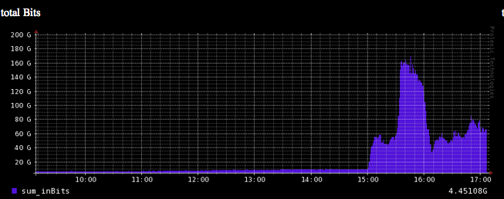
About the recent issues…
Spend the time now on network hygiene rather than spend a lot more dealing with an issue.

Slide 7
Wider Network Hygene
Open resolvers – see:
http://openresolverproject.org

Slide 8
Further reading
MIT - http://spoofer.cmand.org/papers.php
Nico @ COLT NGN Securite http://securite.org/
RIPE 432 – Benefits of BCP38
Openresolver - http://openresolverproject.org

