Slide 1
Remote Peering
William B. Norton
Executive Director, DrPeering International
Chief Strategy Officer, International Internet Exchange (IIX)
wbn@iixPeering.net
UK NOF
London
September 13, 2013

Slide 2
Meet the Presenter
William B. Norton
Started working on Internet (NSFNET) in 1988
1st “Chairman” of North American Network Operator Group (NANOG) (1994-1998)
1998-2008 Co-Founder & Chief Technical Liaison, Equinix Inc. (NSDQ: EQIX)
2008-Present - DrPeering, Executive Director
Two-day On-Site Peering Workshops (EU/Africa)
2013 International Internet Exchange (IIX) CSO
White paper process…

Slide 3
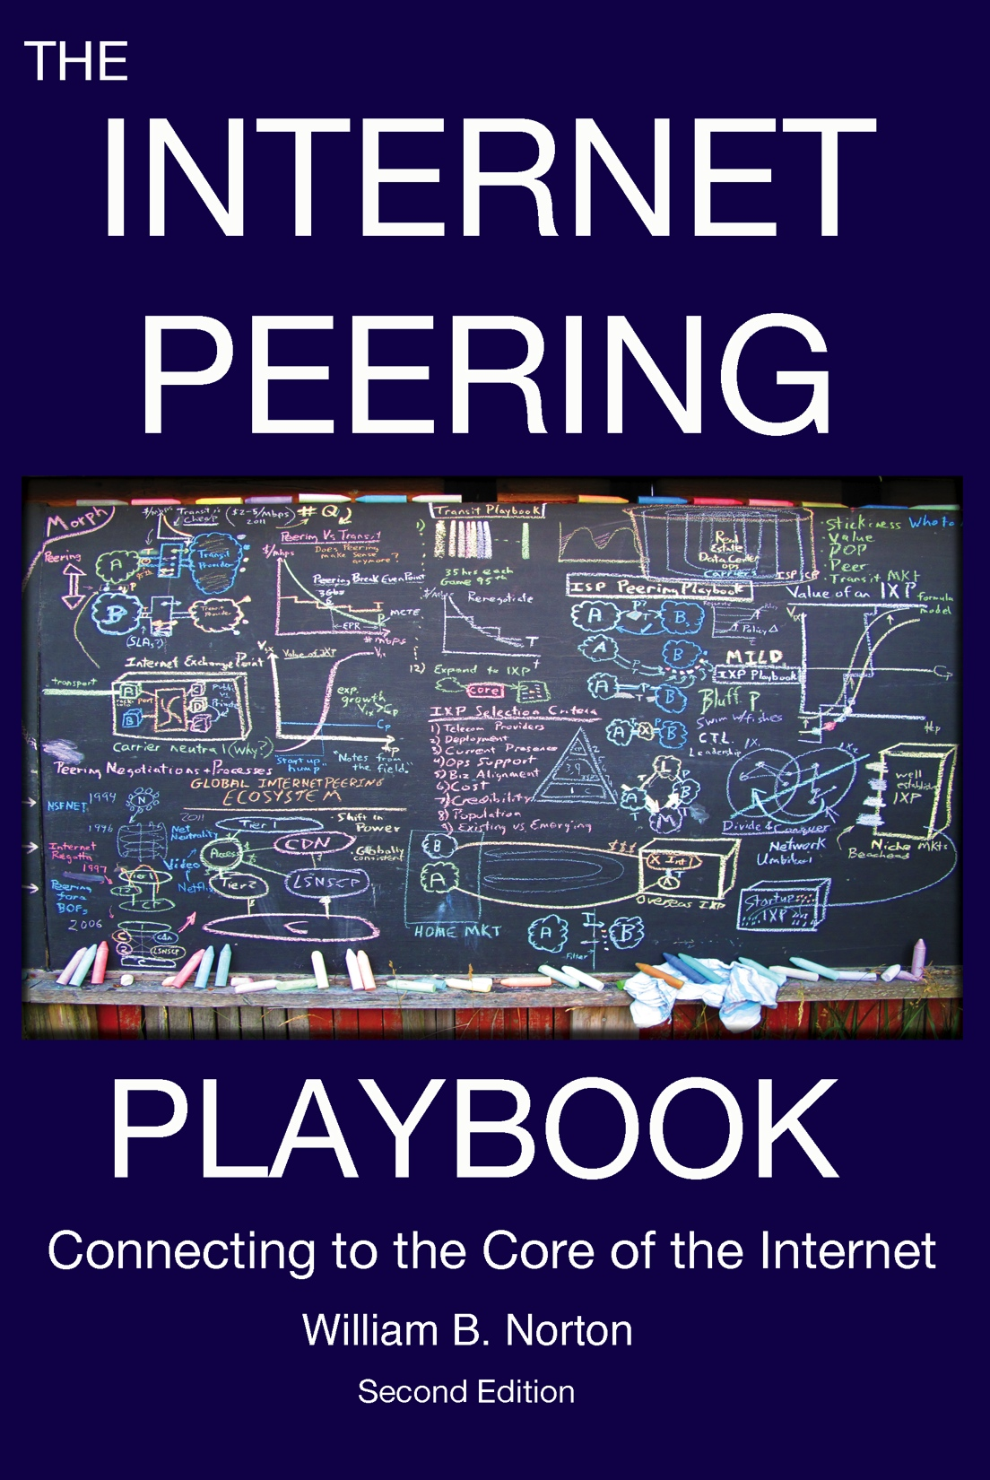
White Paper Process
Peering : under-documented Internet Operations Topic
Interconnection Strategies for ISPs
“When does peering make sense?”
Lunches, document answers, create model, review, stepwise refinement
Result: White Paper that reflects the community mindset
2008: 12 white papers --> Book
on Amazon.com
DropBox
iTunes
Freely available on
http://DrPeering.net
What has changed?

Slide 4
Interesting things
ePubishing – price<=$9.99 70%, 30%
Content Providers Network Savvy & Peering
Obstacles to African Fiber Deployment
Talk about 2 things today:
Remote Peering
…stumbled upon another interesting thing…
Remote Peering…

Slide 5
Remote Peering

Slide 6
Traditional Peering Model
Component | Cost
10G Transport | $1500/mo
Router | $2000/mo
Colo | $1500/mo
10GPeering Port | $2000/mo
 | $7000/mo

Slide 7
Remote Peering Model
Component | Cost
10G RemotePeering | $1500/mo
Router | $2000/mo
Colo | $1500/mo
10GPeering Port | $2000/mo
 | $3500/mo
Transit vs. Peering vs. Remote Peering

Slide 8
The Business Case for Remote Peering
Why does this work?
Component | Cost
10G RemotePeering | $1500/mo
Router | $2000/mo
Colo | $1500/mo
10GPeering Port | $2000/mo
 | $3500/mo
…we remove the relatively static costs
…This economic benefit changes everything
Breath of fresh air…

Slide 9
Breath of Fresh Air to Peering Community
Stumbled upon a new use case…

Slide 10
Peering Improves Security
My new bold thesis

Slide 11
#1) Less vulnerable to side effects of DOS
Denial of Service Attack
Counter:
More Resilience not Secure
Secured communications
Requires that pkts get through!
Therefore,
Peering Improves Security
A longer AS Path is less secure…

Slide 12
#2) Less Points of vulnerability
A Network Operator that Peers
A Network Operator that only buys Internet Transit
Transit
Transit
F
H
A
C
A
Vs.
A
E
G
A
I
D
Z
Z
J
K
Longer paths are more vulnerable to
Attack, capture, Man-in-the-middle, etc.
Less visibility along traffic path
Counter: Capture at transport layer
Counter-Counter: Worse w/longer AS Path
Breath of fresh air…

Slide 13
#3) Direct NetOps-NetOps relationship
Transit
Transit
F
H
A
C
A
Vs.
A
E
G
A
I
D
Z
Z
J
Practical: Escalation Path
Direct Contact: Personal Relationships
Speed addressing problem

Slide 14
Summary
Remote Peering is peering without a physical router presence required at the IXP
Remote Peering reduces CapEx and OpEx
Enables more networks to start peering
Enables networks to peer in more places
Breathes new life into the peering ecosystem
Peering Improves Security

Slide 15
Thank you for your time!
Email me for a PDF of
Chapter 14: Remote Peering
wbn@iixpeering.net
William B. Norton
Executive Director, DrPeering International
Chief Strategy Officer, International Internet Exchange (IIX)
UK NOF
London
September 13, 2013

