Slide 1
Carrier Ethernet
Service Life-Cycle Management
Anthony Magee, 6th September 2013

Slide 2
Agenda
Service-Lifecycle
Service Level Agreement – Tools/Standards
Enabling Technologies
Summary – Bringing it all together

Slide 3
Service Life-Cycle

Slide 4

The Service Life-Cycle
Planning
  Resources, tools, reporting
Deployment/Installation
  Physical, Service Layer
Performance Assurance
  In-Service monitoring/reporting
Trouble-shooting
  Alarms, Fault identification
Network Maintenance
  Scheduled operations
Planning
Deployment
Performance
Assurance
Trouble Shooting
Network
Maintenance
SLA tools should support the whole service life-cycle

Slide 5
Service Level Agreement Tools

Slide 6


Ethernet OAM - Areas of standards activities
Benchmarking Tests RFC 2544 & Emerging ITU-T Y.1564
UNI
UNI
100FX
Carrier NW
100FX
Customer
Euqipment
Media Converter
Media Converter
Carrier Edge
Carrier Edge
Media Converter
Media Converter
Customer
Equipment
MEF NID
MEF NID
MEF &
ITU Y.1731
IEEE 802.1Qay
Service Layer OAM (UNI to UNI)
Round trip times, Delay variation etc and per QoS
MEF &
ITU Y.1731
IEEE 802.1ag
Connectivity Layer OAM
Service Level loopbacks, link trace etc
IEEE 802.3ah
EFM
Access Link OAM
Access Link OAM
Dying Gasp,Link Level OAM, Port Loopbacks

Slide 7
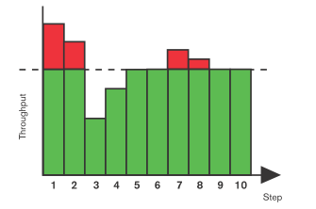

RFC 2544 LAN Benchmarking
IETF RFC 2544
  Widely used test methodology – by vendors in lab
    LAN Benchmarking history
    Tests included throughput, latency, burst and frame loss
    Algorithm - test at max, back off until pass, then increase until fail
  Tools made available to network operators
    When used in the WAN environment – feedback… “Time Consuming”
      Average of about 20 mins per test
    Also lacking test capability which reflect the maturing SLA
      No support for per VLAN/Per Service - really only a port based tool
      No support for PDV, or QoS measurements
      Test for concurrent services not supported, RFC 2544 sequentially tests different ports and different directions
Need for a new standard - (ITU-T Y.1564)
  Reduce test time - couple of minutes per service, and service concurrency
  Improve test coverage – PDV, QoS
X
Port
EVCs

Slide 8
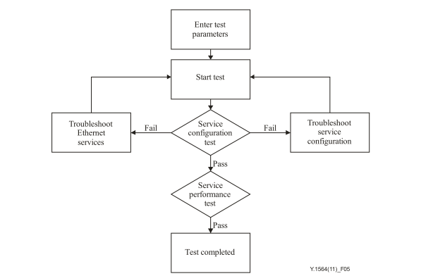
Y.1564 (Service Activation Testing)
Two Test Modes
  Configuration test
    Very quickly verify service
      QoS parameters being met?
      Seconds/minutes
  Performance test
    Verify and report on performance of multiple services concurrently
      Minutes/hours
      15 minutes, 2 hours, 24 hours – catering for different types of networks
        Configurable

Slide 9
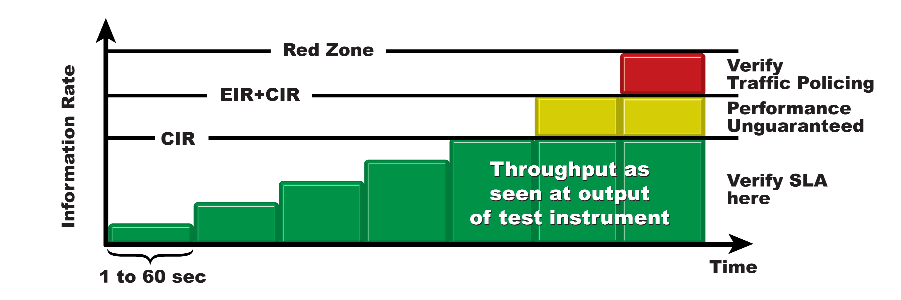
Y.1564 Service Configuration Test
Verify throughput performance for each service at CIR, CIR+EIR and above
  Tests up to CIR to verify committed SLA parameters
  Then increase the traffic rate into the red zone to verify policing
  Performance is uncertain in the yellow zone and needn’t be checked
  Optional CBS/EBS configuration verification
All SLA performance parameters measured at the same time
  Frame Delay, Frame Delay Variation and Frame Loss

Slide 10
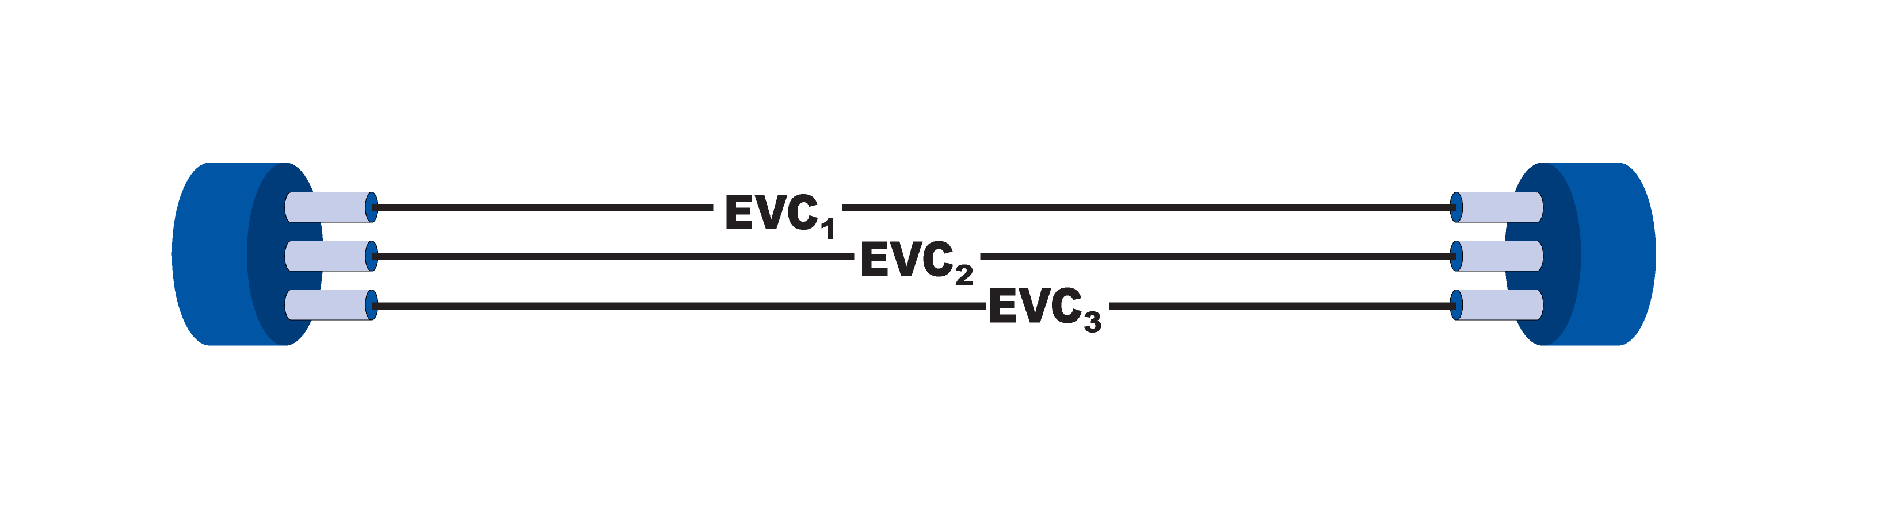
Y.1564 Service Performance Test
Simultaneously validate SLA conformance for all defined services
Generate traffic at CIR for all flows and report performance
Test for 15 minutes to 24 hours
  Configurable parameter

Slide 11
Enabling Technologies

Slide 12
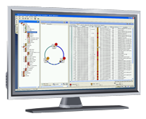
Low-touch provisioning toolkit for simple, quick and automated installation
FSP Management Suite
DHCP server
RADIUS server
Carrier Ethernet network
TFTP server
802.1x, 802.3ah OAM
Device only allowed to join network following RADIUS authentication
  IEEE 802.1x Ethernet port authentication
Detect link up and discovery of remote devices, initial tests and diagnosis
  IEEE 802.3ah Ethernet in the First Mile (EFM)
Get IP address and location/name of boot file to download config
  Dynamic Host Configuration Protocol (DHCP)
Download latest software and site specific config (IP setup for DCN etc.)
  Trivial File Transfer Protocol (TFTP)
Notes:
12

Slide 13

EtherjackTM Service Assurance (ESA)
End-to-end SLA performance monitoring
In-service measurement of frame loss, delay and jitter
Multiple options for synthetic test frames
  Y.1731 DMM/DMR (with LMM/LMR for loss measurement)
  Y.1731 SLM
  IP ICMP Timestamp
  IP ICMP Echo
  IP UDP Echo
Customize test frame size, priority, rate, burst and schedule
IP Network
Probe
Reflector
Test frame
data
Etherjack Service Assurance
End to End SLA Verification

Slide 14
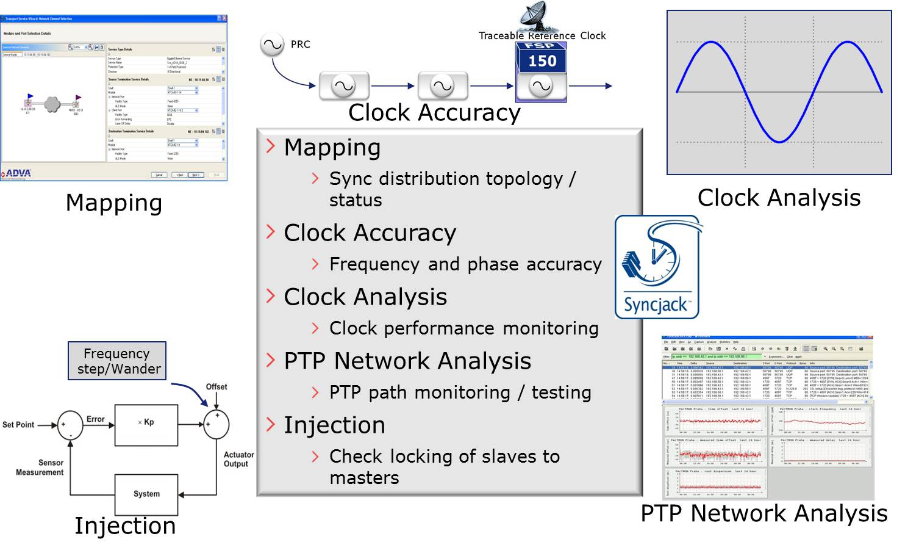
Synchronization Service Verification
SyncjackTM - SLA Tool Suite

Slide 15
Bringing it all together

Slide 16
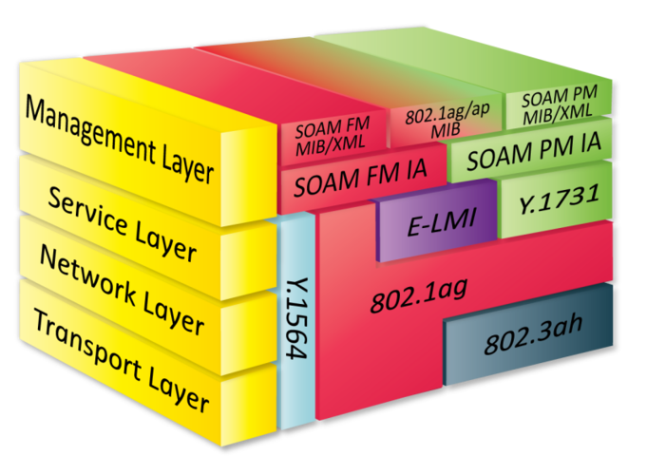
Service Life-Cycle & SLA Tools
Planning
Deployment
Performance
Assurance
Trouble Shooting
Network
Maintenance
SLA tools proven, support full life-cycle – ready for volume deployment!

Slide 17
Thank you
amagee@advaoptical.com
IMPORTANT NOTICE
The content of this presentation is strictly confidential. ADVA Optical Networking is the exclusive owner or licensee of the content, material, and information in this presentation. Any reproduction, publication or reprint, in whole or in part, is strictly prohibited.
The information in this presentation may not be accurate, complete or up to date, and is provided without warranties or representations of any kind, either express or implied. ADVA Optical Networking shall not be responsible for and disclaims any liability for any loss or damages, including without limitation, direct, indirect, incidental, consequential and special damages,
alleged to have been caused by or in connection with using and/or relying on the information contained in this presentation.
Copyright © for the entire content of this presentation: ADVA Optical Networking.

