Slide 1
Whatever happened to rough consensus and running code?
Multistakeholder governance in .uk
Emily Taylor, September 2013

Slide 2
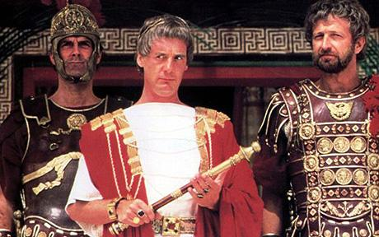
I mean, what has policy ever done for us?

Slide 3
What has policy got to do with network operation?
IPv6 adoption
Ofcom study (2012); situation of UK;
Operational and economic impact of policy decisions (or lack of them)
Carrier Grade NATs
Ofcom study (2013)
Policy implications of operation and economic decisions
Innovation without permission?
Mere conduit?
Internationalised domain names
Impact of ccTLDs (registrars, policies and pricing) on uptake

Slide 5
The IETF
Dave Clark: “We reject: kings, presidents and voting. We believe in: rough consensus and running code".
Culture of openness, and cooperation.
Inspiration for “multistakeholder” governance concept
Not top down
Participation of all stakeholders on an equal footing.

Slide 6
Great power,
great responsibility

Slide 7
Another aspect of multistakeholder governance
Great actual power
Where did the organisations come from?
Contrast with eg government
Accountability and transparency

Slide 8
Commercial pressures and influence of supply chain

Slide 9
Why is transparency important?
Transparency provides information for citizens about what their government is doing (Barrack Obama)
Entities to maintain and improve transparency, inclusiveness and accountability as the Internet continues to grow in range, diversity and importance (APC, Code of Good Practice, 2010)
Reforms are necessary to reinforce the transparency and accountability of the internal corporate governance of ICANN to enhance responsiveness (Neelie Kroes and US Administration, 2011)

Slide 11
Internet Governance Forum
Background:
Arose out of acrimonious World Summit on the Information Society
Not a policy making body, it’s a process
All stakeholders participate on an equal footing (government, civil society, business, technical community)
Pros:
Open consultation process – transcribed; all inputs are published
Lightweight secretariat – Markus Kummer and Nitin Desai leadership; fair summaries
Has become a hub, focus for many actors’ work in the policy area
National and regional processes.
Cons:
Multistakeholder Advisory Group selection and proceedings (improving)

Slide 12
ICANN
Background
Formed by the US government in 1998
Originally described as private sector management
Subsequently rebranded as bottom-up, multistakeholder process.
Policy making at ICANN
A defined policy process – anyone can participate, everyone can have their say

Slide 13
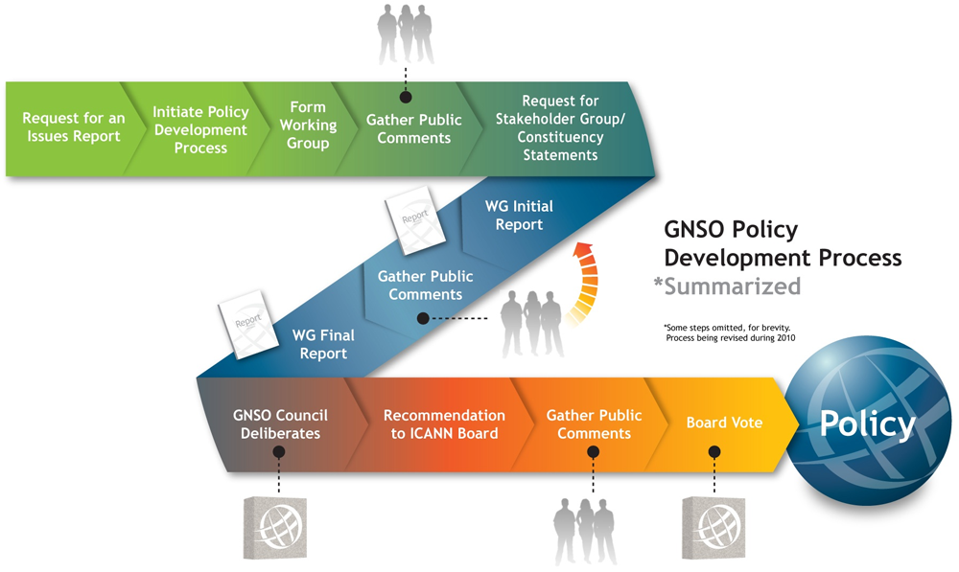

Slide 14
ICANN – is it perfect?
Differences between an open process, and a representative process
Balancing the influence of stakeholders – particularly industry
Who safeguards the public interest?
The role of staff, and the journey from policy to implementation.
Accountability and Transparency – second review ongoing.

Slide 15
Nominet
10 million domain names
Not for profit, public purpose
Self-regulating
Operational and technical excellence

Slide 16
Nominet
“We remain committed advocates of a multi-stakeholder approach to informing our policy development rather than a more top-down method of running the Internet” (July 2013)
Policy development process
Secretariat
UK Policy Stakeholder Committee
Consultations

Slide 17
Case study: direct.uk
Second consultation in less than a year.
Publication (or not) of consultation responses, studies etc
Where are the proposals formulated?
“Our research indicates….”
Proposals have great impact – do relevant stakeholders know?
Who are the winners; who are the losers?

Slide 18
Bottom-up, multistakeholder processes compared
 | ICANN | Nominet
Issues can be suggested by anyone | ✓ | ?
Working groups – open membership | ✓ | ✗
Consultation documents published | ✓ | ✓
Underlying studies published | ✓ | ✗
Public comment | ✓ | ✓
Public comment published | ✓ | ✗
Public meetings transcribed | ✓ | ✗
All decision-making interactions recorded, transcribed | ✓ | ✗
Comprehensive archive | ✓ | ✗

Slide 19
I-organisations, transparency, legitimacy and the public interest
Difficult to get right
Mixture of financial dependence and quasi-regulatory role
Low general awareness or participation
Lack of robust accountability mechanisms
Does multi-stakeholder governance scale?
Is the Internet really so different?

