Slide 1
LTE as a Video & TV Distribution Network
THE MOBILE VIDEO ECOSYSTEM
Bob Sleigh
UKNOF27 Manchester 21st Jan 2014

Slide 2
Mobile Network Capabilities
Typical
Peak
speeds
Min Speed?
30-50 Mbps
300 (Cat6) -> 1000 Mbps
4K Video & Multi-task
Interactivity
16-24 Mbps
100- 150 Mbps (Cat 3/4)
8-12 Mbps
73 Mbps
Gaming / Cloud
Video Conf
4-6 Mbps
21 Mbps
0.7 Mbps
1.8 Mbps
HD Video Streaming
Apps, Downloading
Video Streaming
240 kbps
340 kbps
Music, Web browsing
MMS
Rich Messaging & Communication
100 kbps
250 kbps
50 kbps
100 kbps
Email
Voice, Text
2.5G/Edge
3G
HSPA
HSPA+
4G/LTE
4G+/LTE-A
Data Capacity

Slide 3
LTE - UK is becoming a global leader
LTE
October 2012 First LTE live in UK
December 2013 over two-thirds of population coverage
…
December 2014? 98% population coverage
LTE-A
November 2013 Techcity LTE-A 300Mb Trial
During 2014 First commercial LTE-A live in UK

Slide 4
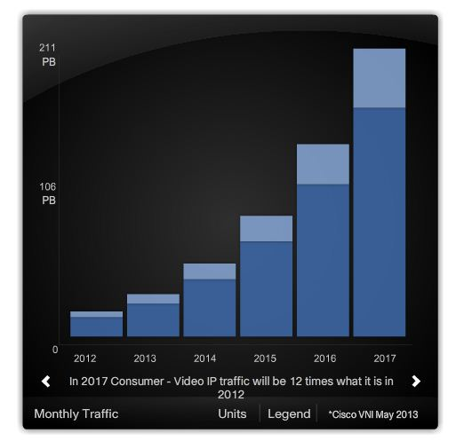
Forecast Mobile Data & Video Demand for UK
Mobile Data
Mobile Video

Slide 5
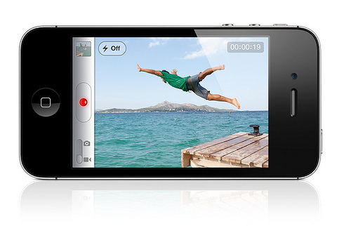
What does ‘Good’ look like? How do you benchmark QoE?
Short form or long form
Live, catch up or VOD
Purchased or free
Device type
Buffering or adaptive streaming
Amount of buffering or lower bit rate
Where in the video this occurs
Original quality of the video (SD, HD etc)

Slide 6
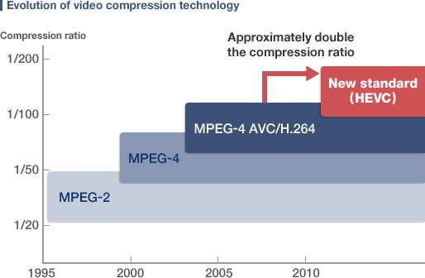
Video Codec Evolution How the evolution in video codec’s can reduce bandwidth
Reduced bit rate and file size but similar resolution
Reduces network traffic
Improved User Experience with lower bandwidth
High Efficiency Video Coding (HEVC) has nearly halved the bit rate and file size of the previous HD standard – Advanced Video Coding (AVC)
Combining the latest compression technology with Adaptive Bit Rate (ABR) technology could provide a reduction in traffic whilst maintaining a higher QoE
HEVC is one of the key elements in the move towards Ultra High Definition TV (UHDTV) which is likely to push the bit rate back up to AVC levels
HEVC (H.265) Video
PSNR – 39.72dB
Bit Rate 610kbps
File Size 3.10MB
AVC (H.264) Video
PSNR – 39.65dB
Bit Rate 1183kbps
File Size 6.01MB

Slide 7
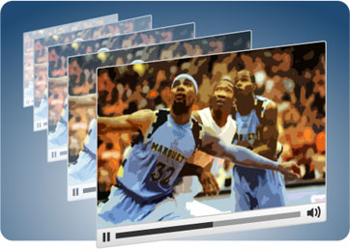
Adaptive Bit Rate Technologies Using Adaptive Bit Rate (ABR) to manage video traffic
Historically, mobile video streamed at a fixed bitrate
Buffering and loss when connection speed too low
Users preferred lower resolution over buffering
User could sometimes select video resolution
ABR tailors stream to the device and available bandwidth
Connection speed changes, bitrate adapts in real time
Reduces buffering
Better user experience in congestion and at cell edge
Minimises user interaction
Left unmanaged, ABR can lead to unpredictable data usage
Content streams at the highest bit rate available
HD uses significantly more data than SD

Slide 8
Standardisation - DASH Standardising ABR with Dynamic Adaptive Streaming over HTTP
Multimedia file partitioned into segments
MPD file describes segment information
timing, URL, media characteristics eg video resolution, bit rates
Delivered to client using HTTP
DASH is audio/video codec agnostic
Segments can contain any media data
But spec provides specific guidance and formats
MPEG-4 file format
MPEG-2 Transport Stream
Multiple representations (different resolutions, bit rates)
Selection can be made based on
Network conditions, device capabilities, user preferences

Slide 9
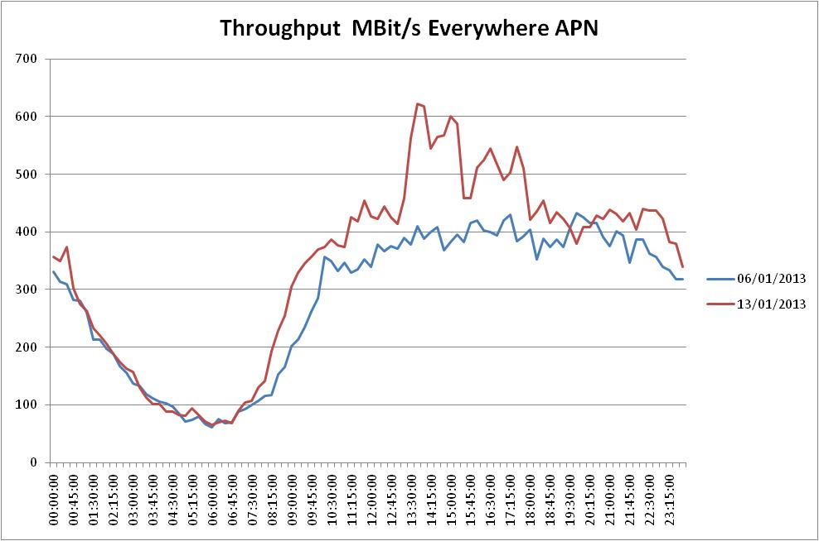
Multimedia broadcast technology An example of live sport driving data usage
Half Time
Bandwidth (actual bandwidth removed due to sensitivity)
Arsenal vs Man City
KO 16:00
Man U vs Liverpool
KO 13:30

Slide 10
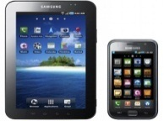
Caching mobile video Pro’s and con’s of caching video within a mobile network
Efficient use of backhaul
Technology in development
Good for dense environment
Reduces latency
Does not address spectral constraints
Number of users viewing same content
Low cost delivery
Value add content
Disparate solutions
Complex integration
Hosting costs
Requires redundant capacity
Minor improvement in Latency
Devices
(Multiple Millions)
Aggregation
Sites
Co-location Data Centre London
Connectivity Sites (10’s)
Cell Sites
(10’s of thousands)
Main CDN’s and content providers have a presence
Peering is inexpensive
CDN’s are optimised for video
No significant investment for operator owned and operated infrastructure
No opportunity for operator optimization
Can be deployed in smaller numbers
Helps with internet bottlenecks
Supports operator optimisation
Suboptimal for YouTube (unless using GGC)
Unless optimisation platform installed limited advantages over using CDN
Reduces capacity on core infrastructure
Aggregates multiple 1000’s of cell sites
No benefit over aggregation sites.

Slide 11
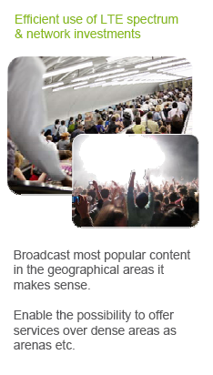
Multimedia broadcast technology How reduce video traffic using broadcast technology
BBC & Sky predict rise in linear TV over the mobile networks
MNOs reviewing commercial/technical viability of broadcast technologies
The current technological standard for LTE is eMBMS
evolved Multimedia Broadcast Multicast Service
Huawei - technology centre in Shenzhen for development of eMBMS
Qualcomm - demonstrated eMBMS with E/// at MWC2012
Verizon - may do Superbowl 2014 over eMBMS

Slide 12
Video distribution - Satellite Comparing mobile video delivery with traditional methods
Alignment of technical roadmaps
Control of QoE
Ability to be able to perform end to end testing

Slide 13
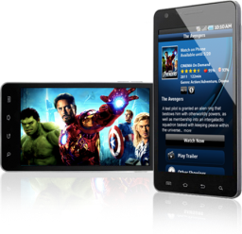
Video distribution - Mobile Comparing mobile video delivery with traditional methods
?????

Slide 14
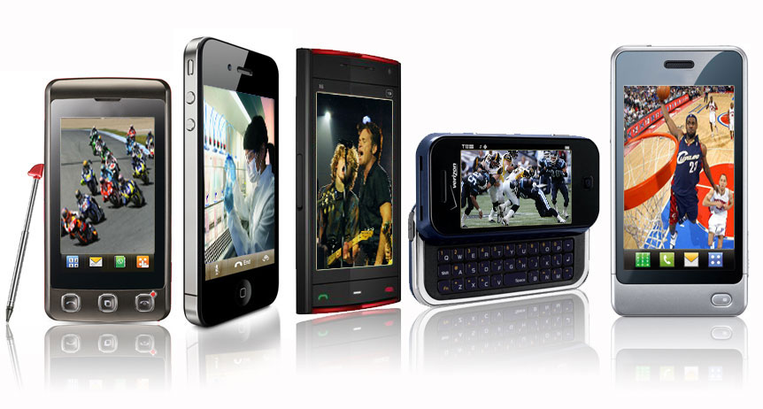
Current and future technologies Analysis of current and future Mobile Video technology
There is currently a technology disjoint in the end to end mobile video chain. Without increased communication and knowledge share between the parties technology advances cannot be fully exploited
Content caching
Device
Core
Edge
Video codec evolution
Adaptive Bit Rate
Multimedia broadcast technology
Video optimisation platforms
Content Delivery Networks
Self build
Pure play
Federations
There is no ‘Silver Bullet’ as an operator we will need to a have a constantly evolving ‘tool kit’ of technologies

Slide 15
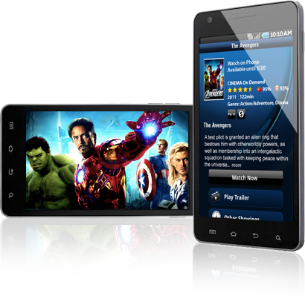
Where now? 2014 – When mobile video becomes an ecosystem
Industry discussion and knowledge share is key to a successful mobile video industry
Ensuring Users QoE is not impacted by the ‘Mobile Video Tsunami’ can no longer be seen as something for operators to sort out alone
Any party working in isolation may negatively impact the customer experience
and cost to serve
An end to end understanding of mobile video technologies
will lead to greater innovation from all parties
Use the combined weight of the whole industry to back
mutually beneficial technology e.g. MPEG-DASH
Globally congested mobile networks do not benefit anyone

Slide 16
Thank you

