Slide 2
Random Subdomain Attacks
Plaguing the Internet

Slide 3
Introduction
DNS based DDoS attacks increasing
  Late 2012 - DNS amplification remerges as a problem
  January 2014 - new innovation with random subdomain attacks
Major attack vector - open home gateways
Severe stress on DNS worldwide
  ISP resolvers – spikes of recursive requests
  Authoritative servers – overwhelmed with NXD responses
  Use of Response Rate Limiting in authorities is causing even more stress

Slide 4
Random Subdomain Attacks
RANDOM
TARGET NAME
wxctkzubkb..liebiao.800fy.com
Queries with random subdomains
  Answer with “non-existent domain” (NXD)
Creates lots of work for resolvers
  Queries require recursion
Creates lots of works for authoritative servers
  Heavy volumes of NXD queries often cause failure
Example query:

Slide 5



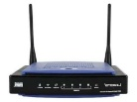
Random Subdomain Attacks
Open DNS Proxies are the Vector for Attacks
Target
Web Site
Authoritative
Server
Compromised
hosting
3
NXD
responses
Internet
1
Query with
randomized
subdomains
2
Recursive
queries
ISP
ISP
Resolver
Open DNS Proxy
(Home Gateway)

Slide 6
Open Resolvers Are Declining
Mar 25
Sep 4

Slide 7
Open Resolvers By Country (Sep 4 2014)
AU | 93835
BE | 22093
DE | 97558
DK | 10572
ES | 119116
FR | 113499
GB | 194285
GR | 109503
HN | 2264
IE | 12450
IT | 180377
LI | 361
NL | 76644
PT | 20485

Slide 8
But Attack Traffic Went Up
Start of attack activity
Jan 28, 2014

Slide 9
Random Subdomain Attacks
Home
Gateway
Attacker
Border
Resolver
Authority
Bad Case
Spoofed IP
Query (UDP):
Ivatsnkb.web.pay1.cn
Proxy query,
translate IP
Recursion
Proxy query,
translates IP
Spoofed IP
NXD
NXD
NXD
Worse Case
Spoofed IP
Query (UDP):
Ivatsnkb.web.pay1.cn
Proxy query,
translate IP
Recursion
Response
Rate
Limiting
Truncate
Retry TCP
Proxy query,
translates IP
Spoofed IP
NXD
NXD
NXD

Slide 10
Why These Attacks Hurt
Home
Gateway
Attacker
Border
Resolver
Authority
Spoofed IP
Randomized queries
Proxy query,
translate IP
Recursion
Truncate
Response
Rate
Limiting
Retry TCP
Resolver stress
TCP overhead
Authority
Fails
High traffic
with
TCP overhead
Resolver doesn’t
get responses,
tries new Authorities,
cascading failures

Slide 11
Popular Names are Attacked
About 9% of names attacked are popular
Alexa 1000 Names
Name Rank
baidu.com 5
blog.sina.com.cn 14
xlscq.blog.163.com 33
www.bet365.com 177
www.lady8844.com 379
cloudfront.net. 413
www.appledaily.com.tw 647
Other names you might recognize
Cloudflare
Akamai CDNs
Attacks on popular names have to be
handled carefully – Precision Policies, Whitelists

Slide 12
Example Attack Queries
Hundreds of millions of randomized subdomains
~ 1,000 target
names used thus far
krsfwzohwdghqx. | www.appledaily.com.tw.
wxctkzubkb. | liebiao.800fy.com.
avytafkjad. | www.23us.com.
gfqhuxenun. | wuyangairsoft.com.
uv. | vip.mia0pay.net.
Ivatsnkb. | web.pay1.cn.
wfmlgzyrufaxid. | www.zhaobjl.com.
qzgziliv. | 978sf1111.ewc668.com.
qxgtqfyv. | www.500sf.com.

Slide 13
Attacks Coordinated Worldwide
Large ISP EMEA
Large ISP LATAM
Large ISP North America
Large ISP APAC

Slide 14
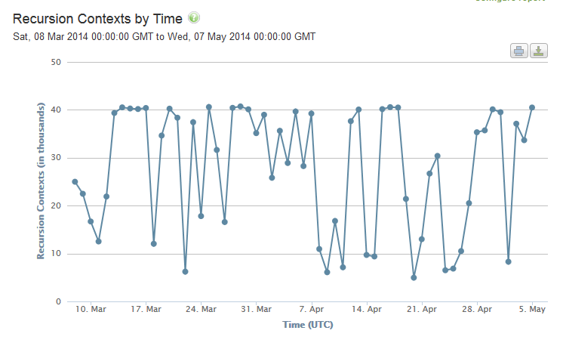
Resolver Impact

Slide 15
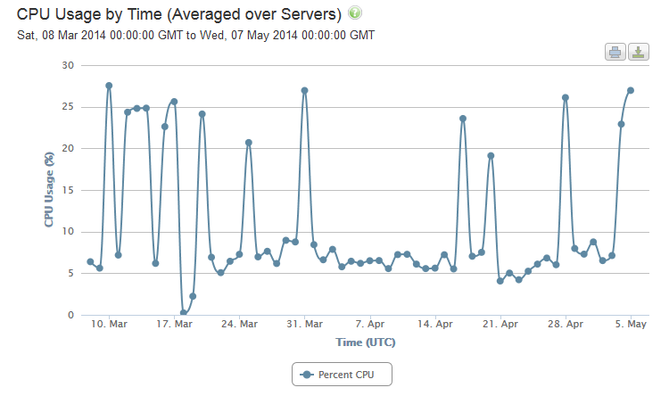
Resolver Impact
CPU spikes during attacks are caused by more expensive recursion
Removing useless random subdomain queries reduces processor load

Slide 16
Many Problems
Home Gateways mask spoofed source IP
  “Challenges”, “DNS cookies” won’t work
  Blacklisting eliminates all queries from legitimate IPs
RRL by authorities increases work for resolvers & authorities
  It was designed for attacks directly on authoritative servers
  Rate limiting resolvers is counter productive – “death spiral”
Surrounding recursion with too much logic can be problematic
  It does not address root cause – too much useless traffic
  Collateral damage is observed:
    Servers marked as non-responsive by recursor recovering but still not being used
    Nameservers serving multiple domains taken out of service by traffic for one domain
Tendency for cascading failures
  Authorities successively fail, increasing stress on remaining authorities
  This in turn increases stress on resolvers

Slide 17
Solution
Filter traffic at ingress to the resolver
  Near real time block lists
    Randomized subdomains used for attacks
    Purpose built DNS amplification domains
Protect good traffic
  Whitelist
Fine grained policy
  Tie the lists together:
  Block bad traffic
  Answer good traffic
  Selectively filter other attack traffic on an ad hoc basis

