Slide 1
Network Function Virtualisation Network Functionality Within The Cloud
Presenter : Kenny Marlow JNCIE #210
SP Architecture Team Lead

Slide 2
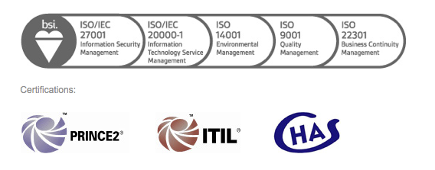
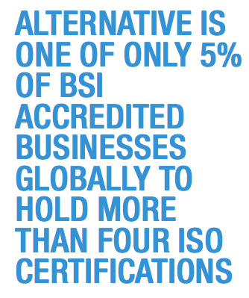
INTRODUCTIONS
Alternative Networks – Providing Solutions From Device to Data Centre

Slide 3
AGENDA
One of our current development area’s is with Network Function Virtualisation (NFV), and how we can integrate hybrid virtual and physical network infrastructure.
Why NFV connectivity testing and not straight into SDN and orchestration / automation
NFV and ETSI
What are we doing at Alternative:
1. Continual connectivity testing within hybrid environments (VXLAN / EVPN)
2. Virtual Route Reflector / Virtual Routing deployment as virtual host
3. SDN – move NFV connectivity into Openblock (service chaining)
Notes:
This is an example of a typical MP-BGP point to point L3 VPN, using route reflection to advertise routes from the PE routers for their respective CE connections.
LSP’s are established between the PE routers and the Route Reflector to validate the next hop reachability of the received routes, and to allow the Route Reflector to advertise those active routes.
However this typical network configuration is prone to potential service impacting outages, inherent from the way the Route Reflector and PE routers interact for the dissemination of the PE advertised VPN routes.
If the LSP is lost between a PE router and the Route Reflector, next hop reachability information for PE advertised routes is lost, resulting in the VRF routes becoming inactive or hidden by the Route Reflector. Causing a service impacting outage.
Similarly if the Route reflector has a complete hardware or control plane failure and all peering PE routers lose connectivity, again all VRF or VPN routes will be after a period of time become withdrawn from the PE routers VRF routing table.
In all of these service outages, the physical forwarding path is still active between the PE routers, and LSP’s are still established.

Slide 4
Why NFV connectivity testing and not straight into SDN
Network function virtualisation can be tested and deployed today without
SDN orchestration tools
Understand ease of deployment of virtual network function and packet flow
Look at hybrid and virtual network environments in context of NOC operator / or user
Core network integration with virtual network elements , VXLAN, MPLS , EVPN
Once the virtual and physical network connectivity is understood, we will be in a
better position to understand SDN overlay and orchestrated deployment of virtual
network elements.
Did not want to be just another voice in the room talking about the same SDN
controller concepts.
Notes:
To overcome this kind of service impacting outage, BGP PERSITANCE has evolved with draft-uttaro-idr-bgp-persistence-00. This addition to the BGP standard will become a configurable option in router operating software over the next 12 – 18 months.
BGP PERSISTENCE : Allows for the provision of three new communities that are used to identify the capability of a BGP NLRI to persist or if the path is live or stale.
PERSIST – Attaching the PERSIST community should be controlled by configuration. Attaching the PERSIST community indicates that the PEER should maintain its forwarding state in the case of a session failure. This community will be set to DISABLE by default.
Do_NOT_Persist – Attaching of the Do_Not_Persist community should be controlled by configuration. The default functionality should be disabled.
STALE – Attaching of the STALE community is limited to a path that currently has the PERSIST community attached.

Slide 5
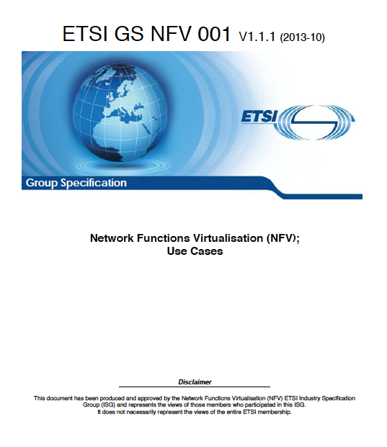
Network Function Virtualisation and ETSI
ATT, Century Link, Verizon
BT, Colt, Deutsche Telecom
Orange, Telecom Italia
Telefonicia
China Mobile, KDDI, NTT, Telstra
ETSI NFV Home Page
http://www.etsi.org/technologies-clusters/technologies/nfv highlight=YToxOntpOjA7czozOiJuZnYiO30

Slide 6
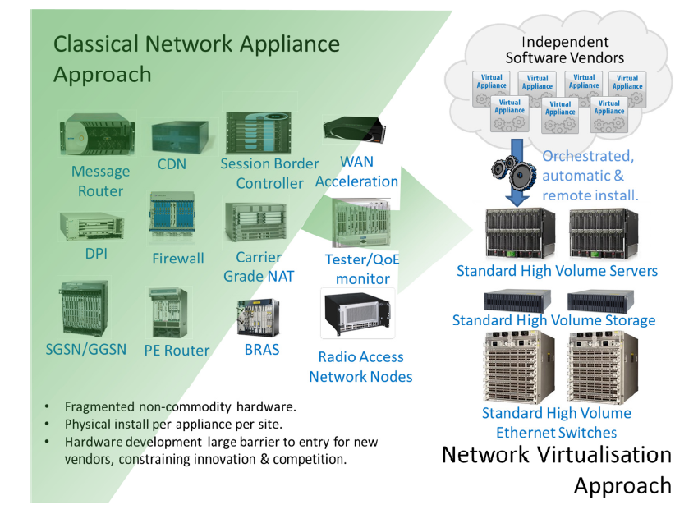
Network Function Virtualisation and ETSI
“…Leverage standard IT virtualization technology to consolidate many network equipment types onto industry standard high volume servers, switches and storage that can be located in DCs, Network Nodes and in the end-user premises.”*
Notes:
To overcome this kind of service impacting outage, BGP PERSITANCE has evolved with draft-uttaro-idr-bgp-persistence-00. This addition to the BGP standard will become a configurable option in router operating software over the next 12 – 18 months.
BGP PERSISTENCE : Allows for the provision of three new communities that are used to identify the capability of a BGP NLRI to persist or if the path is live or stale.
PERSIST – Attaching the PERSIST community should be controlled by configuration. Attaching the PERSIST community indicates that the PEER should maintain its forwarding state in the case of a session failure. This community will be set to DISABLE by default.
Do_NOT_Persist – Attaching of the Do_Not_Persist community should be controlled by configuration. The default functionality should be disabled.
STALE – Attaching of the STALE community is limited to a path that currently has the PERSIST community attached.

Slide 7
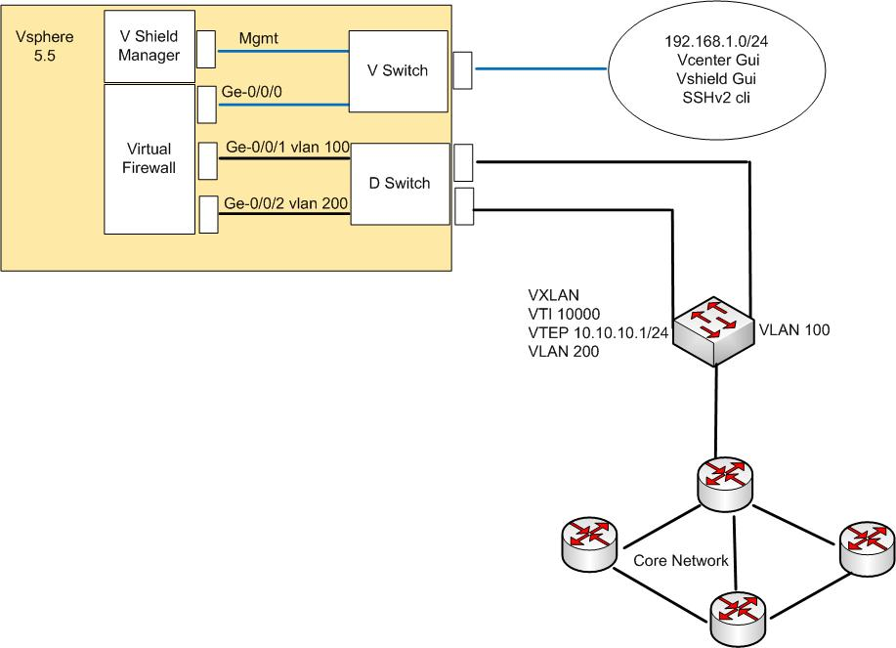
Network Function Virtualisation and ETSI
Test from ETSI use cases based on current user requirement
Virtual CPE – Hybrid virtual and physical network infrastructure
Nothing new, but confirming potential demarcation point for network and system engineering
Notes:
To overcome this kind of service impacting outage, BGP PERSITANCE has evolved with draft-uttaro-idr-bgp-persistence-00. This addition to the BGP standard will become a configurable option in router operating software over the next 12 – 18 months.
BGP PERSISTENCE : Allows for the provision of three new communities that are used to identify the capability of a BGP NLRI to persist or if the path is live or stale.
PERSIST – Attaching the PERSIST community should be controlled by configuration. Attaching the PERSIST community indicates that the PEER should maintain its forwarding state in the case of a session failure. This community will be set to DISABLE by default.
Do_NOT_Persist – Attaching of the Do_Not_Persist community should be controlled by configuration. The default functionality should be disabled.
STALE – Attaching of the STALE community is limited to a path that currently has the PERSIST community attached.

Slide 8
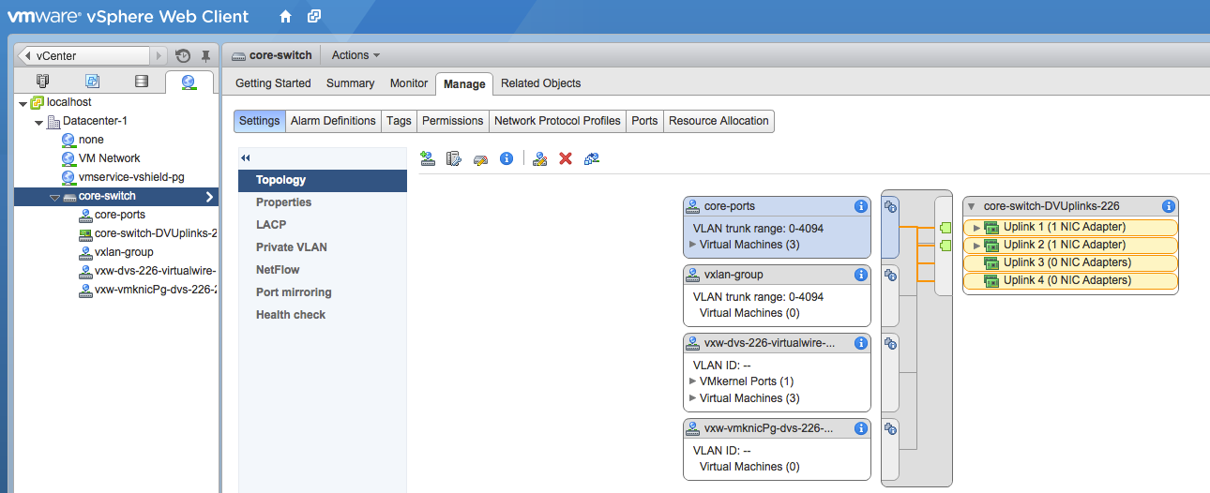
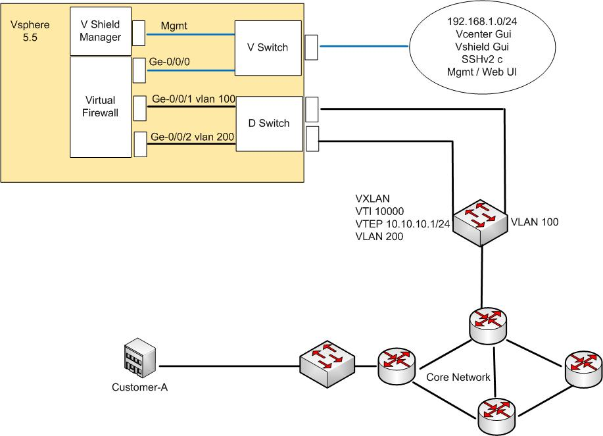
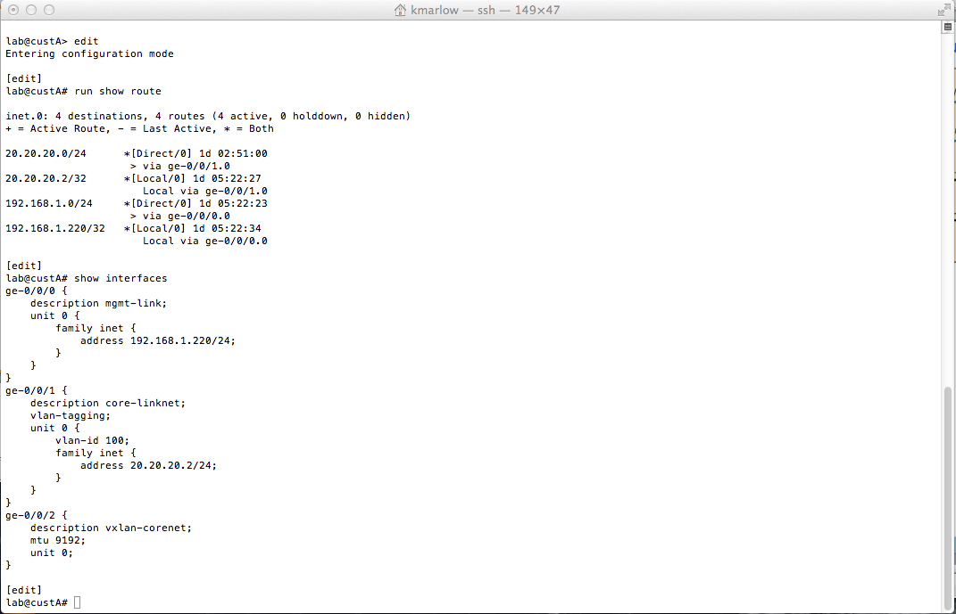
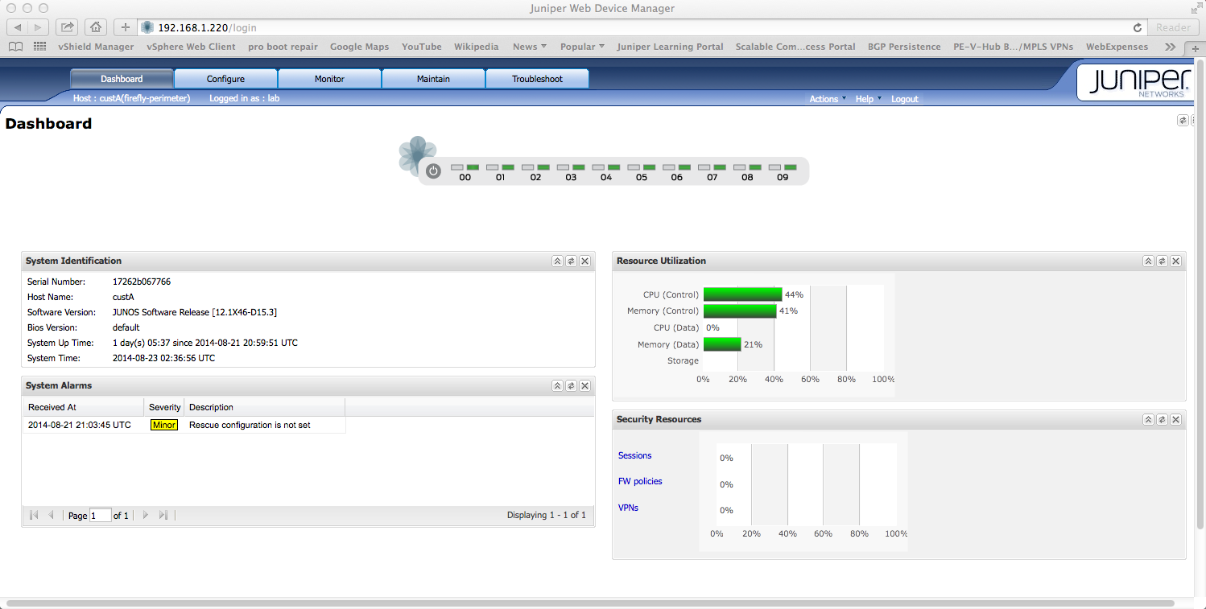
Network Function Virtualisation and ETSI
Notes:
To overcome this kind of service impacting outage, BGP PERSITANCE has evolved with draft-uttaro-idr-bgp-persistence-00. This addition to the BGP standard will become a configurable option in router operating software over the next 12 – 18 months.
BGP PERSISTENCE : Allows for the provision of three new communities that are used to identify the capability of a BGP NLRI to persist or if the path is live or stale.
PERSIST – Attaching the PERSIST community should be controlled by configuration. Attaching the PERSIST community indicates that the PEER should maintain its forwarding state in the case of a session failure. This community will be set to DISABLE by default.
Do_NOT_Persist – Attaching of the Do_Not_Persist community should be controlled by configuration. The default functionality should be disabled.
STALE – Attaching of the STALE community is limited to a path that currently has the PERSIST community attached.

Slide 9
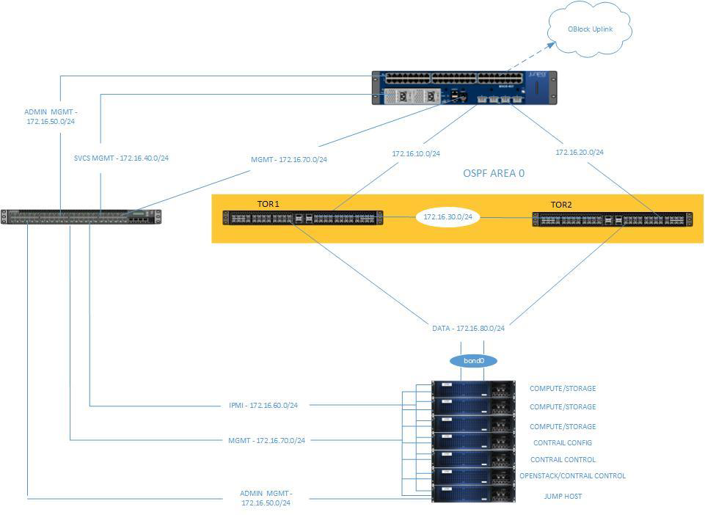
Were next – further testing: OpenBlock - Contrail / SDN POD
Junos Space: Network Director, Security Director Virtual Director, Service Activation Director Service Management Systems
OpenStack, CloudStack
Virtual Machine Management System
Notes:
To overcome this kind of service impacting outage, BGP PERSITANCE has evolved with draft-uttaro-idr-bgp-persistence-00. This addition to the BGP standard will become a configurable option in router operating software over the next 12 – 18 months.
BGP PERSISTENCE : Allows for the provision of three new communities that are used to identify the capability of a BGP NLRI to persist or if the path is live or stale.
PERSIST – Attaching the PERSIST community should be controlled by configuration. Attaching the PERSIST community indicates that the PEER should maintain its forwarding state in the case of a session failure. This community will be set to DISABLE by default.
Do_NOT_Persist – Attaching of the Do_Not_Persist community should be controlled by configuration. The default functionality should be disabled.
STALE – Attaching of the STALE community is limited to a path that currently has the PERSIST community attached.

Slide 10
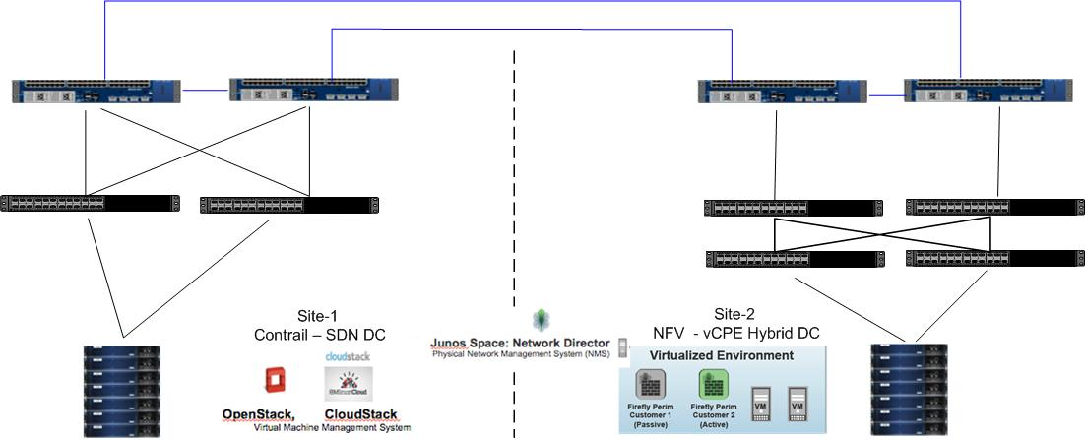
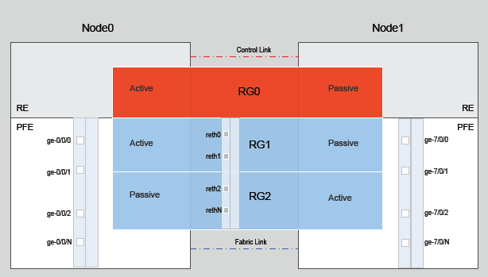
Continual Testing
Notes:
To overcome this kind of service impacting outage, BGP PERSITANCE has evolved with draft-uttaro-idr-bgp-persistence-00. This addition to the BGP standard will become a configurable option in router operating software over the next 12 – 18 months.
BGP PERSISTENCE : Allows for the provision of three new communities that are used to identify the capability of a BGP NLRI to persist or if the path is live or stale.
PERSIST – Attaching the PERSIST community should be controlled by configuration. Attaching the PERSIST community indicates that the PEER should maintain its forwarding state in the case of a session failure. This community will be set to DISABLE by default.
Do_NOT_Persist – Attaching of the Do_Not_Persist community should be controlled by configuration. The default functionality should be disabled.
STALE – Attaching of the STALE community is limited to a path that currently has the PERSIST community attached.

Slide 11
In Summary
NFV tested, proven, and moving into production now
vCPE , seen as potential to drop CPE CAPEX and drive new revenue generation
Hybrid virtual and physical networks are more likely to be deployed using available
tools today.
No need to wait for production proven SDN orchestration and self care portals
to deploy virtual network functionality such as vCPE.
-
80% of the Service Providers surveyed will deploy Virtual CPE by 2016 but 52% will deploy in 2014 / 2015 (Surveyed Service Providers representing 51% of worldwide telecom operators)
Notes:
To overcome this kind of service impacting outage, BGP PERSITANCE has evolved with draft-uttaro-idr-bgp-persistence-00. This addition to the BGP standard will become a configurable option in router operating software over the next 12 – 18 months.
BGP PERSISTENCE : Allows for the provision of three new communities that are used to identify the capability of a BGP NLRI to persist or if the path is live or stale.
PERSIST – Attaching the PERSIST community should be controlled by configuration. Attaching the PERSIST community indicates that the PEER should maintain its forwarding state in the case of a session failure. This community will be set to DISABLE by default.
Do_NOT_Persist – Attaching of the Do_Not_Persist community should be controlled by configuration. The default functionality should be disabled.
STALE – Attaching of the STALE community is limited to a path that currently has the PERSIST community attached.

Slide 12
Thank you
Alternative Networks
Chatfield Court
56 Chatfield Rd
London
SW11 3UL

