Slide 1
HEAnet’s Optical Backbone & Schools Connectivity
Brian Nisbet
Network Operations Manager
@natural20
@heanet
UKNOF 29, Belfast

Slide 2
HEAnet’s Mission
  “To realise Ireland’s education and research goals in partnership with our clients by providing advanced infrastructure and services.”
  Source: HEAnet Strategic Plan
  2014- 2016 “Collaboration – The Key to Development and Success”

Slide 3

Who We Are
HEAnet is Ireland’s National Education and Research Network
Set up in 1983 as a collaborative body by the seven Irish Universities & The Higher Education Authority
Became a non-profit, Limited company in 1997
Approx. 50 staff members whose areas of expertise lie in:

Slide 4
Network Members
  7 Universities & DIT
  13 Institutes of Technology
  16 Third Level Colleges and ETBs
  24 Non-profit Education and Research organisations
  Government agencies / Administrative bodies
  In excess of 200,000 end users
  4,000 primary and post-primary schools – 800,000 end users

Slide 5
HEAnet schematic, March 1994

Slide 6
Initial Dark Fibre Network
Lighting dark fibre in 2003
Removed some reliance on traditional telcos
Optical network around Ireland on ESBT fibre using ADVA equipment.
Drop off at HEAnet PoPs & hooks into MANs where appropriate
30Gbps backbone
National network due for upgrade in 2013 (note, this slide written in 2011ish)

Slide 7
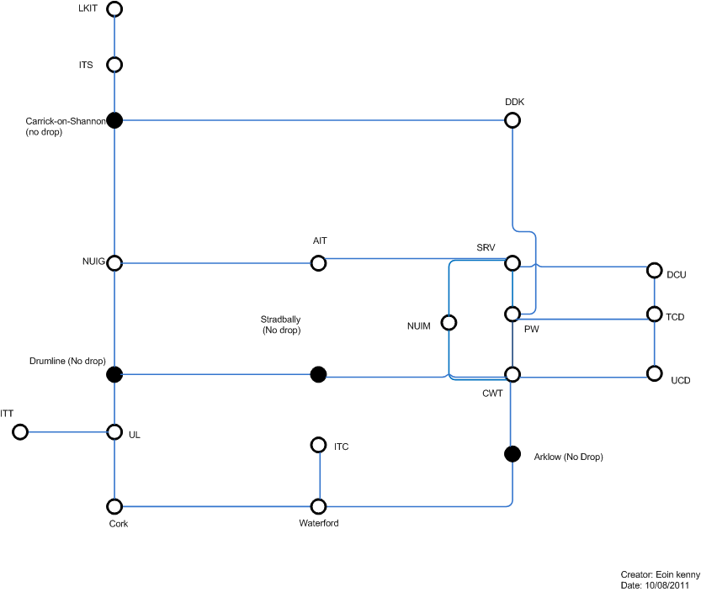
Core Optical Network

Slide 8
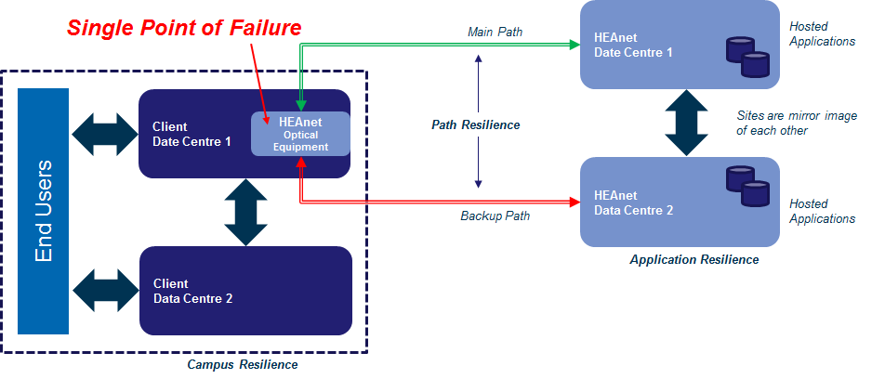
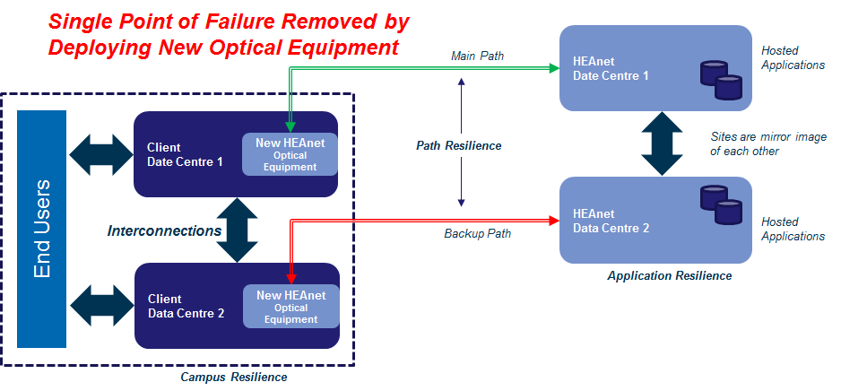
Optical Resilience Problem
Current
Situation
Proposed
Solution

Slide 9
Reasons for NGN Project
Enhanced resilience
Replace old equipment (Could not buy more)
10Gbit/s upgrades for regional clients
Support for 100Gbit/s

Slide 10
3 Projects
Dublin Core Ring Upgrade
National Backbone Replacement 2013
Optical Resilience Configuration Review

Slide 11
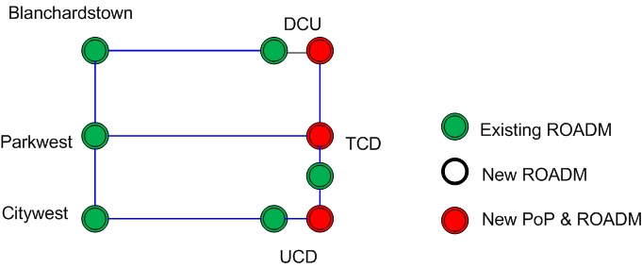
Dublin Optical Network

Slide 12
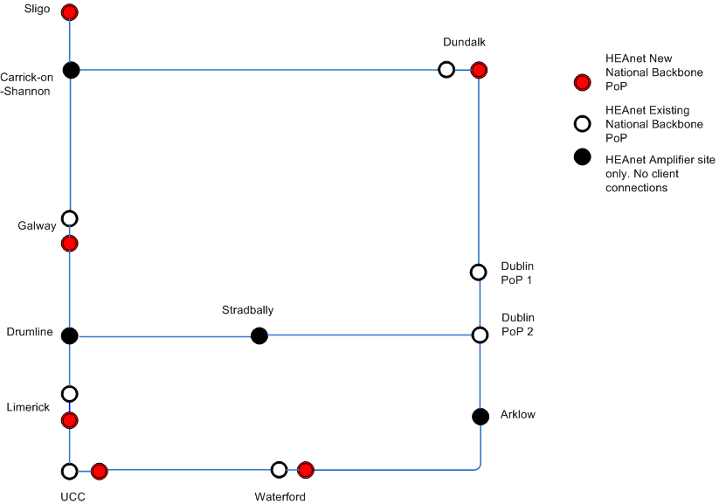
National Optical Network
NetOps moved
7x10G circuits moved in 4 days

Slide 13
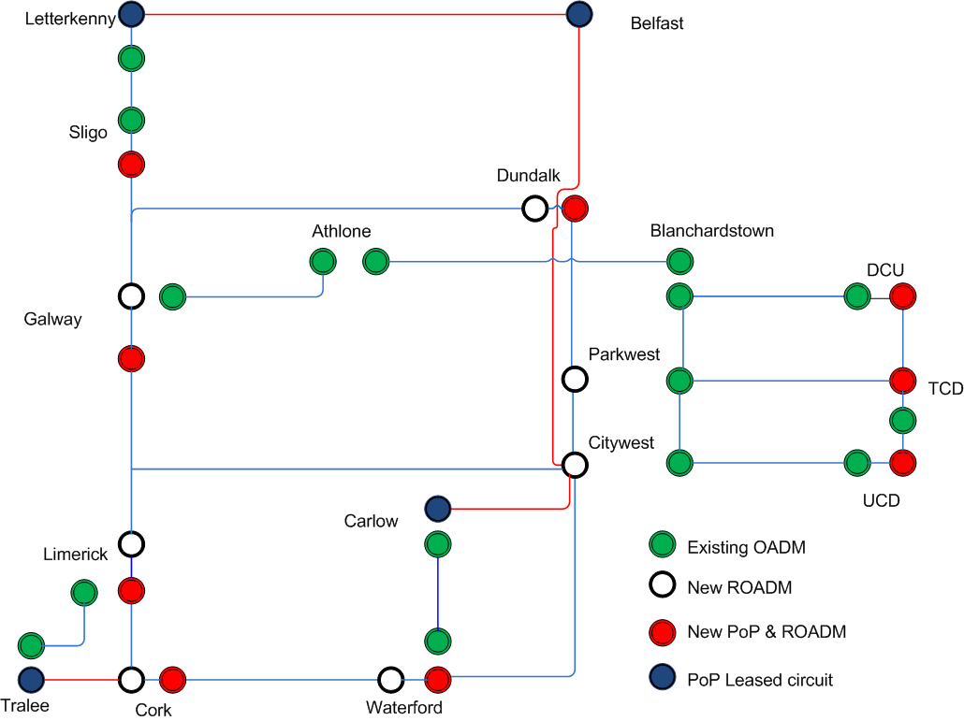
National & Dublin

Slide 14
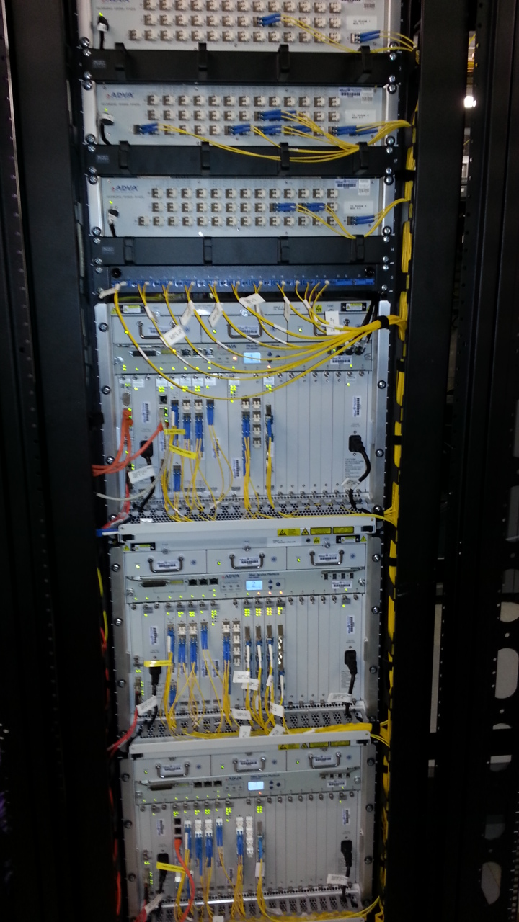
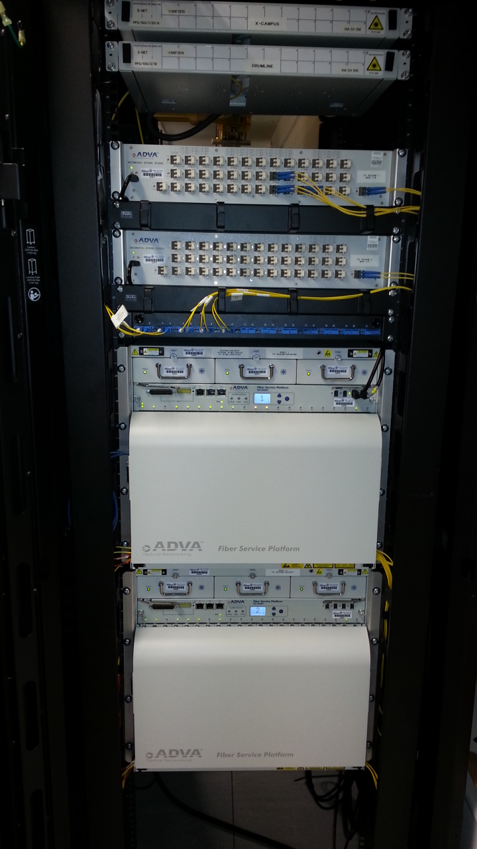
Adva Equipment
Notes:
ADVA FSP3000R7s

Slide 15
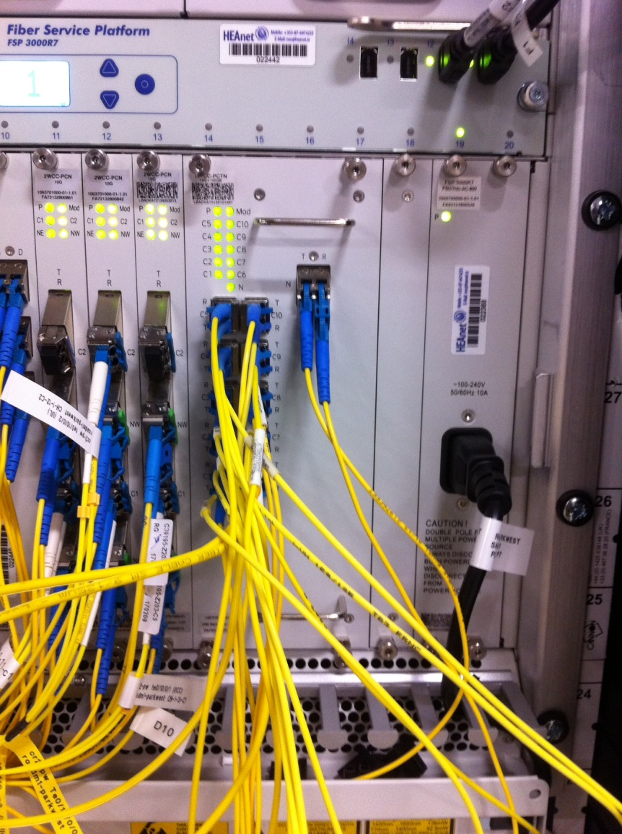
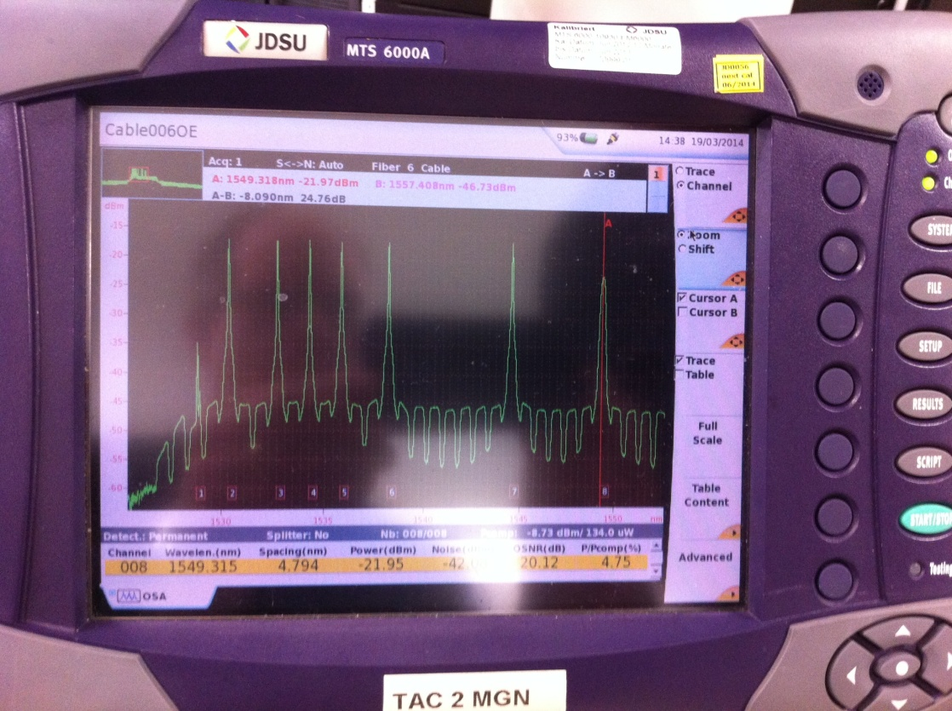
100Gbit/s Testing

Slide 16
Aftermath
All projects delivered in time and under budget
Enhanced resilience & room to grow
Operational reality & gotchas?

Slide 17
Schools Connectivity Programmes (update?)
  100 Mbit/s POST-PRIMARY PROGRAMME
      2010 : 78 school pilot nationwide
      2012 : 202 schools across 14 western/midland counties
      2013 : 235 schools across Dublin, Kildare & Meath
      2014 : 250+ schools across rest of Leinster/Munster
  BROADBAND FOR SCHOOLS PROGRAMME
      HEAnet connecting all 4,000 schools since 2005
      Phase III (2012) delivering increased levels of broadband
      Significant reduction in schools relying on satellite technology
Notes:
17

Slide 18
Schools Services
Managed School Router
Web Filtering
Security
Webhosting & Blogs
Proactive Monitoring & Tech Support
IP Allocation & DNS

Slide 19
100Mb Programme Summary
Connects all 2nd Level Schools in Ireland (approx. 785)
100Mb symmetrical bandwidth
Joint Government Funding:
  Dept of Communications (Capital Outlay)
  Dept of Education (Recurrent Outlay)
EU Funding: NDP, EU Structural Funds, ERDF
HEAnet as Contracting Authority
Leverages HEAnet Backbone & Resources
3-Year National Roll-Out

Slide 20
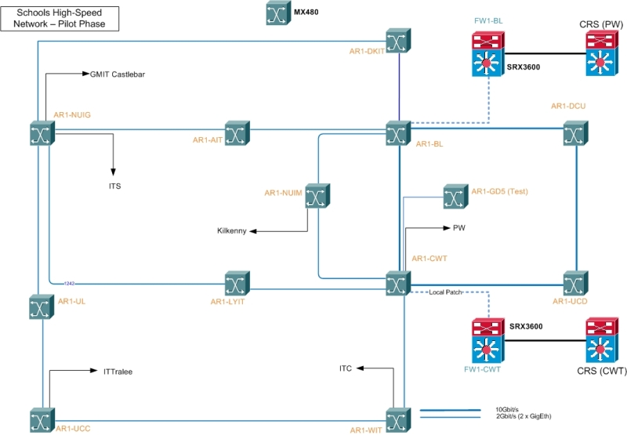
Network Infrastructure

Slide 21
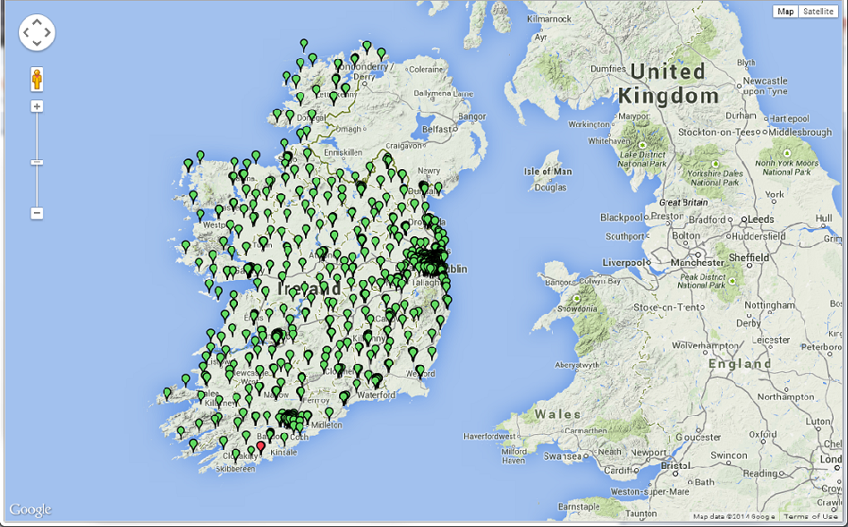
Ignore the Red Dot

Slide 22
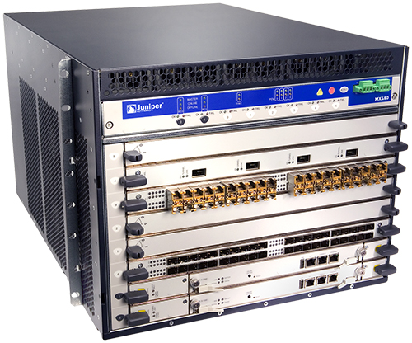
Weapon of Choice 1
Juniper MX480 in every PoP

Slide 23
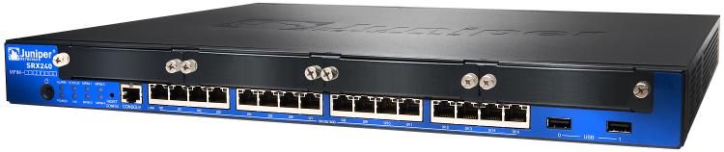
Weapon of Choice 2
Every school has a Juniper SRX240
Fully managed by HEAnet
Schools strongly discouraged from touching!

Slide 24
Routing
MPLS network, each school in a .1q trunk
Single L3 VPN for all
BGP between access routers & schools
All ARs accept BGP from certain ranges, all end points in same private AS
Provisioning via Tenjin text templates, pulled out of DB with Perl scripts

Slide 25
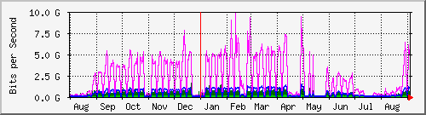
We built it and...
Massive usage uptake – 20Gb connection to core, average daily usage of ~5Gb, expected to increase
All network traffic goes via core filtering boxes & interconnects with HEAnet core

Slide 26
Operational Issues
Huge geographic diversity!
Multiple providers
Provisioning
Huge variance in local knowledge levels

Slide 27
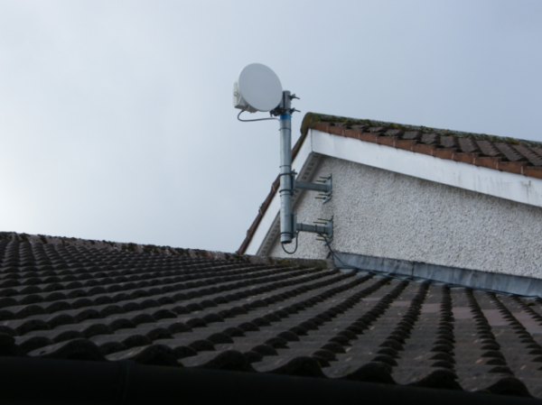
Up In the Air

Slide 28

Down In the Ground
Notes:
I know you’re sitting there saying, “Oooh, fibre, yeah, sure, whatever...” but this is important and ground breaking (hur, hur)

Slide 29
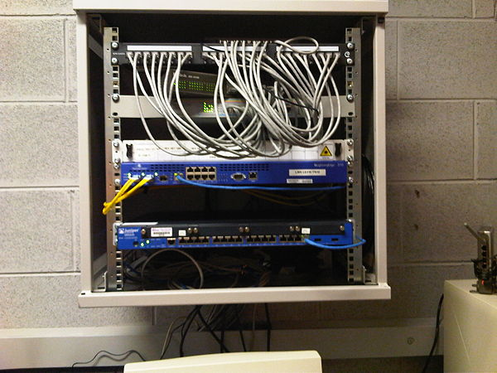
All Looks So... Proper!

Slide 30
Advice To Schools
Equipment needs to be kept in a controlled environment
Communications Room (or room with restricted access) required
This location needs to be identified early in the process
Must be located adjacent to LAN and POWER points
Two dedicated power supplies
HEAnet will provide a comms rack if required

Slide 31
Lessons Learned
Bad location selection leads to problems in service...

Slide 32
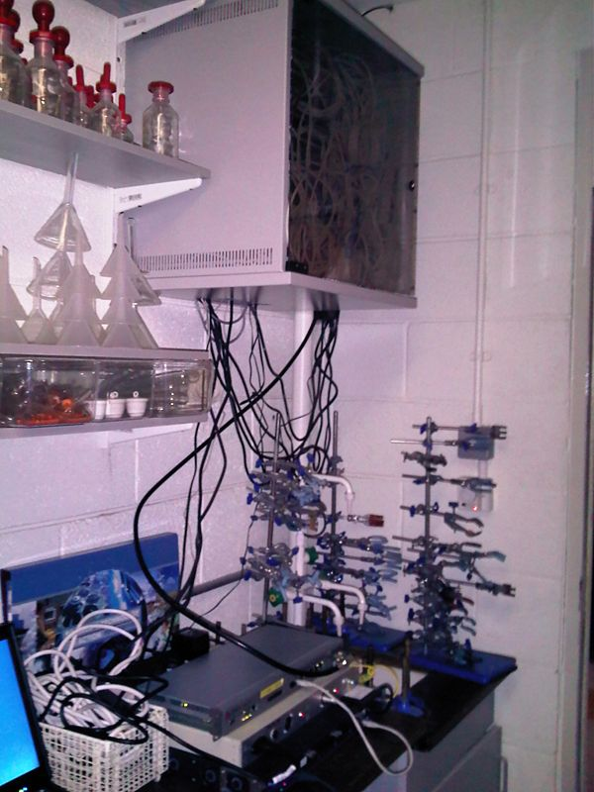

Slide 33
Lessons Learned
Majority of roll-out delays attributable to poor location of equipment
Cost of moving equipment can be equivalent to the cost of an install
Majority of performance issues relate to mis-configured LANs
Having IT person available at time of router install pays dividends

Slide 34


Slide 35
brian.nisbet@heanet.ie
@natural20

