Slide 1
Open-IX: Beyond Year One
Keith Mitchell
Board Member, Open-IX Association
UKNOF30
January 22, 2015

Slide 2
Interconnection for Data Centers
The Internet: a network of networks
Peering and Interconnection
Agreements between networks to exchange data
A variety of motivations and business terms
Can occur over a private or public exchange fabric but Interconnection almost always happens within Data Centres
Internet Exchanges offer a neutral local network where operators can exchange traffic.

Slide 3
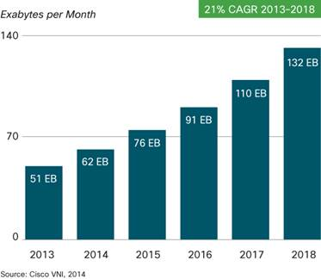
Interconnection
Network interconnection and exchange (peering) are critical to handle massive growth in traffic across enterprise, mobile and broadband networks
Passing traffic at the edge improves
service quality by reducing congestion or other possible network bottlenecks
OIX seeks improve the environment for Interconnection
Standards help create more resiliency and better reliability

Slide 4
About Open-IX
MISSION
To build community and consensus that foster data center and Internet Exchange Point (IXP) standards, ultimately improving the landscape of Internet peering and interconnect.
OPEN▪IX
The Open-IX Association* is a self-regulated community that fosters the development of critical data centre and IXP technical and operating standards to:
Promote uniform specifications for data transfer and physical connectivity.
Create resiliency to improve reliability.
Certify IXPs and data centers that meet the community-developed standards.
*Open-IX is a 501(c)(6) non-profit Trade Association
Notes:
<number>

Slide 5
Why Open-IX?
Before Open-IX
Few choices in the N. American IXP market.
Significant concentration in single facilities in many markets.
With Open-IX
Multiple IXPs being certified, offering choice.
Multiple data centers being certified, decreasing concentration.
Competitive response from incumbent exchange / interconnect providers.
Benefits of Open-IX
Less density, more choice, increased resiliency and decreased cost.
Better performance and uptime for all.

Slide 6
How Does It Work?
INDIVIDUAL MEMBERS | CERTIFICATION PROGRAMS
Individual members help shape data center and IXP standards to create a level playing field for all. | Data centres and IXPs adopt community-created professional standards and then become certified.
$50.00 per member | $5,000.00 per facility/IXP MSA

Slide 7
Membership
Open to anyone with an interest in IXPs, data center infrastructure, interconnect engineering or research, and who wishes to participate in shaping the operations and engineering of the future of Internet interconnect.
Members:
Vote in all Open-IX elections.
Nominate and elect the Board of Directors.
Serve on volunteer standards committees.
Provide input on Certification Applications.
Application process:
One class of membership for all.
12-month term.

Slide 8
Data Centres
Mega Data Centres
Large footprint ~250,000 – 1,000,000 sq. ft.
Low cost of power
Favorable cooling options
Remote locations tethered by long-haul fiber
Data storage
Non-latency sensitive / low bandwidth applications
Delivery of last resort
Smaller Data Centres
Typical footprint <10,000 sq. ft. to 100,000 sq. ft.+
Located proximate to population centers
Highly connected
Content delivery networks
Latency / jitter sensitive applications
Reduce / manage backbone traffic
<number>

Slide 9
Certification
Any company can adopt Open-IX standards and apply for certification.
Certification signifies that your company will adopt the OIX standards, indicates that your operations comply with these standards and provides you the ability to use the certification marks publicly.
Certification is now open to any organisation worldwide, not just N. America.
OIX-1 IXP Technical Requirements
For organisations that operate a physical network infrastructure with the purpose to facilitate the exchange of Internet traffic between Autonomous Systems (AS).
OIX-2 Data Center Technical Requirements
For building owners, Meet-Me-Room (MMR) operators, and data center providers.
Notes:
<number>

Slide 10
OIX-1 & OIX-2 Standards
OIX-1 IXP
Infrastructure: switching platform, IP space, route server
Standard physical interface
Best practices for traffic forwarding
Clear customer interface demarcation points
Operational: NOC, monitoring & statistical reports
Current in peering contact and config directory
Accessible information on public website
OIX-2 Data Center
Infrastructure: utility feeds, transformers, water sources, network access, MMR, interconnection
Operational: rules, licensing, commissioning, maintenance, operating procedures, change management
Service levels for generator(s), UPS, cooling, interconnect delivery, electrical circuit
Open, non-discriminatory access and pricing
Accessible information on public website

Slide 11
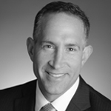
OIX Board of Directors
David Temkin
Co-Founder & Chairman
Will Charnock
Vice Chair
Christian Koch
Secretary
Chris Malayter
Treasurer
Barry Tishgart
Member
Josh Snowhorn
Member
Keith Mitchell
Member

Slide 12
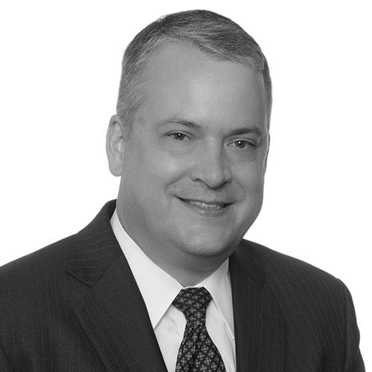
OIX Standing Committees
IXP STANDARDS
COMMITTEE
DATA CENTRE
STANDARDS COMMITTEE
MEMBERSHIP
COMMITTEE
MARKETING
COMMITTEE
PROGRAM COMMITTEE
Henk Steenman
Board Liaison and Chair
Gabe Cole
Board Liaison and Chair
Christian Koch
Board Liaison and Chair
Vinay Nagpal
Board Liaison and Chair
Martin Hannigan
Board Liaison and Chair
Development and maintenance of technical and operational standards for Internet Exchange Points (IXPs).
OIX-1 Standard
Development and maintenance of technical and operational standards for data centres.
OIX-2 Standard
Recruiting Open-IX Association members, membership management and retaining Open-IX members.
Promoting OIX, external messaging and working with certified IXPs and data centres to increase peers on certified exchanges.
Soliciting talks in the industry and working with selected presenters to deliver top quality content to our membership.

Slide 13
OIX-1 Certification
Completed: Two (2) MSAs, Two (2) IXPs
Pending: Four (4) MSAs, Two (2) IXPs
VA/MD/DC
Phoenix (Announced)
NY/NJ
SF Bay Area (Pending)
Chicago (Announced)
Omaha (Announced)
Notes:
<number>

Slide 14
OIX-2 Certification
Completed: 21 Data Centres, Nine (9) Companies
Pending: Six (6) Data Centres, Five (5) Additional Companies
Dallas, TX
Houston, TX
Austin, TX
Cincinnati, OH
Cincinnati, OH
Phoenix, AZ
Los Angeles, CA
San Francisco, CA
Dallas, TX
New York, NY
Atlanta, GA
Suwanee, GA
Richmond, VA
Ashburn, VA
Piscataway, NJ
Durham, NC
Somerset, NJ
Chicago, IL
Manassas, VA
Houston, TX
Santa Clara, CA

Slide 15
Americas Interconnection Summit
When: April 7-9, 2015
Where: The Westin San Diego Gaslamp Quarter, San Diego, CA
Open-IX’s inaugural Americas Interconnection Summit is an open and neutral event that will assemble decision-makers for interconnection and related services aimed at networks around the globe. The event program will feature one-on-one and small group meeting time, networking events, and panels and presentations covering current, relevant topics in peering and interconnection.
Open to all Internet participants interested in interconnection, including:
Internet Service Providers
Content Providers
Content Delivery Networks (CDNs)
Data Center and Internet Exchange Operators
Network Hardware and Software Suppliers
For more details and sponsorship information, contact ixs@open-ix.org
Notes:
<number>

Slide 16
Information – Become a Member
About Open-IX Association
The Open-IX Association (OIX) is a non-profit organisation, tax-exempt under Section 501(c)(6), created to improve the landscape of Internet peering and massive-scale interconnection. OIX encourages the development of neutral and distributed Internet exchanges while promoting uniform standards of performance for interconnections backed by the Internet community. The Association aims to promote common and uniform specifications for data transfer and physical connectivity and improve overall Internet performance by developing criteria and methods of measurement to reduce the complexity that restricts massive scale interconnection in fragmented markets.
VISIT US: www.open-ix.org
CONTACT US: info@open-ix.org

