Slide 1
Dissecting Significant Outages from 2014
Valerio Plessi
CCIE R&S 24744
Customer Success Engineer
valerio@thousandeyes.com

Slide 2
Using Active Probing to Diagnose Outages
Passive Monitoring
Capture traffic from the network by generating a copy of the traffic usually via a span port, mirror port or network tap
Typical Use: Discover what is going on
Active Probing
Generating a synthetic probe that will discover information and report back
Examples: ping, traceroute
Typical Use: Find the root cause
Let’s look at a variety of events to see this in action.
DNS hijack, Cable Cut, BGP hijack, BGP Prepending Error, DDoS
Notes:
TE only does Active Probing, right?

Slide 3
Craigslist DNS Hijack November 2014
Notes:
Craiglist reported a DNS outage diverting traffic to rogue websites
Registrar login credential got stolen and some records forged

Slide 4
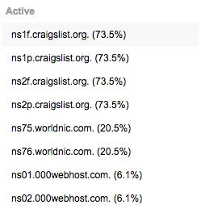
Craigslist DNS Records Compromised
Compromised DNS registrar account used to add records pointing to Worldnic and 000Webhost
At height of attack, 27% of records observed were incorrect
Notes:
The hijacked NS records directed users to four of the attacker’s name servers hosted at Network Solutions’ WorldNic and 000webhost:

Slide 5
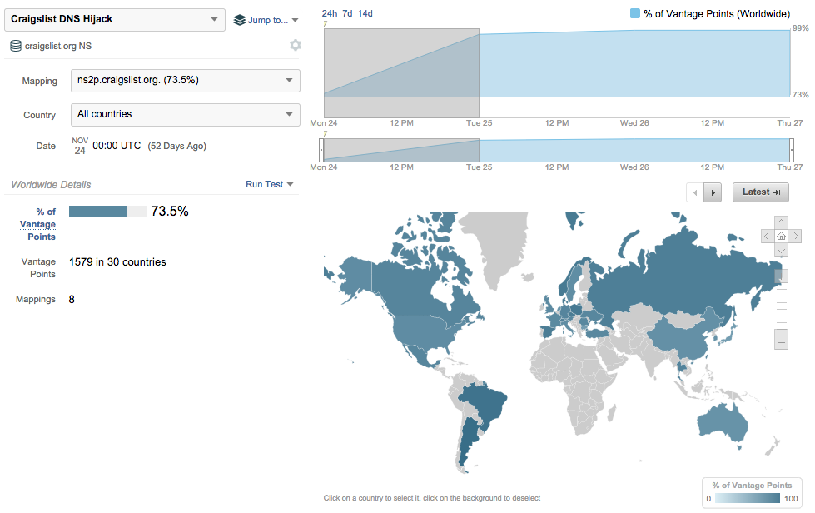
Affected DNS Caching Servers over a Week
From 74% to 99% of vantage points resolving to correct records
Notes:
4 hours into the attack, 26% of DNS resolvers were directing queries to the rogue name servers. 12 hours later craigslist confirmed that the DNS records had been corrected by the registrar
Even a week after a highly publicized (in the network operator world) DNS hijack, some major networks still have not flushed their resolvers’ caches

Slide 6
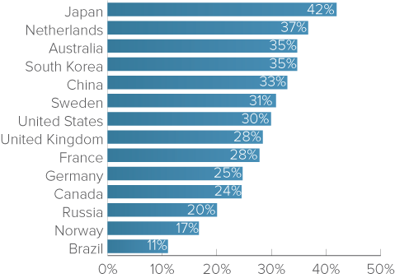
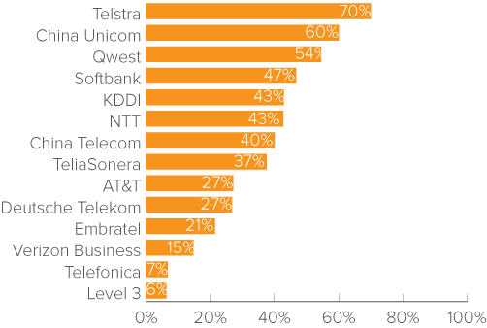
Impact Varied across Countries and Networks
Most affected countries
Most affected networks
Notes:
Asia was hardest hit with more than 30% of DNS resolvers serving hijacked records
Some major networks had over 50% of resolvers serving hijacked records, including China Unicom, Telstra of Australia and Qwest of the U.S

Slide 7
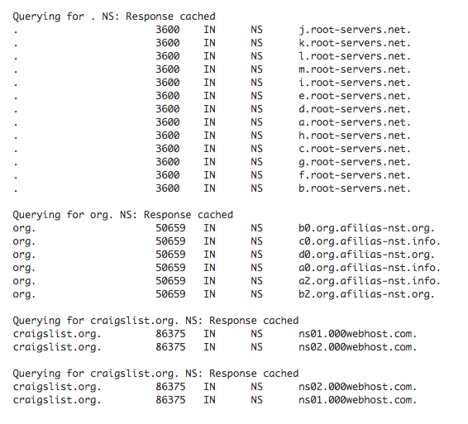
DNS Trace with Hijacked Records
Compromised records pointing to 000Webhost
Notes:
We can look into a specific resolver on the TeliaSonera network after ONE WEEK and the DNS trace resolves still pointing to a 000webhost name server

Slide 8
Yahoo Irish Sea Cable Cut November 2014

Slide 9
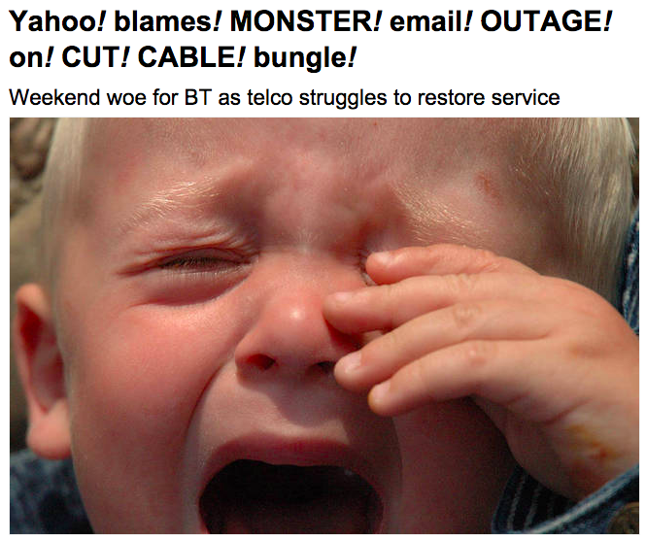
Brits Lose Their Yahoo Email
Notes:
Image from the registrar news
Yahoo and BT mail (based on yahoo mail servers) impacted for around one week accessing from europe

Slide 10
Latency from Europe to Yahoo Dublin Data Center
November 20th
Notes:
Latency increases immediately after the cable cut
High latency persisted for a week

Slide 11
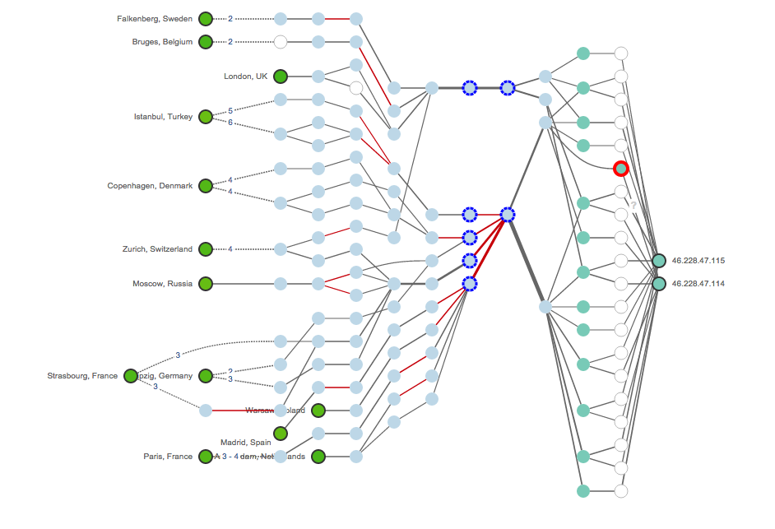
Path Topology Prior to Cable Cut
London to Dublin cable (source of the cut)
Yahoo Dublin
AMS to Dublin cable
Notes:
From Europe two path through AMSTERDAM or LONDON in reaching Dublin

Slide 12
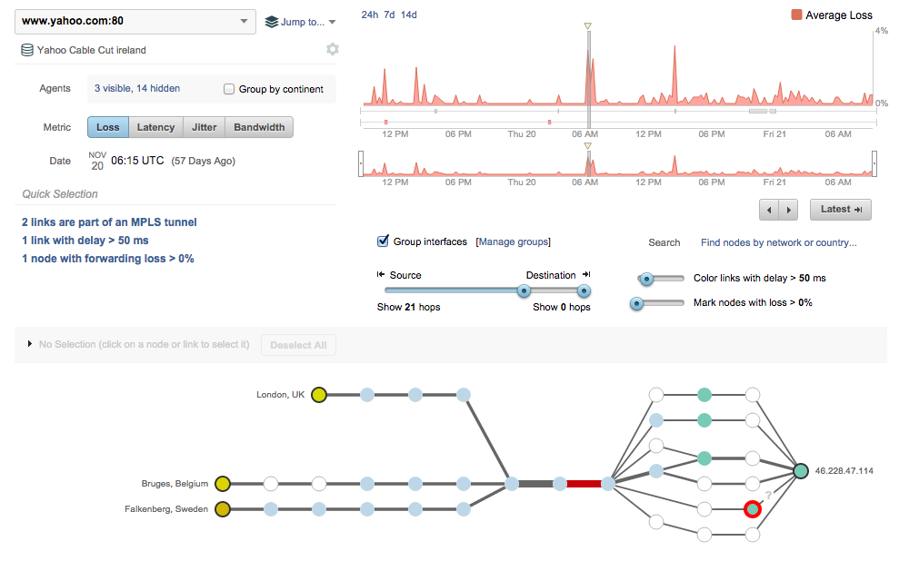
When Cable Repair Ships Attack
Cable cut occurs (8ms →80ms over Irish sea)
Notes:
Latency increased from 8ms to 80 ms so probably some fibers in the cable were damaged, some survived

Slide 13
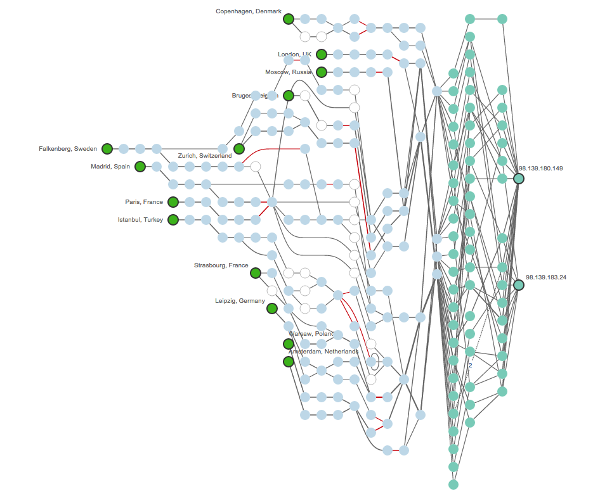
High Latency Topology After the Cable Cut
Yahoo New York
Transatlantic links in red
Notes:
Traffic from Europe was promptly re-routed to US so high latency for a week
Now yahoo uses more locations to spread data center

Slide 14
Indosat BGP Hijack April 2014

Slide 15
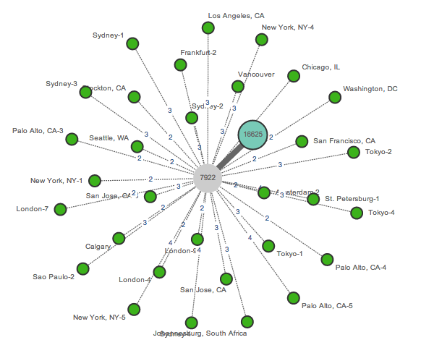
Normal Routes to PayPal
PayPal / Akamai prefix
Akamai AS 16625
Comcast upstream AS7922
Notes:
Indosat, a large Indonesian telecom, incorrectly advertised a majority of the global routing table, in effect claiming that their network was the destination for a large portion of the Internet.
BGP advertisements are generally trusted among ISPs, errors or improper filtering by an ISP can be propagated quickly throughout routing tables around the Internet.
Paypal is hosted by Akamai and was hardly affected by the hijack, having the traffic routed to Indosat for nearly AN HOUR

Slide 16
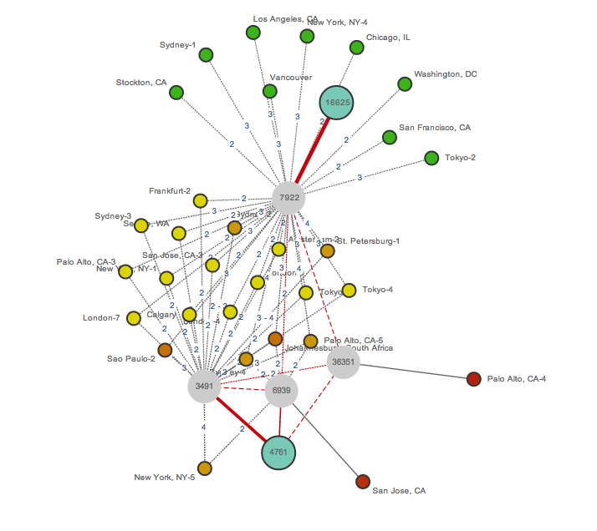
Routes Advertised from Indosat
Correct AS16625
(Akamai)
PayPal / Akamai prefix
Comcast upstream AS7922
PCCW upstream AS3491
Locations with completely hijacked routes
Hijacking AS4761 (Indosat)
Notes:
hijack in progress, with two origin ASes, the correct one for Akamai (AS 16625) and the incorrect one for Indosat (AS 4761)
for approximately 30 minutes Indosat was the destination for 90% of our public BGP monitors
While this hijack was not intentional, the effects are serious.

Slide 17
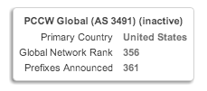
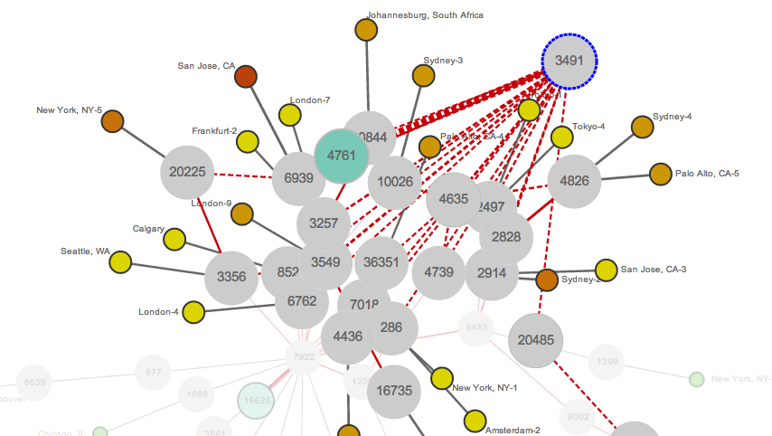
PCCW Has No Routes to PayPal AS16625
PCCW Network only connected to Indosat
Not to Akamai / PayPal AS16625
Notes:
PCCW network only connect to Indosat and so the traffic destinatned to paypal was dropped (see next slide)

Slide 18
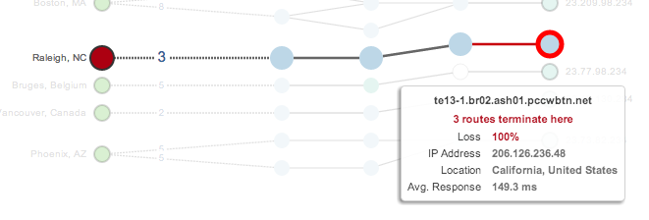
Causing All Traffic to Drop
Traffic transiting PCCW has no routes and terminates

Slide 19
Country Financial BGP Prepending October 2014
Notes:
connection issues with Country Financial’s website.
We saw a dip in availability and alerting on this test for over an hour

Slide 20
Routing Topology Before the Event
Access2Go
Cogent
HE
Country Financial

Slide 21
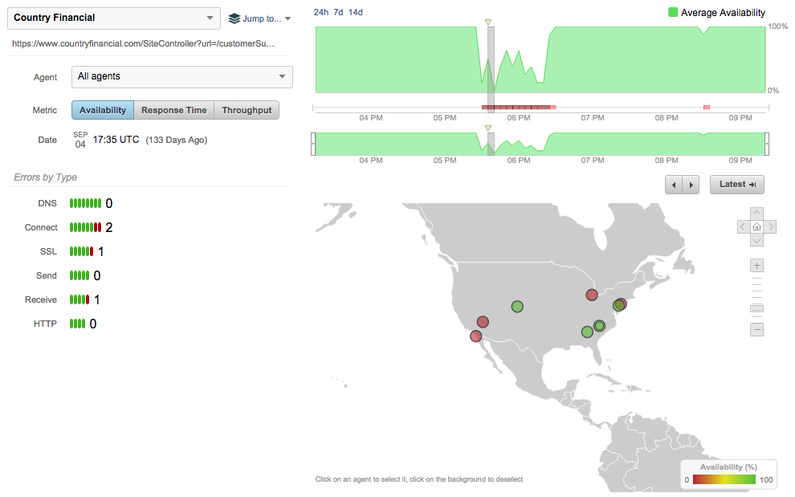
Country Financial Experiences Outage
TCP connection issues
Notes:
cloud agents started alerting to connection issues with Country Financial’s website.
We saw a dip in availability and alerting on this test for over an hour

Slide 22
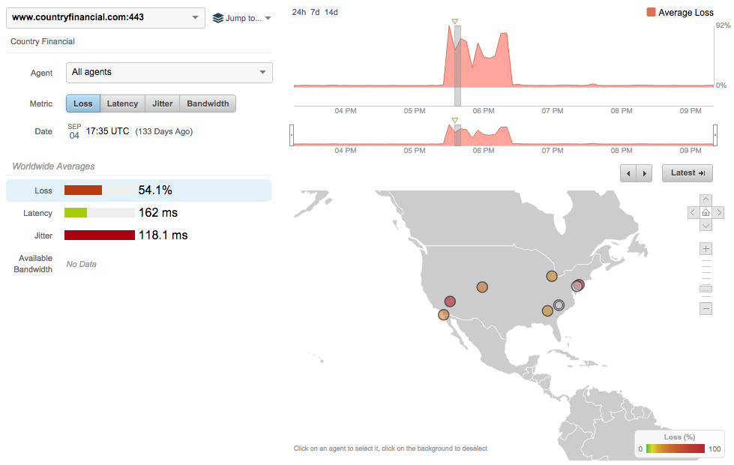
And Corresponding Packet Loss
And packet loss of >50%
Notes:
Spikes in the packet loss

Slide 23
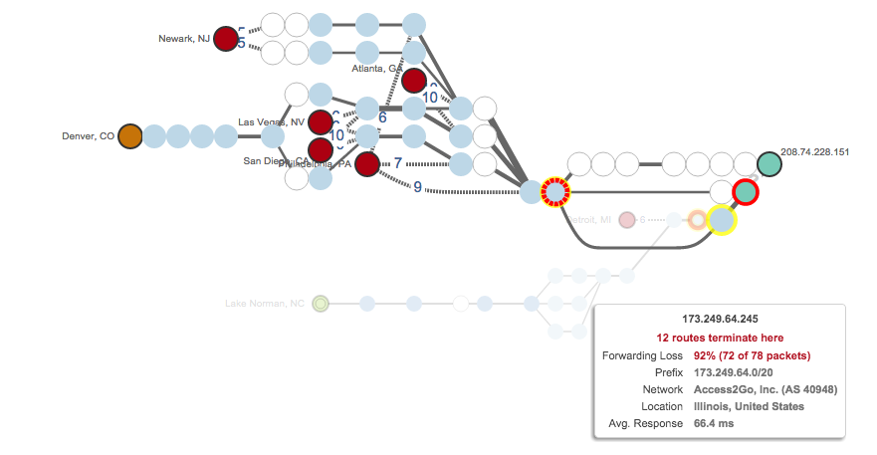
Path Visualization During the Event

Slide 24
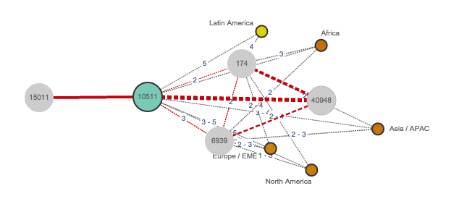
Routing Topology During the Event
Oooops! Jaguar Communications is AS15011 and no monitors connected..
Notes:
the provider used AS-path PREPENDING mistyping 15011 instead of 10511

Slide 25
And the Routing Table Says…
Doh!
Notes:
So traffic was seen as transiting AS15011-Jaguar Communication and so taking the wrong route

Slide 26
HSBC America DDoS February 2014
Notes:
DDOS attack targeting the two upstream nodes of HSBC website

Slide 27
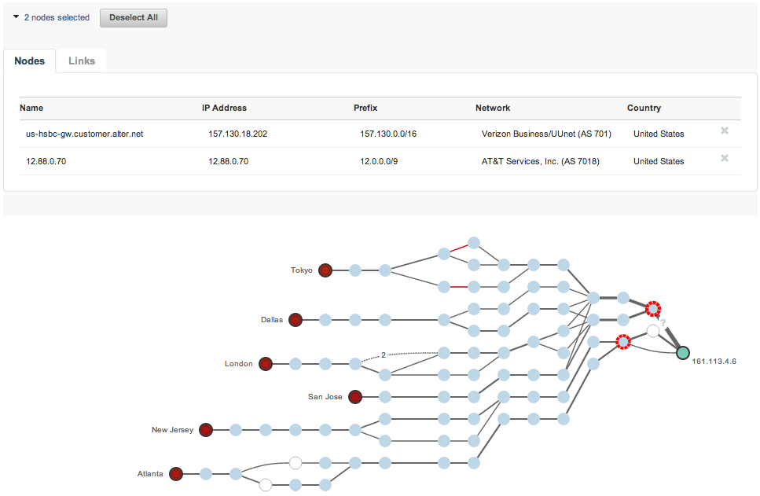
Congested Nodes in Upstream ISPs Verizon, AT&T
Packet loss in upstream ISPs Verizon and AT&T
Nodes with >25% packet loss
High packet loss from all testing points
HSBC bank website under attack
Notes:
DDoS attack in progress, with widespread service degradation and packet loss clearly visible

Slide 28
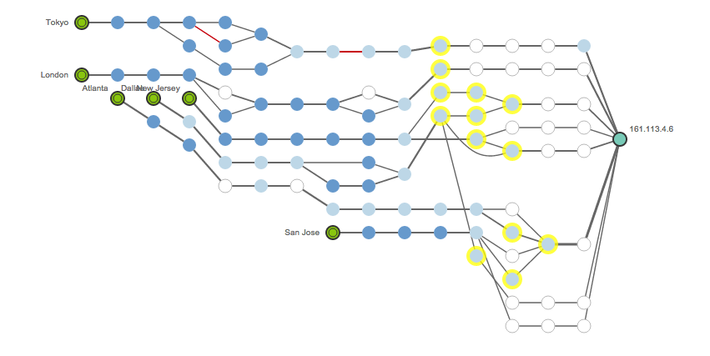
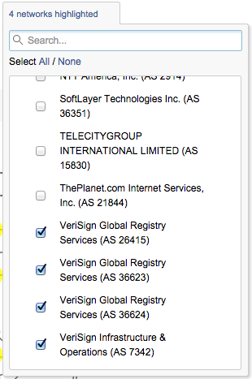
Mitigation Effectiveness Using Verisign
Verisign DDoS mitigation networks in yellow
Notes:
In response to the DDoS attack, the bank begins rerouting traffic from their own network to that of their cloud-based DDoS mitigation vendor.

Slide 29
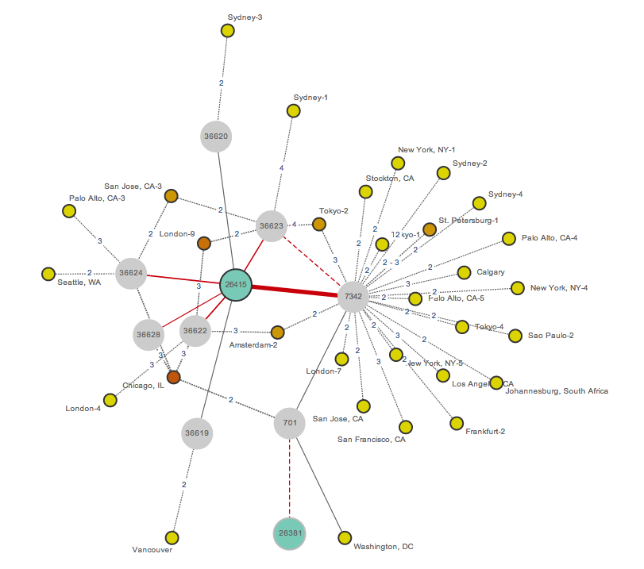
Mitigation Handoff to Verisign Using BGP
New Autonomous System (VeriSign)
HSBC prefix
New routes
Withdrawn routes
Prior Autonomous System (HSBC)
Notes:
The rerouting to mitigation center is evident from the BGP path changes that are being advertised, switching from the bank’s Autonomous System to that of its mitigation provider in order to begin scrubbing of traffic.
we see BGP path changes propagate

Slide 30
Thanks! valerio@thousandeyes.com
Notes:
And all what you saw is available to try for FREE at thousandeyes.com or come visit us at our booth

