Slide 1
Distributed Prevention of DoS
Collaboration is key

Slide 2
DoS Background
What is a Denial of Service attack?
An attempt to consume finite resources, exploit weaknesses in software design or implementation, or exploit lack of infrastructure capacity
Effects the availability and utility of computing and network resources
Attacks can be distributed for even more significant effect
L7 attacks can be time consuming and involve high levels of manual process to ensure live users remain enabled
The collateral damage caused by an attack can be as bad, if not worse, than the attack itself
Attacks can be sustained for months

Slide 3
What is Denial of Service?
The main point:
DoS is an Outage!
Slow starvation or volumetric (simple attacks are still hitting the headlines)

Slide 4
DoS vs. DDoS?
One system is sending the traffic vs many systems are sending the traffic
Does it really matter?
…in what cases?

Slide 5
Youtube

Slide 6
Botnets & C&C Servers
Botnet – (Zombie Army) A collection of internet connected programs to perform certain tasks. The can be used to send spam or launch Ddos attacks.
C&C Servers - A botnet's originator (known as a bot herder or bot master) can control all these compromise programs to basically send bad traffic to a destination machine.
Control signal
x2000 compromised hosts
Notes:
Botnet ( Robot Network)
C&C Servers – Command and Control servers

Slide 7
Key Considerations For DDoS Protection
Scalability - How many resources may be brought to bear?
Different levels of scale depending on positioning
Flexibility - What types of attacks may be mitigated & what techniques may be used?
Specialized Resources, Expertise & Focus - Who or what is analyzing the attacks, what resources are available, and who has the responsibility to coordinate the defense?
What is the full breadth of tools at your disposal?
Cost, not just monetary, but collateral damage (Brand damage)
Insurance or Loss?
Notes:
Scalability – Is you detection and mitigation able to handle todays large attacks. Flexibility – Do you have the resources to understand the threat landscape.
Cost – cost !
Post forensics, storage,
Do I have the right tools, do I have too many…

Slide 8
Contributing factors (what can you influence?)
Not patched Content Management Systems (CMSes)
Available reflectors (DNS, NTP, SSDP)
…with ability to amplify
More bandwidth available
Unpatched embedded devices – version control awareness
Misconfigured nodes
Vulnerable network elements i.e. CPEs
Weak security

Slide 9
Reflective attacks
Attacks where the an unwilling intermediary is used to deliver the attack traffic
The attacker would normally send a packet with a forged/spoofed source IP address to the intermediary. The forged address is going to be the one of the target. The intermediary will deliver a response which will go to the target instead of the attacker
Note to audience: think what protocols we can use for that?

Slide 10
Reflector types
The ones that are of interest and provide reflections are:
DNS
NTP
SNMP
SSDP
Other UDP???

Slide 11
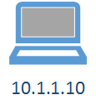
What is DNS resolution?
The process of mapping: www.a10networks. com => 191.236.103.221
…if the answer was cached

Slide 12
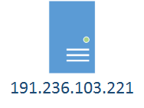
What is DNS reflection?
What happens if an attacker forges the victim address as its source?
…the reflected traffic goes to the target server
… and what if hundreds of misconfigured open DNS resolvers are used?

Slide 13
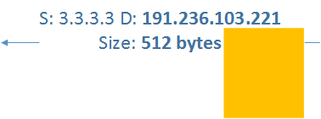
What is an amplification attack?
Asymmetric attack where the response is much larger than the original query

Slide 14
Amplification types
The ones that are of interest and provide reflections are:
DNS
NTP
SNMP
SSDP
What else?

Slide 15
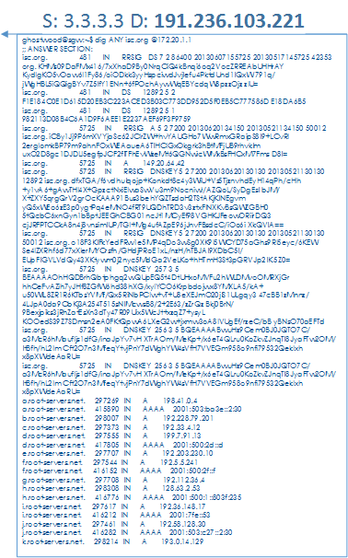
Reflection and Amplification

Slide 16
What is a subdomain attack?
Direct or Reflection attack where the intermediary and victim spend cycles on nonsense
S: 191.236.103.221 D: 3.3.3.3
What is the IP for
Xyz1234.www.cisco.com?
S: 3.3.3.31 D: 91.236.103.221
NXDOMAIN
Response to legitimate protocol query

Slide 17
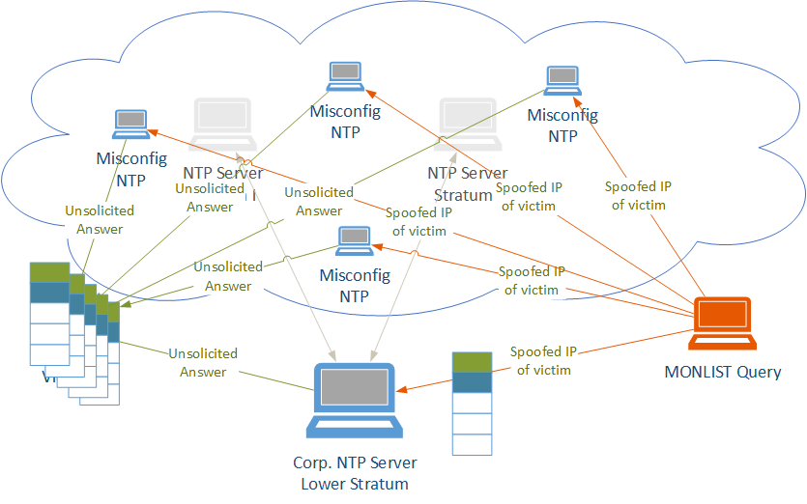
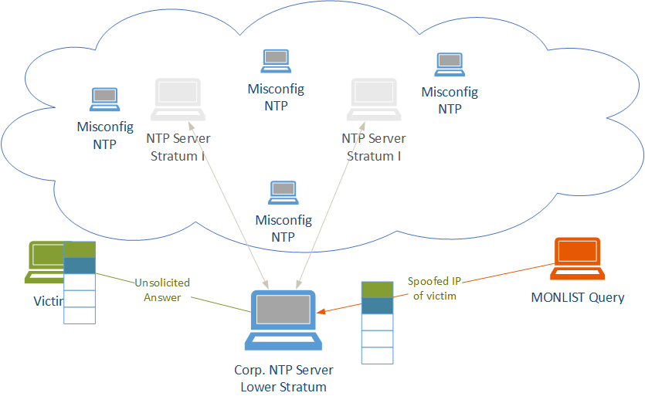
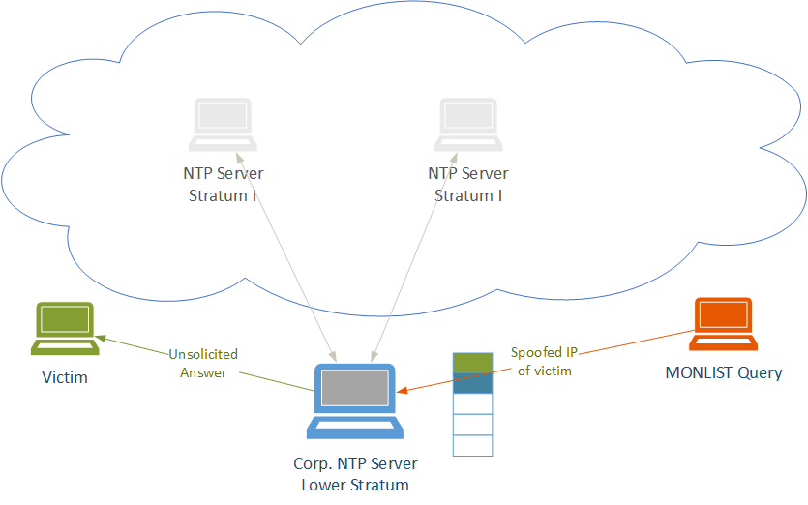
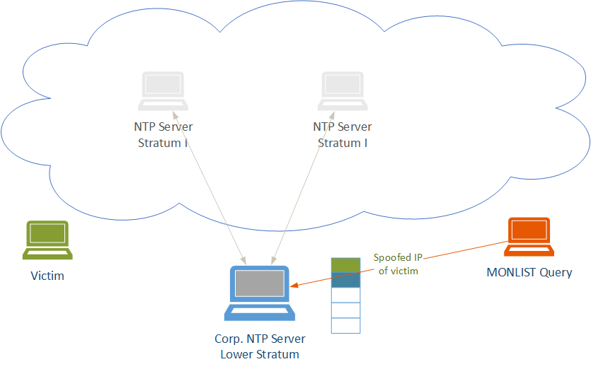
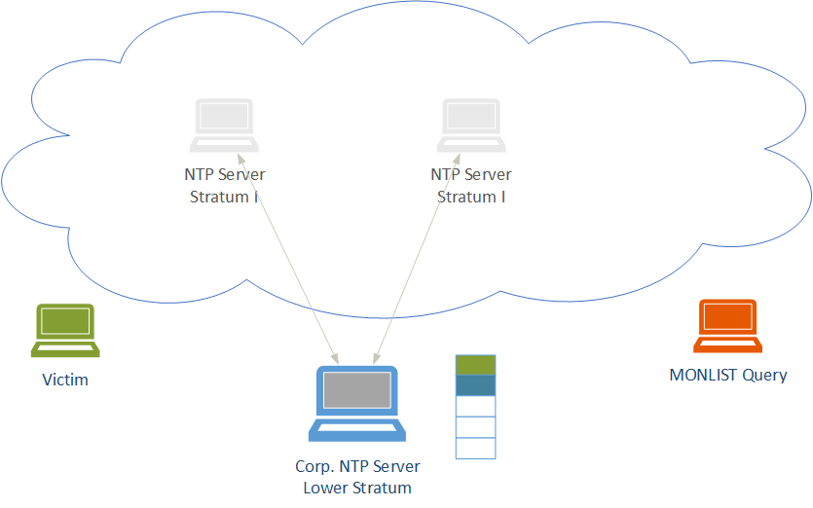
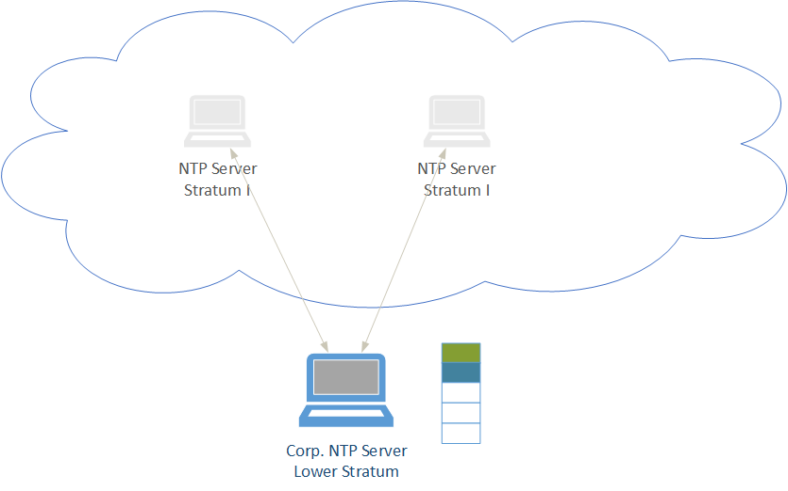
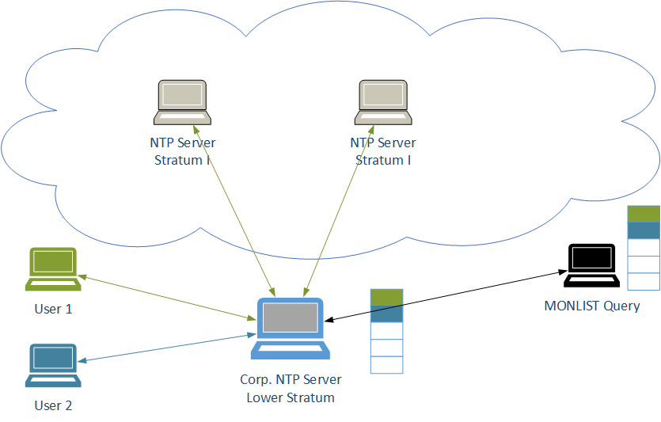
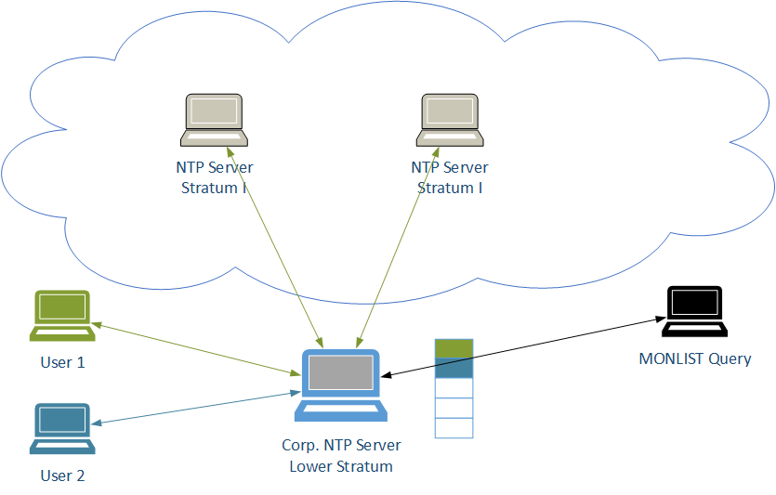
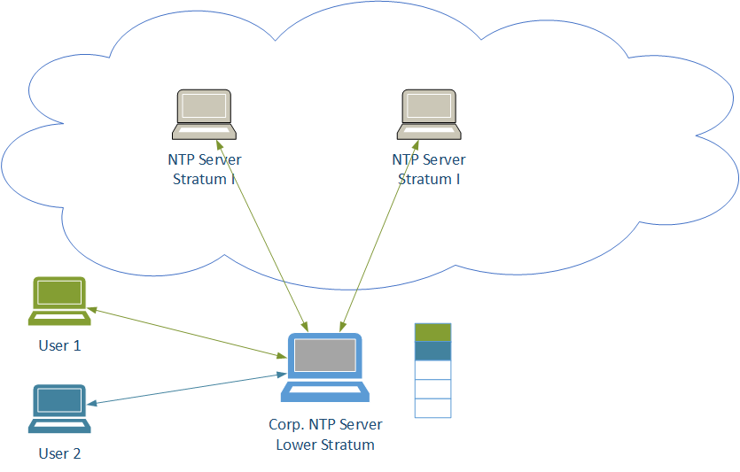
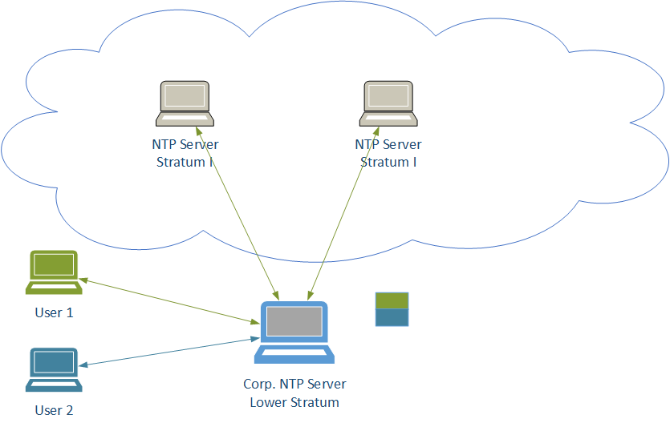
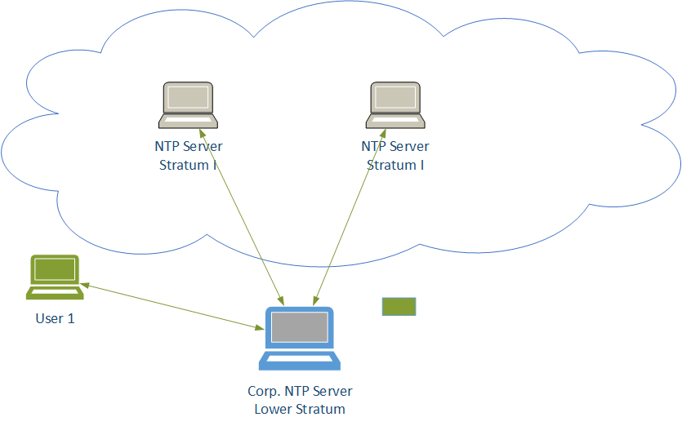
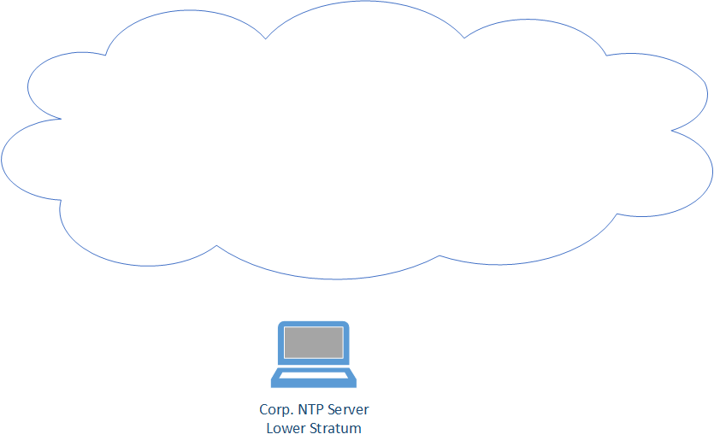
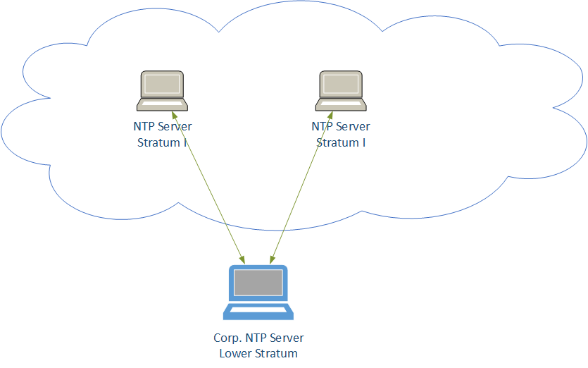
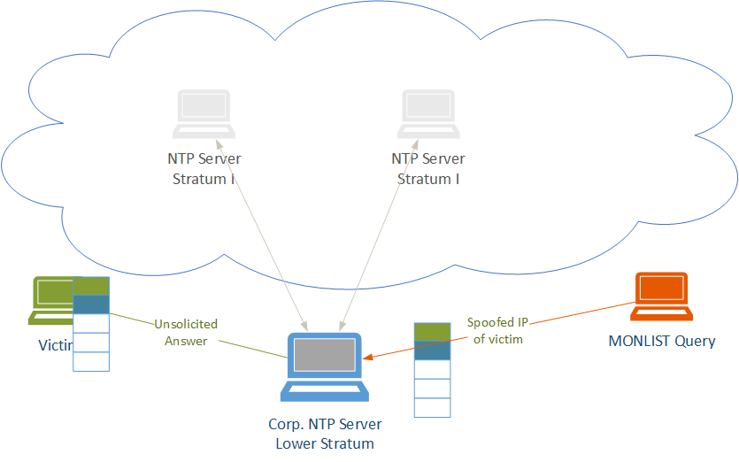
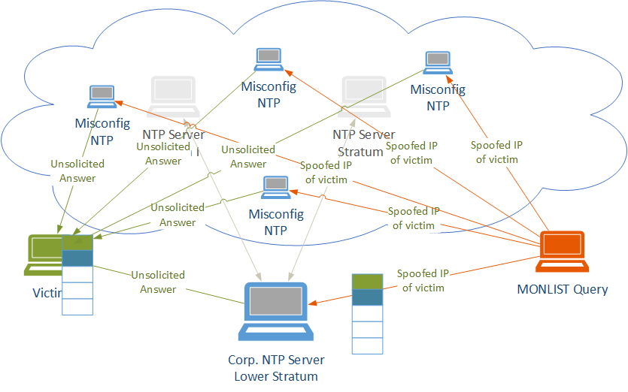
NTP servers
Stratum servers
NTP queries
MONLIST command
provides a list of clients that have time readings
What’s next?

Slide 18
Solution?
DNS “Any” Request Filtering
DNS “Any” requests can be used for a DDoS attack, since they occupy DNS server resources as the target server sends its many records to the requesters.
DNS Request Rate Limiting—by FQDN
IP address – Limits the rate of queries from a given source.
Requested domain name – Limits the rate of requests for the same domain name, from any sender, i.e. DNS Birthday attack
Scope for FQDN rate limiting– Specify how many labels of the FQDN to consider together when applying the rate limit
Maximum label length – Specify the maximum length for a given label within the FQDN, either at any suffix position or beginning at a specific suffix position.
DNS Request Rate Limiting—by Record Type
NXDomain Inspection and Rate Limiting

Slide 19
Solution?
Label Inspection and Label Length Limiting
Limit the label length of the FQDN after a number of suffixes
Anything greater than suffix x will be limited
Ddos template dns tp-dns
fqdn-label-length 15 suffix 2
fqdn-label-length 10 suffix 3
www.googlegooglegoogle.com
test.www.google.com
randominvalidstring.google.com Does not pass label length 15 after suffix 2 check
alongstring.www.google.com Passes label length 15 after suffix 2 check,
but does not pass label length 10 after suffix 3 check

Slide 20
Backscatter
What is backscatter and why do I care?
Traffic that is a by-product of the attack
Why is that interesting?
It is important to distinguish between the actual attack traffic and unintended traffic sent by the victim
Classify the attacker and victim differently

Slide 21
Metrics
Bandwidth (Kbps, Gbps)
PPS
QPS
Storage
CPU
Application specific – usually latency
Bad actors
Victims
Geo-temporal

Slide 22
Good Internet citizenship

Slide 23
Mitigations (Assumption – preaching to the converted)
Defend yourself
Anycast
Some form of IPS/DDoS mitigation gear – inline or asymmetric (service dependent or independent?)
Overall network architecture
Defend the Internet
Rate-limiting
BCP38/140 (outbound filtering) source address validation
Securely configured DNS, NTP and SNMP servers
No open resolvers
Talk to other security professionals like yourself
Talk to vendors like A10 Networks

Slide 24
Are you noticing the imbalance?
Defend yourself/your consumers
Defend the Internet
Anycast (DNS)
Some form of IPS/DDoS mitigation gear
Rate-limiting
BCP38/140 (outbound filtering) source address validation
Securely configured authoritative DNS servers
No open resolvers
Lots of money
Effective, scalable, faster to rollout
Somewhat cheap
More touch points, slower to rollout

Slide 25
What’s the point I’m trying to make?
It’s not feasible to mitigate those attacks single handedly all of the time
Companies need to start including “defending the Internet from themselves” as a part of their budget – not only “defending themselves from the Internet”
We need cooperation amongst Service Providers and Security Vendors
More can always be done, the war continues
Shared intelligence is key

Slide 26
In Summary (Assumption – this is part of your strategy already)
Evaluate the quick wins in your own network
RFC 2827/BCP 38
If possible filter all outgoing traffic and use proxy
BCP 140: “Preventing Use of Recursive Nameservers in Reflector Attacks”
Collaborate with your peers to raise the bar collectively
Use high-scale, high performance mitigation infrastructure that defends your network and gives your consumers and peers levels of protection that keep pace and exceed the pace of change
Use dedicated DDoS platforms that understand the in-the-wild attacks
Don’t exacerbate the situation, reduce the backscatter
Share the key metrics, KPIs and mitigation techniques (public forum?)

Slide 27
THANK YOU
www.a10networks.com

