Slide 1

Some thoughts on Automation
________________________________________
Andy Davidson Allegro Networks (an IIX Company)
@andyd on twitter Monday 20th April 2015
UKNOF31 Manchester, UK

Slide 2
Agenda
Somewhat wooly slides re: NetDevOps mindset
Potentially useful information about Netconf
Free Software you can run today!
Other automation frameworks to think about
An invitation to buy various circuits

Slide 3
This may be a little unstructured, sorry
I am a believer.

Slide 4
This may be a little unstructured, sorry
I am a believer in software.

Slide 5
This may be a little unstructured, sorry
I am a believer in software.
  Inevitable future of network orchestration
A few days work to build tools that help:
  Consistent decision making
  Consistent provisioning
  Consistent troubleshooting

Slide 6

Automation is not the product
Automation is the enabler
Consistency
Speed of Delivery
Ease of Support
Speed to integrate
Compliance
Integrated OSS/BSS
Confidence
Commodity
Devolved control

Slide 7
“Software first” mindset
Writing simple software will be a network engineer’s job tomorrow, as much as writing configuration is the job today

Slide 8


So where on earth can you start ?
Take one single (boring?) process and automate it out of existence
Don’t worry too much about your software quality on day one of the project
If your tool catches on, you’re binning the first iteration (so make it simple to bin!)
You are exclusively focussed on delivery, saving money, saving effort, removing pain, learning
Driven by a feedback loop

Slide 9
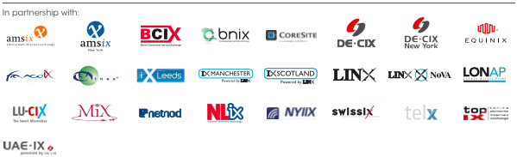
An example!
Over 30 IXPs (and growing)
Thousands of willing peers
Where do we have traffic and missing adjacencies?

Slide 10
What makes this a good example of a first step?
Experience reading from the network
  (If you start by writing then you’re writing all your mistakes to production config!)
It solves a real life problem/question so it has a feedback loop attached to it

Slide 11
Where to start with Netconf?
API to configure network devices
Manage configuration and state
XML RPC using SSH as transport
Mirrors device configuration, capabilities
Candidate configuration
Running configuration

Slide 12
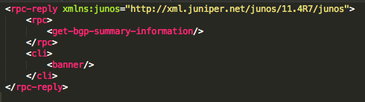

Slide 13
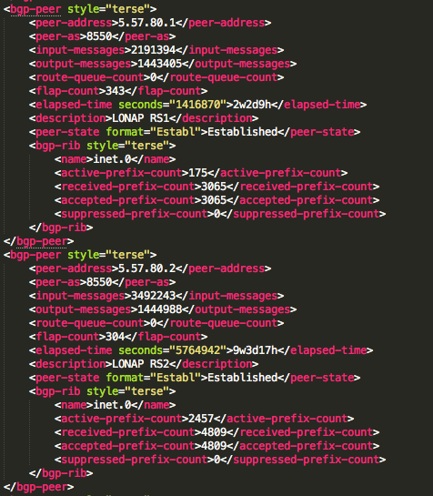

Slide 14
WTF IS XML?

Slide 15
What does it actually look like in your code ?
(using PyEZ – will explain shortly.)

Slide 16

Analyse it
“Make a list of peering session linknet IPs adjacent to Asxxxxx”

Slide 17
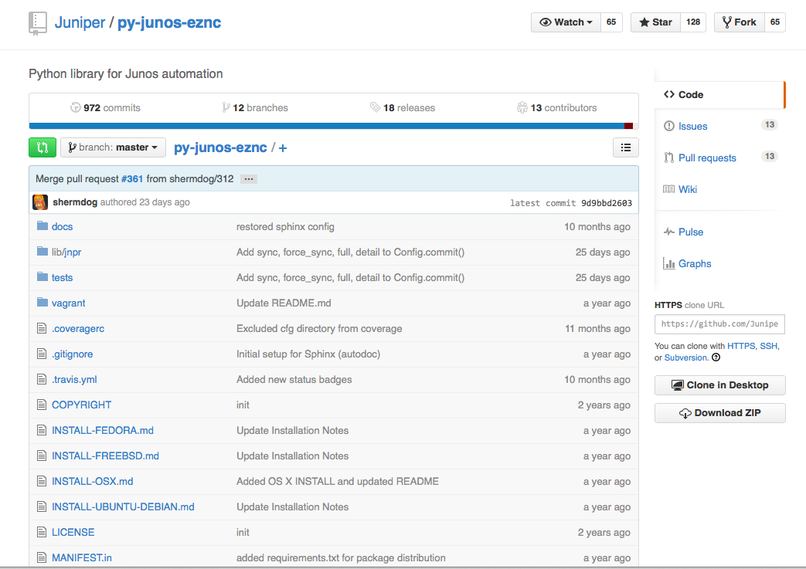
PyEZ ? Abstraction ?

Slide 18
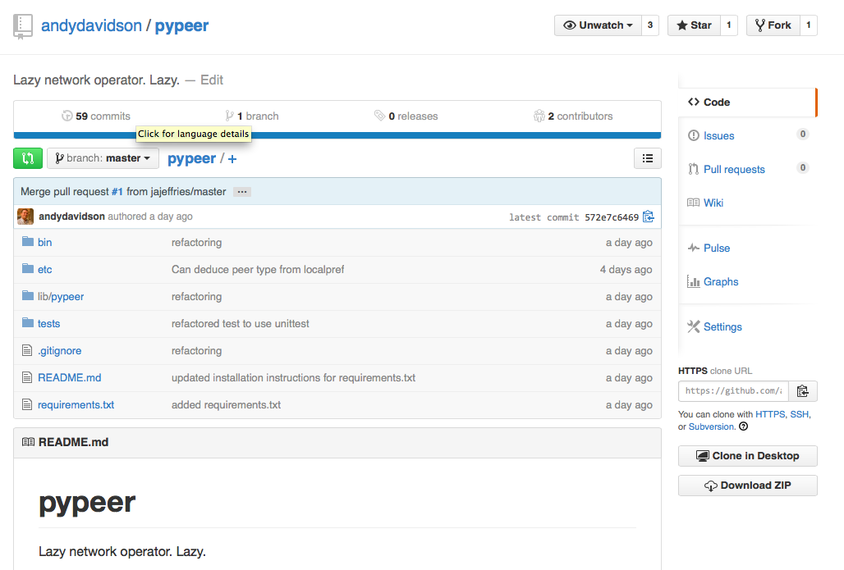
PyPeer, aiming to go a stage further

Slide 19

Zero effort extensions for PyEZ

Slide 20
When kit gets real
Consuming data from the real world as well as your routers.
Comparing your router’s view with the one in RIPE, Euro-IX DB, PeeringDB, etc.

Slide 21
When kit gets real
Consuming data from the real world as well as your routers.
Comparing your router’s view with the one in RIPE, Euro-IX DB, PeeringDB, etc.
I believe the youths call this a ‘mashup’

Slide 22
This is in PyPeer right now

Slide 23
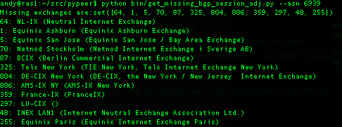
So how am I doing with my example need for sofware?

Slide 24
In other words
Version one of a network engineer’s script^H^H^H^H^Hoftware:
  Hack and stack
  Copy and paste
  Hemi-code stolen from stackoverflow.com
  Iterate and improve with feedback

Slide 25


Iterate, iterate, iterate

Slide 26
Netconf downsides
Although a “standard” quite vendor specific implementations
Requires entry level programming skill
Knowledge ends up living in scripts, not that portable.

Slide 27
Ansible
SSH + Python based orchestration
“Playbooks” written for tasks
Can be implemented across vendors
Designed for servers
  Mixed unix/network environments will love this!

Slide 28
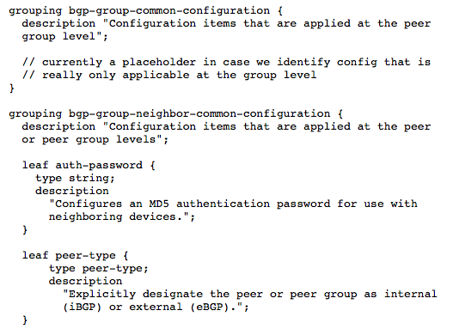
YANG
Modeling language for network configuration and state
  Think of it as config as code … as config. ☺
  YANG -> XML -> Device
  More Cross Platform
  Example draft-shaikh-idr-bgp-model-00

Slide 29
OpenFlow
“Holistic” network orchestration/management
  Arguably more scalable than scripts
  Arguably more likely to get cross-vendor support?
  Config as “apps”.

Slide 30
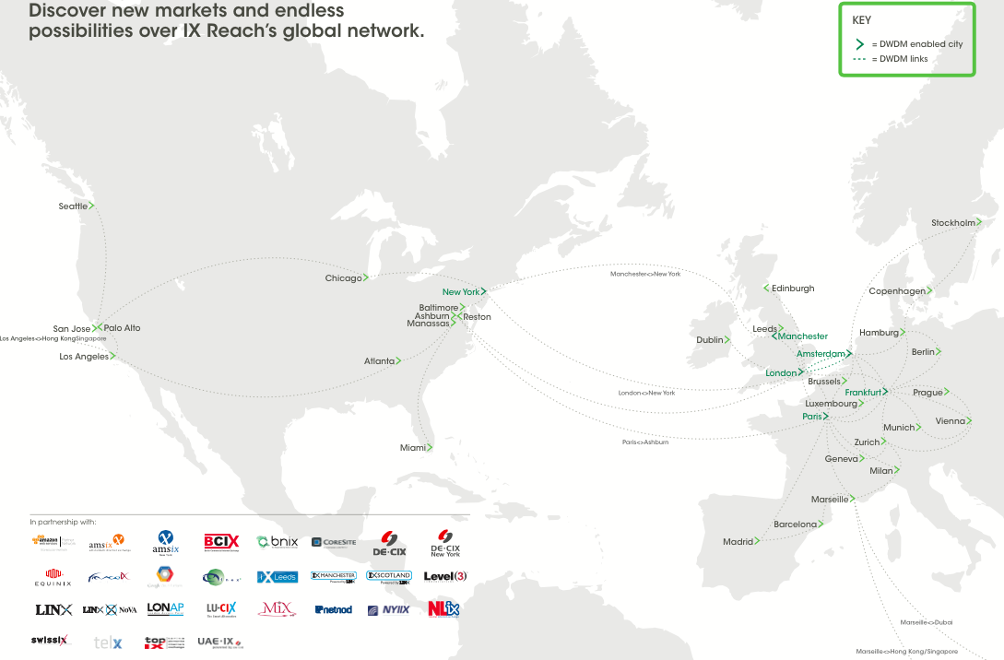

Slide 32
More information
www.ixreach.com
enquiries@ixreach.com
T: @andyd
adavidson@iix.net

