Slide 2
DNS-Based DDoS Evolving Threat UKNOF Sept 2015 Manchester, UK
Ralf Weber

Slide 3
Nominum Research
2 Terabytes of data analyzed per day
Anonymized from ISPs worldwide
Estimate about 3% of ISP DNS resolver traffic
Team of data scientists
Algorithms searching for:
DDoS
Bots
Malware
Machine generated traffic
Many other trends

Slide 4
DNS DDoS: Rapid Evolution
2012
Authorities see surge in DNS amplification
Resolvers see spikes in amplification
Open Resolver Project reports 30 M open resolvers
Open DNS proxies in home gateways discovered
“Purpose built” amplification domains
2013
Random subdomain attacks generate huge spikes
Attacks targeting popular domains (Alexa 1000).
Bot-based DNS DDoS malware
2014
Attackers refine their exploits - stealth
New attacks combine randomization & amplification
2015

Slide 5
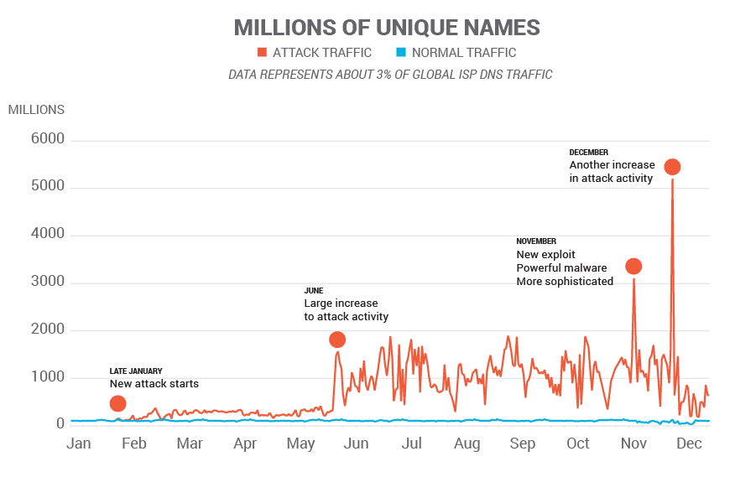
2014 Random Subdomain Attacks
2014 Data

Slide 6
2015 Random Subdomain Attack Activity
No big spikes
Concentrated attacks – observed as much as 8000QPS from a single IP
Identified as a surveillance camera!
Small number of IPs – 100-200 per attack
~100 IPs took down large network
Attacks seem to be stealthier

Slide 7
Typical “Day in the Life” DNS Queries Seen at a Resolver
DDoS
Other

Slide 8
Typical Day in The Life DDoS Queries Seen at a Resolver
Amplification
Random
Subdomain

Slide 9
Typical Day in The Life Random Subdomain Queries Seen at a Resolver
Queries per hour
www.bet16.com
888fy.com
888fy.com

Slide 10
An Hour in The Life Random Subdomain Queries Seen at a Resolver
Queries per second
www.bet16.com

Slide 11
A Few “Things” Generate Intense Attack Traffic
1 IP sourced ~ 9M queries
15 IPs sourced ~61M queries
200 IPs sourced ~83M queries
1
206
# IPs involved in attack

Slide 12
Diverse Attacks
4 major kinds of attacks
Early attacks used open DNS proxies in home gateways
Latest attacks use bot malware in home gateways and other “Things”
LOTS of other attack activity out in the long tail
Different Random Label Patterns = Different Attacks

Slide 13
Attacks Using Bots
Target
Web Site
Authoritative
Server
3
NXD
responses
Internet
Bot infected
devices
ISP
2
Recursive
queries
1
ISP Resolver
Queries
with randomized
subdomains
Home
Gateways

Slide 14
What’s Happening?
Network scans for vulnerable devices:
Home gateways or other “Things”
Attempts login with default passwords
Most consumer devices use Busybox:
Many utilities at the attackers disposal
Load and run malware
Other vectors possible: Bots with loaders, Rompager

Slide 15
Lots of Scanning Activity
TechWorld Feb 25, 2015
(translated from Swedish)
Note: “Attack” is scan
http://techworld.idg.se/2.2524/1.608986/50-000-attacker-per-dygn

Slide 16
Likely Source of Home Gateway Malware
Description of malware translated from Russian
Shows how busybox is used
http://vms.drweb.com/virus/?i=4242198

Slide 17
Bots Can also Load DDoS Malware And They’re Everywhere
Threat Type | Query Count
Spybot | 1,679,616
Vobfus | 925,323
Nitol | 883,376
Gamarue | 878,672
VBInject | 864,944
Spambot | 613,449
Ramnit | 418,984
Bladabindi | 90,486
Palevo | 60,324
Sdbot | 59,314
Threat Type | Query Count
Dorkbot | 52,935
Morto | 35,912
Sality | 35,711
Virut | 32,027
SMSsend | 16,000
Jeefo | 14,645
Gbot | 11,853
GameOver | 9,407
Phorpiex | 5,875
Buzus | 5,123
Bot queries on a typical day
Bots with loaders in RED

Slide 18
Attacks Cause Many Problems
Attacks on popular domains complicate filtering
Home Gateways mask spoofed source IP
Bots operate wholly within provider networks
Filtering DNS at borders won’t work
Observed tendency for cascading failures
RRL by authorities increases work for resolvers & authorities
This seems to have gone away for now

Slide 19
Remediation
Traditional approaches are ineffective
Filtering DNS (port 53) at borders
In-place DDoS equipment
Scripts
DNS defenses
Ingress filtering at resolvers
Rate limiting queries to authoritative servers

Slide 20
Testing efficiency of rate limiting
Authoritative
Server
Internet
Attack Traffic
ISP Resolver
User traffic

Slide 21
Setup for testing efficiency
Auth Server only answer a certain rate (e.g 100qps)
Normal User traffic gets 100% replies
Insert Attack Traffic
This will overflow the auth server rate
Measure good replies

Slide 22
Challenge: Protecting Good Traffic
Example: Recent attack on Amazon.co.uk
Blocking amazon.co.uk queries won’t work!
Blocklists and whitelists are needed

Slide 23
Protecting Good Traffic
Whitelist to protect legitimate queries
Blocklist to eliminate malicious traffic
www.appledaily.com.tw.
liebiao.800fy.com.
www.23us.com.
wuyangairsoft.com.
*. www.appledaily.com.tw.
*. liebiao.800fy.com.
*. www.23us.com.
*. wuyangairsoft.com.

Slide 24
Examples
Query: www.appledaily.com.tw.
Answered, protected by whitelist
Query: avytafkjad.www.appledaily.com.tw.
Blocked by blocklist
Query: www2.appledaily.com.tw.
Answered through normal resolution

Slide 25
Summary
Constant DNS Based DDoS evolution
Open Home Gateways remain a problem
Malware-based exploits create broad exposure
Not clear where attacks are headed
Evidence attackers refining techniues
Remediation needs to be undertaken with care

