Slide 1
UKNOF
September 2015

Slide 2
Ultrafast Broadband - recap
On 30th January 2015, Gavin Patterson announced our Ultrafast broadband vision
A Ten year vision of 500Mbps available across most of the UK
Supplemented by premium 1Gbps fibre broadband services for high-demand customers
© British Telecommunications plc 2015

Slide 3
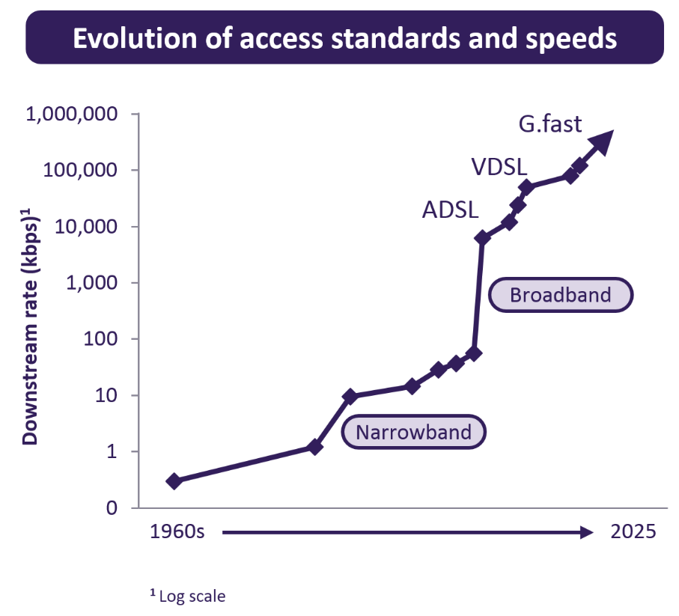
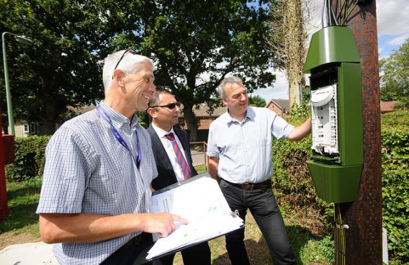
G.Fast – New technology delivering Ultrafast speeds
BT has been working to define international standards for a cutting-edge new technology - G.fast – for several years.
Our lab trials at Adastral Park in Suffolk have shown that G.fast is capable of delivering ultrafast speeds of several hundred megabits per second.
G.fast is therefore at the heart of BT’s ambitious plans to increase the speed of our access network.
© British Telecommunications plc 2015

Slide 4
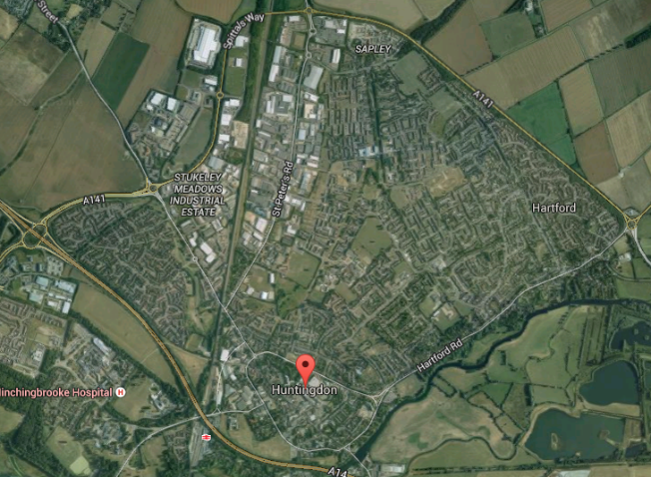
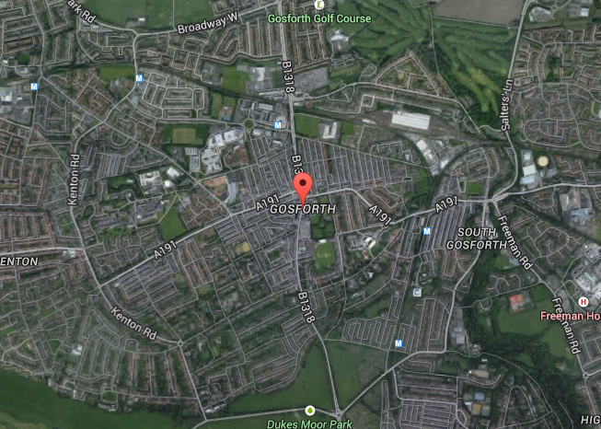
NGA2 Trials – proposal and update
Openreach have just started the trials of G.fast technology and NGA2 Fibre on Demand from August 2015
The trials are in Huntingdon, Cambridgeshire and Gosforth, Newcastle-upon-Tyne
Around 2000 premises will be covered in each trial area
Both services are being provided over dedicated paths to the customer premises, with an engineer install required for both NGA2 G.fast and NGA2 FOD.
The services will terminate on an Openreach supplied CPE, with CPs providing their own routers.
The service is delivered over dedicated infrastructure, with dedicated head ends, and cablelinks in the local exchange.
There is no impact on the customers existing services
Huntingdon
Gosforth
© British Telecommunications plc 2015

Slide 5
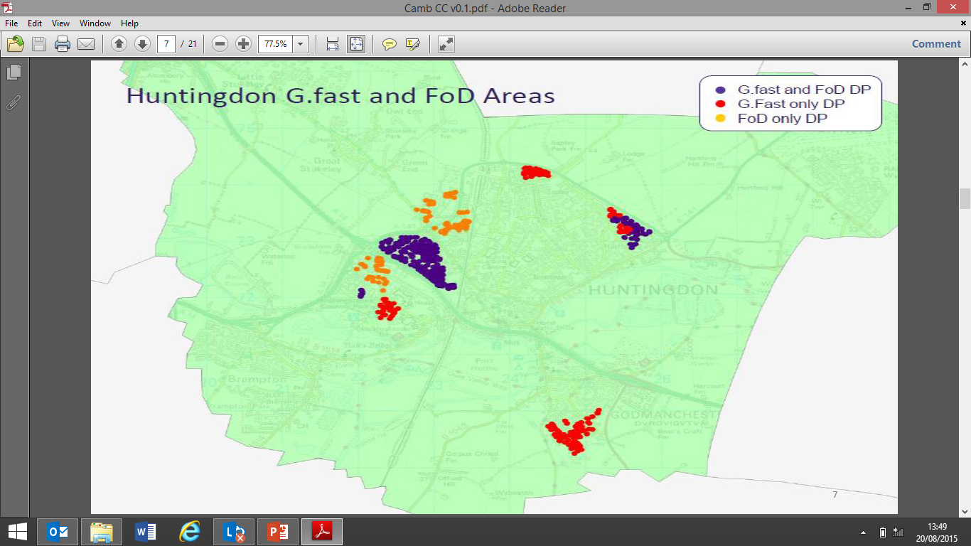
Trialling Ultrafast Broadband – a close up on Huntingdon’s role
Huntingdon has been chosen as the location for the first large-scale customer trial of Ultrafast Broadband technologies.
Openreach, BT’s local access network business, will pass 2000 homes and businesses with G.fast & NGA2 Fibre-to-the-Premises on Demand (FoD).
Because Openreach serves all communications providers equally, customers will have a choice of service provider.
© British Telecommunications plc 2015

Slide 6
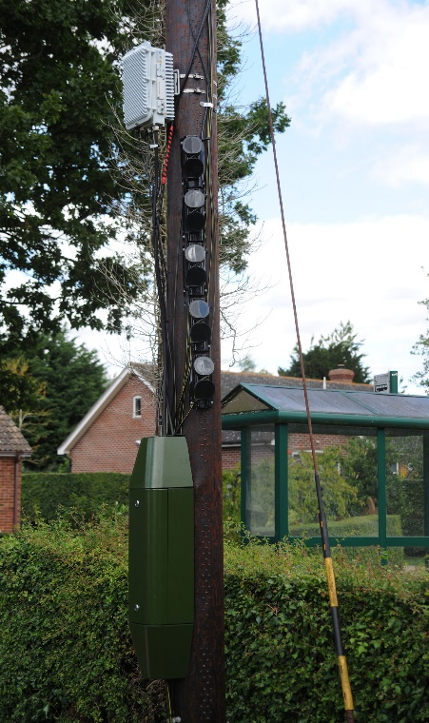
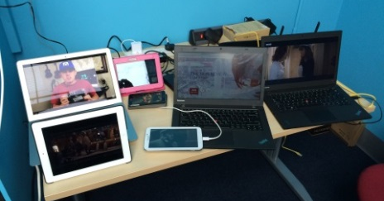
The 2 NGA2 Technology types being trialled
(1) NGA2 G.Fast
Up to 330 Mbit/s downstream
Up to 30 to 50 Mbit/s upstream
Downstream prioritised rate 80Mbit/s
Multicast enabled
(2) NGA2 Fibre on Demand (FOD)
Up to 1Gbit/s downstream
Up to 100 Mbits/s upstream
Downstream prioritised rate 100Mbit/s
Multicast enabled
© British Telecommunications plc 2015

Slide 7
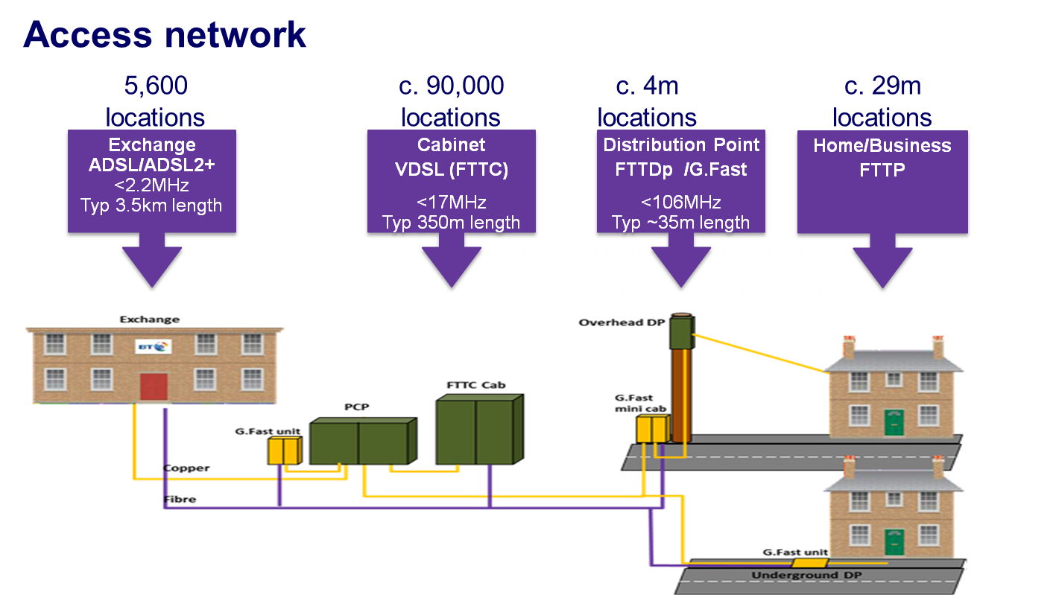
New technology delivering ultrafast fibre speeds
Openreach are seeking to verify the results of the G.fast laboratory tests from the Gosforth and Huntingdon trials , and understand the interplay between G.fast and NGA2 FoD in terms of G.fast unit locations.
G.fast can be deployed in a variety of locations depending on the network in a given area
Our NGA2 FoD trials will also further explore the use of different types of fibre deployment.
© British Telecommunications plc 2015

Slide 8
One of our early objectives was to engage with industry on the trial
Openreach have been keen to encourage CPs to partake in the trial, and we are pleased that Talk Talk group and BTW have been really engaged with us, upfront and early in the trial
Both Talk Talk group and BTW have drawn on their experience with customers to help us refine the trial, and offer early suggestions, including the use of spare pairs within our existing customer lead ins to help us better understand how G.fast works across our network.
Both CPs have helped us improve our interaction with them, understand their requirements from the technology, and work with us to improve our order journeys and fault identification.
BTW have also encouraged take up of their trial with their own customers, further increasing the potential take up and learning.
© British Telecommunications plc 2015

Slide 9
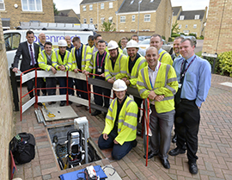
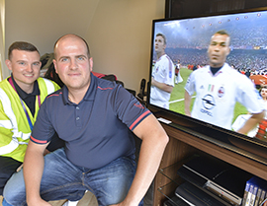
Progress to date and initial results from the trial
First customers connected on the 25th August.
Initial results very promising, and completely in line with our lab modelling.
Almost all customers connected so far are receiving 300Mbps +, and are capable of receiving higher speeds.
This is more than enough to watch multiple streams of 4k UHD TV, browse the internet and play games online, all at the same time.
Most customers connected so far are fairly close to the distribution point. We’ll be trialling G.fast over longer distances and from different points in the network as the trials progress.
We’ll also start to trial NGA2 FoD later in the year.
These results give us confidence that G.fast is an excellent technical solution to deliver ultrafast speeds to most homes.
Ultrafast website launched: http://www.ultrafast-openreach.co.uk/
© British Telecommunications plc 2015

