Slide 1
PNDA.io: when big data and OSS collide

Slide 2
Simplified OSS / BSS Stack
[Build Slide]
Customer
Order
Bills and Reports
BSS
Order Mgmt
Billing and Reporting
Orchestration is responsible for service provisioning and pushes state to the infrastructure
The “C” in FCAPS
OSS analytics is responsible for collecting data from the infrastructure, monitoring and analysis
Orchestration
OSS Analytics
OSS
Provisioning & Activation
Monitoring and analysis
The “F_APS” in FCAPS
Network and Services
Service
Data

Slide 3
OSS Analytics is becoming a big data problem!
Performance
Big data analytics-based
Small data analysis
Engineering effort (time)

Slide 4
What changes?
 | PMO | FMO
Orientation | Single domain | Cross domain
Realisation | Small data, tool driven | Big data, data driven
Data aggregation and analysis | Coupled | Decoupled
Domain Data Schema | Scheme-on-write | Schema-on-read
Analysis | Prescriptive | Prescriptive + Stochastic + ML
Customisation | Design time | Run time

Slide 5
Today’s siloed analytics pipelines
Tight coupling of data aggregation/store/ analysis
Multiple analytics pipelines implemented from open source components
Common design patterns ~75% of effort wasted / duplicated
Siloes limit the potential of big data analytics and lead to industry divergence
Logs
Kafka
Spark Streaming
Hbase
Impala
Metrics
Streamsets
HDFS
MapR
Query
Telemetry
Kafka
NiFi
Storm
Dashboard & Reporting
Data sources
Data aggregation
Data store
Data analysis
Outputs

Slide 6
What is PNDA? PNDA brings together a number of open source technologies to provide a simple, scalable open big data analytics Platform for Network Data Analytics Linux Foundation Collaborative Project based on the Apache ecosystem

Slide 7
PNDA
Simple, scalable open data platform
Provides a common set of services for developing analytics applications
Accelerates the process of developing big data analytics applications whilst significantly reducing the TCO
PNDA provides a platform for convergence of network data analytics
Processing
Query
Visualisation and Exploration
PNDA Applications
ODL
Real
-time
SQL Query
Data
Exploration
Unmnged
App
Logstash
Unmnged
App
Stream
OLAP Cube
Metric Visualisation
Data Distribution
OpenBPM
Batch
Search/ Lucene
Event Visualisation
PNDA Mnged App
pmacct
File Store
NoSQL
Time Series
PNDA Mnged App
XR Telemetry
PNDA Plugins
Platform Services: Installation, Mgmt, Security, Data Privacy
App Packaging and Mgmt
PNDA Producer API
PNDA Consumer API

Slide 8
PNDA
Horizontally scalable platform for analytics and data processing applications
Support for near-real-time stream processing and in-depth batch analysis on massive datasets
PNDA decouples data aggregation from data analysis
Consuming applications can be either platform apps developed for PNDA or client apps integrated with PNDA
Client apps can use one of several structured query interfaces or consume streams directly.
Leverages best current practise in big data analytics
Processing
Query
Visualisation and Exploration
PNDA Applications
ODL
Real
-time
SQL Query
Data
Exploration
Unmnged
App
Logstash
Unmnged
App
Stream
OLAP Cube
Metric Visualisation
Data Distribution
OpenBPM
Batch
Search/ Lucene
Event Visualisation
PNDA Mnged App
pmacct
File Store
NoSQL
Time Series
PNDA Mnged App
XR Telemetry
PNDA Plugins
Platform Services: Installation, Mgmt, Security, Data Privacy
App Packaging and Mgmt
PNDA Producer API
PNDA Consumer API

Slide 9
Why PNDA? There are a bewildering number of big data technologies out there, so how do you decide what to use? We've evaluated and chosen the best tools, based on technical capability and community support. PNDA combines them to streamline the process of developing data processing applications.

Slide 10
Why PNDA? Innovation in the big data space is extremely rapid, but combining multiple technologies into an end-to-end solution can be extremely complex and time-consuming PNDA removes this complexity and allows you to focus on developing the analytics applications, not on developing the pipeline – significantly reducing the effort required and time-to-value

Slide 11
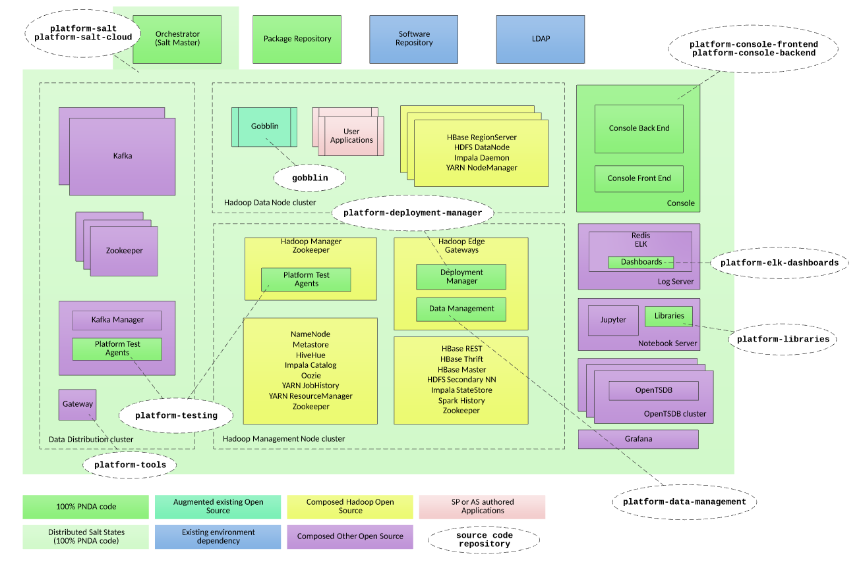
PNDA Software Components

Slide 12
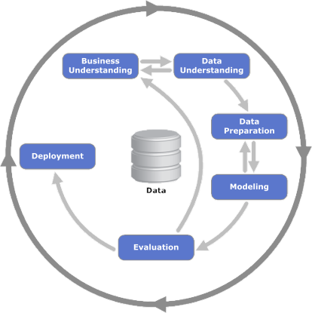
Design time vs. runtime
standard
pico

Slide 13
BGP meets ’Big-data’

Slide 14
Building the application
Domain expertise
Data science specialist
Web ‘full stack’ specialist

Slide 15
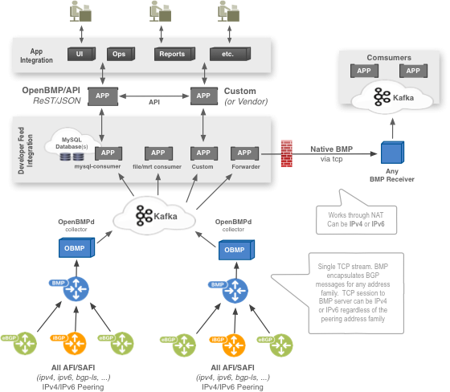
Architecture
Needs BGP Speakers with BMP protocol support
BMP session established between BGP Speakers and OBMP
Notes:
OpenBMP UI uses Angular. The widgets use angular-nvd3, which uses nvd3, which uses d3. D3 uses SVG for rendering

Slide 16
Architecture
Logstash required to perform ‘avro’ encoding of BMP data
BGP App runs as Batch job, running periodically
Notes:
OpenBMP UI uses Angular. The widgets use angular-nvd3, which uses nvd3, which uses d3. D3 uses SVG for rendering

Slide 17
What does this give us?
OBMP gives us the ability to record the dynamics of the Internet
PNDA platform enables
‘Raw’ event recording capability, with horizontal scaling (HDFS)
Run analysis over large data-sets with parallelism
Ask questions of the aggregate data about the Internet
Drill down analysis
Per-prefix
Per-AS
Per AS-Path

Slide 19
Potential
What can we do with large-scale collection of historical event information?
Event impact analysis –
Stability
Security
Misconfiguration
Application of ML/DL to data-set
Pattern-detection and network ‘weather forecasting’

