Slide 1
Decoding Major Internet Outages in 2017
Nitin Nayar
Senior Solutions Engineer

Slide 2
AGENDA
3 Major Outages from 2017:
Marketo DNS
AWS S3 outage
Rostelecom Route Leak

Slide 3
What happens when Domain Name expires?
The Marketo Story

Slide 4
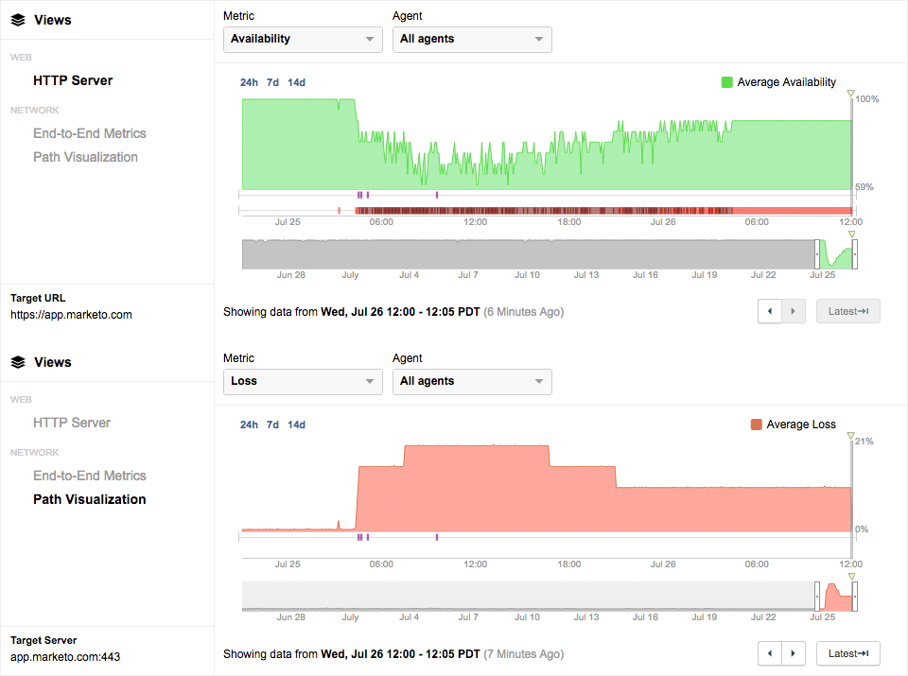
Marketo’s Domain Name Expiry
On July 25th at 4:25am PST, Marketo’s main domain started experiencing an outage
HTTP Availability dipped to 60-70%
Network packet loss ~20%
ShareLink: https://ciuvrxmw.share.thousandeyes.com

Slide 5
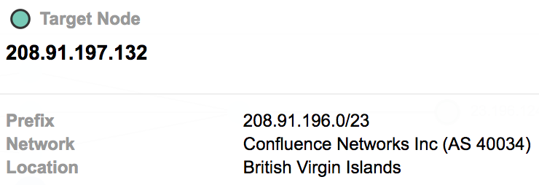
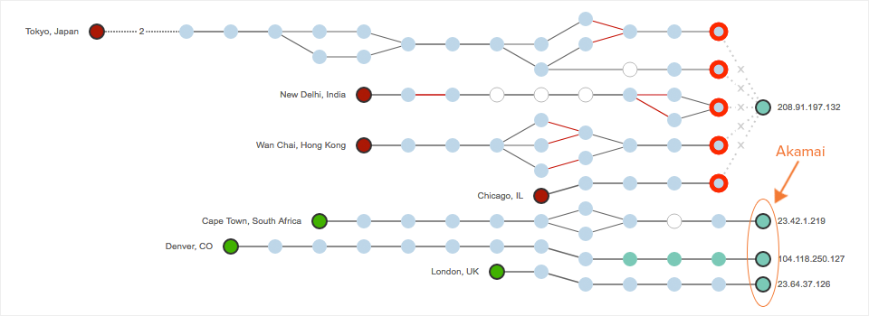
Marketo’s Domain Name Expiry
Why is Traffic being sent to AS 40034- Confluence Networks?

Slide 6
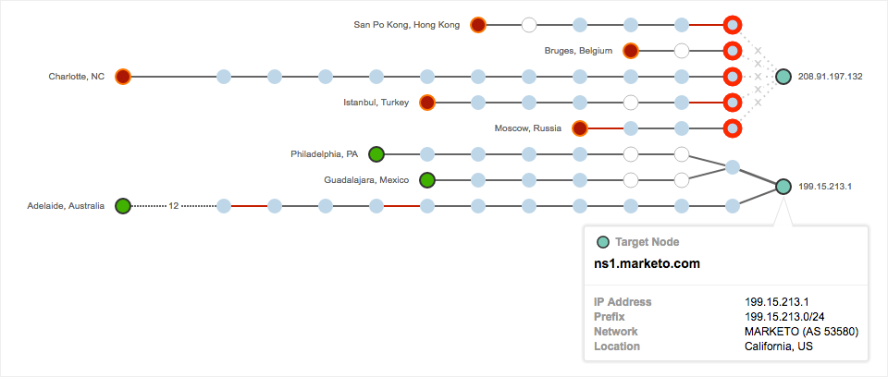
Marketo’s Domain Name Expiry
DNS Network Topology
Marketo has 2 DNS servers: ns1.marketo.com & ns2.marketo.com
Why is there a NEW DNS Server: 208.91.197.32?
ShareLink: https://gmhux.share.thousandeyes.com
Notes:
DNS Server tests were setup to the CNAME servers for app.marketo.com
CNAME authoritative servers: ns1.marketo.com and ns2.marketo.com -> Resolving to the same bogus IP address we saw in the previous slide (but that was app.marketo.com)

Slide 7
Marketo’s Domain Name Expiry
WHOIS Lookup
Nameservers used by “Network Solutions” for expired domains.
Notes:
At the beginning of the Marketo outage, we performed a WHOIS lookup for marketo.com and got some interesting results. First note that the creation and expiration dates both occur on July 23rd. This outage occurred on July 25th, which is suspiciously close to that date. Because domain name renewals generally occur on annual or multi-year cycles, it’s likely that the Marketo domain expired on July 23, 2017.
As further evidence of expiration, Marketo’s nameservers are listed as ns1.pendingrenewaldeletion.com and ns2.pendingrenewaldeletion.com. These are the nameservers that the registrar, Network Solutions, uses for domains that have expired. After querying these two nameservers for random domain names, we found that they always return the same IP address in Confluence Networks (208.91.197.132) that we saw previously, regardless of the domain name.
Based on war stories from a similar event in 2013, Network Solutions transfers expired domains to their partner, Confluence Networks, in order to monetize the traffic sent to those expired domain names. This is exactly what we saw: when Marketo’s domain expired, Network Solutions changed their nameservers to ns1.pendingrenewaldeletion.com and ns2.pendingrenewaldeletion.com, which direct traffic to one specific IP address in Confluence Networks (208.91.197.132).

Slide 8
Marketo Outage Root Cause Summary
Outage was a direct result of “marketo.com” domain name expiry
On expiry, traffic to Marketo was black-holed in a new network belonging to “Confluence Networks”

Slide 9
AWS S3 Outage

Slide 10
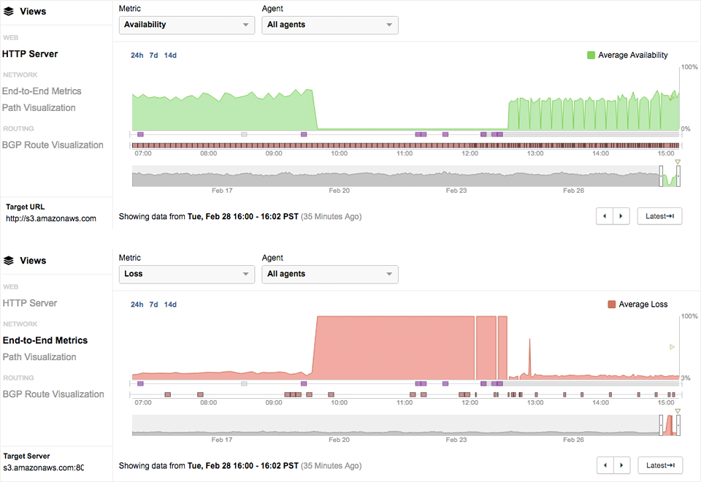
AWS S3 Outage
AWS S3 (US-East Region) experienced a massive outage on Feb 28th between 9:40am – 12:36am PST
Impact of the outage was widespread disrupting multiple services like Quora, Coursera, Docker and Down Detector
The outage highlighted the dependency across various AWS services
ShareLink: https://gokahptkc.share.thousandeyes.com
Notes:
AWS S3 (Simple Storage Service) is a cloud object storage solution that many services rely on to store and retrieve files from anywhere on the web. In addition, many other AWS services that depend on S3 — Elastic Load Balancers, Redshift data warehouse, Relational Database Service and others — also had limited to no functionality.
Highligthing the dependency across AWS services and the interworkings of the services.

Slide 11
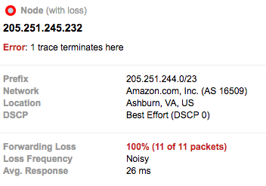
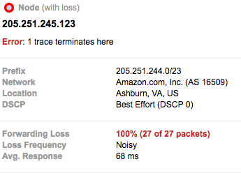
AWS S3 Outage Root Cause Analysis
100% Packet Loss / Complete loss of TCP connectivity
Root Cause: Human error that mistakenly took down more servers than intended.
Notes:
Services may rely on S3 in a variety of ways:
A service may be directly hosted on S3, in the case of static websites. These services’ fates are tied to S3’s — during the outage, these services would have suffered a complete outage.
A service may have objects on its web pages that are hosted on S3. In this case, the service would not be completely unavailable, but certain objects served out of S3 may be unable to load, and page load times may be impacted.
A service may have critical sub-services (such as user session management, customer records or media files) that depend on S3 or other impacted AWS services. This might manifest itself as a complete outage or reduced functionality.
As a result, the many affected services’ failure modes during the AWS S3 outage turned out to be telling indicators of the ways in which they rely on Amazon’s services.

Slide 12
Rostelecom BGP Route Leak

Slide 13
Rostelecom BGP Route Leak
On April 26th between 22:36-22:43 UTC, Rostelecom, (Russia’s largest ISP) leaked dozens of routes
The affected IP prefixes belonged to financial services firms, e-commerce and payment services
136 prefixes affected (36 belonged to financial companies)
Mastercard SecureCode, Smart Data and MasterPass
Verified by Visa and Visa-owned CardinalCommerce
Symantec WebSecurity and Geotrust
RSA’s email servers
Online banking sites for French banks BNP Paribas and CIT, and Polish Bank Zachodni owned by Santander
Traffic to indented destinations was steered through Rostelcom’s network
Notes:
Notes:
- Of these 137 prefixes, approximately 100 belong to organizations in Russia and, as such, likely as part of normal network operations. However, 36 prefixes belonged to companies such as Symantec, Visa, Mastercard, BNP Paribas and EMC.

Slide 14
Rostelecom BGP Route Leak
Rostelecom (AS 12389) advertised and withdrew routes to its neighbors
Peers such as Cogent (AS 174), Hurricane Electric (AS 6939) and Tata (AS 6453) accepted these routes and propagated them across the Internet.
Notes:
Rostelecom (blue dotted circle) advertised and then withdrew routes (red dotted lines). Route Monitors (diamonds) in orange and red were impacted, while those in green continued sending traffic to the legitimate origin network (green circle).

Slide 15
Rostelecom BGP Route Leak
Traffic from Canada steered through Rostelecom’s network, and going over 60+ intermediate hops!
Notes:
Correlating Traffic with Routes
ThousandEyes data includes not just routing information but also the traffic path taken by IP packets across the Internet in a view called Path Visualization. You can see in Figure 2 that traffic entered the Rostelecom network and then returned back out to the destination network, in this case via Cogent in Stockholm. But Rostelecom took the traffic for a ride, through 60+ interfaces in what was either an unintentional routing loop or a very intentional series of devices to inspect the traffic. You can see these as the white, unresponsive, interfaces in the visualization.

Slide 16
References
AWS S3 Outage
ShareLink: https://gokahptkc.share.thousandeyes.com
AWS Root Cause Analysis- ThousandEyes Blog: https://blog.thousandeyes.com/aws-s3-outage-likely-caused-by-internal-network-issue/
Marketo:
ShareLink-HTTP: https://ciuvrxmw.share.thousandeyes.com
ShareLink-DNS: https://gmhux.share.thousandeyes.com
Marketo Root Cause Analysis- ThousandEyes Blog: https://blog.thousandeyes.com/what-happened-when-marketos-domain-name-expired/

Slide 17
Thank You

