Slide 1
Detecting UK ISP Filtering
UKNOF 38
12 September 2017
Sheffield, UK

Slide 2
Who am I
Gareth Llewellyn
@NetworkString
Hats:
AS28715
Dedicated ISP for operating UK Tor Exits
Open Rights Group Technical Volunteer (I am in no way an official representative of ORG)

Slide 3
Brief History of UK Net Censorship
Jun 2004 BT Introduces CleanFeed

Slide 4
CleanFeed

Slide 5
CleanFeed

Slide 6
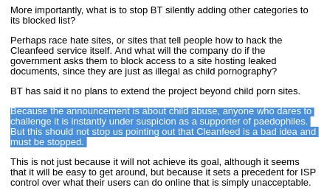
CleanFeed Immediately identified as slippery slope

Slide 7
Brief History of UK Net Censorship
Jun 2004 BT Introduces CleanFeed
~ 2005 OFCOM publishes mobile ‘framework’
https://www.ofcom.org.uk/research-and-data/media-literacy-research/childrens/ukcode

Slide 8
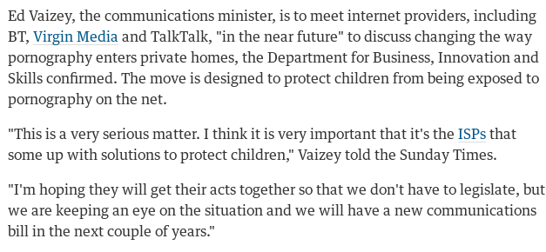
Brief History of UK Net Censorship
Jun 2004 BT Introduces CleanFeed
~ 2005 OFCOM publishes mobile ‘framework’
Dec 2010 Gov threatens to legislate blocks
https://www.theguardian.com/society/2010/dec/19/broadband-sex-safeguard-children-vaizey

Slide 9
Brief History of UK Net Censorship
Jun 2004 BT Introduces CleanFeed
~ 2005 OFCOM publishes mobile ‘framework’
Dec 2010 Gov threatens to legislate blocks
Oct 2011 MPA wins High Court Ruling against BT

Slide 10
Brief History of UK Net Censorship
Jun 2004 BT Introduces CleanFeed
~ 2005 OFCOM publishes mobile ‘framework’
Dec 2010 Gov threatens to legislate blocks
Oct 2011 MPA wins High Court Ruling against BT

Slide 11
Brief History of UK Net Censorship
Jun 2004 BT Introduces CleanFeed
~ 2005 OFCOM publishes mobile ‘framework’
Dec 2010 Gov threatens to legislate blocks
Oct 2011 MPA wins High Court Ruling against BT
Feb 2012 Another High Ruling (PirateBay)

Slide 12
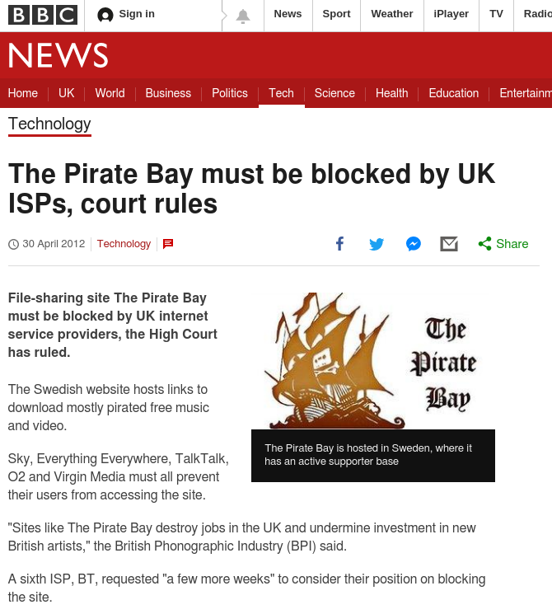
Brief History of UK Net Censorship
Jun 2004 BT Introduces CleanFeed
~ 2005 OFCOM publishes mobile ‘framework’
Dec 2010 Gov threatens to legislate blocks
Oct 2011 MPA wins High Court Ruling against BT
Feb 2012 Another High Ruling

Slide 13
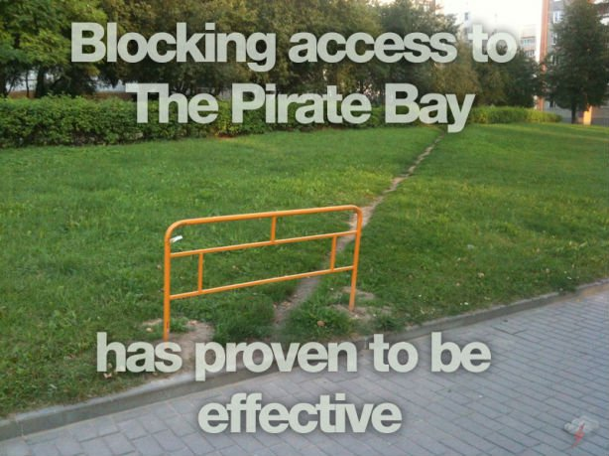
Google Image Search: Pirate Bay Block

Slide 14
Brief History of UK Net Censorship
Jun 2004 BT Introduces CleanFeed
~ 2005 OFCOM publishes mobile ‘framework’
Dec 2010 Gov threatens to legislate blocks
Oct 2011 MPA wins High Court Ruling against BT
Feb 2012 Another High Ruling (PirateBay)
Jan 2014 Large UK ISPs enable “Parental Filters”

Slide 15
Poor Uptake
By July 2014 most customers were ignoring it;
5% of new BT customers signed up
8% opted in for Sky
4% for Virgin Media.
TalkTalk rolled out a parental-control system two years before the government required it and has had much better take-up of its offering, with 36%

Slide 16
Brief History of UK Net Censorship
Jun 2004 BT Introduces CleanFeed
~ 2005 OFCOM publishes mobile ‘framework’
Dec 2010 Gov threatens to legislate blocks
Oct 2011 MPA wins High Court Ruling against BT
Feb 2012 Another High Ruling (PirateBay)
Jan 2014 Large UK ISPs enable “Parental Filters”
Jul 2014 Blocked.org.uk re-launches

Slide 17
Brief History of UK Net Censorship
Jun 2004 BT Introduces CleanFeed
~ 2005 OFCOM publishes mobile ‘framework’
Dec 2010 Gov threatens to legislate blocks
Oct 2011 MPA wins High Court Ruling against BT
Feb 2012 Another High Ruling (PirateBay)
Jan 2014 Large UK ISPs enable “Parental Filters”
Jul 2014 Blocked.org.uk re-launches
Apr 2017 The Digital Economy Act 2017 is law

Slide 18
Digital Economy Act 2017
23 Regulator’s power to require internet service providers to block access to material
(1)Where the age-verification regulator considers that a person (“the non-complying person”) is—
(a) contravening section 14(1), or
(b) making extreme pornographic material available on the internet to persons in the United Kingdom,
it may give a notice under this subsection to any internet service provider.
(2) The notice must—
(a) identify the non-complying person in such manner as the age-verification regulator considers appropriate;
(b) state whether it is subsection (1)(a) that applies or subsection (1)(b) or both;
(c) require the internet service provider—
(I) to take steps specified in the notice, or
(ii) (if no such steps are specified) to put in place arrangements that appear to the provider to be appropriate, so as to prevent persons in the United Kingdom from being able to access the offending material using the service it provides;
(d) provide such information as the regulator considers may assist the internet service provider in complying with any requirement imposed by the notice;
(e) provide information about the arrangements for appeals to which section 16(6)(d) applies;
(f) provide such further particulars as the regulator considers appropriate.

Slide 19
Blocked.org.uk Launch Video
https://youtu.be/60eKauWFFPk

Slide 20
July 2014 - Blocked.org.uk

Slide 21
July 2014 - Blocked.org.uk
Nov 2013 - Bowdlerize.co.uk

Slide 22
Bowdlerize.co.uk
Thomas Bowdler (11 July 1754 – 24 February 1825) was an English physician best known for publishing a version of Shakespeare that was more appropriate for 19th century women and children than the original.
The eponymous verb bowdlerise (or bowdlerize) has associated his name with the censorship of elements deemed inappropriate for children

Slide 23
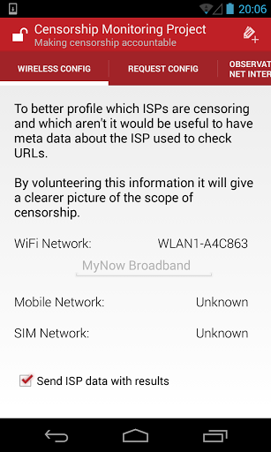
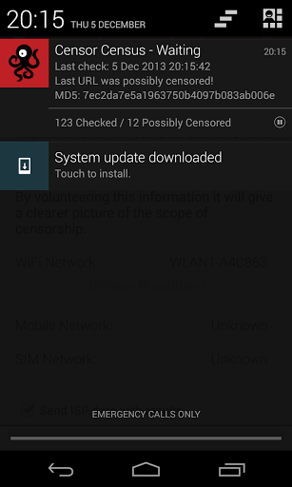
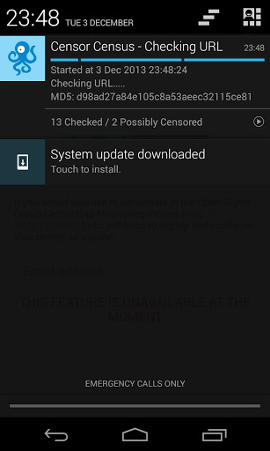
Bowdlerize.co.uk

Slide 24
Bowdlerize.co.uk
Concerns about building a “shopping list” of ‘illegal’ websites
Concerns from users about “being put on a list”
Concerns of legality regarding Copyright Designs and Patents Act

Slide 25
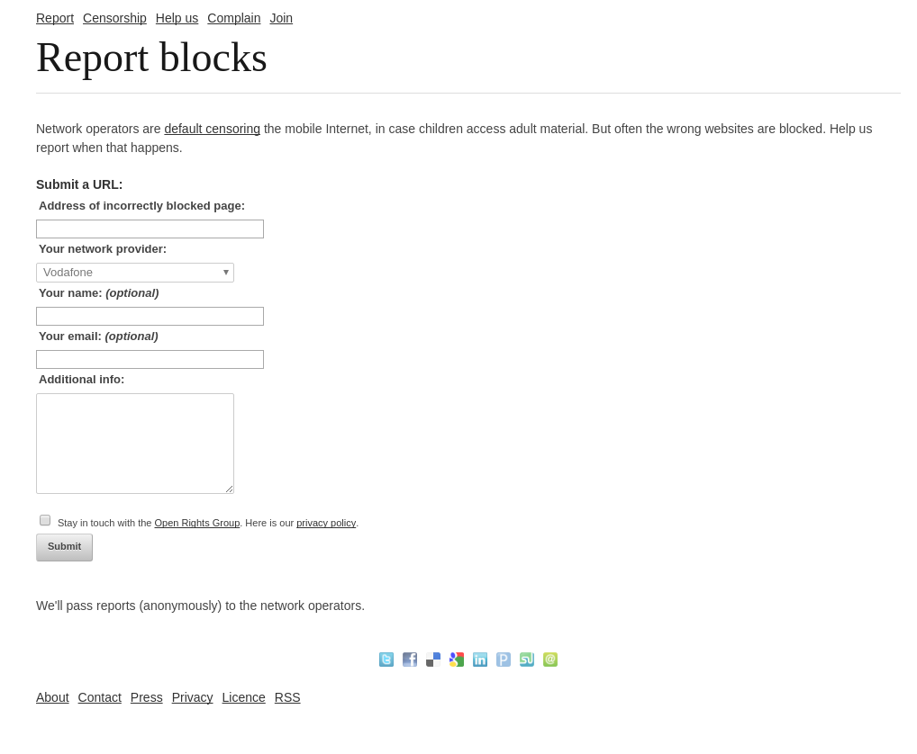
Found Blocked.org.uk
Checked each URL manually on a phone

Slide 26
Bowdlerize.co.uk > blocked.org.uk
Donated all code (server side and client side) to Open Rights Group

Slide 27
Blocked.org.uk How It Works

Slide 28
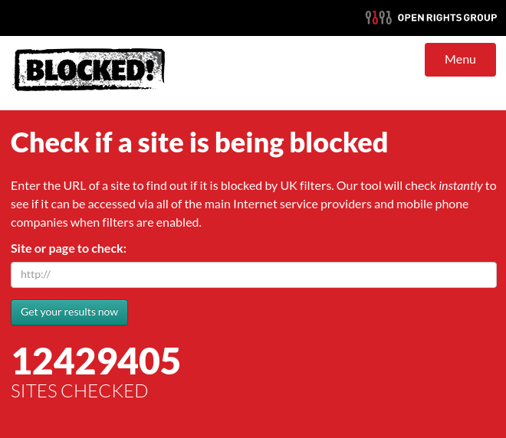
blocked.org.uk
Raspberry PI
BT
3
Sky
TT

Slide 29
blocked.org.uk
BT
3
Sky
TT

Slide 30
blocked.org.uk
DB
BT
3
Sky
TT

Slide 31
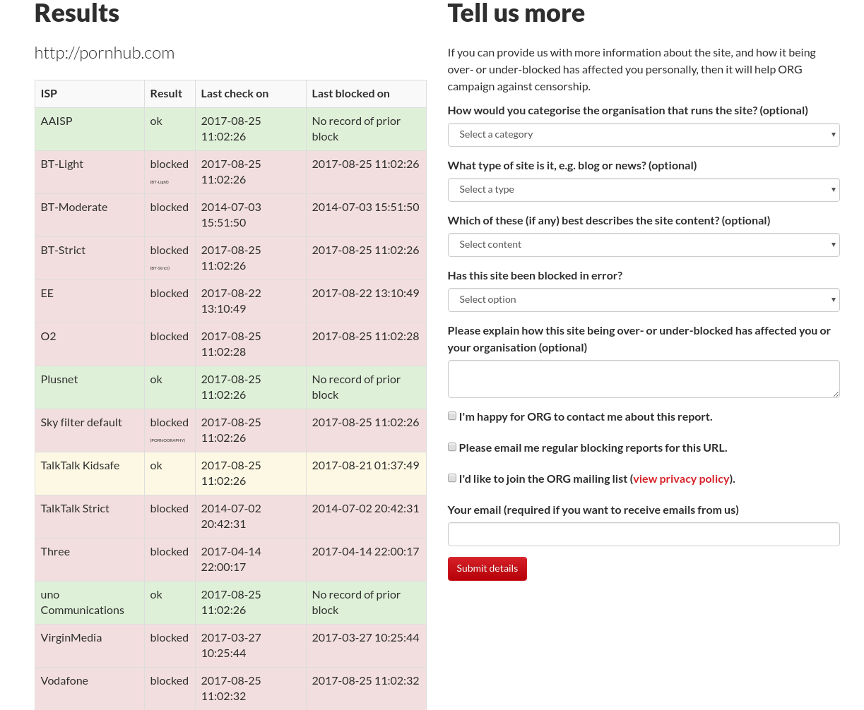
blocked.org.uk
DB

Slide 32
blocked.org.uk
DB

Slide 33
Detection https://github.com/openrightsgroup/Blocking-Middleware/tree/master/config
{
"rules": [
{
"isp": "Name of ISP1",
"match": [
"regex",
]
},
{
"isp": "Name of ISP2",
"match": [
"regex",
]
}
]
}

Slide 34
Detection - Mobile
T-Mobile:
http://www.t-mobile.co.uk/service/wnw-mig/entry/
http://tmobile.ee.co.uk/common/system_error_pages/outage_wnw.html
http://ee-outage.s3.amazonaws.com/outage-v1/outage-v1.html
http://ee-outage.s3.amazonaws.com/content-blocked/content-blocked-v1.html
EE:
http://www.t-mobile.co.uk/service/wnw-mig/entry/
http://tmobile.ee.co.uk/common/system_error_pages/outage_wnw.html
http://ee-outage.s3.amazonaws.com/outage-v1/outage-v1.html
http://ee-outage.s3.amazonaws.com/content-blocked/content-blocked-v1.html
http://ee-outage.s3.amazonaws.com/content-blocked/content-blocked-nobranding.html
https://myaccount.ee.co.uk/anonymous-content-lock
Vodafone:
http://online.vodafone.co.uk/dispatch/Portal/ContentControlServlet?type=restricted
http://online.vodafone.co.uk/en_GB/assets/static/contentcontrol/branded/restricted_access.html
http://online.vodafone.co.uk/en_GB/assets/static/contentcontrol/unbranded/restricted_access.html

Slide 35
Detection – Fixed Line (Why we use regex)
"re:url:^http://blockpage\\.bt\\.com/pcstaticpage/blocked\\.html",
"re:url:^http://www\\.ukispcourtorders\\.co\\.uk/",
"re:body:^<p> Error \\- site blocked </p>",
"re:body:^<p> Error .*? site blocked</p>"

Slide 36
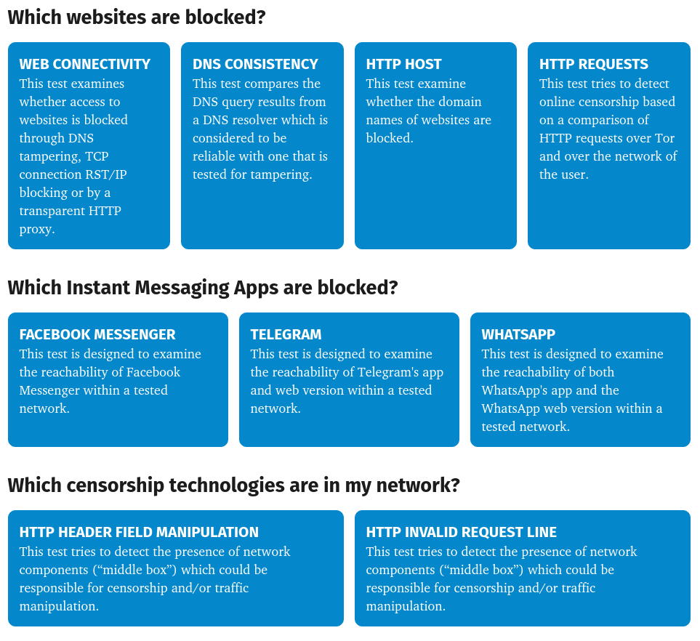
OONI (Open Observatory of Network Interference)

Slide 37
OONI Web Connectivity
DNS blocking: If the DNS responses (such as the IP addresses mapped to host names) do not match
TCP/IP blocking: If a TCP session to connect to websites was not established over the network of the user
HTTP blocking: If the HTTP request over the user’s network failed, or the
**HTTP status codes don’t match, or all of the following apply:
The body length of compared websites (over the control server and the network of the user) differs by some percentage
The HTTP headers names do not match
The HTML title tags do not match

Slide 38
OONI DNS consistency
Tests Google DNS
Tests ISP
Intercepted by the likes of Nominum etc so relies on additional tests / control server
GeoDNS etc also leads to false positives

Slide 39
OONI HTTP Host Header
Is the host name blocked?
detect the presence of “middle boxes”
assess which censorship circumvention techniques are capable of bypassing the censorship
This test implements a series of techniques which help it evade getting detected from censors and then uses a list of domain names (such as bbc.co.uk) to connect to an OONI backend control server.

Slide 40
OONI HTTP Request Comparison
Body length
The HTTP request over the user’s network fails
The HTTP headers do not match
Fails when Tor Exit is discriminated against (e.g. CloudFlare Captcha)

Slide 41
OONI HTTP Header Manipulation
HTTP headers with variations in capitalization.
Such requests are sent to a backend control server which echos back
Like for like echo is good
Iinterception software will likely normalize the invalid headers that we are sending or add extra headers.

Slide 42
OONI HTTP invalid request line
Instead of sending a normal HTTP request, this test sends an invalid HTTP request line - containing an invalid HTTP version number, an invalid field count and a huge request method – to an echo service listening on the standard HTTP port.

Slide 43
Why bother?

Slide 44
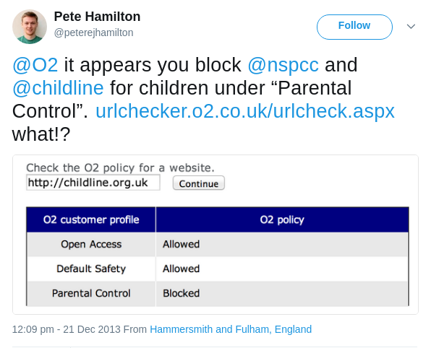
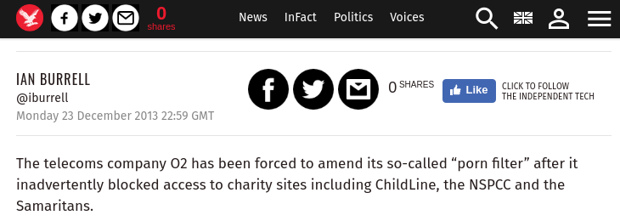
Over/Under Blocking

Slide 45
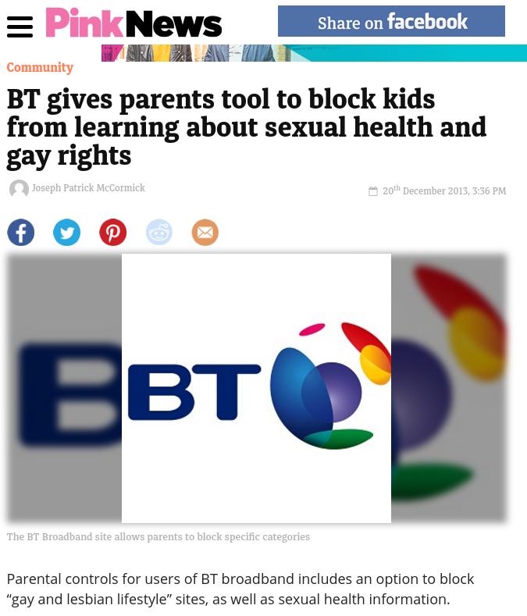
Over/Under Blocking

Slide 46
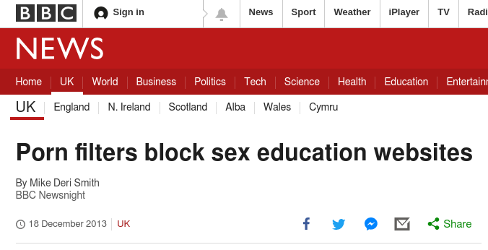
Over/Under Blocking
[…] Among the sites TalkTalk blocked as "pornographic" was BishUK.com, an award-winning British sex education site, which receives more than a million visits each year.
TalkTalk also lists Edinburgh Women's Rape and Sexual Abuse Centre website as "pornographic."

Slide 47
Making things better
(Distribution of clue...)

Slide 48
HTTP/451

Slide 49
HTTP/451 - RFC7725
[…] This status code can be used to provide transparency in circumstances where issues of law or public policy affect server operations. This transparency may be beneficial both to these operators and to end users. […]
[…] Responses using this status code SHOULD include an explanation, in the response body, of the details of the legal demand: the party making it, the applicable legislation or regulation, and what classes of person and resource it applies to. […]
[…] Clients cannot rely upon the use of the 451 status code. It is possible that certain legal authorities might wish to avoid
transparency, and not only demand the restriction of
access to certain resources, but also avoid disclosing that
The demand was made. [...]

Slide 50
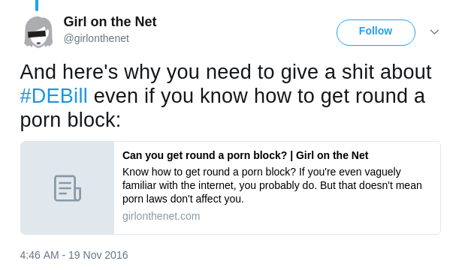
Pfft, doesn’t apply to me
Mitigations:
Tor
Proxies
VPN
Turn it off

Slide 51
Tor

Slide 52
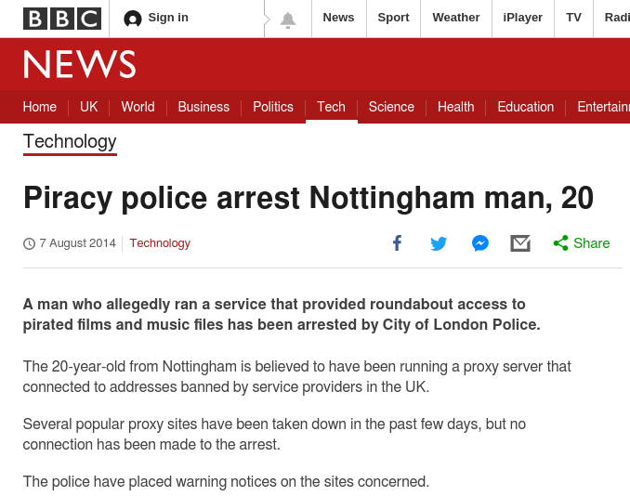
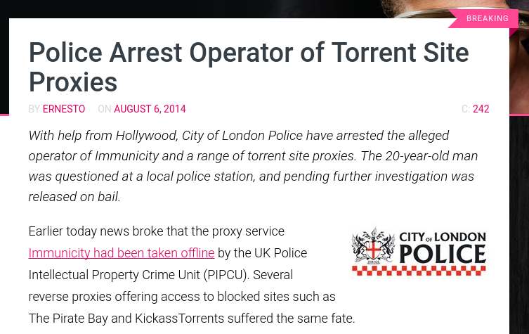
Proxies

Slide 53
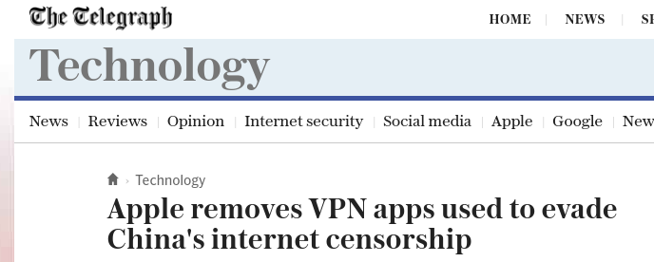
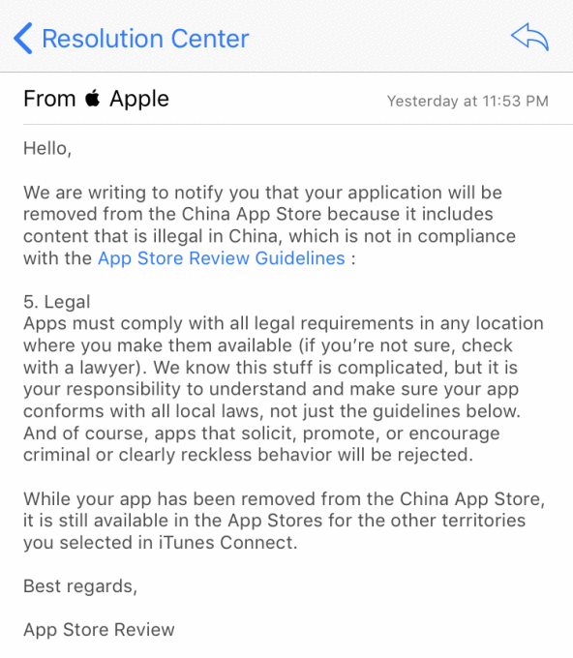
VPNs

Slide 54
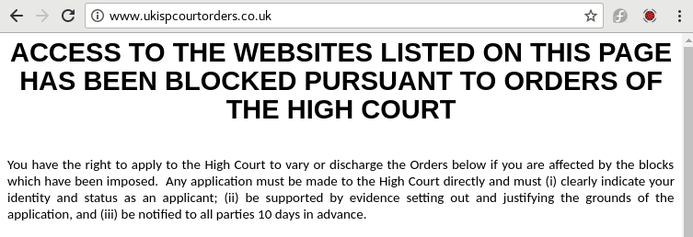
Turn the filters off

Slide 55
Questions?

