Slide 1
UK Education: Skills gaps and recruitment
@DebugEdu
Colin Smith, Curriculum Director Computing @ UTC Sheffield

Slide 2
What is this about?
UK Education has changed A LOT
The priorities for schools/colleges are not necessarily what you think they are
There are problems, and potential solutions
Where industry fits with this
Notes:
For many of us, it seems like a mighty long time since we were at school or college.
What can you really remember for that time? And what about your own education, was it helpful to your job now?
How schools and colleges work has also changed, we are beholden to the government and must ‘perform’ as they expect or be taken over or worse closed.
This presentation is designed to give you an insight into what is happening in the technical education sector and some suggestions on how this could be improved.
Its not just about the educationalists, it’s about us all.

Slide 3
About me
@DebugEdu
Curriculum Director of Computing
A head of department
Design the Computing Curriculum for 14-19 year olds
22 lessons a week
CAS Master Teacher
CCNA
.NET Technical Specialist
Computing Degree
Business Owner
Notes:
So here is a little about me. My name is Colin Smith, and my ‘official’ title is Curriculum Director of Computing at UTC Sheffield OLP. Its sounds kind of grand but I really am a classroom teacher.
At least – that is the main part of my job. I am technically a head of department and teach 22 lessons a week at a school that pride’s itself on it’s technical offerings. In other words: if you want to get into the computing and IT sector, this school is the place to be.
But I am also a technical person at the heart of it. I came from industry as a developer, and with lots of opportunities to get involved in infrastructure and large scale projects both as a business owner and with several other IT sector businesses. For 15 years I did that before becoming a teacher – it is not what I thought it would be. I see things being taught that are not industry standard, or things completely omitted that I think are important.

Slide 4
What are the changes to education?
The government decided back in 2012 that IT was not ‘fit for purpose’ so it would be removed
Computer Science was to take it’s place, but in a new form.
Computer Science now holds a lot of the networking practicalities that IT did have.
Notes:
Well, back in 2012 a new secretary of state in Education (Michael Gove) decided ‘enough of this vocational nonsense, we want academia to be back into schools’ (that’s not a quote by the way…
So the main ‘offender’ of the ‘vocational’ pathways were the IT qualifications. So with the power of OfQual (Office of Qualifications and Examinations) he set about with his plan (probably with steepled fingers or at least with a white long haired cat).
Computer Science was to be the forefront of this change, with aspects that were deemed important to be retrofitted to the Computer science qualifications, and IT to be all but removed entirely.

Slide 5
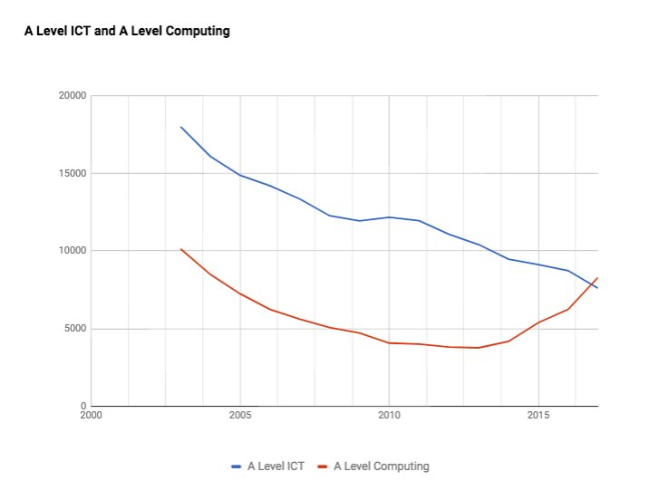
Notes:
This clearly demonstrates what is happening as a direct result of all the governmental changes. As you can see particularly at A Level IT has decreased (and of next year there will no longer be an A Level IT). There is also evidence that A Level Computer Science is also levelling off, and even uptake in GCSE has stalled. More on this later.

Slide 6
What is Computer Science
Programming/Algorithms
Computing fundamentals
Networking/Infrastructure
Database
Systems analysis and design
Security
Maths, lots and lots of maths
Notes:
Programming is probably the cornerstone of what computer science has to offer. Its not just about C or Java or Python, it’s about problem solving, creative thinking or ‘Computational thinking’ which is a buzz phrase at the moment.
Computing fundamentals is a catch all term for hardware/architecture and the nuts and bolts
Networking and infrastructure is arguably the most important to you all that does cover connectivity between devices and hardware/software principals.
Databases is what it says on the tim
Systems analysis and design is the business side of IT that covers all those aspects.
Security is not just about internet security but cyber security, law, people as the weak points
Maths – it’s fundamental whether it’s binary addition/subtraction/multiplication or conversion or even the dreaded sub net calculation – by hand

Slide 7
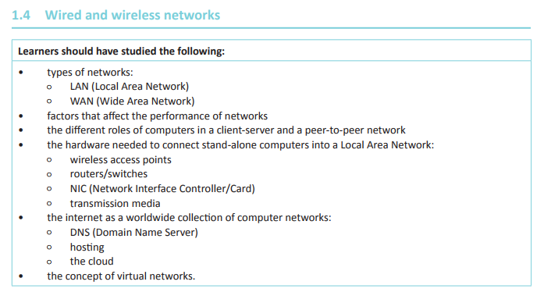
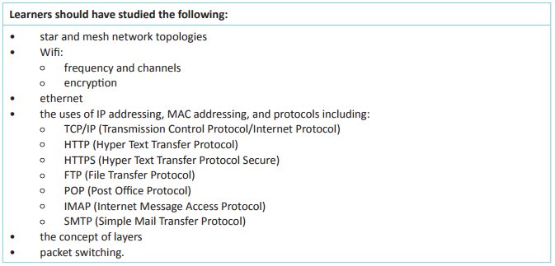
Computer Science in key stage 4 (14-16 year olds)
Exam board: OCR
Notes:
So we move onto looking at what the qualifications in schools are teaching about networking.
We start with GCSE which we call key stage 4 – generally for 14 to 16 year olds.
Here we are going to look at an ‘academic’ course (lots of writing and less coursework, more exams) provided by one of the major examination boards, OCR.
As you can see, there are some general terms LAN/WAN and touching upon certain aspects of hardware and some bits about the actually principals.
In my opinion, lacking the overall principals that tie these topics together, and there is a lot to learn in a short space of time.

Slide 8
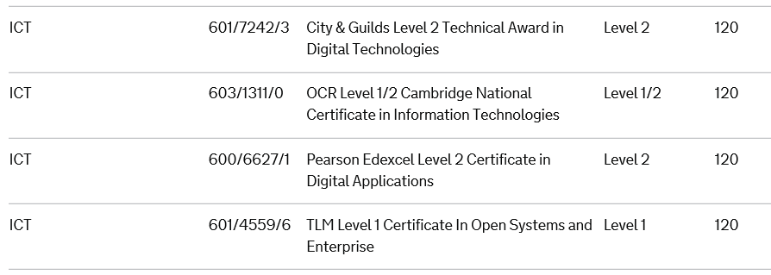
IT in key stage 4
From government published ‘performance tables’
‘Vocational’ courses
Notes:
Now we look at IT. I know I said earlier that the government were removing IT, well it turns out that this is taking some time, and It is almost unrecognisable now, focussing on ‘digital technologies’ which is much lighter in tough on any principals and almost completely devoid of networking.
You now get to choose from 4 different courses, and one of those is ‘Level 1’ (i.e. suitable for children 11-14 year old)
For example purposes, the Certificate in Digital Applications (or CiDA) is 30 hours of learning about fundamentals (where about 15% is about networking) and 90 hours on a project like game making or Digital marketing.
Note: It is worth mentioning at this point that there are more qualifications offered, but these are the only ones that draw ‘performance table points’ which is the measure that schools and colleges are judged on by OfSted (Office of standards in Education) who do have the power to change and close schools.

Slide 9
Computer Science in key stage 5 (16-19 year olds)
OCR Exam Board
An ‘Academic’ course
Notes:
Key stage 5 now for 16 to 19 year olds.
Computer Science at A Level is considered a more academic route, where students will have to write in depth answers and a fundamental understanding of the concepts behind networking.
As you can see here there is more of a focus on some very basic concepts. How this is taught is up for discussion as students will have to answer questions in an exam paper rather than demonstrate any practical skills. For example a question could be “Explain what packet switching is” or “Describe the benefits of Packet switching”.
Interesting to see some aspects of network security here as well, this seems to also have come from a government focus.

Slide 10
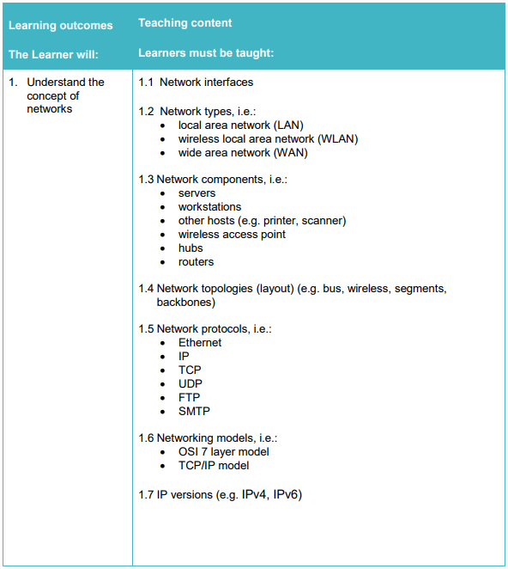
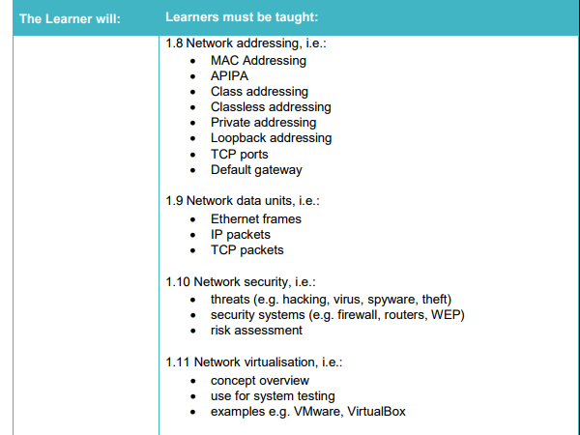
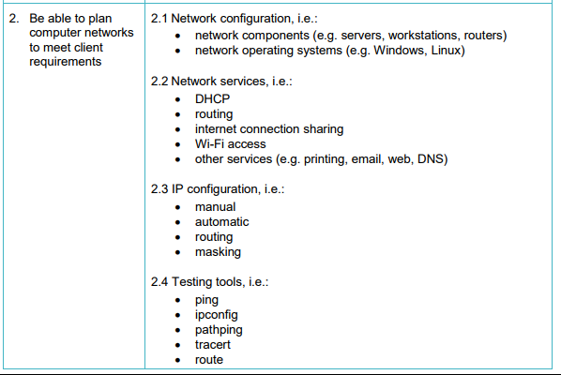
IT in key stage 5
OCR Cambridge Technical
A ‘ Vocational’ Course
Notes:
A ‘vocational’ course is equivalent to an A Level (although some universities do not recognise this). There are many flavours of these courses all with differing requirements and specifications.
What I am about to show you is the specification from the Cambridge Technicals Level 3 from OCR (I teach this). The caveat is that this modular course and what I will show you is only taught IF THE TEACHER is happy to teach it.
You can see that is much more in depth, and is tested by coursework that is modelled on a real world situation (although it can be done virtually rather than physically based on the resources available to the school/college/learning provider).

Slide 11
Problems so far?
Heads of department/school leaders decide on the courses taught to students
Courses that do not appear in the governments ‘performance tables’ are not routinely taught.
Even where the course unit is a ‘good fit’ teachers can choose which units to teach
Notes:
So the problems with all this:
Well firstly that school leaders and heads of department like myself can pick an choose the courses and indeed the units to be taught, that does not mean that they will cover everything that you would expect or even what the students expect.
Secondly, even tough we can choose the courses only certain courses appear in government ‘performance tables’ so if they (or OfQual) decide that this is not worthy of stature then the learning provider will not be given funding to run it.
Lastly even if you think there is a good course from a good provider, teachers can still tailor the course and choose different modules. If the teacher feels that either the students are not capable or they as teachers are not confident enough to deliver a certain unit, that can be changed for another.

Slide 12
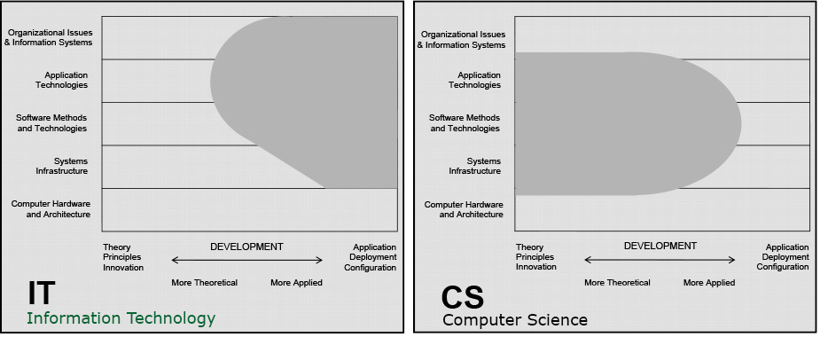
Degree Level
Notes:
So you could argue that for many these courses are only a gateway to University. The major issue for universities is the changes to IT and computer science in A Level and GCSE are having a knock on effect on take up and students knowledge/skills.
Here you can see that although the two courses do have some cross over, there are still some things that are being neglected (particularly computer hardware and architecture).

Slide 13
‘Soft’ skills
Leadership.
Ability to work in a team.
Communication skills (written)
Problem-solving skills.
Strong work ethic.
Analytical/Quantitative skills.
Technical skills.
Communication skills (verbal)
Notes:
So what about supposed soft skills?
You could argue that some of these skills are taught at all levels, but no one specification explicitly deals with them.

Slide 14
So where do the skills come from?
Well, from you
Apprenticeships (Advanced/higher)
On the job training
Experience
Notes:
So when you recruit individuals to your business, there is a fair amount of ‘bringing together’ all these skills that they need, from soft skills to technical skills that are not covered at schools/colleges. The challenge here is that no one learning provider will be the same, nor student the same so it feel like there is a lot do to.
You could always decide to put your new recruits through some industry training like CCNA or CompTIA related courses which may help, but don’t expect them to arrive with them either!
There is no substitute for practical experience in the field, a remember as a young programmer learning more in my first 3 months as a junior than I did at Uni

Slide 15
Why not from school?
Teachers are not always computer scientists/IT academics
Teachers have limited experience
Teachers are far too afraid of failure/performance tables/teaching outside the 'spec'
Notes:
So why do we expect schools and colleges to not provide these skills to your recruits?
There are some issues with the teaching, and the specifications of courses and indeed government ‘meddling’ I as a teacher can only do so much within a framework that I am authorised to do. Other teachers may well suffer from some of these issues, being ‘academic’ with little or not practical experience, or just plain afraid of failure and not meeting our ‘performance targets’

Slide 16
Student uptake
See the problems with teaching
Cannot see the career paths open to them
Get poor advice on how to move into the industry
Are not seen as 'fit' to sit certain subjects based on other things (academic/vocational)
Notes:
The next issue is how students perceive these courses and providers. At school, students go to the teachers they ‘trust’ when they get those options, and careers guidance mainly comes from that (unless the school or college has better provision for careers).
But it is difficult to spot the students with ability in certain aspects and nurture them in a career path.
There is also an issue with students when moving onto the next level being less able in one subject or another, and unfortunately ‘vocational’ is still a dirty word. (This is why they are being replaces with ‘technical’ levels or ‘T Levels’

Slide 17
What is being done
From government level? - well not a whole heap
From exam board level? - e.g. OCR asking for MEI
From Teachers? - panic!
From Industry? - Well I can throw that out to you
Don't rely on schools/colleges for training
On the job/apprenticeships
Notes:
So how are these issues being tackled?
Well you could argue that the government have done ‘something’. But what they are doing seems to be exasperating the problem.
Exam boards are working with OfQual to try improve ‘Meaningful Employer Involvement’ where for certain aspects of the courses employers or industry workers are getting involved.
Teachers can do one of two things, try to fit in what they can or just panic as our power only extends so far.
From the industry itself? Well you will know more than I do. I imagine however that it is putting into place for your recruits a training program on some description.

Slide 18
The cycle
Government
Exam Boards
Schools/Colleges
Industry
Notes:
So in terms of what ‘can’ be done, it’s about who is involved. Government in the guise of ‘OfQual’ dictate to the schools and colleges and exam boards what to teach and the specific requirements.
Schools and colleges will turn out students into the big wide world for their time industry.
The big issue here is that the information and communication is largely one way, where we cannot directly affect what is being passed to us.
In a perfect world, industry would inform government of what is required, and the government would make those changes and the exam boards would implement it.
I suppose that one that I have been working on is kind of the reason for me delivering this to you.

Slide 19
BCS – Computing at School
The Computing At School COMMUNITY
CAS is a community of individuals who are passionate about giving our children a great education in computing. It is a community of professional practice, which we join as colleagues in a shared endeavour. It is not a service to which we subscribe.
The CAS Community members and champions run over 150 regional hubs. Here, we meet together, talk, exchange ideas and share resources. Join CAS to become a member of this community. It’s free, you get no spam, and you’ll have access to 20,000+ colleagues, 3,000+ resources, the online discussions, and much more.
Notes:
The British Computing Society have their own ideas on how to help resolve the problem of recruitment demands, with the formation of Computing At School of which I am a member of.

Slide 20
CAS is a community of individuals who are passionate about giving our children a great education in computing. It is a community of professional practice, which we join as colleagues in a shared endeavour. It is not a service to which we subscribe.
The CAS Community members and champions run over 150 regional hubs. Here, we meet together, talk, exchange ideas and share resources. Join CAS to become a member of this community. It’s free, you get no spam, and you’ll have access to 20,000+ colleagues, 3,000+ resources, the online discussions, and much more.
Notes:
CAS is a great resource, it’s a way of linking to others and is open to academics and industry professionals alike. The forums are a great way to talk to schools and colleges directly, and there is a large network of individuals to be able to spread information, share resources and ultimately change Computing/IT education in this country.
It is part of the BCS, and there are regional centres, local hubs (like right here in Sheffield) and a network of master teachers. We would love to discuss any/all of these things with you, please sign up and get in touch.

Slide 21
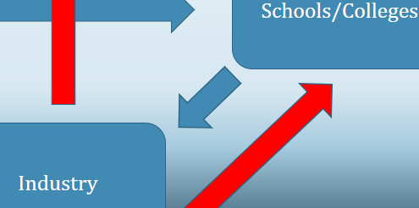
Industry outreach
Teachers LOVE others to do the job for them!
One off talks
Visits to sites (I would love to take my students to a data center!)
Working to deliver certain aspects of curriculum (e.g. DNS)
Project work (MEI – a mock or real life project for students to get stuck into)
Recruitment/careers advice for students (and teachers)
Sign up to the Computing at School site, offer something or reach out to your local master teacher
Notes:
There are a bunch of things that we can do to improve things, and something that at the UTC we are very keen on.
Getting involved in local schools and colleges does not need to be daunting or difficult, and the benefits are that you get to size up the next set of recruits, and even shape their education.
The simplest way of one off talks is a great way to start, it doesn’t have to be technically in depth, it could even be about careers.
Visits are something that students in schools still do. If you do have an idea for somewhere for me to take students I am very interested!
Project work in vocational courses is a great way to communicate directly with interested students and give them a slice of what the industry is all about, again something that at the UTC we are very keen on doing.
Computing at School is something that is a great resource for teachers and industry professionals.

Slide 22
Industry as a Power
Convincing government that the changes that are being made are harming the industry, not helping it
Working with Computing at School and the BCS
Working with exam boards/OfQual and feeding back the problems with the syllabus
Universities/Colleges – what you need as graduates
Notes:
Of course if you are not getting involved locally then maybe it’s time as an industry to use some power to change at a higher level.
The government is beholdent to it’s citizens and it’s businesses. We can work together to put pressure on the Education secretary to provide the education that we need for the industry to thrive.
Working with Computing at School is a great way to improve education in any form.
Universities are also always open to discussions with interested partners about how they can improve their own provision.

Slide 23
In conclusion
Education has changed
There is a skills shortage coming
There are things we all can do: working in partnership
Are goals are the same
Notes:
So a summary:
Education has changed, perhaps forever.
There is a shortage of skills coming, so what is your organisation doing to prepare for that?
Working in partnership with the learning providers is one way to prepare for this, but maybe a more effective way is to work with the government directly to ensure that you get the recruits you need.
We all want the same, teachers, students, government and industry all want to be successful, so it’s about time we started working together.

Slide 24
Thank you
Any questions?

