Slide 1
IXPs and Robust Configuration
aka. “interesting” configs we have seen…
Rob Lister
UKNOF24
17 January 2013

Slide 2
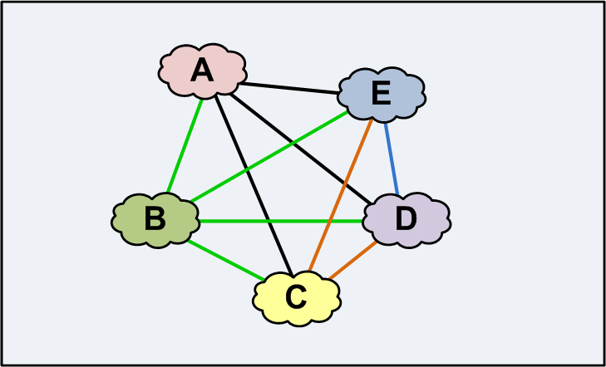
Original purpose of IXPs…
In the years Before Exchanges (BE)
Notes:
Life before Internet Exchanges.
Networks within a city or region began to see the benefit of directly interconnecting with each other.
At the time, they could also have been quite geographically dispersed…i.e. there weren’t many neutral facilities which are commonly used today..
This made direct interconnections expensive and time consuming to install, and inevitably disputes ensued about who would be paying the bills.
It also made rapid connection in to a city or region difficult. Every new player had the same problem.

Slide 3
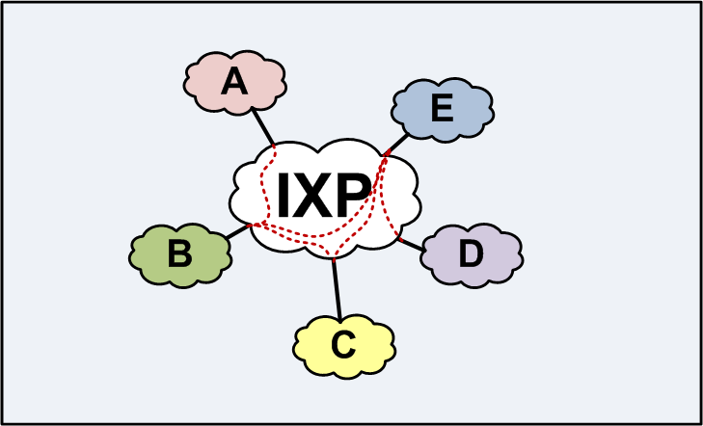
..enter the IXP…
Notes:
So it would seem like a fairly obvious step to establish both common locations and a neutral exchange platform (a switch!)
to which every network has a connection, and can enable (or not) BGP sessions with each other rapidly over a common infrastructure.
This saves both time and cost, networks could decide between themselves who they wanted to interconnect with.

Slide 4
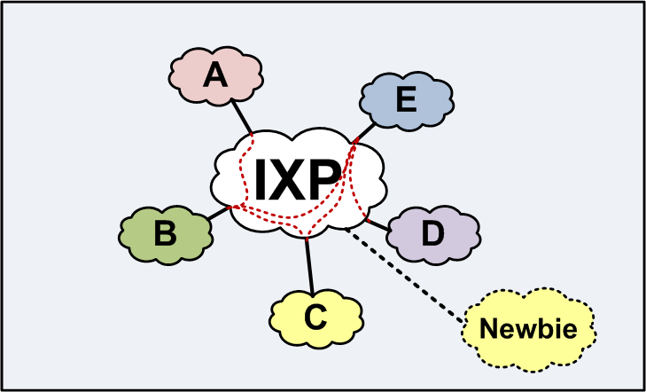
..enter the IXP…
Notes:
Another benefit was that it made it much easier for new networks to achieve an excellent level of peering interconnection.
Exchange Policies too have evolved. Originally fairly restrictive, limited only to “classic” ISPs, but today we allow pretty much any type of network to join.

Slide 5
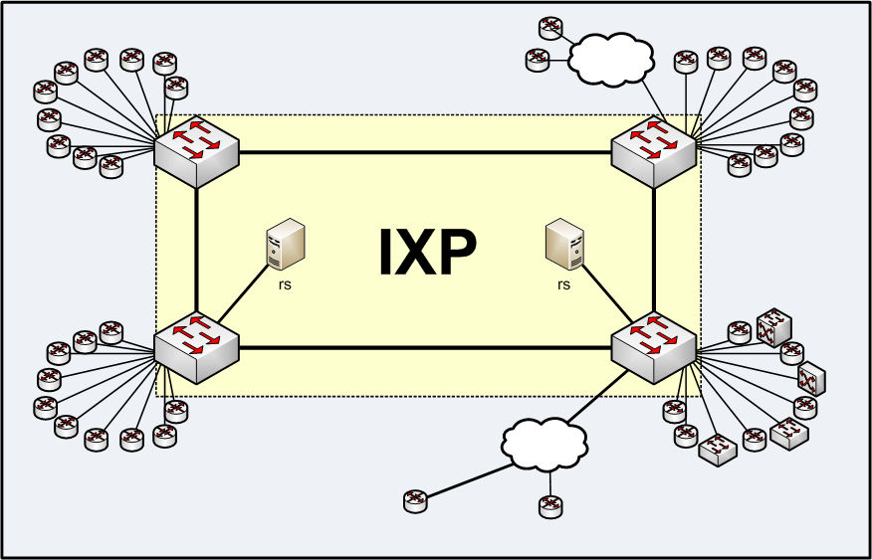
The IXP today
Notes:
Originally most exchanges permitted only direct connections to routers, but over time, flexibility has increased.
Most exchanges now allow intermediate devices to connect.
Many exchanges have the concept of resellers, so connected networks don’t have to be in the same city, or even country.
Route servers have been added to make establishing open peering quicker and more convenient…
It’s important to note that not so long ago, all of these things would probably have been considered a no-no by most exchanges.
Not so long ago, connecting a switch to an IXP was out of the question.
But devices, and service have become more flexible over time.

Slide 6
From ISPs to… $thing provider
Original ‘Tier 2’ access ISPs
Academic Networks
Larger Telcos
Large Content Networks
Medium Hosting Networks
Layer 2 Resellers
Name Services, DNS Registrars, Network Service Providers…
Small access networks (birth of xDSL)
Small Hosting Networks
Online Gaming
VoIP Service Providers
Huge web sites, social media, Video on demand
Gambling, Banking…
Connected Enterprises
Notes:
IXP environments have become more diverse in terms of types of connections, and types of networks and
organisations that would have typically connected a few years back.
The traditional markets for IXPs became more limited, and eventually opened up to new types of network where peering
would also be beneficial for the usual variety of reasons.. lower cost.. lower latency... peering relationships..
So over time, we have moved away from the traditional “Internet” network, into organisations whose sphere of
knowledge and expertise is quite different. Many connected networks today do not specialise in Internet, BGP etc
and just need this peering thing to work. They concentrate their skills elsewhere and are not touching their network
every day….
Their primary focus is some other activity. Routing, BGP and networks isn’t always high on the agenda – they aren’t
always dealing with routing, BGP and networking day in, day out. Their expectation of the internet exchange itself may
also different – they expect it to ‘Just work’ with minimum hassle and overhead.

Slide 7
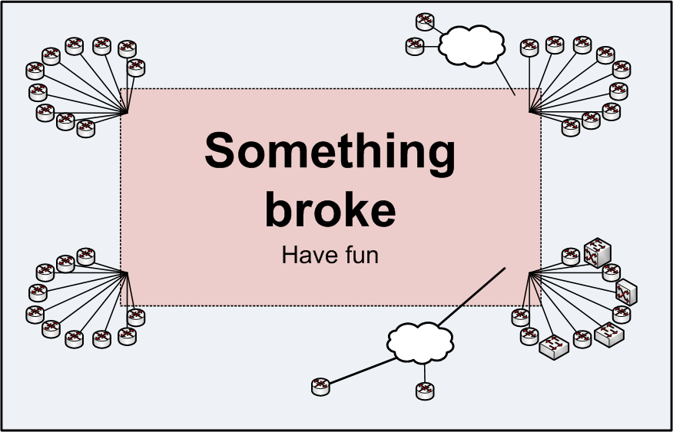
IXP Protection
“Layer-2 blob” works great most of the time!
Until something / someone screws up
Can be difficult to find and fix

Slide 8
IXP Protection (1)
IXPs have allowed traffic policies
We ask you nicely not to do evil things!
If we find evil things, we will unplug you…
“Router only” policy didn’t break much ☺
This was enough for a long time….

Slide 9
IXP Protection (2)
IXPs have allowed traffic policies
We ask you nicely not to do evil things!
If we find evil things, we will unplug you…
“Router only” policy didn’t break much ☺
This was enough for a long time….
Some evil happens too fast!
Notes:
Evil started to get too quick to deal with manually.
There were more ports, a wider range of devices, and more scope for things to go wrong.

Slide 10
IXPs protecting against evil…
IXPs enable various port security mechanisms
Limit to particular MAC
Restrict to 1 MAC address
Shut port down if > 1 MAC
(Hopefully) stop loops!
Limit ethertype?
IXPs enable various rate limiting features
Limit broadcast traffic
Limit unknown unicast
Quickly stops most (but not all) evil..
Notes:
Initially, port security features were quite buggy and didn’t always work properly.
It has taken some switch vendors several attempts to deliver port security features that actually work, especially for IXPs.
Today, they mostly work!
rate limiting… works but difficult to pick the initial numbers… what do I put in that won’t break?
Requires some monitoring of packet counts.

Slide 11
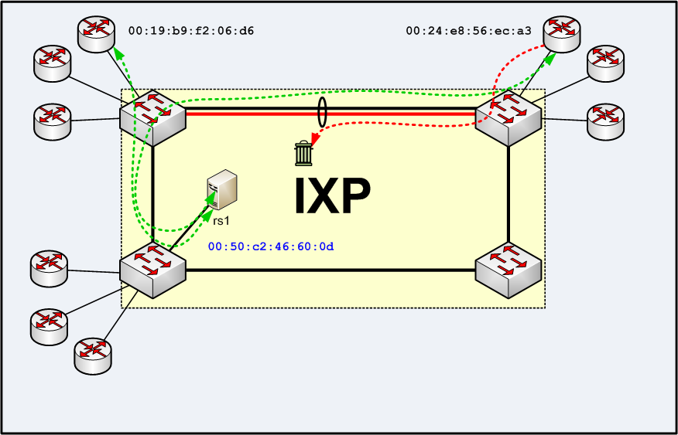
IXP Forwarding Path Failure
Notes:
This problem can occur at internet exchanges but is hopefully rare.
Route servers are a great benefit, but mean separation of the routing exchange and the actual data path.
Typically caused by some failure meaning that some MAC addresses are unable to reach some other MAC addresses.
e.g. a load sharing problem on an aggregated link between two switches.
The route server is able to communicate with both MAC addresses, so routes are exchanged for both peers.
However, the peers are unable to send traffic.
These problems are often hard to detect and diagnose.
Tools are emerging to make it easier to monitor individual links in a trunk, but still not 100% perfect.
Stuff breaks…

Slide 12
What goes wrong with members?
“Magic” protocols like VTP/DTP/STP
Proxy ARP / IPv6 ND etc.. DHCP…
Internal routing issues
BGP configuration
Other configuration
“Interesting” network designs…

Slide 13
DTP/VTP/STP (Cisco…)
DTP/VTP: Automatic trunk configuration and VLAN distribution….
STP: Fail-over/loop resolution
Harmless… until another device starts sending you these frames.. then bad things happen!
STP topology change issues
Port shuts down due to VLAN config mismatch
Notes:
Don’t leak these protocols outside of administrative boundaries….

Slide 14
Proxy ARP
Somebody starts responding to ARP that’s not for its interface’s IP address.
Commonly caused by mask misconfiguration
Cisco – often enabled by default on interfaces

Slide 15
How BGP detects deadness
Next hop for a route must be in routing table
When an interface goes down, BGP tears down all (eBGP) sessions reached via that interface
BGP sends keepalives to peers every 30 seconds
When3 keepalives are not received, the BGP session is torn down.
Notes:
If the next hop for a prefix received via BGP is unreachable (not in the routing table), the route is not installed into the routing table. When a router interface goes down, the connected subnet(s) associated with it are removed from the routing table. Thus, when a connected next hop disappears, the routes associated with it are withdrawn from the routing table. BGP will select the “next best” alternative path, if available.
On most platforms, when a router interface goes down, BGP tears down all (eBGP) sessions reached via that interface immediately.
By default, BGP sends keepalives to peers every 30 seconds. When 3 keepalives are not received from a peer, the BGP session is torn down, and routes are recalculated.

Slide 16
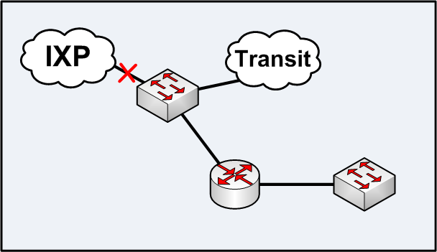
Intermediate Switches / BGP
Member connects a switch to the IXP
Not many good mitigations…
Notes:
Perhaps a port security shutdown at the IXP causes the port connected to the switch to go down…
The router will not realise for quite some time that the IXP has gone away, until BGP timeout occurs.
BFD… CPU intensive and not widely deployed
Happily, once the config is working and no portsec violations occur, it’s a reasonably rare event.
Sometimes switches just do not want to shut up!

Slide 17
‘SLA’ Features
Pings some external IP and shuts down interface or withdraw route if unpingable
Pick the destination carefully…
Maybe not much faster than BGP timeout… ☹
Notes:
Then again, what do you ping?, and can you guarantee that it will only be reachable via a particular IXP interface?
Might not be much faster than BGP timeout.

Slide 18
Switch Features
“Uplink group”/LFS type feature shuts down ports when another port goes down…
Not practical for tagged links
Notes:
Some switches have “uplink group” ability to shut down one port when another port goes down, however
this is often impractical for tagged links, but possible for “media conversion” switches.
If you were just using the switch for media conversion, however, this might be a good solution.
Doesn’t both ways, however (switch port to the IXP doesn’t shut down if router interface goes down.)
however this may be less of an issue.

Slide 19
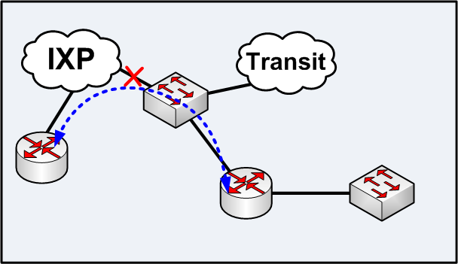
BFD - Bidirectional Forwarding Detection
[RFC 5881] – BFD. Detects failures in the forwarding path between routers
Good – not widely used inter-AS (yet)
Notes:
BFD offers a promising solution, and enables detection of forwarding failures in the path between two routers…
Not yet widely deployed, and limitations on number of BFD sessions that can be configured on certain platforms.
Possibly something route servers could handle, but BFD doesn’t provide an easy means of handling this problem
(next hop is not the route server etc..)

Slide 20
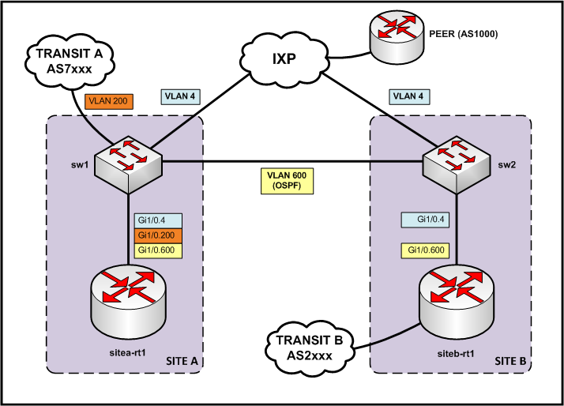
Multiple IXP Connections
Notes:
So.. given the problem with intermediate switches… we can consider some other network designs.
When transit B goes down, routes are withdrawn immediately.
Maybe not so with transit A…
Both of the LONAP (IXP) connections work as expected.
But what happens when one of them goes down?

Slide 21
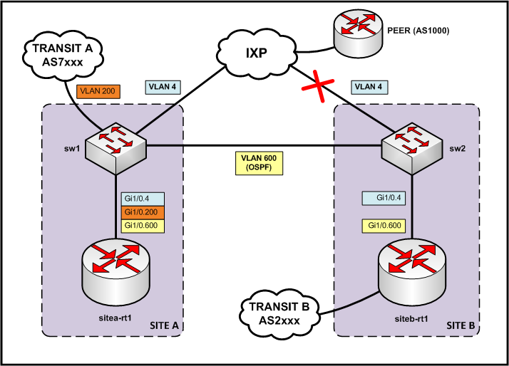
Multiple IXP Connections
Notes:
But what happens when one of them goes down?

Slide 22
Multiple IXP Connections
First, verify connectivity to an IP in our peer’s network:
sitea-rt1>ping 10.10.0.1
Type escape sequence to abort.
Sending 5, 100-byte ICMP Echos to 10.10.0.1, timeout is 2 seconds:
!!!!!
Success rate is 100 percent (5/5), round-trip min/avg/max = 8/15/20 ms
Then, show the route going out via the directly connected interface to LONAP:
sitea-rt1>sh ip bgp 10.10.0.0/16 subnets
BGP table version is 899, local router ID is 192.168.20.1
Status codes: s suppressed, d damped, h history, * valid, > best, i - internal,
r RIB-failure, S Stale
Origin codes: i - IGP, e - EGP, ? - incomplete
Network Next Hop Metric LocPrf Weight Path
*> 10.10.0.0/16 193.203.5.10 0 0 1000 i
* i 193.203.5.10 0 100 0 1000 i

Slide 23
Multiple IXP Connections
Now we shut down the interface (or the BGP goes down somehow…)
sitea-rt1#conf t
Enter configuration commands, one per line. End with CNTL/Z.
sitea-rt1(config)#int Gi1/0.4
sitea-rt1(config-subif)#shut
Mar 12 20:34:40.186: %BGP-5-ADJCHANGE: neighbor 193.203.5.10 Down .. .
We see that we have one remaining route via iBGP:
sitea-rt1>sh ip bgp 10.10.0.0/16 subnets
BGP table version is 901, local router ID is 192.168.20.1
Status codes: s suppressed, d damped, h history, * valid, > best, i - internal,
r RIB-failure, S Stale
Origin codes: i - IGP, e - EGP, ? - incomplete
Network Next Hop Metric LocPrf Weight Path
*>i10.10.0.0/16 193.203.5.10 0 100 0 1000 i

Slide 24
Multiple IXP Connections
However, when we try to ping 10.10.0.1 again, it doesn’t work…
sitea-rt1>ping 10.10.0.1
Type escape sequence to abort.
Sending 5, 100-byte ICMP Echos to 10.10.0.1, timeout is 2 seconds:
.....
Success rate is 0 percent (0/5)

Slide 25
Multiple IXP Connections
Verify how we reach the next hop address:
sitea-rt1>sh ip route 193.203.5.10
Routing entry for 193.203.5.0/24
Known via "bgp 65009", distance 20, metric 0
Tag 7xxx, type external
Last update from 203.0.113.14 00:03:31 ago
Routing Descriptor Blocks:
* 203.0.113.14, from 203.0.113.14, 00:03:31 ago
Route metric is 0, traffic share count is 1
AS Hops 1
Route tag 7xxx
sitea-rt1>sh ip bgp 193.203.5.10
BGP routing table entry for 193.203.5.0/24, version 901
Paths: (1 available, best #1, table default)
Advertised to update-groups:
1 2
7xxx
203.0.113.14 from 203.0.113.14 (203.0.113.1)
Origin incomplete, metric 0, localpref 100, valid, external, best

Slide 26
Routing Fun…
Default Administrative Distance for eBGP
Appropriate in service provider networks??
Protocol | Administrative Distance
Directly Connected | 0
Static Route | 1
External BGP (eBGP) | 20
OSPF | 110
IS-IS | 115
RIP | 120
Internal BGP (iBGP) | 200
Why is this?
Notes:
Routers use Administrative Distance to decide which route to prefer when the same route is received via multiple sources.
The route from the source with the lowest Administrative Distance is installed in the routing table.
The default is to actually prefer eBGP over OSPF… Why is this? I never managed to get an answer.
What this means for service providers is that.. you are prepared to trust any old external BGP route in preference to something
directly connected in your network… this is probably not good?

Slide 27
Multiple IXP Connections
One way…
sitea-rt1#conf t
Enter configuration commands, one per line. End with CNTL/Z.
sitea-rt1(config)#router bgp 65009
sitea-rt1(config-router)#distance bgp 150 200 200
sitea-rt1#clear ip bgp 203.0.113.14
Mar 12 20:48:28.122: %BGP-5-ADJCHANGE: neighbor 203.0.113.14 Down User reset
Mar 12 20:48:36.870: %BGP-5-ADJCHANGE: neighbor 203.0.113.14 Up
sitea-rt1>sh ip route 193.203.5.10
Routing entry for 193.203.5.0/24
Known via "ospf 1", distance 110, metric 20, type extern 2, forward metric 1
Last update from 172.16.1.2 on GigabitEthernet1/0.600, 00:00:05 ago
Routing Descriptor Blocks:
* 172.16.1.2, from 192.168.20.2, 00:00:05 ago, via GigabitEthernet1/0.600
Route metric is 20, traffic share count is 1
sitea-rt1>ping 10.10.0.1
Type escape sequence to abort.
Sending 5, 100-byte ICMP Echos to 10.10.0.1, timeout is 2 seconds:
!!!!!
Success rate is 100 percent (5/5), round-trip min/avg/max = 8/32/56 ms

Slide 28
Fixes for the blackhole
We could change the odd eBGP Admin Distance
And/or filter out connected IXP prefixes
Fiddle with next-hop-self? Maybe…

Slide 29
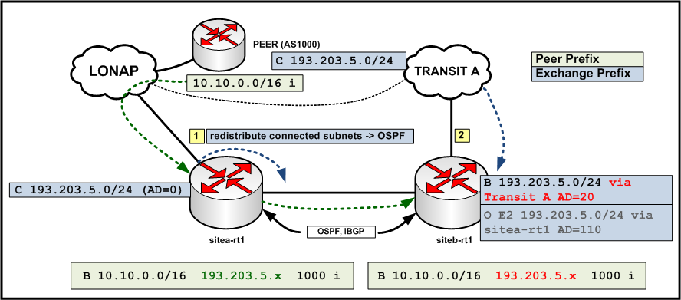
Routing Fun…
Possible solutions…
Filter out IXP prefixes and more specifics
Tweak Administrative Distance…
Notes:
A similar blackhole situation can also occur with a single LONAP connection, and two or more routers...
LONAP is connected directly to sitea-rt1 (1) in this example. This router has a directly connected route to the peering LAN, 193.203.50.0/24.
193.203.50.0/24 is configured to be redistributed in to the IGP, in this case OSPF, and is announced to siteb-rt1
The peer AS1000 is advertising us the prefix 10.10.0.0/16 via a BGP session at LONAP.
This prefix is advertised via iBGP to siteb-rt1, with a next-hop pointing to the peer’s LONAP IP address.
Transit Provider A is connected to siteb-rt1, (b) but also happens to see the LONAP peering LAN prefix from somewhere (maybe from a peer, or perhaps they are also connected to the LONAP peering LAN)
Transit Provider A advertises the LONAP prefix via eBGP to siteb-rt1
Since EBGP has a default Administrative Distance of 20, this takes precedence over the OSPF route received on siteb-rt1, OSPF has an Administrative Distance of 110.
Traffic routed to 10.10.0.0/16 works correctly via sitea-rt1, but siteb-rt1 will try to route this traffic via the route received from Transit A.
Transit A’s router will not be expecting to receive traffic over this link with a next hop 193.203.50.x, and so traffic is dropped, and a blackhole is formed.
It might also be advisable to filter out prefixes of any exchange LANs (and more specifics) that you are connected to, so they are never received over eBGP.

Slide 30
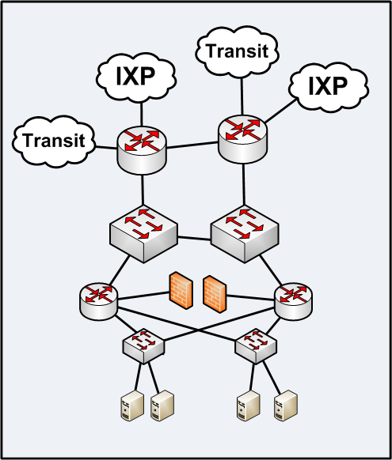
Network Design
Some thought
Layered design
Redundancy
Failover
There are others!
Notes:
Service provider networks… to take this quick ‘back of a fag packet’ drawing, typically consist of various layers, and
hopefully some redundancy, fail-over etc.
These could be divided into core, distribution, access… some networks even have separate border and core layers…

Slide 31
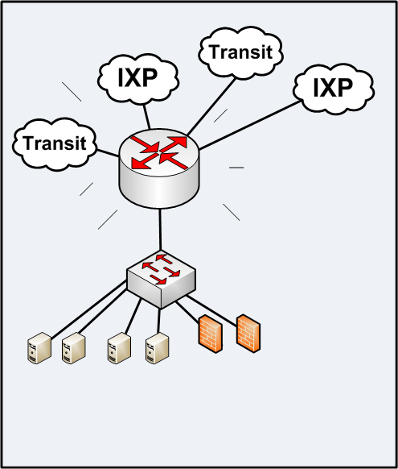
Network Design
BIG SCARY BOX
“We paid $$$ for it”
“Temporary”
Use it for everything
Never touch it
Never document it
Run away!!!
Notes:
Alternatively, we have seen the BIG SCARY ROUTER approach.
Temporary situation… often becomes permanent in the end!
This is only a valid approach if you don’t care, usually because you have many ‘nodes’ or ‘instances’ of the same thing
in diverse locations. i.e. doesn’t matter if the service goes away for an extended period.
It makes for a very complicated configuration. Problems are hard to debug, and changes are scary to make.

Slide 32
So..
Do these things get fixed?

Slide 33
It depends…
Understanding
Confidence
Money
Motivation
Internal Politics
Downtime
Successful Fix
Ongoing Learning…
Notes:
Understanding – Do I understand enough about how to fix?
Confidence – Can I confidently fix this?
Money – If I am not confident to fix this.. do I have the money to pay somebody to fix it, or maybe I need to buy hardware?
Motivation – Do I care about this enough? If it doesn’t affect me too much, do I really care… if it was breaking every week.. maybe I should fix it?.. Are there more pressing matters?
Internal politics – To get a change done, will I have to wade through loads of internal red tape, change control procedures…
remember the consequences for getting this wrong could be a big outage…

Slide 34
It’s a community…
APRICOT
IETF
RIPE
?
NANOG
LONAP
UKNOF
LINX
People who operate a network
“Network Operators”
Notes:
We would like for members to become part of a wider community, UKNOF is a great example, but we have to face it that there are certain organisations
that are hard to engage for a variety of reasons… either distance, language, resources, lack of will….
These hard to engage people are also amongst the “hard to convince to fix…”
There are network operators in the traditional sense…
And then people who operate a network.
Example of voice provider. Our organisation users voice, but it isn’t our primary concern… if one of those guys looked at
my Asterisk config, they’d probably think it was all a shocking mess…
But what might unite us more?

Slide 35
It’s a community…
Beer
APRICOT
IETF
RIPE
?
NANOG
LONAP
UKNOF
LINX
People who operate a network
“Network Operators”
Notes:
I did some fairly extensive research and discovered some common ground…

Slide 36
It’s a community…
Beer
Fancy
Cocktails
or something?
APRICOT
IETF
RIPE
?
NANOG
LONAP
UKNOF
LINX
People who operate a network
“Network Operators”
Notes:
I did some fairly extensive research and discovered some common ground…
Don’t know what these other people drink? But there’s enough overlap here to work with..

