Slide 1
The IPv6 Matrix Measuring IPv6 Deployment
Tim Chown
Electronics and Computer Science
University of Southampton
tjc@ecs.soton.ac.uk
UKNOF27, Manchester, 21st January 2014

Slide 2
Measuring IPv6 deployment
Some good examples out there already
Includes a couple of nice catalogues of measurements
http://www.worldipv6launch.org/measurements/
https://labs.ripe.net/Members/mirjam/content-ipv6-measurement-compilation
Good stats, but generally
Presented in a ‘matter of fact’ style
Not very interactive, if you want to explore the stats
Underlying data is not available

Slide 3
The IPv6 Matrix
A tool that measures IPv6 deployment by looking for and testing DNS entries in the Alexa top 1,000,000 domain list (a free download)
http://s3.amazonaws.com/alexa-static/top-1m.csv.zip
Initial ‘crawler’ code was developed by ISOC England in conjunction with Nile University in 2009/10
Started crawling the data, with basic display mechanisms
Due to Arab Spring, the crawler moved to Telehouse
The project now has three+ years of data

Slide 4
Improving the IPv6 Matrix
ISOC England worked with a group of 4th year MEng students at the University of Southampton
Group Design Project (3/8ths of students’ final year)
Around 30 such projects run each year
The ISOC customer brief was to improve the presentation of the crawler data
And as a secondary priority to harden the crawler
Included Open Data principles (see http://theodi.org)
As part of project, crawler moved to Southampton
See http://www.ipv6matrix.org

Slide 5
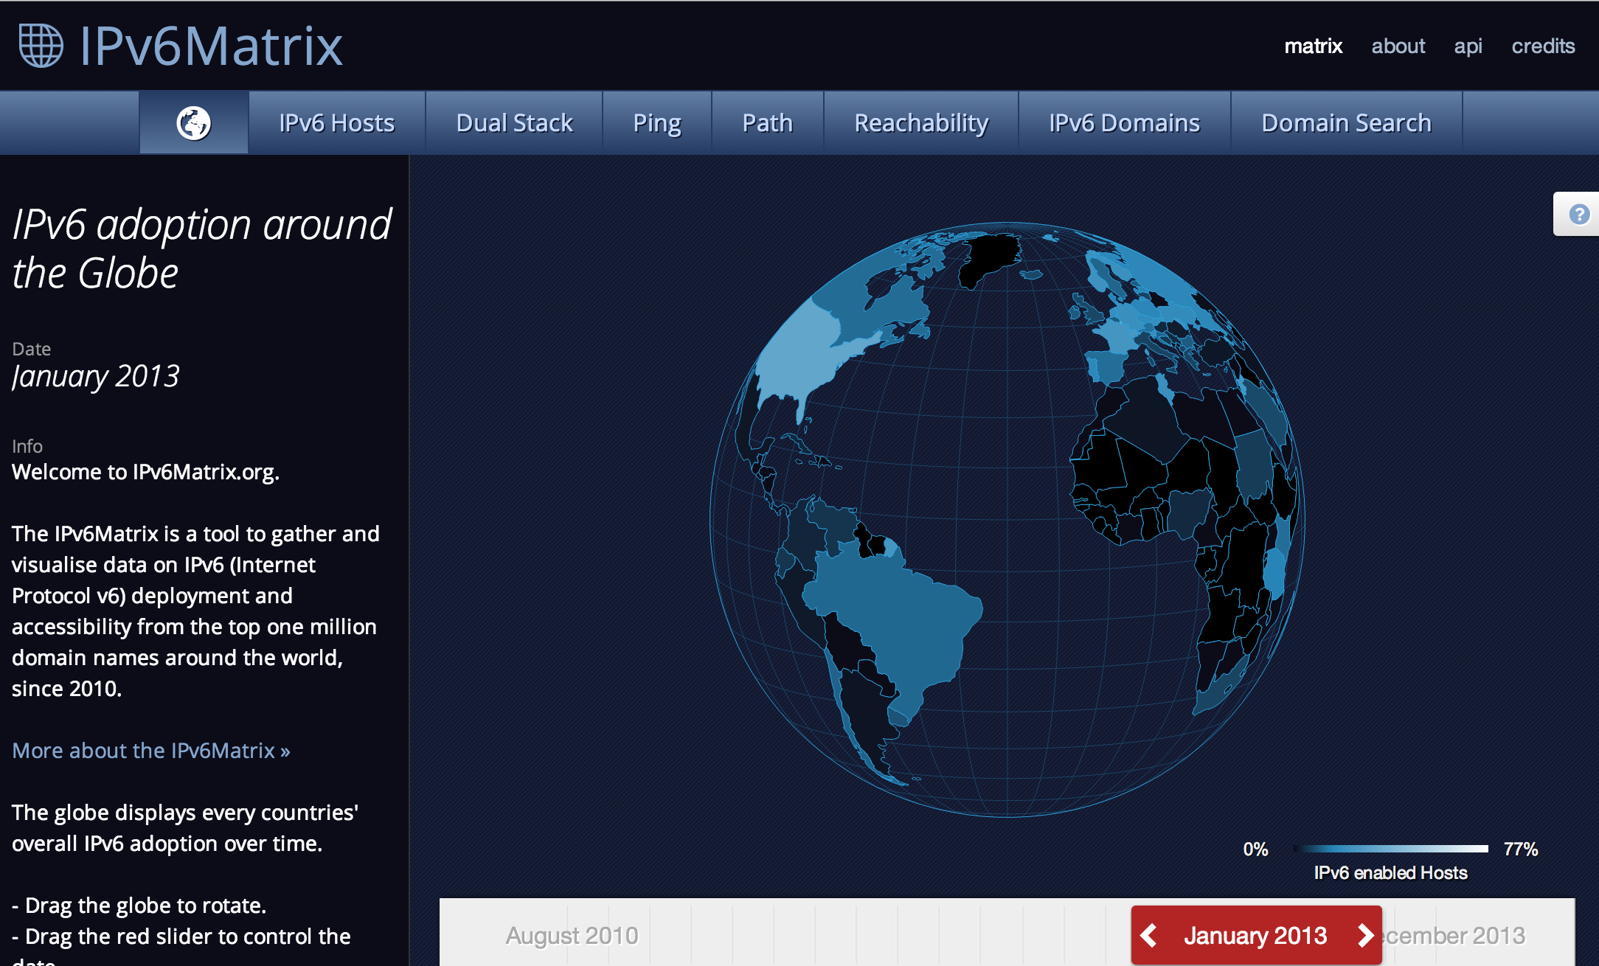

Slide 6
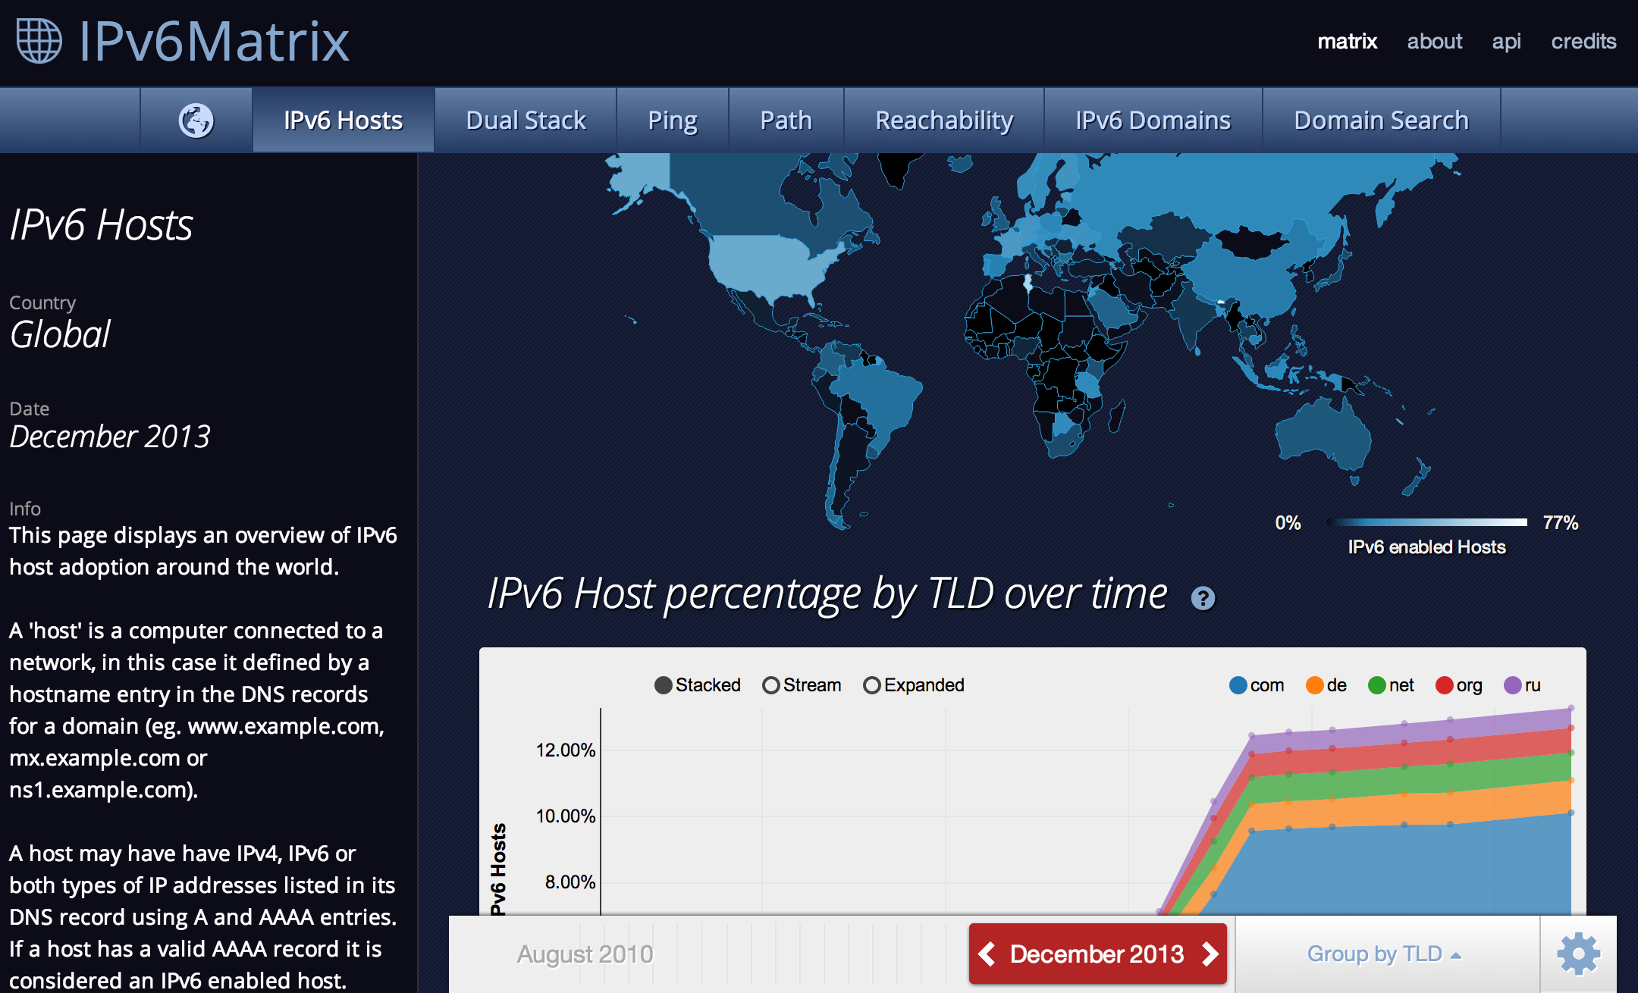

Slide 7
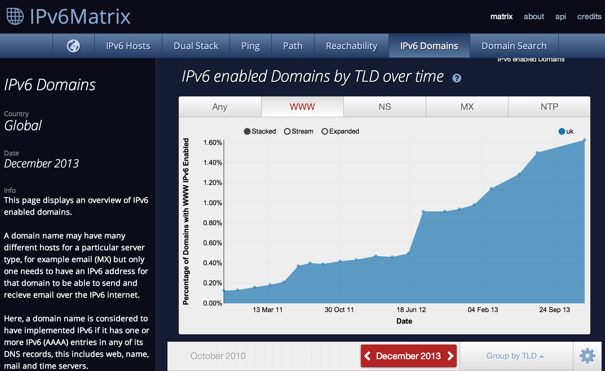

Slide 8
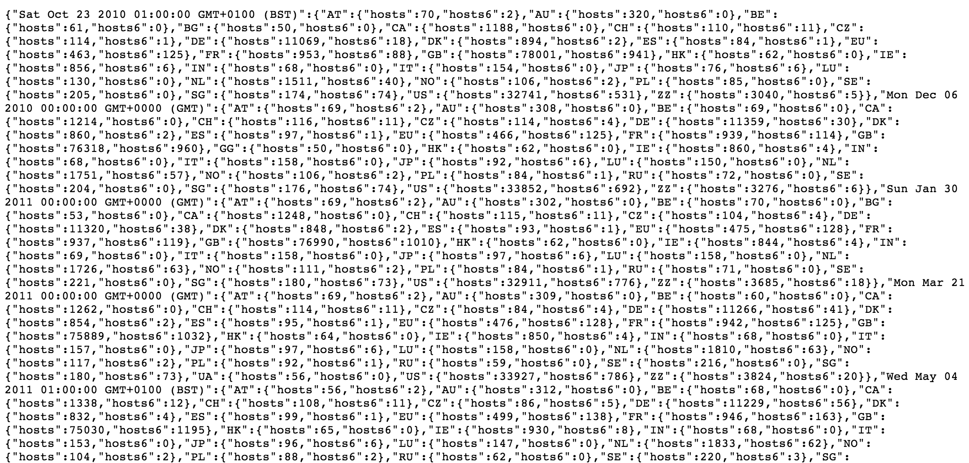

Slide 9
Summary
A new version of the IPv6 Matrix is now available
Significant improvements to interactivity
Shows potential for organisations/companies to work with universities to prototype ideas
There are lots of very good students out there!
Promotes use of Open Data
We urge other measurement projects to publish their data
Goal is to enable interesting data mash-ups
We need your feedback
Send to feedback@ipv6matrix.org

