Slide 1
Corero
DDoS Protection for your Network and Services
Bipin Mistry
VP Product Management

Slide 2
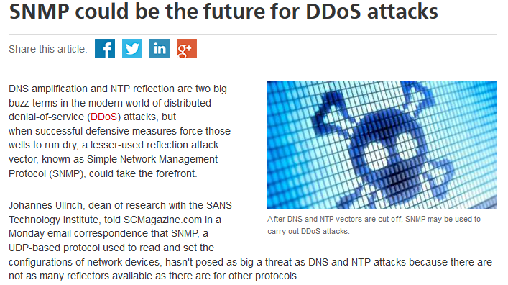
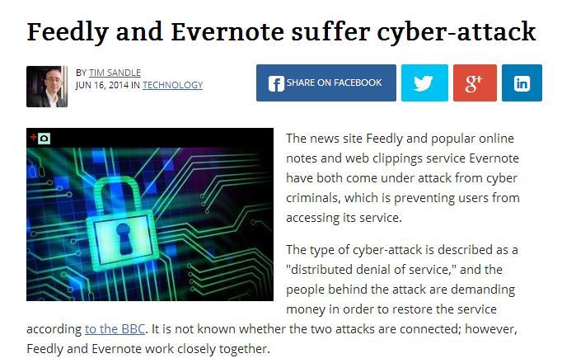
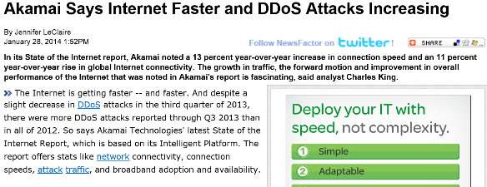
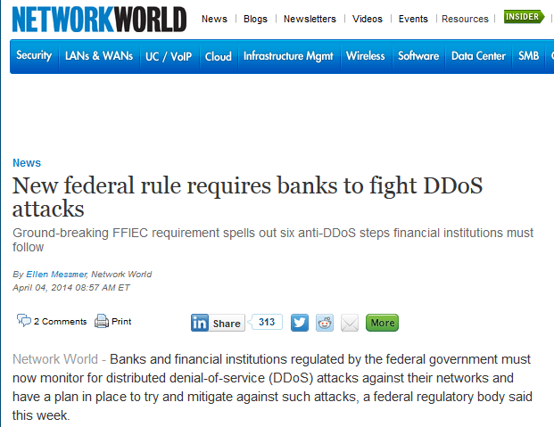
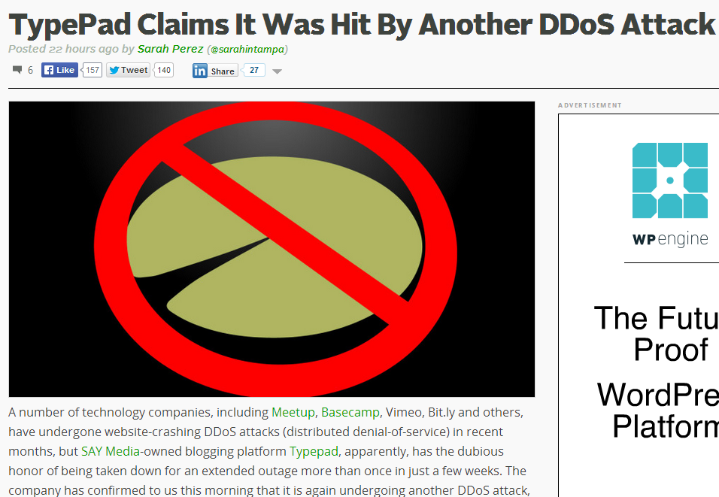
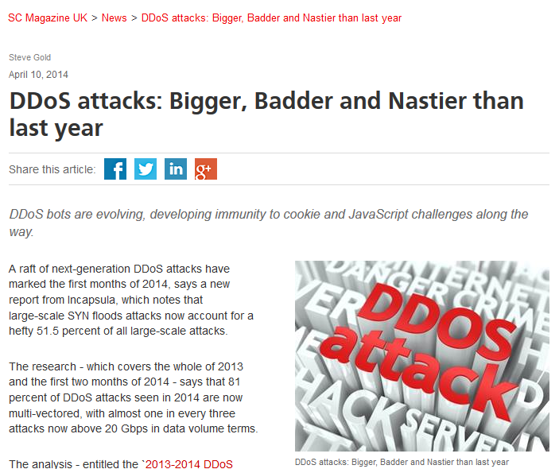
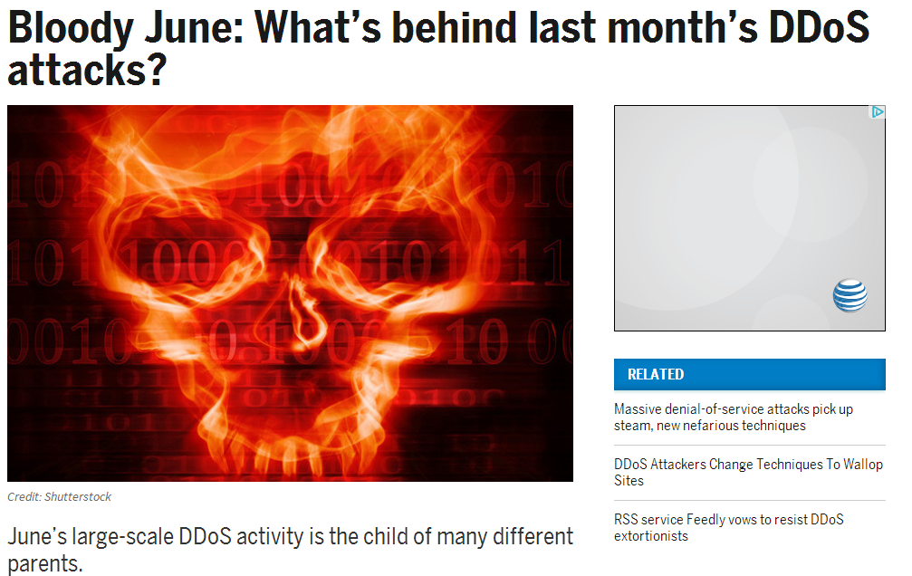
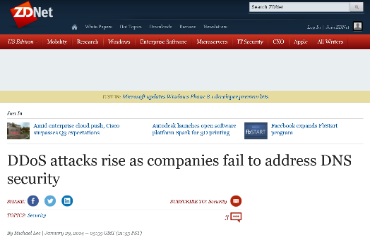
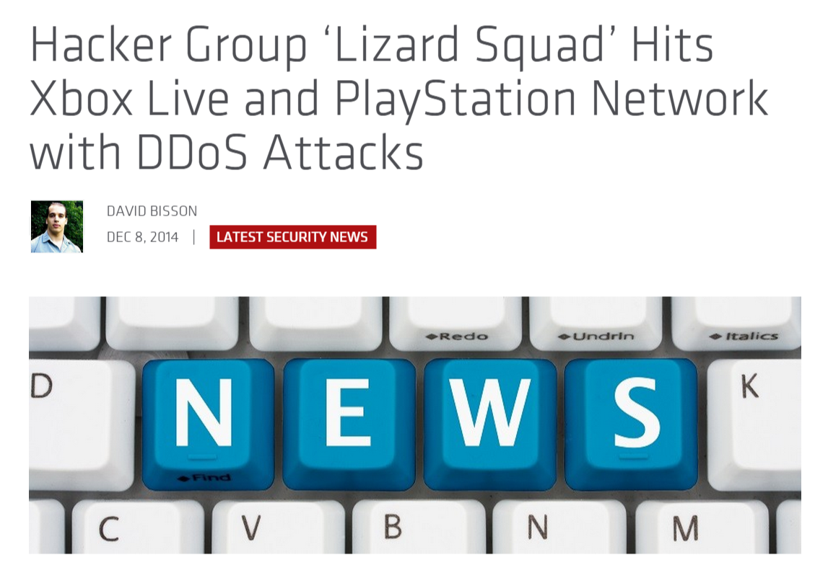
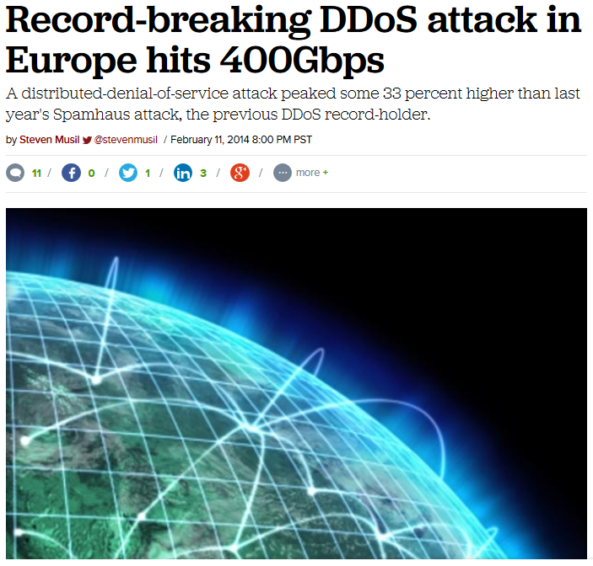
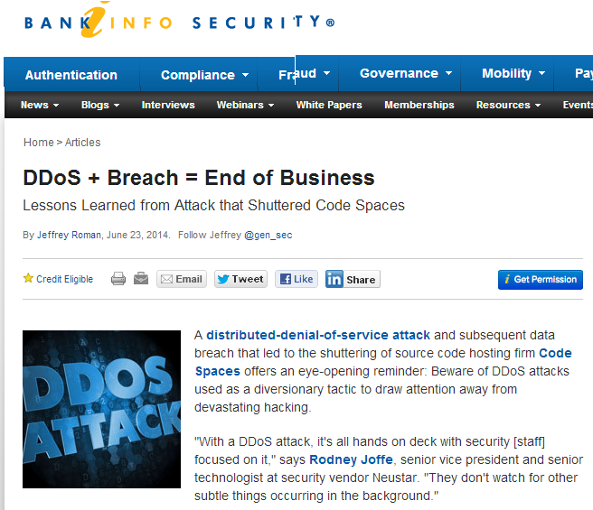
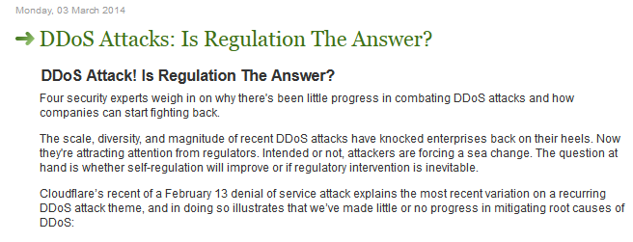
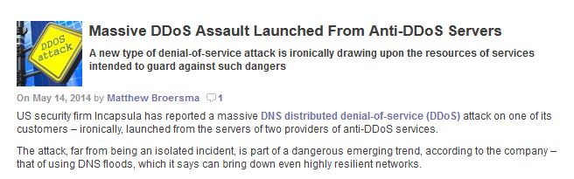
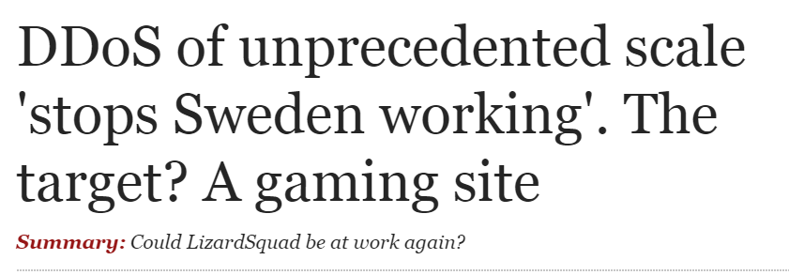
DDoS attacks making headlines

Slide 3



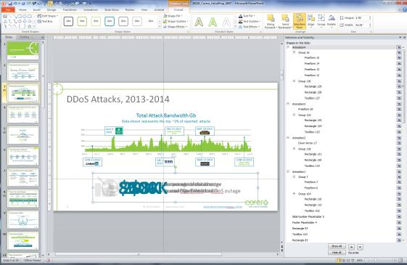



DDoS Attacks, 2013-2014 – Cost Impact
To edit animated text on the bottom of the page:
Select a text box
Click the Format tab
Click Selection Pane
You will see the Animation1, Animation2, Animation3 and Animation4
Click on the eye icon to hide these layers
This will allow you to edit the text on the animation you want
Total Attack Bandwidth Gbps
Data shown represents the top ~2% of reported attacks
400
AUG 9
2013
DEC 31 2013
MAJOR HOSTING SITES
MAR 29 2014
Format tab
300
Selection Pane
Eye Icon
200
100
Animation Layer
JUN 1
JUL 1
AUG 1
SEP 1
OCT 1
NOV 1
DEC 1
JAN 1
2014
FEB 1
MAR 1
APR 1
MAY 1
JUN 1
JUL 1
JUNE 21 2013
DEC 4
2013
MAR 17 2014
JUNE 23 2014
HONG KONG VOTING SITES
$700K
86
20%
$8K
per incident is the
average cost of a DDoS outage
minutes is an average of data center downtime due to DDoS attacks
of data center downtime
is caused by a DDoS attack
per minute is the average
cost of this downtime
Source: Network Computing/Ponemon Institute
Source: Digital Attack Map - DDoS attacks around the globe
Notes:
DDoS attacks have been increasing in frequency, capacity and overall effectiveness in recent months.
This is just a sampling.
You will notice a variety of spikes on this chart that indicate single attacks that that neared or exceeded 300Gbps per second.
100Gbps attacks are no longer uncommon, and there are very few environments that can withstand that class of attack.
20% of datacenter downtime is attributed to DDoS attacks
Average downtime of 86 min, translating to an average of 86k in costs. With Total outage damage averaging 700k
This is a sophisticated problem that requires a First Line of Defense.

Slide 4
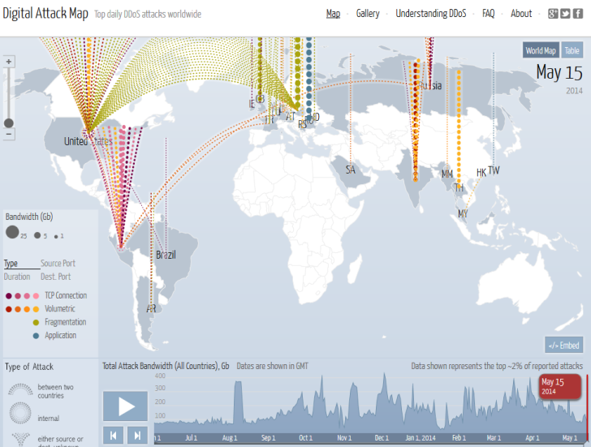
DDoS Digital Attack Map
http://www.digitalattackmap.com/
Fragmented
Application
Volumetric
TCP Connect
According to a recent survey conducted by the
SANS Institute…
“The most damaging DDoS attacks mix volumetric attacks with targeted, application-specific attacks.”

Slide 5
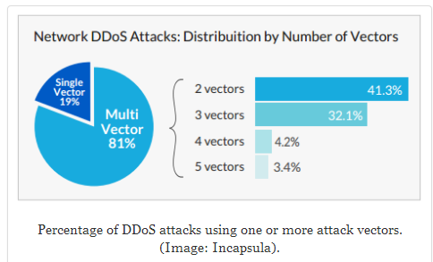
Are the attackers getting smarter?
Researchers are finding an uptick in the number of new techniques
Attackers defeating traditional protection (Firewall, ACL, Blackhole)
Attackers are developing new methods of bypassing defenses
Network DDoS Attacks: Distribution by Number of Vectors

Slide 6
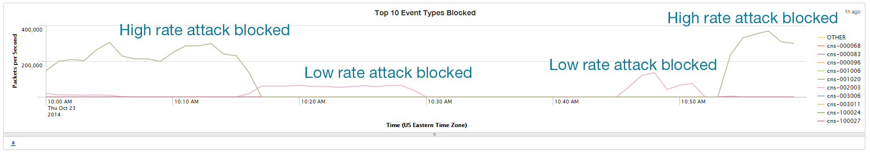
Are the attackers getting smarter?

Slide 7
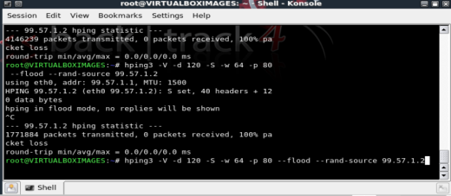
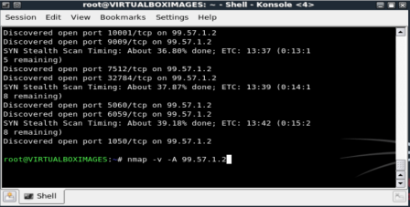
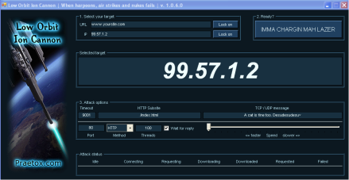
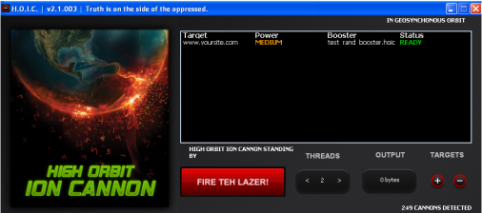
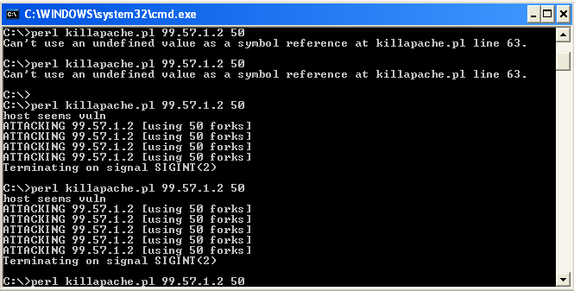
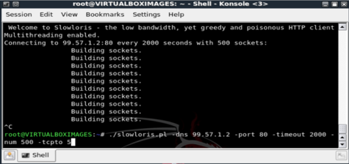
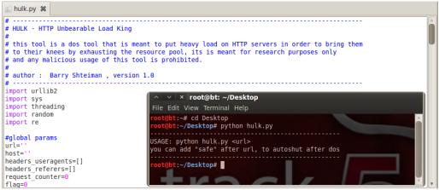
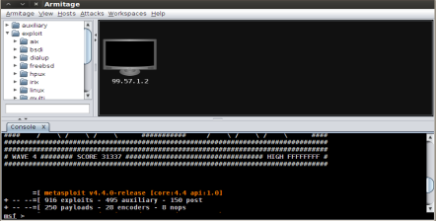
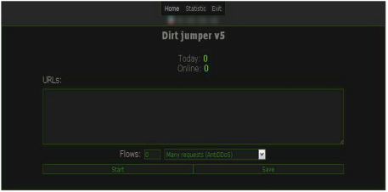
It’s Getting Easier to Attack…
Hping3
NMAP
Low Orbit ION Cannon
www.yoursite.com
High Orbit ION Cannon
KillApache.pl
Slowloris
HULK
Metasploit
SlowHTTPtest

Slide 8
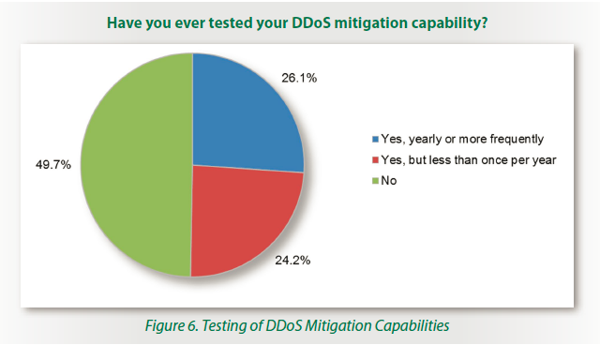
Are you prepared ?
40% - completely unprepared
23% - have no current plan
16% - have no future plan
26% - rely on operational infrastructure
50% - have never tested
Access the entire report:
www.corero.com/SANS-DDoS-Survey

Slide 9
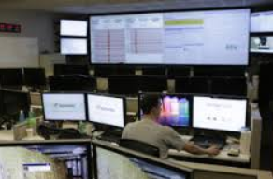
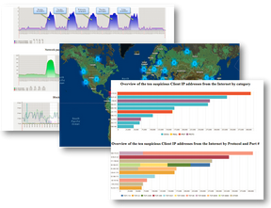
What is your visibility solution for DDoS?
Ideal solution provides:
  Traffic visibility even under attack
  Monitor incoming connections
  Monitor requests/responses
  Detect unwanted traffic
  Log security policy violations
  Record/Analyze attack traffic
    sFlow/PCAP/SIEM
  Gather attack intelligence and forensics
    Both real-time and historical
    Aggregate and granular reporting

Slide 10

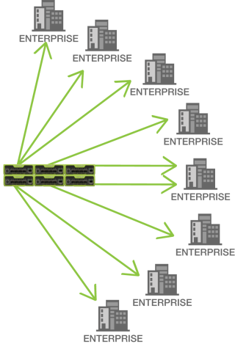
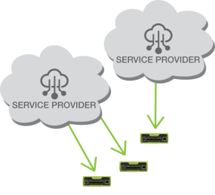



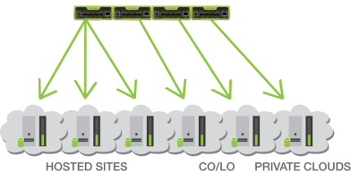
Where does Corero fit in the Network/Cloud?
Infrastructure Protection at
Peering Points
Enterprise Protection
CoLo, Cloud & Hosting Protection

Slide 11




Thank You
Bipin.mistry@Corero.com
Enterprise
Hosting
Service Provider
MSSP

Slide 12
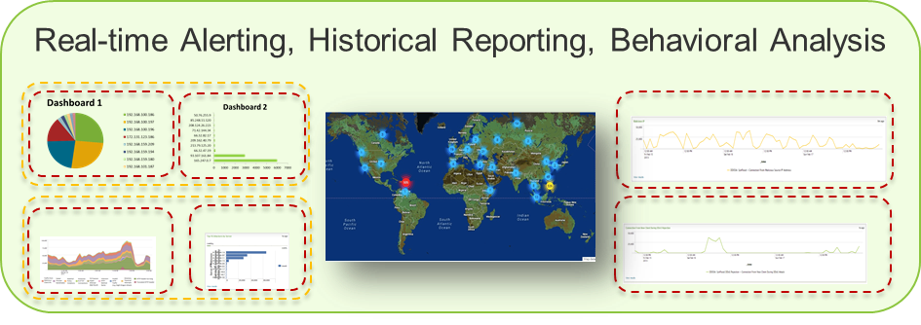

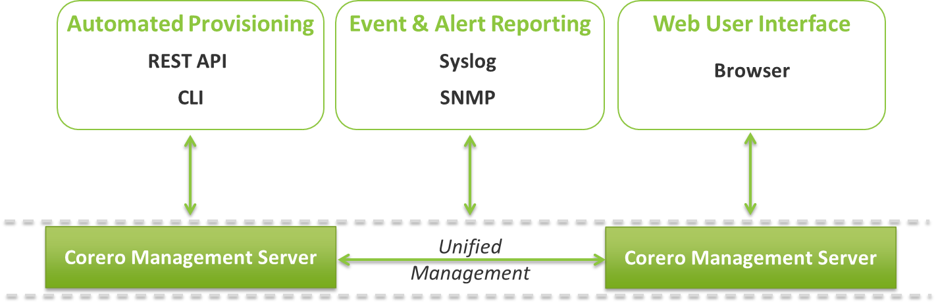

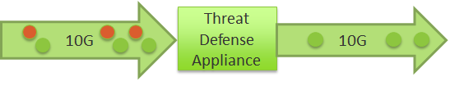

SmartWall – Solution Architecture
Technology
Partners
Analytics
& Reporting
Engine
Automation and
Provisioning
System
Do No Harm
Detection &
Protection
n x 1/10G

Slide 13
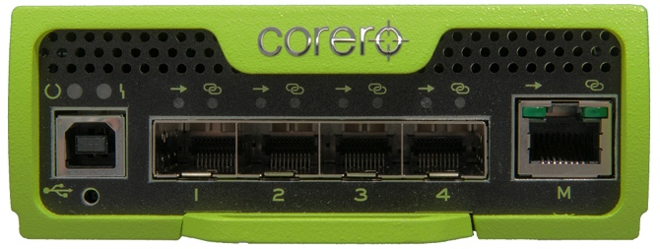
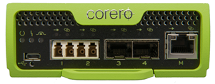
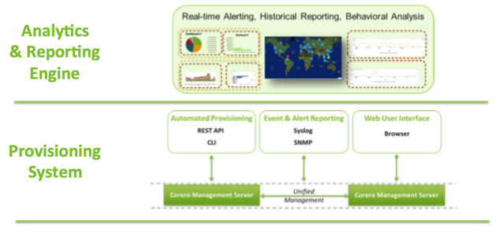
SmartWall – ecosystem of products
Family of Appliances (1G & 10G SFP+)
  Network Threat Defense (DDoS)
  Network Forensics (PCAP)
  Network Bypass (ZPB, TAP)
Provisioning and Analytics System
  CMS
  Splunk
  GUI, CLI, RestAPI, SNMP, SYSLOG

Slide 14
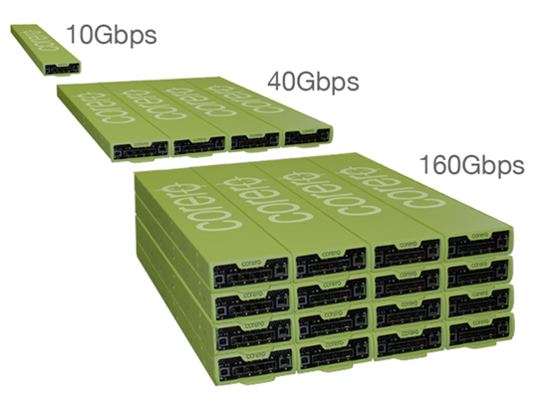
SmartWall TDS – Power in a Small Package
Scalable Deployment
Increments of 10 Gbps @ 30M PPS
¼ rack width
4U
19”

Slide 15
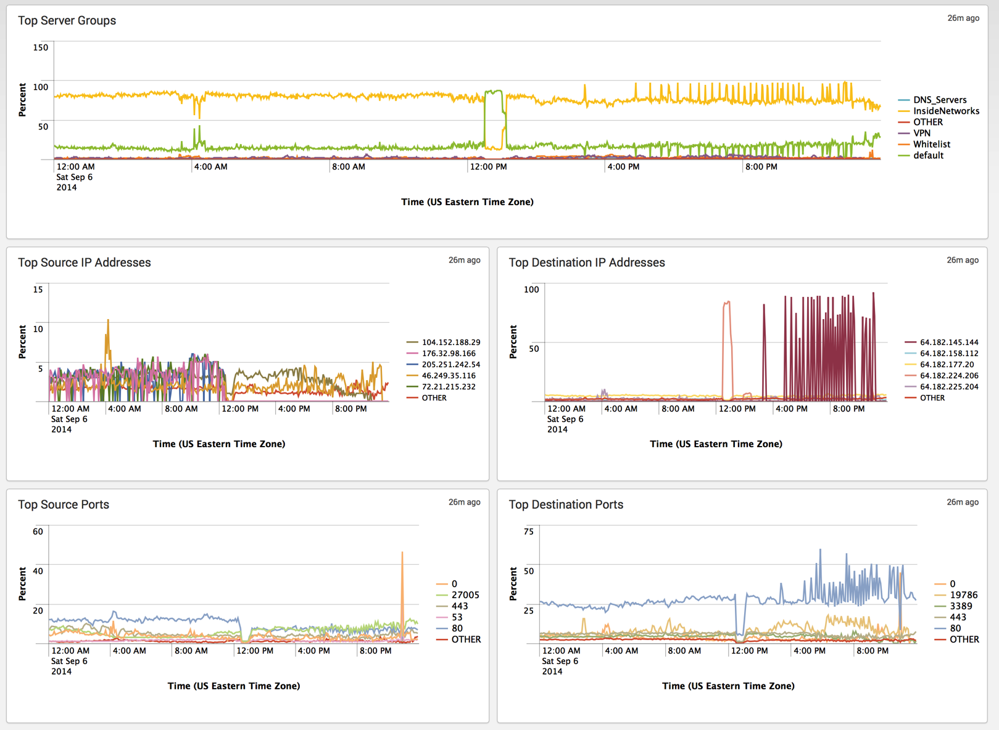
Visibility – Attack Analytics & Reporting
Anon
Anon
Anon

