Slide 1
DHCPv6 Operational Challenges
Tom Coffeen, IPv6 Evangelist
UKNOF January 2015

Slide 2
Agenda
IPv6 is here! (Really, we mean it this time…)
DHCPv6 (i.e., Oh, look what IPv6’s dragged in!)
Stuff that’s (more or less) working
Prefix delegation
DHCPv6 fingerprinting
Stuff that’s (more or less) borked
Failover
Sanity in mixed autoconfig environments
Conclusion

Slide 3
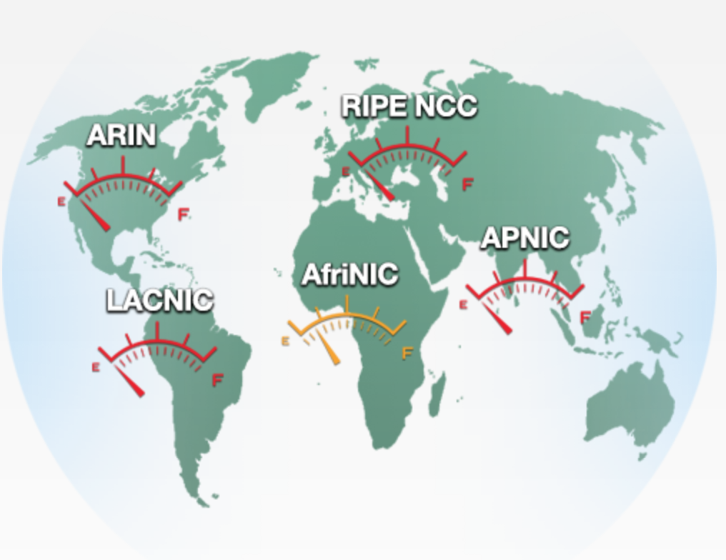
IPv4 is depleted…

Slide 4
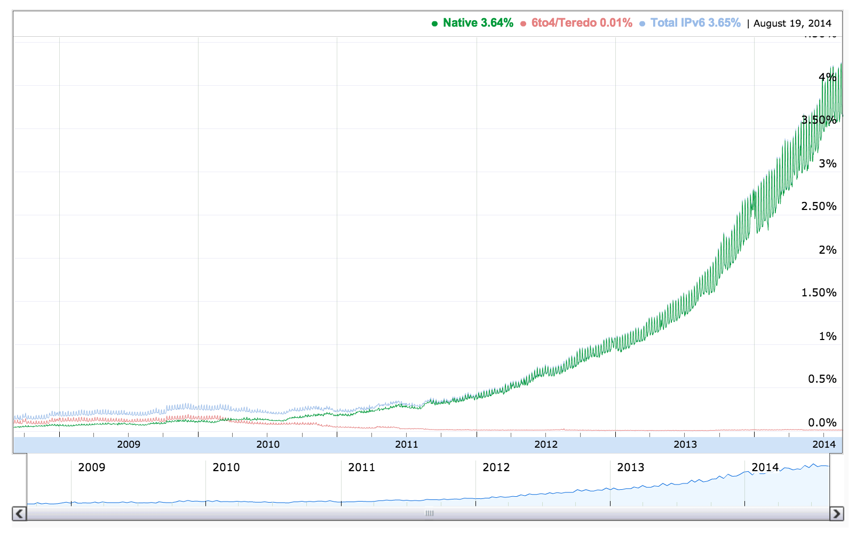
IPv6 is Here…

Slide 5
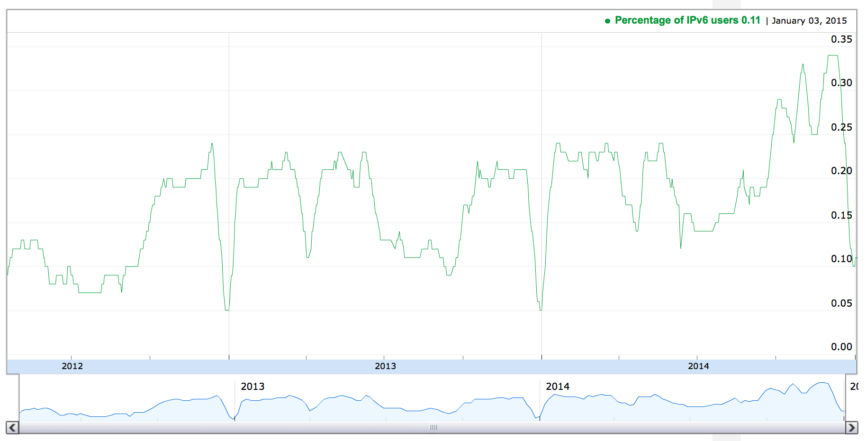
IPv6 is…Over There…
UK Percentage of IPv6 Users
0.33%

Slide 6
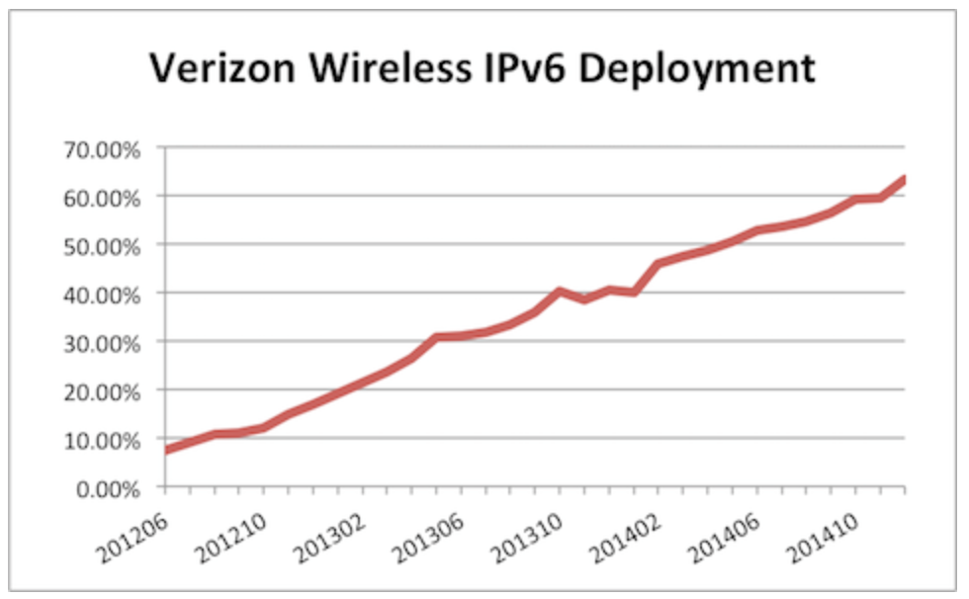
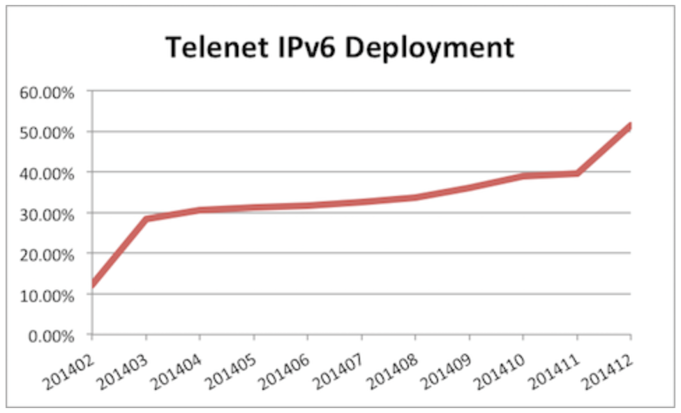
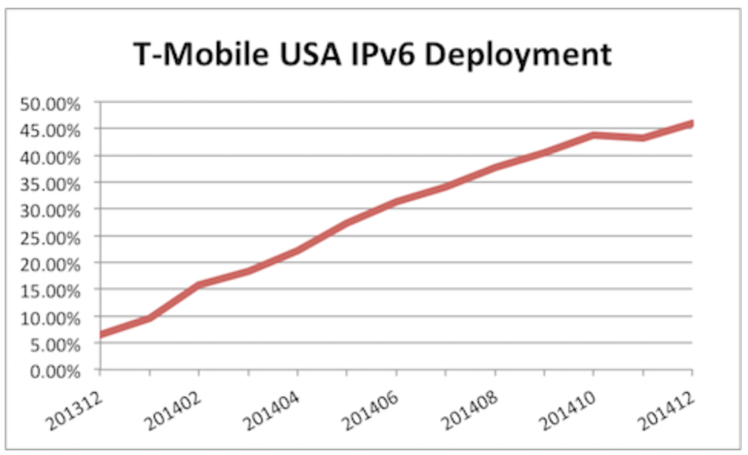
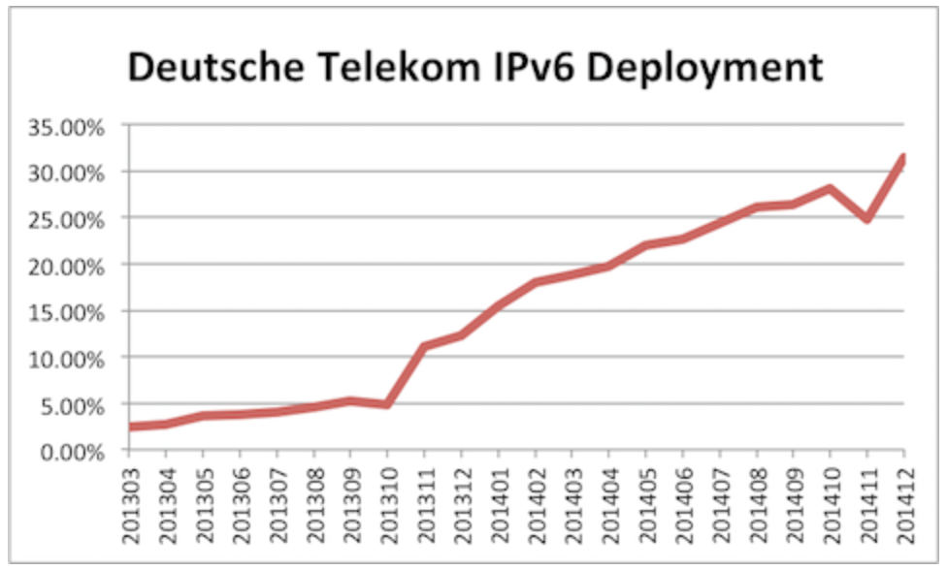
Some IPv6 Network Operator Measurements
63%
51%
46%
31%
Source: http://www.worldipv6launch.org/measurements/

Slide 7
UK IPv6 Network Operator Measurements
Source: http://www.worldipv6launch.org/measurements/
Notes:
We present measurements of network operator participants in World IPv6 Launch, based on data received from major website participants, as described in more detail below. We present a simple average of the data received, and list all networks with measurements from at least two sources, with a simple average above 0.1%. The network operator participants list includes some networks that measured above the threshold leading up to June 6th 2012, but for which we have insufficient measurement data to list here.
Akamai, Facebook, Google, LinkedIn, Yahoo

Slide 8
DHCPv6 – What’s (More or Less) Working
DHCPv6 Prefix Delegation

Slide 9
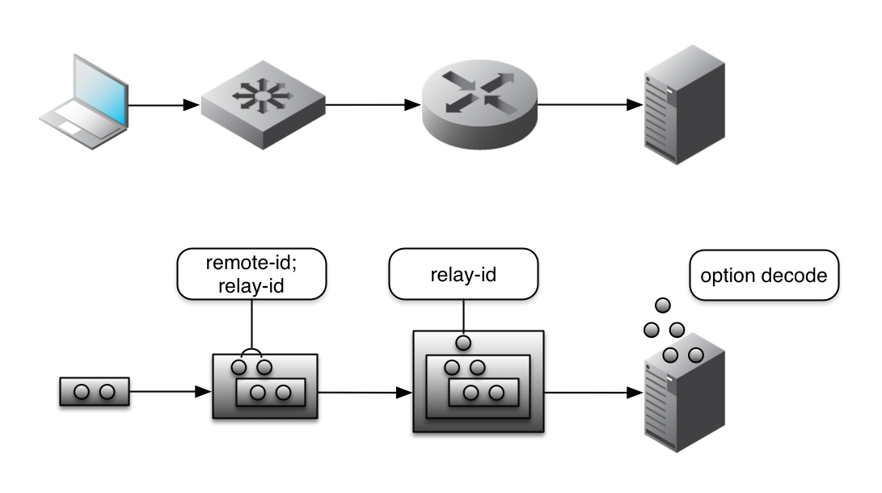
DHCPv6 Relay – ISC 4.3
Custom provisioning of DHCPv6 info for a particular client or client type or circuit ID
Classes can now be created based on DHCPv6 relay-provided options (rather than just client-provided options)

Slide 10
DHCPv6 Relay – ISC 4.3

Slide 11
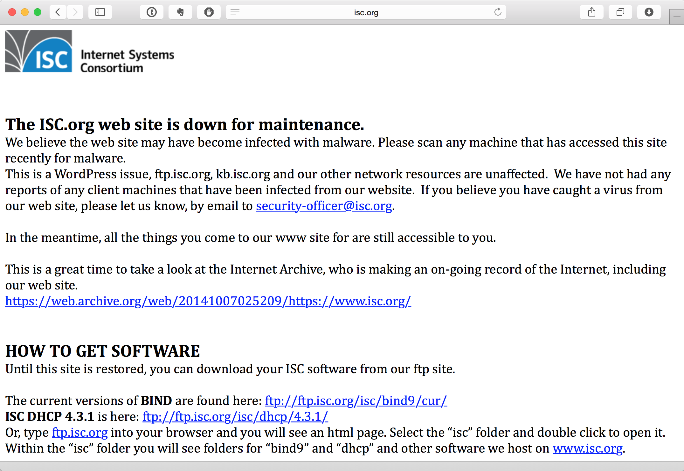
DHCPv6 Relay – ISC 4.3

Slide 12
DHCPv6
DHCPv6 Fingerprinting

Slide 13
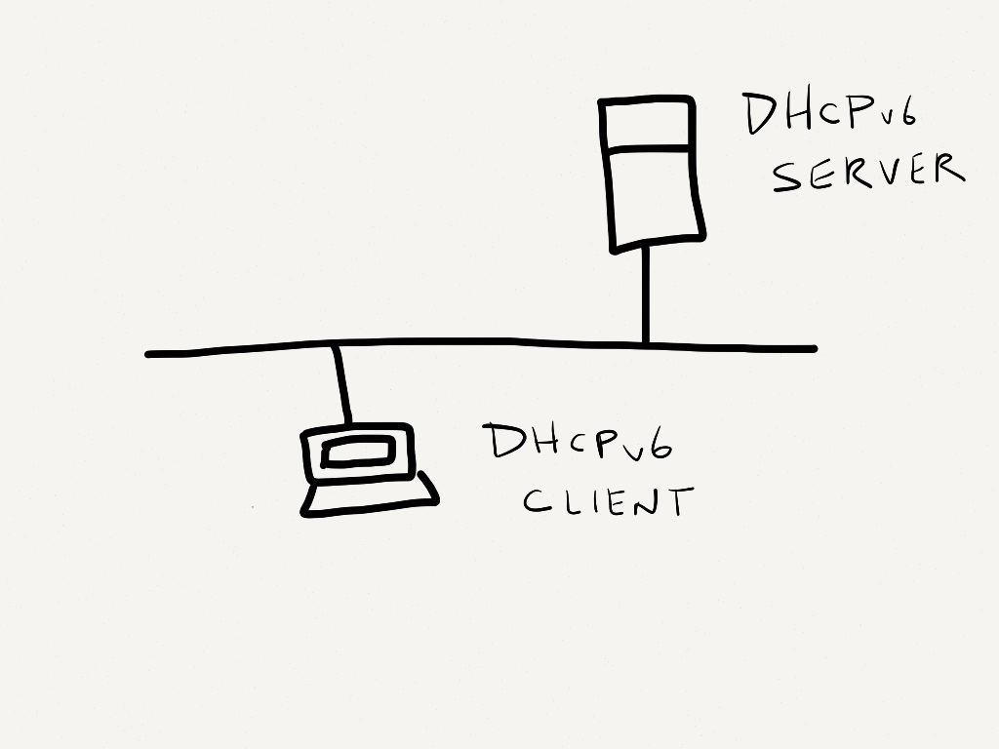
DHCPv6 Fingerprinting

Slide 14
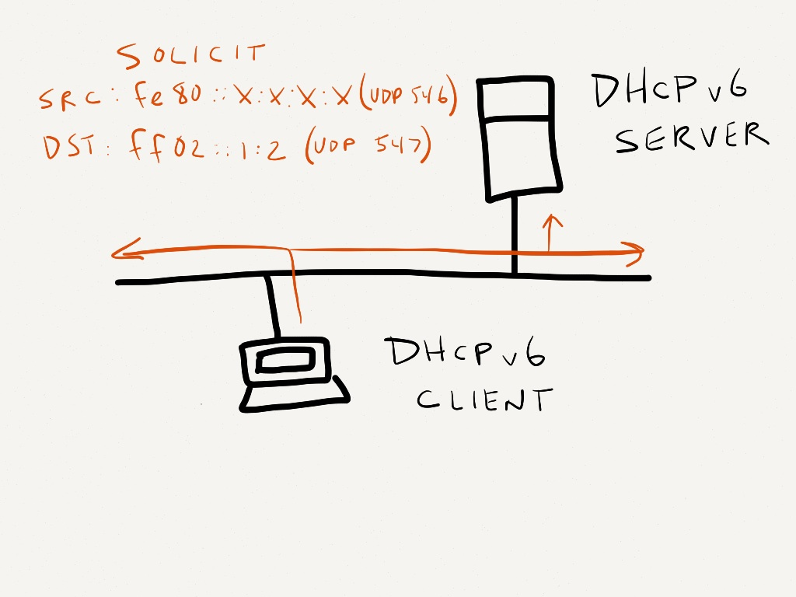
DHCPv6 Fingerprinting

Slide 15
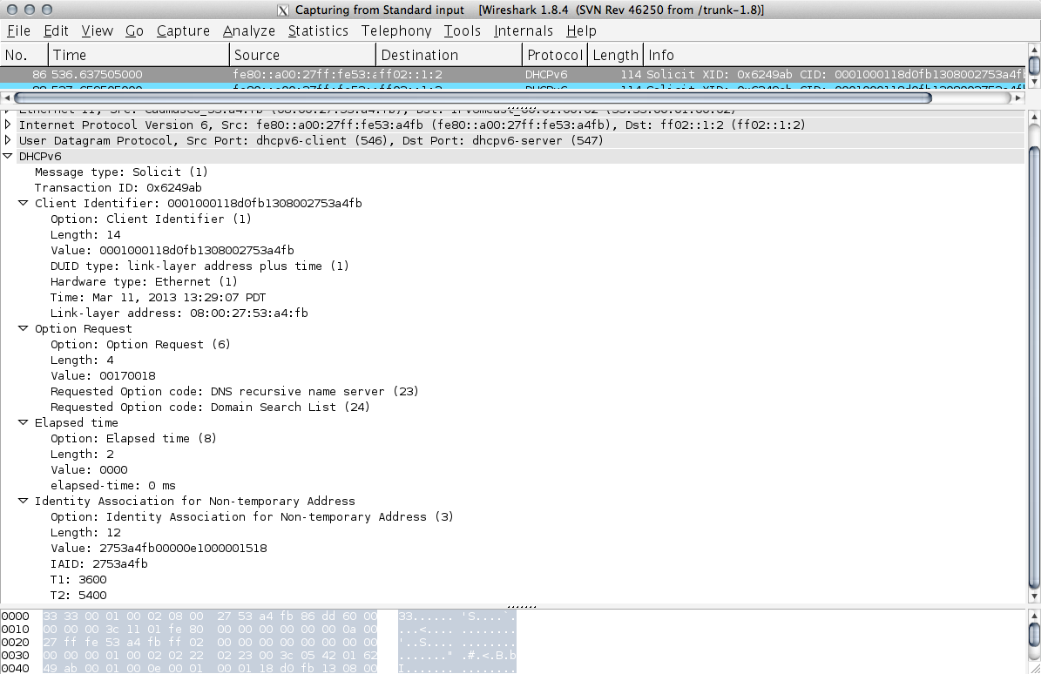
DHCPv6 Fingerprinting

Slide 16
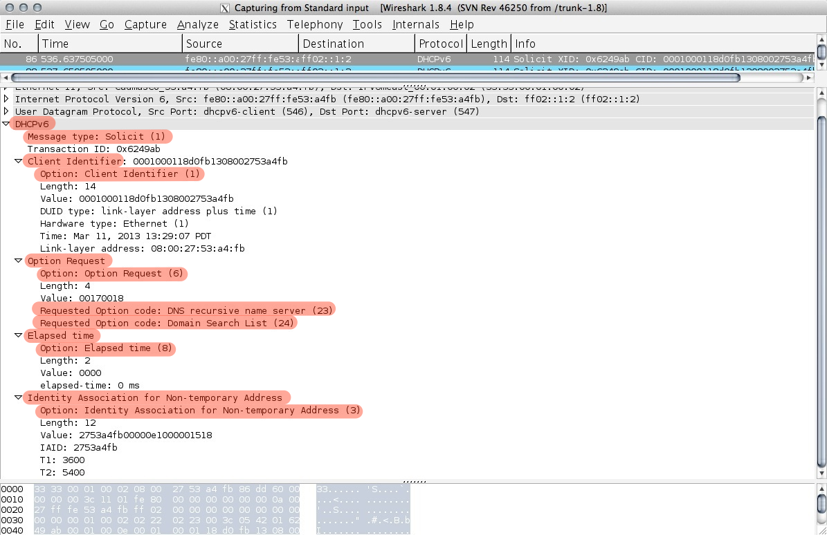
DHCPv6 Fingerprinting

Slide 17
DHCPv6 Fingerprinting
IPv4 DHCP Option Request (Option 55)
≈
DHCPv6 Option Request (Option 6)
Typically, fewer options appear under Option 6 in a DHCPv6 SOLICIT
Other elements may be required to validate the device type or system
Vendor Class field (where present)
Timing how often the client sends a SOLICIT message
In dual-stack environments, correlation with the IPv4 fingerprint
The Client Identifier field in a DHCPv6 SOLICIT

Slide 18
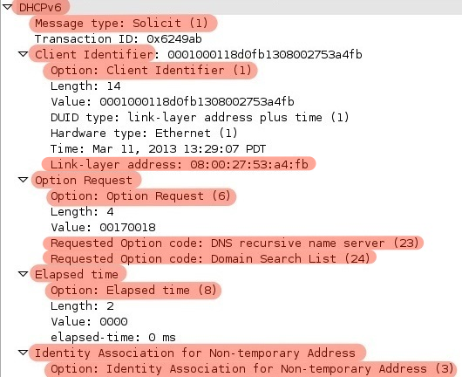
DHCPv6 Fingerprinting

Slide 19
DHCPv6 Fingerprinting
=
SOLICIT, 1, 6, 23, 24, 8, and 3
=
Fedora 17

Slide 20
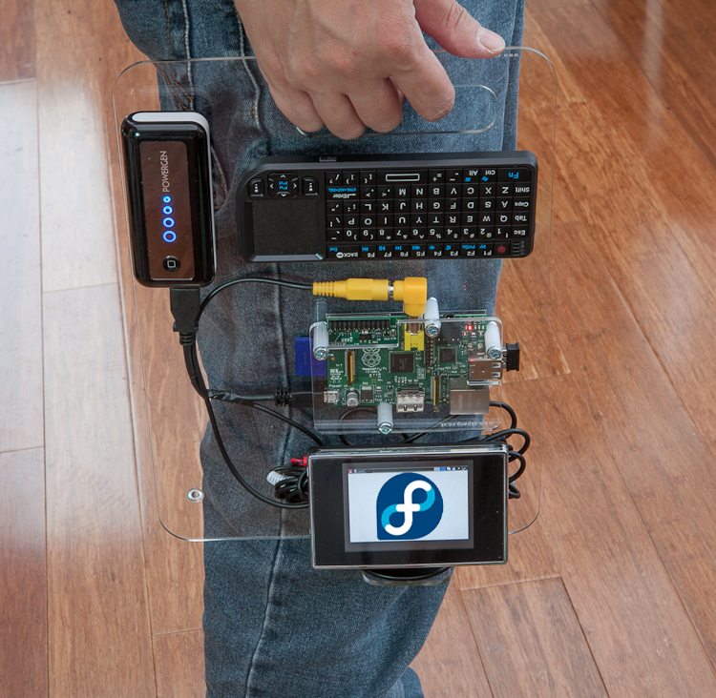
DHCPv6 Fingerprinting and BYOD
BYOD
or GTFO

Slide 21
DHCPv6 Fingerprinting and BYOD
Actionable data
(Very basic) Security
Is this type of device allowed on the network? (i.e., will it be allowed an IP address assignment via DHCP)
Reporting
What devices are connecting (or attempting to connect)?
Passive -- no additional transactional overhead
compare with nmap host OS detection

Slide 22
DHCPv6 Fingerprints
Currently, 198 unique fingerprints for DHCP
None for DHCPv6
Likely due to a lack of general IPv6 deployment in environments where fingerprinting is potentially most useful (i.e., enterprise/corporate networks)
Thus, BYOD not generally a challenge for IPv6 (yet…)

Slide 23
DHCPv6 – What’s Borked
DHCPv6 Failover

Slide 24
DHCPv6 Failover
Often repeated that it’s not needed (unless you’re doing PD)
Many enterprises are insisting on it
“We do it this way in IPv4 and we want to be able to do it the same way in IPv6…”
Still no standards
DHCPv6 Failover Requirements
draft-ietf-dhc-dhcpv6-failover-requirements-07
DHCPv6 Failover Design
draft-ietf-dhc-dhcpv6-failover-design-04
Still no proprietary implementation:
Notes:
Not for reasons of session persistence

Slide 25
DHCPv6 Failover
Workarounds:
Split prefixes
Take a /64 and split it into two /65s, one per DHCPv6 server; e.g.:
2001:db8:1:1:0000::/65
2001:db8:1:1::/64
2001:db8:1:1:8000::/65
Use DHCPv6 Preference option (primary server at 255, secondary at 0)
Drawback: Over time, uneven distribution of leases between servers
Additional workarounds in RFC 6853 - DHCPv6 Redundancy Considerations
Notes:
Not for reasons of session persistence

Slide 26
DHCPv6 – What’s Borked
SLAAC/DHCPv6 Interaction

Slide 27
DHCPv6 – Autoaddressing Review
SLAAC
Routers advertise prefixes that identify the subnet(s) associated with a link, while hosts generate an "interface identifier" that uniquely identifies an interface on a subnet. An address is formed by combining the two.

Slide 28
DHCPv6 – Autoaddressing Review
DHCPv6 (stateful)
The Dynamic Host Configuration Protocol for IPv6 (DHCP) enables DHCP servers to pass configuration parameters such as IPv6 network addresses to IPv6 nodes. It offers the capability of automatic allocation of reusable network addresses and additional configuration flexibility.

Slide 29
DHCPv6 – Autoaddressing Review
DHCPv6 (stateless)
Used by nodes to obtain configuration information, such as the addresses of DNS recursive name servers, that does not require the maintenance of any dynamic state for individual clients. A node that uses stateless DHCP must have obtained its IPv6 addresses through some other mechanism, typically stateless address autoconfiguration.

Slide 30
DHCPv6 – Autoaddressing Review

Slide 31
Autoaddressing – Renumbering scenarios
Address from
Autoaddressing
Method 1
Address’ from
Autoaddressing
Method 1
Release/replace
Address from
Autoaddressing
Method 1
Address from
Autoaddressing
Method 2
Release/replace
Address from
Autoaddressing
Method 1
Address from
Autoaddressing
Method 2
Retain/add

Slide 32
DHCPv6/SLAAC Interaction
Host State | Input | Behavior
Host has not acquired any addresses | No RA | Some popular OSes acquire DHCPv6 addresses.
Host has not acquired any addresses | RA with M=0, O=1 | Some popular OSes acquire other info from DHCPv6 addresses. Others do so only if A=1.
Host has acquired address from DHCPv6 only | RA with M=0 | Some OSes release DHCPv6 immediately. Some release upon expiry.
Host has acquired address from SLAAC only | RA with M=1 | Some OSes release DHCPv6 immediately. Some release only if SLAAC address expires and can’t be refreshed.

Slide 33
DHCPv6/SLAAC Interaction
Test, test, then test some more…

Slide 34
Questions?
tcoffeen@infoblox.com
twitter: @ipv6tom

Slide 35
References
ISC DHCP 4.3.0 is now online!
https://www.isc.org/blogs/isc-dhcp-4-3-0-is-live/
Dynamic Host Configuration Protocol for IPv6 (DHCPv6), RFC 3315, IETF, Jul. 2003
Chatter on the Wire: A look at DHCPv6 traffic, by Eric Kollmann, Nov. 2010
http://chatteronthewire.org/download/chatter-dhcpv6.pdf

