Slide 1
SDN/NFV Truths
Stuart Bates – Strategy & Innovation – Axians Networks

Slide 2
Who?

Slide 3
“Software is cheap”

Slide 4
“must be Open Source”

Slide 5
“Free at last!”

Slide 6
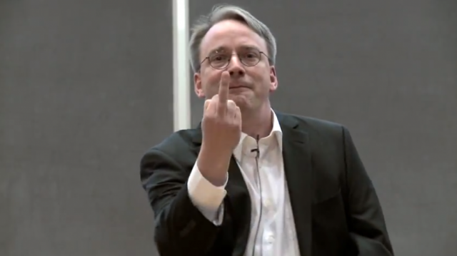
Really?

Slide 7
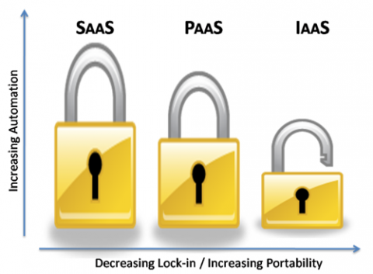
What’s right for you?

Slide 8
“I’m out of a job”

Slide 9
“It’s all so EASY”

Slide 10
“Everything Virtual”

Slide 11
“Virtual doesn’t scale”

Slide 12
Marketing Hype

Slide 13
You don’t believe?

Slide 14
Thank you.
Stuart Bates
stuart.bates@imtechict.co.uk
Twitter: @recoveringtechy
PROGRAM

