Slide 1
Anycast on a shoestring
Nat Morris - @natmorris
Thursday 22nd January 2015 – UKNOF30, London

Slide 2
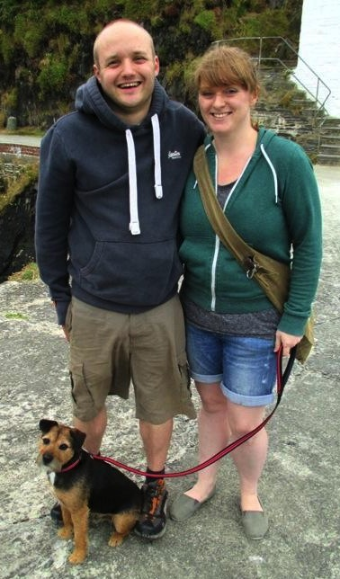
About me
Consultant, Esgob Ltd
Team leader, Cumulus
Board member, UKNOF
Based in West Wales
Aspiring lighthouse keeper

Slide 3
Anycast 101
Simple concept:
Announce the same address space from multiple locations
Multiple paths in BGP, best one selected based on policy
Benefits:
Increased reliability
Load balancing
Improved performance
Localized impact of DoS attacks

Slide 4
Summary
Fancied deploying a DNS Anycast service
Motivated by:
Bill Woodcock, PCH
SANOG8: “Best Practices in DNS Anycast Service-Provision”
Dave Knight, ICANN (now Dyn)
RIPE64: “Dense Anycast Deployment of DNS Authority Servers”
Gain more experience automating distributed environments.

Slide 5
Thoughts
Can I do it without spending too much?
What to offer?
Initially only secondary DNS
IPv4 + IPv6
Free service - no SLA, no Revenue
Does Claire need to find out?
Must be sub $1000/yr running cost

Slide 6
Requirements
Separation from existing management network - AS30746
Had spare PI /24 + /48
Applied for new ASN - got AS60564
Need highly automated framework
Wanted to play with new tools
Open source everything
https://github.com/esgob

Slide 7
Network
Each anycast node:
Announce /24 + /48 via BGP
Static default route to the provider (accept no routes)
BGP Announce
193.47.147.0/24
2001:067c:1b43::/48
BGP Announce
193.47.147.0/24
2001:067c:1b43::/48
Upstream A ASxxx
Upstream B ASxxx
/30 + /64
Node 2
AS60564
Node 1
AS60564
Upstream C ASxxx
Upstream D ASxxx
BGP Announce
193.47.147.0/24
2001:067c:1b43::/48
BGP Announce
193.47.147.0/24
2001:067c:1b43::/48
Node 4
AS60564
Node 3
AS60564

Slide 8
Network
All management traffic inside OpenVPN
Additional RFC1918 loopback per node
No need for TSIG from AXFR to anycast nodes
Protects beanstalk traffic, API, collectd, zone transfers
Upstream A ASxxx
Upstream B ASxxx
Node 2
AS60564
Node 1
AS60564
Upstream C ASxxx
Upstream D ASxxx
Node 4
AS60564
Node 3
AS60564
Management GW

Slide 9
DNS zone transfers
Master servers operated by others
Anycast nodes
ns1.esgob.com
AS60564
Zone transfer
Zone transfer
Zone transfer
ns0.esgob.co.uk
(only my zones)
axfr.esgob.com
AS30746
Supports notifies from masters

Slide 10
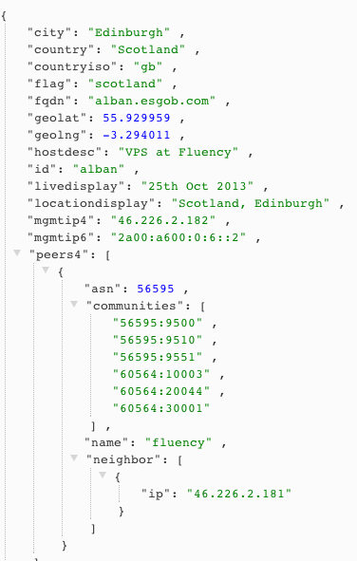
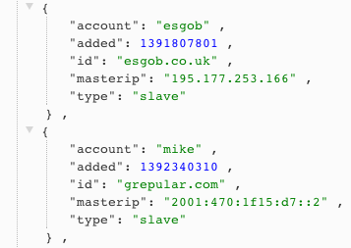
Store everything in JSON
Data stored in RethinkDB
Distributed JSON document database
Free form, easy to add attributes

Slide 11
Application design
REST API - Python + Flask framework
cronjob + rsync free zone
Beanstalk - Message queue
Add/change/removal of zones via API triggers job to be added to queue
Daemons on AXFR + Anycast nodes wait for jobs
New zones live on all nodes with 5 seconds
Website
Python + Flask
Users
Redis
BeanstalkD
job
REST
API
job
Scripts / Daemons
Config files
Jinja2 templates
RethinkDB
Python + Flask

Slide 12
Where to host the anycast nodes?
Can’t cost too much each month
Ruled out renting co-lo / dedicated servers
Need a wide reach
Virtual machines
Swap with friends?
Low cost hardware

Slide 13
Mythic Beasts
UK clueful hosting company
£7/month = £84/yr = $141/yr
512mb RAM, 1 CPU, 10gb HDD, 75gb BW
Bought a VM, opened a support ticket
BGP not listed on the website.
Me: “I have a /24 + /48 of PI, can you set me up a BGP session? see AS60564 + AS-ESGOB-ANYCAST”
Them: “Peer with these IPs, sessions are ready!”
Too easy!

Slide 14
Quest to find more friendly VM hosts
LowEndBox.com
Blog / adverts for VM providers, all < $10 month
Usually OpenVZ based
Need KVM/XEN/VMWare to support Quagga/BIRD
LowEndTalk.com
Message board, various small scale VM hosts
Google
“vps bgp session”

Slide 15
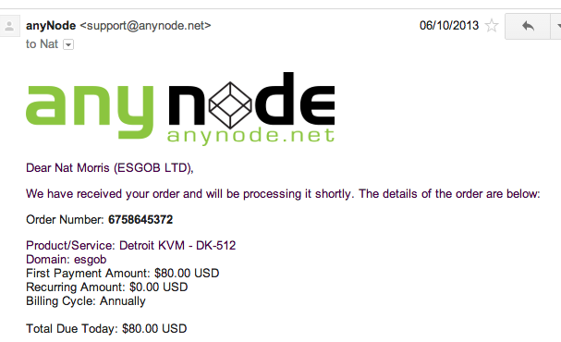
Anynode in Detroit
Listing on LowEndTalk
Asked if they could support BGP.
Yes on any VPS!!
$80/yr, 1 CPU, 512mb, 40gb HDD, 500gb BW

Slide 16
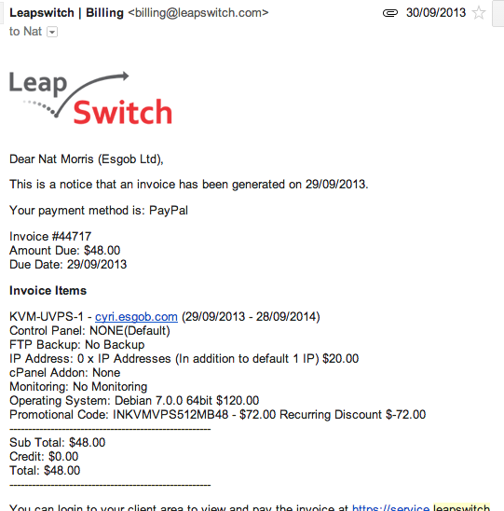
Indian bargin!
LeapSwitch, based in Pune, India.
New VPS host, saw an offer advertised
$120/yr, 1gb RAM, 20gb HDD, 500gb BW

Slide 17
Growing - Oct 2013
Up to 4 VMs
London A (on existing KVM server)
London B
Detroit
India
Spinning up VM taking about 10 minutes
Add JSON entry into RethinkDB
Install Debian
Install Puppet (Collectd, BIND, Quagga, custom daemons etc)
Done
Pub!

Slide 18
Friends - Oct 2013
Offers to host VMs for free from:
Edinburgh @ Fluency
Boston @ TorwardEx
One swap:
Bremen, Germany @ Fremaks
Quickly up to 7 nodes after 1 month

Slide 19
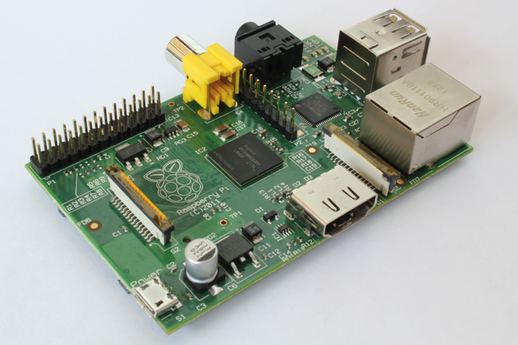
Friends
“We can host something, but not a VM”
Various issues:
Network engineers didn’t have access to VM hosts
No VM infrastructure at all
All VMs routed by hypervisor, can’t bridge to BGP routers
Solution…
Raspberry PI, $35
512mb / 16gb SD Card
800mhz (overclocked)

Slide 20
Raspberry Pi
Sent RPI to Belfast – David Farrell @ Tibus
Ran NSD3 great, ~200qps
Adding / removing zones with NSD3 required service restart ☹
Swapped to PowerDNS, testing went ok
pdns_control segfault’ing on ARM
Gave in and moved to BIND

Slide 21
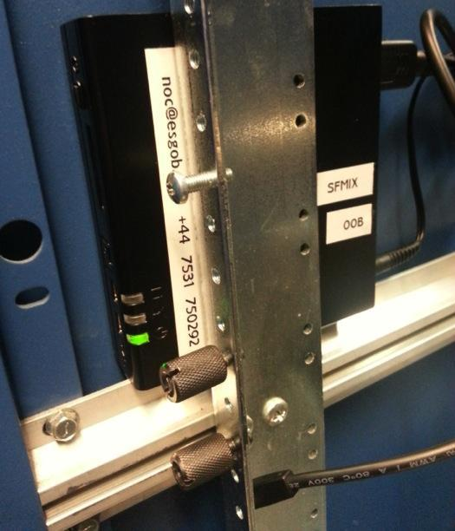
Time to peer - Jan 2014
Offer of a node at SFMIX from Matt Peterson
San Francisco based IXP
Couldn’t turn this down.
Zero U install
Needed 2 NICs, IX + OOB
FitPC2i - perfect ☺
Atom 1.6ghz, 1gb RAM, 16gb SSD
$150 on eBay
Peering with:
HE.net, ISC, Unwired, PCH
Layer42, Lookout, DigitalOcean

Slide 22
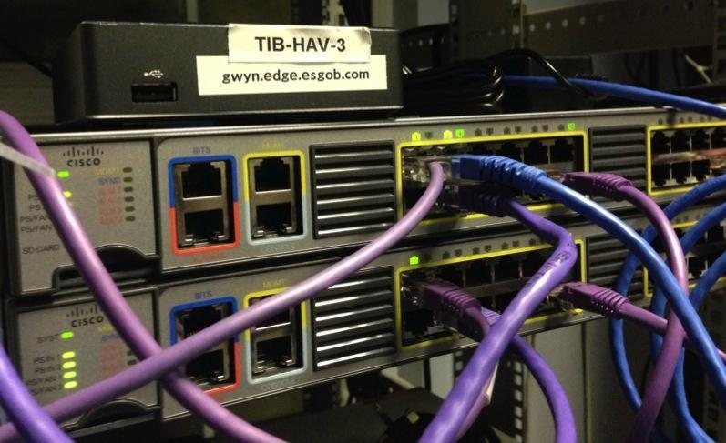
Pi problems
Puppet slow + loading zones taking too long
More offers to host h/w nodes
Manchester, Andy Davidson @ Allegro
Gigabyte BRIX
Quad Core, 1.8ghz, 4gb RAM, 30gb MSATA
Swap out Belfast Pi

Slide 23
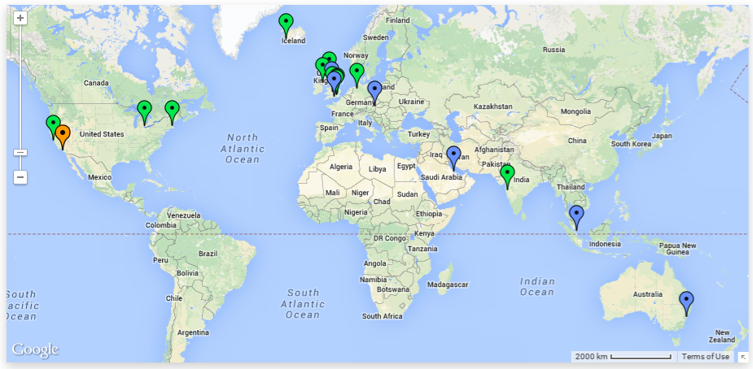
Still growing today
12 nodes live, 6 in build
As of 3rd Nov 2014

Slide 24
Fun along the way
First BGP customer for some of the VM hosts:
Assisted educating them…
Prefer transit routes over customers, eek
No BGP filters / route-maps or prefix lists - Ahhhhh!
Some hosts don’t have communities
Helping people get those implemented
RIPE Atlas
Scheduled measurements to look at latency + CHAOS id.server
RIPEstat
Using the REST API to query visibility of a /48 anchor from each instance, 15mins to get working.

Slide 25
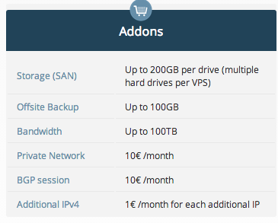
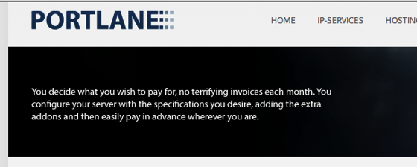
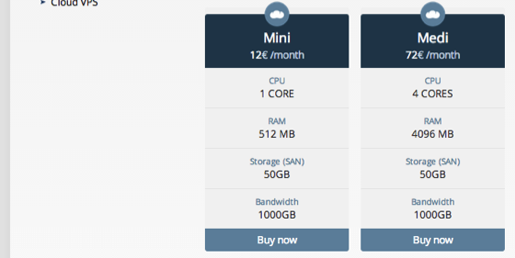
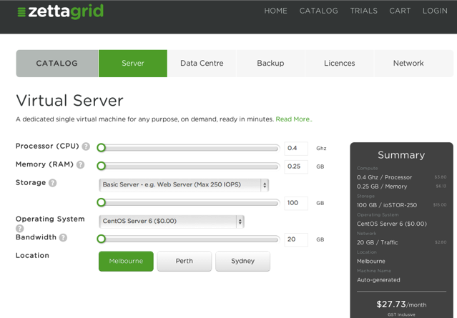
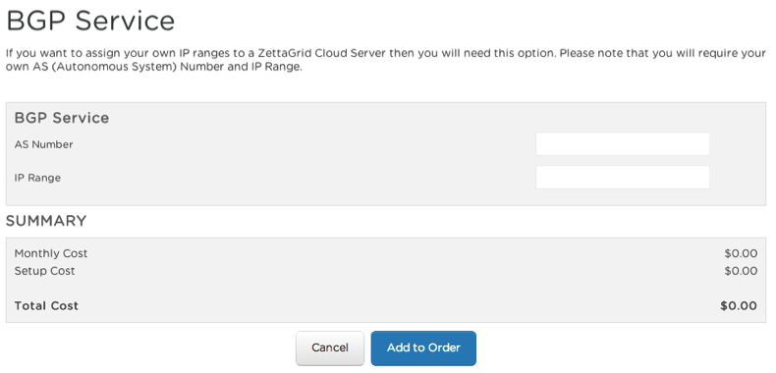
Market for VMs with BGP sessions

Slide 26
Discoveries
Easy to find budget anycasters
Webhost forums / LowEndTalk / bgp.he.net
“Interesting” deployment methods
Shared /24
Dedicated IP, custom fwd/rev DNS, slaved zones
Hosted /24
Same as above but customer provides /24 to announce
Shared /24, /32 tunneled
Dedicated IP, tunneled by anycaster to customer via GRE
Single /24
Anycaster only has one /24, website + mail + mgmt in same space. DNS answered at edge, other IPs tunneled to another VM/dedicated box.

Slide 27
Discoveries
Not all budget DNS hosting companies host every zone at the edge
Some host zones centrally and cache at the edge
Some tunnel all DNS traffic back to a location:
Looks like anycast
Poor DNS performance
GRE from edge to a single auth server
Selling /32 GRE tunnels to customers!

Slide 28
Not just DNS?
Simple HTTP/HTTPS service to assist debugging
local.esgob.com
local4.esgob.com / local6.esgob.com
Returns JSON via lighttpd on each node
nat@enw:~ $ curl http://local.esgob.com
{
"city": "London",
"country": "England",
"countryiso": "gb",
"flag": "england",
"locationdisplay": "England, London, B",
"ref": "ql7f823b"
}

Slide 29
What next?
Keep honest – host every zone at the edge
Finish web interface
Make the Github repos consumable:
Produce install instructions
Getting started guide
Support: Multi master, TSIG inbound
Mix of routing and DNS daemons
configurable per node via JSON in RethinkDB
BIND, NSD4, KNOT, Quagga, BIRD + ExaBGP
Looking for friendly hosts:
Europe, Africa, India, Asia, South America, anywhere!

Slide 30
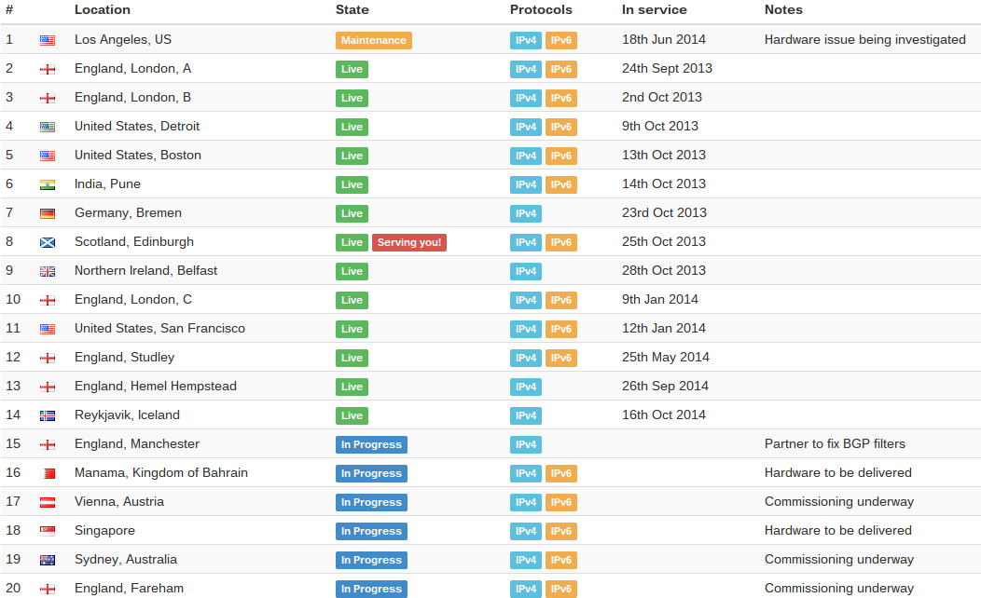
As of today...
Currently costing just under $480/yr - Claire compliant!

Slide 31
Take aways
Low barrier to entry - VM with BGP full table $40/yr
Don’t become part of the problem
Ensure your customers aren’t hijacking prefixes
Always use IRR prefix lists on cust BGP sessions
Using anycast can improve service delivery to your customers
Automate all things!
Have fun and share your experiences

Slide 32
Questions?
https://noc.esgob.com
@esgobltd
https://nat.ms
@natmorris

