Slide 1



On Factors Affecting the Usage and Adoption of a
Nation-wide TV Streaming Service
Dmytro Karamshuk¹, Nishanth Sastry¹, Jigna Chandaria², Andy Secker²
¹King's College London, ²BBC R&D
CD-GAIN: EPSRC project in collaboration with BBC R&D, http://bit.ly/cd-gain

Slide 2




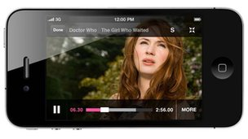
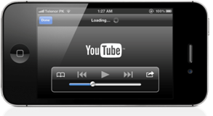
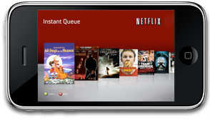
Some Figures
CISCO Visual Networking Index
Video traffic is predicted to reach 79% by 2018
Three-fourths of mobile traffic will be video by 2019

Slide 3
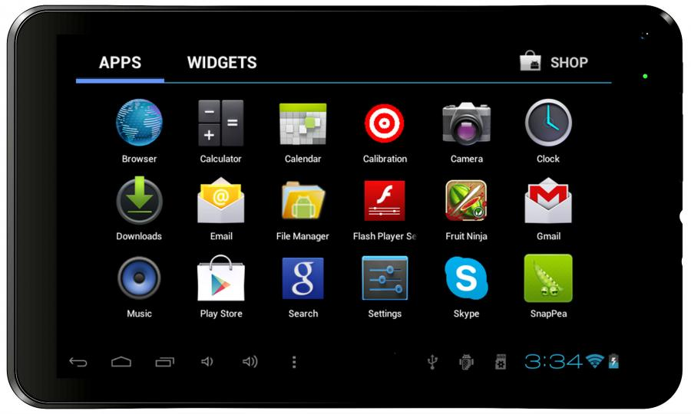




…which Raise Some Issues
User Experience
Infrastructural Support
Business Models

Slide 4








Data-driven Analysis
2 x [INFOCOM’2015], [WWW’2013]
2 x [Under Submission]
Sessions - 1.9 Billion
May 2013 – Jan 2014
Users - 32 M/month
IP address – 20 M/month
≈ 50% of the UK population

Slide 5








Roadmap
Geography
Fixed-line ISPs
Pricing Models
ISPs
Cross-ISPs
Mobile ISPs
Devices

Slide 6

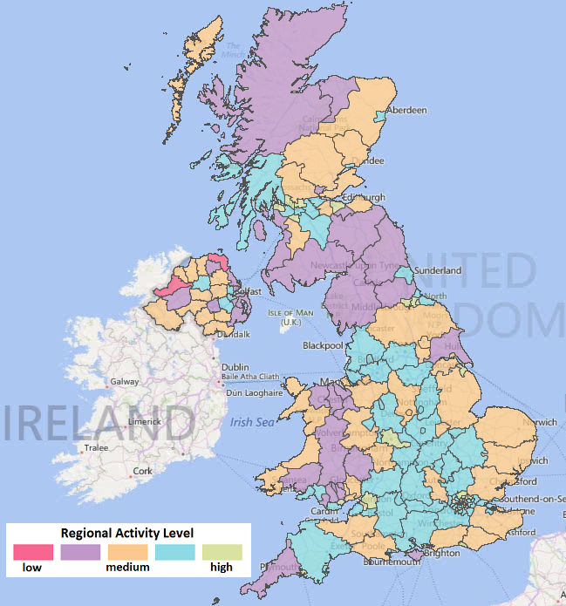
Geographic differences
Average per-user # sessions
Correlation with Ofcom statistics
Infrastructural support is important

Slide 7

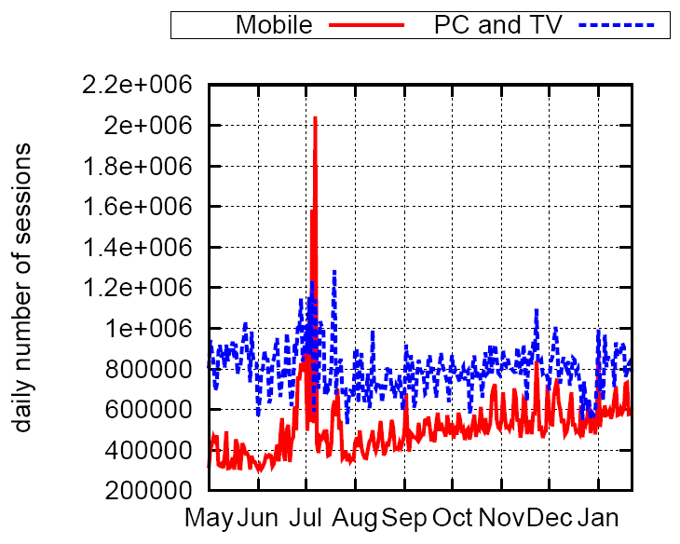
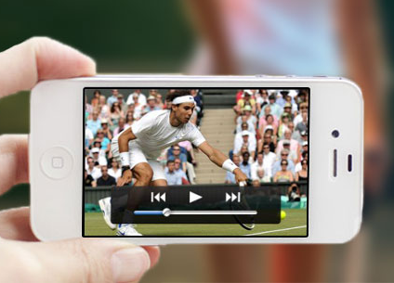
Device-specific differences
Daily volume of Live accesses
… jumps for mobiles during Wimbledon
Mobile consumption is affected by external events

Slide 8

Roadmap
Geography
Fixed-line ISPs
Pricing Models
ISPs
Cross-ISPs
Mobile ISPs
Devices

Slide 9

ISP-level view
Fixed-line Internet market
(5 representative providers)
Mobile Internet market
(5 representative providers)
Mobile market is more dynamic than the fixed-line Internet market

Slide 10
Pricing Models
Limited-cap data packages
(M2 – M4)
All-you-can-eat data
(M1, M5)
All-you-can-eat plans boost users’ consumption

Slide 11
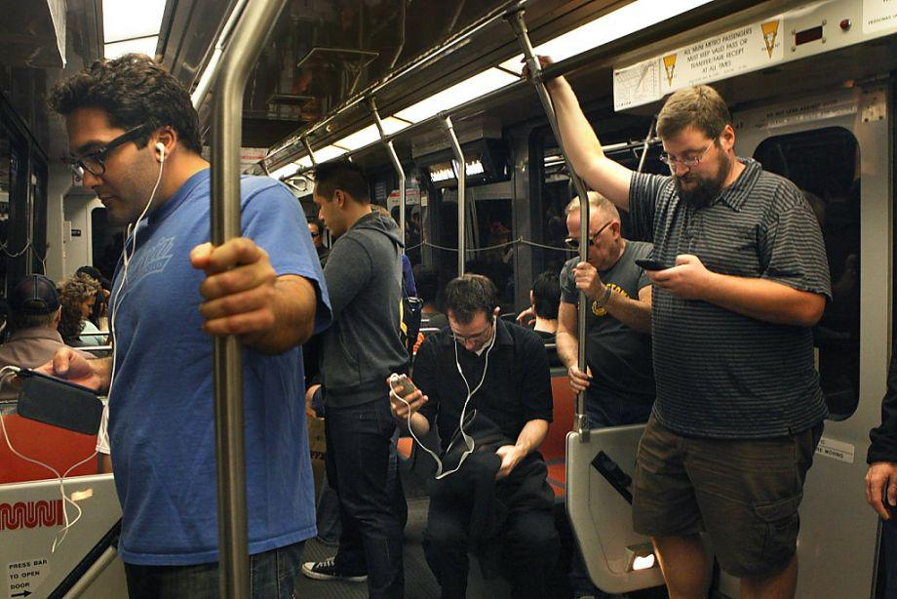
Behavioral Shift
Fixed-line accesses (F1-F5) peaks in the evening
Mobile users watch more
during commutes
Limited data caps (M2-M4) peak in commute hours

Slide 12
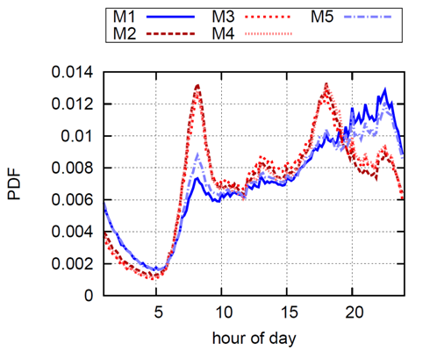
Behavioral Shift
+
=
Unlimited data plans (M1, M5) is
a superposition of both

Slide 13
Roadmap
Geography
Fixed-line ISPs
Pricing Models
ISPs
Cross-ISPs
Mobile ISPs
Devices

Slide 14
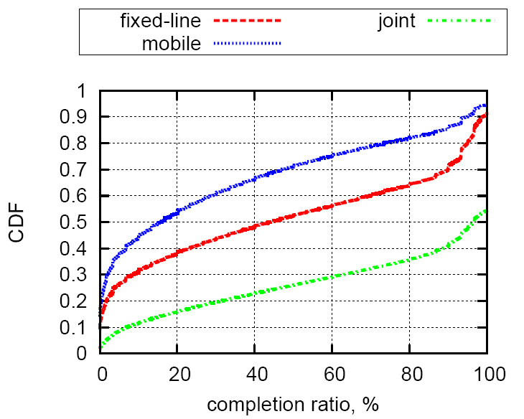



Cross-ISPs watching patterns
Completion across different ISPs
Fixed-line ISPs
Mobile ISPs
Users complete watching across different sessions and networks

Slide 15


Speculative Content Pre-fetching
Pre-fetch at home
Watch during commutes
Speculative pre-fetching can save up to 50% of mobile traffic

Slide 16




Conclusion
Infrastructural Support
Business Models
User Experience
user engagement depends on the level of infrastructural support
… as well as on pricing models
and there is a lot potential for mobile content pre-fetching

Slide 17
Our website:
http://bit.ly/cd-gain
Dmytro Karamshuk
King's College London
follow me on Twitter: @karamshuk

