Slide 1
UK IPv6 Council
Veronika McKillop
19/1/2016 @ UKNOF33

Slide 2
What is UK IPv6 Council?
Technology User Group
The aim is to:
Bring together a community and enable dialog about IPv6 deployment
Develop sense of togetherness, share knowledge and experience

Slide 3
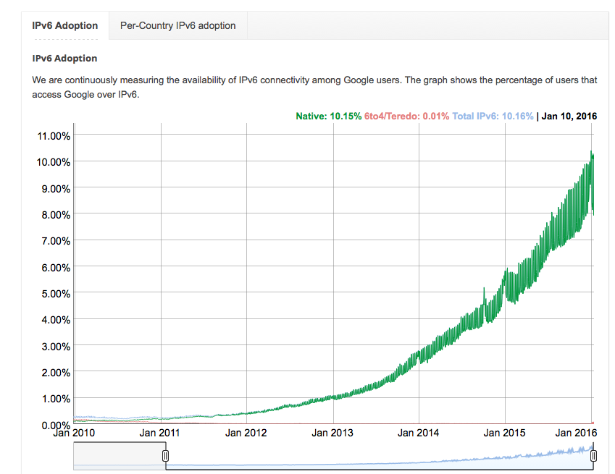
Why are we doing this?
The world has been changing since June 2011
IPv6 has accelerated in the last 12 months
US grew from 10% to 23.6%
We don’t want the UK to be left behind

Slide 4
 iOS IPv6 – June 2015
“Because IPv6 support is so critical to ensuring your applications work across the world for every customer, we are making it an AppStore submission requirement, starting with iOS 9.”
Source: http://www.internetsociety.org/deploy360/blog/2015/06/apple-will-require-ipv6-support-for-all-ios-9-apps/

Slide 5
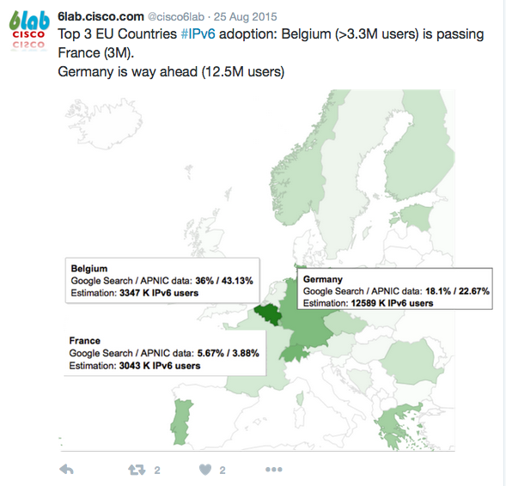
IPv6 in Europe

Slide 6
ARIN IPv4 pool depleted – September 2015

Slide 7
IPv6 Globally – January 2016
IPv6 turned 20 in December 2015

Slide 8
Where were we 16 Months ago?
UK Enterprise and IPv6?
UK and IPv6?
Source: http://en.wikipedia.org/wiki/Desert
Source: http://www.fitsnews.com/2012/07/20/if-you-believe-2/
IPv6 in general?
Source: http://www.dailymail.co.uk/news/article-566719/Why-ostriches-DONT-bury-heads-sand--surprising-truths-great-animal-myths.html

Slide 9
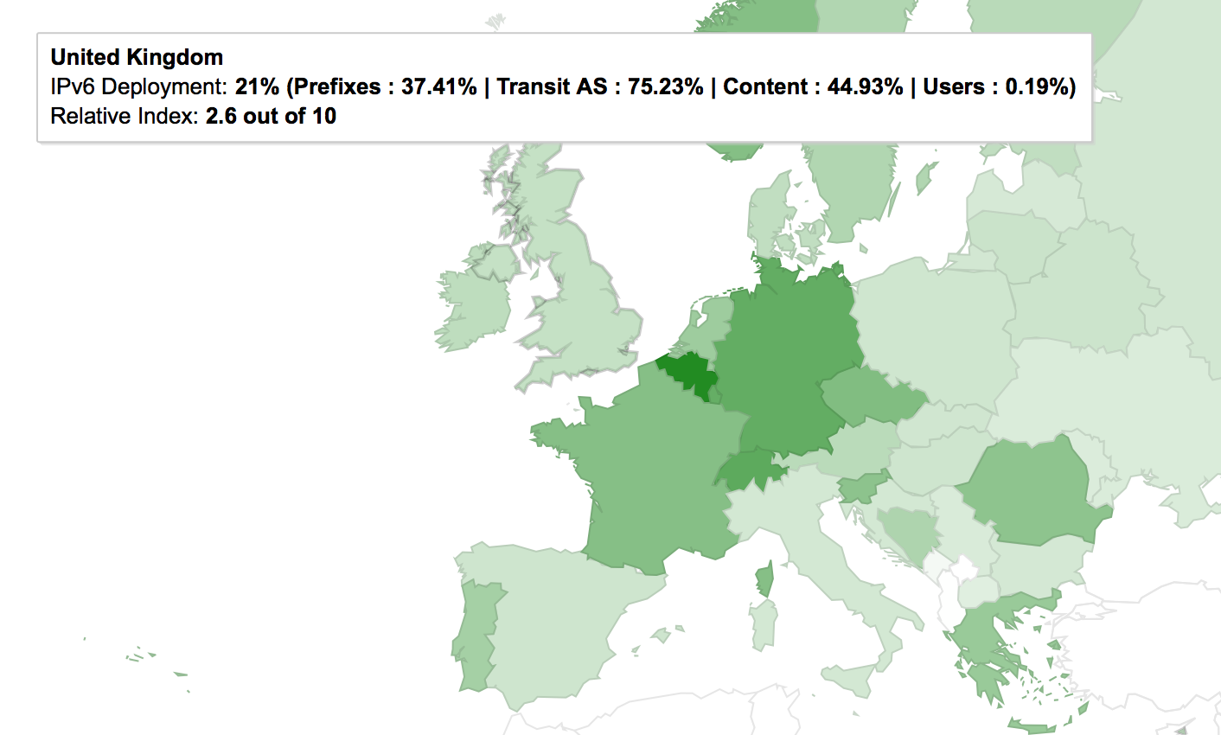
UK IPv6 Adoption – 05/09/2014
Users: 0.19%
Source: http://6lab.cisco.com/stats/

Slide 10
What did this mean?
We were missing the deployment in residential networks
BT > 7,879,000 subscribers
Sky UK > 5,750,000 subscribers
Virgin Media > 4,625,800 subscribers
TalkTalk > 4,097,000 subscribers
EE > 927,000 subscribers
Source: http://www.ispreview.co.uk/review/top10.php
When one major ISP starts to enable IPv6, the change is going to be significant
Now, we are in 2016….
>23M out of ~24M broadband subscribers

Slide 11
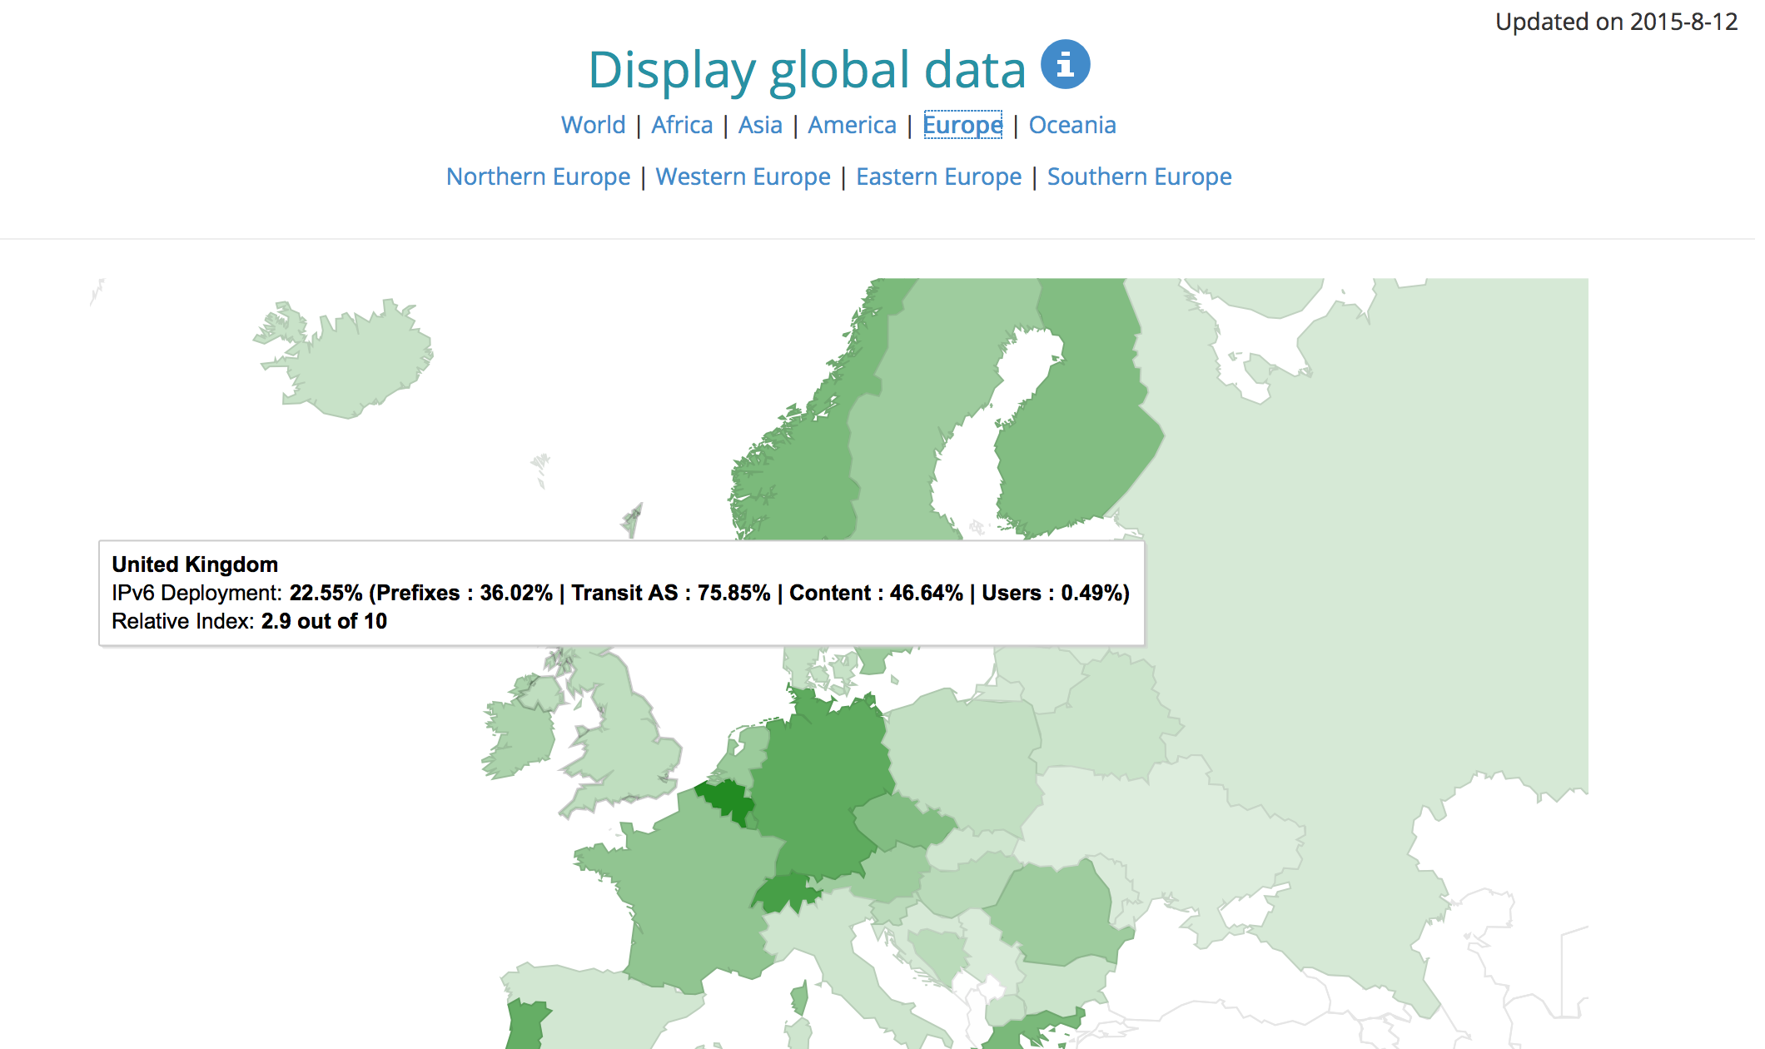
12/08/2015
Users: 0.49%
Source: http://6lab.cisco.com/stats/

Slide 12
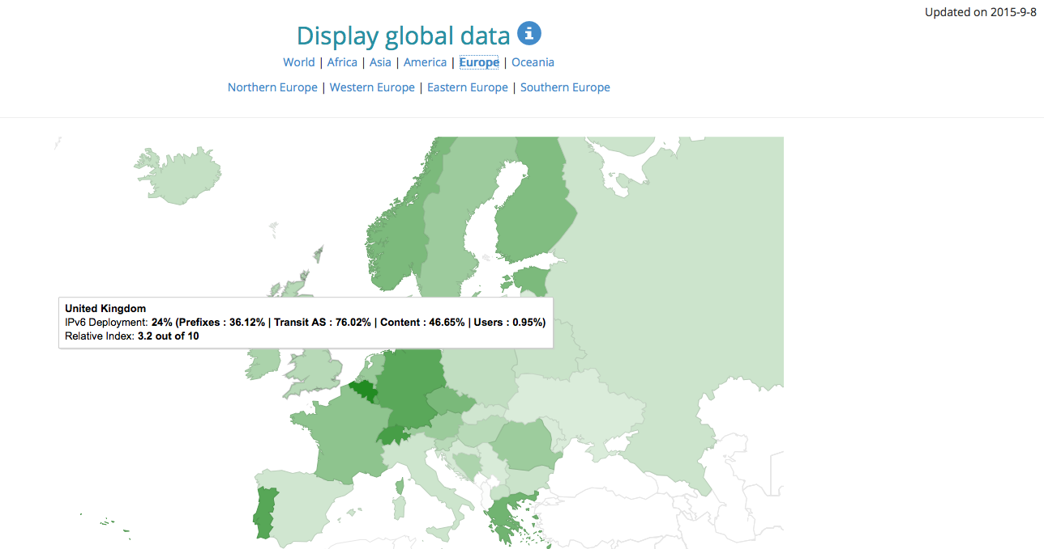
08/09/2015
Users: 0.95%
Source: http://6lab.cisco.com/stats/

Slide 13
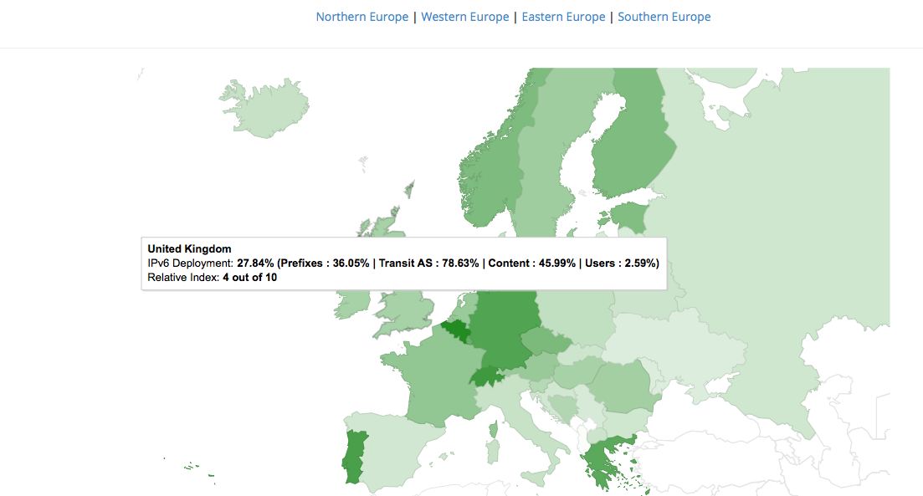
15/1/2016
Users: 2.59%
APNIC Labs: IPv6 User ratio 5.39%
GB is #26
http://labs.apnic.net/dists/v6dcc.html
Source: http://6lab.cisco.com/stats/

Slide 14
Definition of Success
✔
IPv6 traffic in the UK will grow
People inspired/encouraged by the UK IPv6 Council, will (re)start IPv6 projects in their own organisations
IPv6 moving beyond ISPs only
✔

Slide 15
What did we do over the 16 months?
The mission of the Council:
Create a platform for discussion and sharing of information
We have grown to 360 members
> 100 posts
2 Annual meetings
October 2014 & September 2015 (recordings on our website)
3 Round-table discussions
April 2015 - Various IPv6 topics
June 2015 - Reasons for deploying IPv6 in the UK
November 2015 – IPv6 in hosts; Containers and IPv6

Slide 16
We want YOU to take active part
Stop waiting for others!
Are YOU deploying IPv6?
Or are YOU still waiting for “someone” to write YOUR business case?
Successful IPv6 deployments are those ones where YOU get completely involved and YOU lead

Slide 17
Get in touch with UK IPv6 Council
Free and open for all!
LinkedIn Group: UK IPv6 Council
http://tinyurl.com/UK-IPv6-LinkedIn
Website: www.ipv6.org.uk

Slide 18
Thank you.

