Slide 1
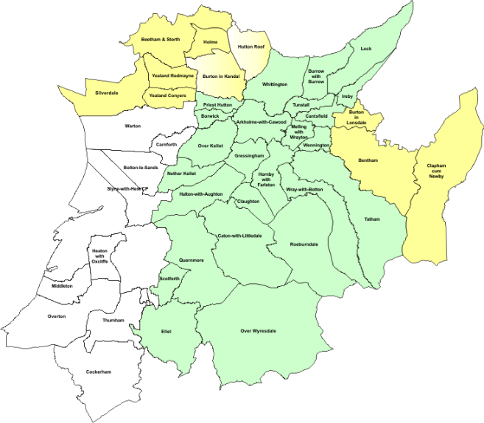
The evolution of the B4RN Network
Tom Rigg
T.Rigg@b4rn.org.uk
www.b4rn.org.uk

Slide 2
Lancaster District
Area = 576Km²
Population = 139,700
Pop Density = 243/Km²
Properties = 60,761
Prop Density = 105/Km²

Slide 3
Summary of the B4RN model
Not for profit community benefit society
Set up to provide world class broadband for rural areas in the North West of England
Provides 1Gbps symmetrical FTTH/P over PtP
Government grants, although often available, put too many hurdles in the way (process not designed for a community project).
Therefore self funded by the community

Slide 4
B4RN Coverage Area
Area includes the majority of the Lancaster District and now parts of the Wyre, Preston and Craven Districts
B4RN area = ~637Km²
Properties = ~6000
Prop Density = ~9/Km²

Slide 5
Rollout Update
Over 1750 properties connected
800km of core fibre installed
Average take up around 65%
Total of 778 shareholders holding a total of £1.5 Million in shares and another £1 Million in loans from the community.
Originally 16 nodes required, now 24 active nodes with an additional 14 nodes to be installed over the next two years. Total of 38 nodes able to supply over 20,000 properties.
8 Full time and 2 part time employees. Hiring another 4 this year to expand the team and build a civils dept.
Countless volunteers who drive the project in both their respective parishes and the overall area.

Slide 6
B4RN Planned Expansion
Network build is heading further into the Craven District and into the Ribble Valley and South Lakeland Districts
B4RN planned area = ~1130Km²
Properties = ~15000
Prop Density = ~13/Km²
For comparison
Gt Manchester area = 1156Km²
Properties = 213529
Prop Density = ~184/Km²

Slide 7
Process of connecting a parish
Parish requests service – given indicative cost for 100% coverage
Parish volunteers conduct their own feasibility study
Parish comes back with an idea of take up and investment pledges
Network design stage – local volunteers approach Landowners
Build stage – Farmers dig their own land with the help of volunteers
B4RN Engineering team install fibre infrastructure to provide end-to-end service

Slide 8
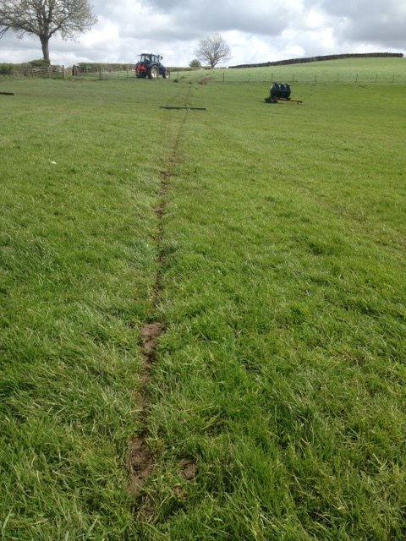
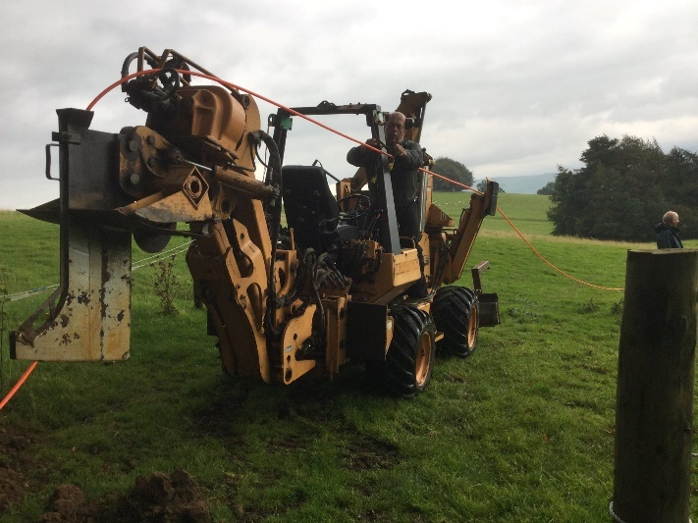
Mole Plough

Slide 9
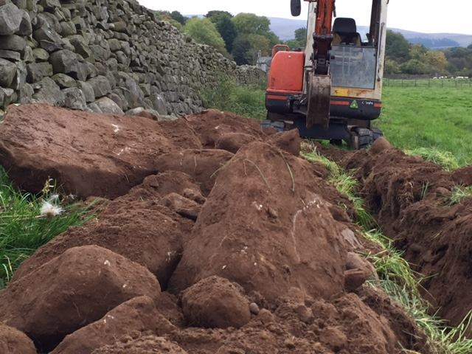
Trench Digging

Slide 10
What really powers the troops?

Slide 11
Core Network Design
Backhaul trunk route follows edge connectivity (dig once)
Scalability – reserved fibre pairs on core routes
Current power design – AC based on Enterprise kit
Upside, local volunteers can fault find, easy to install
Downside, uptime during outages compared to telecoms grade equipment
Decision not to Carrier NAT - Trade-off between interim solution and ideals. So far doing it the ideal way has won
Dual stack v4/v6 for the foreseeable future

Slide 12
Core Equipment
Network border – Juniper MX240
M247 Transit peer
IX-Manchester
LINX Juniper LAN
TNP Ltd – Mutual backup peering
Network core – Juniper EX4550
2x10Gbps uplinks via physically diverse routes providing 20Gbps aggregate to each edge node

Slide 13
Quernmore
Abbeystead
Arkholme
Dolphinholme
Wray
Capernwray
10 Gbps diverse routed links
North
South
32 x 10Gbps lambdas
Telecity
Manchester

Slide 14
Edge Equipment
Costing of Telco grade equipment does not fit the model
The choice to use Enterprise grade equipment
Switching
Netgear M5300-28GF3
8x24 port stack gives 192 1Gbps SFP ports 2x10Gbps for backhaul
Power
APC - Schneider Electric

Slide 15
Edge Node

Slide 16
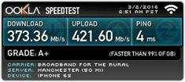
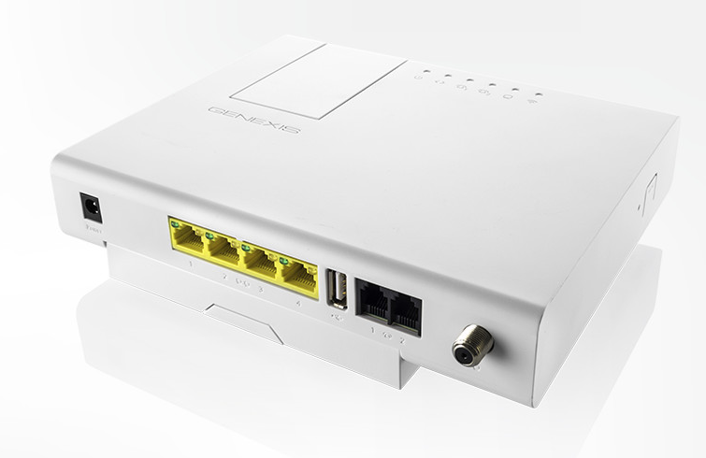
CPE Equipment
Complete control of CPE devices
Refreshed to keep up with latest technology
WiFi, technology available/customer expectations
Genexis Residential Gateway

Slide 17
IPv4 Deployment
Started with /21 block
Additional /22 block received from RIPE
With expansion plans, 3072 no longer enough
Carrier NAT not the ideal solution
Additional /20 bought through IPv4 Market Group
7168 enough to start the next build stage
What next?!

Slide 18
IPv6 Deployment
/32 allocated from RIPE
Each switch stack allocated /48
Each residential customer allocated /56
IPv4 and IPv6 CPE allocations match
256 IPv4 addresses per switch stack
256 /56 IPv6 subnets per switch stack
Businesses allocated /48
Open to development and change over time

Slide 19
Customer usage patterns
Bandwidth perhaps not the issue people might expect (at least up to now)
Digital divide
Connecting those who have been used to 150Kbps for a long time.
Education of technology available
Smart TV
Home automation
Internet of things

Slide 20
Customer usage patterns
AS | Flows | Bytes | Packets | AS Name
20940 | 632899 | 49.08 GB | 35607468 | Akamai
15169 | 2076971 | 38.81 GB | 32317605 | Google
2906 | 171565 | 26.45 GB | 19175856 | Netflix
22822 | 157459 | 11.26 GB | 8431025 | Limelight
6185 | 42724 | 7.53 GB | 5417660 | Apple
32934 | 1018810 | 6.41 GB | 5796113 | Facebook
3356 | 82432 | 5.47 GB | 3993075 | Level3
16509 | 980414 | 4.67 GB | 5101504 | Amazon
16625 | 905557 | 3.05 GB | 2834722 | Akamai
13285 | 36761 | 2.67 GB | 2226279 | TalkTalk
32590 | 27137 | 2.14 GB | 1651124 | Valve
25460 | 39881 | 1.84 GB | 2212067 | TNP
23456 | 138466 | 1.48 GB | 1457736 | 4 byte AS transitional placeholder

Slide 21
Growth Challenges
Keeping up with demand!
Core node locations
Resilient backhaul for core
IXScotland
Edge resilience
Future expansion

Slide 22
Members of the Most Excellent Order of the British Empire!!

Slide 23
Tom Rigg
T.Rigg@b4rn.org.uk
www.b4rn.org.uk

