Slide 1

How we networked the Tour de France
Jon Holgate
University Information Services

Slide 2

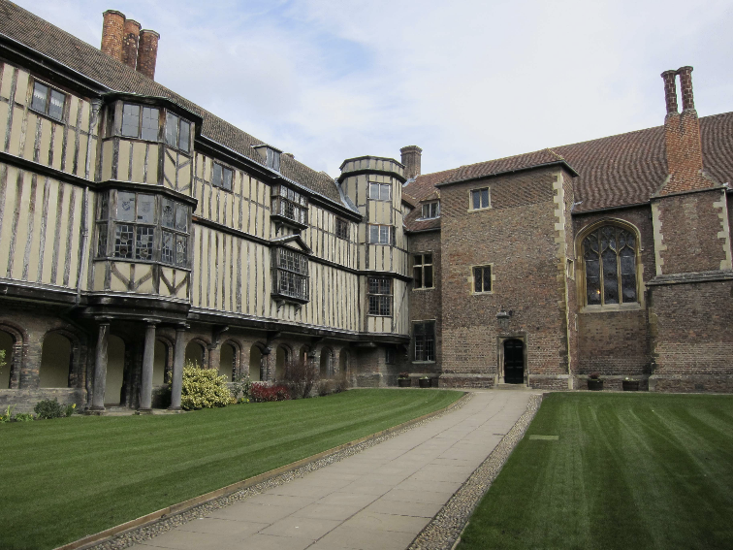

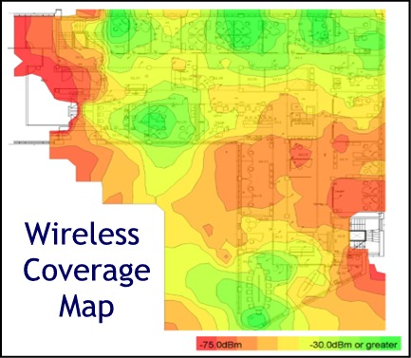
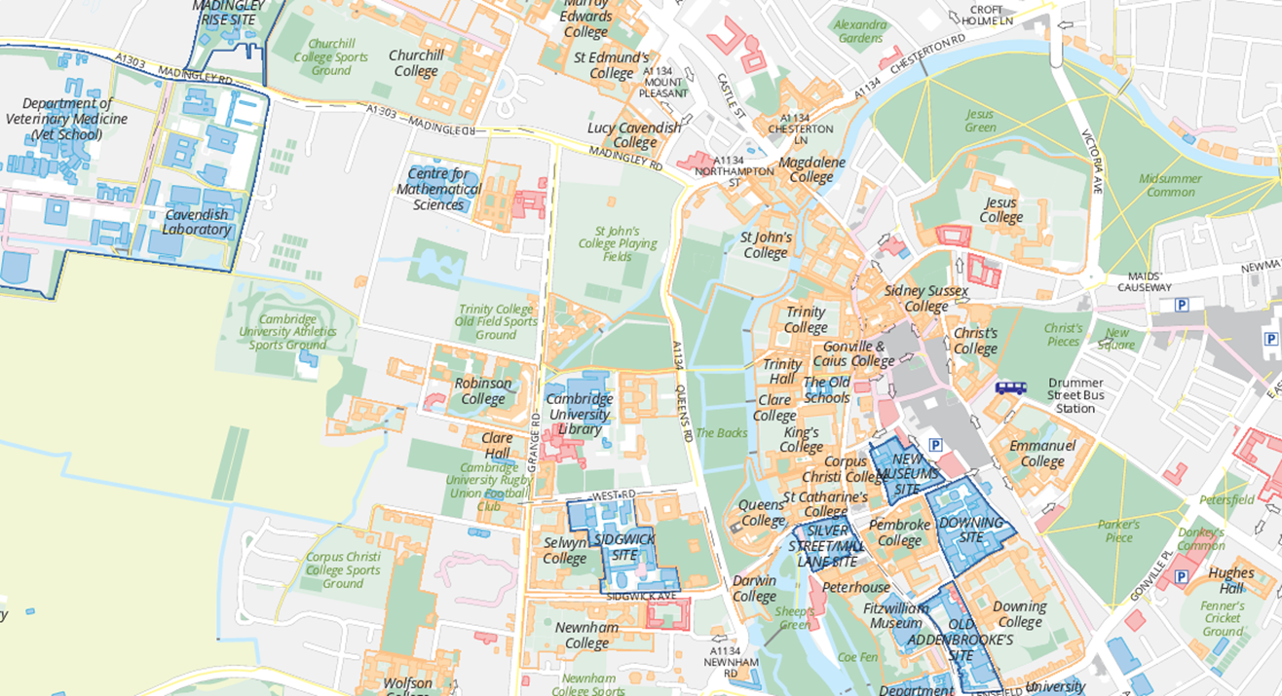
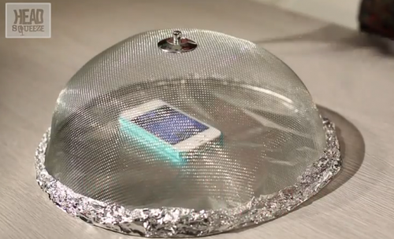
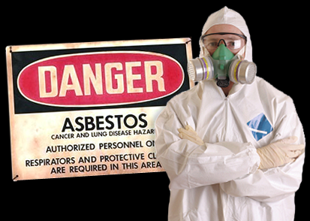
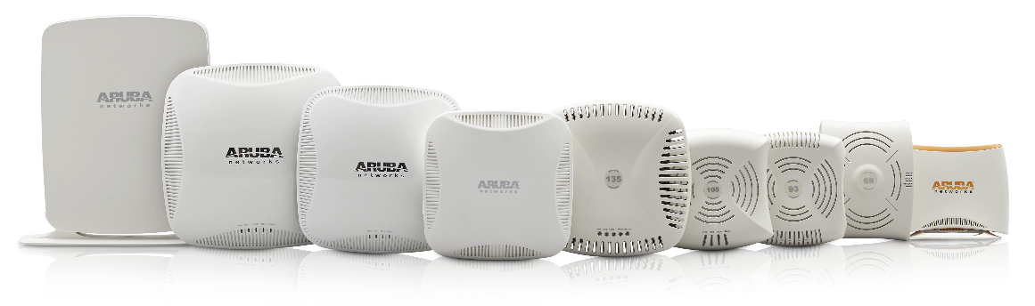
Wireless deployment

Slide 3
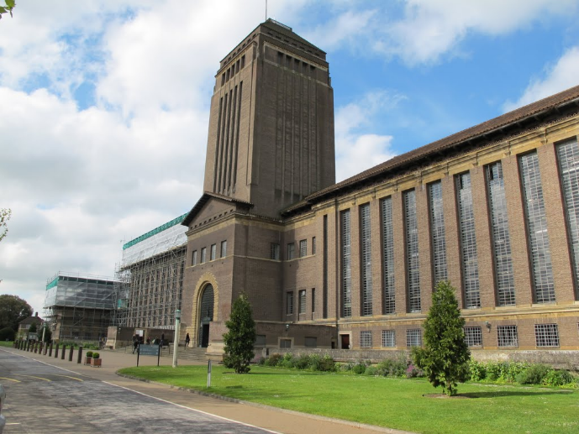
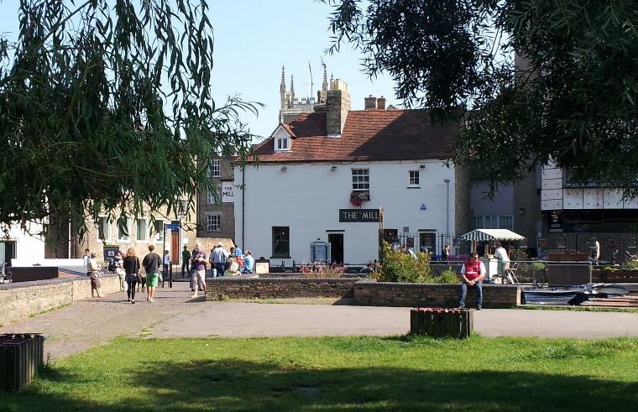
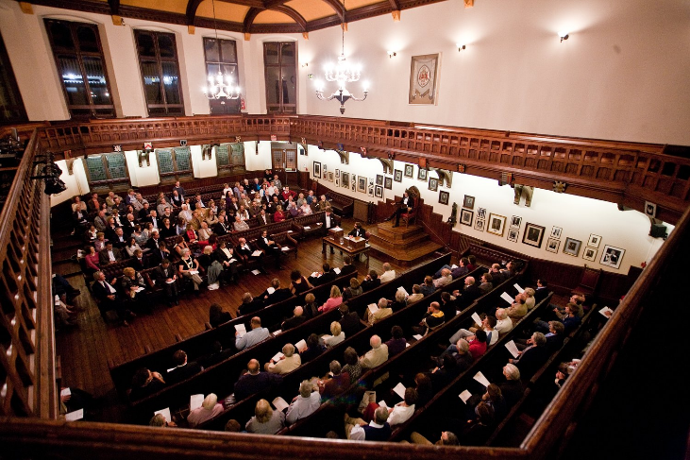
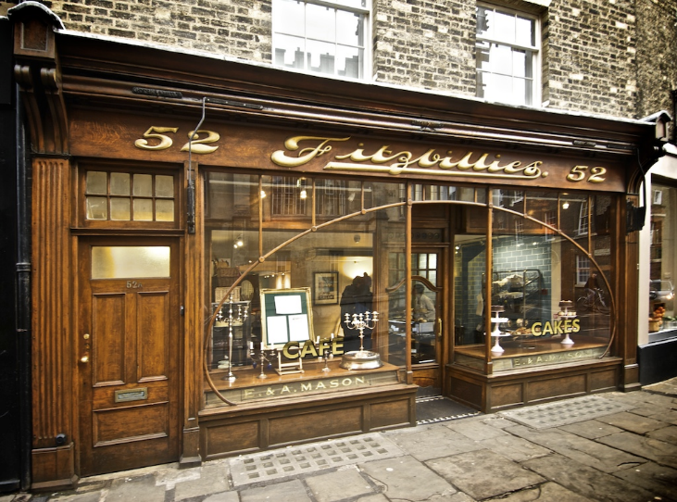
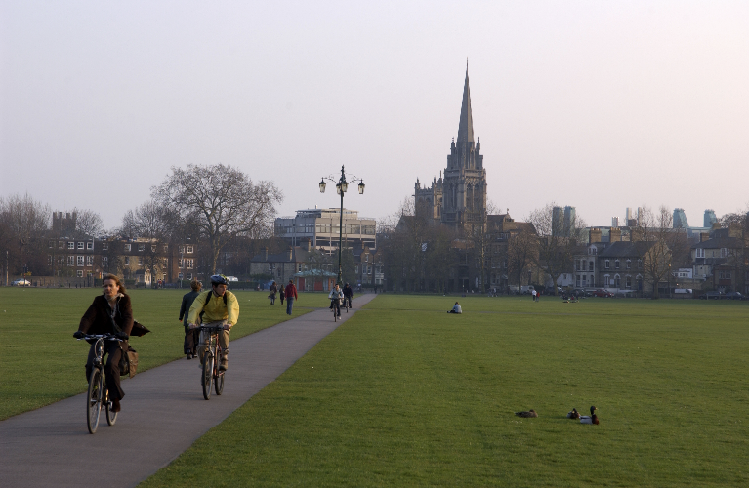
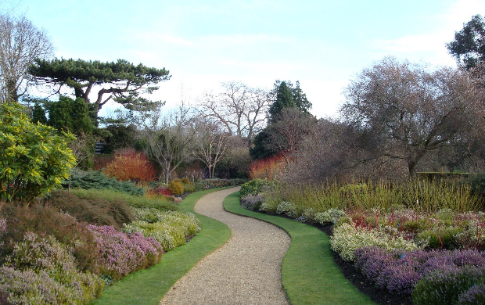
Students

Slide 4
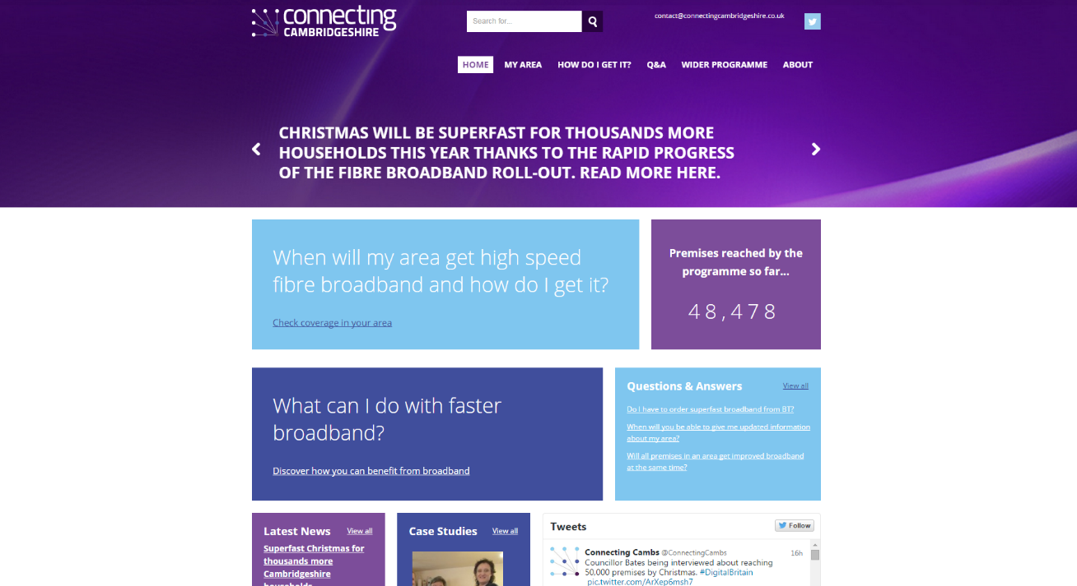
Connecting Cambridgeshire

Slide 5

The Tour is coming to town….
January 2014

Slide 6





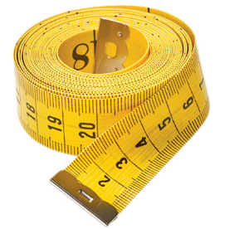
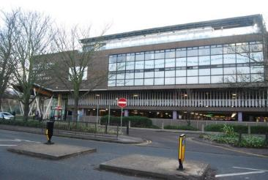
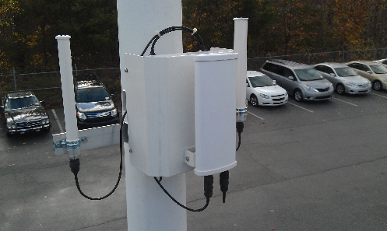


Project Evaluation
Known
unknown’s
Known’s

Slide 7

How many people…..?
February 2014
5,000
“Our preliminary analysis suggests between…..”
150,000
July 7th 2014

Slide 8
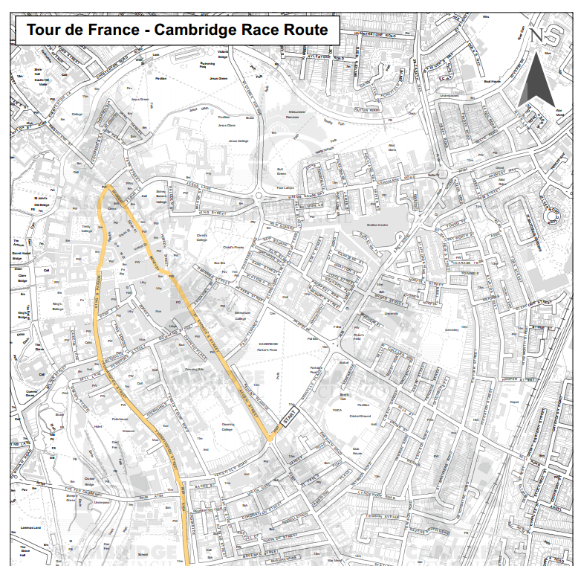
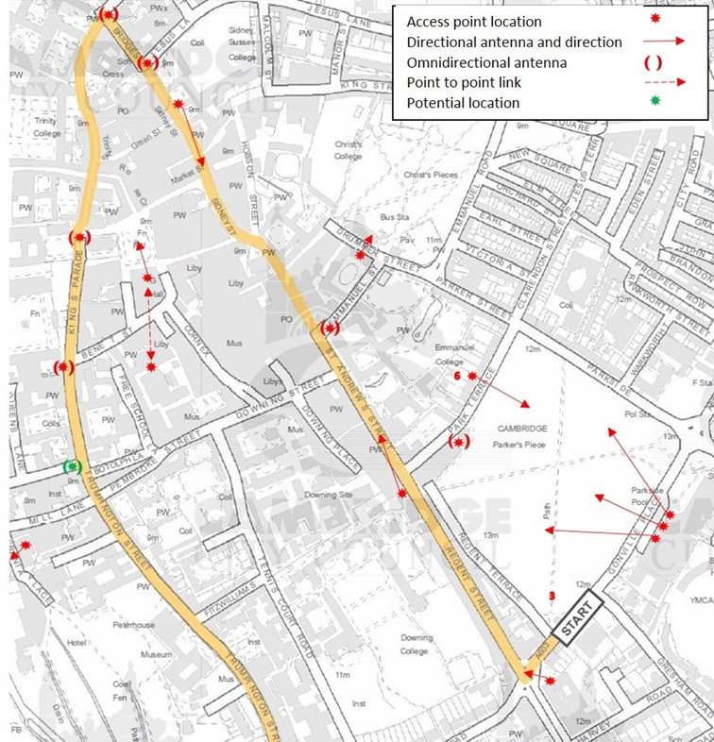
Cover the route

Slide 9
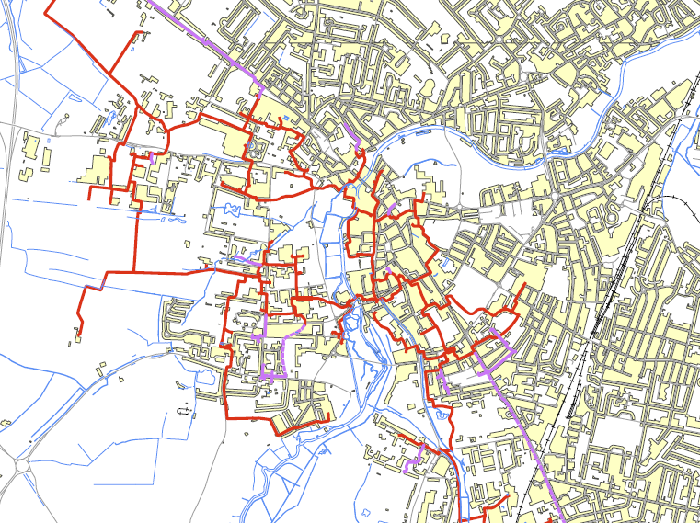

Slide 10
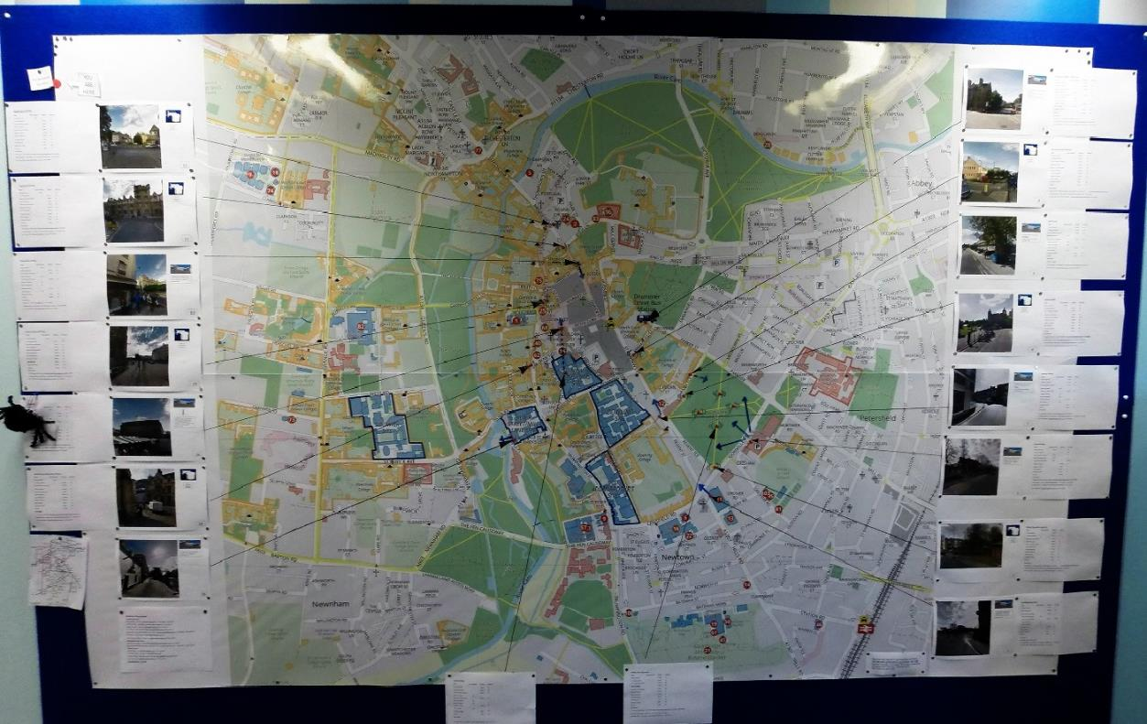
Tour de France plan

Slide 11
Tour de France 2014 – sample site
Jesus Lane CCTV Pole
Action Date Completed Deadline UCS Lead
Initial survey & coverage planning 10th Jan AC
Premises Approval 13 Feb JH
LA Planning Approval 28 April EM
Power Arrangements Agreed 7 March AC
GBN Access Agreed 7 March RC
Equipment Location Agreed 7 March AC
Way leaves Obtained 24 March RC
Section 50 Obtained 24 March RC
Equipment Ordered 3 March AC
GBN Completed 4 April RC
Equipment Installed 9 May NH
Equipment testing & evaluation 25 May JH
RFS Date 30 May RF
Key Contacts :-
CCTV Manager - Martin Beaumont martin.beaumont@cambridge.gov.uk 01223 457390
LA Planning Officer – Toby Williams Toby.Williams@cambridge.gov.uk 01223 457312
EM – Richard Griffin Richard.Griffin@admin.cam.ac.uk 01223 7(65637)

Slide 12
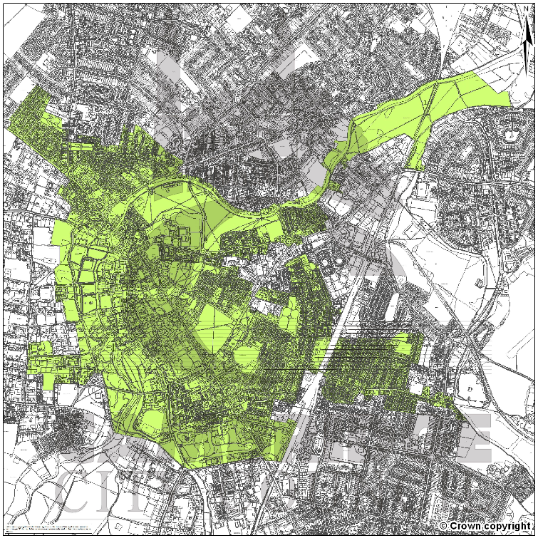
Conservation area

Slide 13
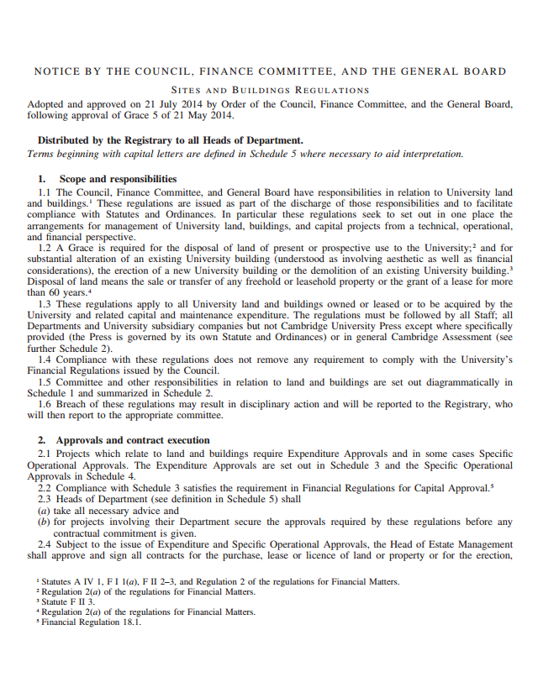
Planning consent
3.7 The Buildings Committee oversees applications for planning approvals for the Operational Estate and is consulted by Cambridge University Press and Cambridge Assessment about planning applications for premises
and land in the city of Cambridge. Planning Applications which it considers are in consistent with the University’s long-term estate strategy and agreed principles and policies for planning and design may be referred to the Estates
Strategy Committee before any approval is given.
“paragraph 3.6 of the Sites and Buildings Regulations implies that the University cannot seek planning consents without the endorsement of the Buildings Committee.
“as far as I can see… this project is highly unlikely to proceed.”

Slide 14
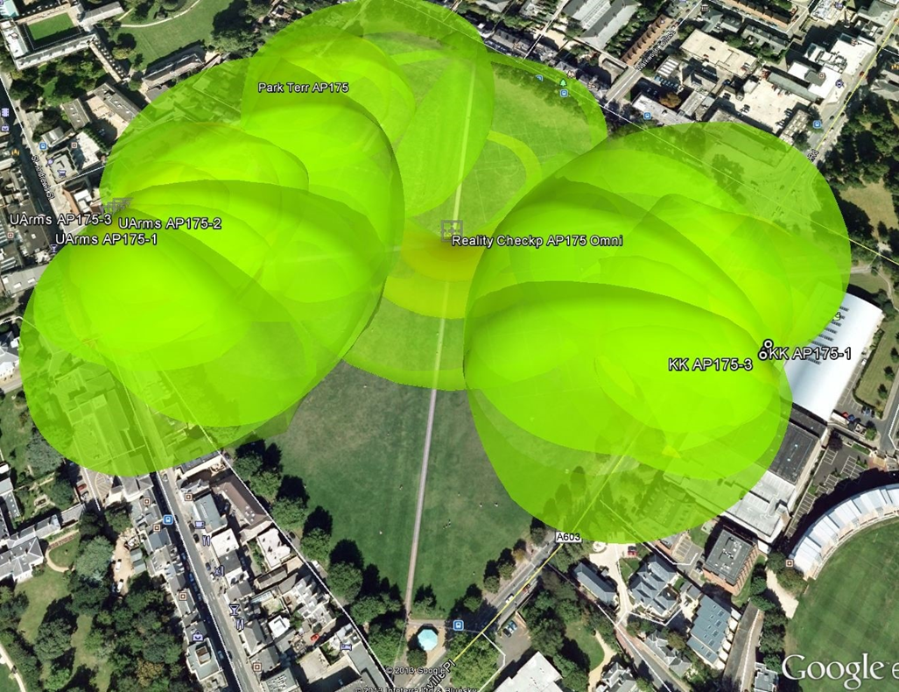
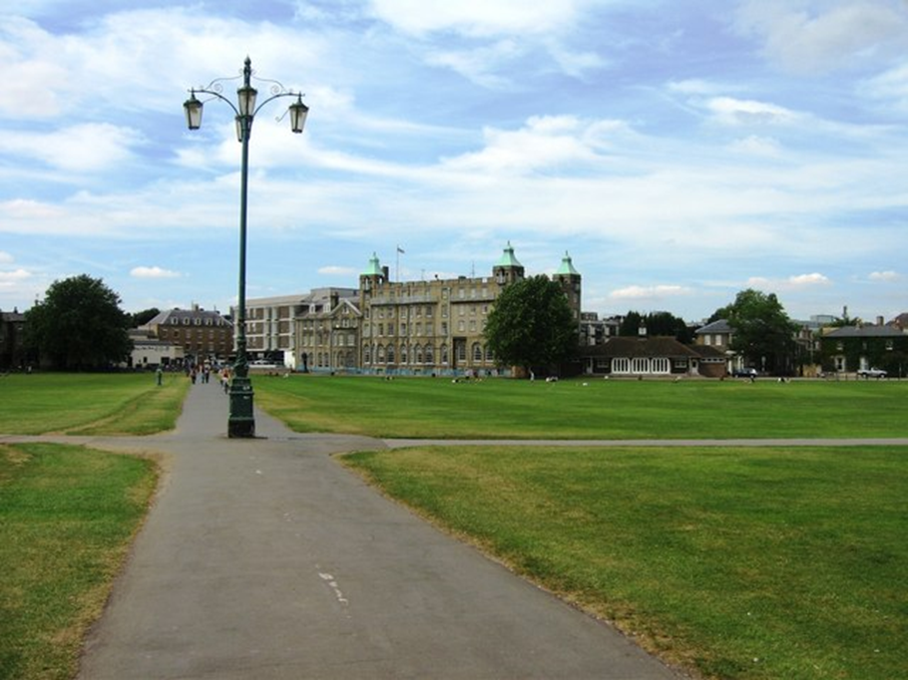
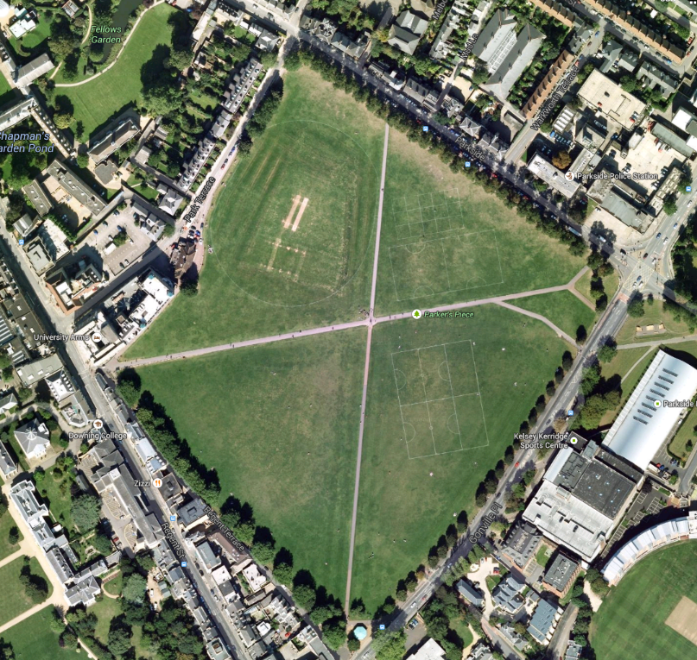
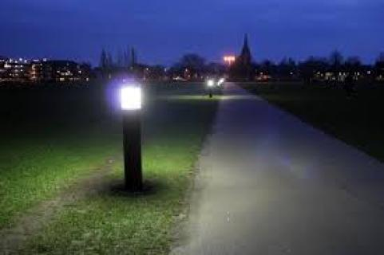
Parkers Piece
Access
Point ?

Slide 15
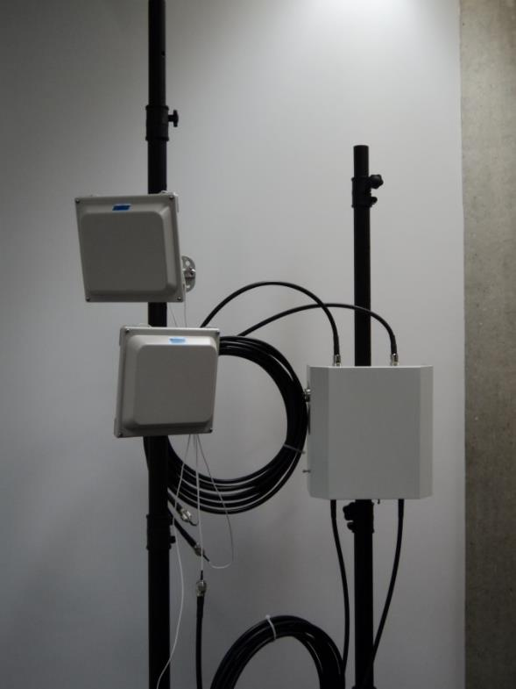
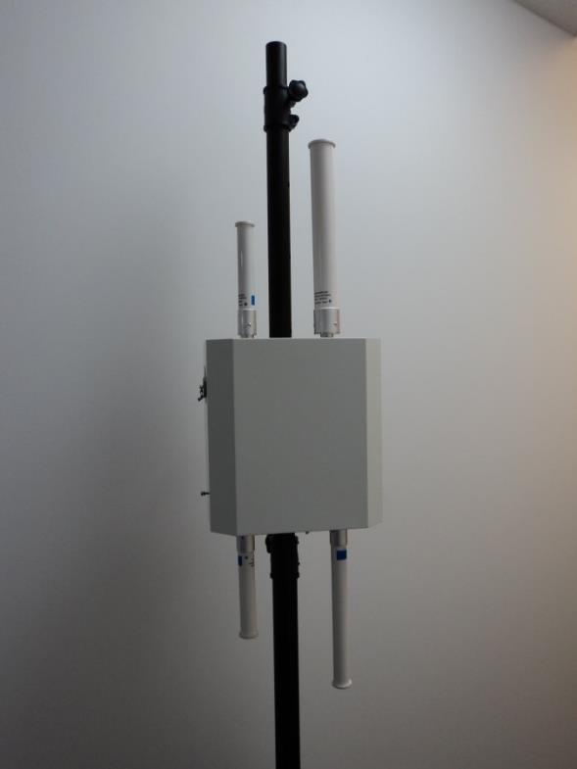
AP-175

Slide 16
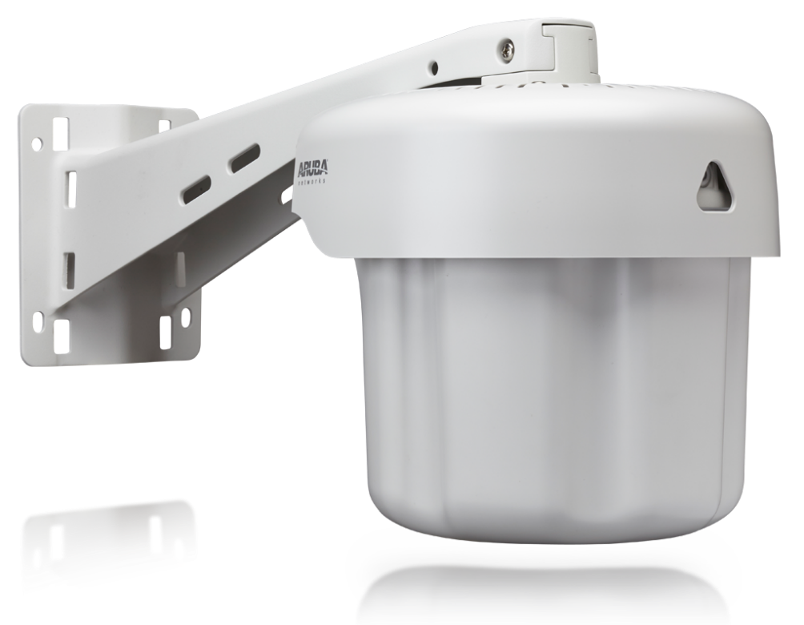
AP-275

Slide 17
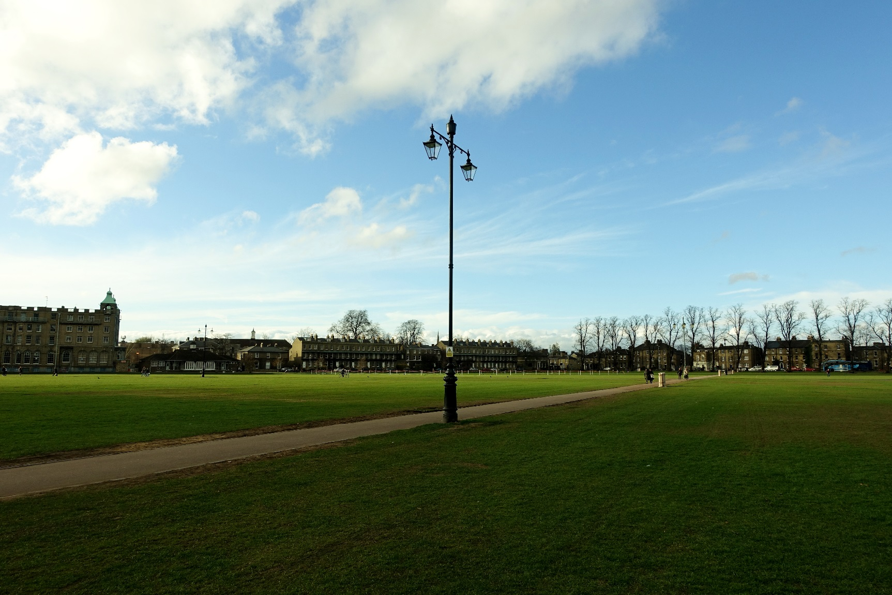
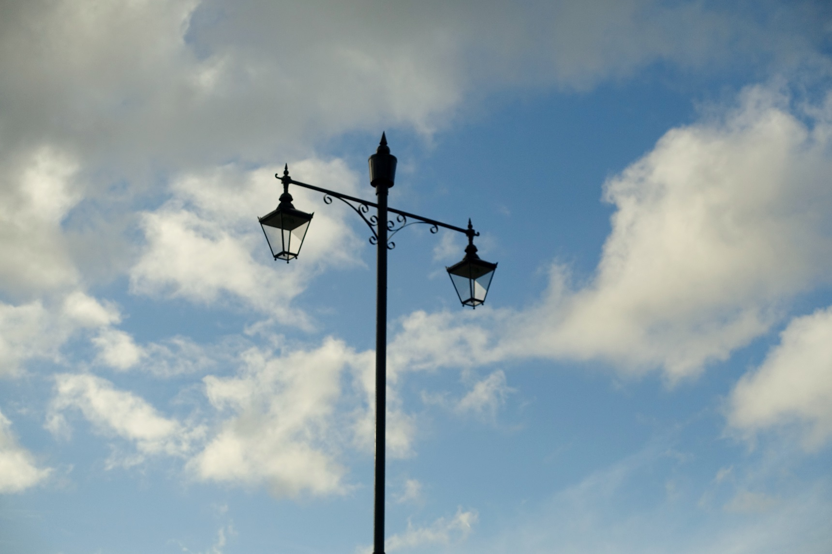
Lamp posts

Slide 18
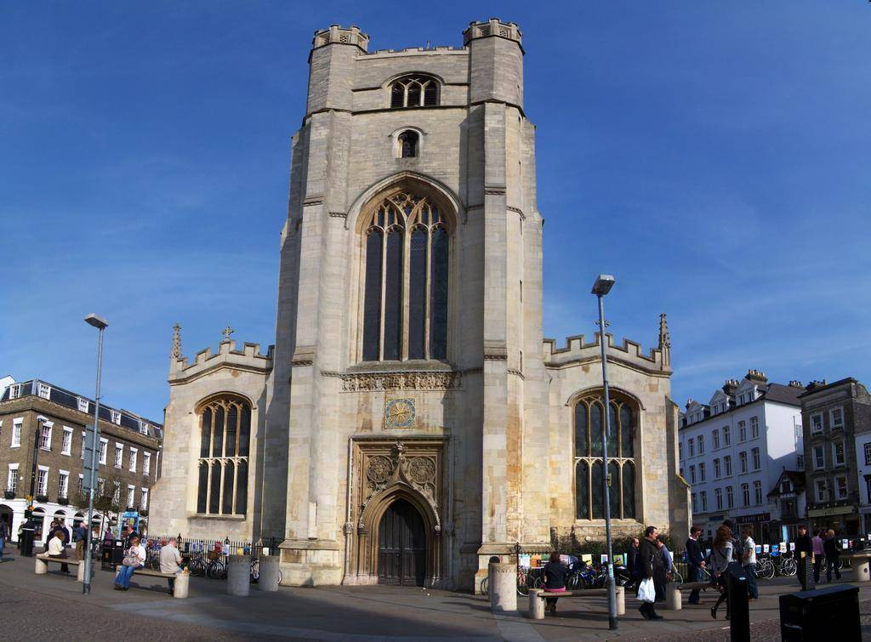
Street Furniture
CCTV

Slide 19
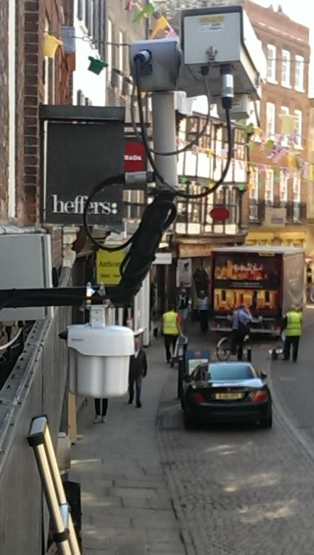
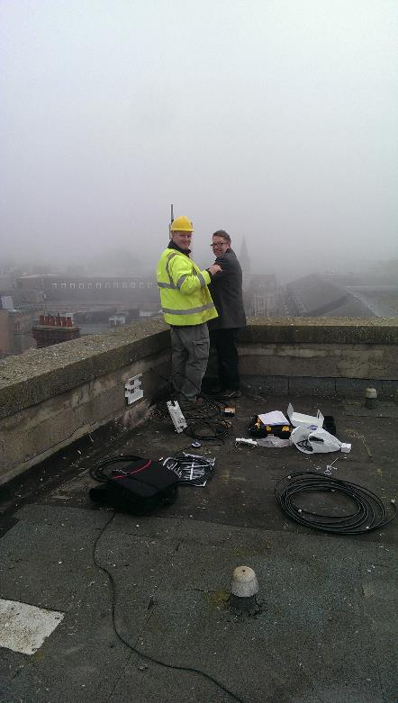
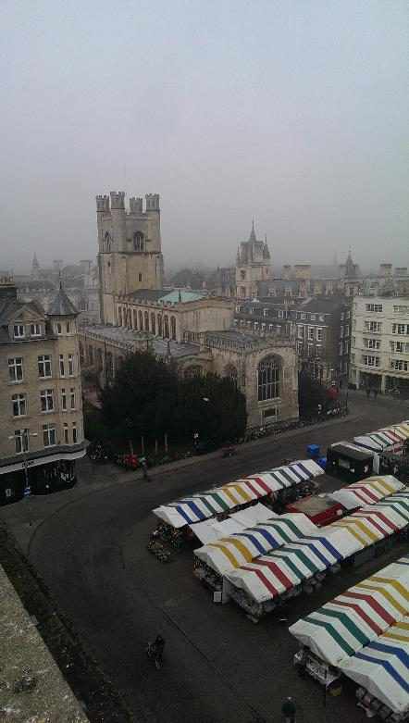
Installing

Slide 20
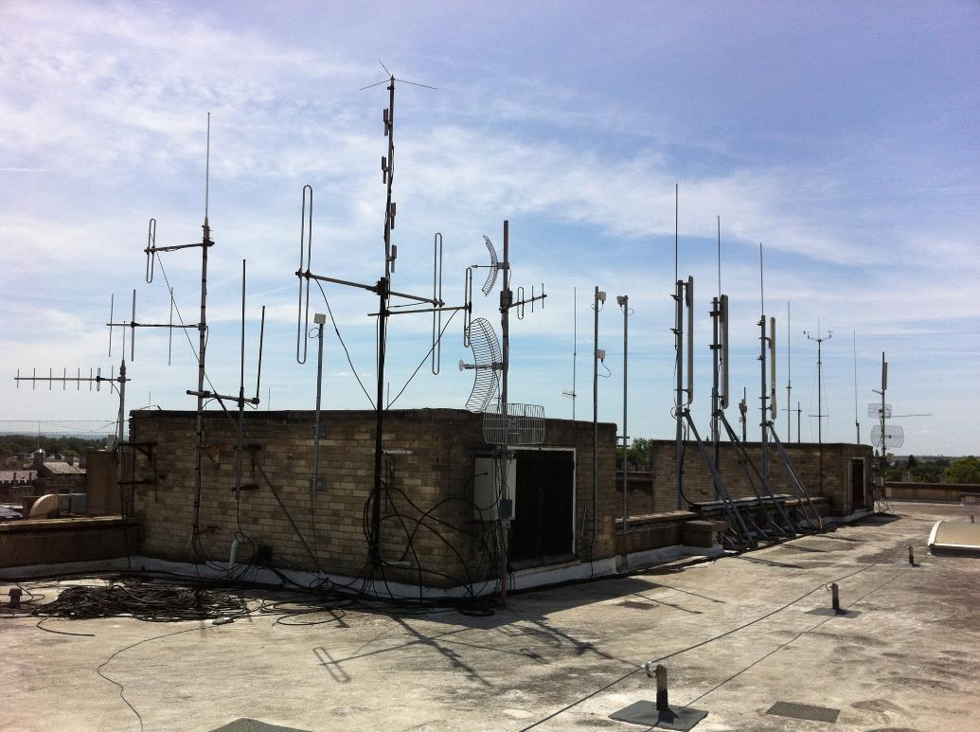
GSM masts

Slide 21
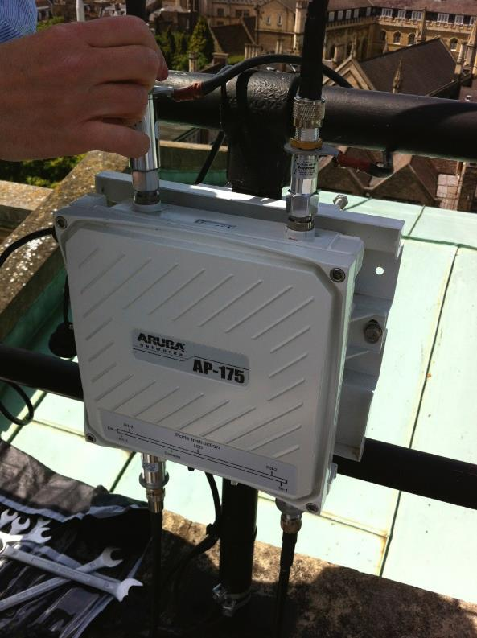
Band pass filter

Slide 22


Free Public Wifi

Slide 23
Working with ‘The Coud’

Slide 24
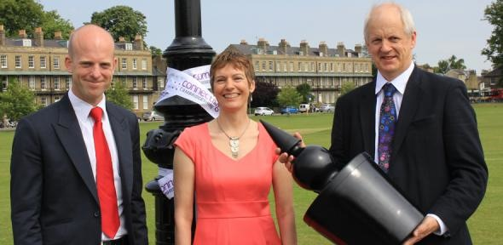
Media launch

Slide 25
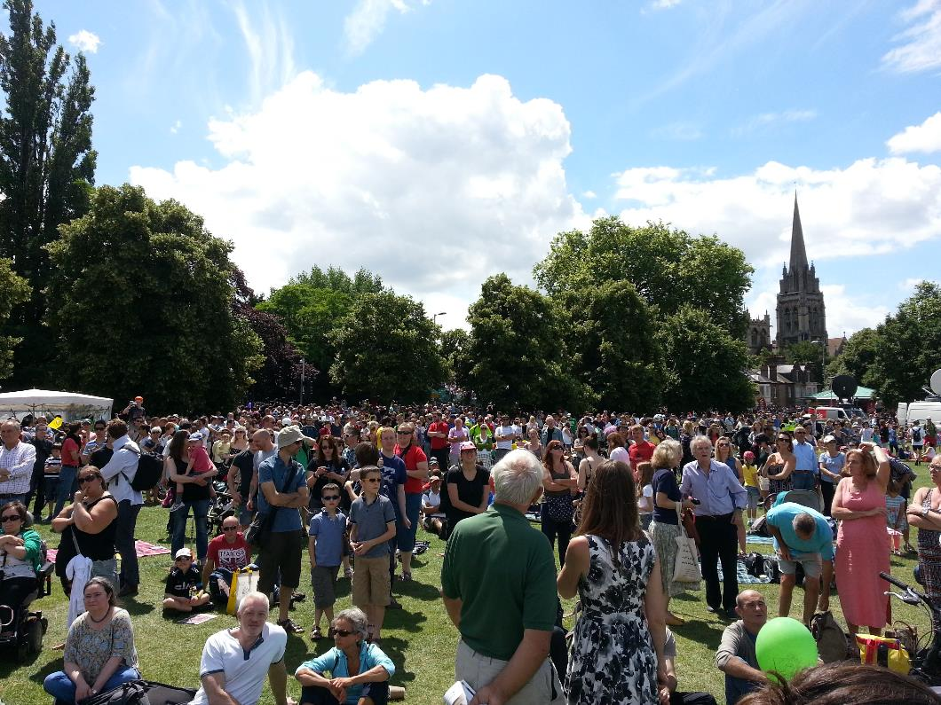
On the day

Slide 26
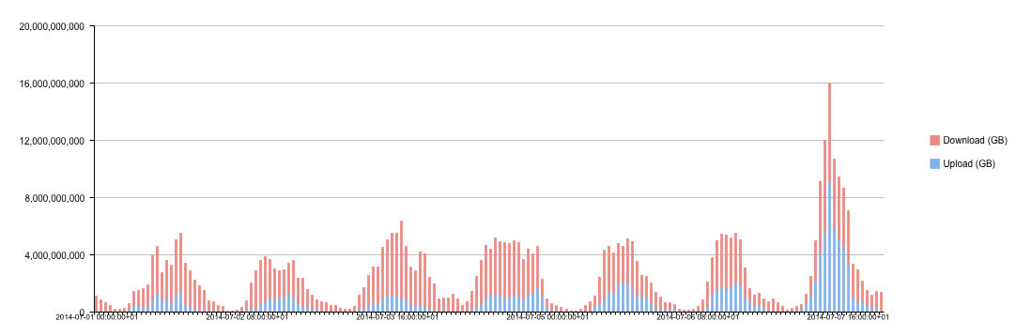
On the day

Slide 27
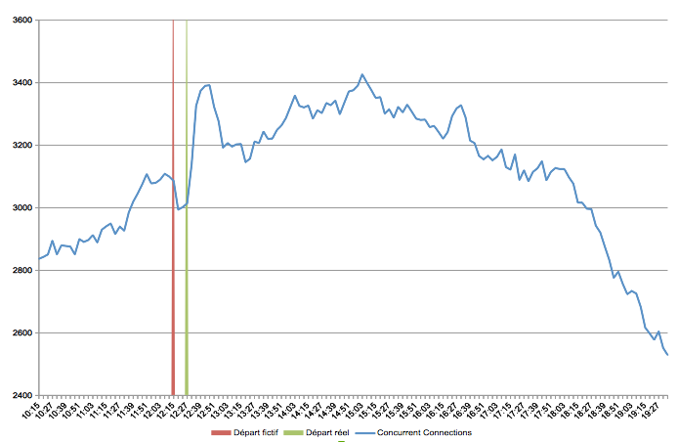
On the day

Slide 28
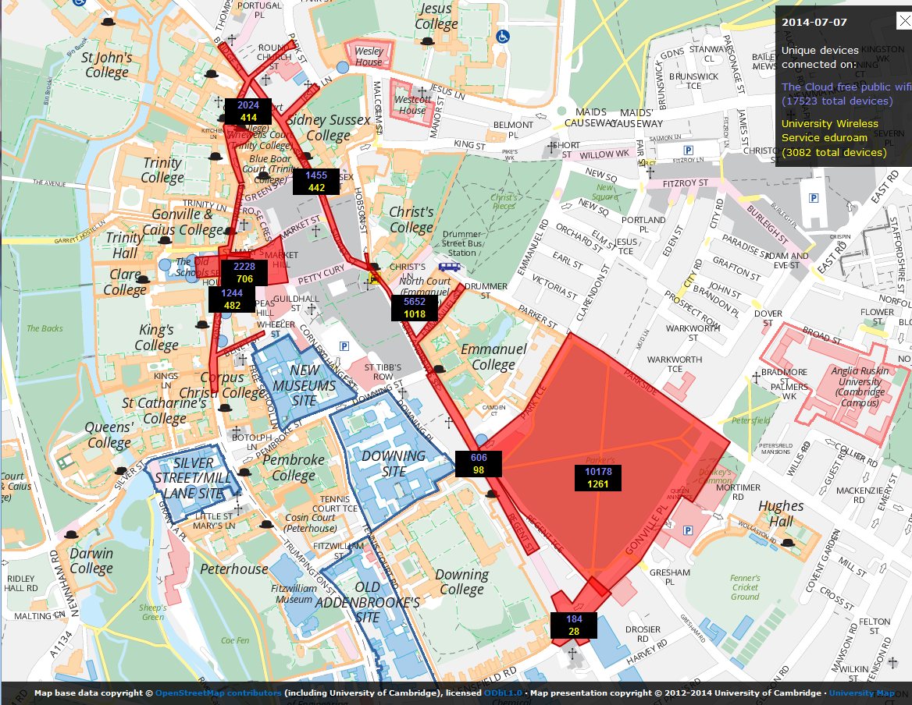
On the day

Slide 29
Personal observations
The number of connected devices was far lower than the expected footfall.
The system is STILL being used…
…at capacity…
…even when an event is not in progress.
I expect many people could not connect on the day (but I could).
The cloud router is under-specced.
We need to write better monitoring scripts.

Slide 30
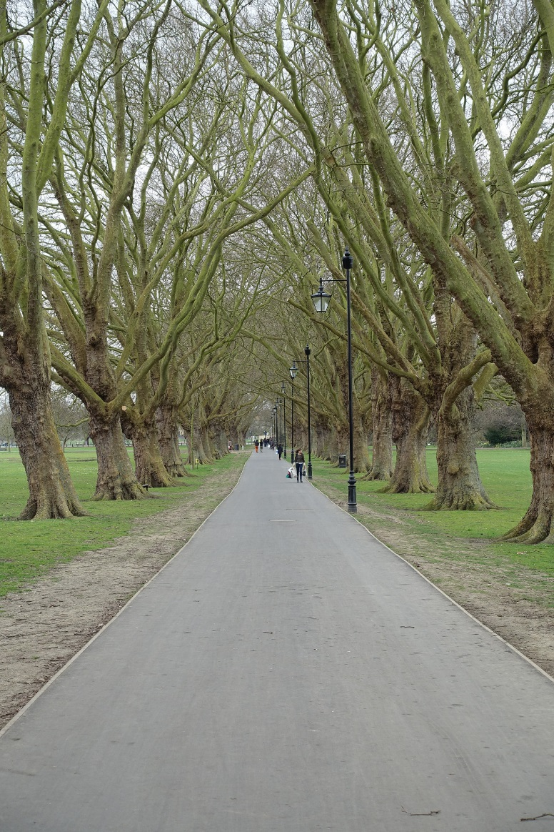
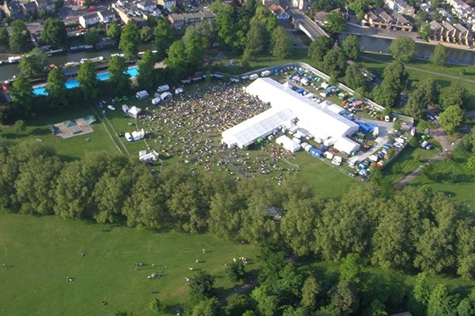
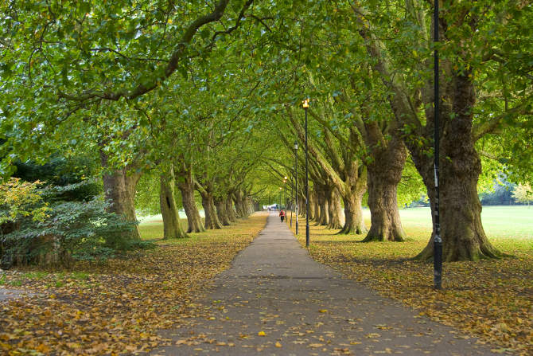

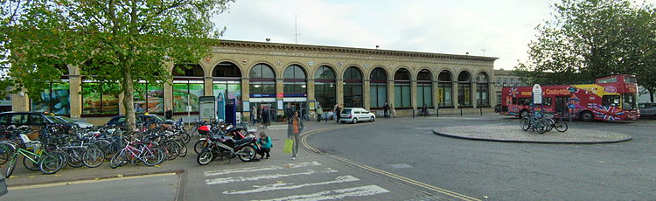
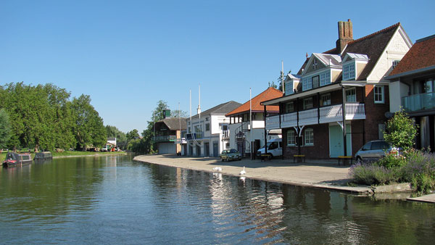
What next?

Slide 31








Lessons learned…..

Slide 32
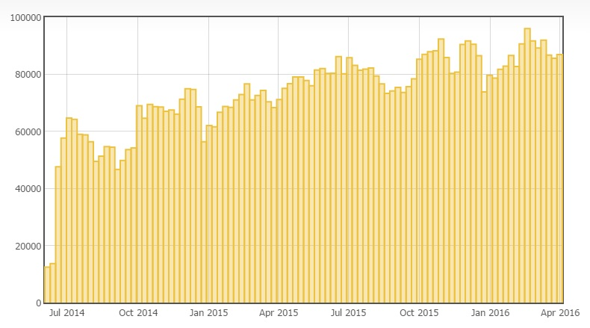
Ongoing usage
Devices (per week)

Slide 33
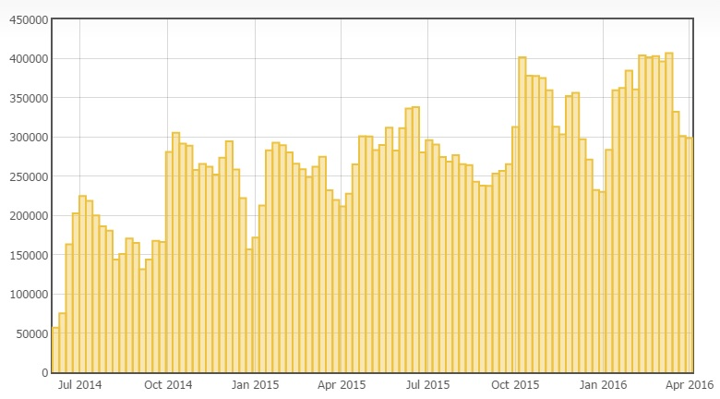
Ongoing usage
Sessions (per week)

Slide 34
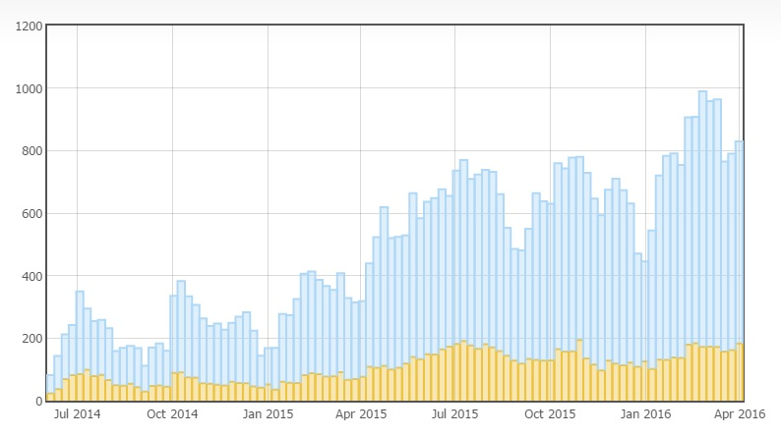
Ongoing usage
Traffic in GB (per week)

Slide 35

Questions?

