Slide 1
The evolution of an Educational WAN
Robin Williams (yes really!)
robin.williams@tnp.net.uk

Slide 2
Overview
Snapshot in time at Lancaster Uni networking team from mid to late 2000’s and the external networks managed by the team
Disclaimer: Not speaking today as Lancaster Uni, Lancashire CC or Cumbria CC
Prof Barry Forde was Chief Architect & Head of Technical Services for Lancaster Uni ISS Dept
  Barry now architects B4RN – see next talk by Tom!

Slide 3
Networks run by Lancaster University (2005-2011 snapshot)
University Campus Network (obviously)
University residences network (RESNET)
CaNLMAN (Cumbria & North Lancashire MAN) – Regional Janet MAN
  Connecting higher education establishments
  Generally higher bandwidths
CLEO (Cumbria & Lancashire Education Online) – Regional Broadband Consortium (RBC) & NGFL (National Grid for Learning)
  Connecting schools, colleges & local gov sites
  Taken in house by LCC under a wider strategic partnership with BT in 2011
Small scale commercial connectivity for University interests
  E.g. shared ownership buildings etc - whose traffic couldn’t transit Janet

Slide 4
Terms
The National Grid for Learning (NGfL) was a United Kingdom Government-funded gateway to educational resources on the Internet. It featured many individually selected links to resources and materials deemed to be of high quality.
Regional Broadband Consortia (RBCs) were created in 2000 under the auspices of what was at the time the Department for Education and Skills, (DfES) to secure lower prices for broadband connections and services for schools by aggregating demand across a region and entering into region wide contracts.

Slide 5
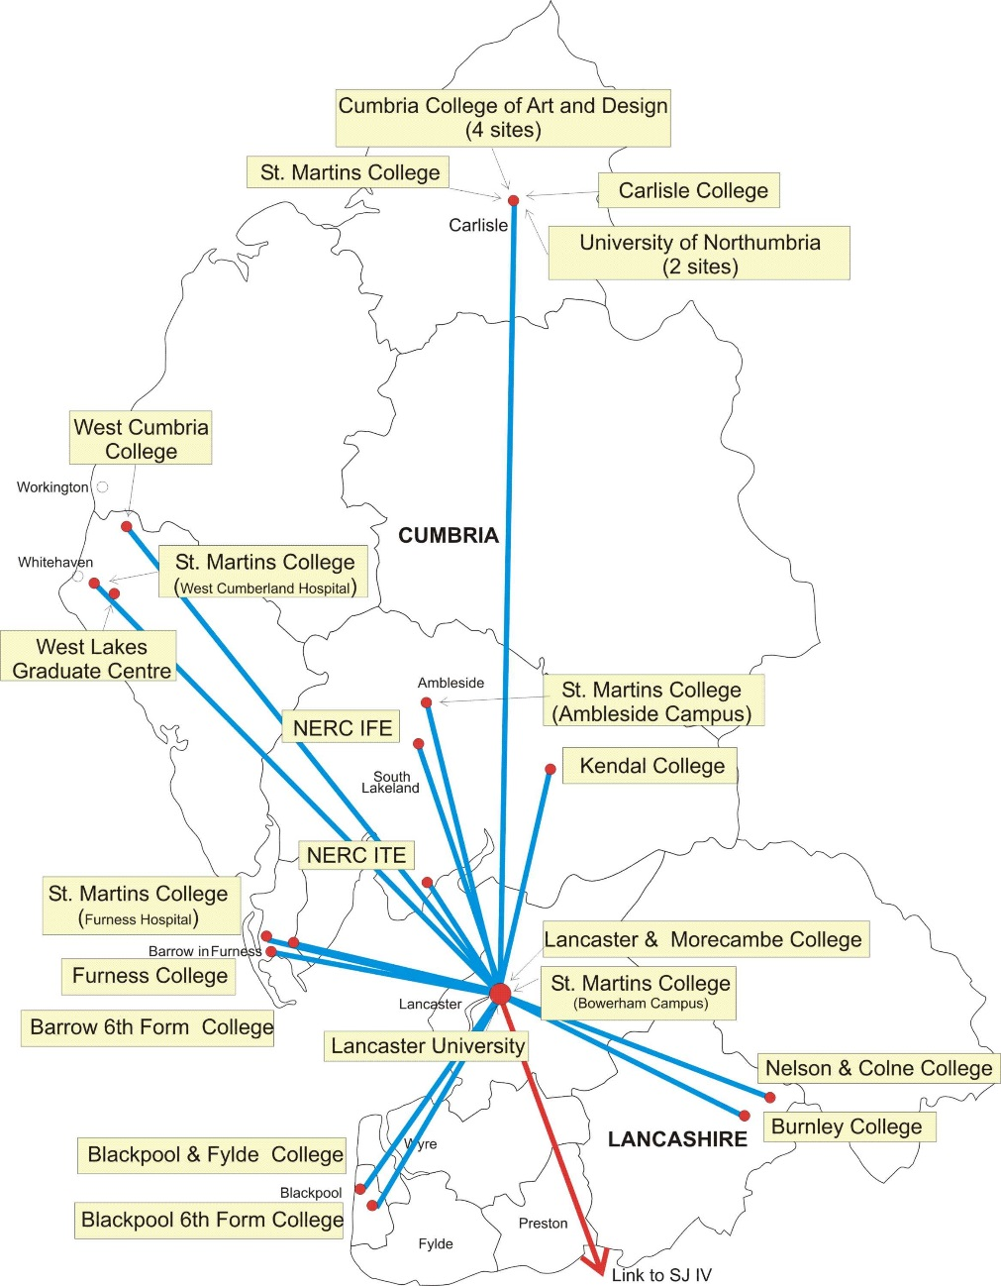
CaNLMAN
CaNLMAN HE partners
Backhauled via Janet initially in Lancaster (SJ4) from Warrington, but later SJ5 in Lancaster and Carlisle
CaNLMAN recently taken in house by JANET along with other MANs

Slide 6
CLEO (Cumbria & Lancashire Education Online)
This talk focuses primarily on CLEO, the larger of the WAN networks.
Backstory:
Pre 1996 most schools were on ISDN 128k or with no connection at all
University Involvement
  University formed “EdNet” (1996/97)
  Initially to connect schools local to the University to Janet
  2Mb/s symmetrical, via microwave or SDSL
  Connected around 12 sites, mainly local high schools
1999 announced pilot broadband for schools
  >= 2Mb/s symmetrical
  2001 this became =>8Mb/s for secondary schools

Slide 7
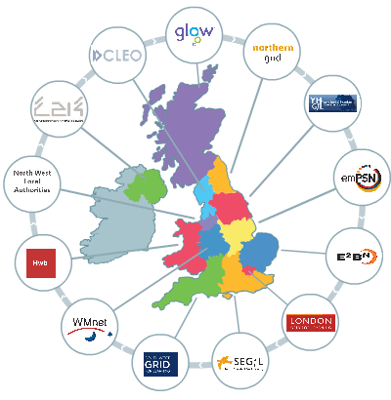
CLEO (Cumbria & Lancashire Education Online)
CLEO was formed
  Three way partnership between Lancashire CC, Cumbria CC & Lancaster University
  Lancaster University was the technology & delivery partner
  The university was the natural choice due to heritage in the region
  Initial funding was 50% county council and 50% DFES.

Slide 8
Geography
Many rural areas
Difficult terrain
Cumbria in particular is sparsely populated
Many parts of Lancashire are also very rural
Pop 487,000
Pop 1,429,000

Slide 9
Initial Connected Sites
> 250,000 pupils
> 1200 sites (more later)
Connect all sites natively

Slide 10
Initial Phase
Drive to get all the sites connected
Core network consisting mainly ATM (later POS) links
Mainly unlicensed band radio or LES circuits from core radio POP sites to strategic aggregation sites (often high schools).
EPS8/9 private copper circuits then used to onward connect smaller sites (multi-pair SDSL) – EPS = Engineering Performance Specifications
  Up to ~9.2Mb/s achievable via 2x EPS8 circuits (4 pairs running at 2.3Mb/s) on a provider/subscriber CPE pair or DSLAM/subscriber CPE

Slide 11
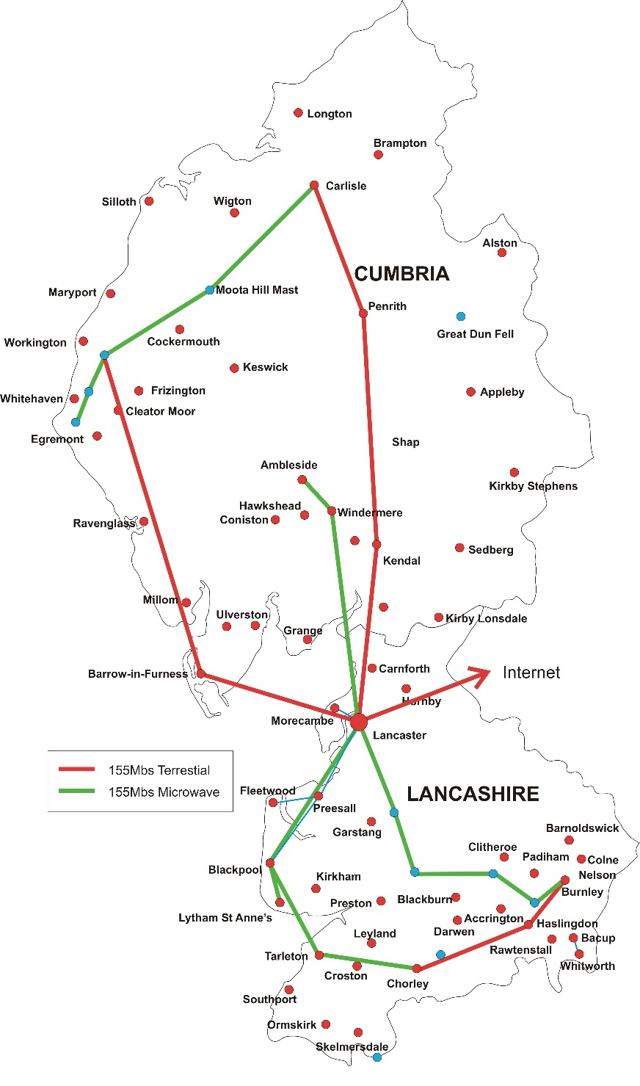
Phase 1 backbone
Circa 2000-2003
Core speed 155Mb/s via fibre or microwave running ATM
Many POP sites are masts (YC/Crowncastle/NTL, as were pre-Arqiva)
Figure of 8 topology for resilience
Core hardware consisting mainly of Cisco 8510s at this point

Slide 12
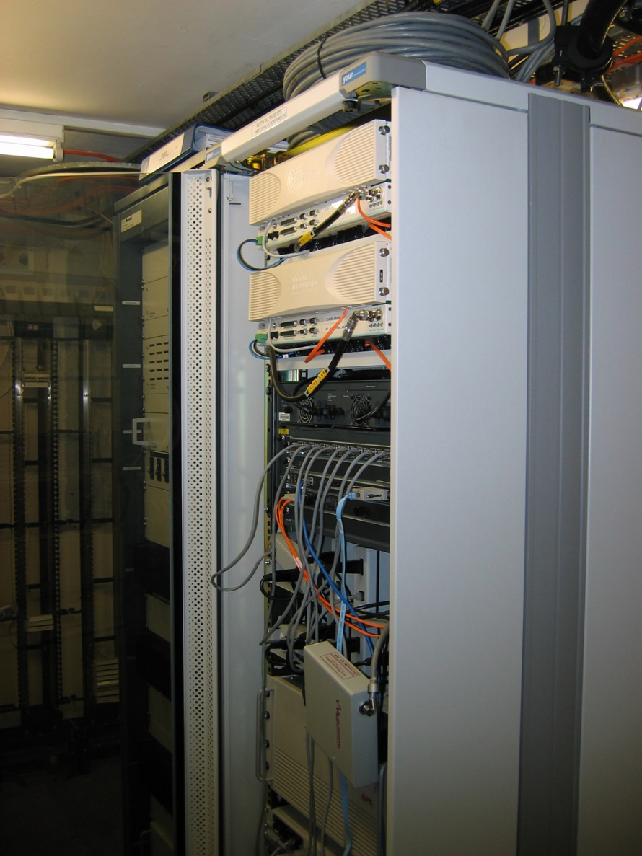
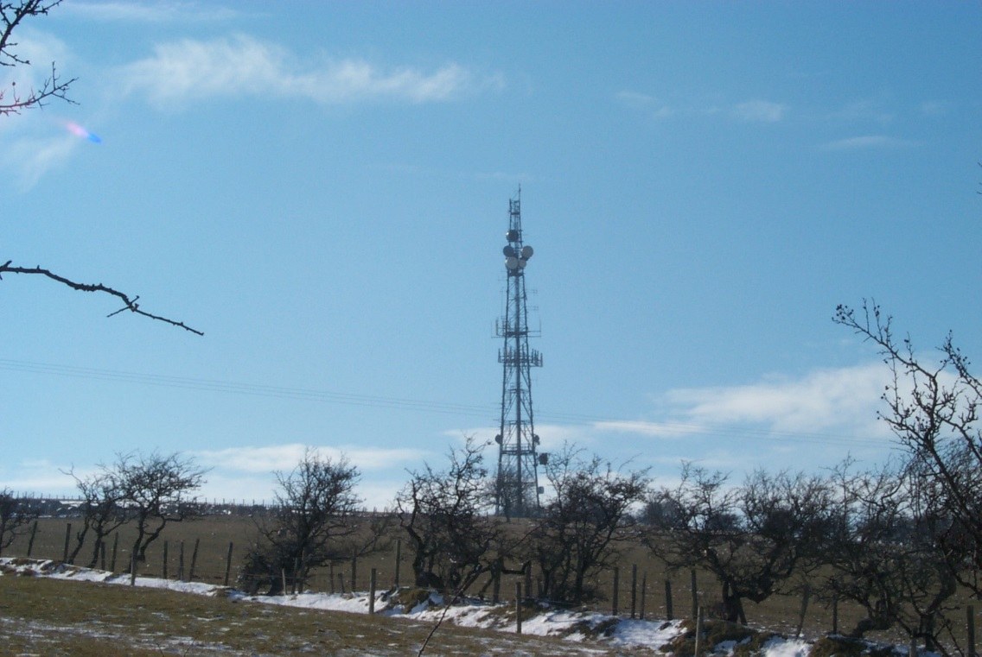
Phase 1 backbone
Example POP fit-out

Slide 13
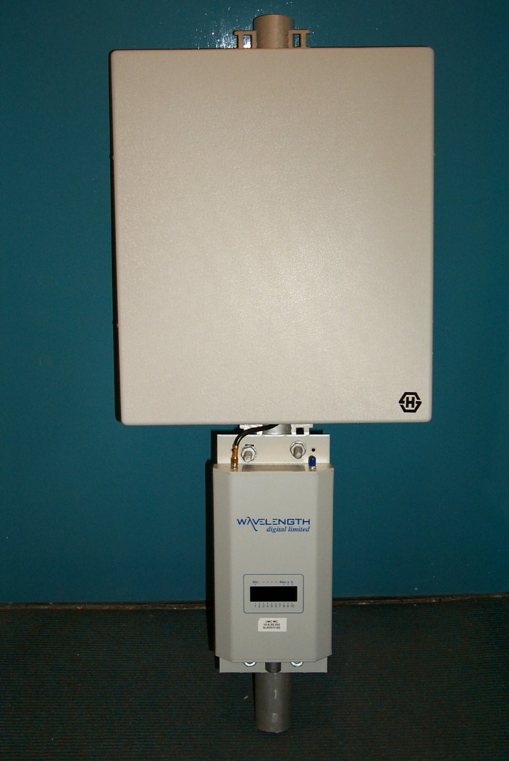
Phase 1 radio access
2.4Ghz radio
18dBi antenna
15km range

Slide 14
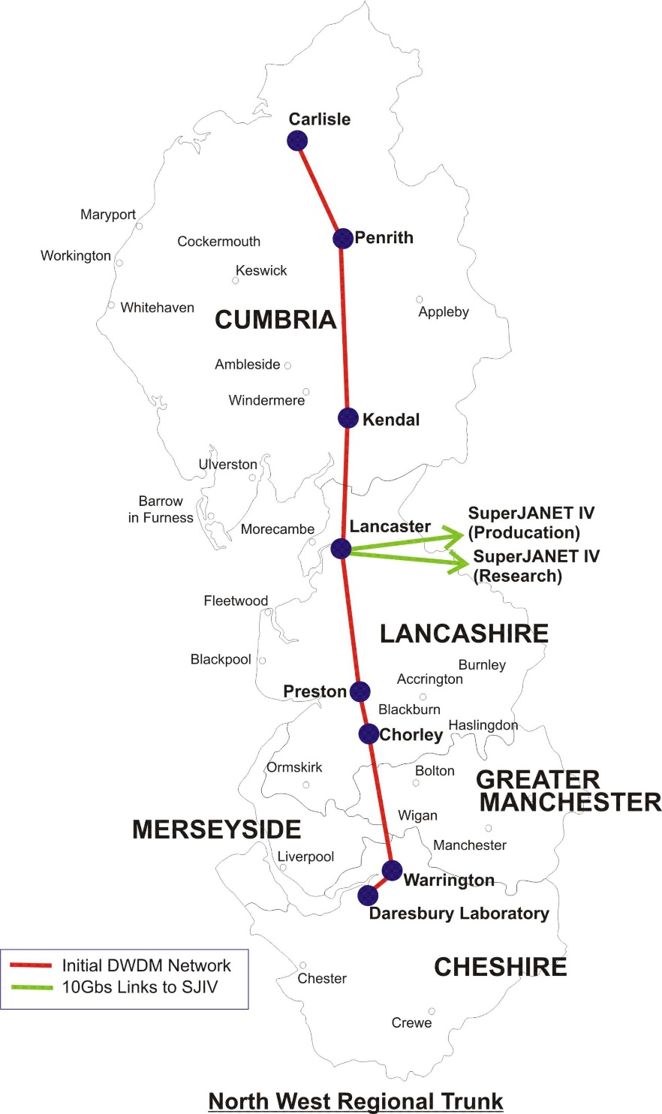
Phase 2 backbone
2003
Access to trans-regional fibre
DWDM
  YC fibre – would later become Thus, C&W then Vodafone

Slide 15
Phase 2 backbone
… augmented the existing core as bandwidths increased.
Several core links now at 10Gb/s

Slide 16
Equipment refresh
Core routers
  33 new routers procured (circa 2005) consisting of Juniper M7i/M10i and M320
  One of the first educational references for Juniper in UK
  Move to IP over POS
  Introduction of L2 and L3 VPN simplified network design for separating multiple clients groups
  RSVP rather than LDP to allow for traffic engineering and finer grained control of LSPs

Slide 17
Equipment refresh
Unlicensed band radios
  Existing 2.4Ghz Aries radios swapped for 5.8Ghz radios
  Alvarion P2P and P2MP (point to multi-point) radios selected
  Offered higher bandwidths
    Up to 30Mb/s rather than 10Mb/s
    Higher power
    Still only 4 non-overlapping channels
    Ranges very good where no interference present (~30km)
    Wide beam sector antennas effective (90 or 120 degree)

Slide 18
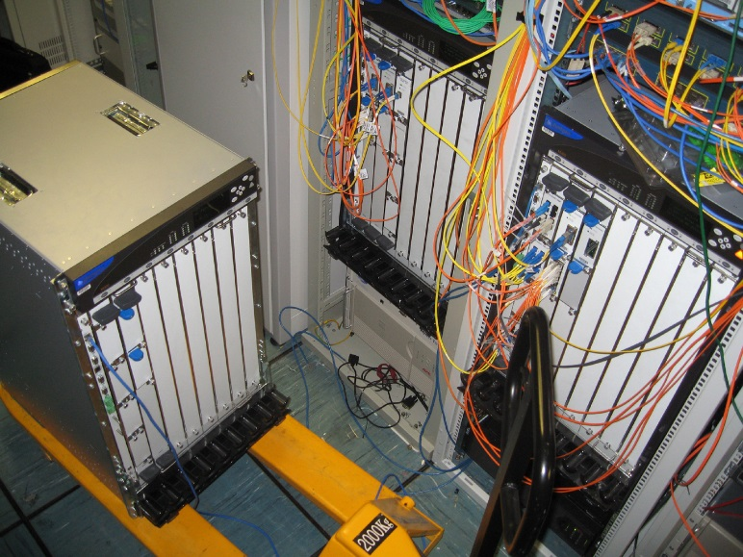
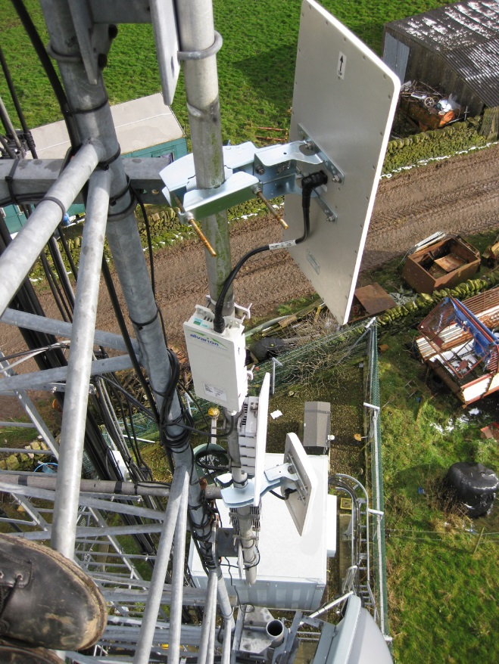
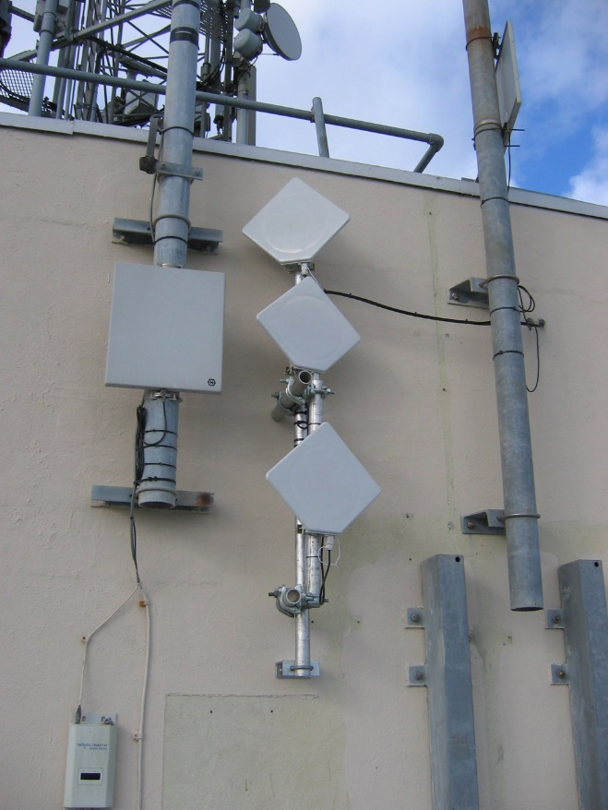
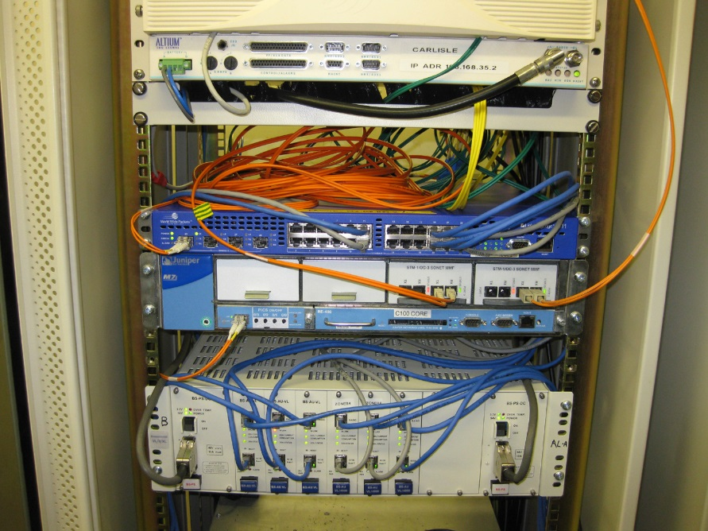
Equipment refresh
New cores being fitted out
5.8Ghz
sector on tower
5.8Ghz
Subscriber/P2P unit

Slide 19
2004-2006 – Openreach & LLU
Telephone exchanges and the local loop become accessible
~125 telephone exchanges unbundled
  Reach to 95% of population
  Microwave fill-in
First exchange delivered October 2004 – last by Dec 2005
MPF (metallic path facility) provides direct copper circuit from exchange to site
Cost effective fibre tails from local exchange
  Was all BES/WES/LES, now EAD/EAD-LA
More control over POP sites (power etc)

Slide 20
Transition to Exchanges
Exchanges initially fed in chains via existing core
  Some exchanges temporarily fed via MPF or radio from existing aggregator or core sites
MPF circuits beneficial over EPS which are gradually phased out
  Actually qualified for data usage unlike EPS
  Better range
  Supplied insertion loss figures (syn spec)
  Regulated pricing
ADSL2+ and SDSL DSLAMs installed
  ADSL2+ available years before it was commonplace
Exchanges become primary means of last mile/access

Slide 21
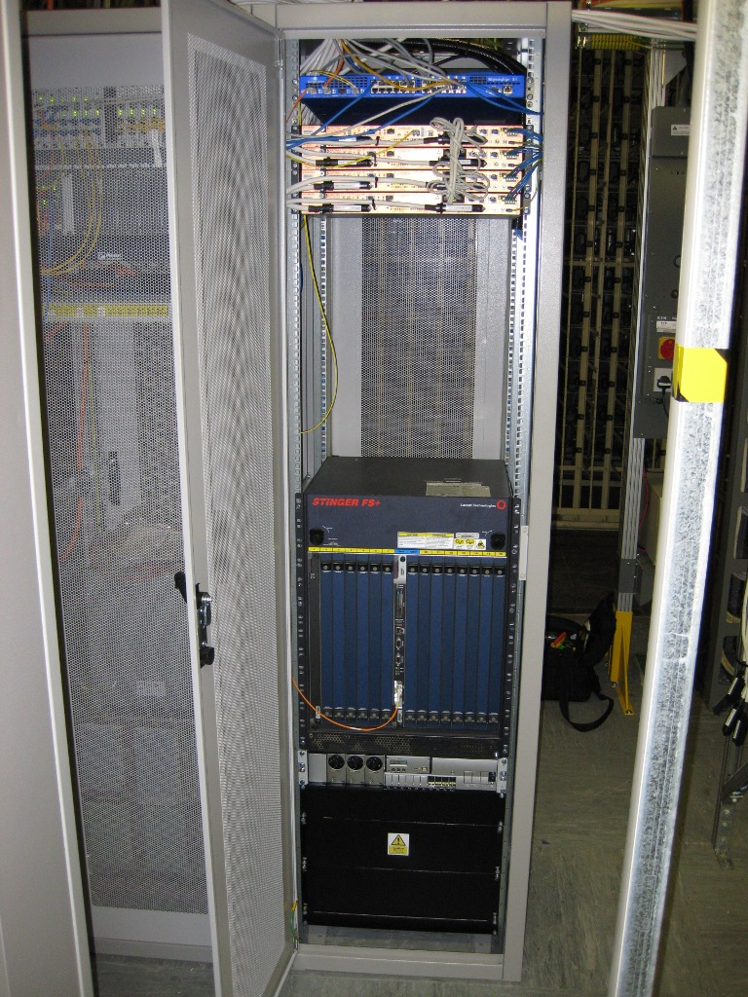
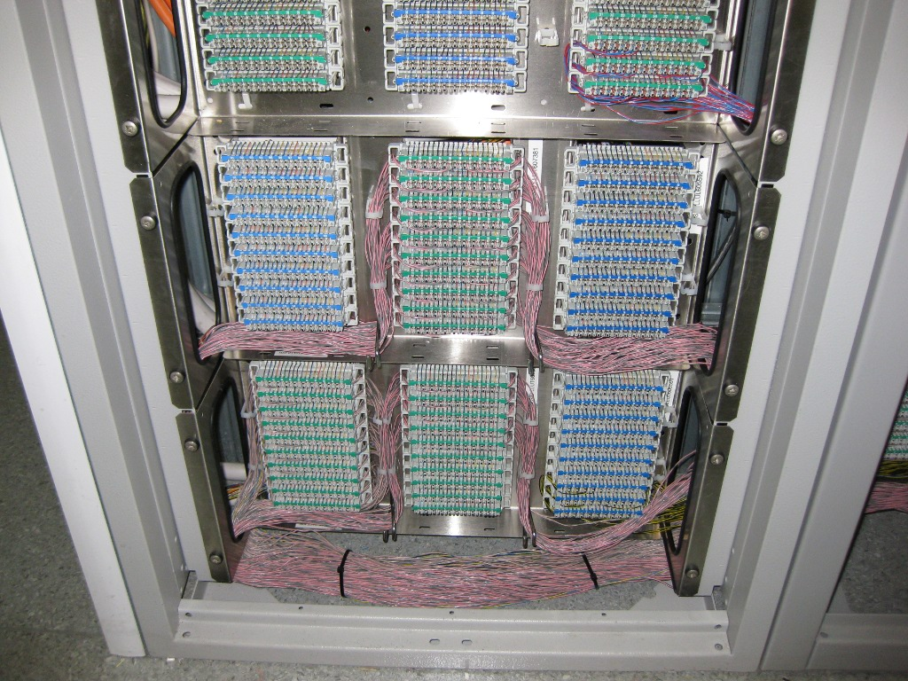
Transition to Exchanges

Slide 22
“CLEO2” Core
Refresh of core network from 2007 onwards
Procurement of Juniper MX480 routers
  Rationalisation down to ~6 primary core locations
    Lancaster, Carlisle, Kendal, Accrington, Preston (x2)
  Metro edge via exchange chains
  Some M7i/M10i remain at mast sites for MPLS drop off
Addition of GEO fibre from Manchester to Carlisle
  Installation of DWDM providing many 10G channels
  Driven long-distance to avoid drop-out to active kit
    Raman amplifier used on (what was then) fairly long legs

Slide 23
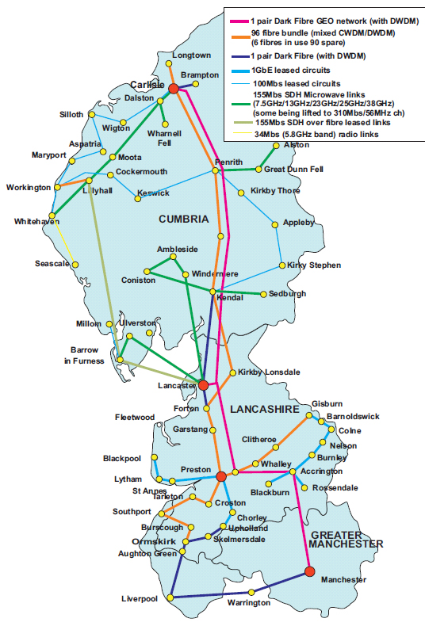
Towards CLEO2 Core
2008-9
Some core dual running during transition
New links and routers bought into place one by one
Standard CLEO2 site bandwidths
  100Mb/s for secondary school sized sites
  10Mb/s for primary school sized sites
  Some 1Gb/s sites

Slide 24
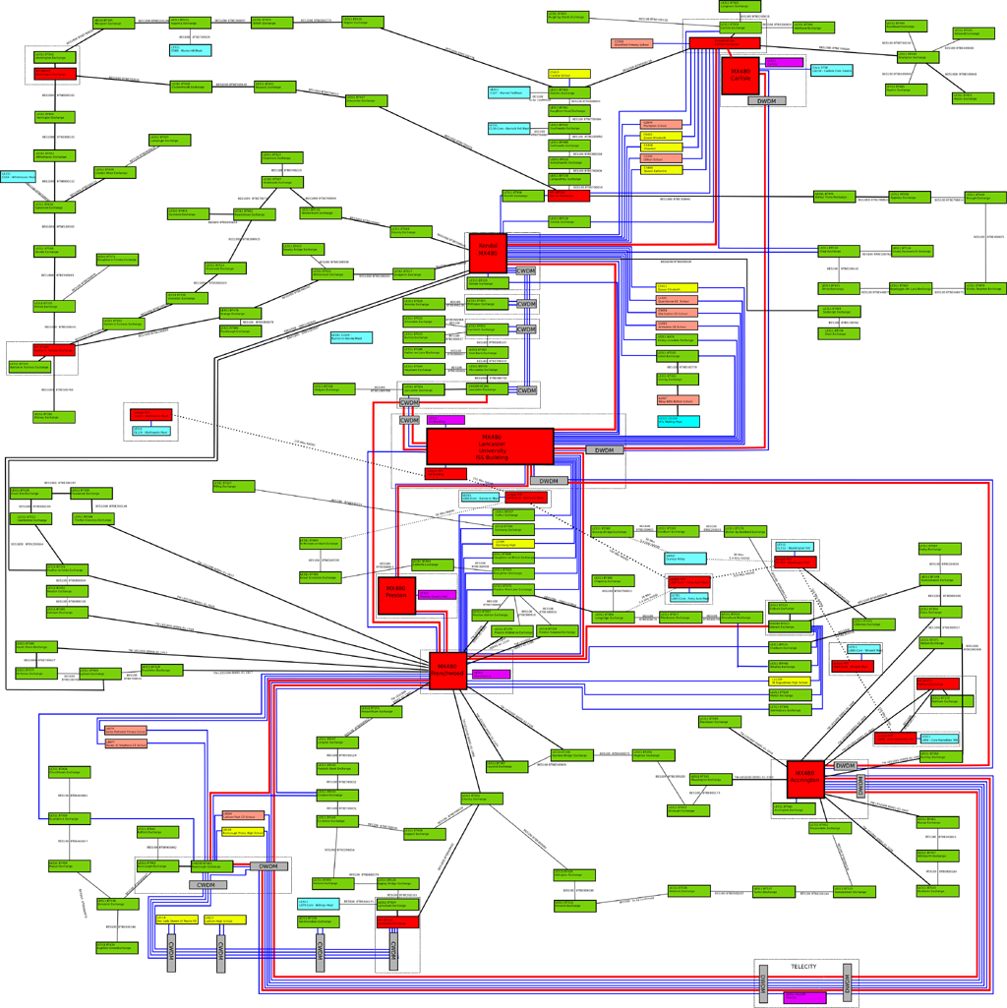
CLEO2 Core
Circa 2010 snapshot
Core POPs (red)
Exchanges (green)
Masts (blue)
Dual fed dark fibre connected edge sites (Yellow/Orange)

Slide 25
“CLEO2” SDSL/EFM
Procurement for replacement SDSL equipment begins in 2008
Hatteras EFM equipment chosen
  Line speeds at the time of 5Mb/s per line
  Standard CPEs could bond up to 8 lines
  DSLAMs could be stacked
    Load-balance lines across stack members for redundancy
DSLAMs in most larger exchanges
  Provider/subscriber pairs used in smaller exchanges where only 1 or 2 sites connected via EFM

Slide 26
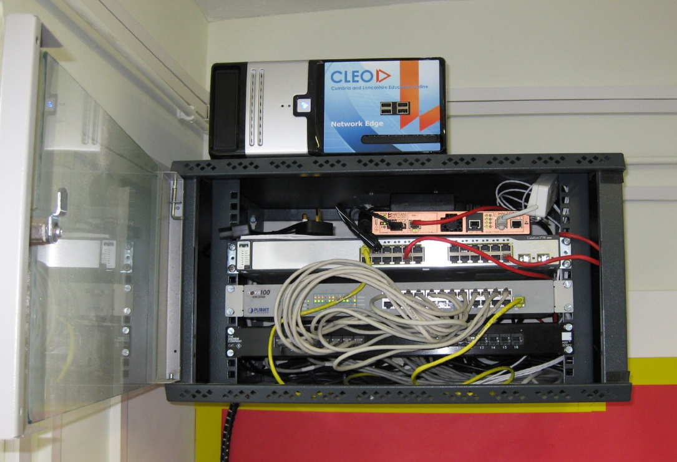
“CLEO2” SDSL/EFM
Site CPE & router in cabinet
Exchange equipment

Slide 27
“CLEO 2” DC Fitouts
Procurement of new Eltek DC equipment for Exchanges/ Cores/ Masts
  Self provided DC allowed for ‘self monitoring’
40 & 100Ah battery strings (48v) depending on size/location of site
  Provided run-time into the days

Slide 28
“CLEO2” Microwave
5.8Ghz C-Band is becoming more commonplace
  Particularly in built up areas
  Interference becoming a problem
3rd radio refresh, predominantly to “B-Band” 5.4Ghz equipment
  Remains with Alvarion
  Staying ahead of the ‘spectrum popularity’ curve
  Lower possible TX power but less interference in general
In CLEO2, radio is less used, but still important
  Exchanges cover most of the last mile
  Radio fill in for lines > 3km and rural sites
Licensed band Nera (now Ceragon) links used for some exchange backhaul and resilience

Slide 29
Backhauling Rural Broadband Projects
With rural projects, backhaul is often the hardest part
CLEO was in the right locations to provide rural backhaul
  Wray Village, Wennington, Great Asby, Barley Village, Alston Cybermoor
In several cases the university became involved with the last mile delivery (sometimes as a research platform)
  Allowed trials and research on mesh networking, v6/multicast testing, mobile ipv6, video on demand
  Not enough time to cover!
  See Dr Nick Race from Lancaster University, here today (n.race@lancaster.ac.uk)
    http://www.lancaster.ac.uk/scc/about-us/people/nicholas-race
    Wray village mesh network slides - https://www.dropbox.com/s/5375qq3z5g64tyy/Wray_ACS.pptx

Slide 30
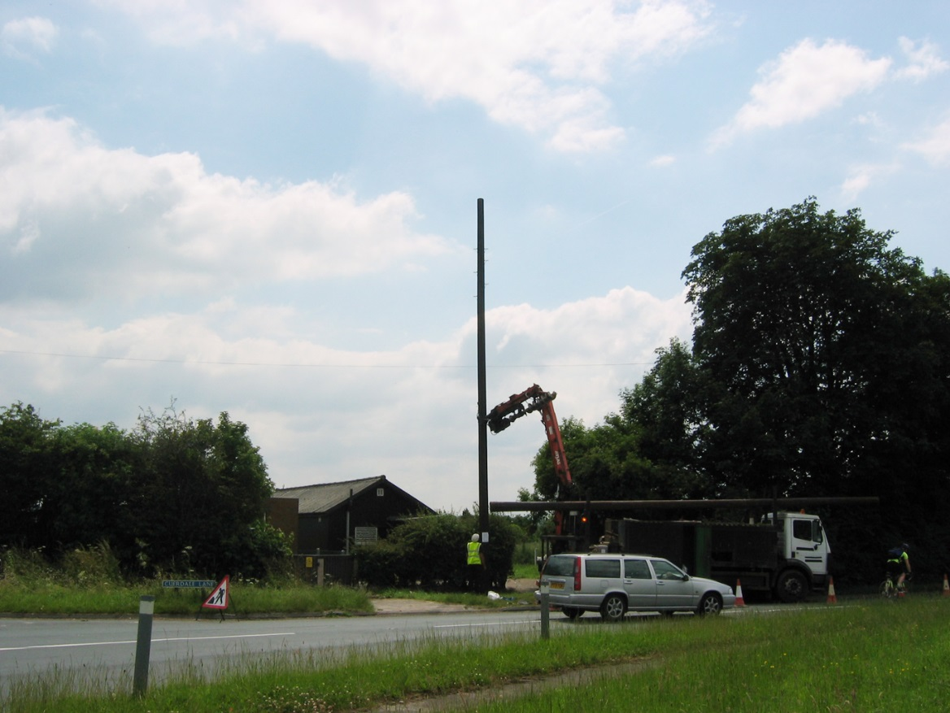
Anecdotes – No power
Exchange backhaul not ready
Site desperately needed connection from exchange
No problem! – drop pole and cabinet outside exchange
Backhaul exchange via radio…

Slide 31
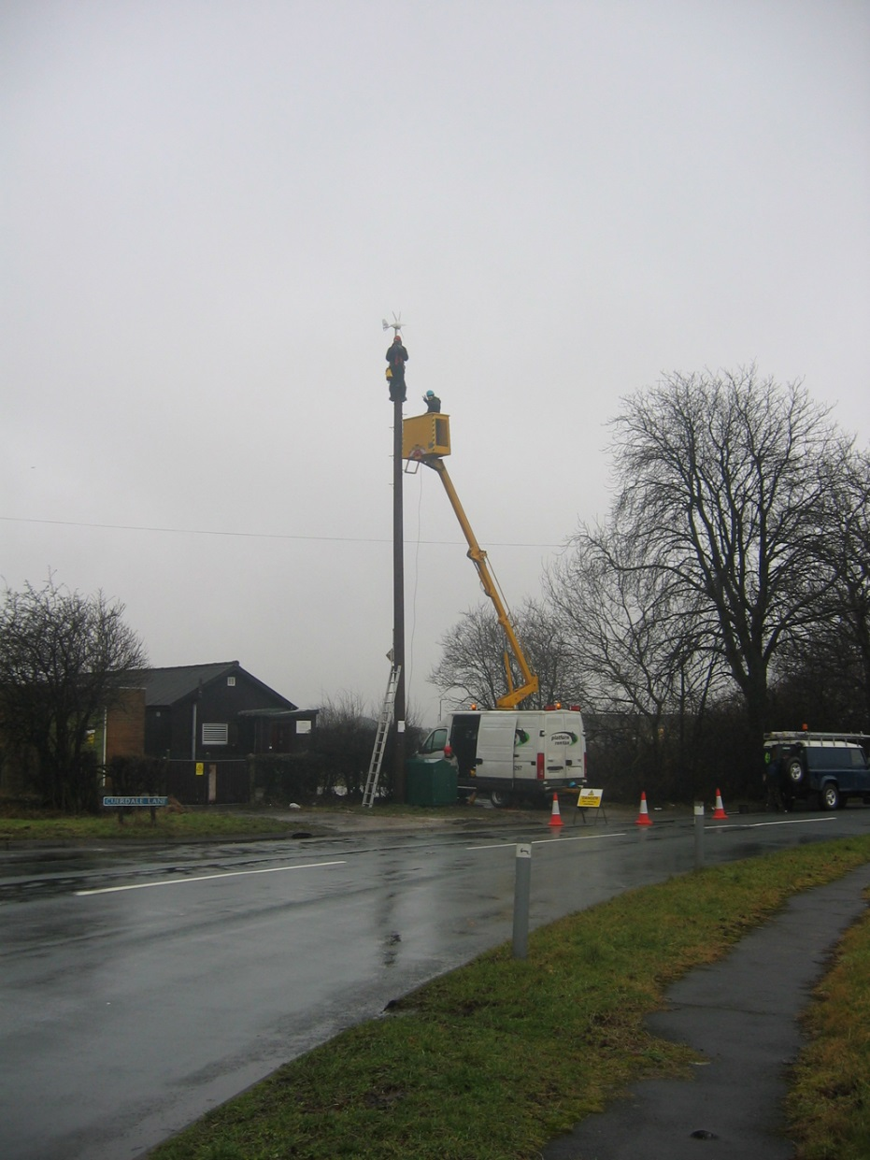
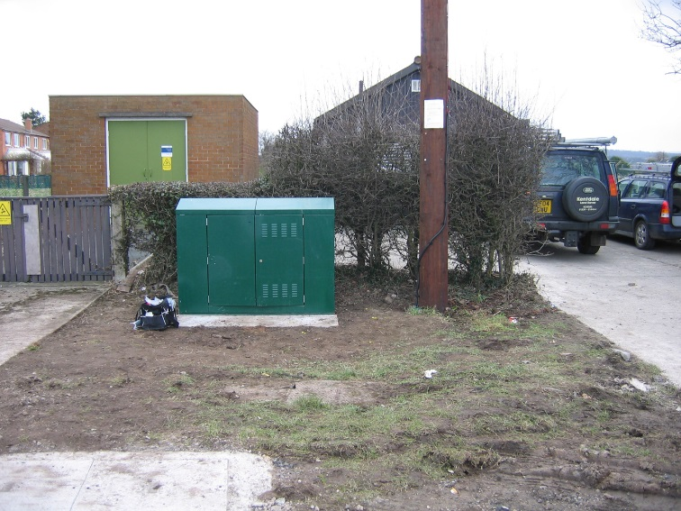
Anecdotes – No power
… power for cabinet has long lead time
No problem! - install batteries & wind generator

Slide 32
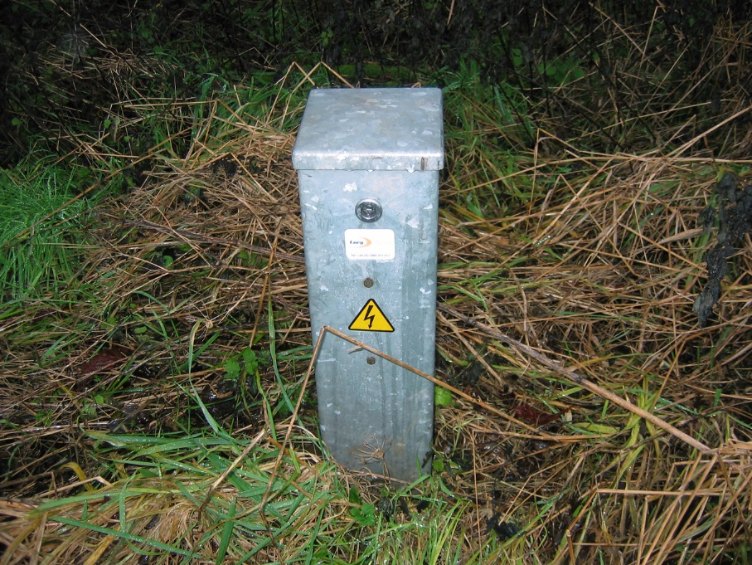
Anecdotes – No power
One day, a call comes in;
Them “Internet is down”
Monitoring hadn’t picked up lack of charge -
Us “Is it windy”?
Them “?????”
Power (and fibre) eventually went in -

Slide 33
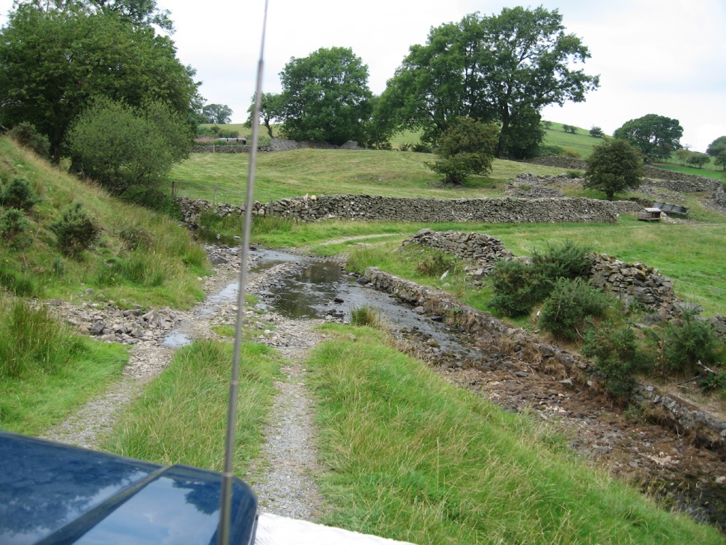
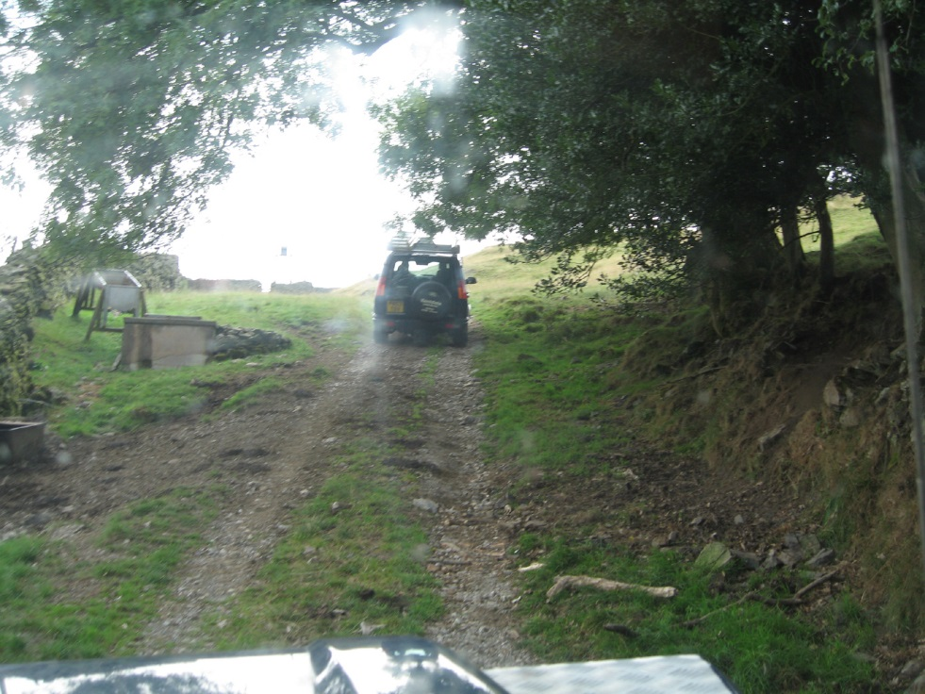
Anecdotes - Sheep
Reports connection down on A-Level results day (siiigh)
Team roll out to climb at rural mast site in Cumbria

Slide 34
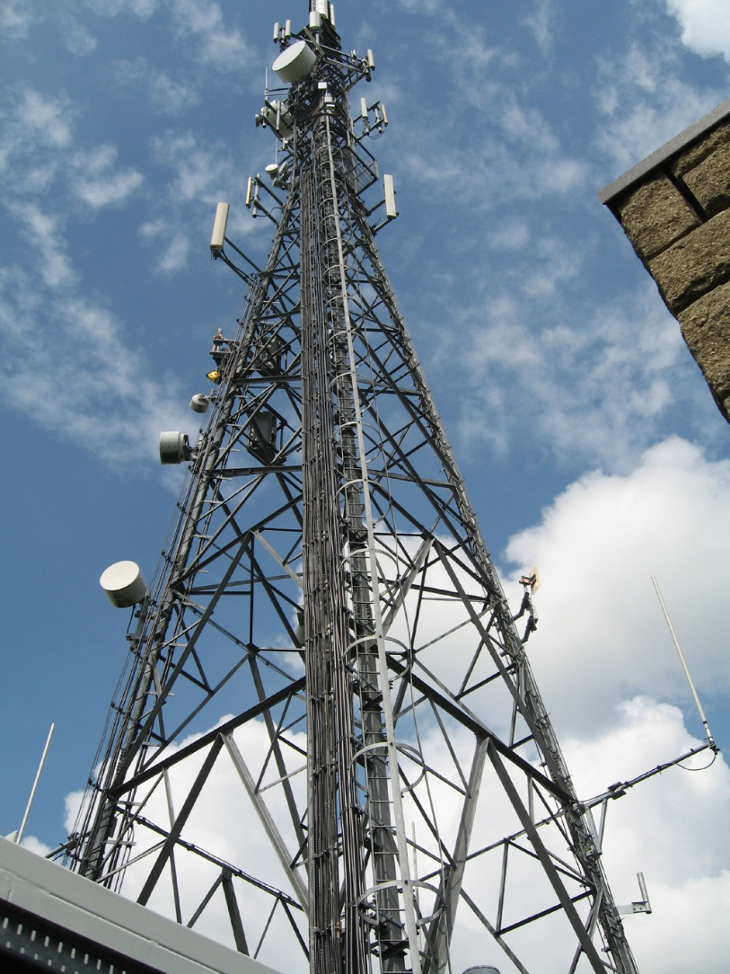
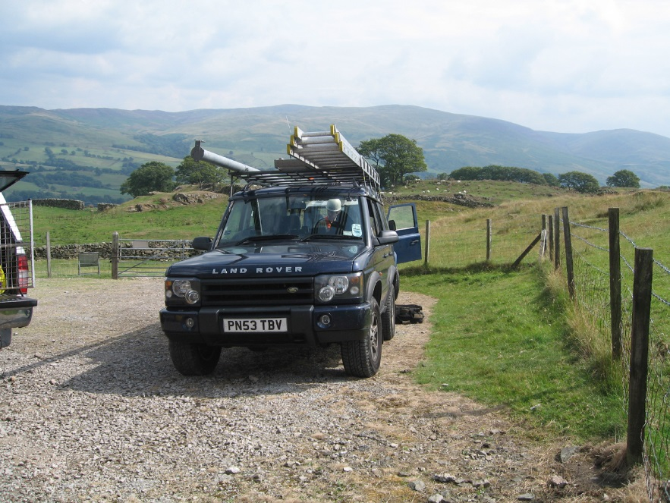
Anecdotes - Sheep
Get out to mast site
Find sheep in compound (uh oh) and damaged fence
Climb to test cable end-to-end

Slide 35
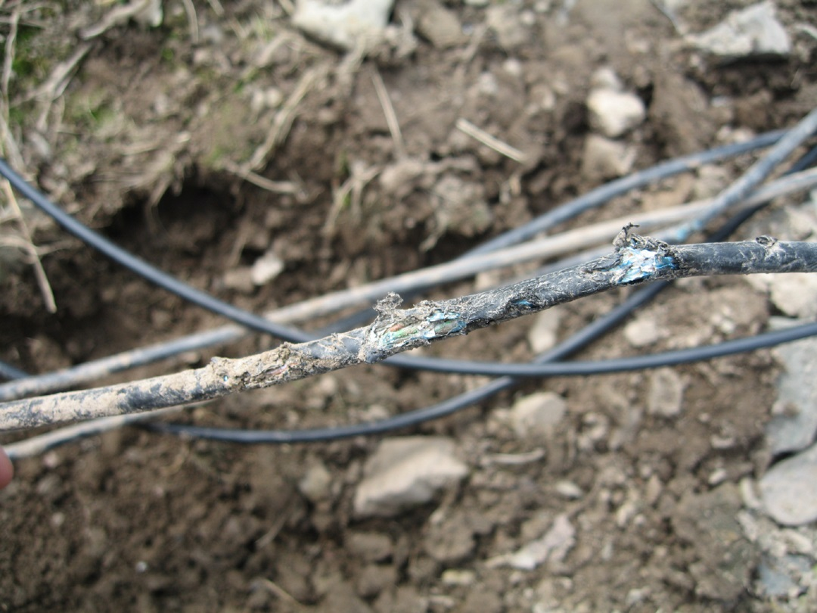
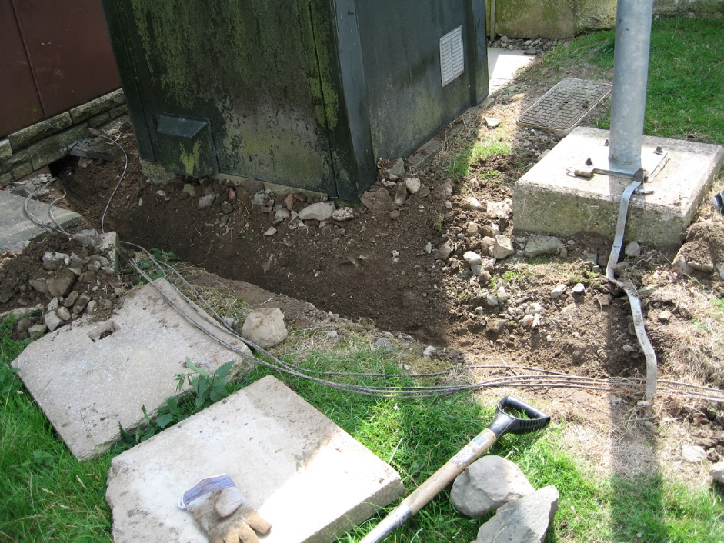
Anecdotes - Sheep
Cable broken in several places by sheep nibbling
Deeper burying (or steel wire armour cable)
Cable re-ran end to end (up tower) to fix
Fence repaired!

Slide 36
Anecdotes - Sheep
Call back to site to explain
Them “?????”
Site translate as ‘sheep ate A-levels’
(“satellite” in article in this case = microwave)

Slide 37
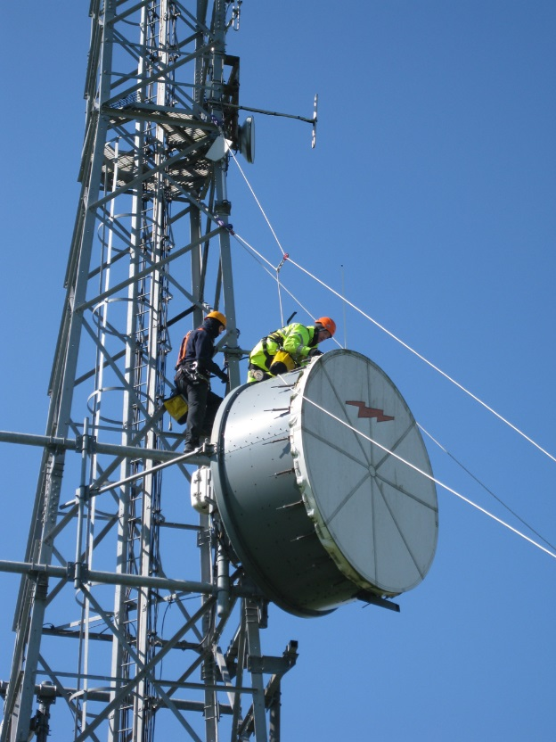
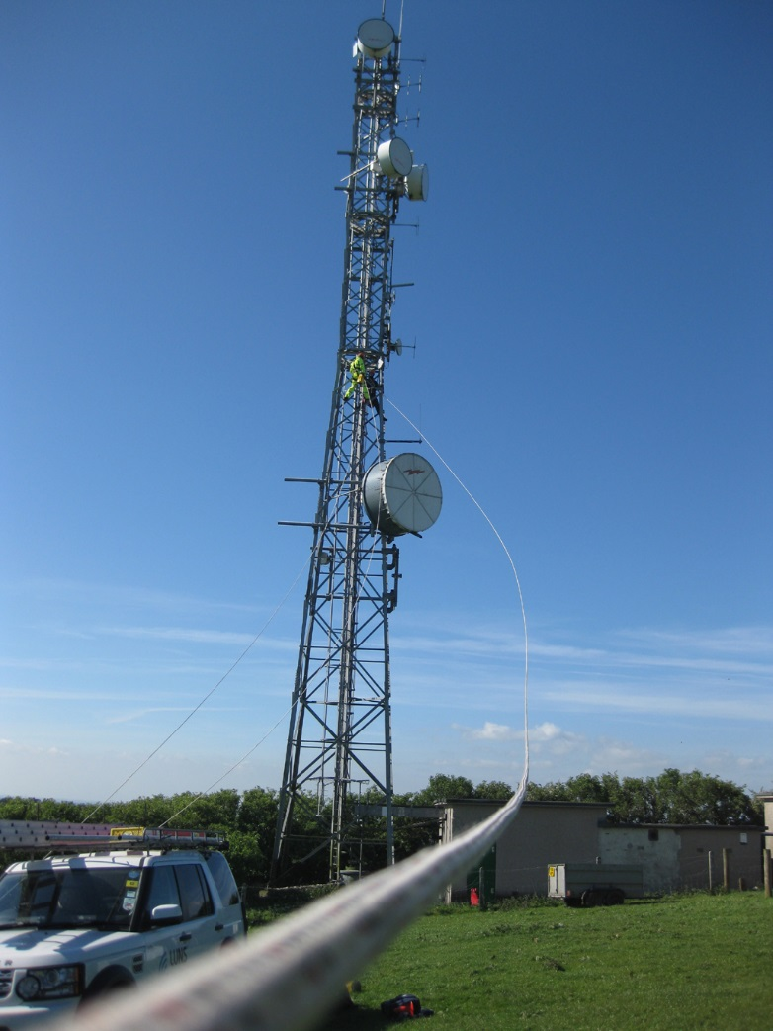
Anecdotes – Dish Decom
Some microwave dishes larger than others
This one was 2.4M
Wind can be an issue (both kinds)

Slide 38
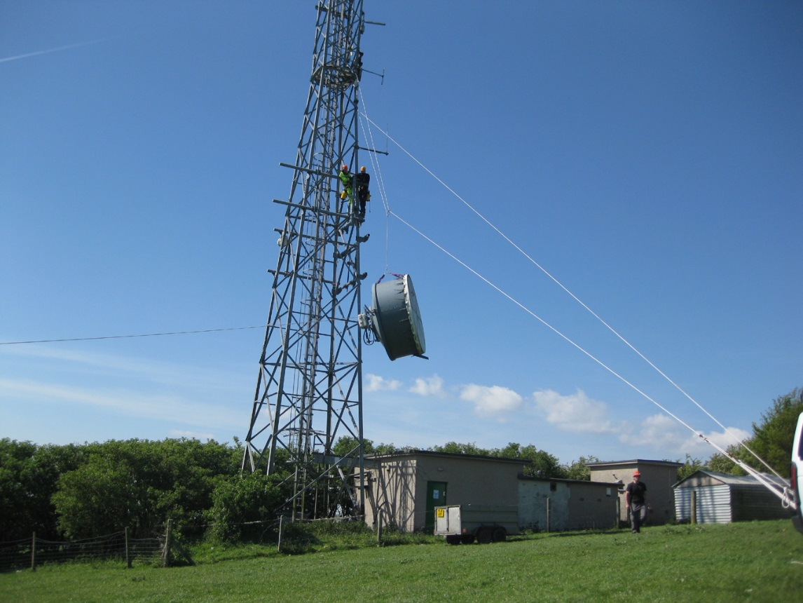
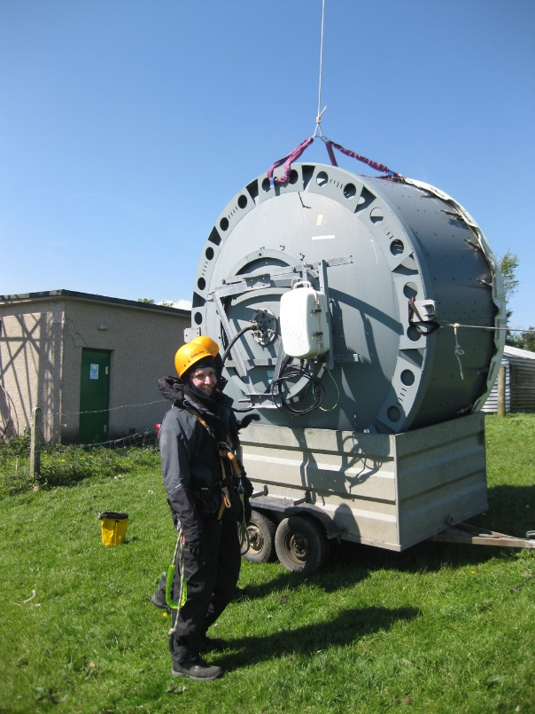
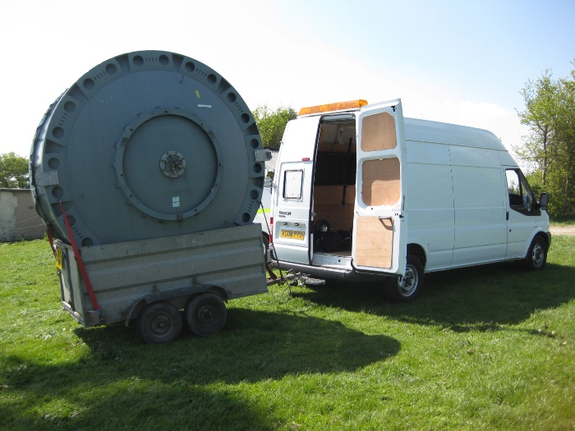
Anecdotes – Dish Decom
Who brought that trailer??
Looks bigger on the ground!

Slide 39
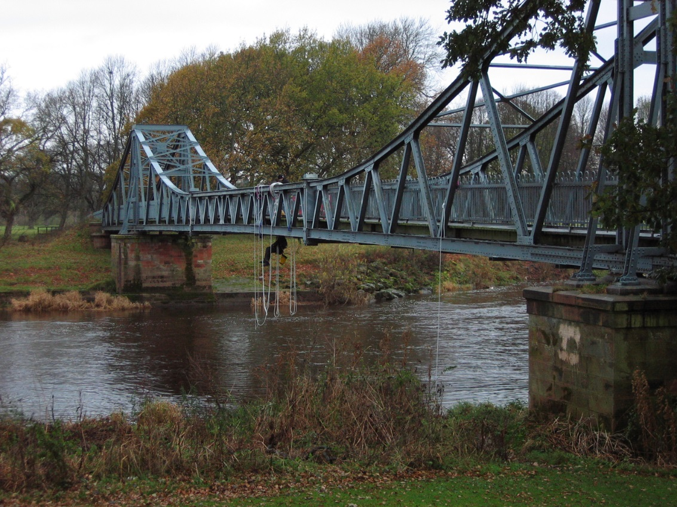
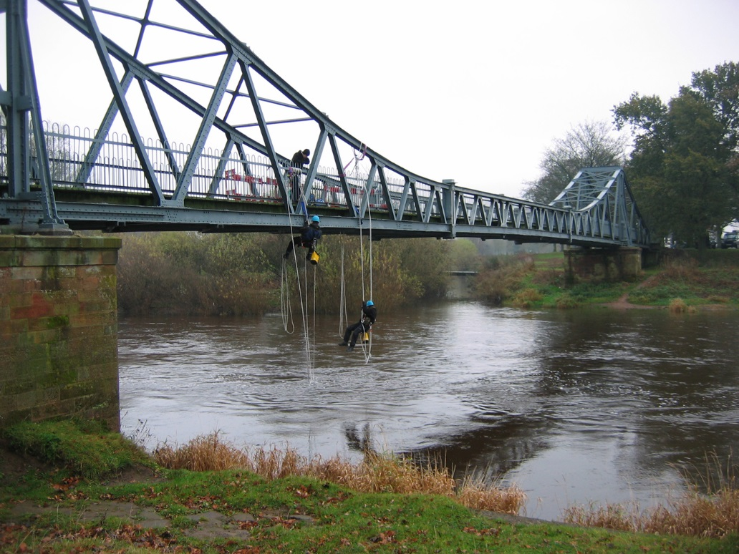
Anecdotes - Rope Access
Fibre run under bridge

Slide 40
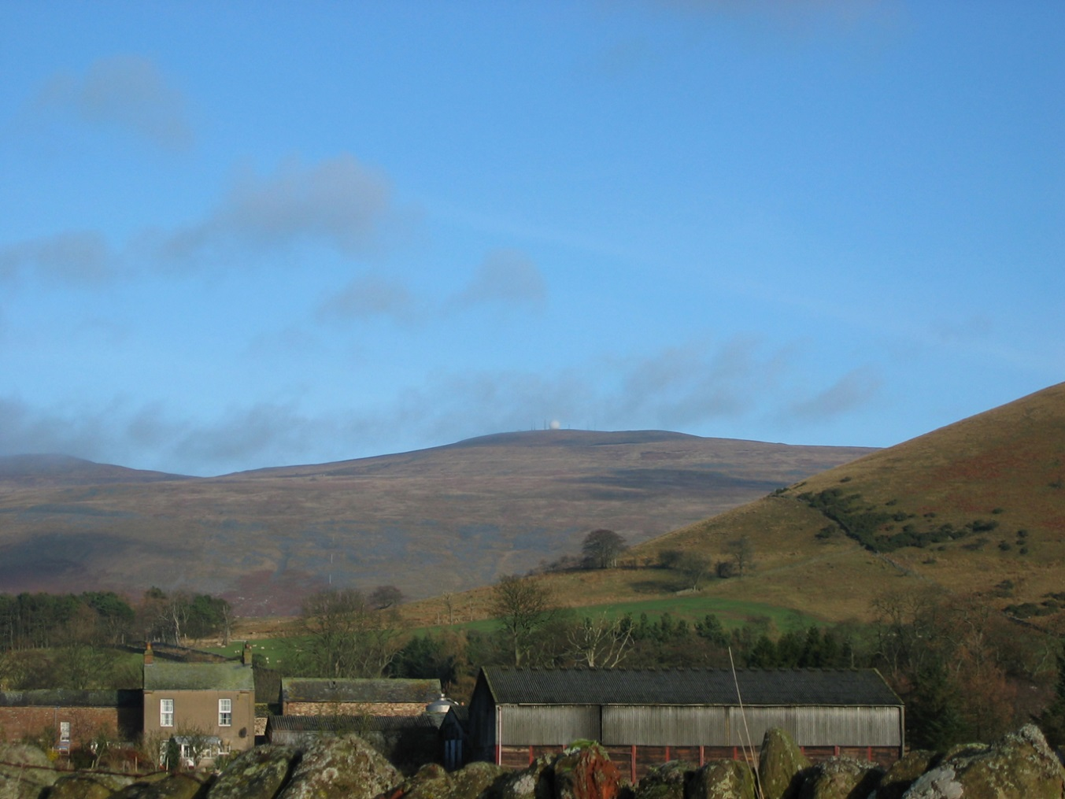
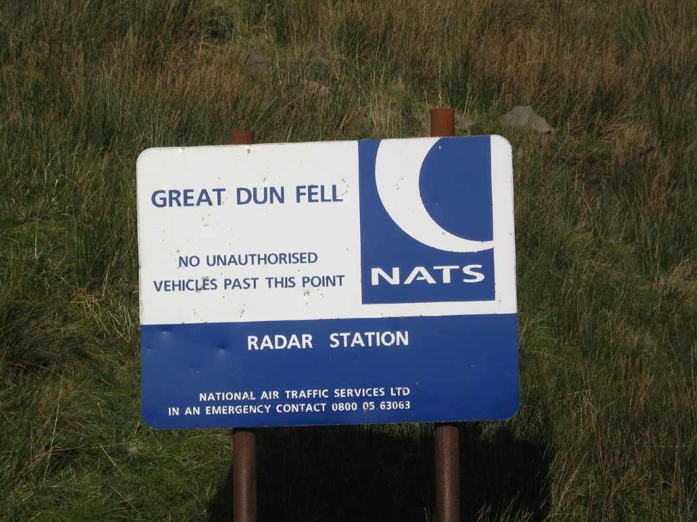
Interesting POPs
Great Dun Fell Radar Station

Slide 41
Interesting POPs
Great Dun Fell Radar Station

Slide 42
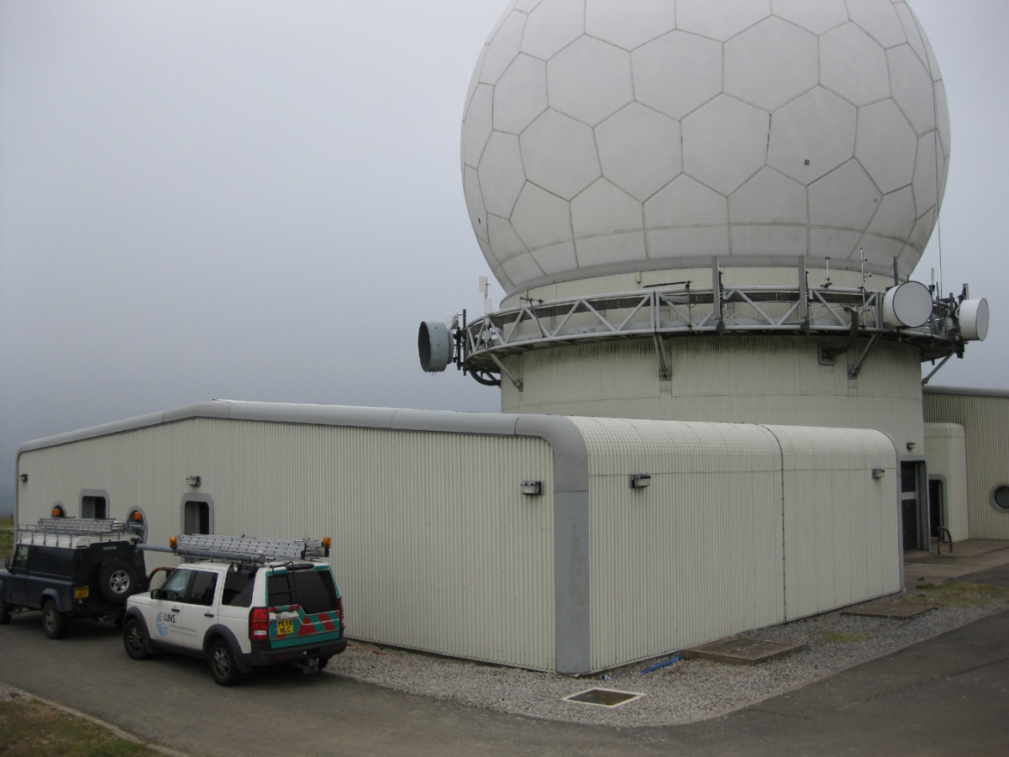
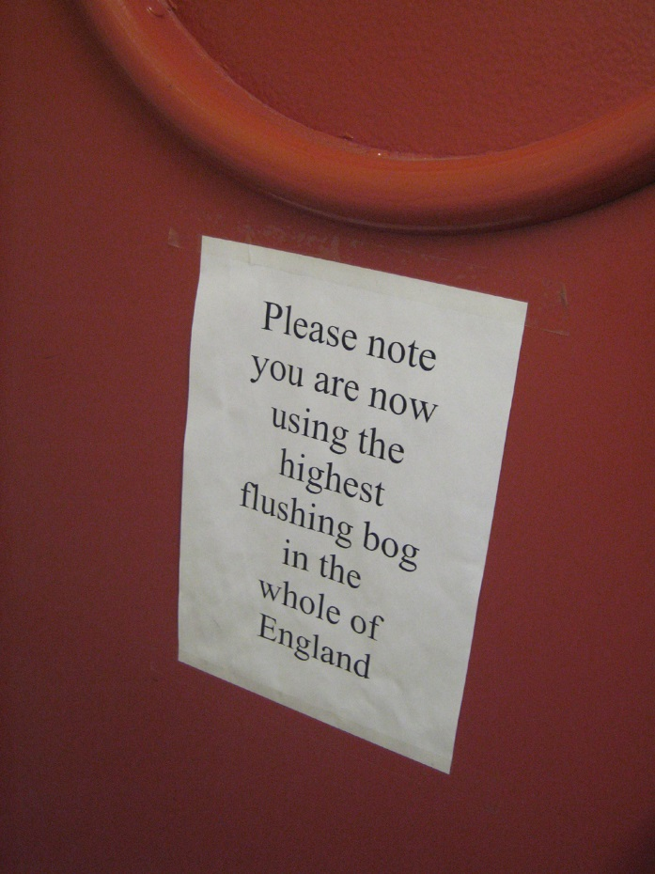
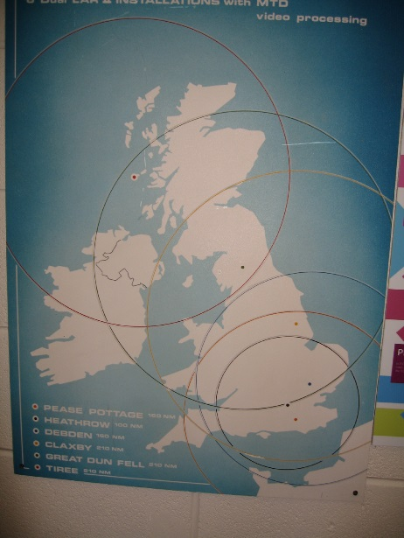
Interesting POPs
Great Dun Fell Radar Station

Slide 43
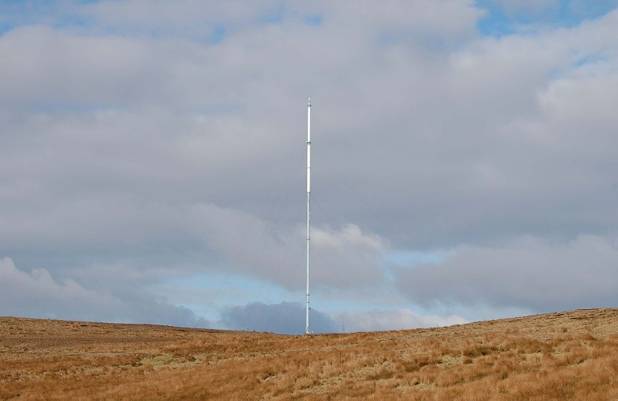
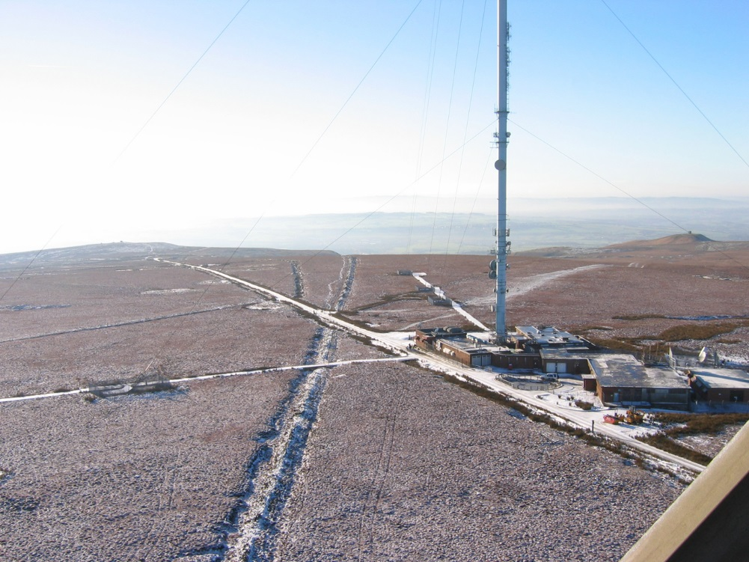
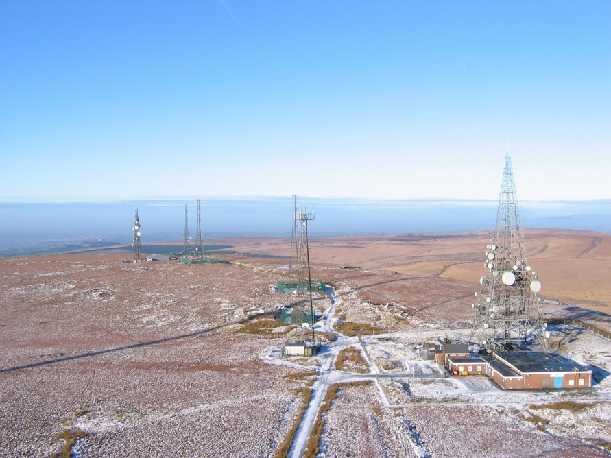
Interesting POPs
Winter Hill
> 1000ft transmitter site
  Highest TV transmitting station in UK at 2500ft above sea level
  Serves 6.3 million people
TV transmission for large area of NW and North Wales

Slide 44
Interesting POPs
Winter Hill

Slide 45
To finish: Some lessons learnt
Use DC power where possible
  (though sometimes good reasons not to)
  Runtime++
  Usually fails ‘on’ if rectifier blows
  Unfortunately vendors know you’re a telco £££
Always clean/scope fibre patches properly before use
  Drum it into the field teams
  Can be difficult where 3rd party DCs/colo ODFs involved
Easy to underestimate supporting systems requirements
  Systems/databases to tracking of orders/circuits/exchange patching
  Nowadays tracking of GEA VLANs/cable links
  Monitoring
  Spreadsheets only work for so long

Slide 46
To finish: Some lessons learnt
OR MPFs/copper lines
  Always use a wetting current/dial tone where possible or pairs will go walkabout
  Have a test-head or set of handheld testers to verify problematic lines
Weather-proof outdoor microwave radios well
  Use denso or self amalgamating tape on all joints/glands
  Use good quality double jacketed or gel filled cable to avoid water running down cables into mast hut/kit if water enters radio or cable gets cut
Unlicensed band sectors in built up areas challenging
  Too much interference & misconfiguration around – bar has been lowered through cheap 5ghz equipment
  Unlicensed P2P links with higher gain antennas still usable
  60-80ghz light-touch licensed useful for higher bandwidths over short distances

Slide 47
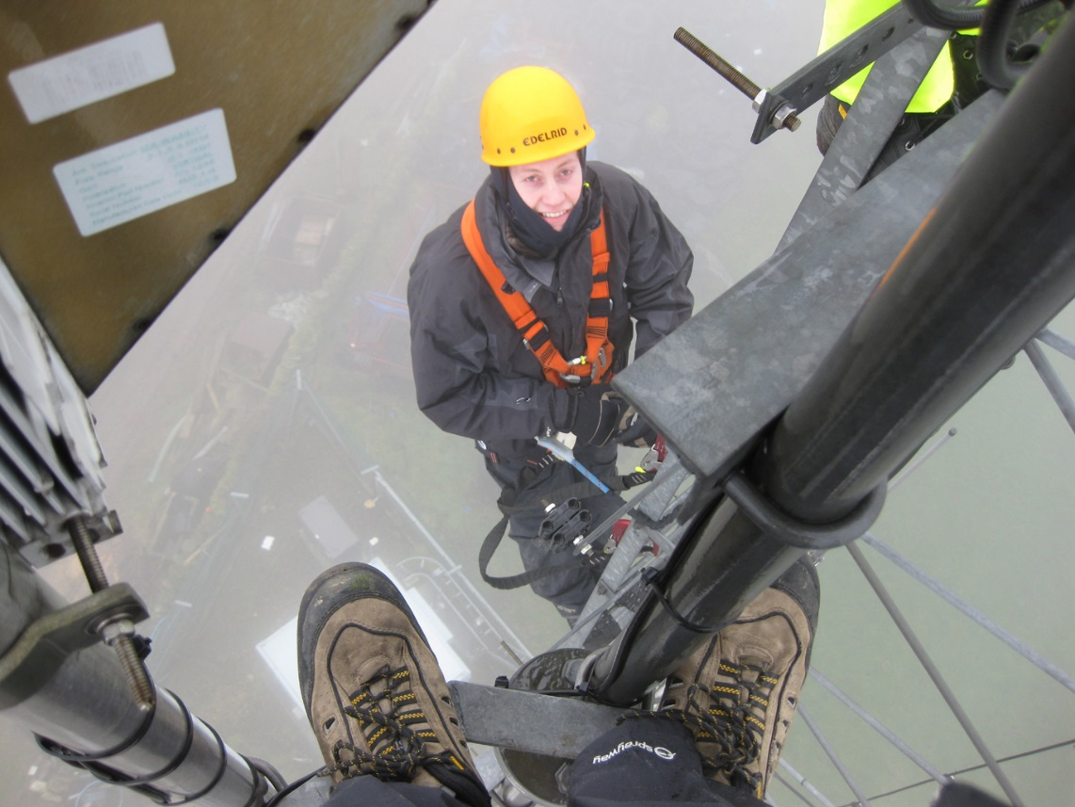
Thanks!

