Slide 1
Oh f$*k I think I'm running a software company
Colin Silcock
UKNOF35 – September 2016

Slide 2


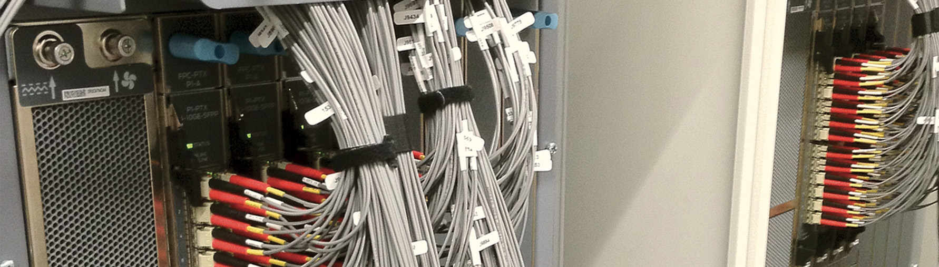





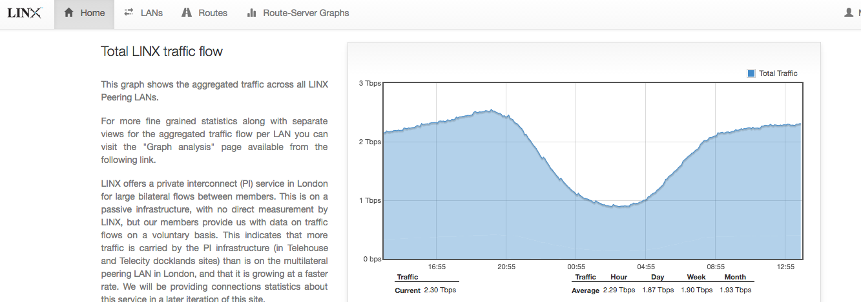
About Me
Colin Silcock
Software Engineering Manager
@colinsilcock
@linxsoftware

Slide 3

Imposter Symdrome

Slide 4

Imposter Symdrome

Slide 5
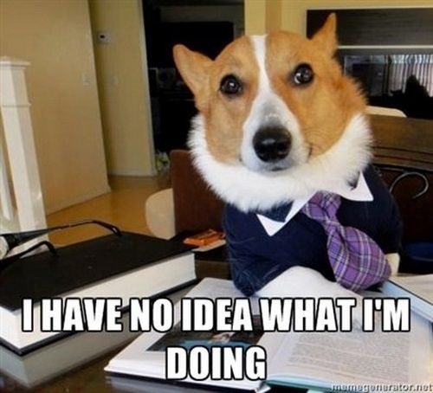
Imposter Syndrome

Slide 6

Building Software: Why do I care?
‘Software is Eating the World’ – Marc Andreeson, 2011
Customer/Service Databases
Network Config Backups
Monitoring configuration generation
Bash/perl/python/ruby scripts
Network Configuration Automation
Network Monitoring Scripts (nagios plugins!)
Reporting Tools

Slide 7
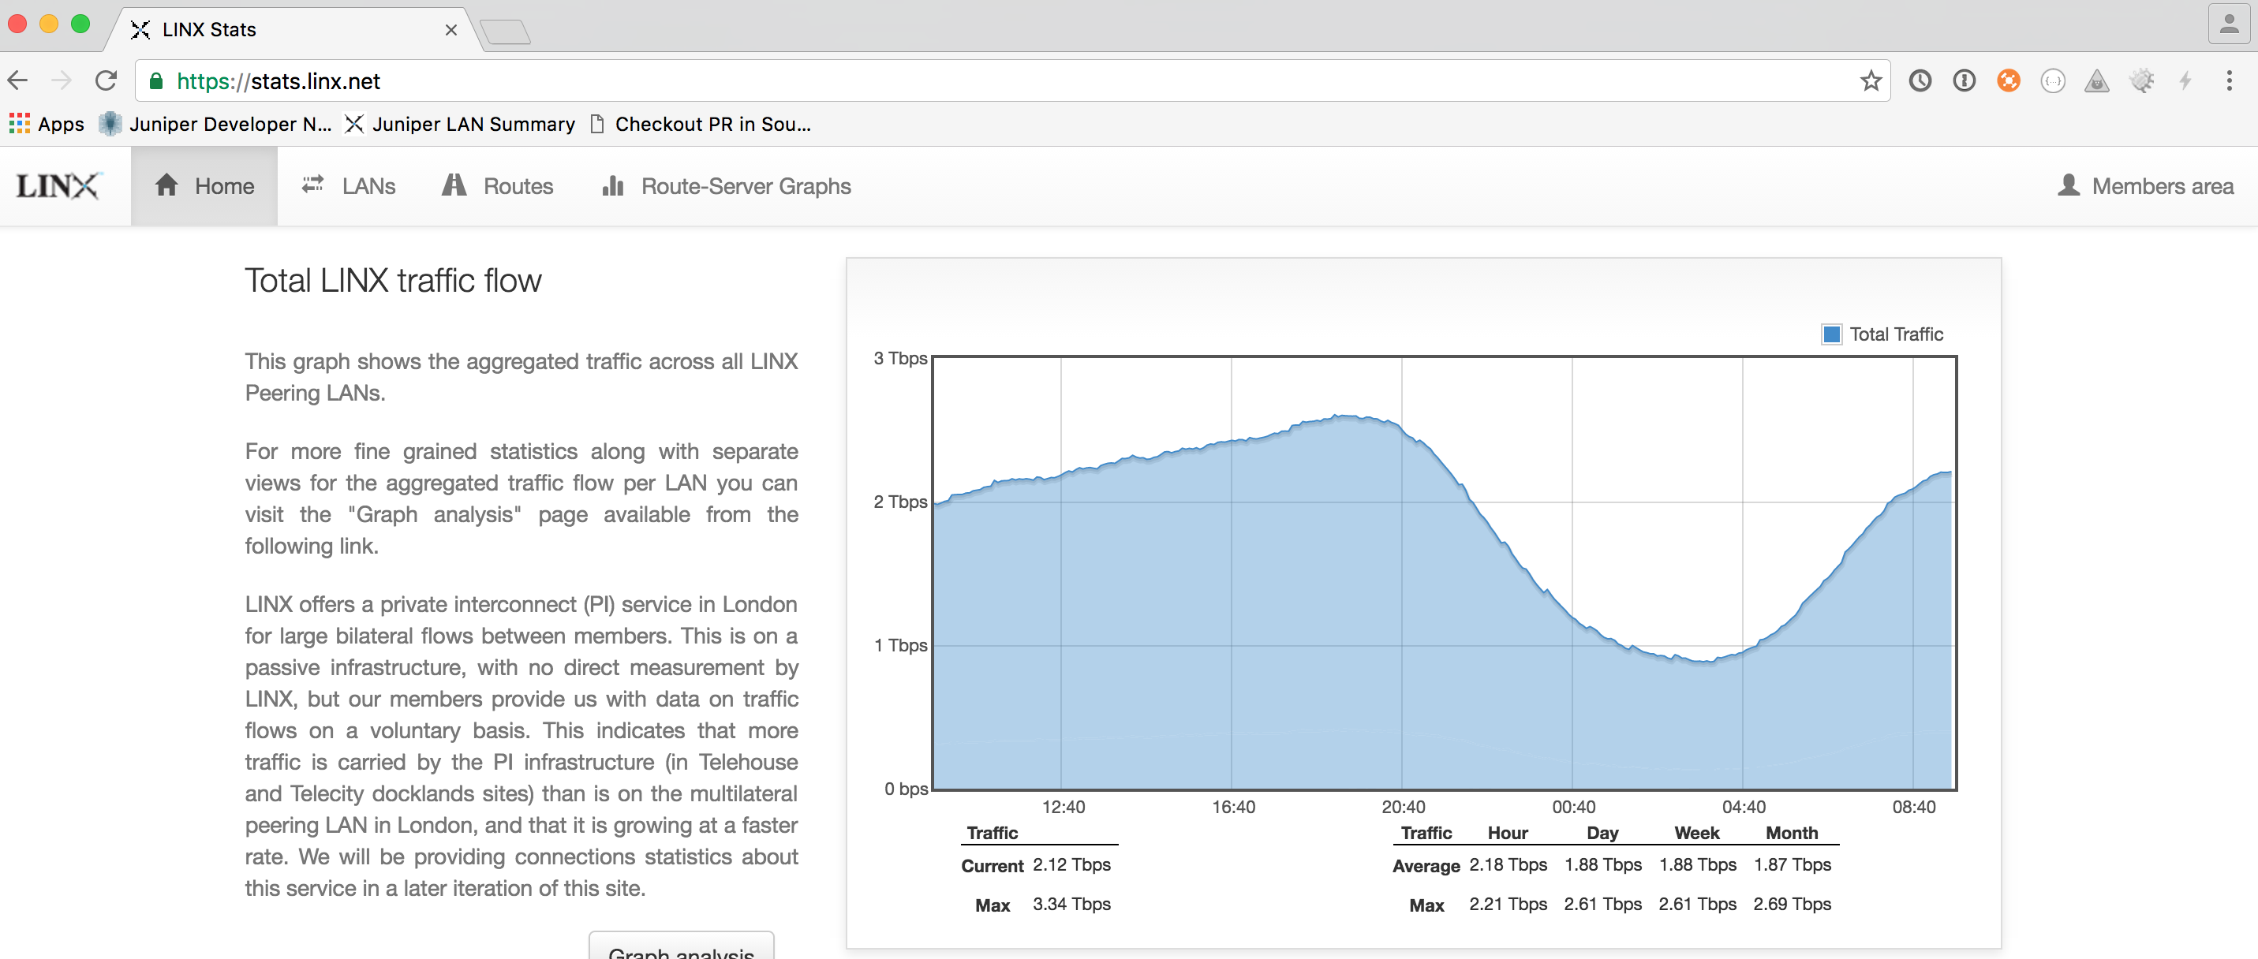
LINX’s Story

Slide 8

LINX’s Story

Slide 9
8 Things I wish I knew before starting a software team

Slide 10
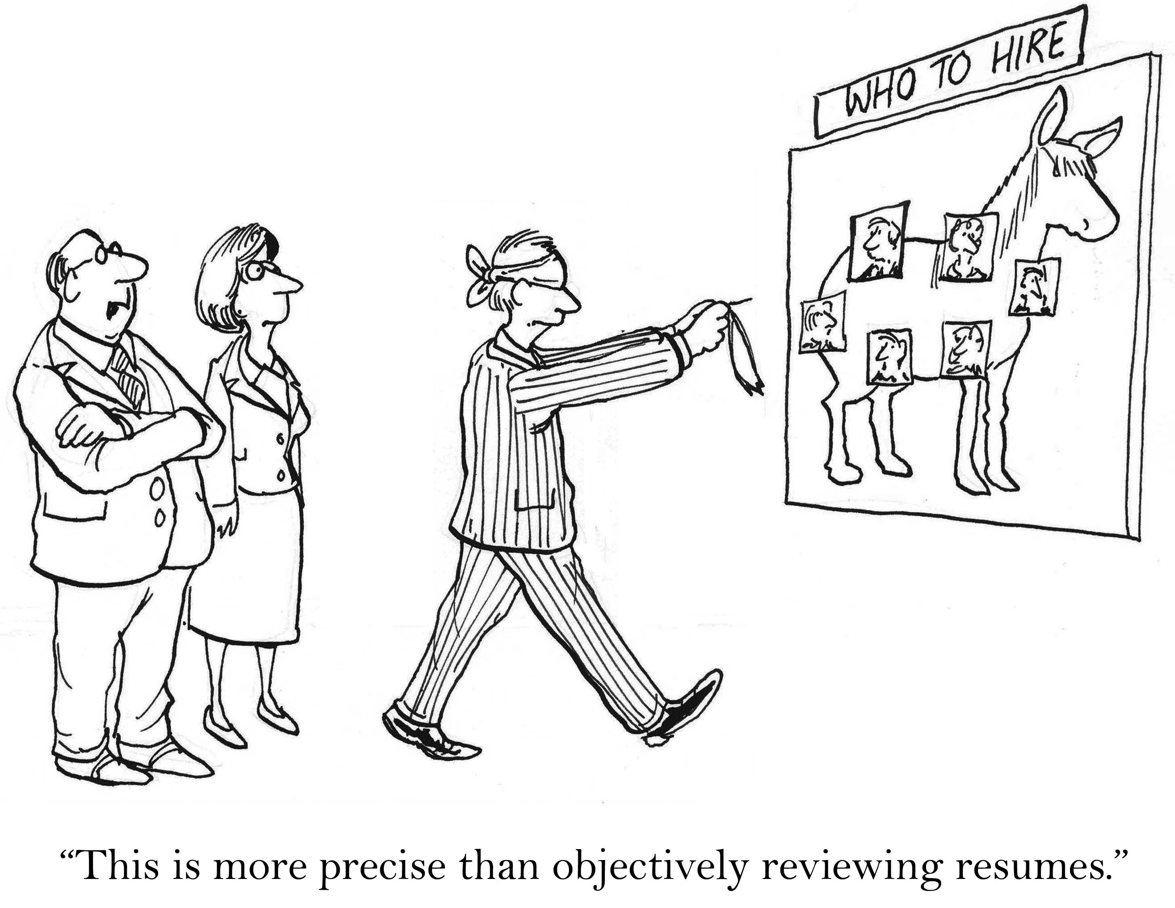
Things I learned #1 - Hiring
Notes:
Hiring Software Engineers I found pretty hard
It’s a very competitive job market
We started by trying to find people with domain knowledge of networking
I’ve followed general hiring advice from Joel Spolsky of Fogcreek Software which says hire:
Smart People
Get Things Done

Slide 11
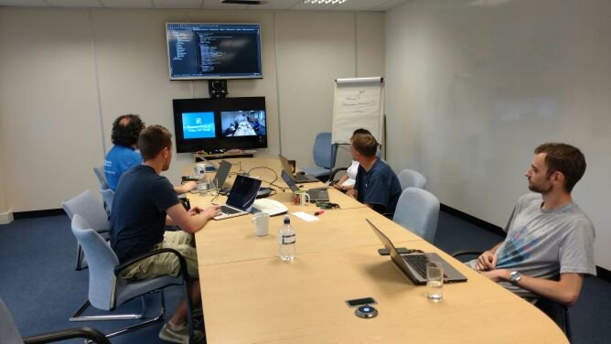
Things I learned #2 - Culture

Slide 12

Things I learned #3 – Becoming Agile
Notes:
Whole world of Advice
Loads of conferences, books, talks, youtube videos to watch
Loads of opinions
Key is optimising process flow and trying to ensure that features with high business value are worked on first

Slide 13
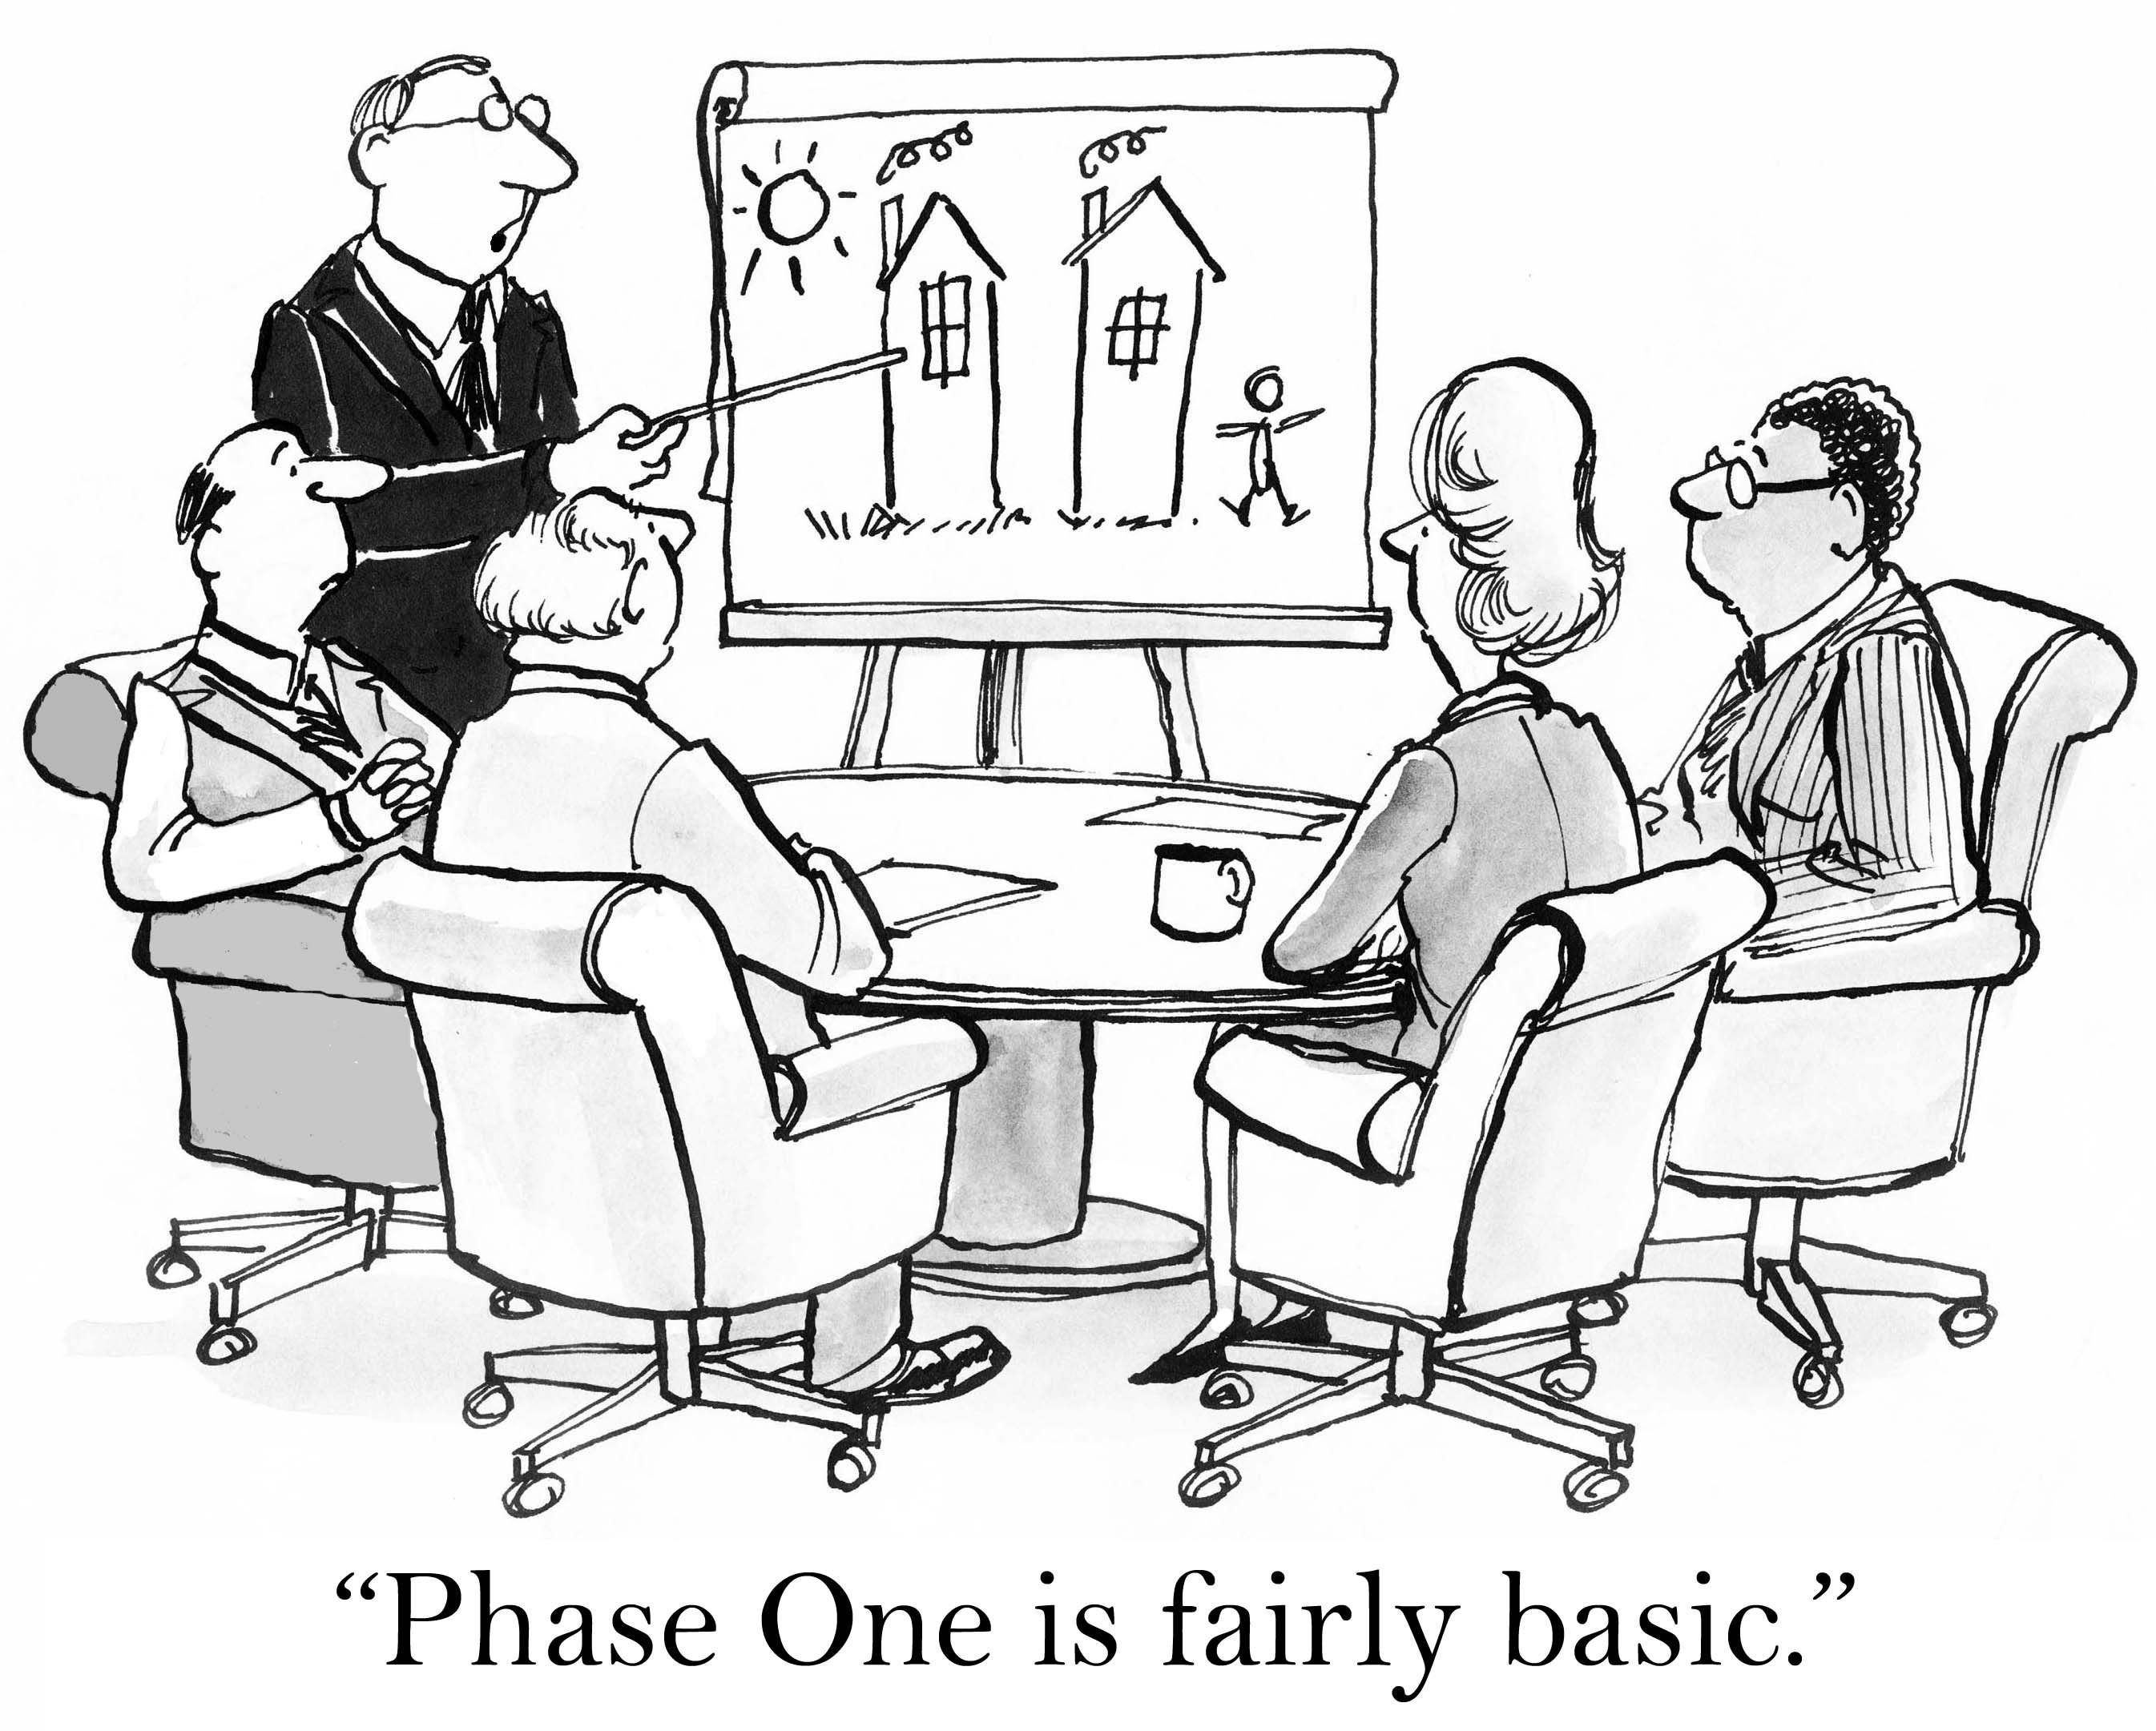
Things I learned #4 – Managing Expectations
Notes:
Don’t overpromise
I found it very easy to get really overexcited about all the really cool things we could do
And the reality is we’re doing them, but it takes a lot of time, and so starting small is key

Slide 14
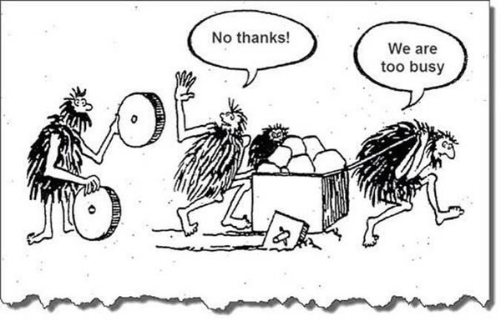
Things I learned #5 – Technical Debt
Notes:
Don’t underestimate or ignore
Builds up as you write code
Paid back when you reorganise / refactor

Slide 15

Things I learned #6 – Take Risks But…
Experience is the name everyone gives to their mistakes
- Oscar Wilde
Notes:
Take risks but fail fast
Safety net, safety helmet is back to the status quo

Slide 16

Things I learned #7 – Hypothesis Driven Development

Slide 17
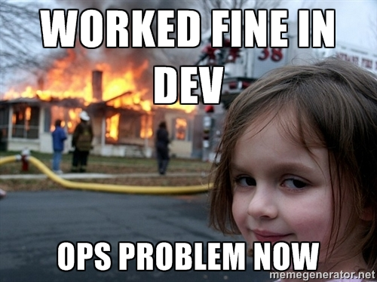
Things I learned #8 – Do the DevOps

Slide 18
Network Automation

Slide 19
Network Automation – Our requirements
Cross Platform
  Juniper, Extreme and Edgecore
Allow manual engineer intervention
Able to approach the solution iteratively

Slide 20

Network Automation – Our Approach
NAPALM

Slide 21
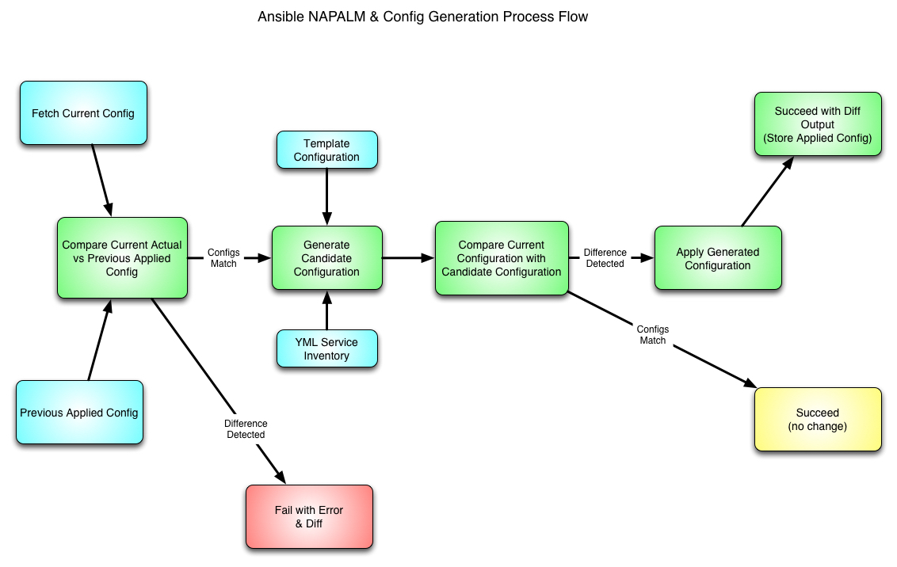
Network Automation – Our Approach

Slide 22
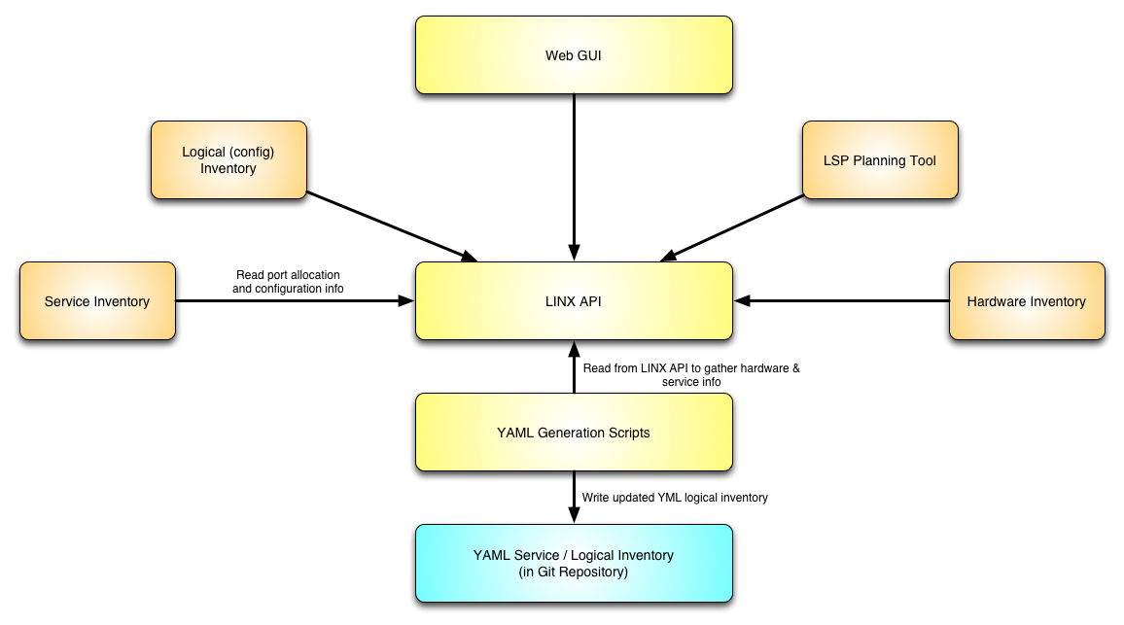
Network Automation – Our Approach

Slide 23
Network Automation – Conclusion & Future
Automated Config Validation
  Syntax
  Reachability
  Capacity
Continuous Deployment
More and more templated
  More power in web frontends

Slide 24
This Page Intentionally Left Blank

