Slide 1
A Cambridge lesson on building your own fibre network
1992 – Present: Reflecting on the first 25 years
Jon Holgate, Head of Networks
Notes:
In 1992, the University of Cambridge completed the installation of its own metropolitan wide fibre optic network, principally to support the transfer of ‘digital books’ for the Classics departments. On its 25th anniversary, Jon Holgate takes the opportunity to reflect on the lessons learned from deploying and managing the largest academic private fibre network in Europe. This presentation reflects on how assumptions made 25 years ago have transpired, the statistical probability of fence post boring machines and the price of peas.

Slide 2
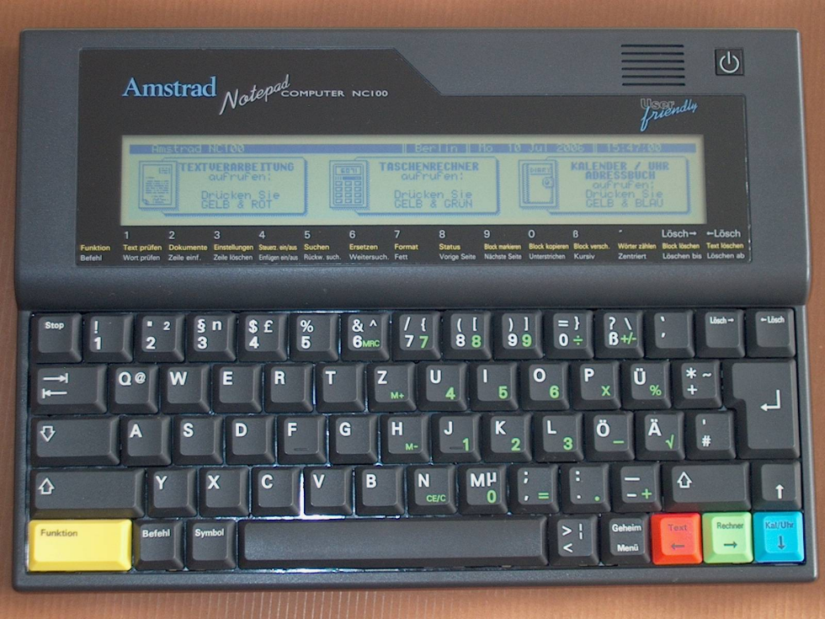
1992 - Present

Slide 3
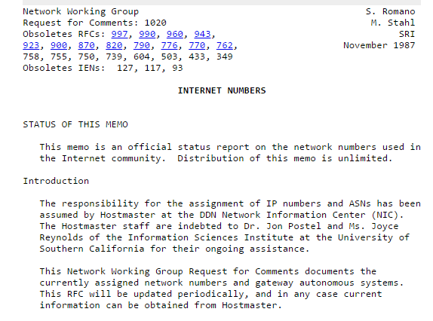
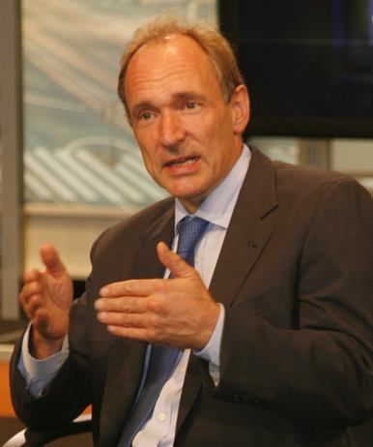
Proposed in March 1987
Zoom Shape 1
World Wide Web - 1991

Slide 4
Proposed in March 1987
World Wide Web - 1991

Slide 6
Proposed in March 1987
World Wide Web - 1991

Slide 7
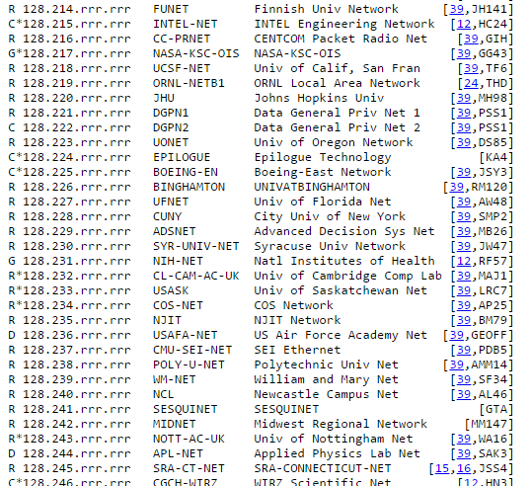
Proposed in March 1987
World Wide Web - 1991
Notes:
In January 1991 the JANET IP Service (JIPS) was set up as a pilot project to host IP traffic on the existing network. Within ten months the IP traffic had exceeded the levels of X.25 traffic, and the IP support became official in November. Today Janet is primarily a high-speed IP network.
In order to address speed concerns, several hardware upgrades have been incorporated into the Janet system. In 1989 SuperJanet was proposed, to re-host JANET on a fibre optic network. Work started in late 1992, and by late 1993 the first 14 sites had migrated to the new 34 Mbit/s ATM system. SuperJanet also moved solely to IP.^{[6]}

Slide 8
Proposed in March 1987
Zoom Shape 1
World Wide Web - 1991

Slide 9
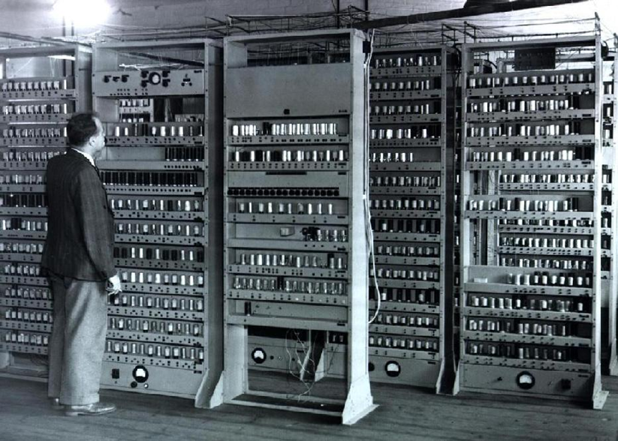
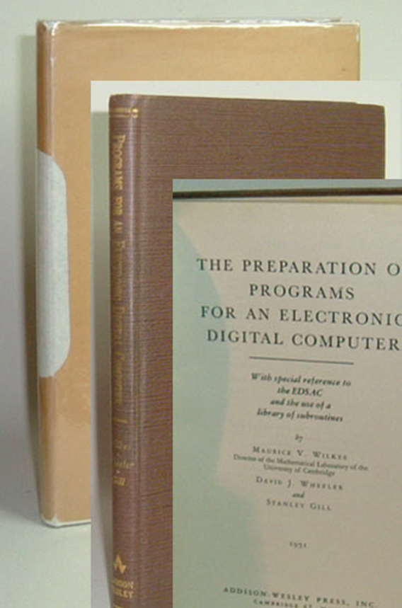
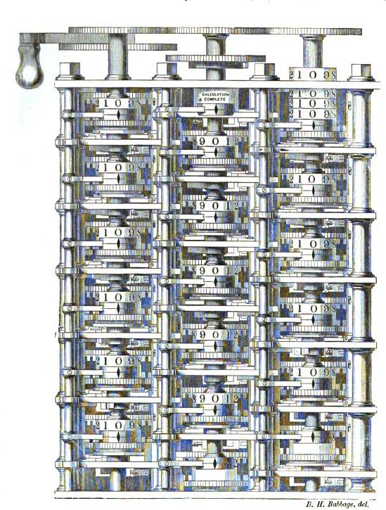
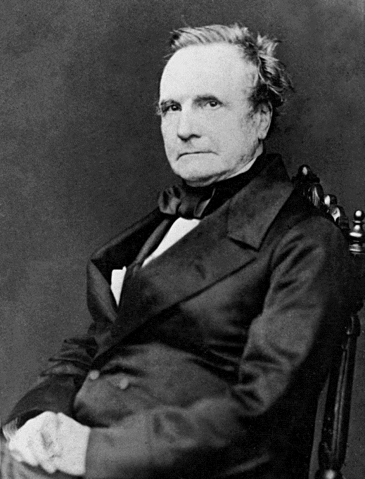
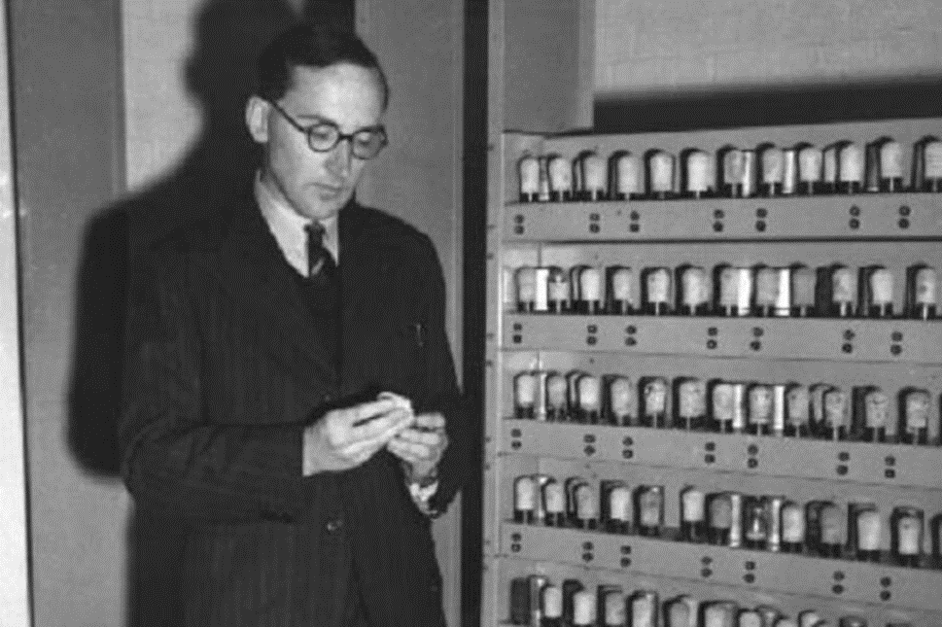
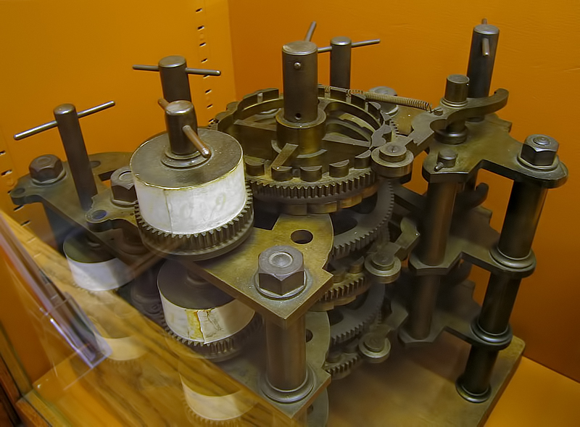
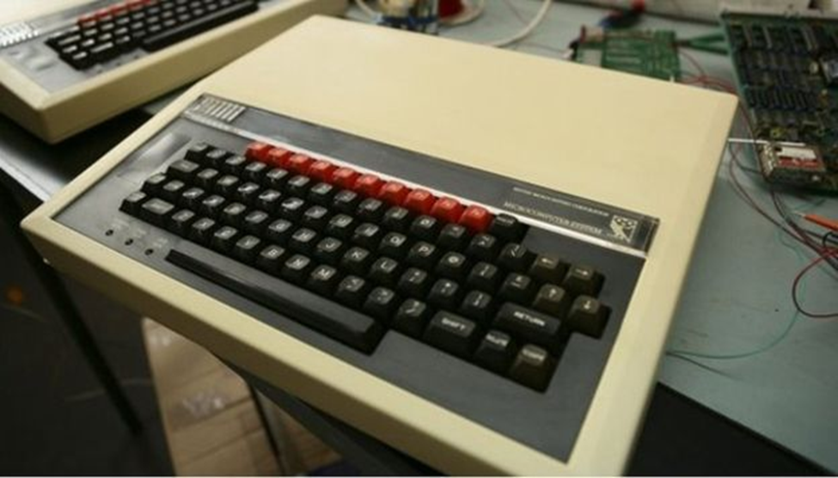
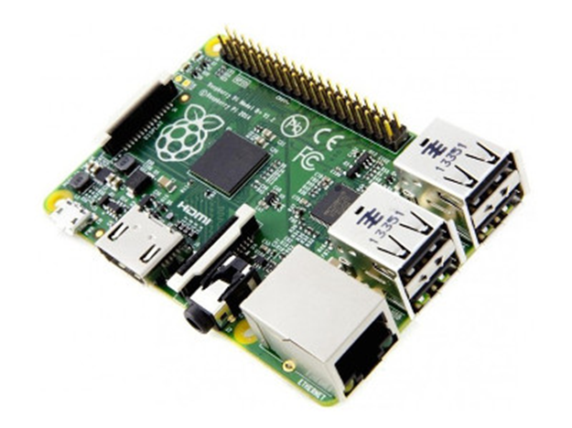
Cambridge was always making a difference (engine)

Slide 10
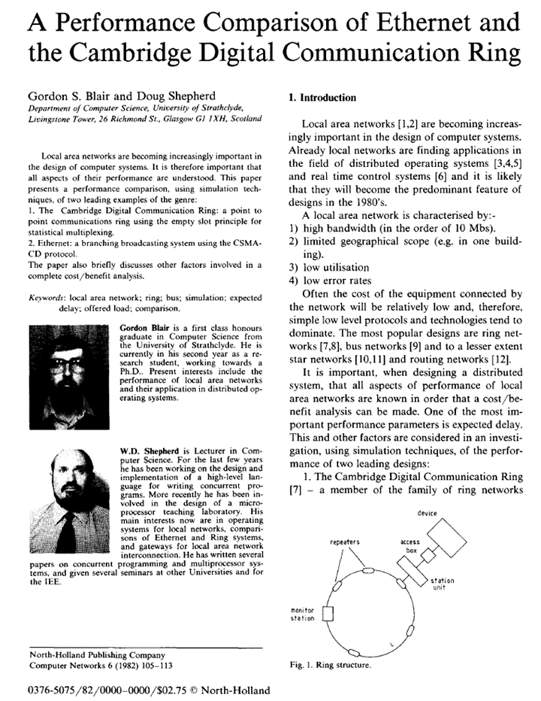
University Network - 1977
Granta Backbone Network - 1987
“Optical fibre cabling across University and Colleges, and combining mainframe with other computers and personal machines.”

Slide 11
University Network - 1977
Granta Backbone Network - 1987
“Optical fibre cabling across University and Colleges, and combining mainframe with other computers and personal machines.”

Slide 12
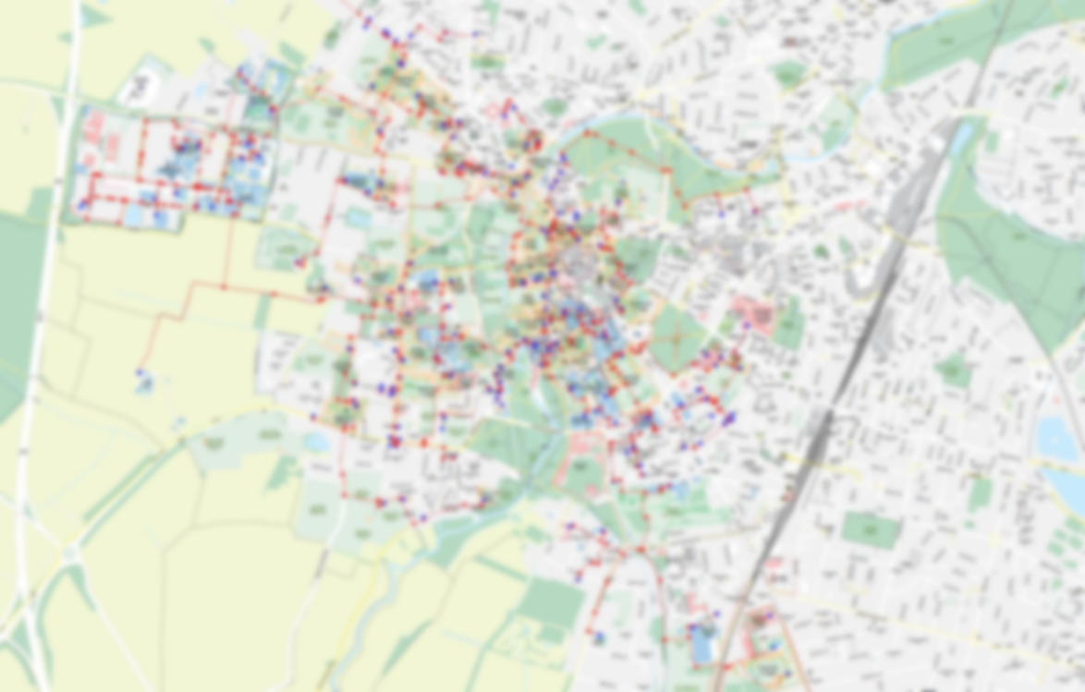
Building a network: 1988 - 1992
£3.9 million (1992)
36kms ducting & tray work
Installed in:
Wine Cellars ~2.2km
Green spaces
Carriageway

Slide 13
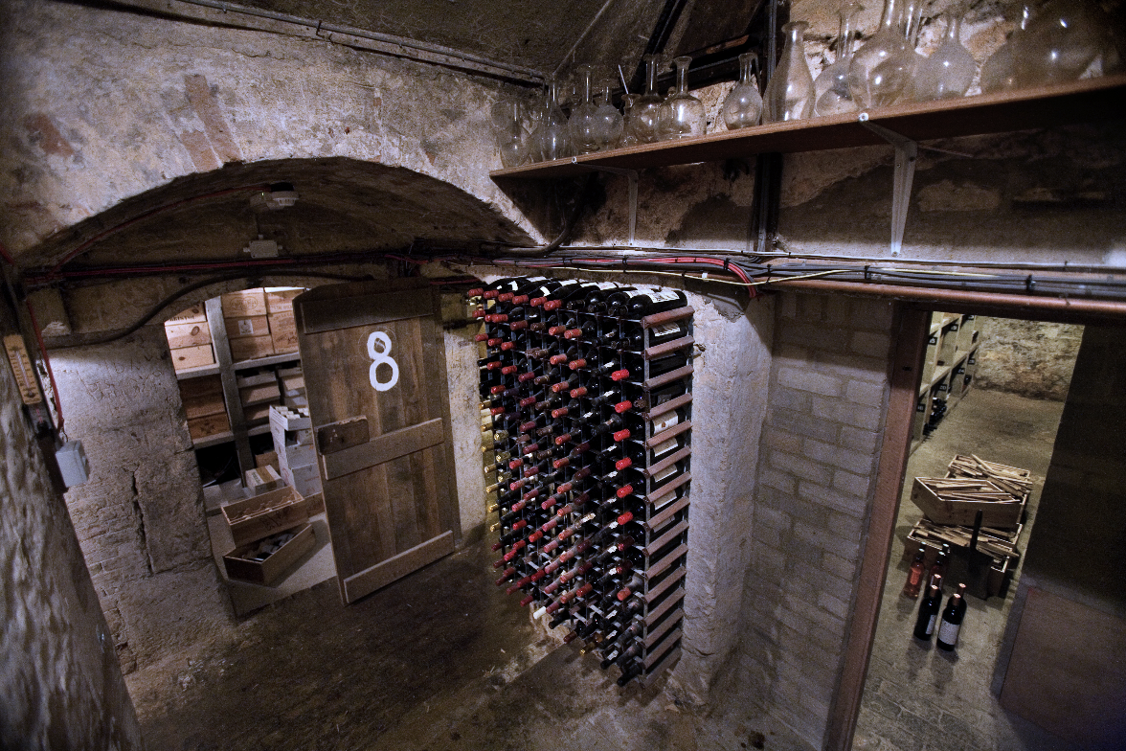
Wine Cellars
Zoom Shape 1

Slide 16
Wine Cellars

Slide 17
Wine Cellars

Slide 18
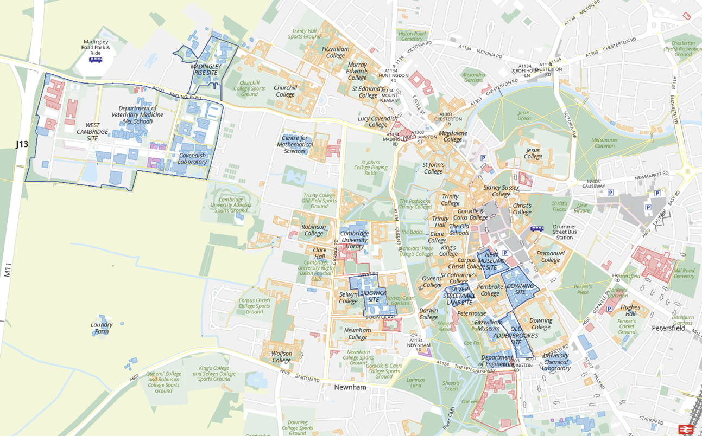
Green spaces and the perils of ‘soft dig’

Slide 19
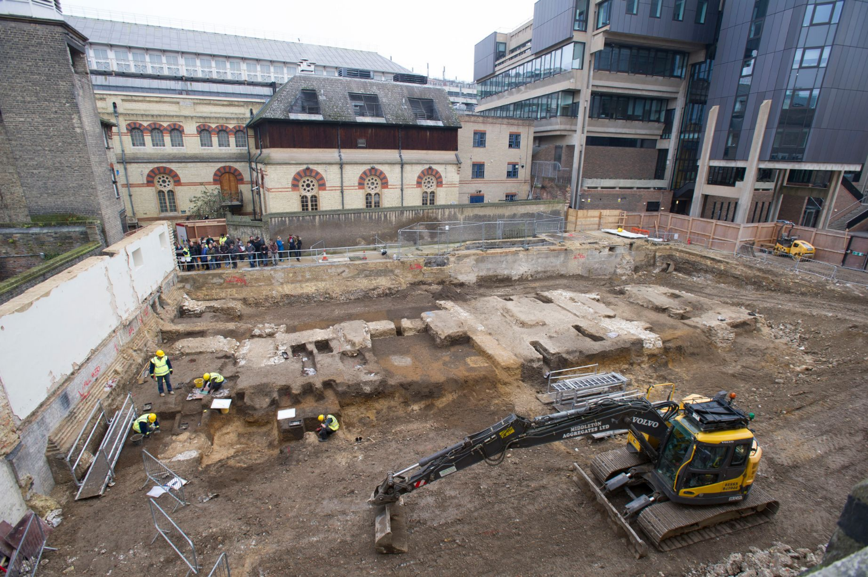
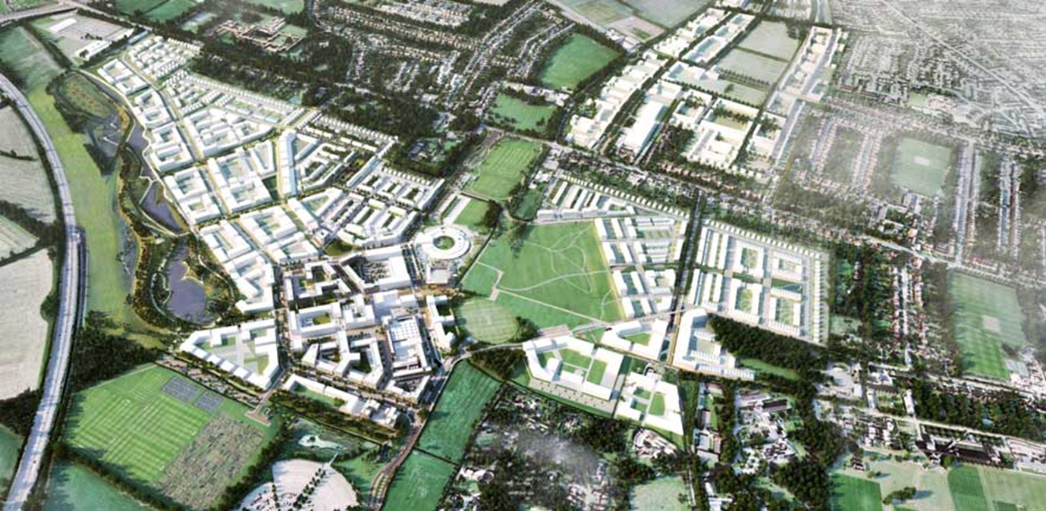
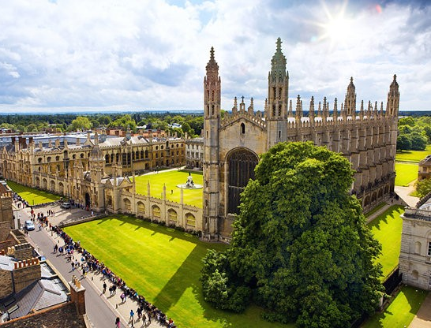
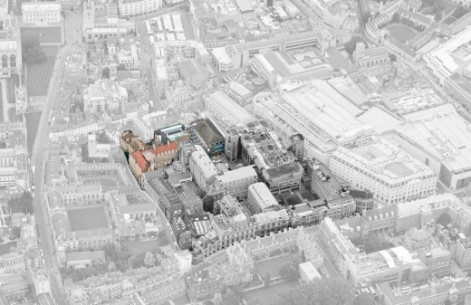
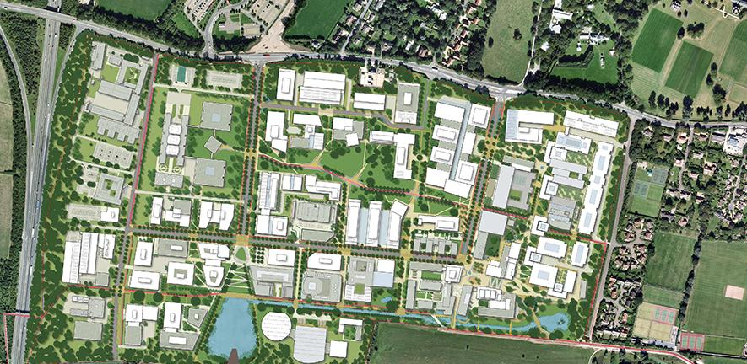
Green spaces and the perils of ‘soft dig’ cont.
Notes:
Lots of College and University green space
Soft dig is 1/4 cost of carriageway (1/2 footpath). ESP in an historic city centre – 1/6 compared to city centre, traffic mgt, restricted hours, cobbles
BUT
Soft dig is vulnerable to fence post borers AND
Where new buildings get put – public highway
PLUS – price of PEAS

Slide 20
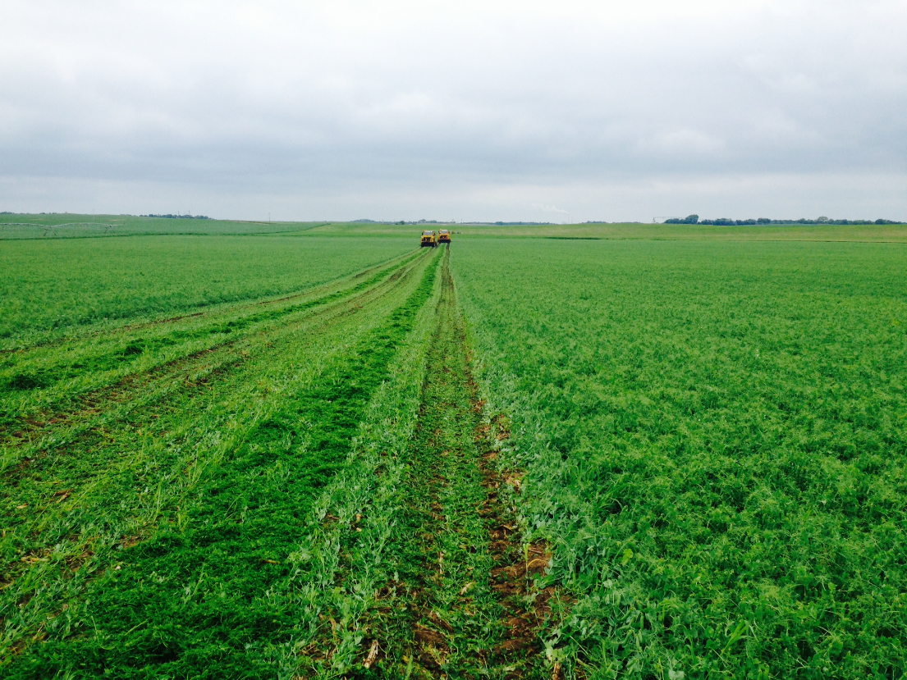
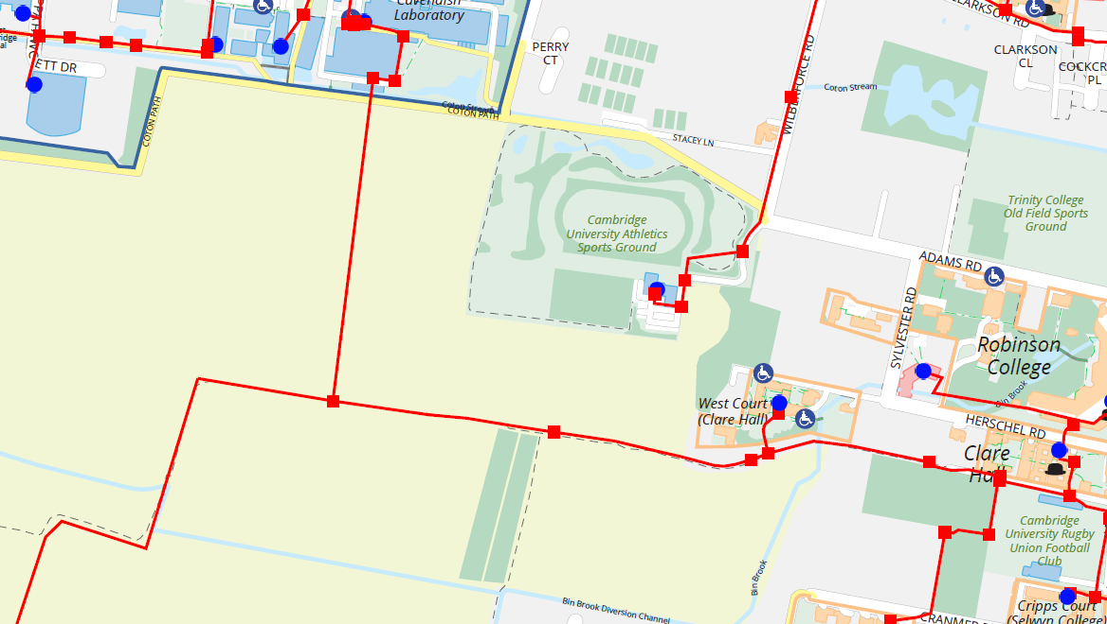
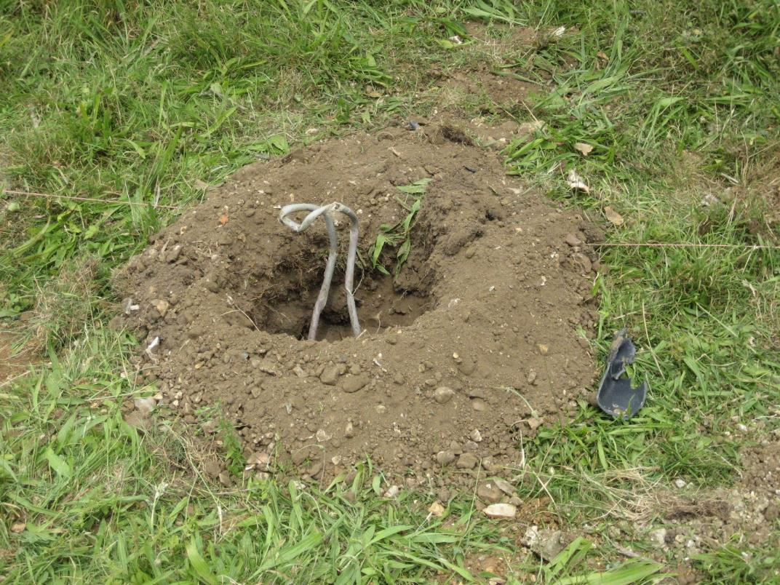
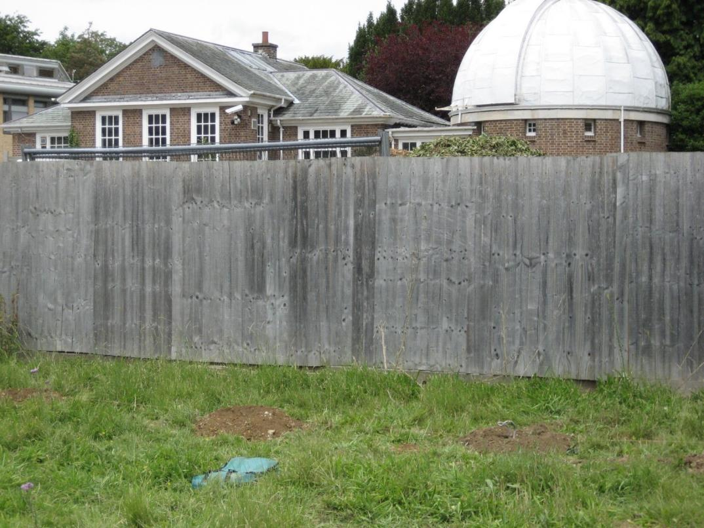
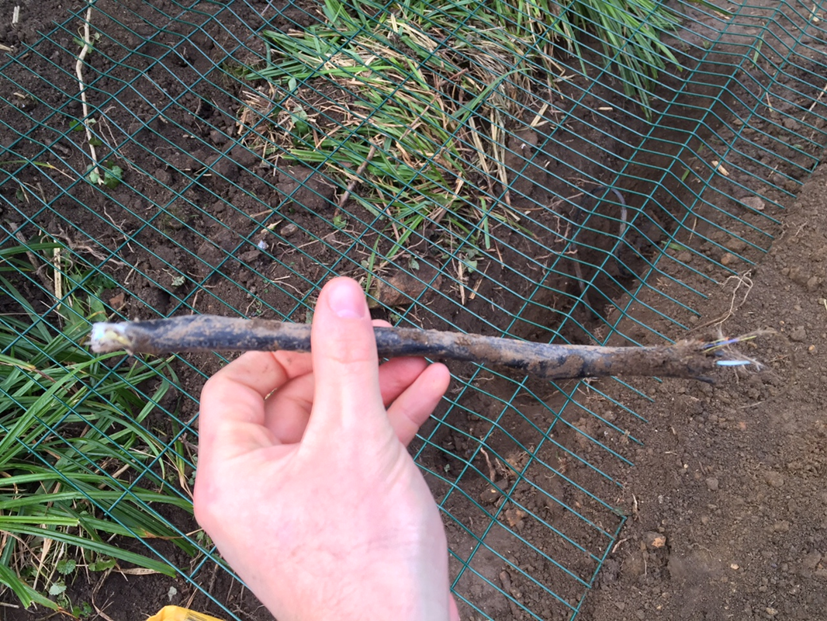
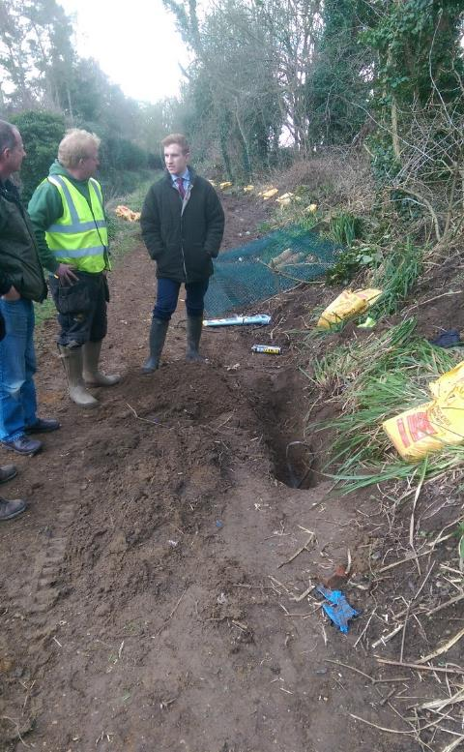
Green spaces and the perils of ‘soft dig’
£1,000

Slide 21
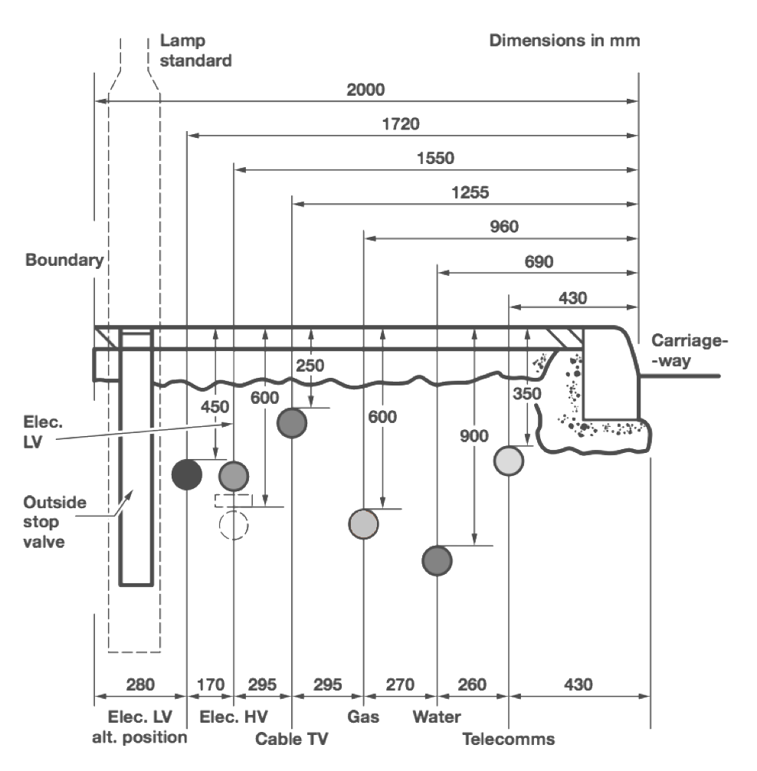
Standards
Zoom Shape 1

Slide 22
Standards

Slide 25
Standards
Footway: 350mm Depth
Carriageway: 600mm Depth
Footway: 600mm Depth
Carriageway: 800mm Depth

Slide 26
Standards
Footway: 350mm Depth
Carriageway: 600mm Depth
Footway: 600mm Depth
Carriageway: 800mm Depth

Slide 27
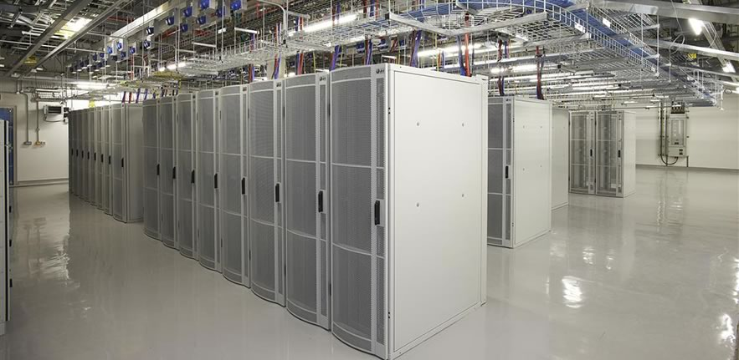
What is the fibre used for?

Slide 28
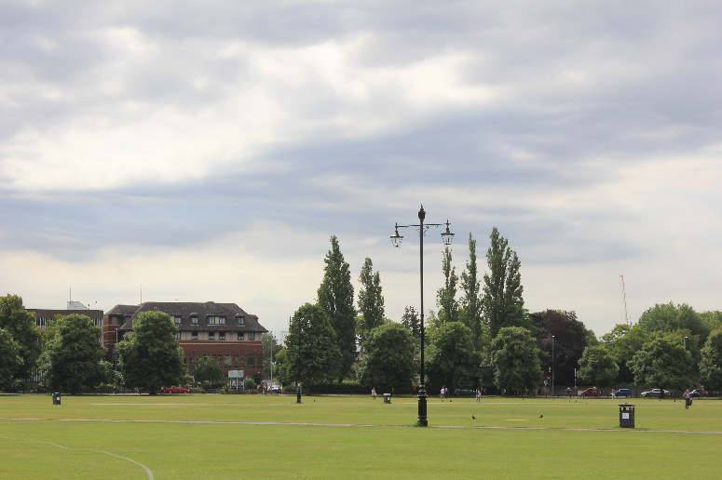
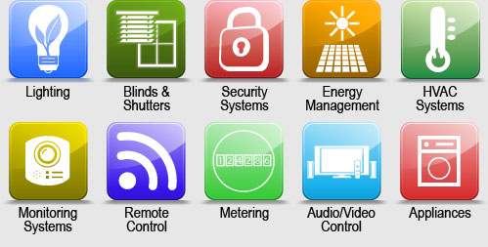
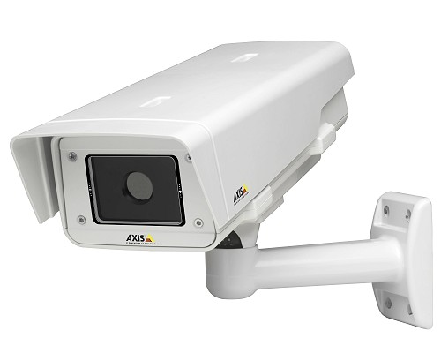
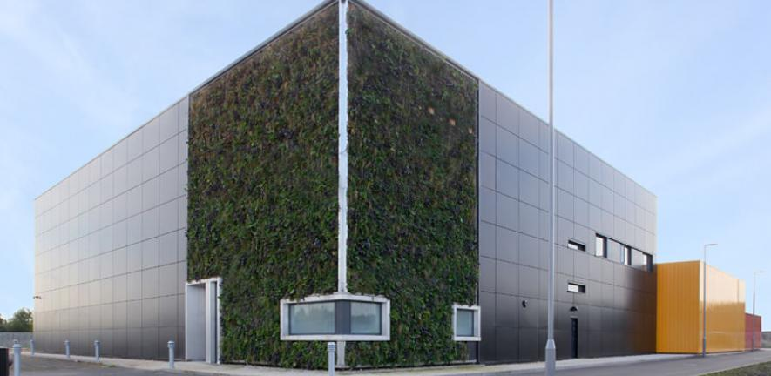
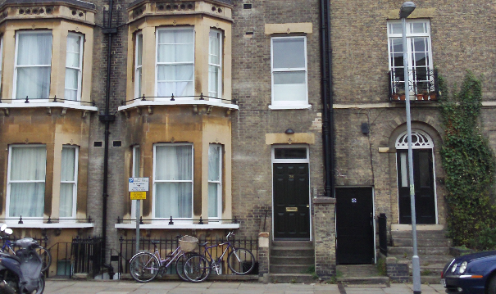
What else is the fibre used for?
Outside Public Wi-Fi
Building Management Systems
CCTV
Data Centre Hosting
College
Hostels

Slide 29
GBN Customers

Slide 30
What is the cost of running a private fibre network?
£500,000

Slide 31
What is the cost of running a private fibre network?
~850 active circuits
£260 per kilometer
Staff
Equipment
Maintenance of the network
Extensions to the network
Office overheads
Promotion
£500,000

Slide 32
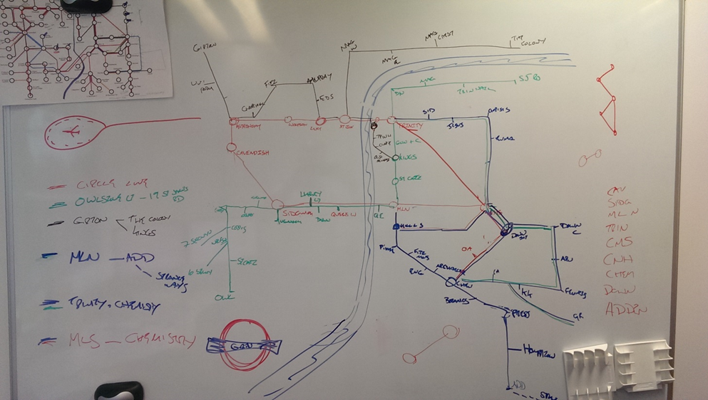
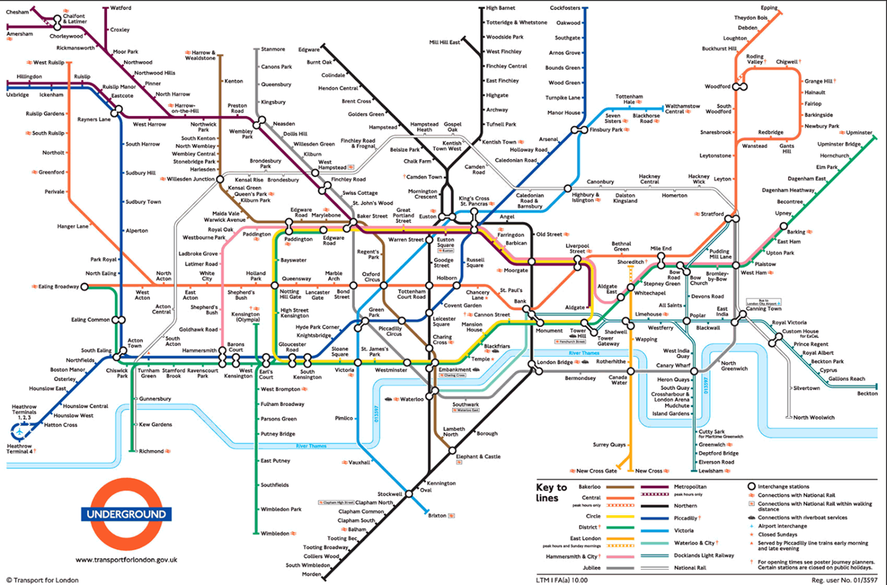
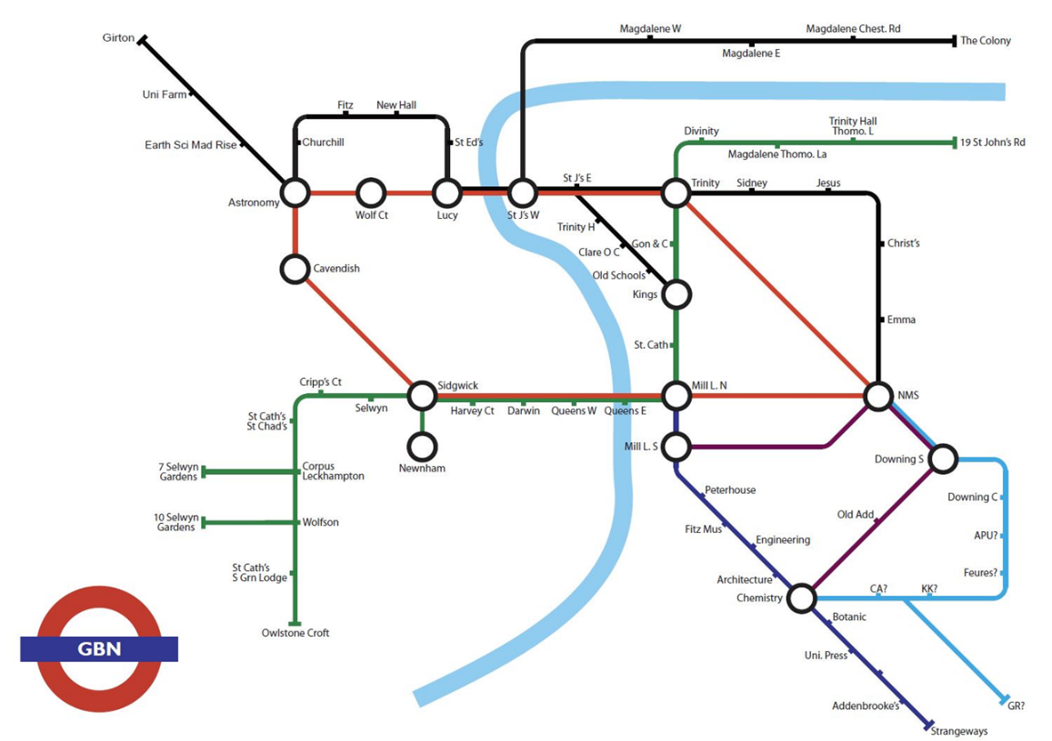
Promoting the network, and the problems of theft

Slide 33
Zoom Shape 1

Slide 38
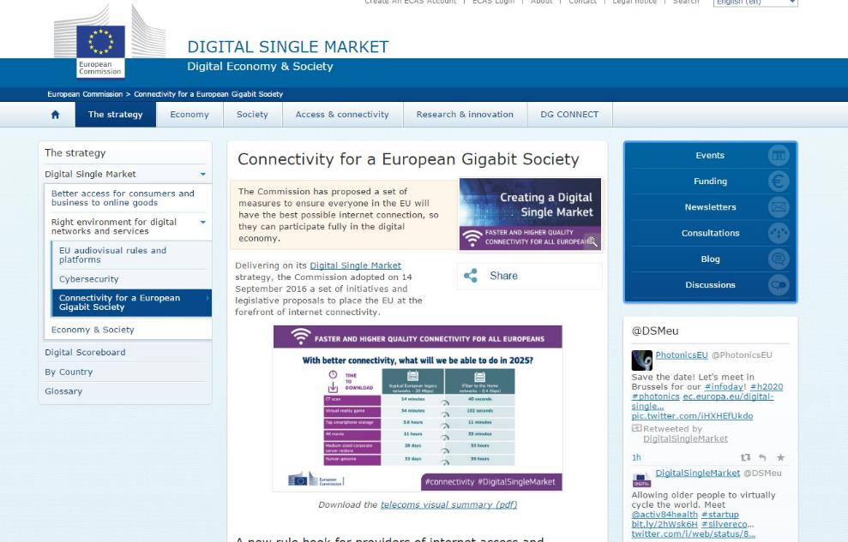
European Commission

Slide 39
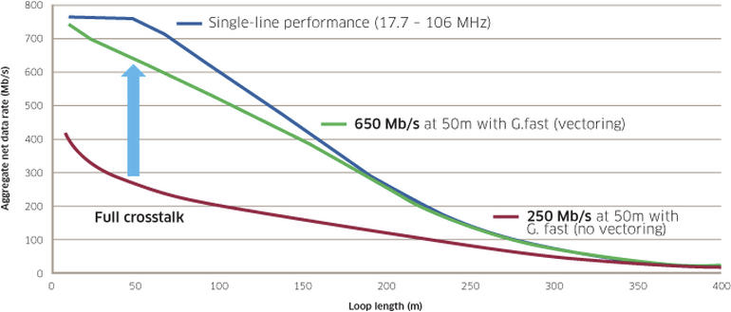
The future is unashamedly fibre
The goal of the GOLD project is to:
Continue the work on G.fast standards to develop the planned second version of the G.fast standard.
Further develop and spread know-how around deployment practices in order to ensure that G.fast becomes a market success.
Boost the usability of G.fast towards dense city areas by developing an alternative backhauling option based on copper instead of fibre. This simplifies G.fast deployment significantly (less fibre digging) and opens a potential mass market for G.fast.
Go beyond the first standard by initiating the planned second version of the standard promising a doubling of the bandwidth reaching 200 MHz, by exploring multiple-gigabit copper access.

Slide 40
The future is unashamedly fibre
The goal of the GOLD project is to:
Continue the work on G.fast standards to develop the planned second version of the G.fast standard.
Further develop and spread know-how around deployment practices in order to ensure that G.fast becomes a market success.
Boost the usability of G.fast towards dense city areas by developing an alternative backhauling option based on copper instead of fibre. This simplifies G.fast deployment significantly (less fibre digging) and opens a potential mass market for G.fast.
Go beyond the first standard by initiating the planned second version of the standard promising a doubling of the bandwidth reaching 200 MHz, by exploring multiple-gigabit copper access.

Slide 41
The future is unashamedly fibre
The goal of the GOLD project is to:
Continue the work on G.fast standards to develop the planned second version of the G.fast standard.
Further develop and spread know-how around deployment practices in order to ensure that G.fast becomes a market success.
Boost the usability of G.fast towards dense city areas by developing an alternative backhauling option based on copper instead of fibre. This simplifies G.fast deployment significantly (less fibre digging) and opens a potential mass market for G.fast.
Go beyond the first standard by initiating the planned second version of the standard promising a doubling of the bandwidth reaching 200 MHz, by exploring multiple-gigabit copper access.

Slide 42
The future is unashamedly fibre
The goal of the GOLD project is to:
Continue the work on G.fast standards to develop the planned second version of the G.fast standard.
Further develop and spread know-how around deployment practices in order to ensure that G.fast becomes a market success.
Boost the usability of G.fast towards dense city areas by developing an alternative backhauling option based on copper instead of fibre. This simplifies G.fast deployment significantly (less fibre digging) and opens a potential mass market for G.fast.
Go beyond the first standard by initiating the planned second version of the standard promising a doubling of the bandwidth reaching 200 MHz, by exploring multiple-gigabit copper access.

Slide 43
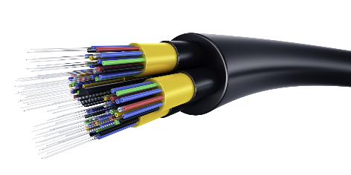
Generic Internet Consumption Chart
DATA
TIME

Slide 44
OECD Fibre Coverage to premises

Slide 45
OECD Fibre Coverage to premises

Slide 46
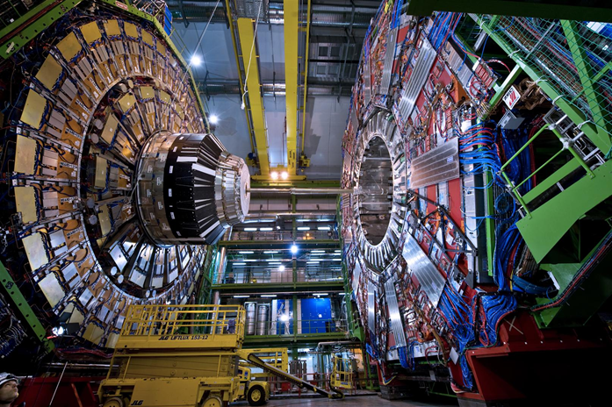
BIG data
40Gb Internet connection
6 YEARS 9 MONTHS

Slide 47
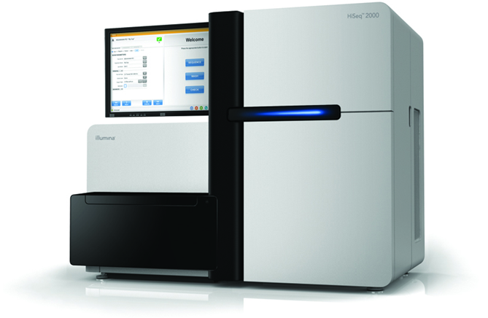
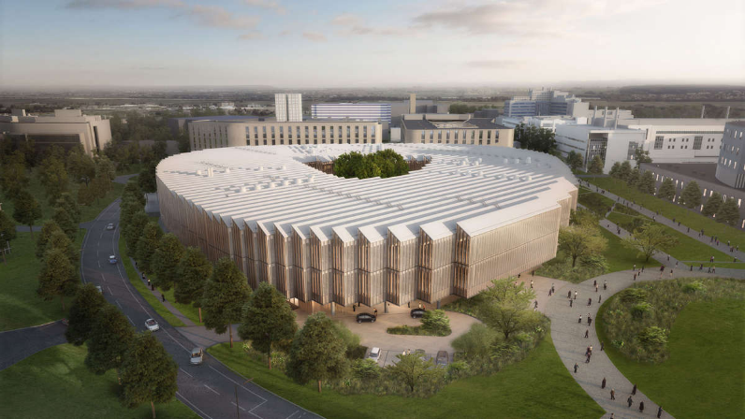
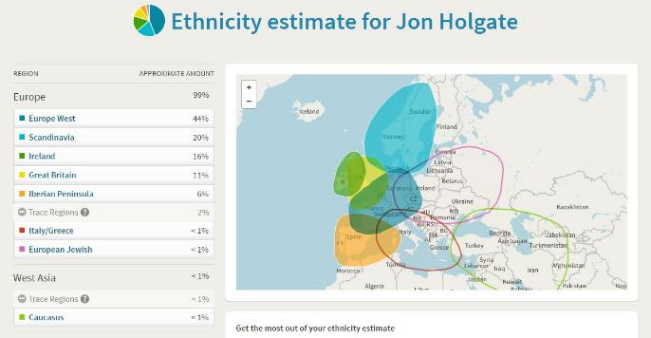
BIG data is coming to us all
Notes:
Illumina Hiseq 2000 – 1TB (6hours)

Slide 48
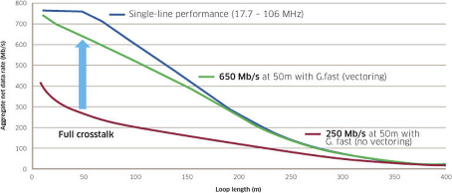
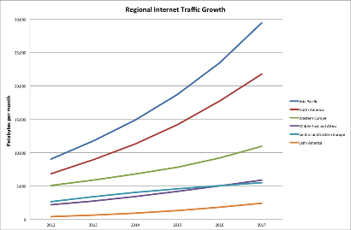
What lessons have we learned
Standards. Standards. Standards.
Data demand is growing.
Fibre IS the solution.
Fibre is REALLY cheap.
Private fibre is easy.
Universities SHOULDN’T be doing this!
£260 km

Slide 49
From research to commodity
RESEARCH
COMMERCIAL
Notes:
“However, while overall connectivity in the UK is high, full fibre coverage is still significantly behind
that of some international competitors both in terms of the current position and
expected future deployment, and we need to stimulate the market to do more
in both urban and rural areas”

Slide 50
Q&A

