Slide 1
Zen Internet
Building For Ultrafast
Andy Furnell <andy.furnell@zeninternet.co.uk>
Technical Architect
Zen Internet

Slide 2






About Zen
OVER
110K
INDEPENDENT
PRIVATELY
OWNED ISP
BROADBAND CONNECTIONS
OVER
£3.5M
1995
10K
450
25
NETWORK INVESTMENT
ESTABLISHED
MOVED TO SANDBROOK HOUSE
2013
£4M
WHOLESALE
& CHANNEL PARTNERS
CUSTOMERS
2002
EMPLOYEES
2008
NETWORK INVESTMENT
1999
2016
2017
2001
PARTNER
FY 15/16
PROGRAMME
£57M
LAUNCHED
TURNOVER
Notes:
21 years
19x which awards
Wholesale since 2012
2010 sponsors

Slide 3
ISP Network Capacity 101
What our customers think we should do
What our FD thinks we should do
Notes:
Quietest possible
Busiest possible, make best use

Slide 4
ISP Network Capacity 101
What our customers think we should do
What our FD thinks we should do
What the engineering team think we should do
Notes:
Trains are better

Slide 5
ISP Network Capacity 101
What our customers think we should do
What our FD thinks we should do
What the engineering team think we should do
What we actually do
Notes:
Balance time vs cost vs quality

Slide 6
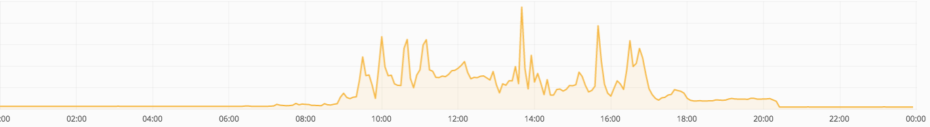
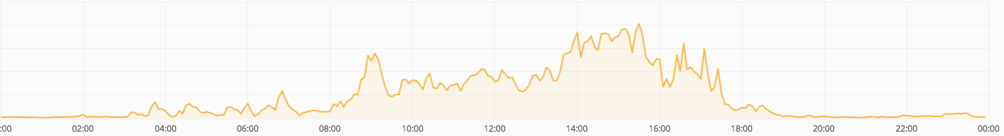
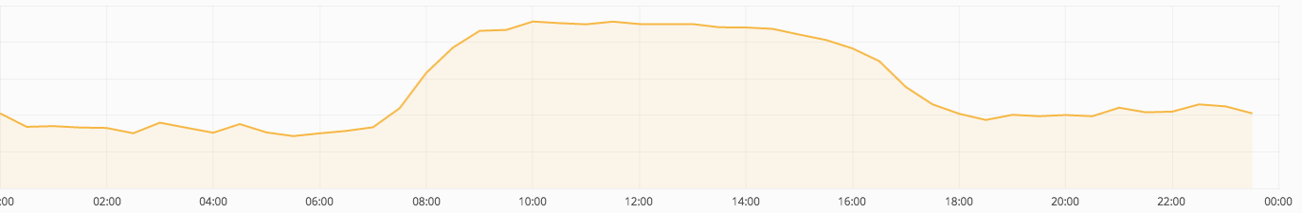
Managing Capacity
1. Know Your Users
Individuals
Peak:mean 7.5:1
Local Exchange
Peak:mean 4:1
Regional Aggregation
Peak:mean 1.6:1
Notes:
Different overheads at different aggregation points
Larger underlying traffic -> more efficient

Slide 7
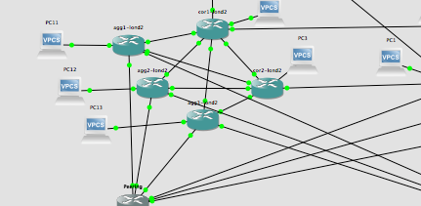
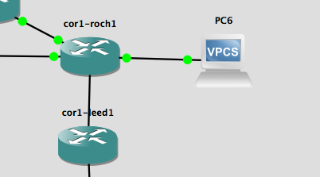
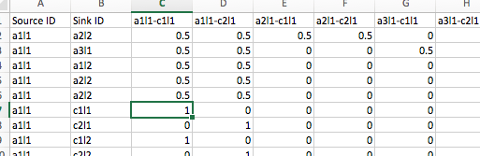

Managing Capacity
2. Know Your Failures
Step 1. Model your network
Step 2. Break some stuff
Step 2. Break Some Stuff
and some more stuff…
and some more stuff…
Step 3. Record how it broke
Step 4. Find your high watermarks
More details coming soon at https://engineering.zen.co.uk/

Slide 8
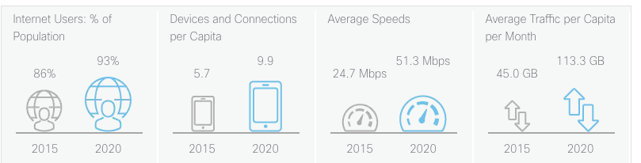
Managing Capacity
3. Predict The Future
Source: Cisco VNI http://www.cisco.com/c/en/us/solutions/service-provider/visual-networking-index-vni/index.html
Mar-2015
+80% year on year growth
Mar-2016
Mar-2017
Mar-2018
Future bandwidth = Subscriber growth * Peak avg growth * Fudge factors
Notes:
Cisco +25% cagr
Zen +80% cagr

Slide 9
Peak average demand
Notes:
Underlying traffic

Slide 10
Vendor reality distortion
Design inefficiencies
Peak average demand
Notes:
LAGs that don’t balance
Boxes choke @64 byte packets

Slide 11
Vendor reality distortion
Resiliency
Design inefficiencies
Peak average demand
Notes:
At least a +1

Slide 12
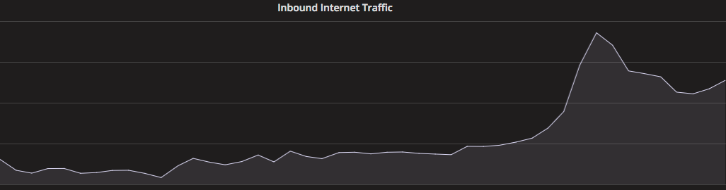
4.5mbit here
Exceptional peaks
Peak max demand
Vendor reality distortion
Resiliency
Design inefficiencies
Peak average demand
1mbit here
Notes:
when politicians start playing games on a Tuesday

Slide 13
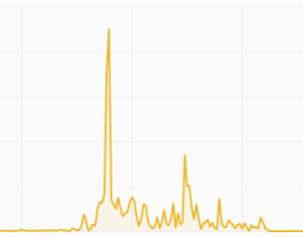
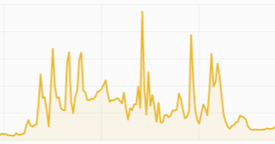
4.5mbit
7mbit here
FTTP 330/30
Exceptional peaks
33:1
7.5:1
Peak max demand
FTTC 80/20
Vendor reality distortion
Resiliency
Design inefficiencies
Peak average demand
1mbit here
Notes:
Ultrafast – ~4x uplift, double the overhead

Slide 14
Oops, We Broke The Network!
A £4M investment to meet the growing needs of our customers:
Expand and refresh our LLU footprint
  201 → 400 exchanges
  Deeper integration with Openreach
  Support service quality improvements, greater operational ownership
  Cost savings
Refresh our core network technology
  Significant scaling challenges ahead
  40G/slot generation kit becoming long in the tooth
  21 years of accumulated legacy awesome

Slide 15
LLU Expansion
Anatomy Of An LLU Deployment
Backhaul
Ethernet Switch
£1/mbps/yr+
£500+
GEA Cablelink
Power and Cooling
£4000-6000
£1250
£200/yr
Rack and Space
£6500
£1000/yr
Notes:
Previously covered
15k investment per exchange
Multiple cablelinks (plus NGA2 cablelinks)

Slide 16
LLU Expansion
Anatomy Of An LLU Deployment
Backhaul
Ethernet Switch
£1/mbps/yr+
£500+
Highlights
~£15,000 investment per exchange
11,000 man hours spent since May-16
Average time to deliver: 7 months
  LLU colo – 3 months
  Cablelink – 1 month
  Backhaul – 3 months
  Testing, integration, migrations – 3+ months
GEA Cablelink
Power and Cooling
£4000-6000
£1250
£200/yr
Rack and Space
£6500
£1000/yr

Slide 17
Core Network Refresh
What Did We Build?
Completely virtualised network
  MPLS end to end
  Decoupled service and transport layer
  Modular approach
Notes:
MPLS to the exchange
Standardised transport services
Automated failover
React to changes in traffic

Slide 18
Core Network Refresh
What Did We Build?
Completely virtualised network
  MPLS end to end
  Decoupled service and transport layer
  Modular approach
Scalable and highly available
  Horizontal scale to 10^{n} volumes
  Built to fail (fast)
More bandwidth
More services

Slide 19
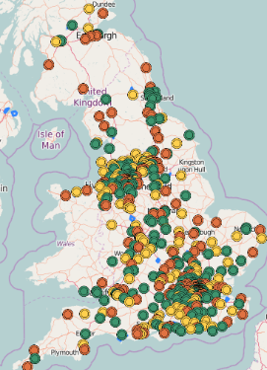
The 5th Largest LLU Operator In The UK
400 unbundled exchanges
7.9M properties passed
110k DSL/FTTx tails
770G GEA capacity
500G LLU backhaul capacity
2.7T core network capacity

Slide 20
Core Network Refresh
Reflections
It’s not (just) about the technology
Right size your choices
Test, test, and test again
(and find someone who will support you with that)
Notes:
Right size technology – big capability, small box
Who do you want to work with?
Test – 1.5s failover of 110k DSL subs

Slide 21
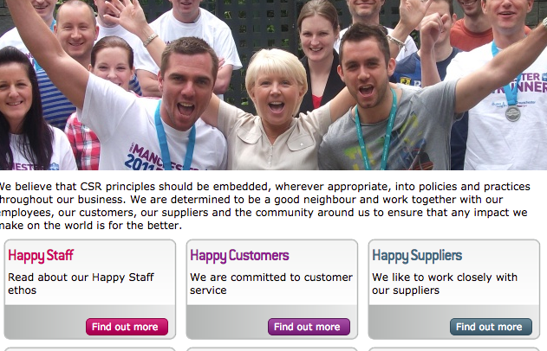
Observations
It’s not (just) about the technology
Right size your choices
*Not to scale
Test, test, and test again
(and find someone who will support you with that)
Notes:
Right size vendors – small/friendly. Service led, personal approach
CSR – happy staff, happy customers, happy suppliers, leads through to customer experience
Wholesale test capability

Slide 22
And Now For The Hard Sell…
One of the largest and most sophisticated networks in the UK
Metered and unmetered, managed and layer 2 wholesale ADSL/FTTC/G.Fast/FTTP offerings
Committed to ultrafast broadband since 2012 launch
Thoroughly nice people ☺
Notes:
Wholesale since 2013
Ultrafast 1.3% market share, stuck with it

Slide 23
Thankyou

