Slide 1
None of us really knew what we were doing, we just made it up as we went along.
Paul Thornton
paul@prtsystems.ltd.uk
UKNOF37
Manchester
20 April 2017
(Part 2 – You were threatened with this)
A further wander down
memory lane stopping off at
the UK Internet in 1998
(give or take a bit)
Notes:
Do we know what we’re doing now?

Slide 2
Previously at UKNOF34
What did the ISPs of the day offer?
How did they do it?
Whose kit did they use?
Did it even work?
PRTsystems
www.prtsystems.ltd.uk

Slide 3
New and improved for this year:
Infrastructure!
How the LINX scaled to 1G.
The important buildings of the day.
The headaches...
PRTsystems
www.prtsystems.ltd.uk

Slide 4
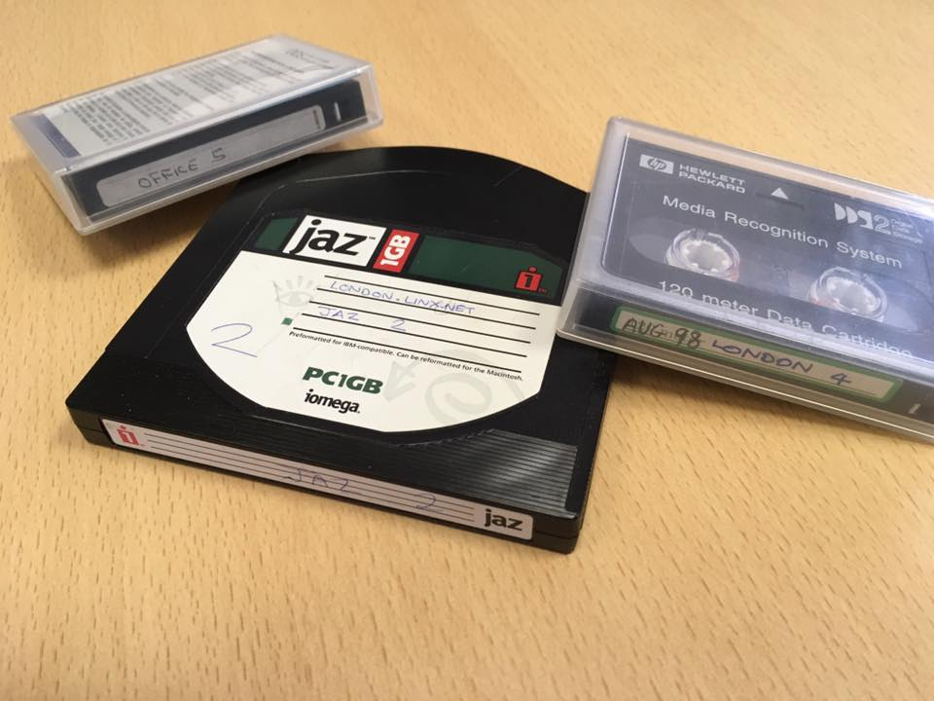
But a small aside before that...
Digital archaeology is hard ☹
PRTsystems
www.prtsystems.ltd.uk

Slide 5
But a small aside before that...
Digital archaeology is hard ☹
dd: /dev/nsa0: Input/output error 0+0 records in 0+0 records out 0 bytes transferred in 48.053826 secs (0 bytes/sec)
PRTsystems
www.prtsystems.ltd.uk
Notes:
It took it 48 seconds to establish that things were not going to work out!
The most reliable storage is my original 1993-era IBM 0663 1G SCSI hard drive.
Think about long-term data storage.

Slide 6
AS5459
“There is no sensible way that the LINX can grow to much more than around 100 members.”
Paul Thornton (1998)
Lets put this into perspective: Thomas Watson from IBM said there was a market for maybe 5 computers worldwide!
PRTsystems
www.prtsystems.ltd.uk
Notes:
And at the time, content providers and tier-2 ISPs as we now know them couldn’t join.

Slide 7
Interconnection
Exchange points were few and far between.
MAE-EAST and MAE-WEST in US.
NetNod, LINX and AMS-IX the only choices in Europe.
Everything was expensive!
PRTsystems
www.prtsystems.ltd.uk

Slide 8
LINX in 1998
Present in Telehouse North only.
7 switches interconnected with 100M FDDI:
2x Catalyst 5000
2x Plaintree 4800
3x Catalyst 1200
These switches were 10/100 + FDDI.
PRTsystems
www.prtsystems.ltd.uk
Notes:
More on FDDI later

Slide 9
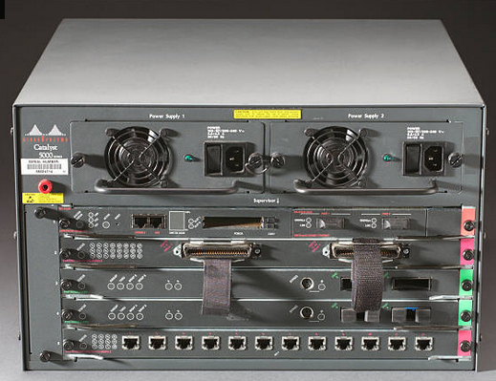
LINX in 1998
Present in Telehouse North only.
8 switches interconnected with 100M FDDI:
2x Catalyst 5000
2x Plaintree 4800
3x Catalyst 1200
These switches were 10/100 + FDDI.
PRTsystems
www.prtsystems.ltd.uk
Notes:
More on FDDI later

Slide 10
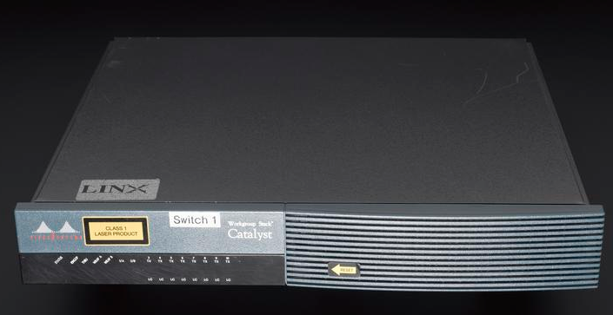
LINX in 1998
Present in Telehouse North only.
8 switches interconnected with 100M FDDI:
2x Catalyst 5000
2x Plaintree 4800
3x Catalyst 1200
These switches were 10/100 + FDDI.
PRTsystems
www.prtsystems.ltd.uk
Notes:
This is the actual switch0.linx.net

Slide 11
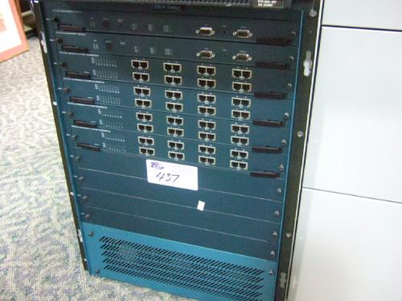
LINX in 1998
Present in Telehouse North only.
8 switches interconnected with 100M FDDI:
2x Catalyst 5000
2x Plaintree 4800
3x Catalyst 1200
These switches were 10/100 + FDDI.
PRTsystems
www.prtsystems.ltd.uk
Notes:
This isn’t a 4800, it’s the larger chassis – but was the only photo I could find.

Slide 12
LINX in 1998
Shamelessly borrowed from Keith’s NANOG15 presentation
PRTsystems
www.prtsystems.ltd.uk
Notes:
More – much more – on FDDI later...

Slide 13
LINX in 1998
53 members (October)
300Mbit/sec average traffic, 400Mbit/sec peak.
9,000 routes out of a global table of 55,000
PRTsystems
www.prtsystems.ltd.uk
Notes:
Graph stolen from Keith’s January 1999 NANOG update.
More on the blip at the beginning of November later...

Slide 14
LINX in 1998
LINX joining process was convoluted, and somewhat counter-productive. Contained the infamous “Three Traceroutes” requirement.
Excluded content providers and smaller ISPs.
Led directly to formation of LoNAP.
PRTsystems
www.prtsystems.ltd.uk
Notes:
L2 services sold by INS/Xara to NY got around the three traceroutes rule.
LoNAP formed in March 1998.

Slide 15
LINX upgrade to 1G
100M FDDI interconnect too limiting, and members were asking about 1G connections.
New LINX topology involved 1G capable switches – Packet Engines PowerRail and Extreme Summit series.
PRTsystems
www.prtsystems.ltd.uk

Slide 16
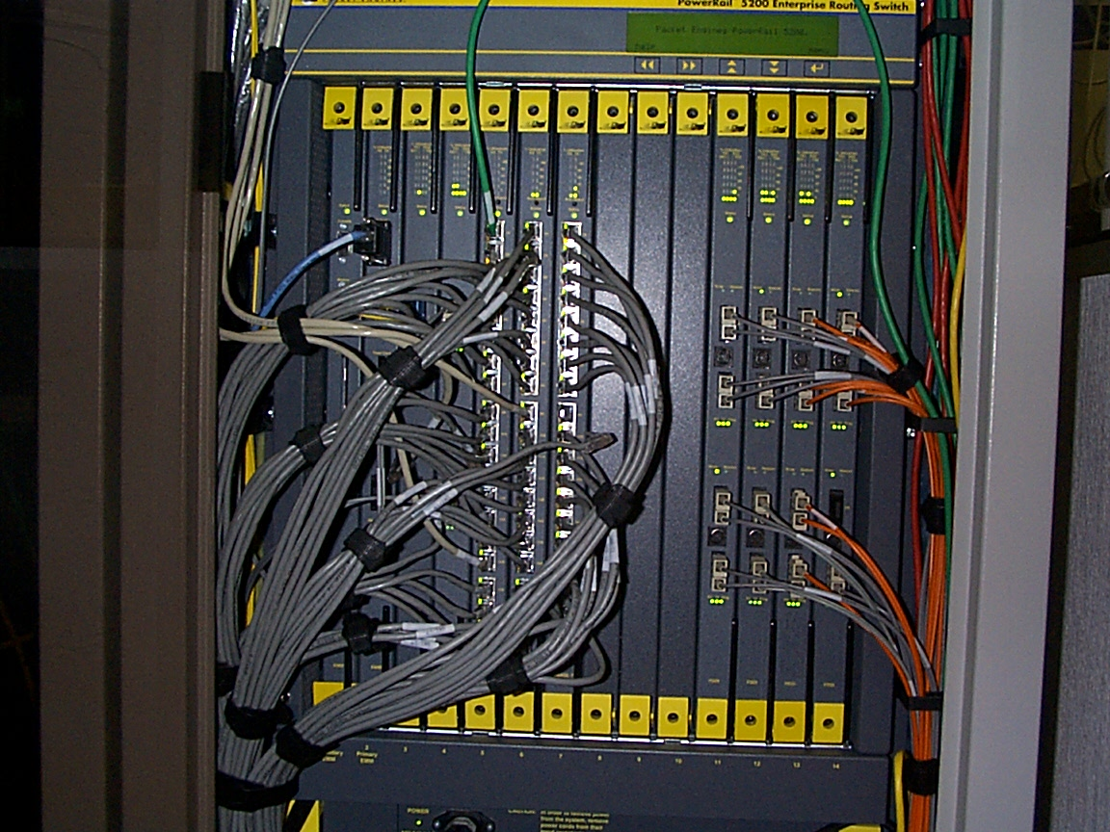
LINX upgrade to 1G
This was the first PR5200 switch at LINX – mixture of 10/100, 1G and FDDI ports.
Shortly afterwards, Packet Engines acquired by Alcatel.
PRTsystems
www.prtsystems.ltd.uk
Notes:
Powerrail had excellent hardware.

Slide 17
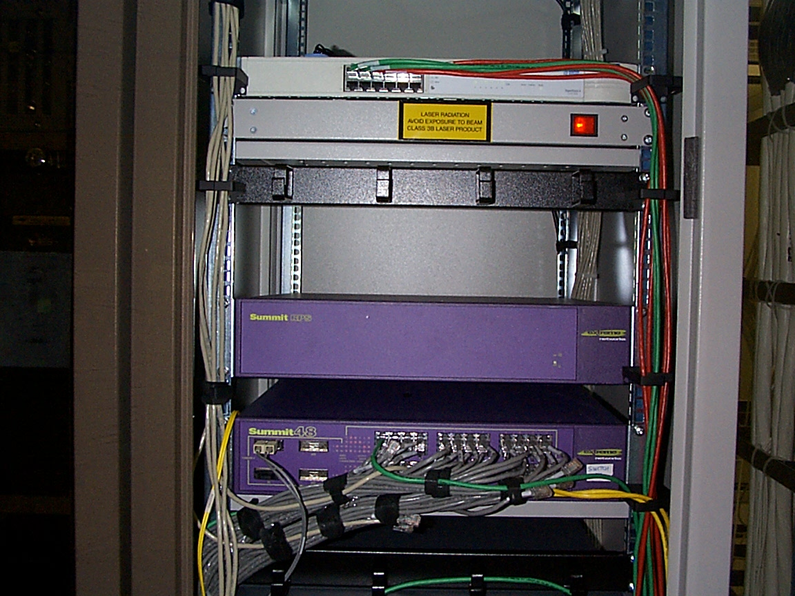
LINX upgrade to 1G
Extreme are still going strong and still have a presence at LINX.
This particular Summit 48 was the first Extreme switch added into the LINX LAN.
PRTsystems
www.prtsystems.ltd.uk
Notes:
This was the original switch7 Summit 48.

Slide 18
LINX upgrade to 1G
FDDI had inherent protection, but gig-E didn’t – we had much debate about the merits of STP.
This was one of the occasions where Keith and I had a ‘full and frank exchanges of technical viewpoints’!
These normally resulted in a good architectural compromise though.
PRTsystems
www.prtsystems.ltd.uk

Slide 19
LINX upgrade to 1G
I remember the initial migration well. It wasn’t a fantastic success.
The first weekend of November: long nights and packet-loss filled days – a number of issues with LINX network and member connections.
The maintenance work and subsequent downtime made the UK national press...
PRTsystems
www.prtsystems.ltd.uk

Slide 20
LINX upgrade to 1G
... but not the tech newsletter of the day.
PRTsystems
www.prtsystems.ltd.uk

Slide 21
LINX upgrade to 1G
This underlined a bit of a recurring theme.
Switch vendors didn’t understand the load that IXPs placed on their equipment.
LAN-centric flow expected: Servers to lots of lower speed clients. Meshy nature of IXPs quickly shows up shortcomings.
PRTsystems
www.prtsystems.ltd.uk
Notes:
Cat 5000 especially prone to this, but all of the hardware suffered from some form of this problem in one way or another.

Slide 22
Addressing challenges
LINX originally had a /23 of IPv4 PI space
This was soon deemed to be much too small.
So we became a RIPE LIR and acquired a /19 of PA space.
Which was duly carved up, and the peering LAN renumbered...
PRTsystems
www.prtsystems.ltd.uk
Notes:
This was the first ‘great renumbering’ in 1998/1999.

Slide 23
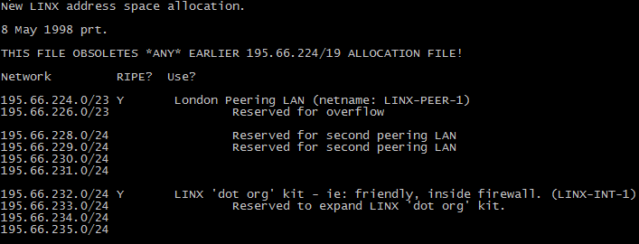
Addressing challenges
PRTsystems
www.prtsystems.ltd.uk
Notes:
LINX members will recall a large renumber to extend the Juniper peering LAN from a /23 to a /22
It was designed that way in the first place!

Slide 24
Addressing challenges
The peering LANs had a /21 reserved for them from day one.
It wasn’t my fault you had to renumber again after all.
PRTsystems
www.prtsystems.ltd.uk
Notes:
LINX members will recall a large renumber to extend the Juniper peering LAN from a /23 to a /22
It was designed that way in the first place!

Slide 25
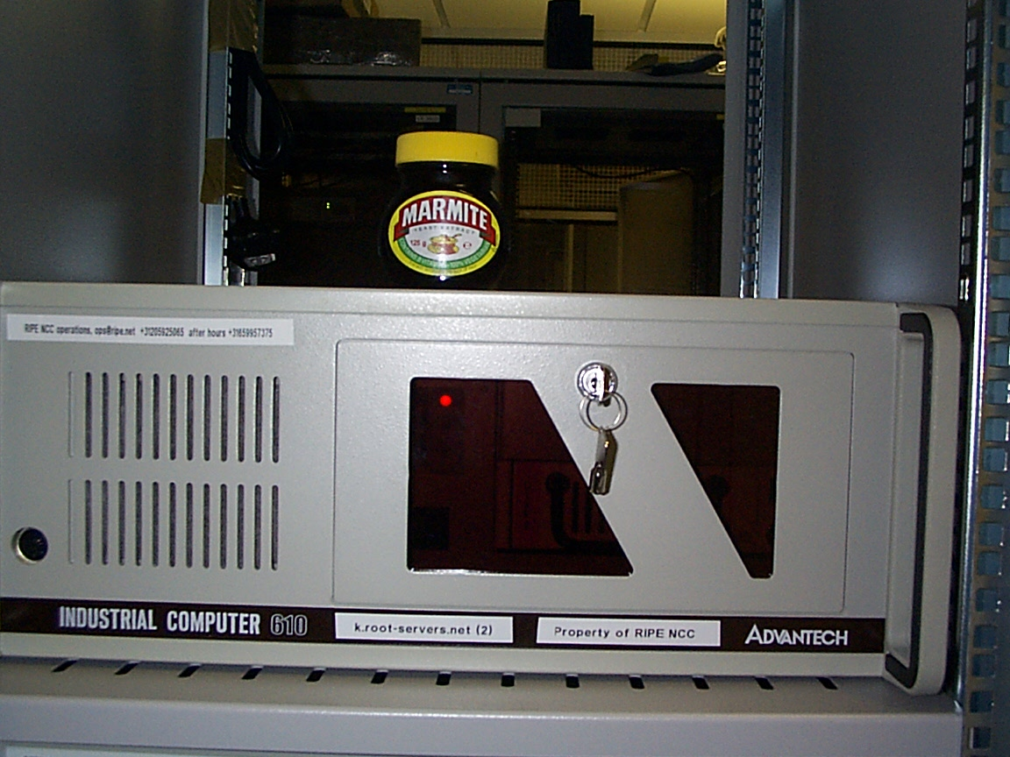
Key Infrastructure
LINX also hosted the original k.root-servers.net machines for the RIPE NCC.
PRTsystems
www.prtsystems.ltd.uk
Notes:
The marmite jar shall remain a mystery for those not aware of the secret brotherhood of marmite

Slide 26
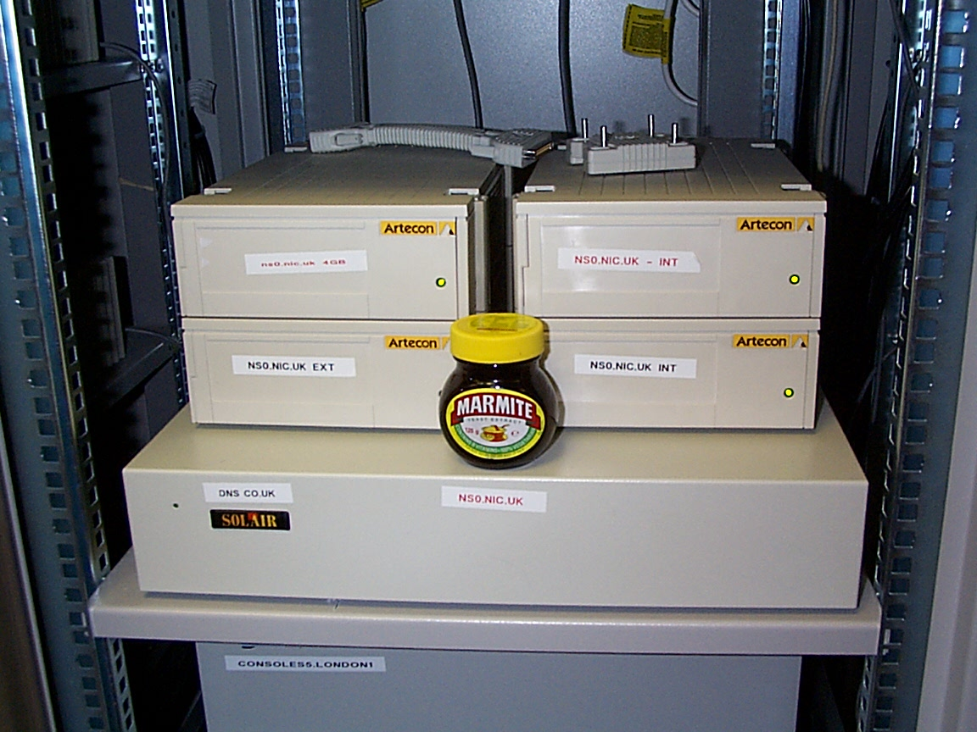
Key Infrastructure
And the .UK primary nameserver, ns0.nic.uk for Nominet.
PRTsystems
www.prtsystems.ltd.uk
Notes:
This was a quality Sun clone inherited from PSINet UK.

Slide 27
Key Infrastructure
DNS traffic was interesting.
Levels were quite low (average of 2Mbit/sec out from k.root, and 150Kbit/sec out from ns0.nic.uk in November 1998).
Looking at queries / responses (for operational reasons, of course) was enlightening.
PRTsystems
www.prtsystems.ltd.uk

Slide 28
Key Infrastructure
Snapshot of 100K queries every 10 mins in August 1998 to k.root yielded the following averages over an hour:
19% of requests led to an NXDOMAIN – mostly due to queries for things like ‘WORKGROUP.’ from Windows machines.
6% of queries originated from RFC1918 space.
PRTsystems
www.prtsystems.ltd.uk
Notes:
I can’t imagine this is any better today.

Slide 29
LINX has left the building
LINX also built a PoP in the new Redbus Interhouse building on Millharbour, now known as Telecity LON1 Equinix LD Digital Realty LHR19
Dark fibre between there and Telehouse North.
LINX and AMS-IX both went multi-site at about the same time.
PRTsystems
www.prtsystems.ltd.uk

Slide 30
Speaking of DCs...
The London scene was thin:
Telehouse North (of course) – but still a lot of DR DR space.
Telehouse Metro recently opened (1997) in City.
Redbus Interhouse Millharbour (1998).
PRTsystems
www.prtsystems.ltd.uk
Notes:
TFM1 and TFM2 don’t look very different...

Slide 31
Speaking of DCs...
And there wasn’t much elsewhere either...
Manchester – original Telecity Williams House
Some other provider-specific facilities, but still thought of more as single-occupancy ‘computer centres’ than a datacentre as we’d consider it today.
PRTsystems
www.prtsystems.ltd.uk

Slide 32
Connectivity Technology
Ethernet had yet to win the “use me for everything” race.
ATM, frame relay, PoS used for WANs.
Typical speeds still 155M / 622M for backbones. 2M down for customers.
PRTsystems
www.prtsystems.ltd.uk
Notes:
Ethernet chipsets not commodity. 1GE switches still only just coming online at a reasonable price

Slide 33
Connectivity Technology
Even on the LAN, Ethernet/IP wasn’t a given.
FDDI / Token Ring still very much in use for physical communication – but expensive.
IPX / Appletalk were still protocols of choice.
PRTsystems
www.prtsystems.ltd.uk
Notes:
All of those protocols so beloved by CCIE question setters!

Slide 34
And finally...
There were the light-hearted moments.
Paul’s tip to IXPs:
A sure-fire way to stop people from transmitting MoU violating frames on the peering LAN is to run a live tcpdump on the projector in the background whilst presenting at a member meeting.
PRTsystems
www.prtsystems.ltd.uk
Notes:
Be sure that the font is large enough that MAC addresses are clearly readable though.

Slide 35
And finally...
One member who shall remain nameless, and didn’t remain a member long afterwards, was caught with GRE tunnels to the US over other members’ connections.
Claimed I’d plugged a Cat5 cable into the wrong port on their router to cause this, and issued a press release explaining how the packets therefore went the wrong way!
PRTsystems
www.prtsystems.ltd.uk

Slide 36
And finally...
LINX hosted RIPE31 in Edinburgh.
The connectivity was provided by LINX, via a GRE tunnel across JANET. Routing used BGP and carried a full table.
The next-hop to the neighbor address in London was learned via the BGP peering session with it. The router had an existential crisis if restarted.
PRTsystems
www.prtsystems.ltd.uk
Notes:
No, I can’t find the router config.
Its hostname was great-uncle-bulgaria.linx.net though.

Slide 37
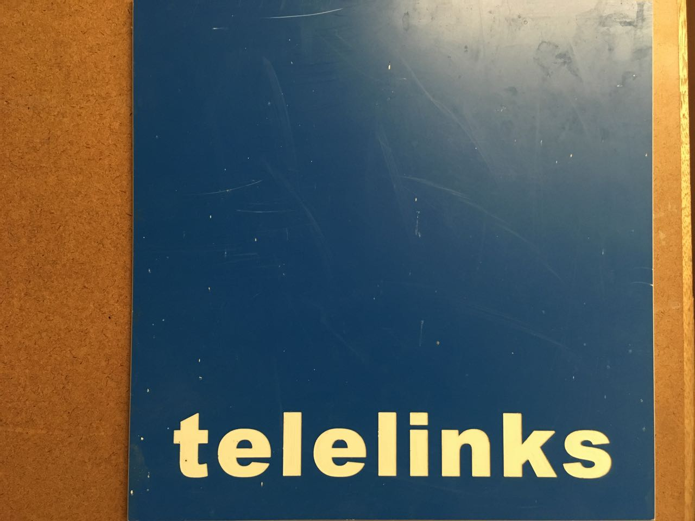
And finally...
One enterprising startup tried to capitalize on both the Telehouse and LINX name, causing consternation to both; and the engagement of lawyers on all sides.
PRTsystems
www.prtsystems.ltd.uk

Slide 38
And finally...
Luckily for both parties, PSINet came along and bought them out - both the name and the problem went away.
That project is a story for another year though...
PRTsystems
www.prtsystems.ltd.uk

Slide 39
Any Questions?
This series of presentations, diagrams, router configurations and other tidbits I managed to locate can be found at:
http://www.prt.org/history
I know that the LINX marketing department simply adore the 1997-era logo.
PRTsystems
www.prtsystems.ltd.uk

Slide 40
Thank you
Paul Thornton
paul@prtsystems.ltd.uk
UKNOF37
Manchester
20 April 2017
PRTsystems

