Slide 1
The Multi-Terabit
DDoS Era - Memcached
Sean Newman
Director Product Management

Slide 2






DDoS Still on the increase…
500 Gbps Hong Kong attack
France swarmed after terror attack
PlayStation & Xbox hit at Christmas
Mirai Botnet
OVH / Krebs / DYN
600 Gbps -> 1Tbps
Memcached
GitHub
1.35-1.7Tbps
Anon hits Church
of Scientology
Spamhaus attack:
Reported to reach 310 Gbps
Rio
Olympics 540 Gbps
Spammers discover
botnets
Reaper Botnet
2M Devices
First Hacktivists:
Zapatista National Liberation Army
ProtonMail
attack
Estonia: Parliament, banks, media, Estonia Reform Party
Coordinated US bank attacks:
Grew to 200 Gbps,
and continue today
DoS for
Notoriety
1993
…
2005
2007
2009
2011
2013
2015
2016
2017
2018

Slide 3
Increasingly Sophisticated IoT Exploits
Mirai – Basic password brute-force
  Pre-populated default user/password pairs
Reaper – Authentication bypass vulnerability
  Empty user and password parameters in URI
Satori/BrickerBot – Huawei Router Vuln (CVE-2017–17215)
  Zero-day vulnerability posted openly on Pastebin
  Injection of commands within a “firmware update”
  Result: Undetected malicious code installed on the device
IoTroop, etc… – Ongoing IoT Challenge
  Low performance devices running lightweight code
  Cheap devices, with focus on function, not secure code

Slide 4
New Attack Vector – Memcached
General Purpose distributed memory caching system
  Often used to speed up database-driven websites
Default …/etc/sysconfig/ enables service for all to use
  Service on TCP, and crucially UDP, port 11211
  Designed for speed, so access does not require authentication
Standard component of common Linux distributions
  Centos, Ubuntu, etc…
  Including most instances hosted in public clouds
UDP Memcached on the Internet enables reflection attacks
  This reflection vulnerability has been around for >10 years

Slide 5

WhiteHat PoC Raised Awareness
2Tb/s Exploit demonstrated at Power of Community 2017
  http://powerofcommunity.net/poc2017/shengbao.pdf
Appealing to attackers for scale of amplification possible…
Within a quarter, we started to see the first DDoS attacks

Slide 6
GitHub Attacked using Memcached
Wednesday 28th February, 2018 – 1.35Tb/s GitHub attack!
Offline for 10 minutes, whilst Akamai figures out mitigation
Within hours Corero customers were being targeted
Four days later, Arbor Networks claimed new largest attack
  1.7Tbps attack against unnamed Arbor customer

Slide 7
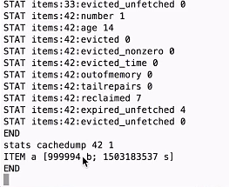
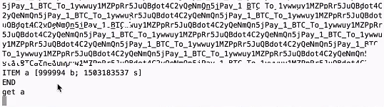
Memcached Attack – Explained
Open memcached port 11211 enables simple telnet access
  stats items command enables simple lookup of memcached ‘slab’ usage
  Typically 42 ‘slabs’ available, #42 is largest @ 10GB in 1MB entries
  Each entry can be filled with data, by any user, and given associated ‘key’
In this case, fetching, with a get, reveals interesting payload
  Entry is filled to within a few bytes of 1MB maximum

Slide 8
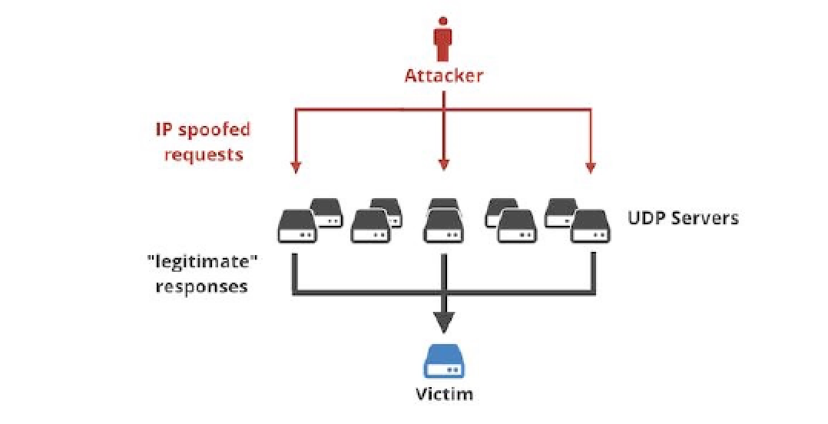


Weaponising Memcached - Searching
1. Attacker Scans
Internet on
UDP 11211
2. Builds list of responding IPs
IP 1.1.1.1
IP 2.2.2.2
….
IP n.n.n.n
@ ~100Mb/s each
~10k needed for 1Tb/s
UDP (stats)
UDP (stats)
UDP (stats)
(reply)
(reply)
(reply)
Vulnerable
memcached
Servers

Slide 9


Weaponising Memcached - Staging
3. Attacker Pre-loads
cache payload
and associated key
~ 1MB to key (a)
Loading thousands
of servers is
non-trivial exercise
Likely takes
10s of minutes
UDP (set a)
UDP (set a)
UDP (set a)
1MB data (a)
1MB data (a)
1MB data (a)
Vulnerable
memcached
Servers

Slide 10
Weaponising Memcached - Activating
4. Attacker Sends
“get a…” to each
server on the list
small message with
source spoofed to
be that of victim
From 100Mbit link
attacker can enable
10k servers in
a single second
UDP (get a a a …)
UDP (get a a a …)
UDP (get a a a…)
1MB data (a)
1MB data (a)
1MB data (a)
Vulnerable
memcached
Servers
1MB data (a)
from n servers
at ~100Mbit/s

Slide 11
Weaponising Memcached - Activating
4. Attacker Sends
“get a…” to each
server on the list
small message with
source spoofed to
be that of victim
From 100Mbit link
attacker can enable
10k servers in
a single second
UDP (get a a a …)
UDP (get a a a …)
UDP (get a a a…)
1MB data (a)
1MB data (a)
1MB data (a)
Vulnerable
memcached
Servers
1MB data (a)
from n servers
at ~100Mbit/s
10,000x
amplification =
Terabits per second

Slide 12

Neutralising Memcached
RELOAD
memcached
(attack payloads)
~ 1MB to key (a)
UDP (set a)
UDP (set a)
UDP (set a)
vulnerable
memcached
servers
1MB data (a)
1MB data (a)
1MB data (a)
COUNTERMEASURE
Respond with
UDP (flush_all)
to each attacking server
UDP (flush_all)
COUNTERMEASURE is 10,000 times more efficient than attacker’s reload – reverse of amplification

Slide 13
Neutralising Memcached
Memcached’s flush_all command instantly clears all cache entries
  Provides ability to rapidly diminish sustained attacks
  No data is destroyed, but, need to be aware of any legal implications
Countermeasure can begin immediately with no collateral damage
  Packet rate is minimal (reverse of amplification)
Automated countermeasure generation is trivial…
  netcat
    python -c "print '\0\x01\0\0\0\x01\0\0flush_all\r\n'" | nc -nvvu xxx.xxx.xxx.xxx 11211 > /tmp/null
  /dev/udp
    echo -ne '\0\x01\0\0\0\x01\0\0flush_all\r\n' > /dev/udp/xxx.xxx.xxx.xxx/11211
  Where xxx.xxx.xxx.xxx is the source IP of an attacking memcached
Once amplification is destroyed memcache is useless for DDoS

Slide 14
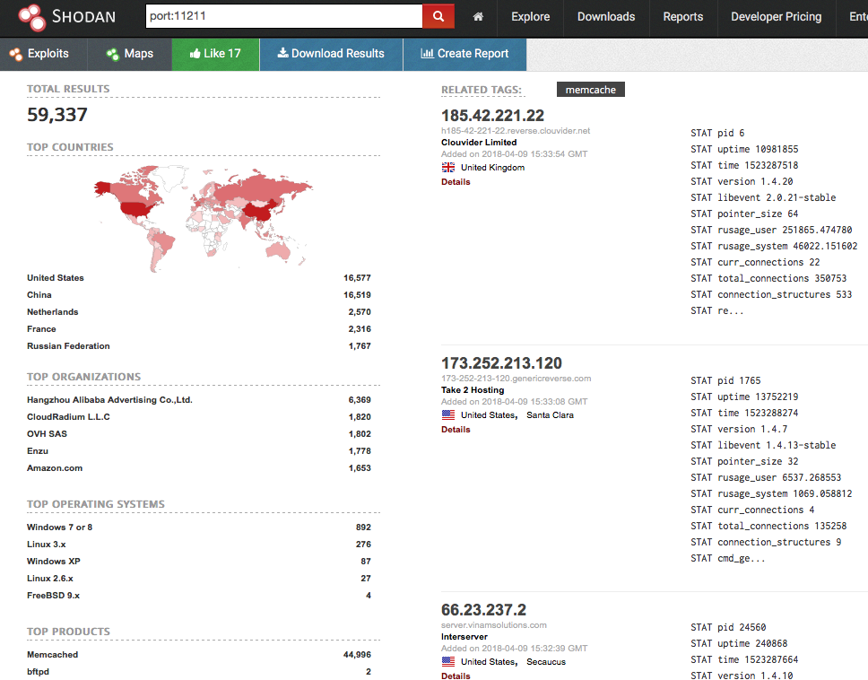
Public Memcached Servers in Decline
April 2018
Oct 2017
Number of vulnerable servers is diminishing due to publicity of exploit

Slide 15
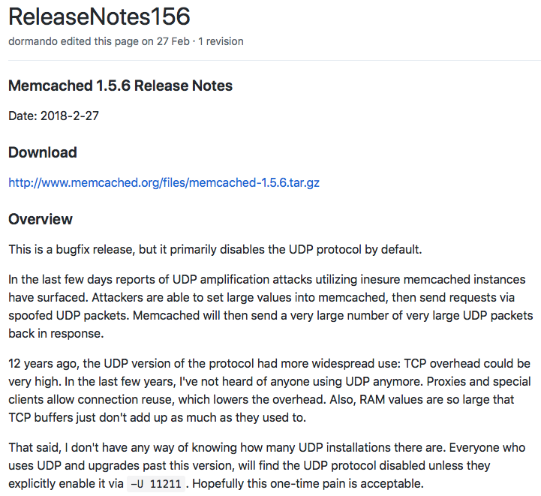
Memcached Vulnerability Fixed?
Memcached authors release latest version with UDP disabled by default

Slide 16
Summary
DDoS as a whole still on the Increase
  Attack Methods/Vectors more Sophisticated
  No surprise that new vectors such as memcached emerge
Traditional Protection is not effective enough
  Typically too slow to react to avoid damage
Service and Hosting Provider Reputation is at Risk
  Many organisation still believe their provider protects them
Deploying Modern DDoS Protection is an Opportunity
  Removes all DDoS Traffic from your infrastructure
  Differentiates you from your competitors
  Can enable incremental revenue stream by selling on as a service

Slide 17

Questions?

Slide 18
Thank You!

