Slide 1
“Uptime” at IXPs - and NIS Directive
Robert Lister
UKNOF 40
27 April 2018 | Manchester

Slide 3
NIS Directive
EU Directive on security of Networks and Information Systems
UK Consultation: (August/Sept 2017): https://www.gov.uk/government/consultations/consultation-on-the-security-of-network-and-information-systems-directive
https://www.ncsc.gov.uk/guidance/introduction-nis-directive

Slide 4
NIS Directive
May require IXPs to report availability / outage metrics
For UK, this means OFCOM:
“Operators who have 50% or more annual market share amongst UK IXP Operators in terms of interconnected autonomous systems, Or:
Who offer interconnectivity to 50% or more of Global Internet routes.”
Notes:
This is what the UK has settled on for defining the size of IXP. At the time though, there were other criteria being talked about.

Slide 5
“High availability”
Availability % | Downtime per year | Downtime per month | Downtime per week | Downtime per day
90% ("one nine") | 36.5 days | 72 hours | 16.8 hours | 2.4 hours
95% ("one and a half nines") | 18.25 days | 36 hours | 8.4 hours | 1.2 hours
97% | 10.96 days | 21.6 hours | 5.04 hours | 43.2 minutes
98% | 7.30 days | 14.4 hours | 3.36 hours | 28.8 minutes
99% ("two nines") | 3.65 days | 7.20 hours | 1.68 hours | 14.4 minutes
99.5% ("two and a half nines") | 1.83 days | 3.60 hours | 50.4 minutes | 7.2 minutes
99.8% | 17.52 hours | 86.23 minutes | 20.16 minutes | 2.88 minutes
99.9% ("three nines") | 8.76 hours | 43.8 minutes | 10.1 minutes | 1.44 minutes
99.95% ("three and a half nines") | 4.38 hours | 21.56 minutes | 5.04 minutes | 43.2 seconds
99.99% ("four nines") | 52.56 minutes | 4.38 minutes | 1.01 minutes | 8.64 seconds
99.995% ("four and a half nines") | 26.28 minutes | 2.16 minutes | 30.24 seconds | 4.32 seconds
99.999% ("five nines") | 5.26 minutes | 25.9 seconds | 6.05 seconds | 864.3 milliseconds
99.9999% ("six nines") | 31.5 seconds | 2.59 seconds | 604.8 milliseconds | 86.4 milliseconds
99.99999% ("seven nines") | 3.15 seconds | 262.97 milliseconds | 60.48 milliseconds | 8.64 milliseconds
99.999999% ("eight nines") | 315.569 milliseconds | 26.297 milliseconds | 6.048 milliseconds | 0.864 milliseconds
99.9999999% ("nine nines") | 31.5569 milliseconds | 2.6297 milliseconds | 0.6048 milliseconds | 0.0864 milliseconds
“LOL.”
“OK.”
Source: https://en.wikipedia.org/wiki/High_availability

Slide 6
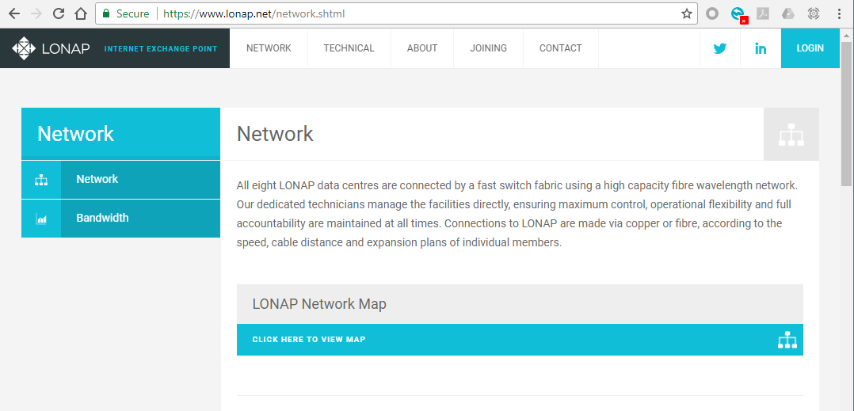
99.99(9)% uptime?
Network Uptime
Current network uptime: 99.999% *
Network Uptime
Current network uptime: 99.999%
Notes:
Could we produce an “uptime” metric for an IXP? Sometimes engineers get asked to generate an “uptime metric”.
Wouldn’t it be good if we could have this? Would it?

Slide 7
99.99(9)% uptime?
Network Uptime
Current network uptime: 99.999% *
9 out of 10 cats local pref our prefixes. The value of your pings may go down as well as up.
We reserve the right to replace lost packets with equivalent size packets at our discretion.
Not to scale. Not actual web site.
Due to rounding, numbers presented may not add up precisely to the totals provided and percentages may not precisely reflect the absolute figures. Figures were correct at time we made them up.
Subject to National Rail Conditions of Travel. Packets valid via any reasonable route.
Contents may settle during shipping.
Notes:
Of course.. It we may be able to produce such a metric, but it would probably come with a bunch of small print…
You would want us to explain how we did it. Would the method we used be reasonable enough to give a meaningful number?
Or would it be so difficult to do, we’d have to make a lot of “exceptions” so the number always looks “good”.

Slide 8
Determine “up” at an IXP
member | ping?
5.57.80.1 | ✓
5.57.80.2 | ✓
5.57.80.3 | ✓
5.57.80.4 | ✓
5.57.80.5 | ✓
…etc…
5.57.80.xx | ✓
IXP Switch
monitoring
R1
R2
R3
R4
R5
= “100% up”
Notes:
So what are the options for determining what is “up” at an IXP – a simple exchange…
If we had a simple infrastructure, the answer might be – just ping every member.
Our monitoring server receives a response from every member. We know all is good. We might even record the latency.

Slide 9
Ping all the things…
member | ping | ping | ping | ping | ping | ping | ping | ping | ping | ping | ping | Available %
5.57.80.1 | ✓ | ✓ | ✓ | ✓ | ✓ | ✓ | ✓ | ✓ | ✓ | … lots more columns … | ✓ | 100%
5.57.80.2 | ✓ | ✓ | ✓ | ✓ | ✓ | ✓ | ✓ | ✓ | ✓ |  | ✓ | 100%
5.57.80.3 | ✓ | ✓ | ✓ | ✓ | ✓ | ✓ | ✓ | ✓ | ✓ |  | ✓ | 100%
5.57.80.4 | ✓ | ✓ | ✓ | ✓ | ✓ | ✓ | ✓ | ✓ | ✓ |  | ✓ | 100%
5.57.80.5 | ✓ | ✓ | ✗ | ✗ | ✗ | ✗ | ✗ | ✓ | ✓ |  | ✓ | 99.65%
Example:
In 24 hours = 1440 minutes.
-5 minutes downtime = 1435 (99.652%)
It would more likely be calculated in seconds: (86400 – 300 = 99.652%)
Notes:
So, we do this a few times, and we begin to build up a picture that we might use to calculate an uptime metric.

Slide 10
Pinging members can suck…
member | ping | ping | ping | ping | ping | ping | ping | ping | ping | ping
5.57.80.1 | ✓ | ✓ | ✗ | ✗ | ✗ | ✓ | ✗ | ✓ | ✗ | ✓
5.57.80.2 | ✓ | ✓ | ✓ | ✓ | ✓ | ✓ | ✓ | ✓ | ✓ | ✓
5.57.80.3 | ✓ | ✓ | ✓ | ✓ | ✓ | ✓ | ✓ | ✓ | ✓ | ✓
5.57.80.4 | ✓ | ✓ | ✓ | ✓ | ✗ | ✗ | ✗ | ✗ | ✓ | ✓
5.57.80.5 | ✗ | ✗ | ✗ | ✗ | ✗ | ✗ | ✗ | ✗ | ✗ | ✗
Some members may have busy routers (high latency/packet loss)
Some do not reply to ping
Might miss shorter outages between pings
Latency is an interesting stat to monitor
Notes:
Ping is a bit sucky, but it does have its uses.
Latency can tell us about remotely connected members, for example.

Slide 11
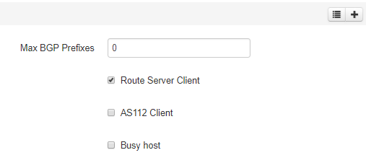
It can get ……. messy
member | ping | ping | ping | ping | ping | ping | ping | ping | ping | ping
5.57.80.1 | ✓ | ✓ | ✗ | ✗ | ✗ | ✓ | ✗ | ✓ | ✗ | ✓
5.57.80.2 | ✓ | ✓ | ✓ | ✓ | ✓ | ✓ | ✓ | ✓ | ✓ | ✓
5.57.80.3 | ✓ | ✓ | ✓ | ✓ | ✓ | ✓ | ✓ | ✓ | ✓ | ✓
5.57.80.4 | ✓ | ✓ | ✓ | ✓ | ✗ | ✗ | ✗ | ✗ | ✓ | ✓
5.57.80.5 | ✗ | ✗ | ✗ | ✗ | ✗ | ✗ | ✗ | ✗ | ✗ | ✗
IXP Manager option:

Slide 12
Correlate pings with other pings!
member | ping | ping | ping | ping | ping | ping | ping | ping | ping | ping
5.57.80.12 | ✓ | ✓ | ✓ | ✓ | ✗ | ✗ | ✗ | ✗ | ✗ | ✓
5.57.80.52 | ✓ | ✓ | ✓ | ✓ | ✗ | ✗ | ✗ | ✗ | ✗ | ✓
5.57.80.48 | ✓ | ✓ | ✓ | ✓ | ✗ | ✗ | ✗ | ✗ | ✗ | ✓
5.57.80.76 | ✓ | ✓ | ✓ | ✓ | ✗ | ✗ | ✗ | ✗ | ✗ | ✓
5.57.80.91 | ✓ | ✓ | ✓ | ✓ | ✗ | ✗ | ✗ | ✗ | ✗ | ✓
Pinging a single host is limited by itself: more useful if we correlate
Multiple members unreachable in the same interval. - May indicate an outage?
Notes:
Despite the limitations, we can correlate pings to make it more useful, for example, if a bunch of members become unreachable within the same time interval.
This is more useful information.

Slide 13
Correlate other monitoring data
member | ping | BGP | RS1 | RS2 | Port | ARP | traffic | errors | …
5.57.80.12 | ✗ | ✓ | ✓ | ✓ | ✓ | ✓ | 50% | 0
5.57.80.52 | ✗ | ✗ | ✗ | ✗ | ✗ | ✗ | 0% | 0
5.57.80.48 | ✗ 7/10 | ✓ | ✓ | ✓ | ✓ | ✓ | 99% | 5068
5.57.80.76 | ✓ | ✓ | ✓ | ✓ | ✓ | ✓ | 38% | 0
5.57.80.91 | ✓ | ✗ | ✗ | ✗ | ✓ | ✓ | 0% | 0
# My clever alert correlation script 1.0
if ($port_down) {
if (…) {
…lots of twisty code
}
}
$uptime = do_magic()
# 2002-08-10: should
# probably rewrite this
# bit sometime…
# 2018-01-28: LOL!
@PORTS = get_snmp_voodoo()
Correlating with other monitoring gives us more insight
This is useful for monitoring ☺
Makes a “single metric” calculation complex ☹
It is both up and down? Wait a bit…
Notes:
We could correlate ping with other data we may have, such as the port status, BGP sessions, etc.
This enables us to determine why a member might not responding to ping, or that they are up, even though they can’t be pinged.
All useful for monitoring, but can be complex to use for an uptime calculation. A lot of data has to be worked through, and assuming we don’t lose any of it make some assumptions about the member’s availability.

Slide 14
Path availability
R3
R2
R4
R1
R5
R10
R6
R9
R7
R8

Slide 15
Path availability
R3
R2
possible paths =
n * (n-1) / 2
10 * (10-1) / 2 = 45
(45 paths available = 100%)
We consider every path,
whether or not peering exists
ASNs don’t peer with themselves.
R4
R1
R5
R10
R6
R9
R7
R8
yes, this slide took forever to draw…

Slide 16
Exchange topology
switch1
switch2
switch3
switch4
Notes:
So how do we go about collecting the data in an IXP?

Slide 17
Exchange topology
switch1
switch2
switch3
switch4
Notes:
First, we need a monitoring device in every site, or connected to every switch.
Every monitoring device pings every other device

Slide 18
Calculating path availability
5
switch1
switch2
10
5
switch3
switch4
2
Notes:
Since we know how many connected ports are in each site, we can easily work out the path availability impact of ports being unreachable

Slide 19
Calculating path availability
5
switch1
switch2
10
5
switch3
switch4
2
Notes:
In this example, we are unable to reach the monitoring station in a particular location. This affects 10 connections, which we can mark as down, rather than waiting to try and ping them all.

Slide 20
Calculating path availability
5
switch1
switch2
Connected Ports | 22
Possible paths | 231 | 22*(22-1)/2
Down ports | 10
Reduced paths by | 105 | 10*(22-1)/2
Remaining | 126 | 231-105
Path Availability | 54.55%
10
5
switch3
switch4
2

Slide 21
Calculating path availability
5
switch1
switch2
Connected Ports | 314
Possible paths | 49141
Down ports | 10
Reduced paths by | 1565
Remaining | 47576
Path Availability | 96.82%
10
5
switch3
switch4
2
Notes:
Here is what it might look like with LONAP ports. In fact, the possible paths is maybe interesting but isn’t really needed – we get exactly the same result using just the port counts.
Possibly we would need to correlate this with other data to account for things like partial outages etc. But it would be more reliable than just pinging members alone.

Slide 22
..another way to do it – by port capacity?
Port | Mbps
Port 1 | 100
Port 2 | 1000
Port 3 | 1000
Port 4 | 1000
Port 5 | 10000
… | …
Connected capacity | 2339000
Capacity down | -13100
Remaining availability | 99.44 %
5
switch1
switch2
10
5
switch3
switch4
2
Notes:
This might be a fairer way to calculate it. Calculate the capacity of the ports affected and work it out as a percentage of total connected capacity.

Slide 23
..another way to do it – by port capacity?
1
switch1
switch2
Port | Mbps
Port 1 | 100000
Connected capacity | 2339000
Capacity down | - 100000
Remaining availability | 95.72 %
10
5
switch3
switch4
2
Notes:
A single 100G port going down in a site would have more impact on the exchange than 24 1G ports going down.

Slide 24
…or use the switches themselves?
switch1
switch2
switch3
switch4
No longer just a flat layer 2 network. The devices are layer 3.
Every core link is an IP, point-to-point link
…we could monitor these to work out “core availability”
Maybe take into account traffic impact (down link may have no noticeable impact)

Slide 25
Happiness

Slide 26
Is it a useful metric?
Do we exclude things like maintenance?
Exclude other factors “outside our control?”
Is that realistic?
Try not to obsess about the number!
100% 99.99% 100% 100% 100% 100% 100% 100% 100% 100% 100% 100%% 100% 100% 100% 100% 100% 100% 100% 100%

Slide 27
What LONAP members said…
“Your job is to move packets. Just monitor ingress and egress packets”
“Don’t spend a lot of effort creating this metric.”
“Just focus on running a reliable service. Don’t break it.”
Use SFLOW to detect problems (find increased TCP SYN)”
“Use whatever metric internally if it helps. Probably not useful to publish it.”
“You need more pictures of cats.”

Slide 28
What other EURO-IX IXPs said…
“We tried and gave up.”
“It’s too complicated to create a reliable number”
“We do a complex calculation to create availability metrics”
Should we try to develop some standard metrics?

Slide 29
Thoughts?

