Slide 1
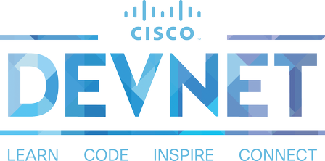
NetDevOps Style Configuration Management for the Network
What it means for network engineers, and why we should care?
Stuart Clark Network Automation Evangelist
Cisco Devnet

Slide 2
Game Plan
Virlutils Network Simulation
What are Infrastructure as Code and Configuration Management?
Benefits of Configuration Management
Recipes, Manifests, Playbooks, and the Tools
Configuration Management with Ansible Example

Slide 3
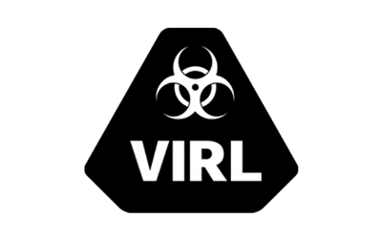
“virl up” Network Simulation Done Right
virlutils makes it easy to start a network simulation
virlutils is written in Python
https://github.com/CiscoDevNet/virlutils

Slide 4
Why Ansible for the Network?
Agentless
Currently popular in network community
ie Lots of examples!
Written in Python
Simple to install and get started!
But explore other options as well!
LINX102

Slide 5
What are Infrastructure as Code and Configuration Management?

Slide 6
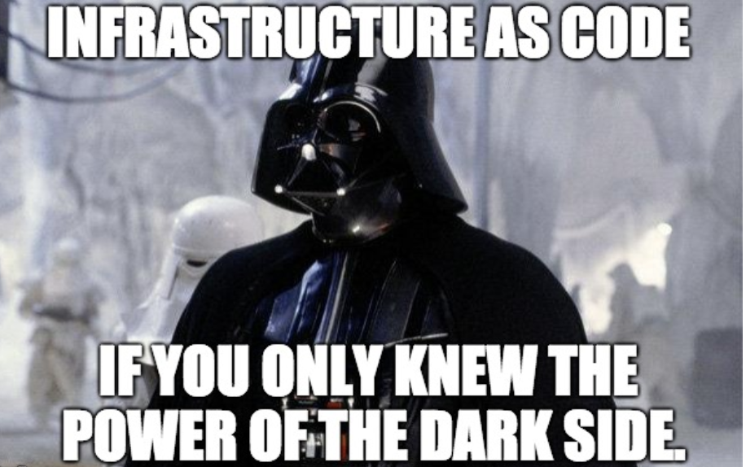
Infrastructure as Code… huh?
“Infrastructure as Code (IaC) is the process of managing and provisioning computer data centers through machine-readable definition files...”
https://en.wikipedia.org/wiki/Infrastructure_as_Code

Slide 7
Some Principals of ”Network as Code”
Store network configuration in source control systems (ie git)
Use ”machine readable” formats like YAML, JSON, XML
Treat the source control as single source of truth
Develop, test, and deploy to prod from same source
Deploy configuration using programmatic APIs and tooling
Limit manual network configuration
Explore “Configuration Management” tooling.

Slide 8
Mechanism = Automation
No more hand to hand combat configuration management
Configuration Management today is about the “tools”
Consistency + Scale Success!

Slide 9
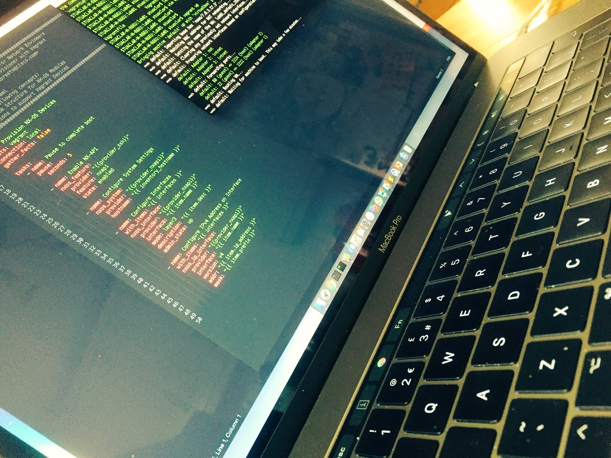
Characteristics = Desired State
The software and version installed
System attributes like name, address, ownership, etc
Feature specific configurations

Slide 10
Benefits of Configuration Management

Slide 11
Quickly Provision Infrastructure
Sequential and Manual

Slide 12
No More Snowflakes
System Variation

Slide 13
Version Controlled Infrastructure
Organic Configuration

Slide 14
Infrastructure as Code
Version Controlled Infrastructure

Slide 15
Commonalities of Configuration Management Tools
Open Source Foundation
Automation and Orchestration
Idempotent Behavior
Facts, lots of facts
Modules and Libraries

Slide 16
Matrix of Common Info and Terms
 | Ansible | Puppet | Chef | SaltStack
Language | Python + YAML | Ruby Based | Ruby | Python
Managed Node Requirements | Agentless | Traditionally Agent Based | Agent Based | Agent Based “minions”
Centralized Management | Any computer can be “controller” Optional “Tower” | Puppet Master | Chef Server | Salt Master
What you create | Playbook / Roles | Manifest / Module | Recipe / Cookbook | Pillar / Include

Slide 17
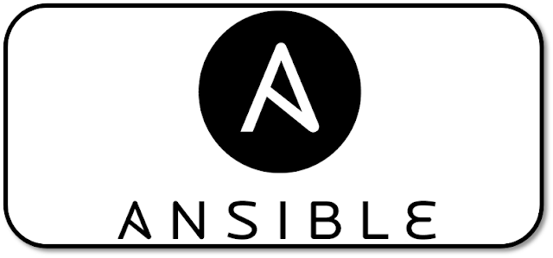
”Network as Code” with Ansible for Configuration Management
Ansible Playbook
Run roles against relevant groups
Ansible Roles
Align to network roles
Inventory File
List network devices
Logically group for configuration
Variable Files
Device specific details
General group details

Slide 18
Starting Network Topology
Physical Topology
“Core” – IOS XE Routers
“Distribution” – NX-OS Switches
“Access” – NX-OS Switches
Network has been cabled already
Management access to devices enabled
No other configuration completed

Slide 19
Desired Network Configuration
Layer 3 Links between Core/Dist
OSPF Area 0 Routing Configured
Distribution configured for VPC Domain
Layer 2 port-channel trunk to access
Set of VLANs Configured
SVIs at Distribution with HSRP Configured

Slide 20
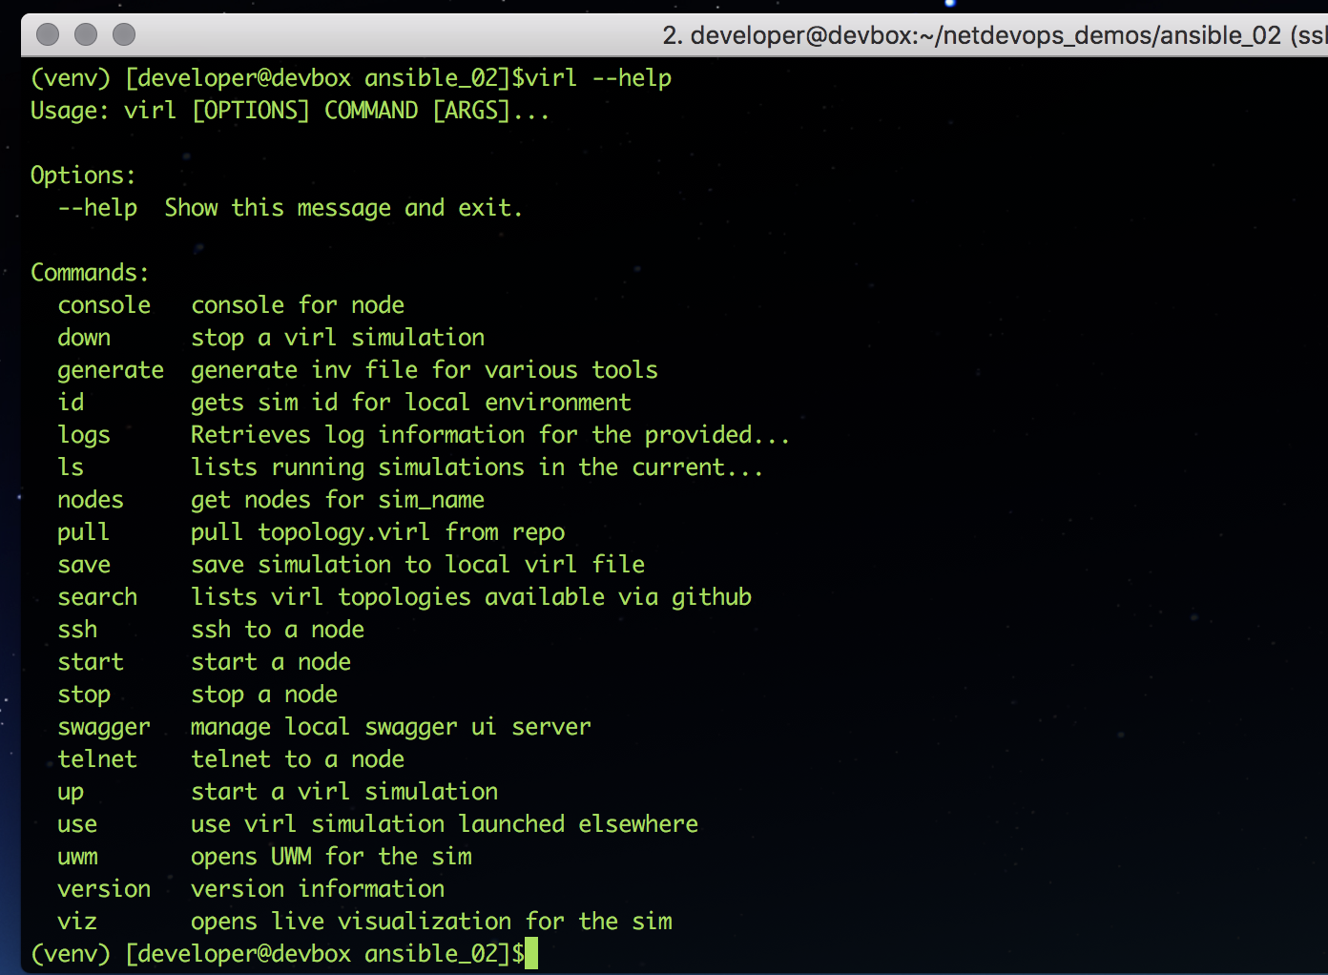
Running the code
Bring up the topology – virl up [virlfiles/name]
Not specifying a virlfile name will import the default one from the current directory
See the simulations are currently running on your server virl ls --all
Check the state of the nodes - virl nodes
This will display the nodes, name, ip address and state
Once the nodes are available - virl generate ansible
Creates the default inventory file
Use virl --help to see the variety of commands that are available

Slide 21
Advantages of VIRL as the development environment
Robust support for large topologies mimicking production
Simulations can include servers and applications in addition to network
Full data plane within the simulation to test traffic flows and protocol behaviour
Off-load simulation to remote server
But there are definite caveats to consider as well.
For typical uses, not a fully local dev environment
Significant time to instantiate networks
Not an insignificant resource requirement for large topologies

Slide 22
What did we cover?
What are Infrastructure as Code and Configuration Management?
Benefits of Configuration Management
Recipes, Manifests, Playbooks, Oh My! The Tools
Configuration Management with Ansible Example

Slide 23
What do do next?
Resources
Network Automation with Ansible (ansible.com)
Network Automation wtih Salt (saltstack.com)
Network Automation with Puppet (puppet.com)
Network Automation with CFEngine (cfengine.com)
DevNet Learning Labs
Introduction to Ansible
Using Ansible with NX-OS Devices
Introduction to ACI and Ansible
Home Lab: Using Ansible from your Desktop OS
Blogs and Videos
What does "Network as Code" Mean?
Automating Cisco ACI with Ansible Eliminates Repetitive Day-to-Day Tasks
NetDevOps Video Module

Slide 24
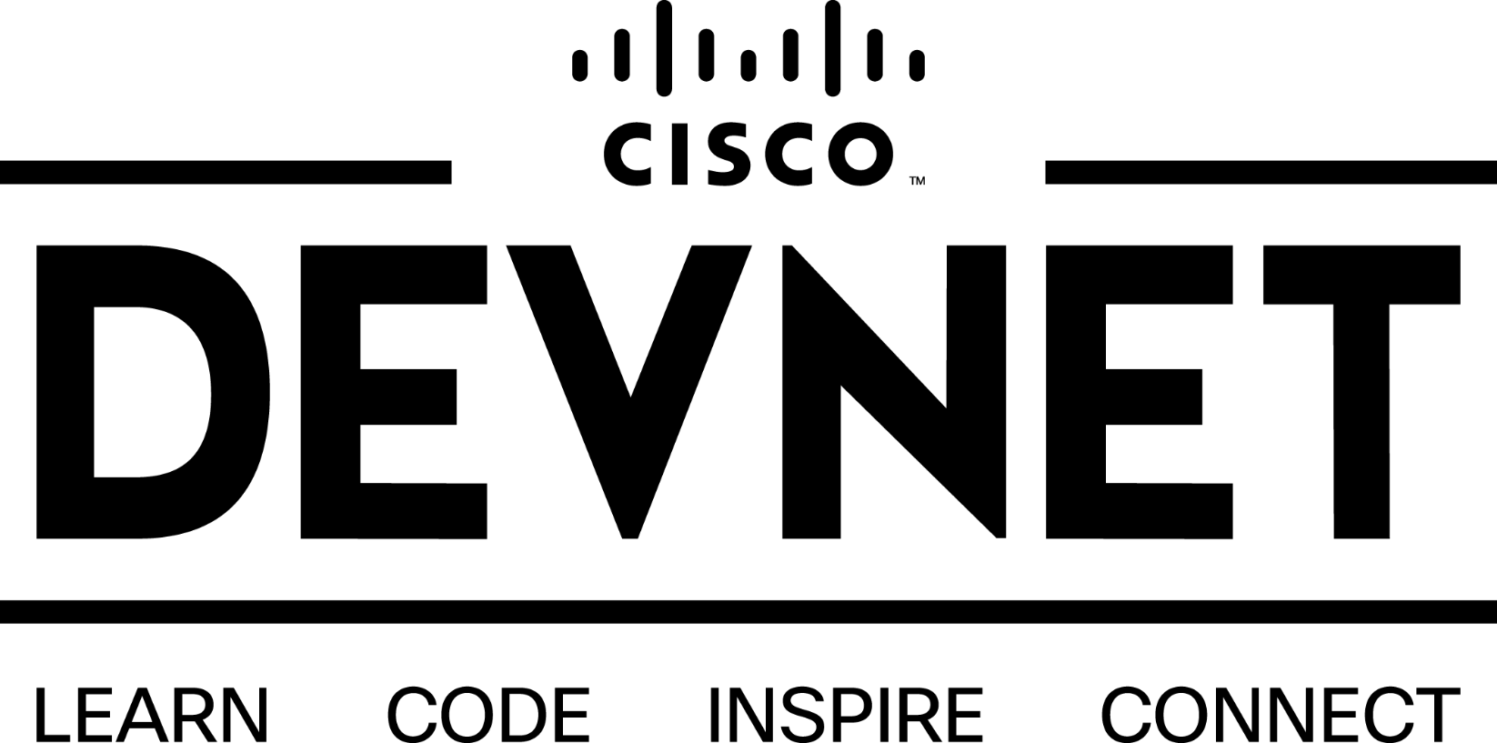
Got more questions? Stay in touch!
Stuart Clark
developer.cisco.com
stuaclar@cisco.com
@bigevilbeard
http://github.com/bigevilbeard
@CiscoDevNet
facebook.com/ciscodevnet/
http://github.com/CiscoDevNet

