Slide 1
Introduction to
UK Fibre Connectivity Forum
Presented by Askar Sheibani, Chair
Notes:
To change the image on this slide, select the picture and delete it. Then click the Pictures icon in the placeholder to insert your own image.

Slide 2
Our vision:
“Full fibre connectivity across all parts of the UK in all commercial and residential buildings. This will be high speed and affordable and delivered on a level playing field for all stakeholders.”

Slide 3
Our mission:
“To be a vocal group, lobbying, influencing and educating policy makers as to the most fair and efficient way to put an end to the digital divide.”

Slide 4
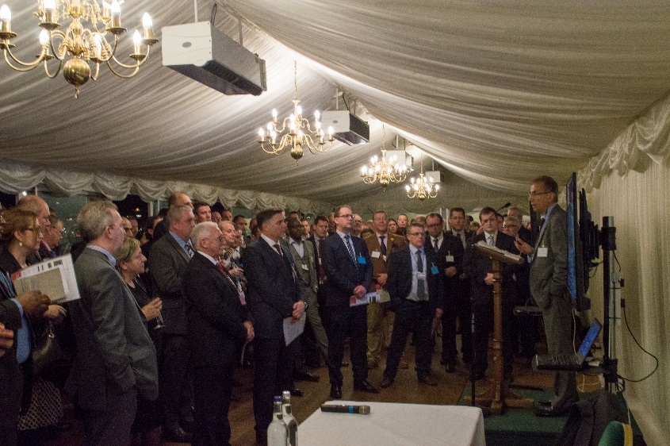
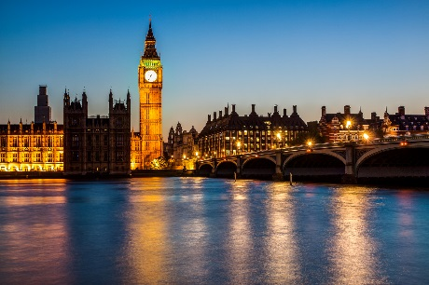
Background
March 2017
Organised by Sorrento Networks
‘Can Fibre Technology Revolutionise the UK Economy?’
Speakers: BT Group, CityFibre, Colt
Concluded with the overwhelming demand for the creation of a dedicated Fibre Connectivity Forum

Slide 5
Key Objectives
To give a loud, strong and collective voice to the UK Fibre optic industry at a grass roots level.
To provide relevant and honest information to influencers and policy makers.
To pursue a strategy leading to high quality, fast connectivity across the UK, regardless of the provider.

Slide 6
Key Objectives
To promote Fibre to the Premises as a crucially important utility.
To identify the problems and seek out solutions, focusing on the need and how we propose to meet it.
To support the government in introducing sound and innovative digital policies relevant to the present global economic conditions.

Slide 7
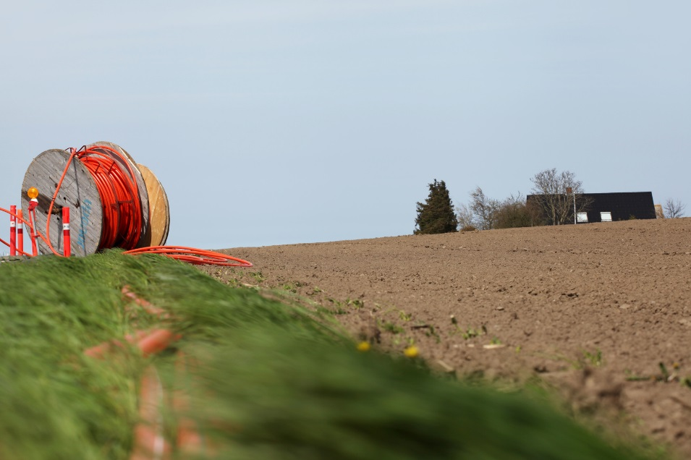
Forum Discussion Topics
Funding and Investment - Access to funding; new sources of capital; input to the Forum provided by one of the UK’s largest and longest established investment houses
Government Programmes (Local Full Fibre Networks and 5G) - Forum support from the Department for Digital, Culture, Media and Sport.

Slide 8
Forum Discussion Topics
Access to Fibre - Dark fibre access; BT; Openreach; ISP competition; Ofcom regulations; rural landscape challenges; etc.
Industry Skills Shortage - Need for qualification standardisation; lack of cohesive training programmes across providers; lack of suitable digital connectivity apprenticeships; etc.
Impact of Brexit - The government’s Post-Brexit Digital Strategy; roll-out of 5G, data security; etc.

Slide 9
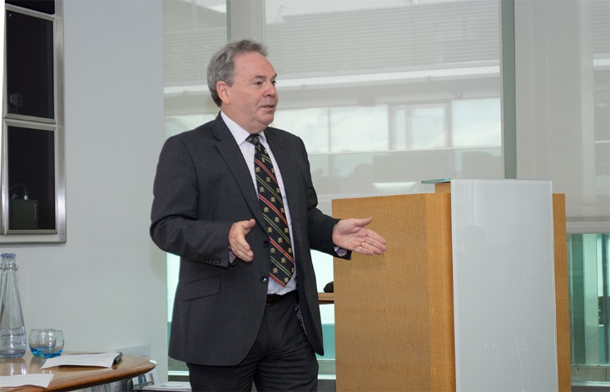
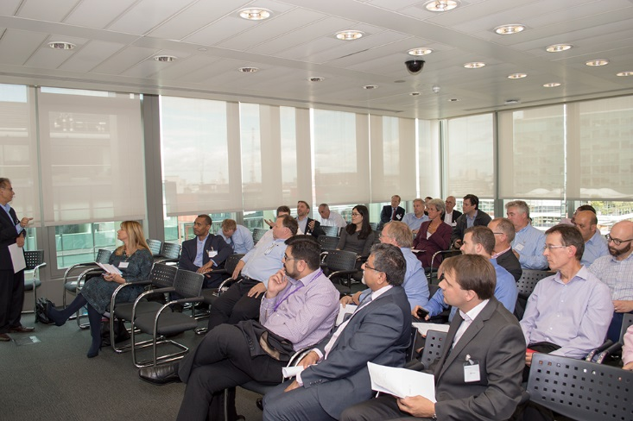
Inaugural Meeting of UKFCF
First quarterly meeting
September 2017
Held at Grant Thornton, London
Topics:
UK Fibre Optic Connectivity Landscape
Universal Services Obligation
Business Rates and Fibre Tax
Openreach Dark Fibre Access
The Digital Divide

Slide 10
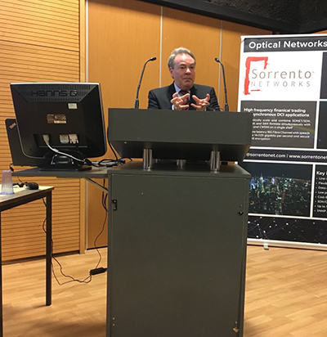
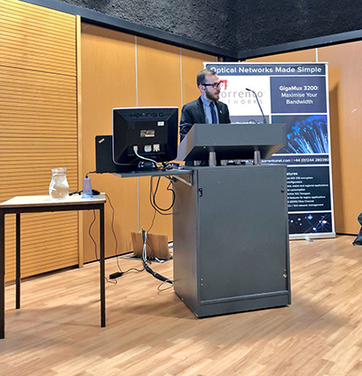
Deeside Business Forum Connectivity Conference
Supported DBF’s connectivity conference
February 2018
Held at Coleg Cambria, North Wales
Speakers: DCMS, ITS Technology Group, FibreSpeed, Pinacl, Aquacomms
Overwhelming support for fibre optic connectivity in North Wales

Slide 11
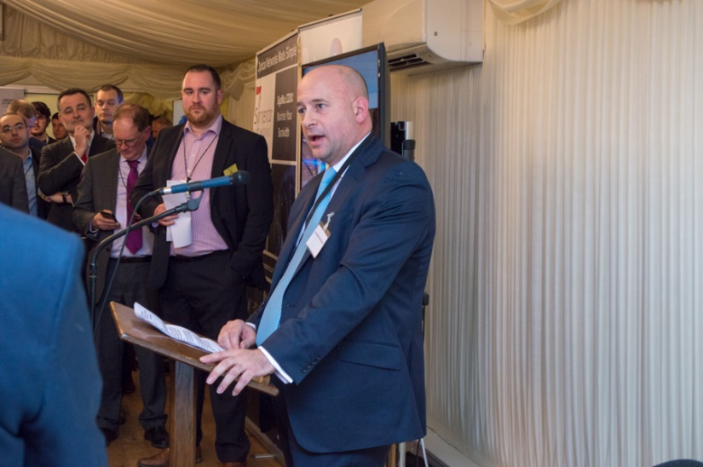
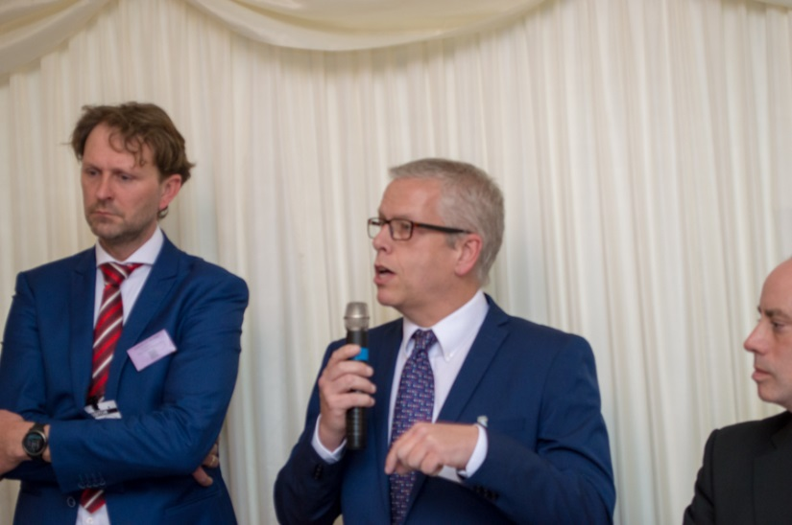
UKFCF at the Houses of Parliament
March 2018
Held at Terrace Pavilion, House of Commons
Panel: FTTH Council Europe, DCMS, Hyperoptic, Fiber Carrier Association, Ventura Next
Speakers: Lord Mendelsohn, Ian Lucas MP, Gavin Robinson MP
Over 200 delegates

Slide 12
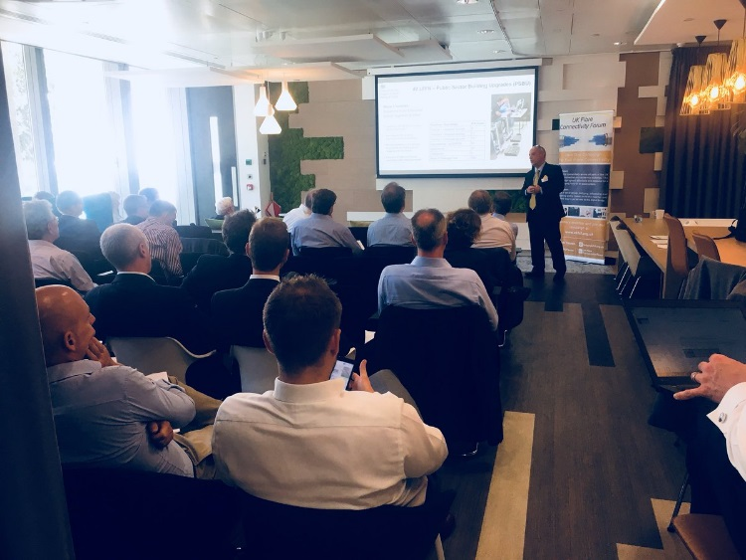
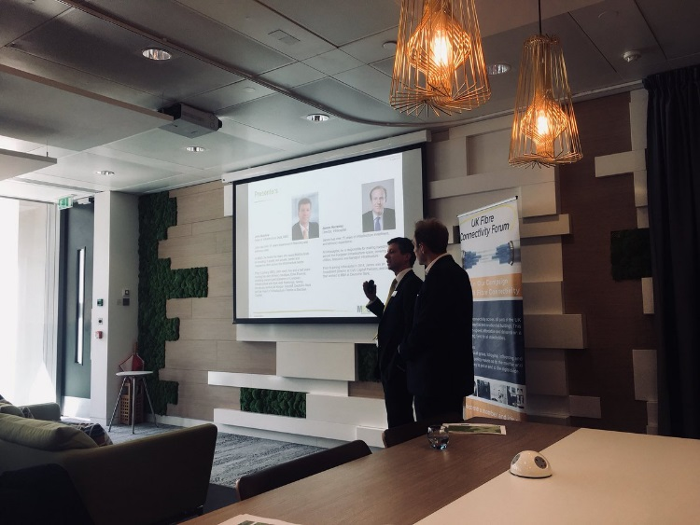
Quarterly Meetings
Non-funded non-profit voluntary organisation
Free membership, members contribute resources and expertise
Involvement of the best of the nation’s expertise and talent

Slide 13
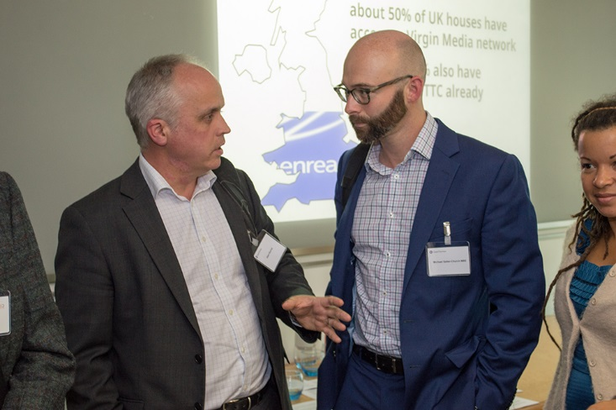
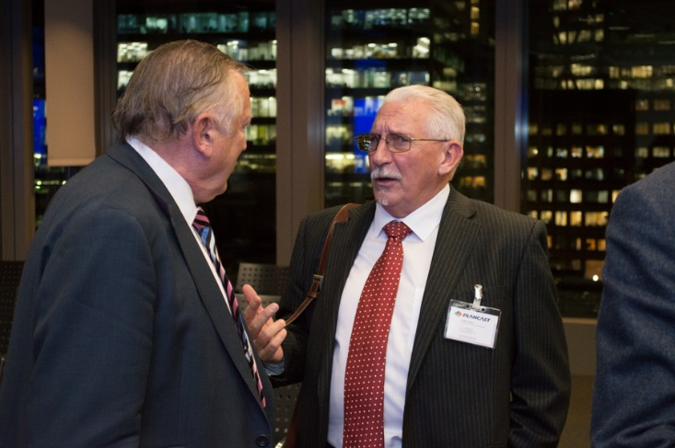
The Future
Continuation of the campaign; especially targeting the public sector with a view to educate on the impact an FTTP revolution would have on their lives, communities and workplaces; changing mindsets
Expand the think tank; welcome further key stakeholders; continue to provide a discussion platform and a voice for SMEs especially, etc.

Slide 14
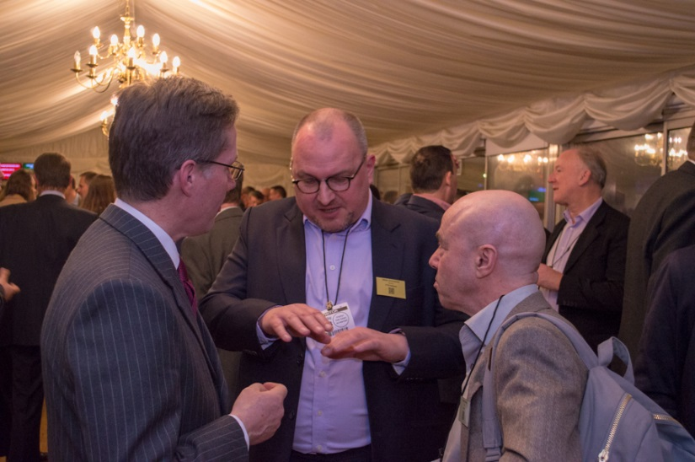
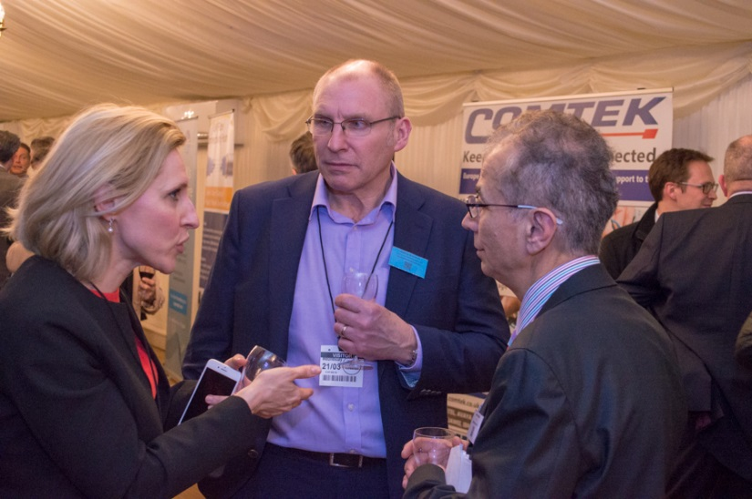
The Future
Strengthening our organisation and our voice through partnership with key organisations - continued support from Grant Thornton UK LLP, one of the world's largest professional services networks of independent accounting and consulting member firms, continued assistance from the Confederation of British Industry (CBI)
Continued engagement with European counterparts - such as the FTTH Council Europe, learning best practice, information sharing etc.

Slide 15
Our Next Meeting
October 1st 2018 2pm – 5:30pm
Grant Thornton, London
Topics:
DCMS - Local Full Fibre Networks
5G Testbeds and Trials Programme
Future Telecoms Infrastructure
Barrier Busting
NI Broadband Industry Report
Register:
https://www.eventbrite.co.uk/e/uk-fibre-connectivity-forum-quarterly-meeting-tickets-47414515091

Slide 16
Useful Links
Forum Inauguration - September 13th 2017
http://bit.ly/2N87G3I
November 27th 2017 - Quarterly Meeting
http://bit.ly/2MBwv8O
Parliamentary Debating Reception - March 21st 2018
http://bit.ly/2wtSLHT
Fibre Systems Magazine - Parliamentary Reception Review
http://bit.ly/2ws5gmX
June 18th 2018 Meeting - Presentations
http://bit.ly/2wpVd1I
LinkedIn Discussion Group - UK Fibre Connectivity Forum
http://bit.ly/2omVQF9

Slide 17
01244 283069
Thank You
info@ukfcf.org.uk
@UKFCForum
UK Fibre Connectivity Forum
Notes:
To change the image on this slide, select the picture and delete it. Then click the Pictures icon in the placeholder to insert your own image.

