Slide 1
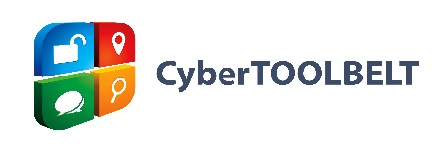
Beyond Whois:
Connecting the Digital Dots
^{Michael Lewis}
Chief Technology Officer, iThreat Cyber Group
Version 2.0, updated October 2018
© 2018, iThreat Cyber Group, Inc. All rights reserved.
Notes:
1

Slide 2
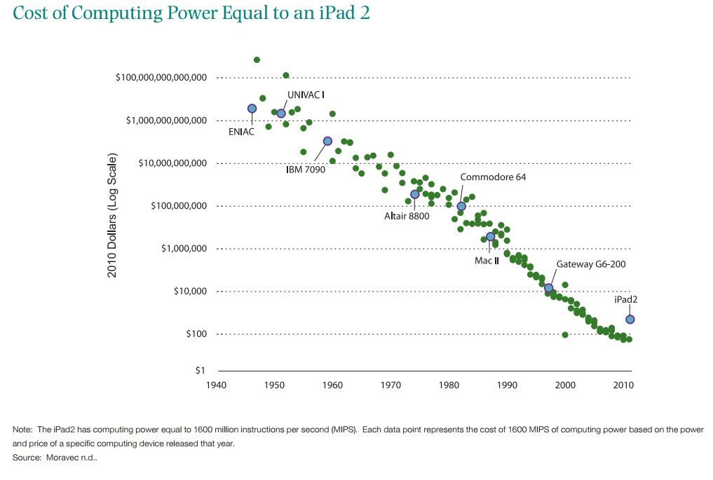
Notes:
See the note at the bottom of the graphic: “The iPad2 has computing power equal to 1600 million instructions per second (MIPS). Each data point represents the cost of 1600 MIPS of computing power based on the power and price of a specific computing device released that year.”
In other words—in 1982, the year the Commodore 64 was released, the computing power in an iPad2 would have cost $100,000,000. A one hundred million dollar iPad.
This graphic was created in 2011—the cost of computing power has decreased even more in the intervening time.
The converse of this declining cost: how much time and effort would it have taken in 1982 to do the same tasks/gather the same information that you do today?
Source
http://www.hamiltonproject.org/charts/cost_of_computing_power_equal_to_an_ipad2
2

Slide 3
D
N
S
DNS DATA
omain
DOES NOT
ame
LIE
ystem
Notes:
You cannot fake DNS data. Period. You can use some tricks to obfuscate it, you can manipulate it, but you cannot fake it. Whois records can be faked. Email addresses can be fake. Telephone numbers can be faked. DNS data cannot be. You cannot fake pointing to your website to a server. You cannot have a fake email server address. When DNS data points you somewhere, that is authentic. An individual sat down and created/updated the records on a domain and made that DNS point somewhere. Those leads are far more authentic than a made up email address or made up phone number on a whois record.
3

Slide 4
Omnipresent and Non-Optional
Every connection that uses a domain name must interact with the DNS system, no matter what.
These connections leave trails and there is only so much you can do to obfuscate/hide them.
Increasing number of services offer DNS based solutions to challenges.
Similarly, increasing number of bad guys using DNS for abuse.
Notes:
4

Slide 5
How do the bad guys make investigators lives more difficult?
Some Examples:
They hide their IP addresses behind reverse proxies
They use bogus Whois information
They use hijacked machines
Notes:
5

Slide 6
Other issues?
GDPR (and of course: California)
Notes:
6

Slide 7
Domain WHOIS
Subdomains
IP WHOIS
Domain
IP address
Geolocation
DNS
Emails
What is the best way to determine this information?
Notes:
“a la carte” process for finding the same information
Evidence of searches if done without a proxy or tool
Would take more time
All steps are not always available
7

Slide 8
Free Tools & Lookups
Domain Whois Info
(CentralOps.net,
Whoxy.com)
IP Address Info (IPLocation.net, CentralOps.net)
Contact Info
(Pipl.com, Spokeo.com)
Unknown 3rd parties possibly collecting information.
Per-day query limitation.
Strictly returns ownership, some historical info.
Returns limited amounts of information that can vary wildly.
Does not necessarily show additional contextual information.
What are these platforms logging?
Connections sometimes made abstractly, unreliably.
Free is not always better
Notes:
8

Slide 9
A Little History
iThreat Cyber Group began as an online investigator in 1999
We developed tools and techniques to streamline online investigations
We started by using the aforementioned tools
We began creating better tools that eventually morphed into CyberTOOLBELT which is available to the public by subscription

Slide 10
Investigative Work Flow
One of the most overlooked/under-appreciated aspects of online investigations is the work flow. How do you pivot, are you doing a lot of copy and pasting to spreadsheets, etc. The tools are important but a ton of time is saved managing work flow.

Slide 11
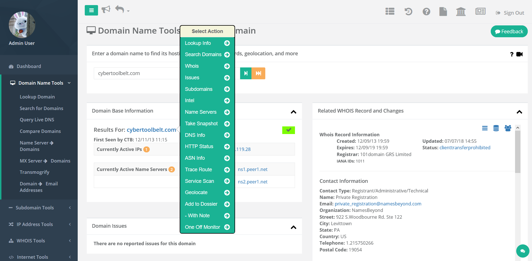
Investigative Work Flow
Just a quick example:

Slide 12
Some Unique Capabilities
We can perform Traceroutes from up to 9 locations around the world at the same time
You can use multiple DNS servers at the same time to run live queries (think dig queries) at the same time
We get data from closed sources not available to other tools
We compile abuse information from many open and closed sources
Notes:
12

Slide 13
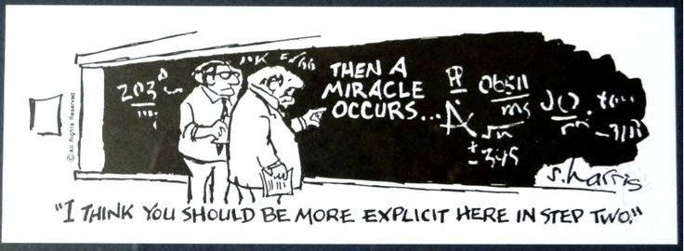
A note before we get started
The following describes a two-day investigation. There will be times where I will be referring to step 2 as shown above.

Slide 14
CASE STUDY: MISLEADING DRUG REHAB FACILITY
A REPORTER FOR A MAJOR NEWSPAPER IN NEW YORK WAS LOOKING INTO DRUG REHAB FRAUD
HE ONLY HAD A SINGLE DOMAIN WHERE A VICTIM’S STORY ORIGINATED

Slide 15
What’s the Issue? What’s the Fraud?
The victim complained that a particular firm referred them to a clinic that was ill-equipped to provide rehabilitation services.
There was a suspicion of kickbacks and referral fees based on the reporter’s initial investigation. Kickbacks and referral fees for this type of business are illegal in the US.
Misleading descriptions of capabilities, services and facilities were provided to victims.

Slide 16
rightpathdrugrehab.com
This is the domain name given to us by the reporter. That’s all he had. He asked our analyst to see if he could find out anything about the company and any ties it had with other organizations, if any, and what we can find out about those organizations.
Notes:
The website was RightPathDrugRehab.com, which claimed to be a luxury rehab facility in Wisconsin. The problem is that all the reviews were posted about the same time, the location belongs to a bank, and there is no lead on who the company actually is using the website.
16

Slide 17
So where do we begin?
Notes:
17

Slide 18
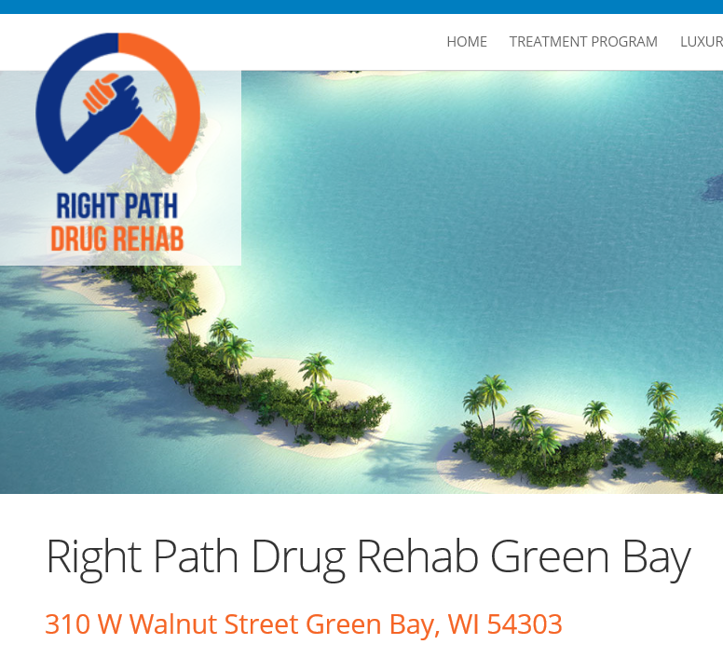
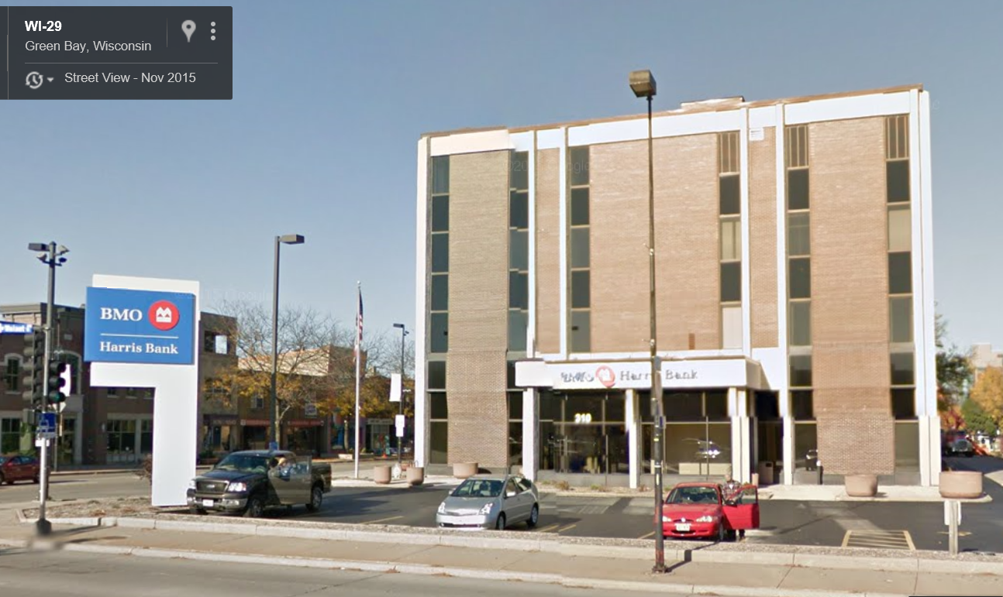
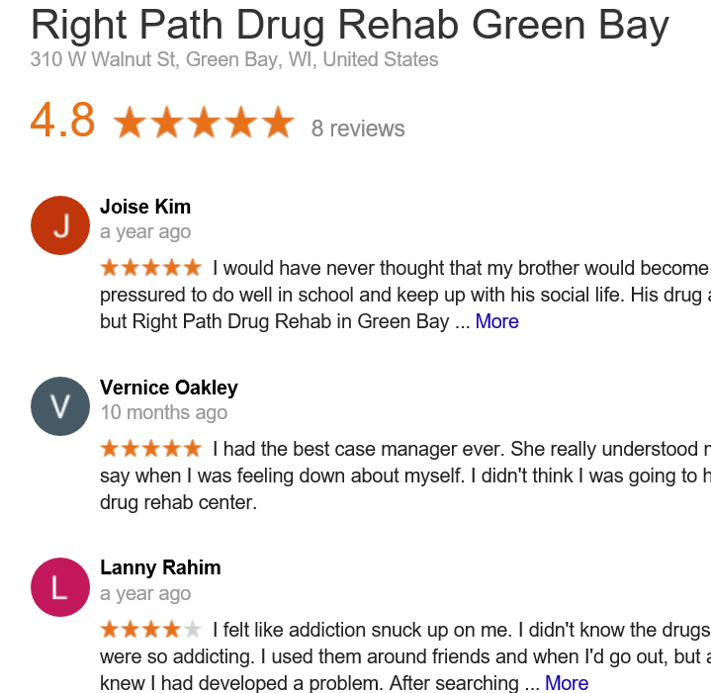
First Step: a simple Google search
Notes:
The website was RightPathDrugRehab.com, which claimed to be a luxury rehab facility in Wisconsin. The problem is that all the reviews were posted about the same time, the location belongs to a bank, and there is no lead on who the company actually is using the website.
18

Slide 19
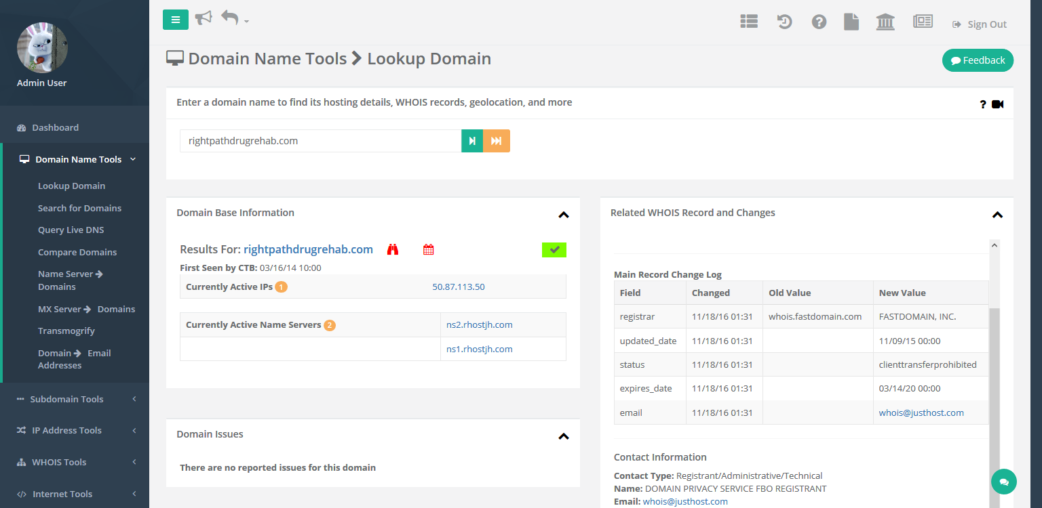
Next Step: Investigate DNS, etc.
Notes:
19

Slide 20
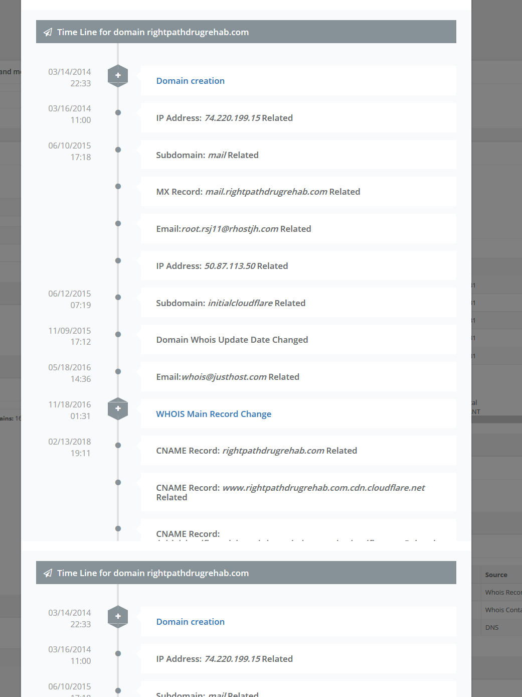
Notes:
20

Slide 21
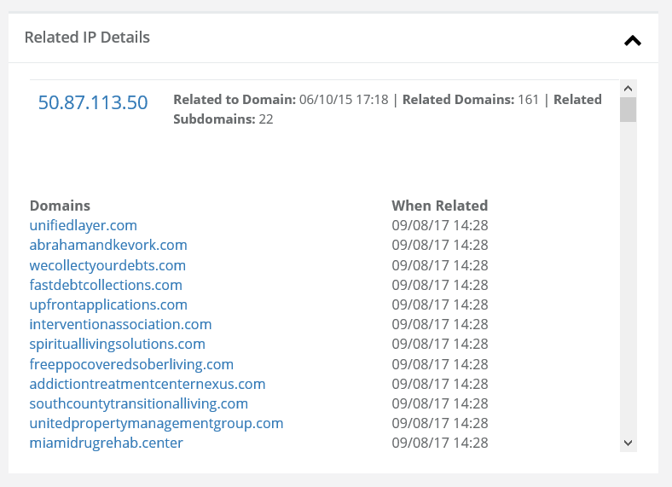
What Next?
Notes:
21

Slide 22
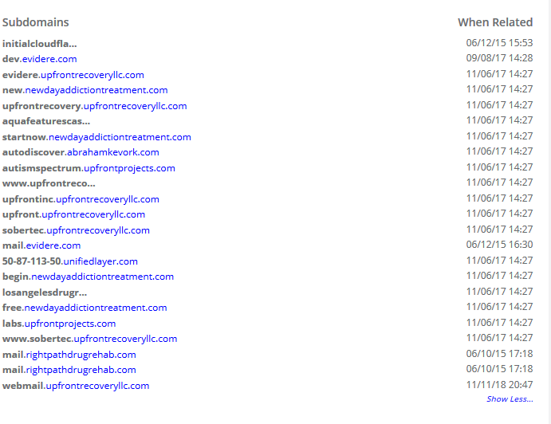
Subdomains
Notes:
22

Slide 23
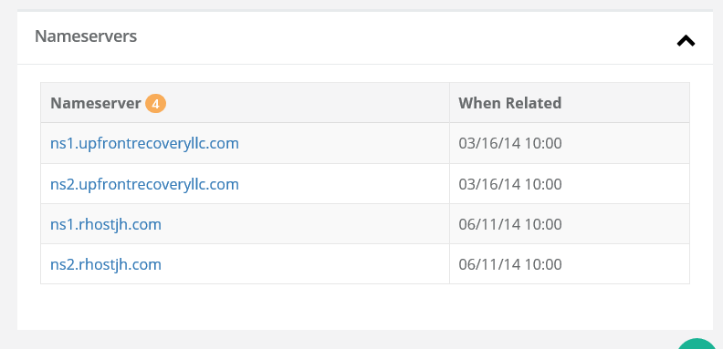
What else is interesting?
Hmm...
Notes:
23

Slide 24
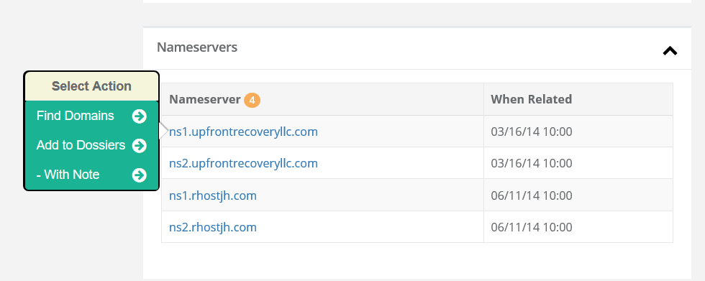
Let’s Investigate Further
As mentioned earlier, we found the vanity/personal name server to be interesting as a possible source of additional information.
Notes:
24

Slide 25
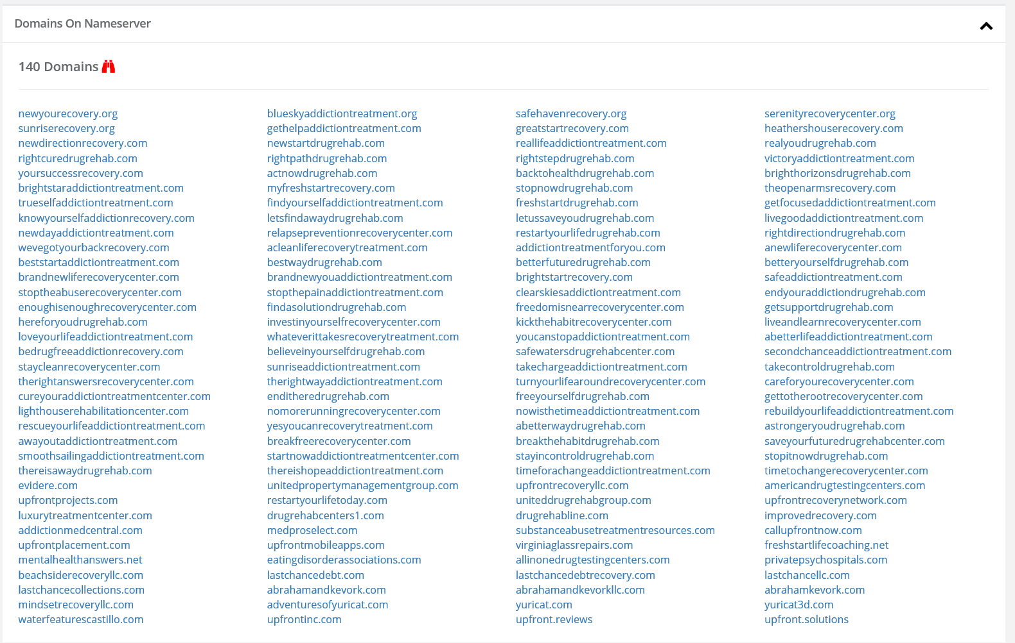
Interesting Domains
Notes:
25

Slide 26
More Hints
It’s somewhat unusual for a small company to run their own name servers. One of the things that caught our eye was they quickly stopped doing so after about three months
The domain names sorted into several interesting buckets: rehab/wellness related, “upfront”, “kevork” and “yuricat” and “pay day” loan related domains.
So we ran a bulk whois lookup using CTB and we noticed a recurring email in some of the more interesting ones: adamreg@live.com
We then did a Whois search on CTB to find all the domains we knew about in our platform related to Adam.
Notes:
26

Slide 27
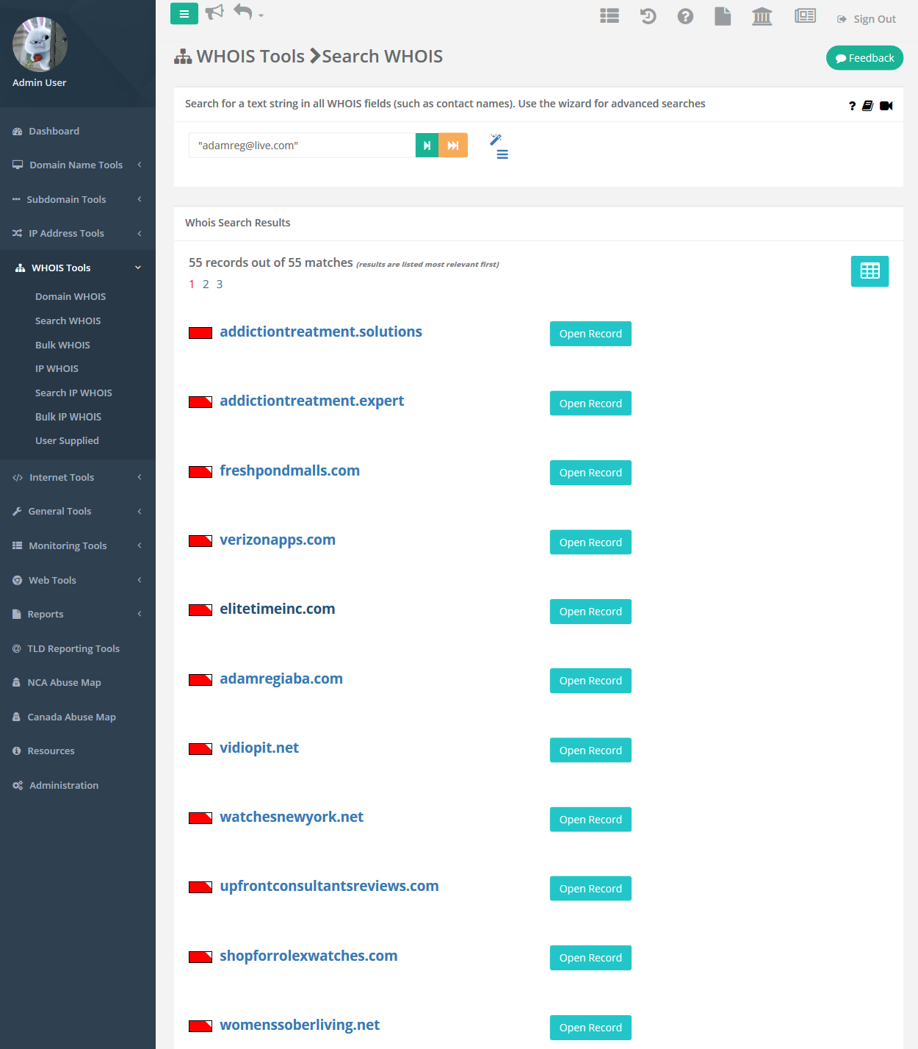
Bingo
Notes:
We’ve got his last name apparently.

Slide 28
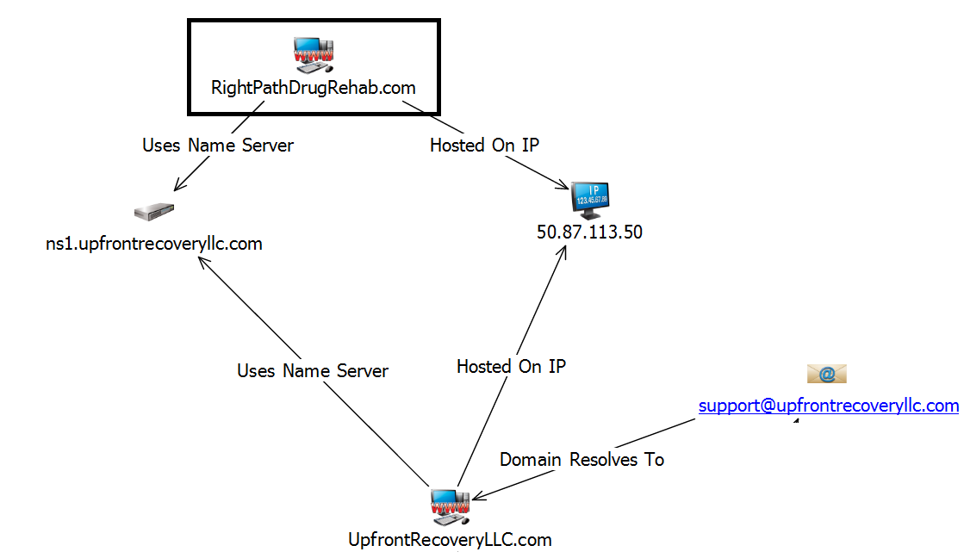
Beginning of the Network
Notes:
In the case of this domain, there were two very interesting leads. First, we can see that they’re using a unique looking name server rather than something provided by the hosting provider. Second, there is an IP address that hosts over 100 other rehab looking domains and hosts some businesses that contain “LLC” in it.
28

Slide 29
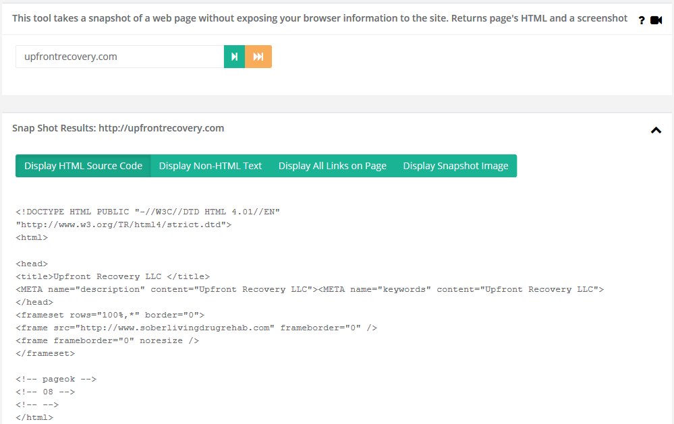
Using another CyberTOOLBELT tool, we decided to look at the upfrontrecovery.com web site.
Interesting….
Notes:
The HTML is merely a container for an iframe whose content is the URL soberlvingdrugrehab.com

Slide 30
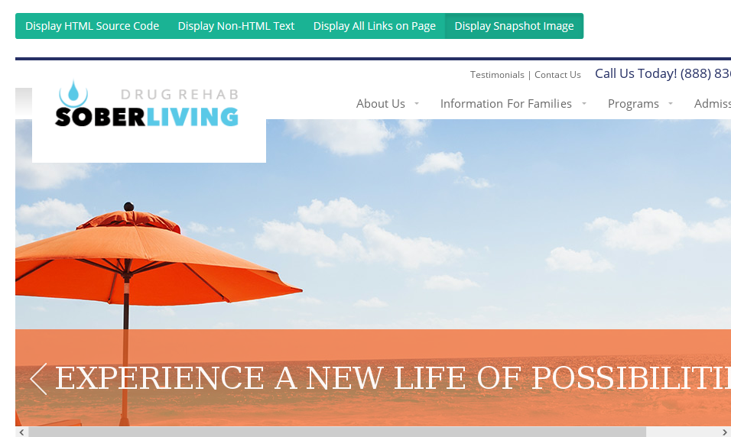
A number of clues have led us to here...This is NOT Wisconsin!
A miracle moment is now going to occur: Through some DNS, Whois and other lookups we determined that soberdrugrehab.com is related to sobertec.com and did a lookup of that domain using CyberTOOLBELT.

Slide 31
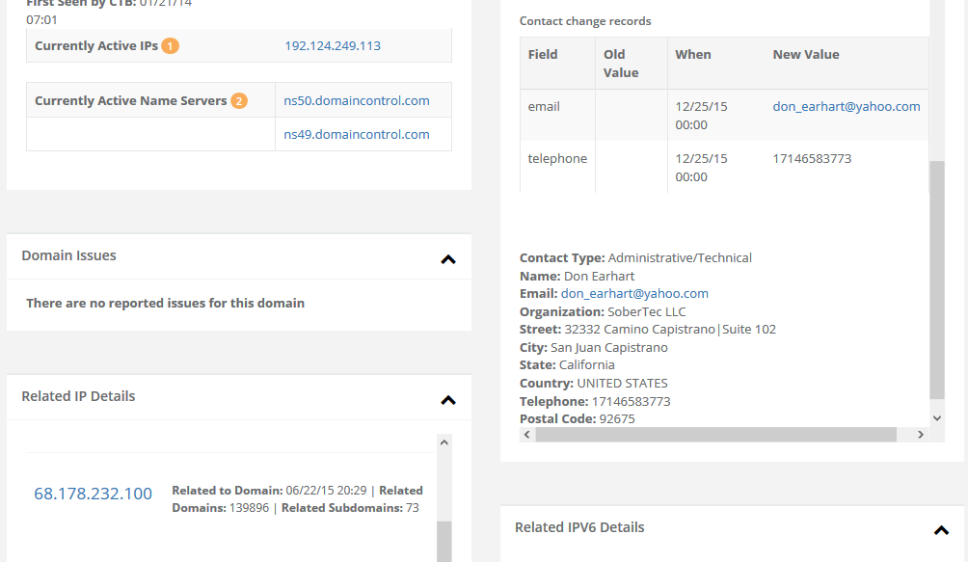
Whois history has uncovered a name, an address and a telephone number related to sobertec.com. A call to the listed number was forwarded to Upfront Recovery

Slide 32
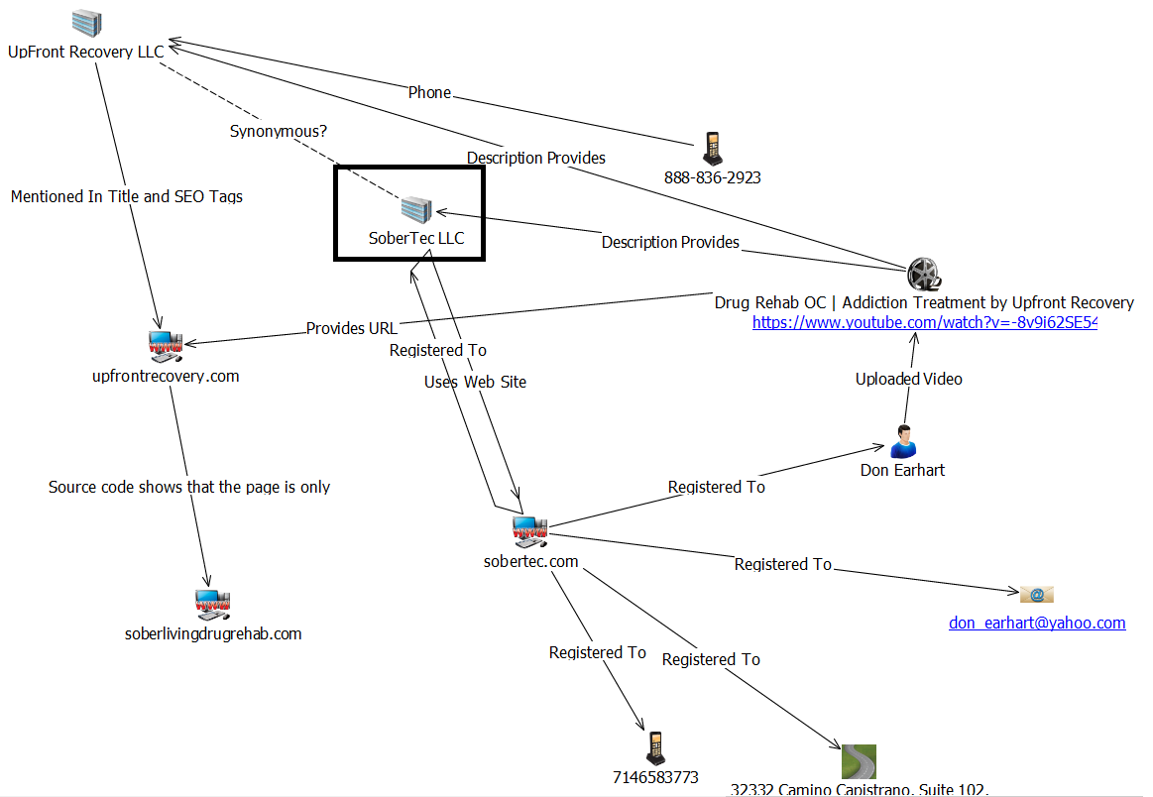
SoberTec
Notes:
The journalist we worked with had run into a dead end. Every time he called a different number he found, a call center answered the phone with “Sobertec” but gave no other information. With a little bit of Google searching and some record lookups, we found another name. Unfortunately, this name was a dead end and there wasn’t any solid information on the business records.
32

Slide 33
The Next Sub-Network
Using the same techniques we can then springboard to another sub-network revolving around Upfront Recovery.
We find domains that contain the same information. For example: Phone numbers, addresses, email addresses, etc.
We also find additional information that leads to further connections regarding Upfront Recovery, LLC.
Notes:
33

Slide 34
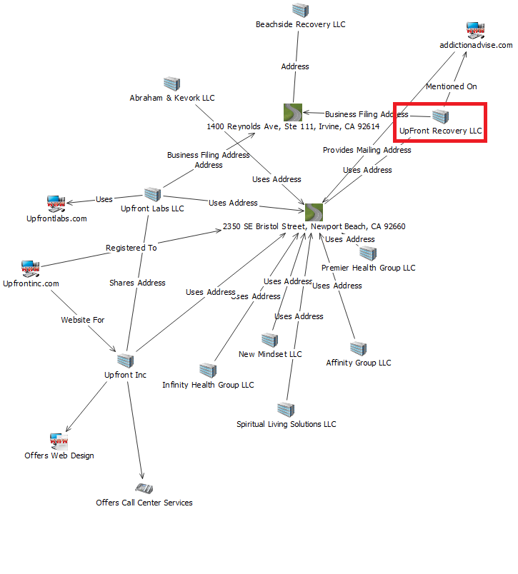
Upfront Recovery LLC
Notes:
Upfront Recovery LLC is indeed a business. With this, we found business records. Business records are just like whois records (name, address, contact information, etc). From this one business, we found several other businesses sharing addresses and, subsequently, domains that went by the same name that also had shared contact information. This portion of the chart showed a business that owned rehab facilities, drug testing centers, a call center, and a law firm. A true one-stop-shop for rehabilitation.
34

Slide 35
The Final Sub-Network
Starting with Upfront Consultants we build out another network using the same techniques as we used in building the prior sub-networks.
Our friend Adam is linked to many of the entities.
Note that as an investigator you sometimes have to make telephone calls or use the Google machine to discover business relationships.
Notes:
35

Slide 36
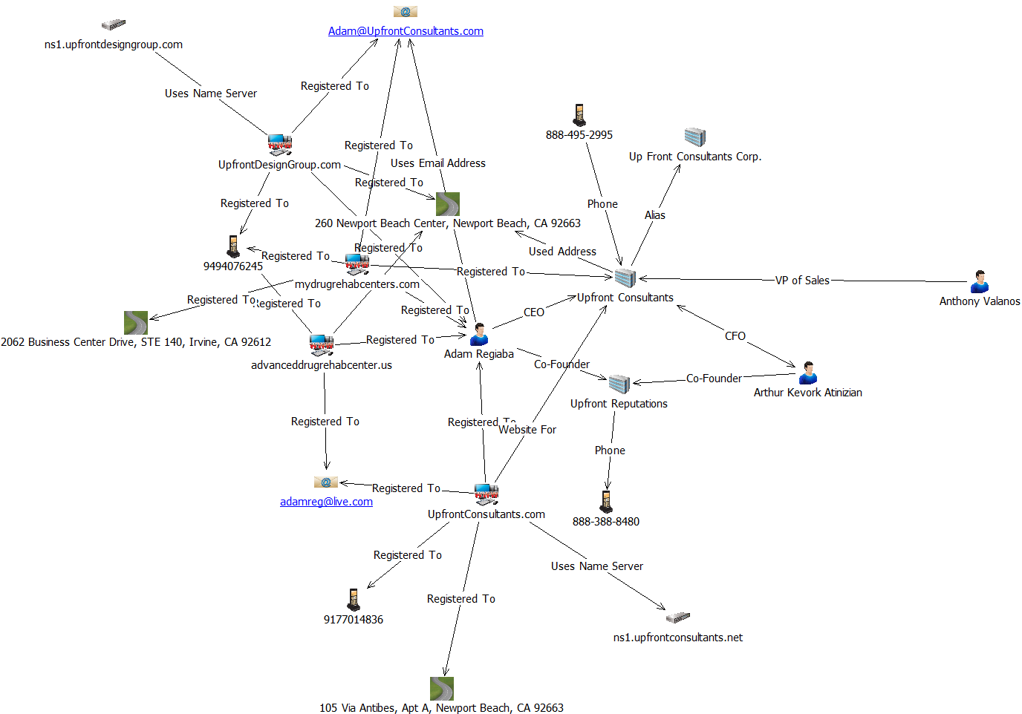
Upfront Consultants Group
Notes:
We found another private name server that connected to one of the company sites. A whois lookup for it gave more names and businesses, exposing another side of the business that did websites and search engine optimization. These guys were their own lead generation service for their own addiction rehabilitation center. The worst part was that they did not disclose any of this anywhere on any sites or in any paperwork.
36

Slide 37
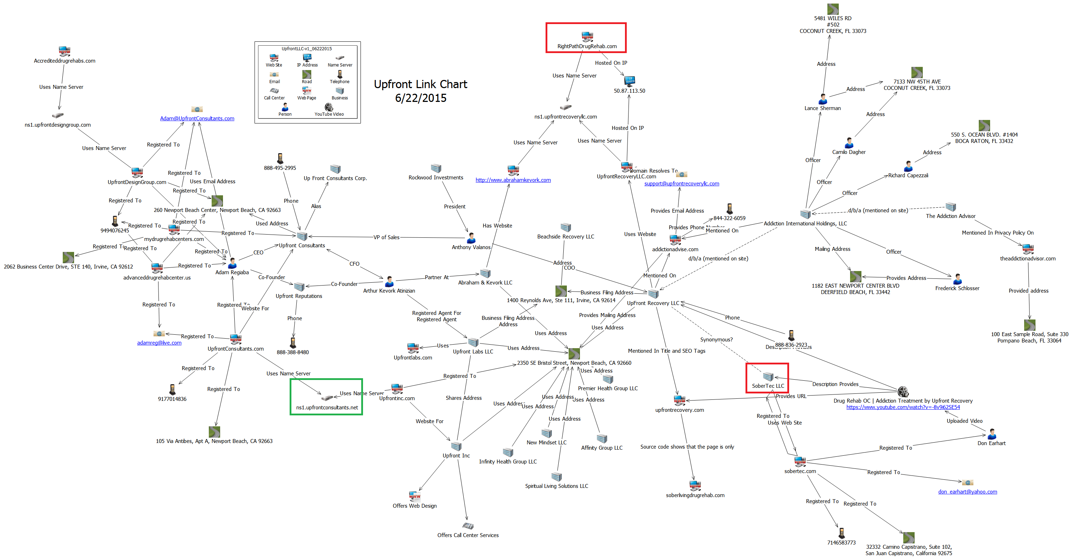
The Not-Upfront Group
Tying it all together gives us the inter-related sub-networks
Notes:
This is a picture of the whole chart, drawn using whois data, business records, and information from the websites visited.
37

Slide 38
Summary
To summarize:
We were able to identify a number of individuals, companies and the linkages between them.
We supplemented our CyberTOOLBELT information with some public records information, Google searches and reaching out to the companies themselves.
The reporter was able to determine that many of the companies involved were giving referral fees that led back to the Upfront companies. He did this by interviewing the individuals we had identified.
After the interview process a number of the web sites went dark and the principals seemed to scatter.
Notes:
The upshot was that the editor changed his mind on running a rehab fraud story. There were some criminal referrals.
38

Slide 39
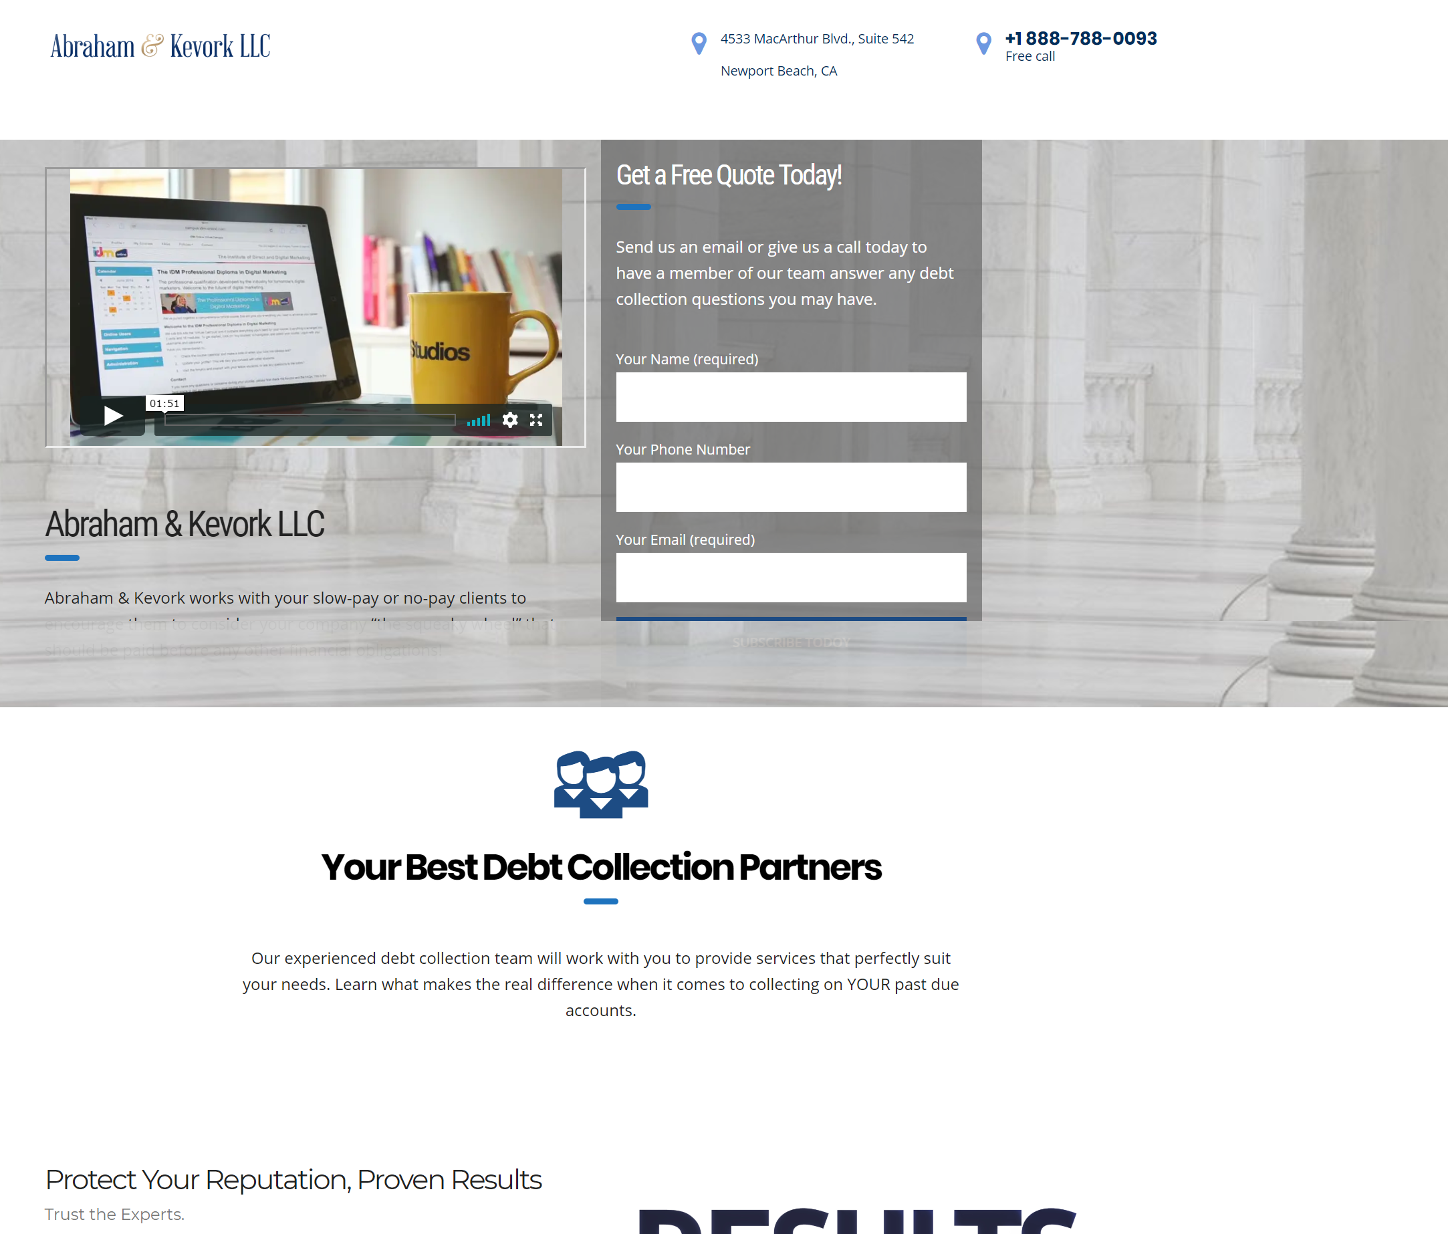
Abraham & Kevork
They are in the debt collection business using the company:
http://medicaldebtcollectioncompany.com
Notes:
39

Slide 40
Michael Lewis
iThreat Cyber Group
mal@icginc.com mike.lewis@cybertoolbelt.com
+1 (609) 806-4963
Questions?
Notes:
40

