Slide 1
IXPDB & Euro-IX Tools
UKNOF 42 - London
January 15th 2019

Slide 2
Association of IXPs
73 affiliated members
54 IXPs in the Euro-IX region, 49 countries, operating over 100 peering LANs
19 IXPs from the rest of the world
Newest Member:
DOrtmund Internet Exchange
Asteroid International

Slide 3
Euro-IX Patrons - 9

Slide 4
Euro-IX Activites
2 Fora a year
33rd in Venice hosted by NAMEX, TOP-IX and VSIX (November 2018)
34th in Toulouse hosted by TOUIX and France-IX
Website & Database
Fellowship & Mentor-IX Programs
Reports – Benchmarking, traffic, hardware, route servers.
Newsletters - https://www.euro-ix.net/en/communications/newsletters/
Route Server Large BGP communities list: https://www.euro-ix.net/en/forixps/large-bgp-communities/
Social media
Twitter @euroix
Facebook fb.me/maineuroix
Youtube youtube.com/channel/UCFyucVRAAMzxyJIsxnGwsjw

Slide 5
IXPDB & Euro-IX Tools

Slide 6
Some History
The original code was written around 15 years ago…
Membership feedback from consultations and the Membership Survey clearly showed IXPs wanted a place to publish an accurate and complete data set.
In 2016 we considered the limitations of the underlying database and structure.
We wanted to move forward with automation and work started on the IXP Member List JSON Schema.
It became very clear we needed to start from scratch if we wanted an extendable schema.
In 2017 we contracted the website and IXP Database work to CZ.NIC.

Slide 7
What we’ve been working on..
You can access the IXPDB via https://ixpdb.euro-ix.net/

Slide 8
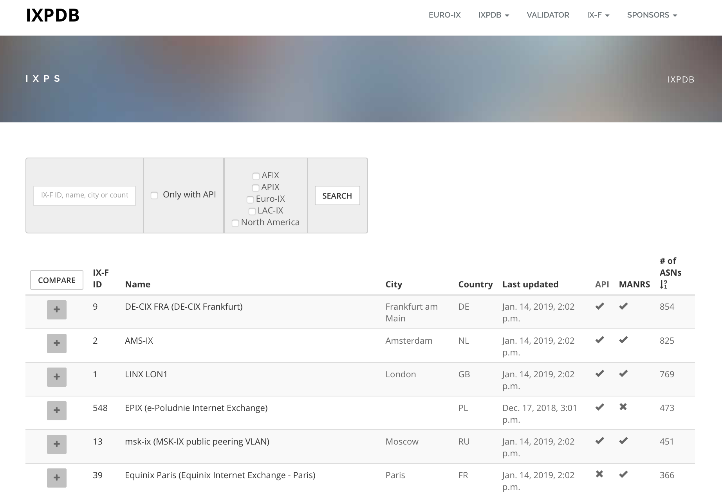
What we’ve been working on..
https://ixpdb.euro-ix.net/en/ixpdb/ixps/

Slide 9
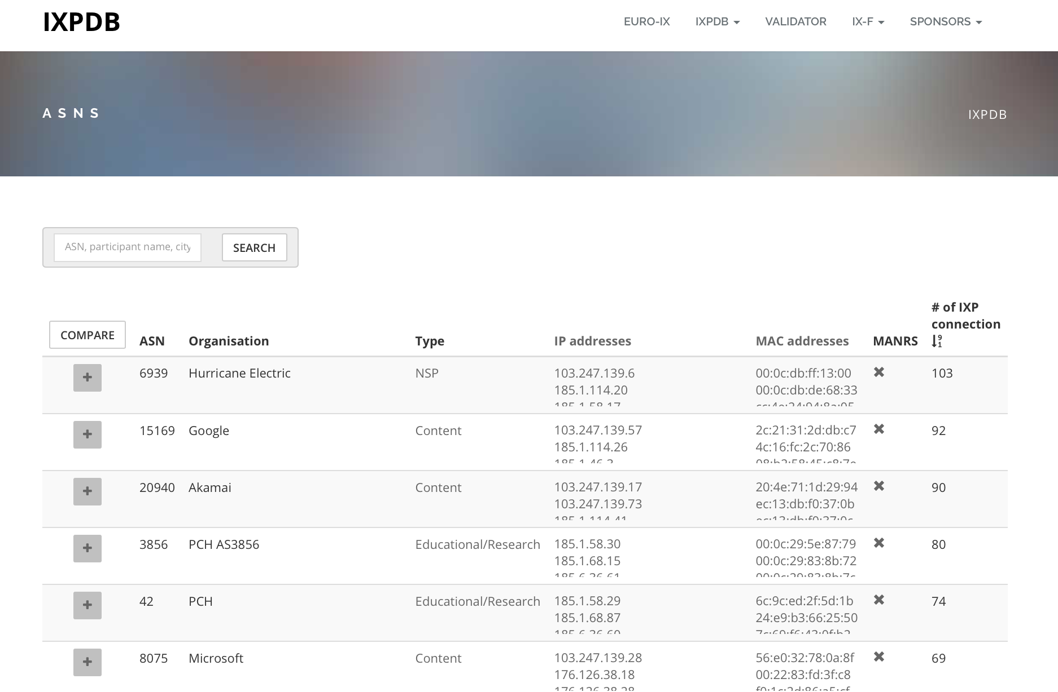
What we’ve been working on..
https://ixpdb.euro-ix.net/en/ixpdb/asns/

Slide 10
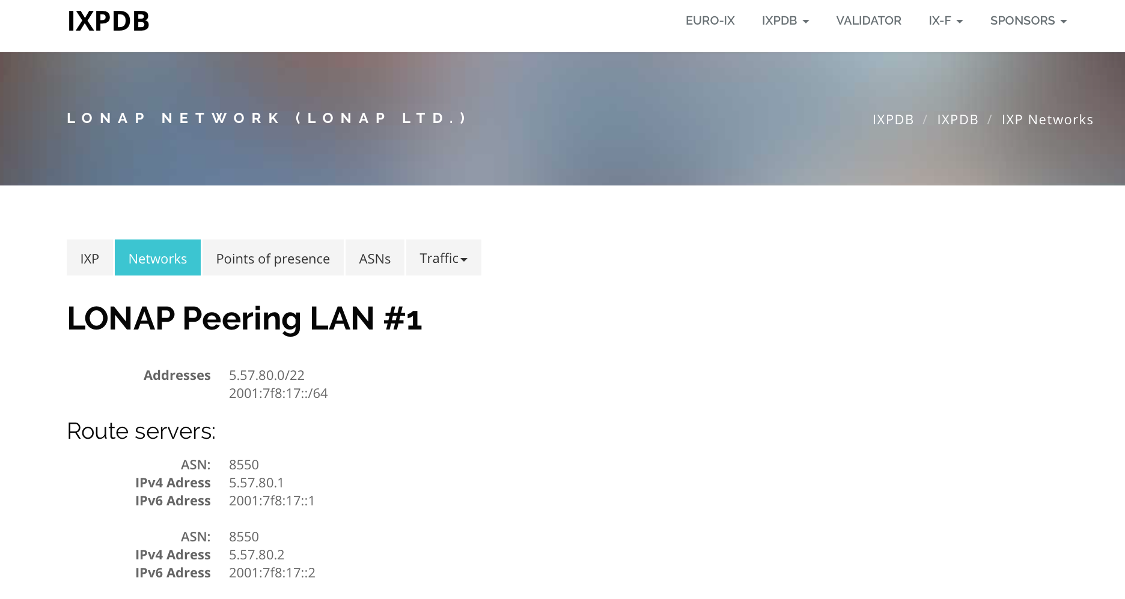
What we’ve been working on..
The Network tab:

Slide 11
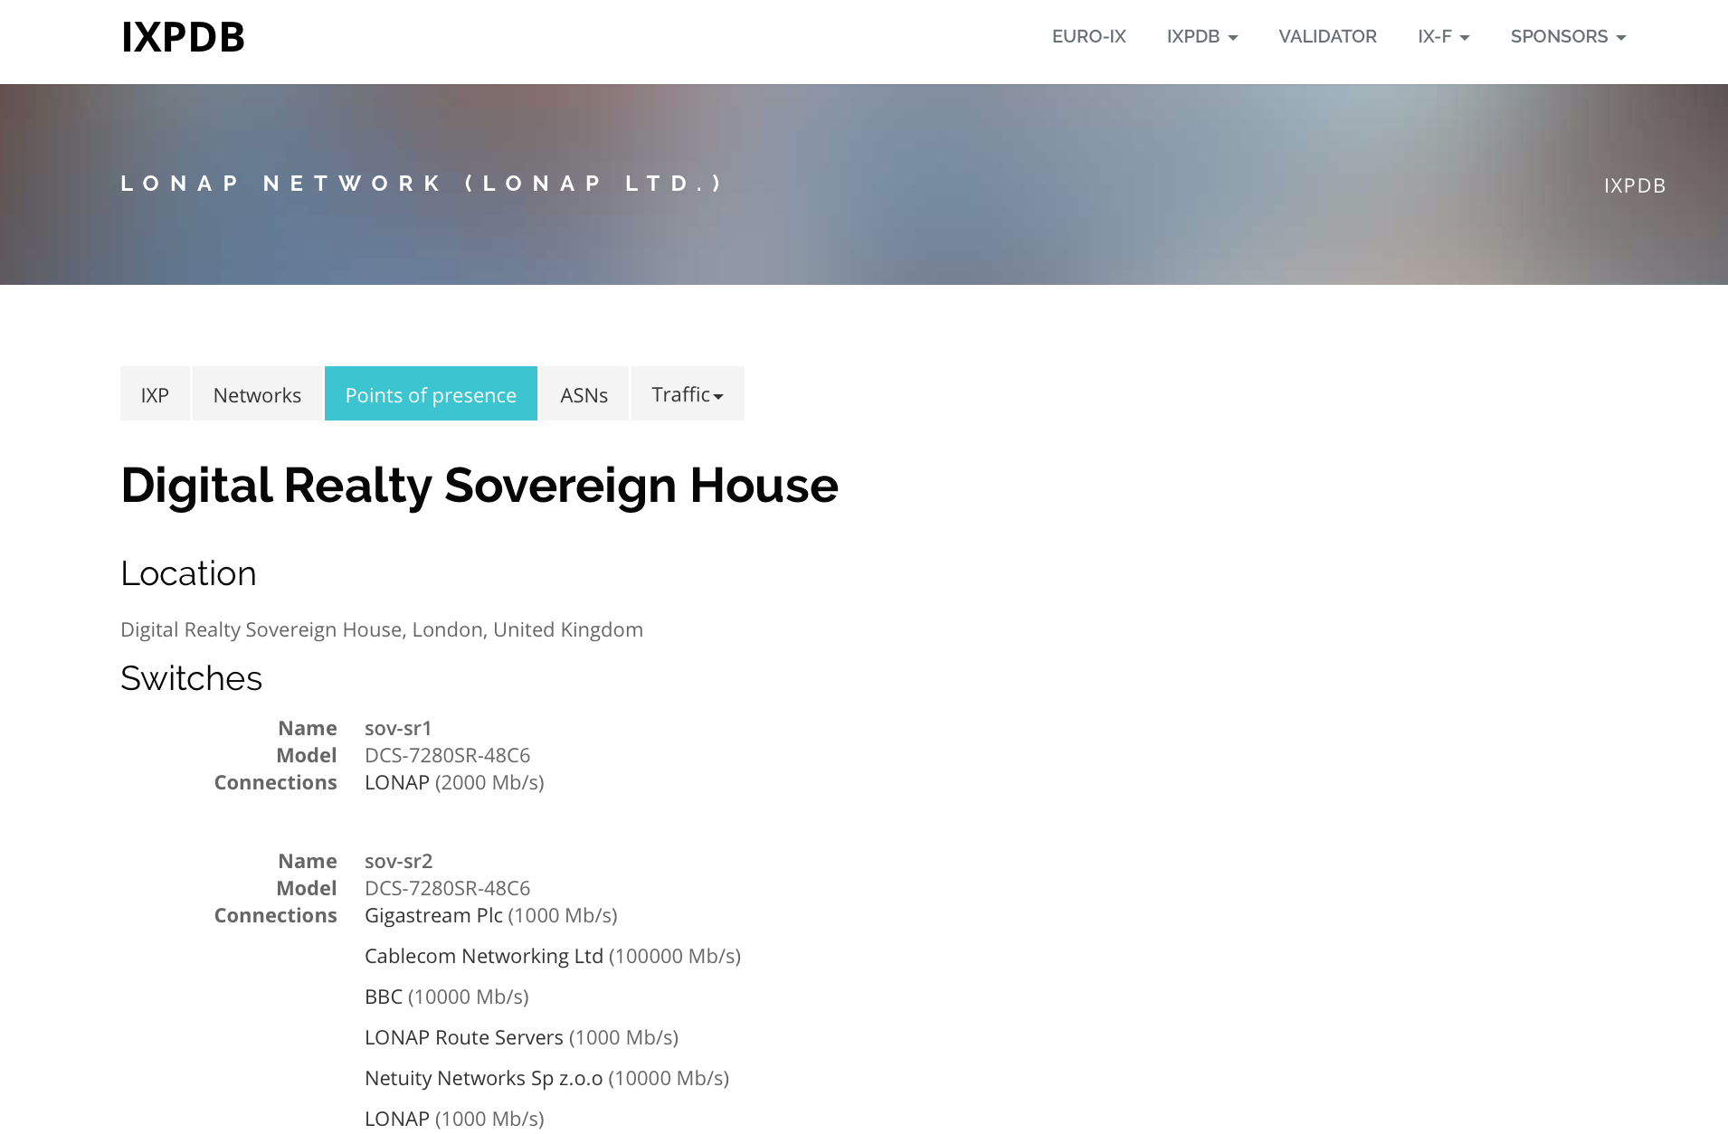
What we’ve been working on..
The Points of Presence tab:

Slide 12
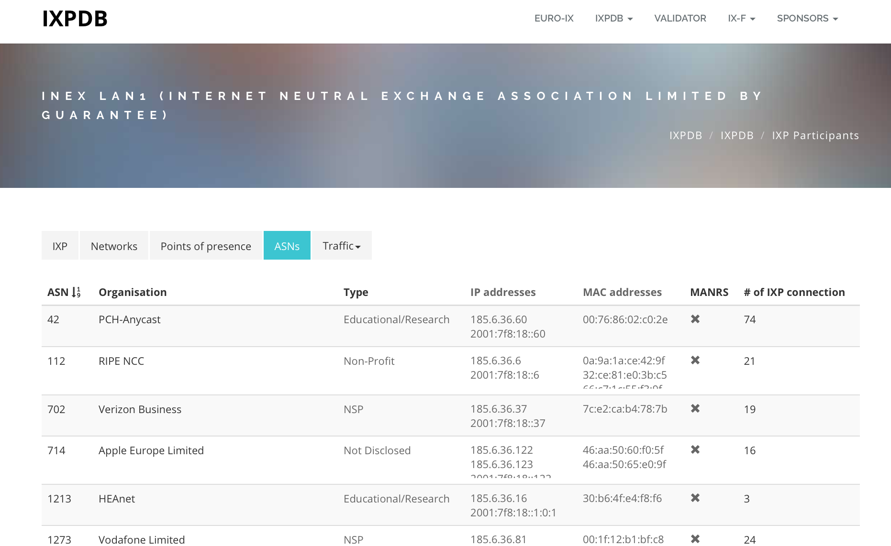
What we’ve been working on..
The ASN tab:

Slide 13
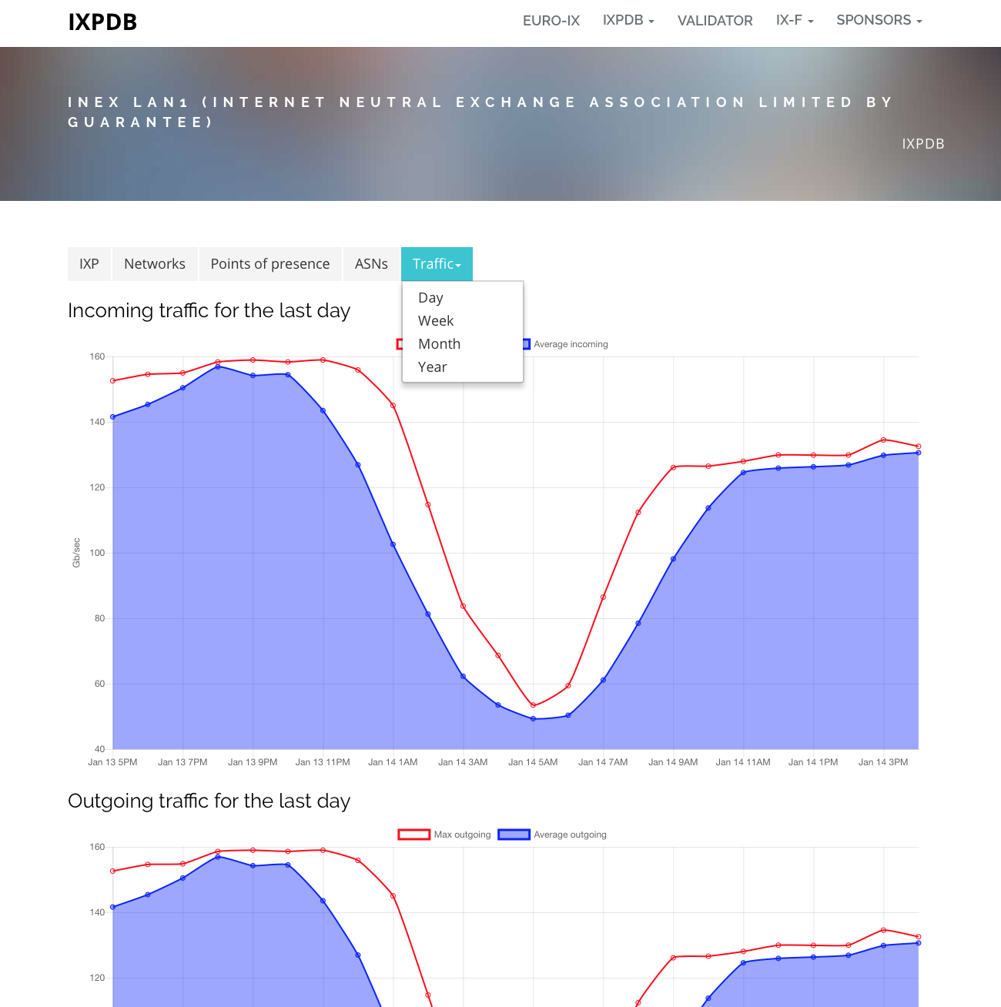
What we’ve been working on..
The Traffic tab:

Slide 14
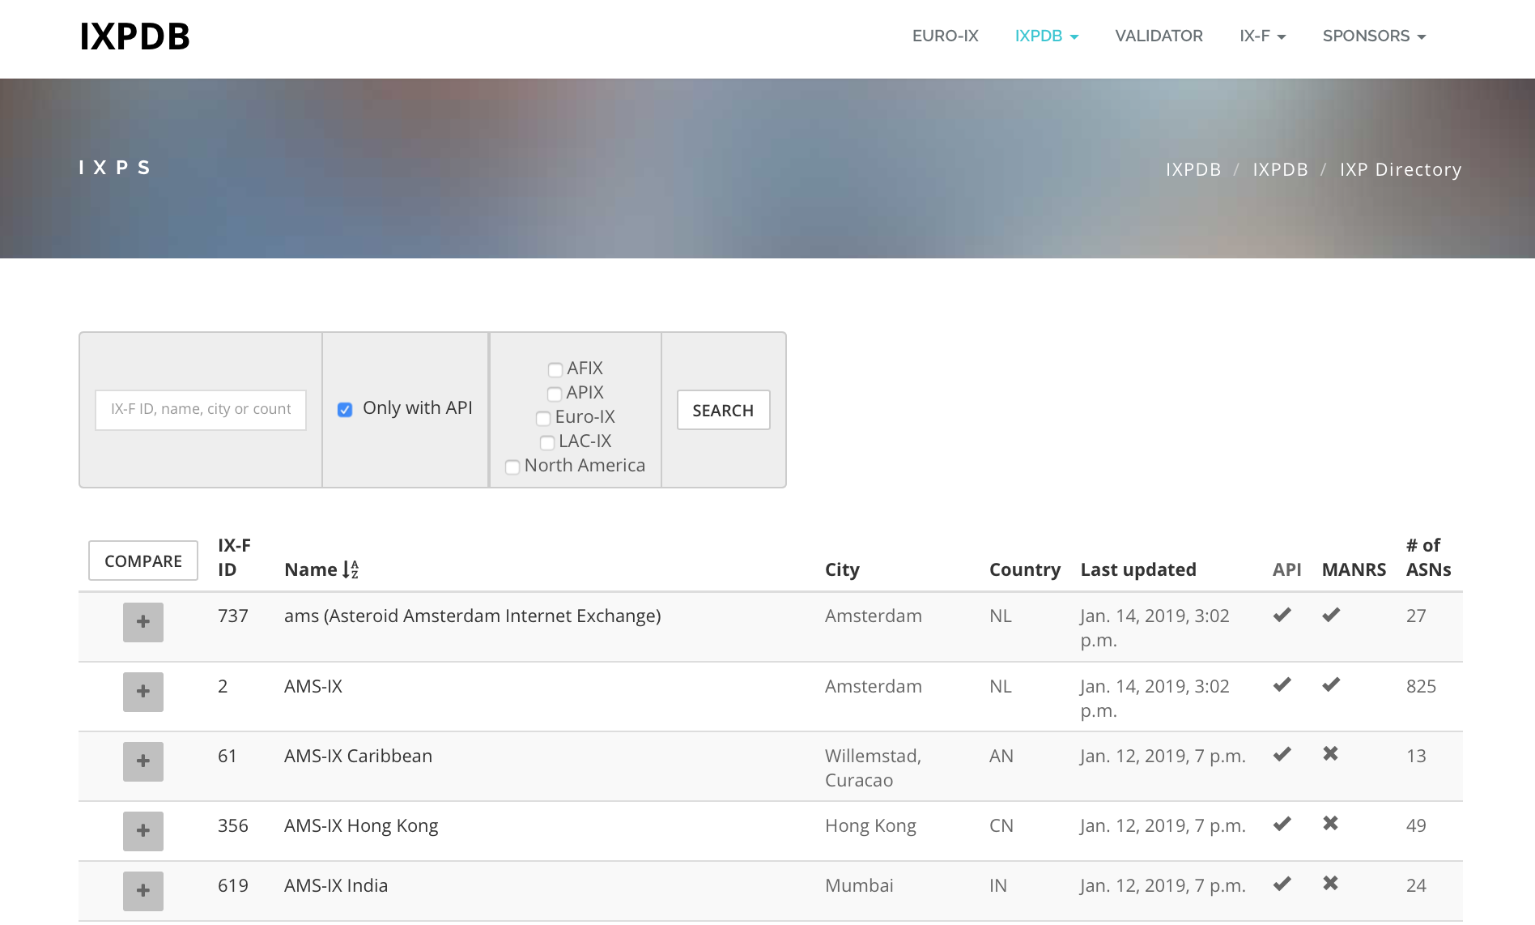
What we’ve been working on..
The new compare function for IXPs:

Slide 15
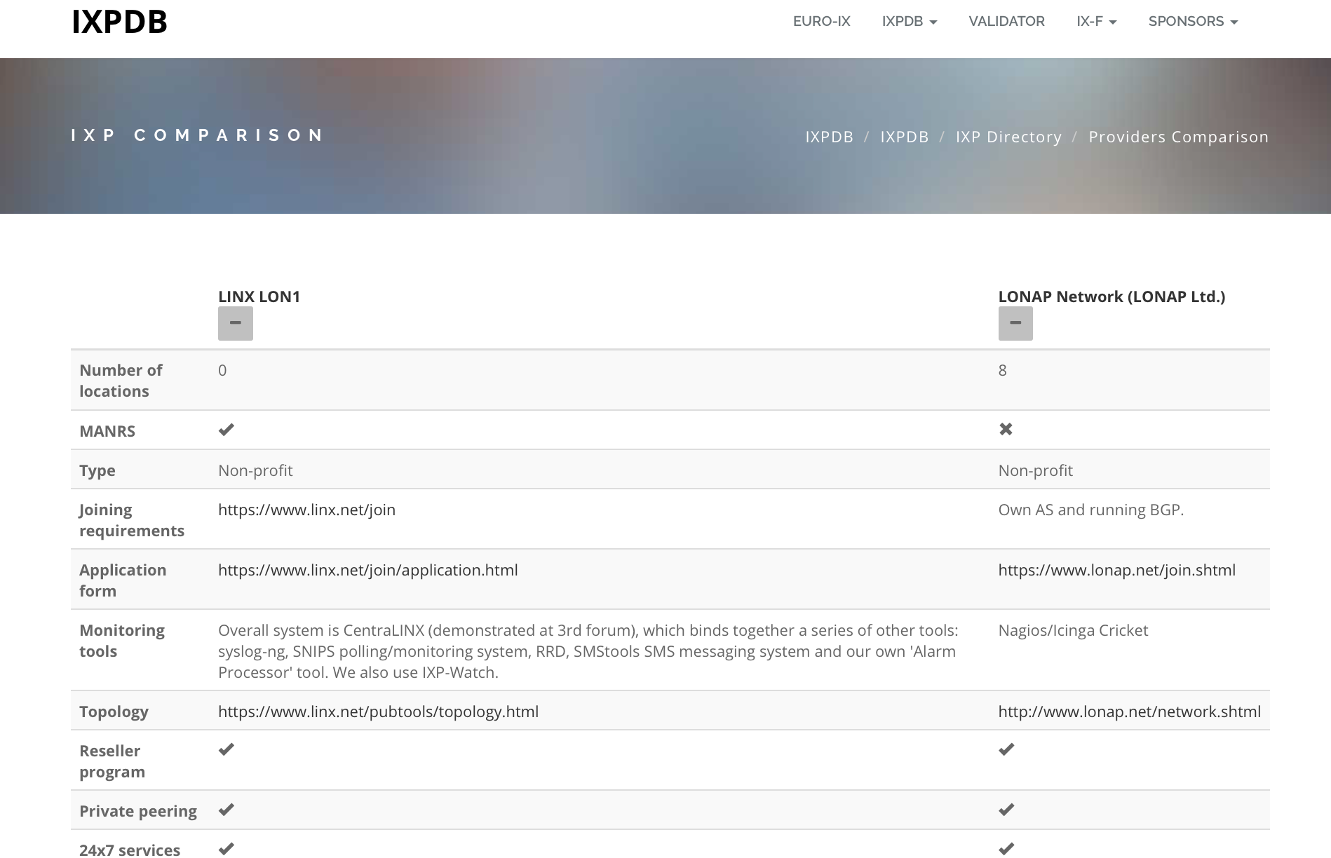
What we’ve been working on..
The new compare function for IXPs:

Slide 16
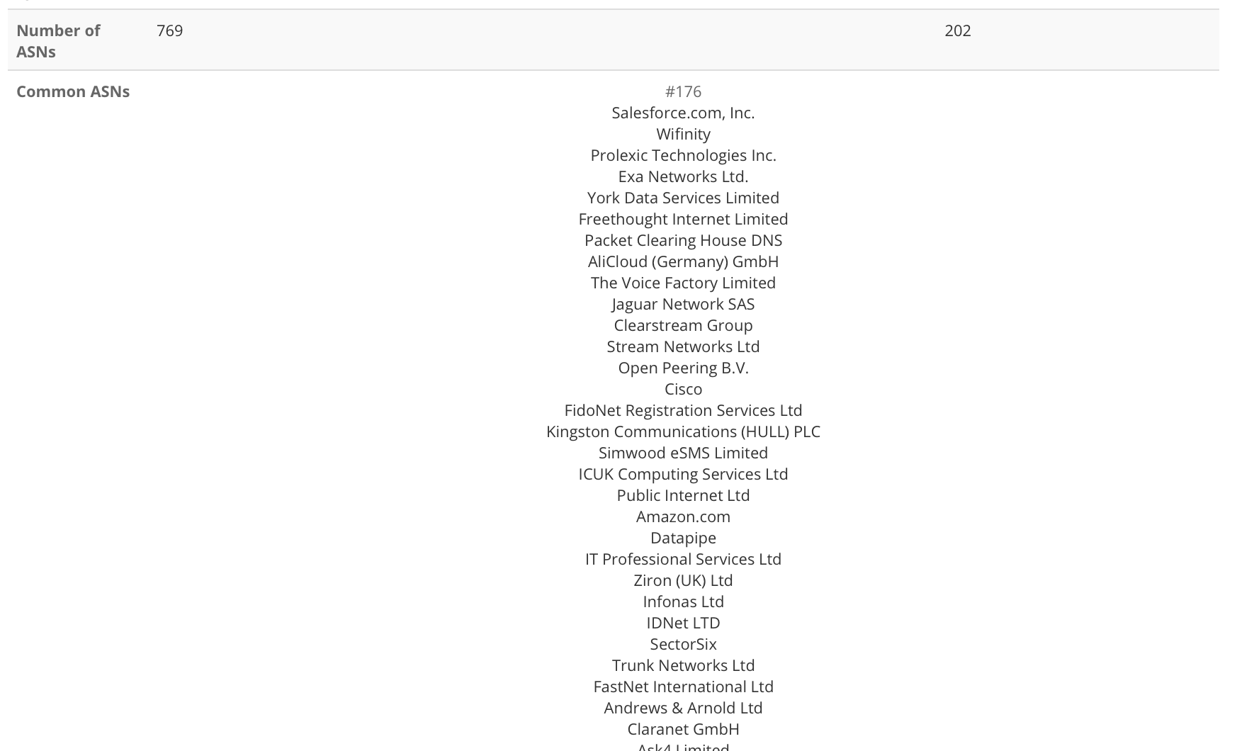
What we’ve been working on..
The new compare function for IXPs:

Slide 17
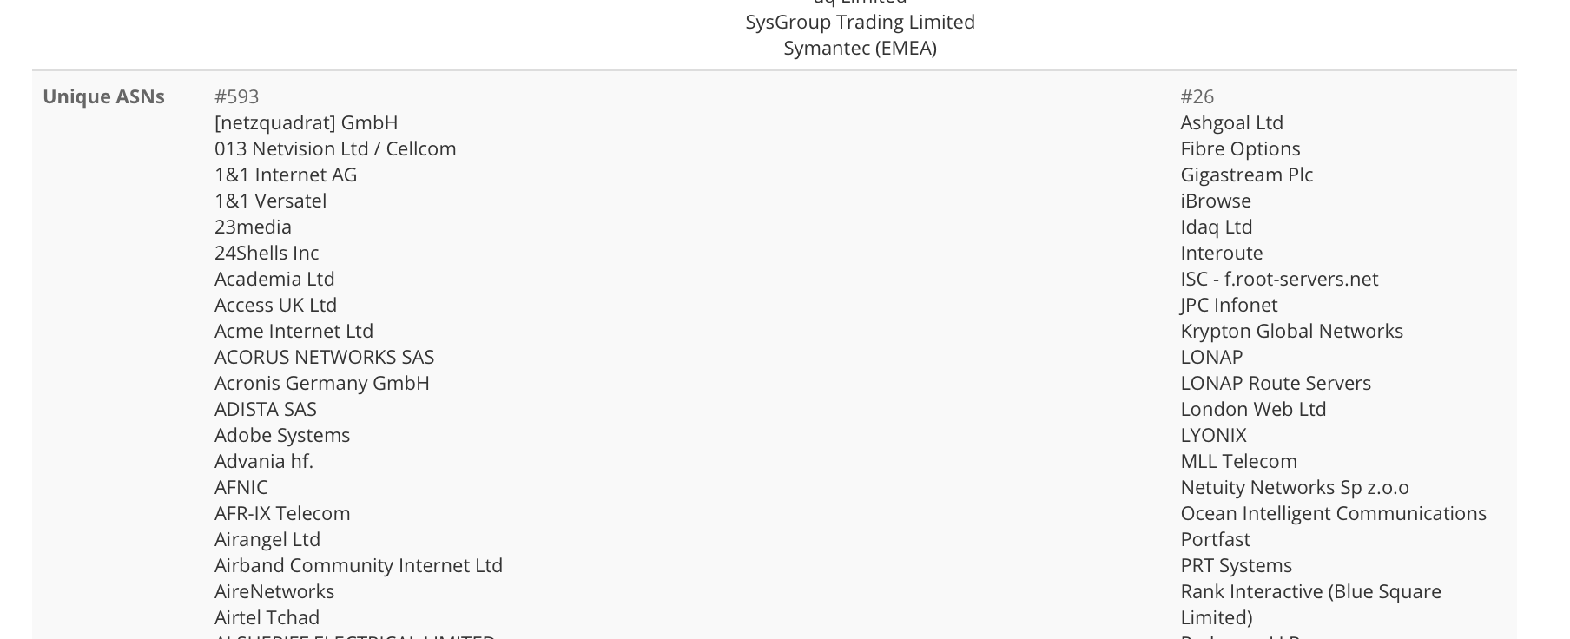
What we’ve been working on..
The new compare function for IXPs:

Slide 18
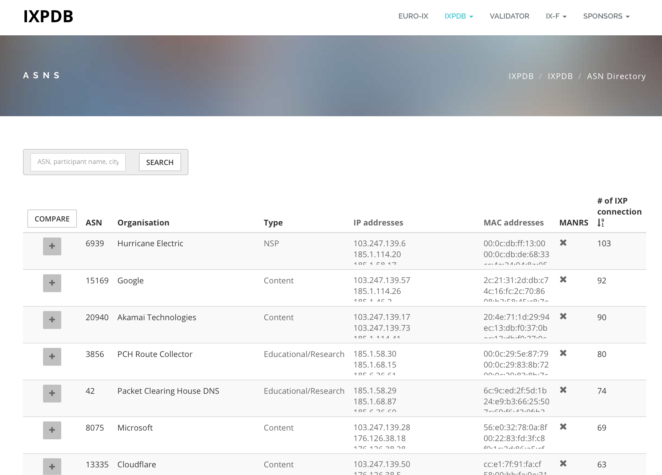
What we’ve been working on..
Compare ASNs

Slide 19
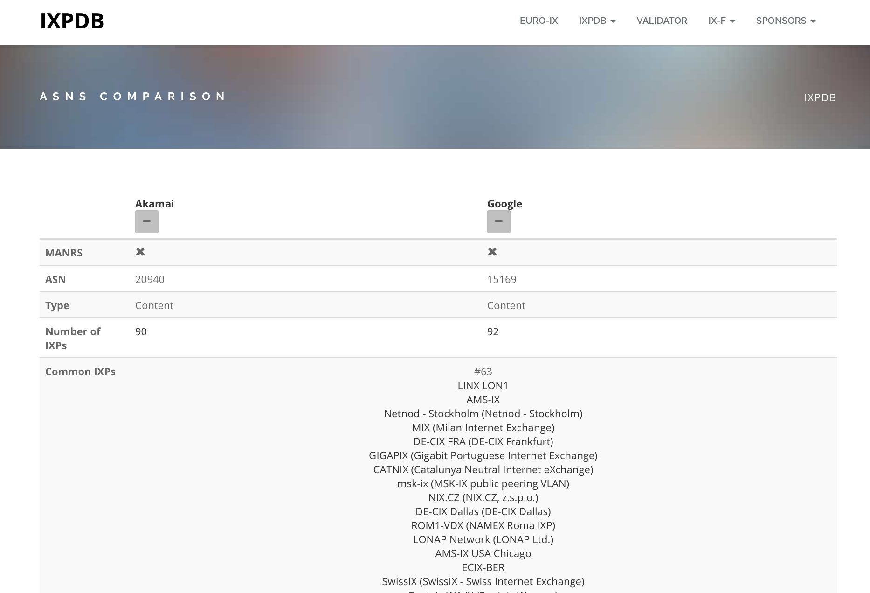
What we’ve been working on..
Compare ASNs

Slide 20
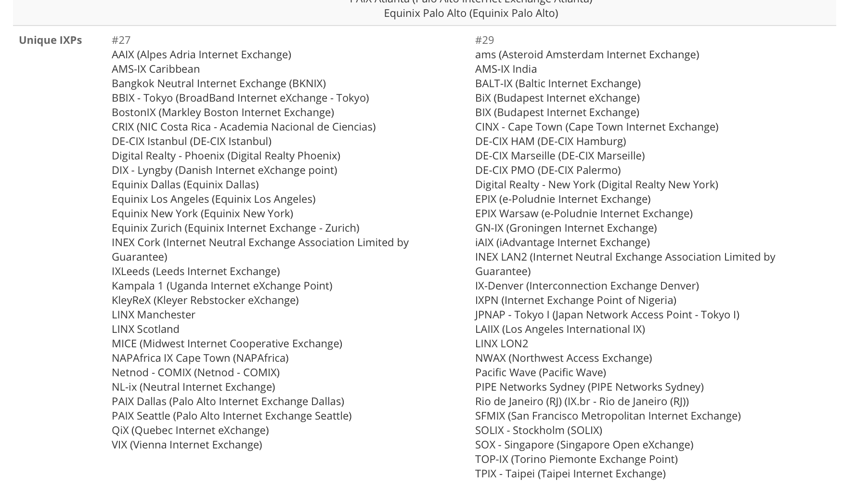
What we’ve been working on..
Compare ASNs

Slide 21
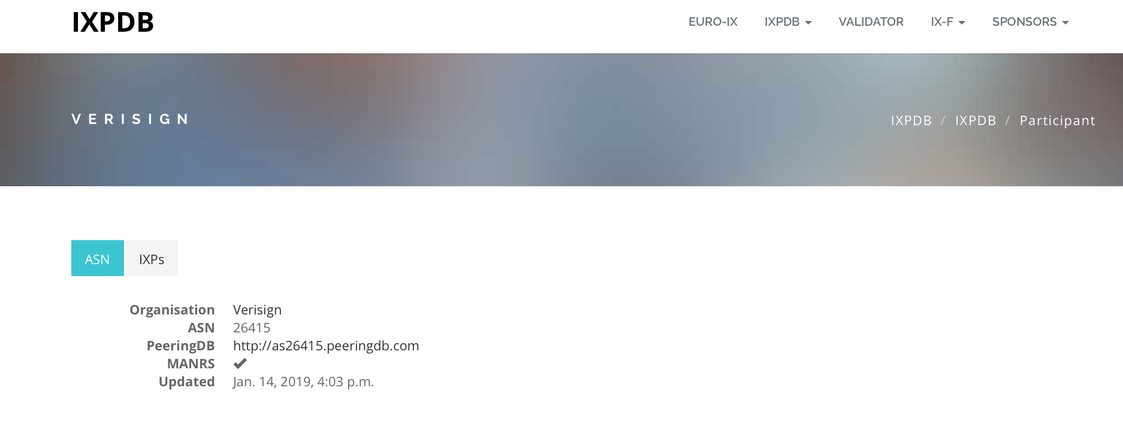
What we’ve been working on..
ASN Details

Slide 22
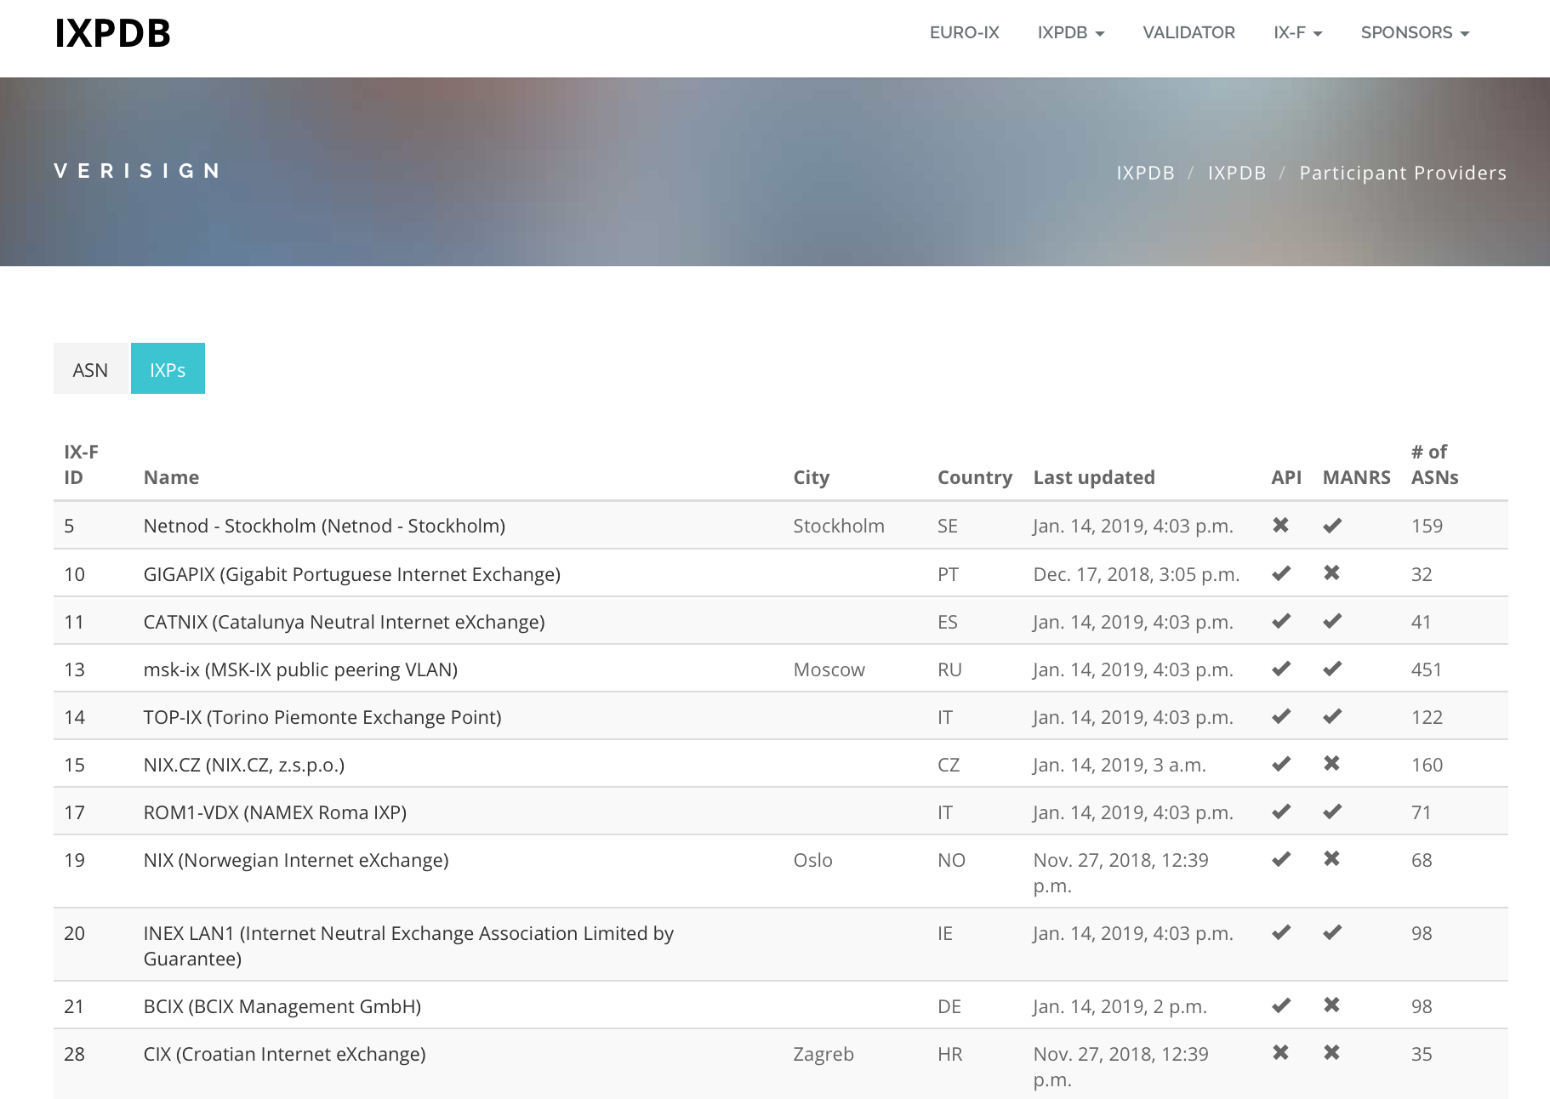
What we’ve been working on..
ASN Details

Slide 23
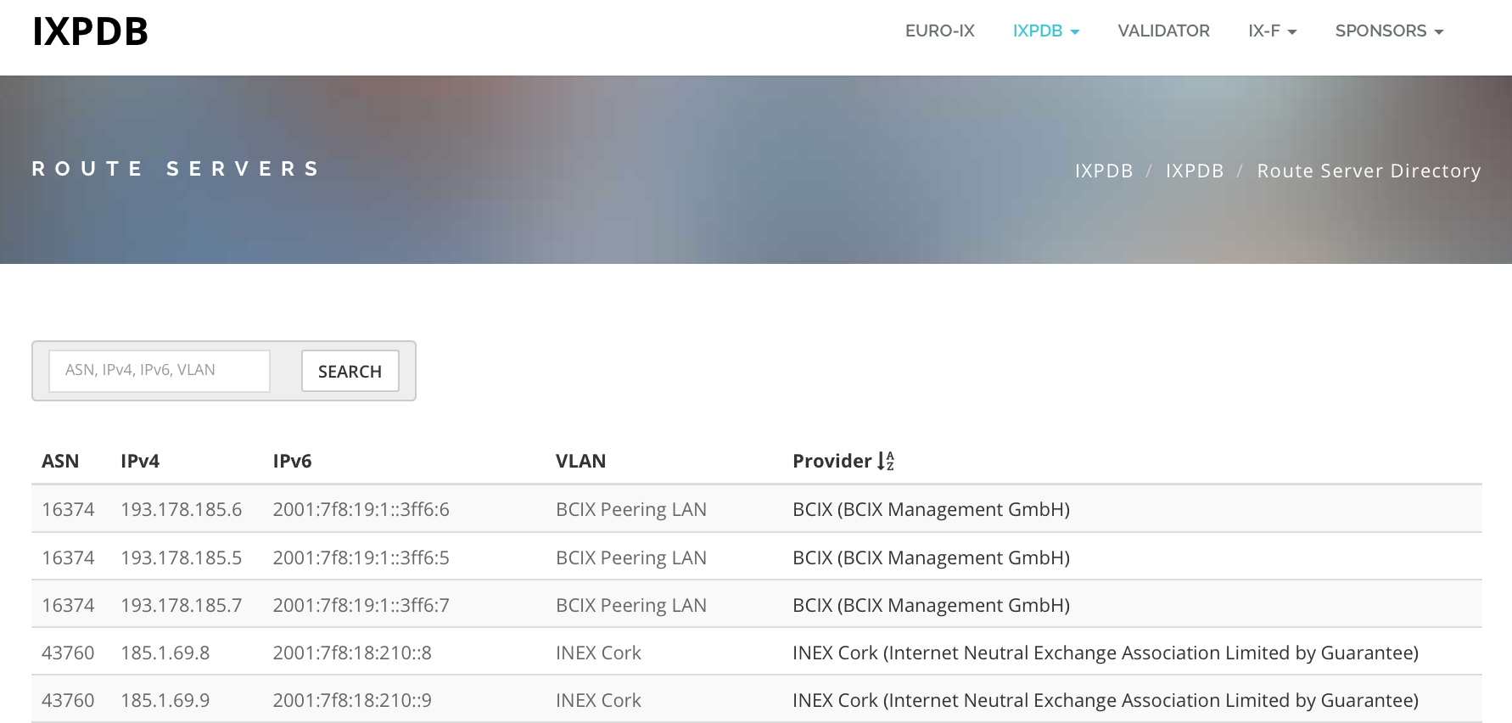
What we’ve been working on..
Route Server Directory

Slide 24
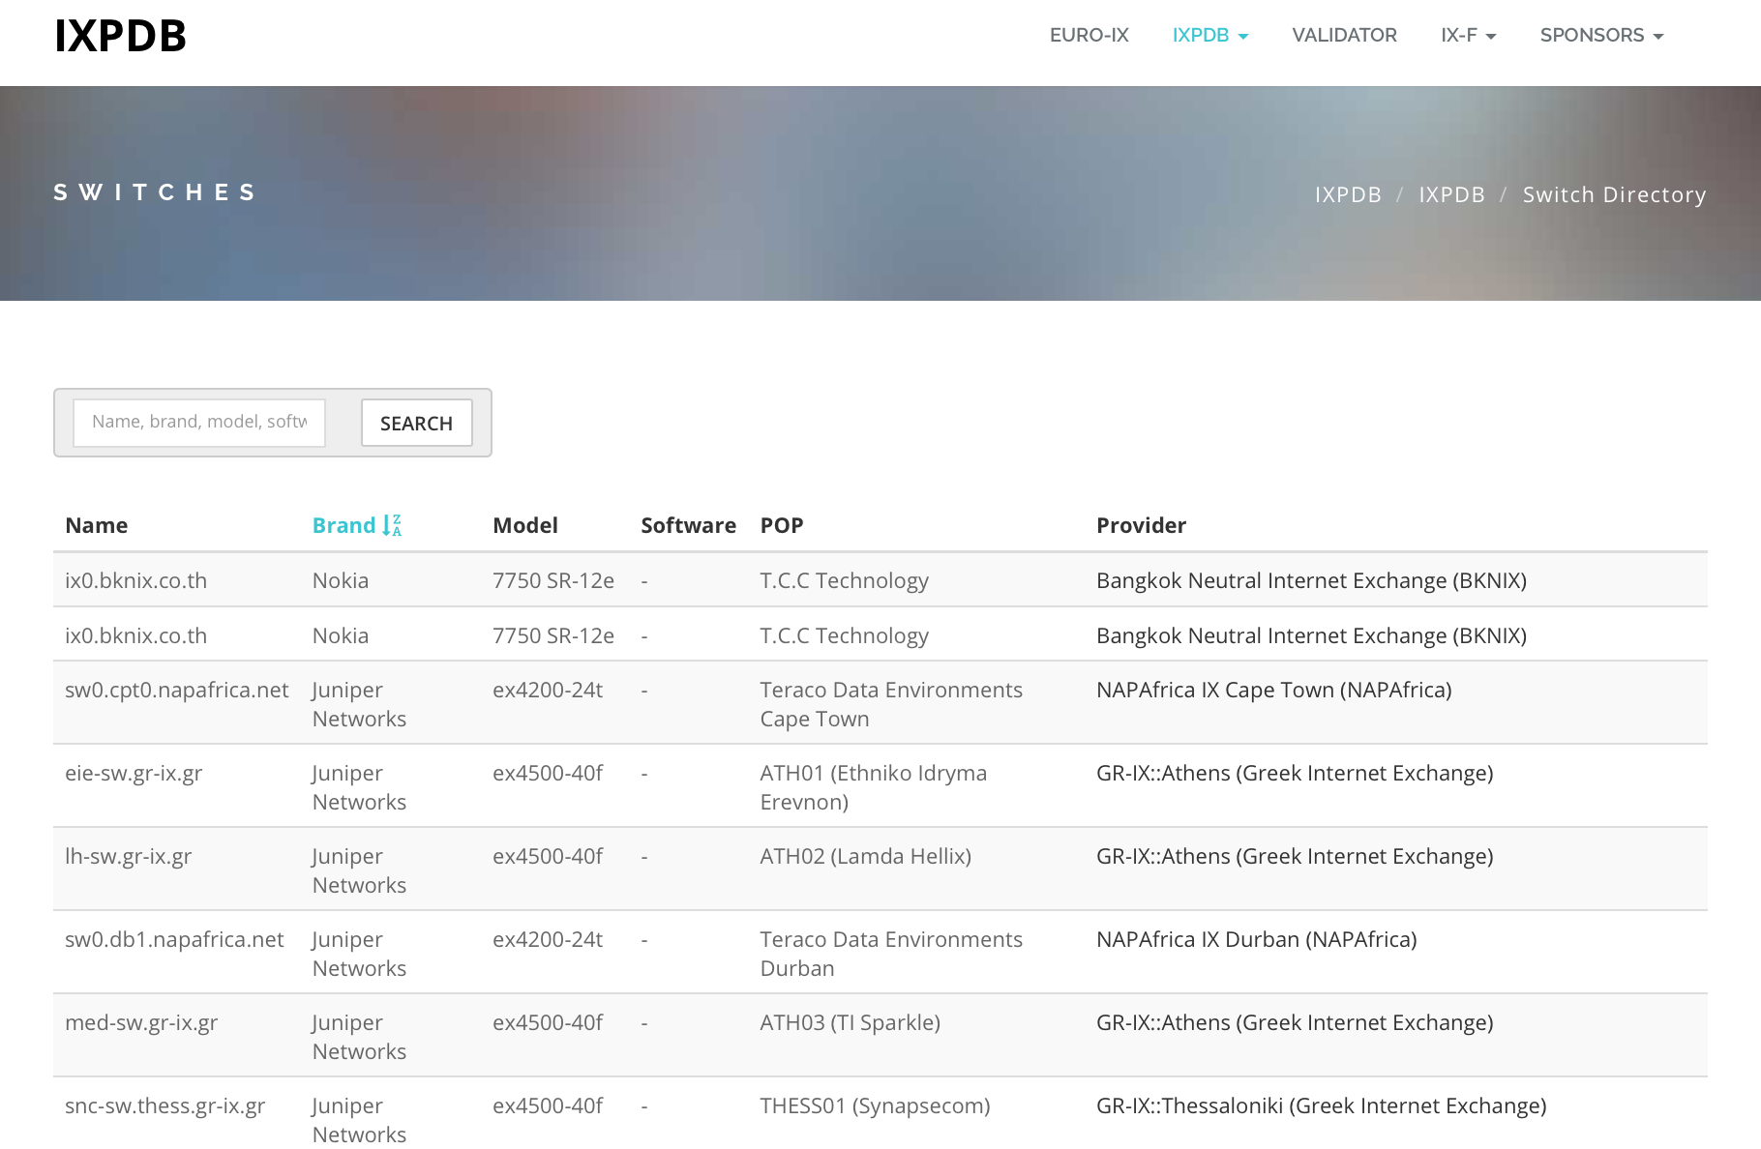
What we’ve been working on..
Switch Directory

Slide 25
What’s next..
New JSON spec to be published
API Authentication – IXPs can choose what data they want public and private (IXPs/Members only)
Highlight ASNs not in PeeringDB IXP profile (managed by networks)
Try it out and let us know if you have ideas we can explore..

Slide 26
What’s next..
Mailing list for users:
https://lists.euro-ix.net/mailman/listinfo/ixpdb
API is available - https://api.ixpdb.net
If you think this is good work, like we do, support us :)
secretariat@euro-ix.net

Slide 27
Thank You

