Slide 1
Peering Economics 101
Susan Forney
Hurricane Electric AS6939

Slide 2
Peering Economics Topics
Why is Peering Never Free?
When is Peering Worth the Investment?
What type of peering should I do?
Why do I need a peering strategy?
Why should I be a good neighbor?

Slide 3
Why Peering is Never Free
Peering a connection between two network devices. Network devices are not free.
People are needed to configure and maintain network devices. People are not free.
The network devices need electric power and a space to occupy. Power and space are not free.

Slide 4
Why Peering is Never Free
Peering has a cost, but as with anything that has a cost, it also has value. To determine its value to you, you need to know:
How much your port costs. Besides the equipment, don’t forget optics, its rack space, power, and support costs.
How much a cross-connect costs at the data center that hosts you and the exchange. Don’t forget setup fees for those cross-connects.
While it is true that each of your transit providers also consumes a port and a cross connection, this is a good exercise to keep track of your costs. If nothing else, it will help you when it is budget time.

Slide 5
Why Peering is Never Free
 | MyISP | MyIX
One-time Costs
Device Port | $200 | $200
Setup Fee for Cross-connect | $500 | $500
Setup Fee for Service | $250 | $500
Recurring Costs
Commit Level (Mbps) | 2000 | n/a
Commit Price | $2,000 | n/a
Price per Mb above commit | $1 | n/a
Price per port | n/a | $500
Cross-connect | $250 | $250

Slide 6
When Peering is Worth the Investment
To determine if your peering port is a good investment, you need to know:
How much your transit and/or settled peering costs are—don’t forget to consider your committed rates.
How much traffic you could move to the port

Slide 7
When Peering is Worth the Investment
To determine how much traffic you could move to the port, you should consider who your potential peering partners will be on the exchange:
Exchanges where you can reach content networks or cloud providers can be very advantageous.
Don’t forget to peer with the caching networks like Akamai, Fastly, Limelight, etc.
Netflow or Sflow can give you a lot of information about your highest traffic sources and destinations.

Slide 8
When Peering is Worth the Investment
Once you have this information, you see if the getting a port on the exchange makes good business sense based on cost:

Slide 9
When Peering is Worth the Investment

Slide 10
When Peering is Worth the Investment

Slide 11
When Peering is Worth the Investment
Don’t forget to factor in operational support costs—and save by streamlining or automating them.
Create two or three peer groups for your neighbors. All you need to know from a neighbor to turn configure the peers are the AS number, their IP addresses, their AS-SET and their suggested prefix limits are.
Consider the support priority of peers. You may not need to wake up your on-call engineers.
Monitor port capacity on your IX connections and increase it before you get into trouble.
Use communities to make your peering smarter.

Slide 12
When Peering is Worth the Investment
It’s not all about the money.
Peering can provide real tangible benefits in terms of reduced latency and improved throughput.
You will gain more diversity at your edge. This will improve traffic flow, decrease latency and can help your routers rebuild their tables more quickly when a link goes down.
Improves the scale of your network and prepares you for future growth.
Your internal and external customers will be happier.

Slide 13
What Type of Peering To Do
The easiest option at most public exchanges is peering with the IX’s route server. This has some advantages:
Your router only has peering sessions with the route servers.
It’s a quick way to get access to many of the networks on the exchange.
Even if you peer individually, you still can peer with the route server as well, but you may want to prefer any directly connected peer routes.
The disadvantage is you have less control, and you may not get all of the available routes. Many networks only advertise a subset of routes to the route server, and some may not choose to peer with the server. Not all exchanges have route servers.

Slide 14
What Type of Peering To Do
Peering also takes place across private direct connections. This connection is created between two networks, usually when a lot of traffic would be exchanged which would justify the cost of a port and a cross connect. In some exchanges, keeping the traffic on the exchange puts a burden on the switch.
As with a peer on the exchange, it can be free or paid. The networks determine who pays for the cross-connect fees.

Slide 15
What Type of Peering To Do
Peering directly with other networks on the exchange switch fabric is the most common and convenient way to set up peering sessions.
You have more routing options routes than you do peering with the route server and once the port is in place, you can turn sessions up in minutes.
Peering across the exchange switch fabric can be free, or it can be a paid or “settled” peering arrangement, in which an arrangement is made to determine who pays for the traffic imbalance.

Slide 16
Why you need a peering strategy
You need a peering strategy to get the most value from your exchange port. Some of the things to consider are:
What networks would benefit you the most?
What exchanges should you join?
How will you route the prefixes you receive in your network?

Slide 17
Why you need a peering strategy
How to determine if network peer make sense for you:
Do you send a lot of traffic to this peer over transit connections?
Could a direct connection with lower latency have a compelling performance improvement on your network?
Do you have excess bandwidth on your IX interface?

Slide 18
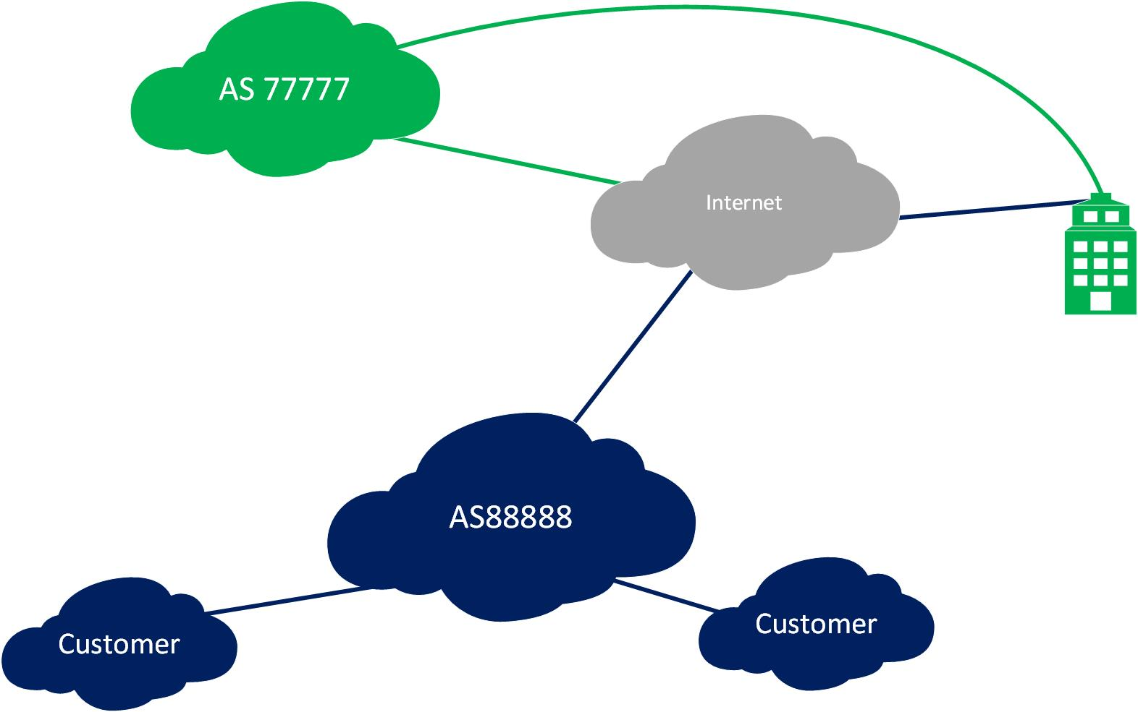
Why you need a peering strategy

Slide 19
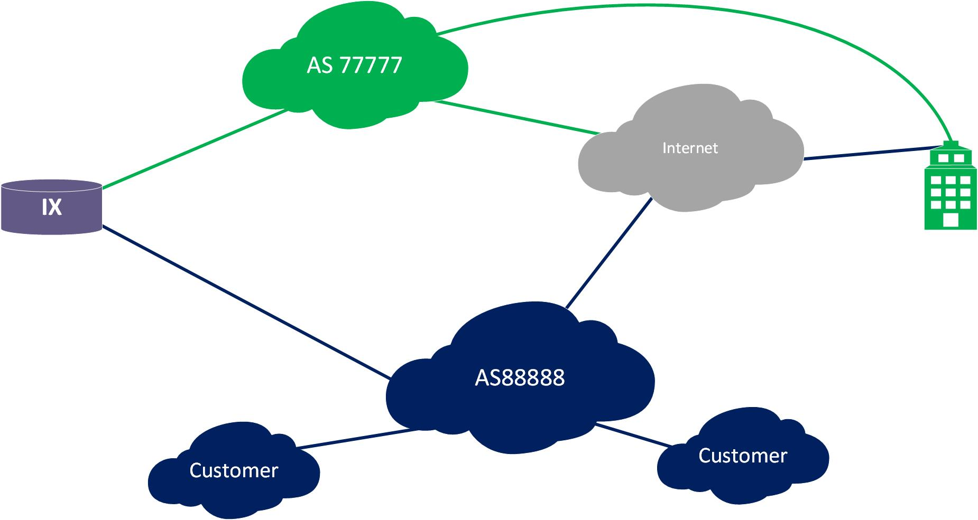
Why you need a peering strategy

Slide 20
Why you need a peering strategy
Peering can improve your routing and reduce latency. Or not.
If you peer at more than one location, consider a routing architecture that allows prefixes to be announced strategically to keep traffic local.
Some peers can benefit your network more than others. Figuring that out can get you a bigger return on your investment more quickly.

Slide 21
Why you should be a good neighbor
Peering works when it is a good experience for both parties.
Clean up your advertisements. You shouldn’t be leaking your private IP space or routes that don’t originate from a public AS.
Be easy to contact by keeping up-to-date routing and contact information in Peeringdb.com.
Keep your IRR records up to date.

Slide 22
Why you should be a good neighbor
While the other network you are peering with is probably a fine organization, trust no one.
Set maximum prefix limits for your peers.
Filter the routes to accept only routes valid from the peer’s AS and deny private IP space and bogons.

Slide 23
Why you should be a good neighbor
Building filters does not have to be hard. You can script it yourself or use a tool like bgpq3. Here is an example using bgpq3 to generate a prefix list for a Juniper router:
Galadriel:~ susan$ bgpq3 -J6l MyNewPrefixList AS44684
policy-options {
replace:
prefix-list MyNewPrefixList {
2a00:1098::/32;
2a00:7d81:1000::/48;
2a00:7d81:1001::/48;
2a00:9b40::/48;
2a06:1c80::/29;
}
}

Slide 24
Why you should be a good neighbor
Be responsive when you are notified of an issue. No one likes a peer who ignores them, especially if they are experiencing a DDoS, phishing, or other types of naughty behavior from users on your network.
No one can take advantage of you without your permission. Control your advertisements.
Not all networks will want to peer with you. This usually is more to do with their peering policy and strategies and less to do with you.

Slide 25
Thank you!
Questions?

