Slide 1
UKNOF Talk From Plan A to Plan B
Making IPv6 Real
Sam Defriez – Head of Networks

Slide 2
Who am I and who are Community Fibre?
Despite the name Community Fibre are not….
Although we are very proud of our presence within much of London's social housing
Largest FTTH provider in London
Fastest ISP in UK 2018 – thinkbroadband.com speed tests
5 *’s on Trustpilot
XGS-PON – alt-net – disruptor?!
Why IPv6 rollout?

Slide 3
Introduction
What we wanted to achieve
Roll out IPv6 to our customers without spending money
Best Consumer ISP ISPA award… doh
IPv4 is expensive now
First step towards a v6 to v4 translation strategy?
Nice simple plan A
We made some interesting discoveries along the way
Good ways to break your own network
That the IPv6 internet has some major blackholes

Slide 4
PLAN A
Pre-IPv6 Project Network Design: Distributed DHCPv4 design
PLAN A: Use the cabinet router to provide DHCPv6 with PD to dual stack customers.
However we hit a few problems…

Slide 5
PLAN B
PLAN B: Centralised DHCP design
OLT as DHCPv6 relay
Multiple advantages to this centralised design.
Simpler DHCP management, and logging
Increased functionality
Free options
Centralised design (above) looks a lot like our logo
DHCPv6 first, DHCPv4 later

Slide 6
First though, an IPv6 subnetting plan. Yay!
We have 75 PoPs and a /29 v6 block from Ripe.
/48’s to our customers
More addresses please Ripe

Slide 7
Centralised DHCP – why KEA
Kea – ISCs newest open source DHCP server.
Quickly able to test
Newbie (us) friendly
Kea met requirements:
DHCPv4 server
DHCPv6 server + PD
Static assignments for v4 and v6
Forensic logging of customer to IP
Redundancy
Flexible REST API

Slide 8
Centralised DHCP Design

Slide 9
Teething Problems….

Slide 10
Financial Restrictions….
Circa 20% of our PoPs do not have an OLT that supports IPv6 DHCP relay.
Equipment refresh required
It’s very hard at present to make a case for spending money on IPv6 migration strategies
Finance – “How much will it make us?”
Engineer – “Nothing at the moment, but at some stage v4 will be deprecated”
Finance – “Come back to me nearer to that date.”
An entirely logical argument.

Slide 11
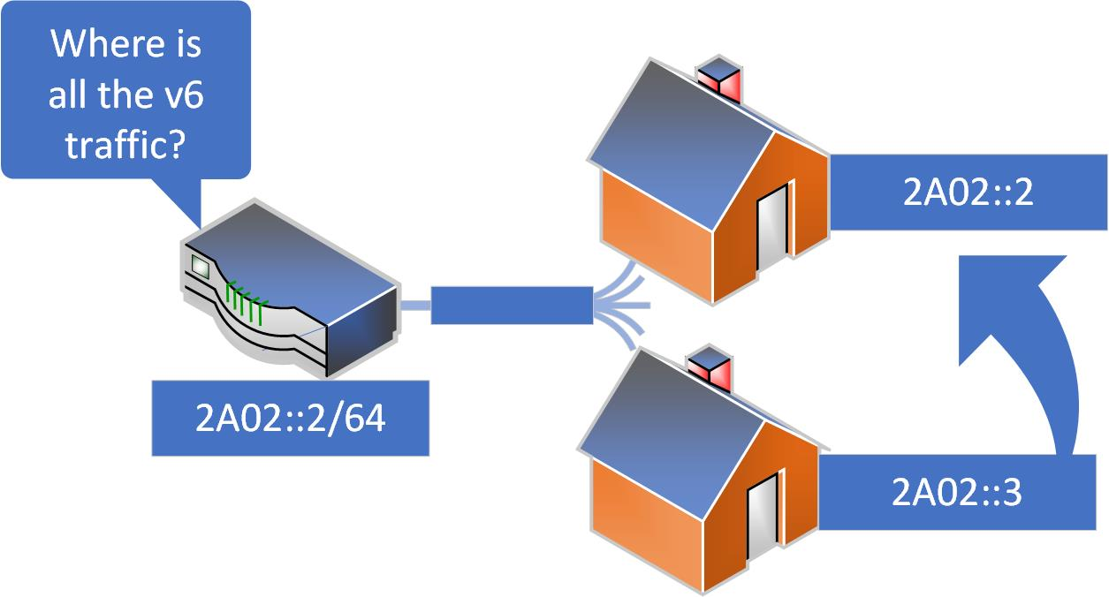
CFL Network Problems….
A few self caused issues. Oops.
Automation fail.
Gateway address as a lease
Swiftly rectified but still…

Slide 12
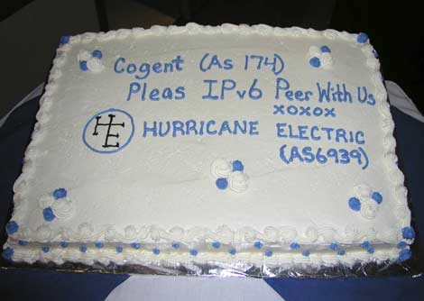
IPv6 Internet Problems….
Cogent!
Upon first testing IPv6 in the lab we could not reach Google.
Cogent blackhole to Google
Cake needed?

Slide 13
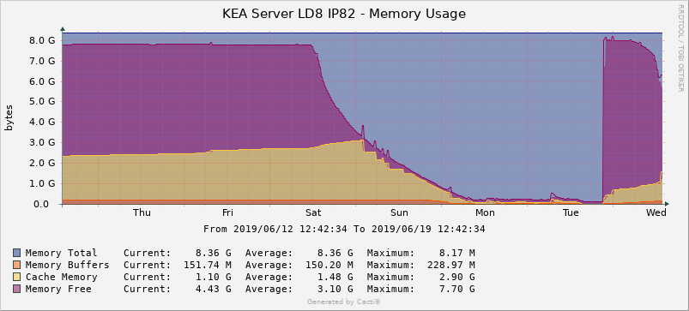
KEA Problems
CPU / memory exhaustion
100% CPU use and resulting memory exhaustion.
Kea HA bug - issue concurrently handling inbound client requests and partner lease updates in some situations
Fixed in v1.6
The graph of server death…..

Slide 14
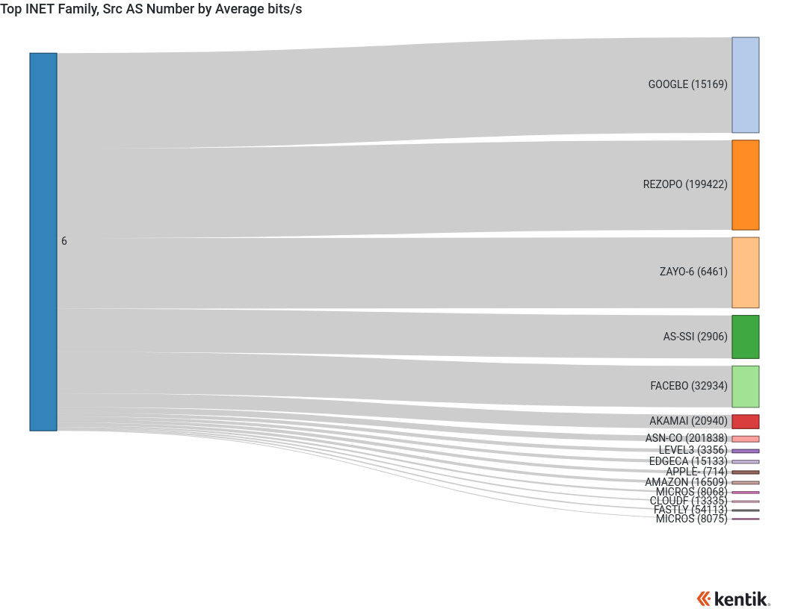
Out the other side and into successful IPv6 deployment!
Around 20% of our traffic now running over IPv6
Expected destinations – Google, Facebook, Netflix, Twitch etc.

Slide 15
Conclusion
We like Kea ☺
ISC support is superb
Key take-aways
Don’t set the default gateway as an available lease address
Don’t rely on Cogent with a default-route for IPv6
Do test Kea if you run DHCP servers and see if you like it

