Slide 1
The latest news in the DNS resolution

Slide 2
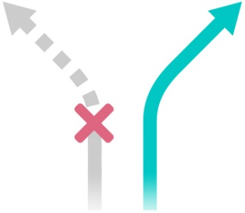
Based on our own practical experience
Whalebone provides DNS resolution for millions of people and devices
Standard compliance, low latency and stability is a must
Added anti-malware and anomaly detection layer
Based on Knot Resolver by CZ.NIC
hacker.com
safety.com

Slide 3
Random subdomain attacks
Also called slow drip attacks
Targeted domain is attacked through default resolvers for the botnet devices globally
Generating many queries to random (therefore non-existent) subdomains from the whole botnet will eventually take the domain down
Eating up the resolver cache and outgoing bandwidth
xyz.ddostarget.com
abc.ddostarget.com
123.ddostarget.com
...

Slide 4
DNSSEC aggressive cache
No need to contact the authoritative server for the proof of non-existence
No need to cache responses for such non-existent subdomains
Shielding the authoritative servers (the queries are handled on the resolver)
Detailed numbers and simulations: DNSSEC aggressive cache (RFC 8198), Petr Špaček (CZ.NIC), https://ripe76.ripe.net/presentations/71-RIPE76-presentation-RFC8198.pdf

Slide 5
Variant of random subdomain attack
Targeted domain: weaverpublishing.com
weaverpublishing.com nameserver = ns1.weaverpublishing.com
weaverpublishing.com nameserver = ns2.weaverpublishing.com
mx2.mx2.mx1.mx1.mx1.mx2.mx2.mx1.mx1.mx2.mx1.mx2.mx2.mx2.mta-sts.mx2.mx2.webmail.weaverpublishing.com.
mx2.mx2.mx2.mx2.mx1.mx2.mx2.mx2.mx2.mx1.mx2.mx1.mx2.mx2.mx2.weaverpublishing.com.
mx2.mx2.mx2.mx2.mx1.mx2.mx2.mx2.mx2.mx1.mx2.mx1.mx2.mx2.mx2.weaverpublishing.com.
mx2.mx2.mx2.mx2.mx2.mx2.mx1.mx2.mx1.mx2.mx2.mta-sts.mx2.mx1.mx2.mx2.mx2.weaverpublishing.com.
mx2.mx2.mx2.mx2.mx2.mx2.mx1.mta-sts.mx2.mx1.mx1.mx1.mx1.mx2.mx1.webdisk.weaverpublishing.com.
mx2.mx2.mx2.mx2.mx2.mx2.mx1.mta-sts.mx2.mx1.mx1.mx1.mx1.mx2.mx1.webdisk.weaverpublishing.com.
mx2.mx2.mx2.mx2.mx2.mx2.mx1.mx2.mx1.mx2.mx2.mta-sts.mx2.mx1.mx2.mx2.mx2.weaverpublishing.com.
mx2.mx2.mx2.mx2.mx2.mx2.mx2.mx1.mx2.mx2.mx1.mta-sts.mx1.mx2.mx2.mx1.cpanel.weaverpublishing.com.
mx2.mx2.mx2.mx2.mx2.mx2.mx2.mx1.mx2.mx2.mx1.mta-sts.mx1.mx2.mx2.mx1.cpanel.weaverpublishing.com.
mx2.mx2.mx2.mx2.mx2.mx1.mx2.mx2.mx2.mx2.mx2.mx1.mx2.mta-sts.mx1.mx2.mx2.autodiscover.weaverpublishing.com.
mx2.mx2.mx2.mx2.mx2.mx1.mx2.mx2.mx2.mx2.mx2.mx1.mx2.mta-sts.mx1.mx2.mx2.autodiscover.weaverpublishing.com.
mx2.mx2.mx2.mx2.mx2.mx1.mx2.mx2.mx2.mx2.mx2.mta-sts.mx2.mx1.mx1.mx1.mx2.mail.weaverpublishing.com.
mx2.mx2.mx2.mx2.mx1.mx2.mx2.mx1.mx2.mx2.mx2.mta-sts.mx1.mx2.mx2.mta-sts.mx2.mx2.weaverpublishing.com.
mx2.mx2.mx2.mx2.mx1.mx2.mx2.mx2.mx2.mx1.mx2.mx2.mx2.mx2.mx1.mx2.mail.weaverpublishing.com.
mx2.mx2.mx2.mx2.mx1.mx2.mx2.mx2.mx2.mx1.mx2.mx2.mx2.mx2.mx1.mx2.mail.weaverpublishing.com.

Slide 7
DNSSEC aggressive cache - issues
F5 BIG-IP Load balancer faulty implementation of proof of non-existence
Query for non-existent record type get NSEC3 response stating that only TXT records exist -> Resolver returns NXDOMAIN for ongoing A records
Workaround and fix provided by the vendor, still not applied at many organizations
Issue originally created by Whalebone and analyzed by CZ.NIC https://github.com/dns-violations/dns-violations/blob/master/2018/DVE-2018-0003.md

Slide 8
DNSSEC aggressive cache - issues
F5 BIG-IP balancers are used by banks, government and large service providers
Issue emerged randomly and disappeared quickly making in very hard to analyze
Error in DNSSEC implementation on F5 BIG-IP load balancers, Petr Špaček (CZ.NIC), https://en.blog.nic.cz/2019/07/10/error-in-dnssec-implementation-on-f5-big-ip-load-balancers/

Slide 9
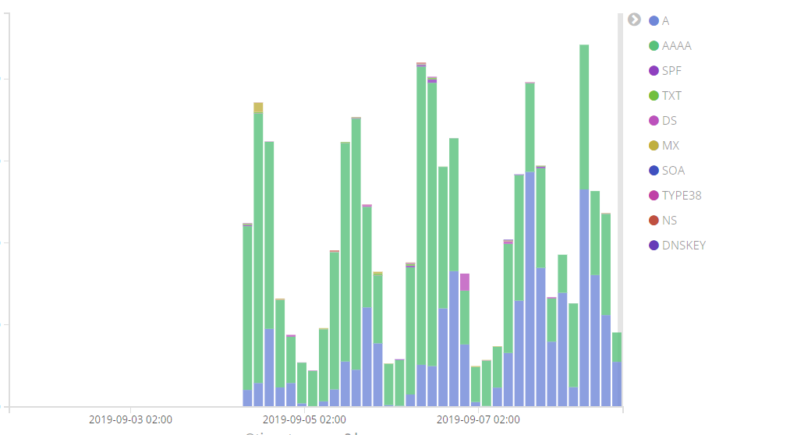
DNSSEC validation failures monitoring
Domains with expired keys
Misconfigured domains (even TLDs!)
Attacks?
ISP will always be the first one to blame ☹

Slide 10
.sk DNSSEC deployment
Overnight TLD DNSSEC deployment with some issues
8 servers with correct configuration
6 misconfigured with wrong proofs
Resolution randomly ended up in validation failure
Unreachable domains for end users resulting in ISP helpdesk calls
Reproduction of the issue unreliable due to majority of correctly configured servers
Fixed quickly once we called them directly
Thanks CZ.NIC and DNSViz for identification!

Slide 11
DNSSEC – is it worth the effort?
We estimate that DNSSEC validation failures are just 0,01% of all DNS queries in our networks
Sign, Validate and Monitor!
DNSViz does a great job at analysis:
Properly configured DNSSEC: http://dnsviz.net/d/nic.cz/dnssec/
DNSSEC issues: http://dnsviz.net/d/szn-broken-dnssec.cz/dnssec/

Slide 12
Filter threats off your network
Robert Šefr, CTO
robert.sefr@whalebone.io
@robcza
https://whalebone.io

