Slide 1
What Does A Good Design Look Like?
Some DOs and DON’Ts of technical design
James Bensley @ UKNOF45

Slide 2
Agenda
Introduction
Engineering Doesn’t Require Complexity
Engineering Requires Tradeoffs
Design vs. Operations
Design Decisions and Examples
Questions / Insults / Solicitations
Review

Slide 3
Introduction
Who:
James Bensley
Designing/building/supporting/decommissioning for 10+ years
I’ve broken many things, and designed many monstrosities…

Slide 4
Introduction
What:
Not this: “a good L3 VPN design must include …” - This is specific to your project
This: “technically agnostic guidelines any design should follow”

Slide 5
Introduction
Why:
Experience has taught me the importance of identifying the correct decisions that need to be made early on, in order to deliver the required solution
Failing to meet expectations is worse than a “broken” solution
These problems aren’t going away (p.s. automation sucks!)

Slide 6
Introduction
How:
Improve the solution design whilst still in the design phase
Share real experiences from networks/projects I’ve worked on (there are no “courses” on network design)

Slide 7
Engineering Doesn’t Require Complexity

Slide 8
Engineering Doesn’t Require Complexity
“Engineering” is typically associated with technical complexity
Overengineering is my biggest issue with technical design work
Many respected figures agree:
“Simplicity is the ultimate sophistication” – Leonardo da Vinci
“Simplicity is a prerequisite for reliability” – Edsger Dijkstra
“E=MC²” – Albert Einstein
KISS

Slide 9
Engineering Doesn’t Require Complexity
The technical aspects of your job are rarely the most demanding E.g., it’s tough working in teams with:
mixed technical abilities
mixed skill sets
mixed availabilities
mixed [communicative] language proficiencies

Slide 10
Engineering Doesn’t Require Complexity
Techies don’t need to memorise $really_complex_thing
Engineers/Architects/Designers/Technicians need to be multifaceted and pragmatic. The E/A/D/T job is to translate between business requirements and reasonable technical methods

Slide 11
Engineering Requires Balance

Slide 12
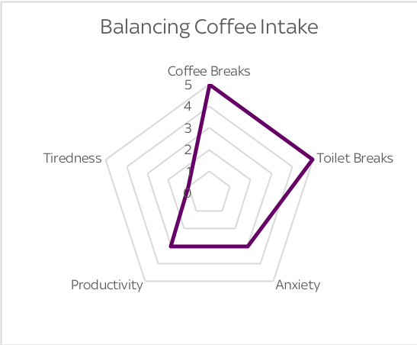
Engineering Requires Balance
Every solution creates strain on different business resources, engineers need to balance the impact of their solution:

Slide 13
Engineering Requires Balance
For example; “which device should we use for this project?” One has to balance the tradeoffs between each of the following:
Cost (to please finance managers)
Lead time (to please project managers)
Vendor SLAs (to please account managers)
Complexity (to please support teams)
Functionality (to please customers)
Compliance (to please auditors)
Standardisation (to please implementation teams)

Slide 14
Engineering Requires Balance
Design conjecture: “Good” designs are formulated by compiling the results from a collection of decisions. The result of each decision is the most balanced option between the impacted BUs of that decision.

Slide 15
Design vs Operations

Slide 16
Design vs Operations
Design
Production
Operations

Slide 17
Design vs Operations

Slide 18
Design vs Operations

Slide 19
Design Decisions
and Examples

Slide 20
Design Decisions: Requirements and Cost
DO: Design a solution that satisfies the problem definition
DON’T: Design what you think would be “like, so cool yeah!”
DO: Keep in mind the budgetary constraints
DON’T: Search default to the cheapest possible solution

Slide 21
Example Scenario: Requirements
Task: “I need 15G of connectivity from A to B”
2x10Gbps
1x100Gbps
Can easily add more 10G links
LAG/ECMP are “known” evils
100G link = 85% spare capacity
Operationally simpler
Notes:
https://commons.wikimedia.org/wiki/File:Rotunda_Sleepover_(20291436945).jpg
https://commons.wikimedia.org/wiki/File:Flickr_-_moses_namkung_-_The_Crowd_For_DMB_1.jpg

Slide 22
Example Scenario: Cost
Task: “I need 15G of connectivity from A to B”
2x10Gbps
1x100Gbps
10G ports and optics are cheap
10G rental is cheap
100G port and optic is cheapish
100G rental is not as cheap
Notes:
https://commons.wikimedia.org/wiki/File:Rotunda_Sleepover_(20291436945).jpg
https://commons.wikimedia.org/wiki/File:Flickr_-_moses_namkung_-_The_Crowd_For_DMB_1.jpg

Slide 23
Design Decisions: Scope and Deliverables
DO: Clarify unambiguously what the project requirements are (ambiguity == problems)
DO: Confirm if the requirements can be broken down (time > features)

Slide 24
Example Scenario: Deliverables
Deliverable “provide an Internet connection at location xyz”
Too specific: “We’ll provide connectivity using four twisted pair copper cables, with each pair signalling at a frequency of 125 Mhz using a 5-level encoding scheme, to achieve a Layer 1 bit rate of 1.25Gbps, with a 2.5 volt peak average differential per twisted copper pair to maintain DC balance…”
Not specific enough: “A 1Gbps handover interface”
Seems OK: “A 1000Base-T Ethernet handover interface using RJ45 terminated Cat5e cable”

Slide 25
Design Decisions: Scope and Deliverables
DON’T: Accept additions to the project scope or a reduction in the project deadline without the impact being accepted
DO: Document which teams/positions accepted the risks/limitations

Slide 26
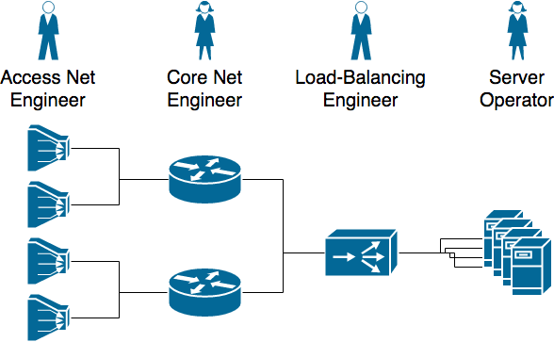
Example Scenario: Scope
In this example engineers designed and tested each section of the network in isolation; the final end-to-end test was a failure, very close to the project deadline.

Slide 27
Design Decisions: Documentation and Support
DO: Think about how you will document the solution. If you can’t easily explain it, how will others understand it?
DO: Think about how on-call engineers will have to troubleshoot the solution at 03.00 AM (HLA, HLD, LLD, config templates, wiki, KB articles, cheat-sheets)

Slide 28
Design Decisions: Documentation and Support
Design
Production
Operations

Slide 29
Design Decisions: Documentation and Support
DO: Try to be so specific in your documentation that you don’t need configuration examples (they are the code comments of network engineering)
DON’T: Mix disciplines, try to make failure domains that a single person or team can troubleshoot

Slide 30
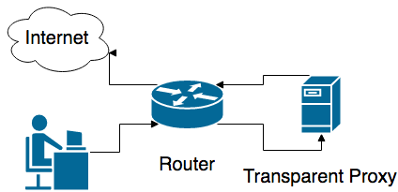
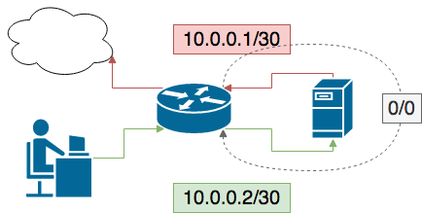
Example Scenario: Documentation and Support
In this example, 1st line network support personal were expected to log into Linux servers and troubleshoot interface connectivity to ascertain why BGP on a router wasn’t working!
Notes:
Who knows how to see the speed and duplex in Linux?

Slide 31
Design Decisions: Standardisation and Monitoring
DO: Standardisation is a major factor of scalability and reducing time to repair, use standardised products and services as much as possible
DO: Accept non-standard ideas, every product catalogue starts empty

Slide 32
Design Decisions: Standardisation and Monitoring
DON’T: Deploy what you can’t support. E.g. if your NMS can’t monitor a service, how will you provide service assurance?
DON’T: Deploy anything that will increase your technical debt. No matter how simple a new technique maybe, who (else) can deploy/support/upgrade it?

Slide 33
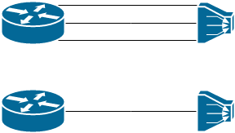
Example Scenario: Standardisation
After foolishly accepting to productise bonded ADSL, I became the single point of contact for all bonded ADSL queries and support escalations.
Other engineers could have easily done this, I was just the first.
3x ☹ vs. 1x ☹

Slide 34
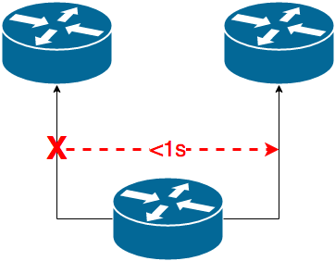
Example Scenario: Monitoring
A customer RFP listed sub-second network failure detection and mitigation as a requirement for a standard service.
It also required that the NMS be able to prove that the failure was detected and mitigated in less than 1 second!
Who polls once per second or faster? How else could this be monitored?

Slide 35
Design Decisions: Upgrades and Failures
DO: Think about how you will keep the design clean over time, will it “deteriorate” over time and become unclean?
DO: Consider the upgrade path of the design for the reasonable future
OSI Model | Potential Lifetime
Layer 4 - Transport | 10s of months?
Layer 3 - Network | Single digit years?
Layer 2 - Data | Up to a decade?
Layer 1 - Physical | Multiple decades?

Slide 36
Design Decisions: Upgrades and Failures
DO: Consider the different failure scenarios that can happen and their individual likelihood, is there a dependency tree of cascading failures?
DON’T: Limit your consideration to technical failures: “if you design it they will use it”

Slide 37
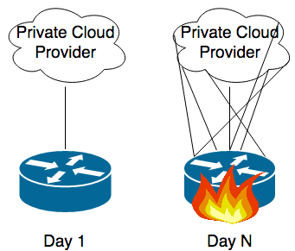
Example Scenario: Upgrades
A customer required a one-off connection to a private cloud provider at a spoke/spur PoP, then word spread; a 2nd customer requested connectivity to the same cloud provide, then a 3rd, then a 4th, and so on…
That cloud provider only supported 10Gbps links and didn’t support LAGs. This cost us ports and capacity in a PoP where we had little of both and overloaded our PE.

Slide 38
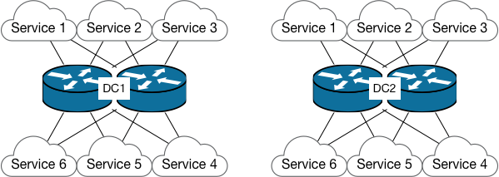
Example Scenario: Expected Failures
Below all services are dual homed to two routers in DC 1, and all services are replicated in DC 2 and dual-homed to another pair of routers there, N+N resiliency, WTFCGW?

Slide 39
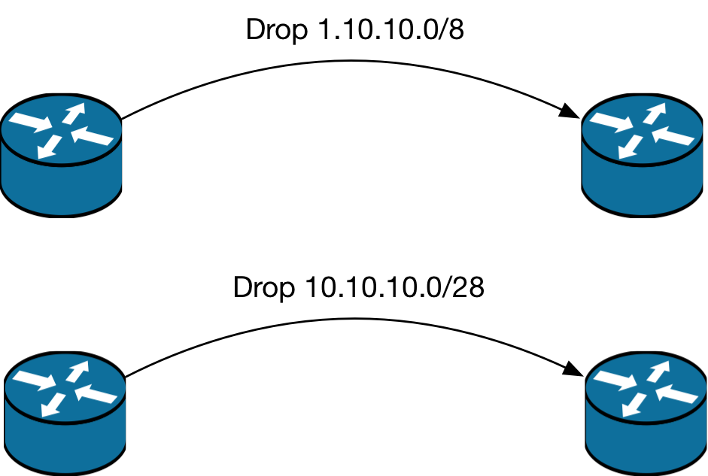
Example Scenario: Unexpected Failures
RTBH Routing → Prefix length validation?
RTBH Routing → Prefix validation?
RTBH Routing → Prefix purpose?

Slide 40
Design Decisions: In-Life and Decommissioning
DO: Think about how it will be decommissioned or partially decommissioned, don’t focus on provisioning only
DON’T: Let the documentation “rot” or in-house knowledge become stale, have “refresher-sessions”

Slide 41
Design Decisions: In-Life and Decommissioning
DO: Think about how you will keep the design clean over time, will it “deteriorate” over time and become unclean?
DON’T: Assume this 3 year project will still be running next year, or that it won’t still be running 15 years later!

Slide 42
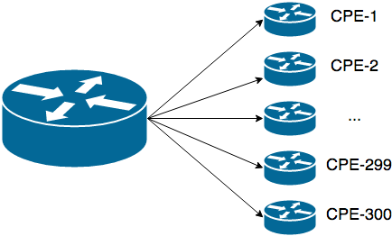
Example Scenario: In-Life
I once had to play a real-life game of ‘would you rather…’ and choose between adding 900 static routes or 300 BGP sessions to a satellite PE, which was already running the maximum number of vendor supported BGP sessions.
How can we be sure such a large number of routes/sessions are still valid 1/2/3 years from now?

Slide 43
Design Decisions: Setting a Precedent
DON’T: Allow exceptions, it won’t remain a “one-off”
DON’T: Implement temporary solutions, they will become permanent

Slide 44
Questions?
send delayed thoughts of love/hate/confusion to: jwbensley@gmail.com

Slide 45
Review…

Slide 46
Review
Requirements: Define the requirement and solution as clearly as possible, demand clarification where ambiguity exists. Continuously refer back to the requirements and evidence fulfilment in your design documents.
Cost: Keep in mind your budgetary constraints but don’t use sub-par materials to please finance.

Slide 47
Review
Scope: Ensure the scope of the design is clear, explicitly state what isn’t included (rather than implicitly by ambiguously not mentioning something). When it’s agreed that something is out of scope or not required, record who approved that exclusion and why.
Deliverables: Ensure everyone knows who’s responsible for which areas of the design, and when each milestone is due.

Slide 48
Review
Documentation: Document how something should behave, how it behaved when tested, what happened when testing failure scenarios, what happened during failures in production, are there any unknowns?
Support: Break the design into smaller managable sections. Create cheat-sheets for troubleshooting these sections. Have operational handover and training sessions to educate the NOC. Have another one 12 months from now when everyone has forgotten. If a big outage occurs after 6 months, move back that 12 month review by another 6 months.

Slide 49
Review
Operational Acceptance: Have someone else validate the deployment is working as expected. If they couldn’t it does work or they don’t understand the design. Share knowledge across team members/colleagues and other teams. Pro-actively train operational support teams rather than assuming they’ll get around to reading the documentation before there’s an outage.

Slide 50
Review
Standardisation: This is a top priority with simplicity. Create standard products (config templates, monitoring templates, support templates) and reuse them throughout your designs. Can you easily hire someone to continue this work? Technical debt doesn’t only exist in a team in the present, but also in the future.
Monitoring: If you can’t easily monitor it, how difficult will it be to add that functionality to your NMS? Will an upgrade of the NMS break that feature? Monitoring is not exempt from the simplicity/standardisation/supportability requirements, as soon as you can’t monitor a service you’re in trouble.

Slide 51
Review
Upgrades: Try to think either a horizontal upgrade path (can we deploy more pizza boxes or add more line cards?) or a vertical upgrade path (what is the next generation of devices that will supersede the current ones?).
Failures: They definitely will happen. Test the mostly likely ones to know what they look like on the CLI/via Syslog/NMS/from the customers perspective. What seemingly non-related infrastructure failures could impact this design?

Slide 52
Review
In-Life Maintenance: In the best case scenario that the product/service is widely deployed, it shouldn’t be cumbersome to maintain with scale.
Decommissioning: If the documentation is up to date and all the components are standardised it should be simple but, the reality is config-rot or CMDB-rot.

Slide 53
Review
Complexity: Avoid complexity as much as possible, there is a direct correlation between complexity and support/billing/customer overhead.
Operations: When trying to balance between design decisions, default to what's best for your operations, not the customer; there’ll be other customers and you need to sleep at night.

